Slide 1
Advanced Metering Working Group (AMWG)
Update to RMS
September 1, 2015

Slide 2
Noteworthy August Meeting Items
SMT patching activities complete
5 consecutive weekends…7/5 – 8/2
First monthly patch maintenance 9/20
Routine monthly maintenance on 3rd Sunday/month
Revisions to the AMWG CR process
Discussion scheduled for Sept. AMWG
Disaster recovery exercise occurred 8/21-8/22 and 8/28 & 8/29…no issues

Slide 3
Improving 3rd Party Access to SMT Workshop II
October 16th @ ERCOT Met Center Room 206
Room 206 9:30 a.m. – 3:00 p.m.
Agenda preparations underway

Slide 4
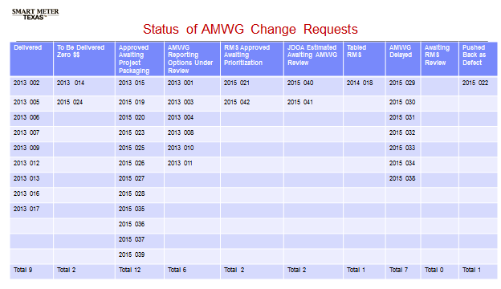
Change Requests (CRs)

Slide 5
Selected SMT Statistics - July
SMT Help Desk Calls 971 (+209)
SMT Help Desk Tickets 865 (+162)
Residential = 768(+187)
GUI access issues = 292 (+109)
Registration issues = 268 (+23)
SMT Registered Users (Res) 60,065 (+1,173)
ESIs in SMT 7,048,982 (+16,462)
Active Meters in SMT 6,977,964 (+16,441)

Slide 6
July Stats – Cont.
Energy Data Agreements 249 (+125)
AEPN = 1; CNP = 59; Oncor = 189
HAN Device Agreements 389 (+1)
HAN Devices 9,471 (-31)
3rd Parties Registered @ SMT 66 (+1)
REPs Registered @ SMT 98 (NC)
On Demand Reads
Customers 4,510
REPs 21
3rd Party 2

Slide 7
2015 Meetings
Monthly, alternating between in-person and WebEx
Next meeting is September 22nd, 9:00 – 3:30, ERCOT Met Center Room 168
Remaining meetings for 2015:
October 21st – WebEx only
November 17th – Room 209 at ERCOT
December 15th – WebEx only

Slide 8
Questions?

