Slide 1
Solar RFP Update: End of Phase 2
ERCOT Operations Analysis

Slide 2
Three Hour Ahead
 | Company A STPVPF | Company A PVGRPP | Company B STPVPF | Company B PVGRPP
Average | 6.985% | 19.181% | 5.703% | 8.481%
Under | 7.321% | 20.269% | 4.253% | 9.450%
Over | -6.691% | -2.310% | -6.516% | -3.786%
Count Under | 220 | 459 | 172 | 390
Count Over | 290 | 29 | 329 | 111
Max | 26.712% | 41.647% | 30.227% | 32.349%
<10 | 2.52% | 1.56% | 0.66% | 0.68%
10<x<50 | 6.54% | 6.87% | 5.10% | 5.61%
50<x<100 | 8.92% | 17.58% | 8.84% | 9.62%
100< | 6.87% | 29.64% | 5.23% | 10.94%
120< | 6.86% | 33.34% | 3.17% | 9.28%
Company B more accurate at high and low output.
*Only forecasts where the real-time output above 0.5 MW were used.
Notes:
<10 14%
10<x<50 13%
50<x<100 23%
100< 35%
120< 14%

Slide 3
Six Hour Ahead
 | Company A STPVPF | Company A PVGRPP | Company B STPVPF | Company B PVGRPP
Average | 7.257% | 19.400% | 5.862% | 7.923%
Under | 7.583% | 20.613% | 4.052% | 8.859%
Over | -6.950% | -2.530% | -6.802% | -3.712%
Count Under | 228 | 456 | 164 | 385
Count Over | 282 | 31 | 337 | 116
Max | 26.738% | 41.300% | 26.695% | 30.120%
<10 | 2.71% | 1.75% | 0.68% | 0.65%
10<x<50 | 7.19% | 7.21% | 5.33% | 5.31%
50<x<100 | 9.43% | 18.25% | 9.13% | 9.26%
100< | 6.83% | 29.50% | 5.31% | 10.00%
120< | 6.32% | 32.88% | 3.29% | 9.07%
*Only forecasts where the real-time output above 0.5 MW were used.
Notes:
<10 14%
10<x<50 13%
50<x<100 23%
100< 35%
120< 14%

Slide 4
Day Ahead
 | Company A STPVPF | Company A PVGRPP | Company B STPVPF | Company B PVGRPP
Average | 7.281% | 19.684% | 5.671% | 8.043%
Under | 7.370% | 20.873% | 4.204% | 8.845%
Over | -7.183% | -3.113% | -6.381% | -4.117%
Count Under | 237 | 441 | 151 | 377
Count Over | 256 | 30 | 334 | 108
Max | 25.620% | 41.086% | 29.690% | 32.773%
<10 | 3.08% | 2.03% | 0.65% | 0.74%
10<x<50 | 7.23% | 7.11% | 4.74% | 5.87%
50<x<100 | 8.90% | 18.10% | 8.63% | 9.91%
100< | 7.14% | 30.02% | 5.54% | 9.66%
120< | 7.26% | 33.80% | 3.06% | 9.78%
*Only forecasts where the real-time output above 0.5 MW were used.
Notes:
<10 14%
10<x<50 13%
50<x<100 23%
100< 35%
120< 14%

Slide 5
STPVPF Comparison
All Hours
 | Three Hour | Six Hour | Day Ahead
Company A | 6.985% | 7.257% | 7.281%
Company B | 5.703% | 5.862% | 5.671%
Hours Ending 17-19
 | Three Hour | Six Hour | Day Ahead
Company A | 8.405% | 8.807% | 8.446%
Company B | 6.112% | 6.272% | 7.870%

Slide 6
Sunrise & Sunset
 | Company A | Company B
Sunrise: HE7 | 0.31% | 0.07%
Sunset: HE21 | 5.09% | 0.71%
*Three hour ahead

Slide 7
Bias
The following numbers are the percentage of forecasts that were under-forecasted.
 | Company A STPVPF | Company B STPVPF | Company A PVGRPP | Company B PVGRPP
Three Hour | 43% | 34% | 94% | 78%
Six Hour | 45% | 33% | 94% | 77%
Day Ahead | 48% | 31% | 94% | 78%

Slide 8
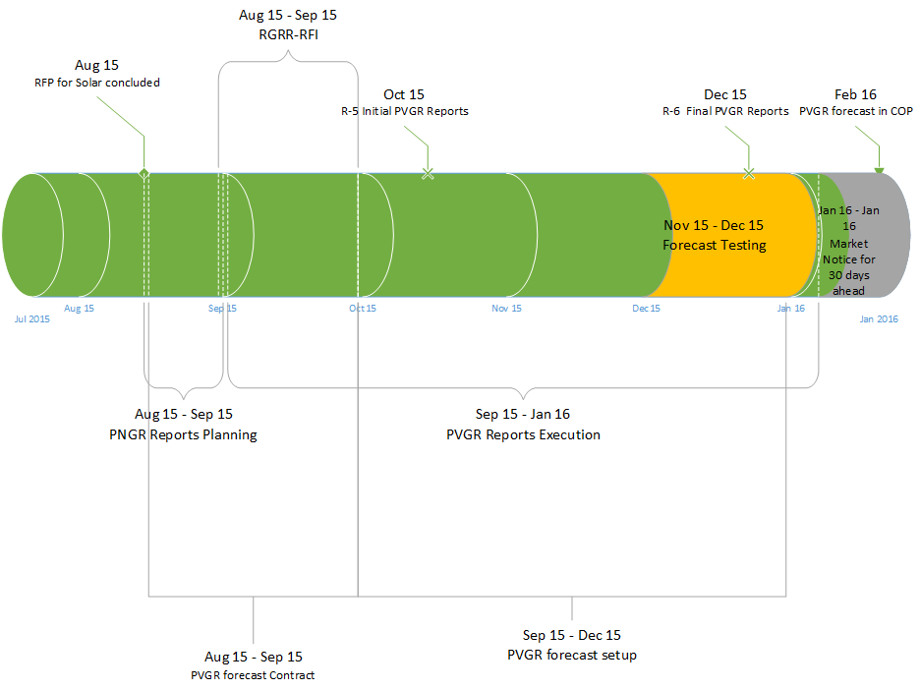
Expected timeline for PVGRR forecast

Slide 9
Questions?

