Slide 1
Hidalgo – Starr Transmission Project
ERCOT Regional Planning Group
August 18th, 2015
Prepared by AEPSC*
Dan Lyons
Supervisor, Planning & Engineering
American Electric Power
*AEPSC Provides Planning, Engineering and Project Management Services for AEP Texas and ETT

Slide 2
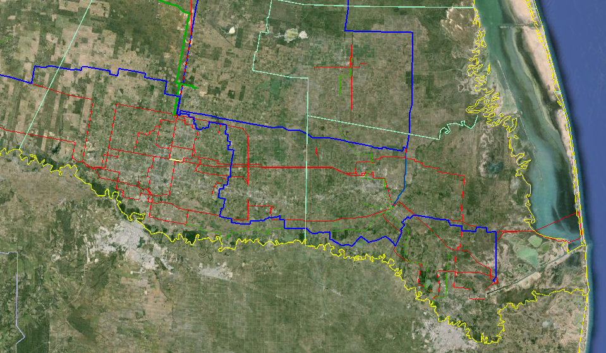
Lower Rio Grande Valley
(2016)
Nelson Sharpe (Corpus)
Lon Hill (Corpus)
Nelson Sharpe (Corpus)
Starr
Hidalgo
Willacy
LRGV Interface
LRGV Interface
Lobo (Laredo)
(Laredo)
MVEC HEC
764MW 536MW
McAllen
Molina
Pharr
Cameron
Alamo
Harlingen
Frontera
524MW
Interstate 2
Railroad DC Tie
±300MW
Brownsville
Silas Ray
46MW
Conventional Generation
-------- 345kV
-------- 138kV
-------- 69kV
Major Load Centers

Slide 3
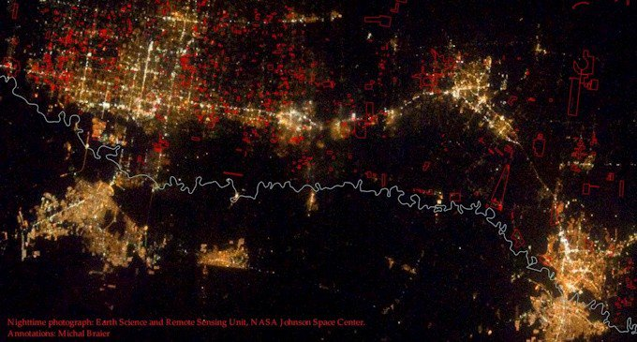
Lower Rio Grande Valley At Night
Reynosa
Matamoros
Thanks to NASA Earth Science and Remote Sensing Unit, Johnson Space Center
“The principal cities of McAllen, Brownsville and Harlingen combine to form the northern half of the Rioplex and are among the most rapidly growing region in America”.
(Source: McAllen Chamber of Commerce)
*Rioplex: Starr, Hidalgo, Willacy, Cameron counties and northern Mexico cities between Matamoros and Ciudad Mier

Slide 4
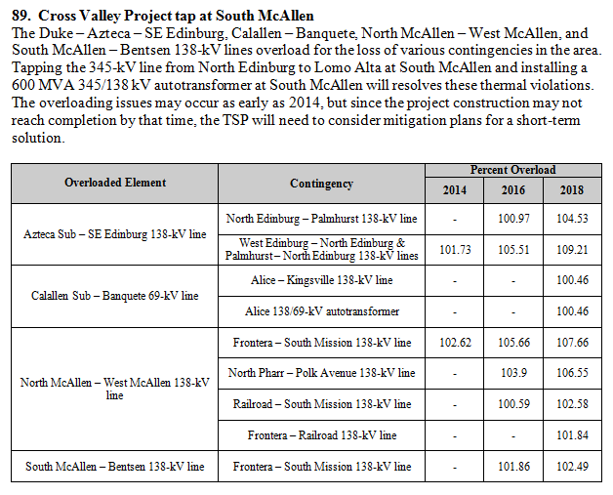
2013 & 2014 ERCOT RTP RESULTS

Slide 5
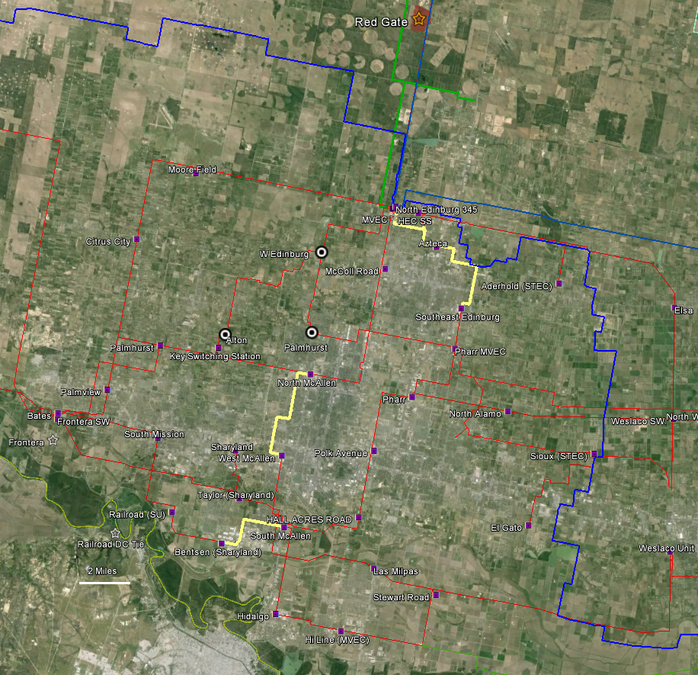
Overloading Identified in 2013 Regional Transmission Plan (RTP)

Slide 6
Study Methodology
Use ERCOT RTP 2017 Summer Peak, 2017 Spring, and 2020 Summer Peak Cases (South and South Central) developed in May 2014.
Since no Spring case was available in the 2020 study year, the 2020 Summer Peak case was scaled down 12% to represent a 2020 Spring scenario.
Evaluate combinations of wind and conventional generation dispatch and Railroad HVDC tie interchange to identify the most stressed On-Peak and Off-Peak cases.
Perform Steady State Analysis on stressed cases to evaluate system performance and compliance with the Transmission Planning Criteria established by NERC, ERCOT, and AEPSC.
Identify any thermal or voltage violations.
Model and evaluate potential transmission system improvements to resolve violations.
Changes to original RTP models
Since the Frontera generating facility will be exporting 100% of its 524 MW capacity to CFE in 2016, the Frontera plant was taken off-line in all cases.
results evaluated
The 2020 Summer On-Peak and 2020 Spring Off-Peak cases with wind generation at base dispatch (about 10%), and Railroad HVDC unchanged at full export were selected to be evaluated.
Contingency Definitions
Contingency Event | NERC Event | Description
N-0 | P0 | System normal, Zero elements out of service.
N-1 | P1 (P7) | Forced outage of a single Transmission line, Transformer, Generating unit, Shunt or FACTS device, (Double Circuit Line > 0.5 mi).
N-A-1 | P6 | Loss of a 345/138 kV autotransformer followed by an N-1 event defined above.
N-G-1 | P3 | Loss of a generating unit followed by an N-1 event defined above.
N-G-G | P3 | Loss of a generating unit followed by the loss of generating unit.
N-1-1* | P6 | A planned maintenance outage followed by an N-1 event defined above.
* Since planned maintenance outages generally occur during off-peak conditions, this study used a 2020 Spring case for the N-1-1 analysis.

Slide 7
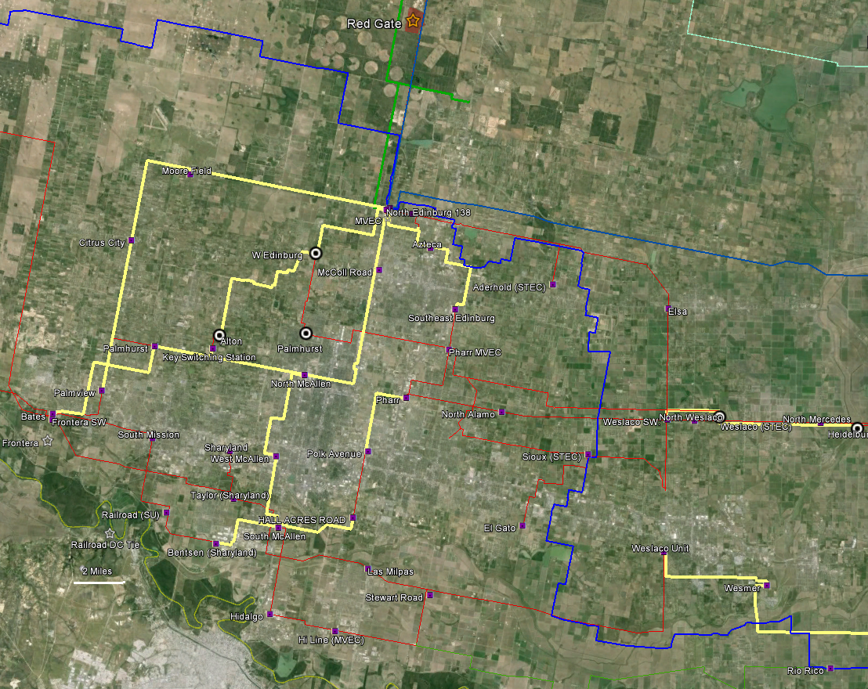
North Edinburg 345/138kV Transformers
Overloading in 2020

Slide 8
West LRGV Study Area
Starr
Hidalgo
Willacy
West LRGV
Cameron
This RPG Submission Addresses Issues in the West LRGV
Issues in the East Valley will be Addressed in a Future RPG Submission

Slide 9
138kV Upgrades Studied
0. Rebuild/Reconductor Offending lines and Replace North Edinburg Transformers.
Looping in the North Edinburg – Palmhurst 138 kV line into West Edinburg 138 kV substation.
Looping in the McColl Road – North McAllen 138 kV line into Pharr 138 kV substation and operate the Pharr – North McAllen 138 kV line segment normally open.
Looping in the Palmhurst – Merret 138 kV line, North Edinburg – North McAllen 138 kV line, and McColl Road – North McAllen 138 kV line into a new switching substation.
Installing a Phase Shifting Transformer at the Duke 138 kV substation in series with the Duke – Aderhold 138 kV line.
Installing a Phase Shifting Transformer at the South McAllen 138 kV substation in series with the South McAllen – Halls Acres 138 kV line.
Installing a Phase Shifting Transformer at the Frontera 138 kV substation in series with the Frontera – Palmhurst 138 kV line.
Constructing a new El Gato – Stewart Road 138 kV line and installing a Phase Shifting Transformer at El Gato 138 kV substation in series with the El Gato – Stewart Road 138 kV line.
Constructing a new substation on the North Edinburg – Moore Field 138 kV line and constructing a new 138 kV line from the new substation to West Edinburg.
Constructing a new double circuit 138 kV line from Stewart Road to the North Edinburg – Loma Alta 345 kV line, adding a new substation and 345/138 kV transformer.
Constructing a new 138 kV line from El Gato to the North Edinburg – Loma Alta 345 kV line, adding a new substation and 345/138 kV transformer.
Constructing a new double circuit 138 kV line from South McAllen to the North Edinburg – Loma Alta 345 kV line, adding a new substation and 345/138 kV transformer.
Plus a Few Others.
Upgrade0 was determined not to be a practical solution since the cost of upgrading 38 miles of 138kV line in an urban area and replacing two 345/138kV high capacity autotransfomers would rival the cost of more robust and longer term solutions.
No single 138kV upgrade above or combination of upgrades were sufficient in resolving the thermal overloads in the 2020 system.
138kV Upgrade1 and 2 exhibited substantial benefits with low cost and were then included with combinations of other 345kV options. These two 138kV upgrades are illustrated in the next slides.
Notes:
Much of the transmission line requiring upgrading is already high temperature, high capacity 138kV transmission line.
Rebuilding or reconductoring 38 miles of transmission line in a densely populated urban area would present logistical challenges and would likely not be possible in some areas.
The cost of upgrading 38 miles of line in this densely populated area and replacing two 345/138 kV high capacity transformers would rival the cost of the other options which are considered to be more robust, long term solutions.

Slide 10
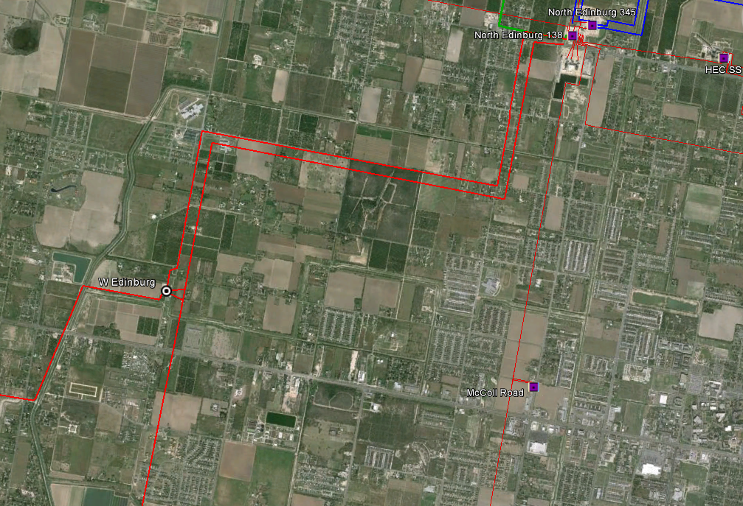
X
138kV Upgrade1
Cut in the North Edinburg – Palmhurst 138 kV line into West Edinburg (STEC) 138 kV Station
(Included with Other Options Going Forward)

Slide 11
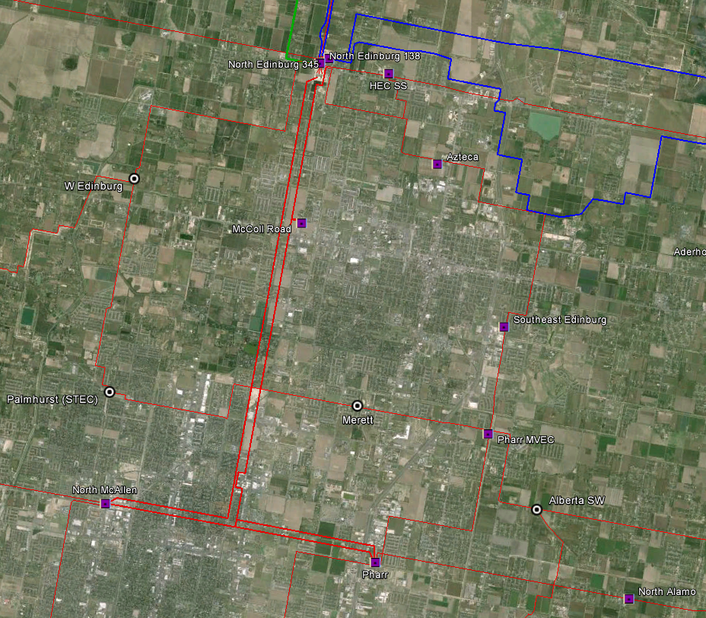
X
Normally Open
138kV Upgrade2
Cut in the McColl Road – North McAllen 138 kV line into Pharr 138 kV Station
Operate the Pharr – North McAllen 138 kV line segment normally open
(Included with Other Options Going Forward)

Slide 12
345kV Options Evaluated
(with 138kV Upgrade1 and 2)
Option 1: Frontera 345kV Station
Option 2: South McAllen 345kV Station
Option 3: Stewart Road 345kV Station
Option 4: Pharr 345kV Station
Option 5: Weslaco 345 kV Station
Options 1 through 5 are illustrated in the next slides

Slide 13
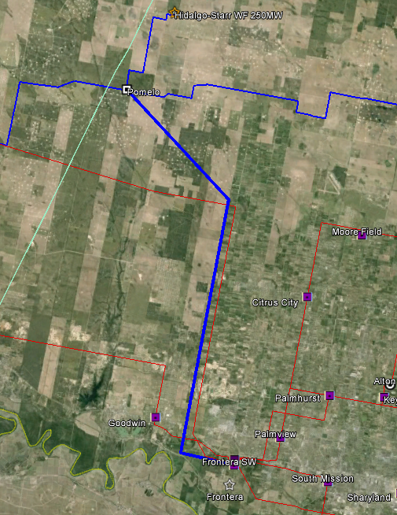
Option 1 -- Frontera 345kV Station
New 345 kV Line between the Planned Pomelo Station and Frontera Station (23 Miles)
Expand Frontera with Single 345/138kV Autotransformer

Slide 14
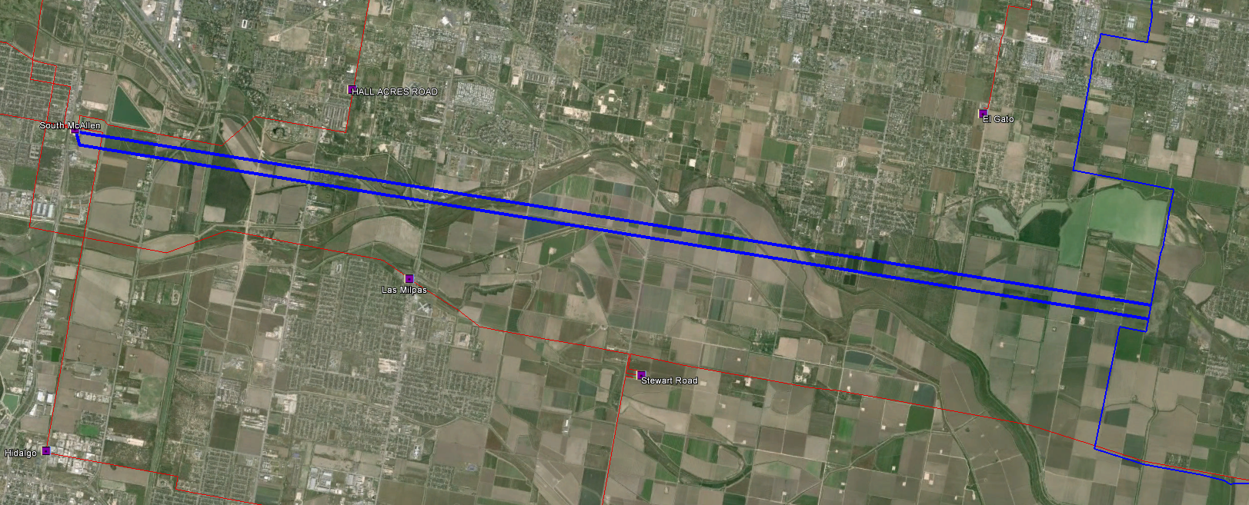
X
Option 2 -- South McAllen 345kV Station
Cut in the North Edinburg – Palmito 345kV Line into South McAllen 138kV Station
(Separate ROW, 12 Miles Each)
Expand South McAllen with Dual 345/138kV Autotransformers

Slide 15
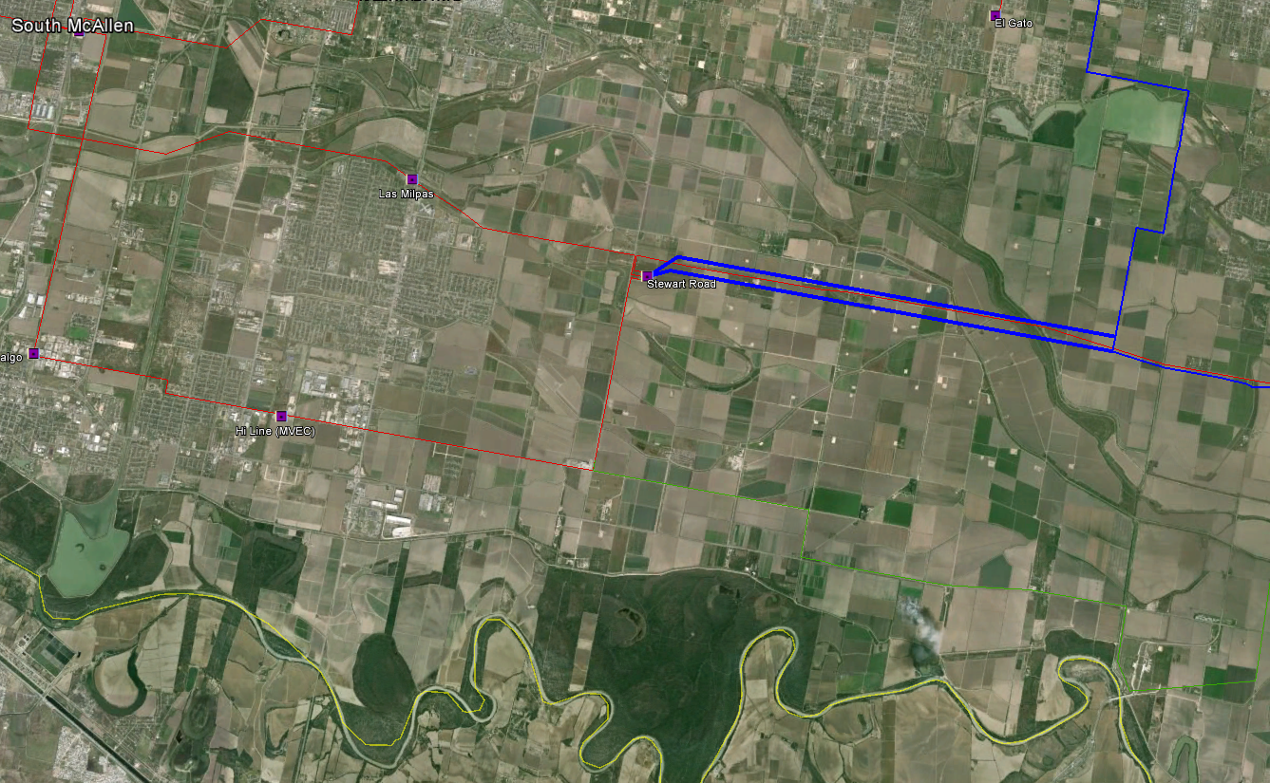
X
Option 3 -- Stewart Road 345kV Station
Cut in the North Edinburg – Palmito 345kV Line into Stewart Road 138kV Station
(Separate ROW, 5 Miles Each)
Expand Stewart Road with Dual 345/138kV Autotransformers

Slide 16
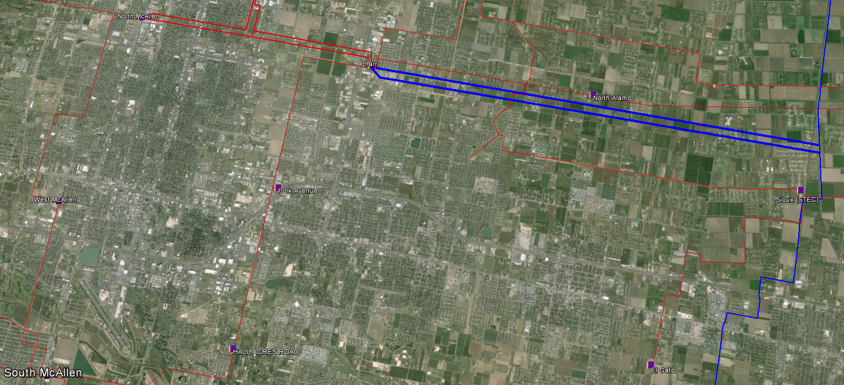
X
Option 4 -- Pharr 345kV Station
Cut in the North Edinburg – Palmito 345kV Line into Pharr 138kV Station
(Separate ROW, 8 Miles Each)
Expand Pharr with Dual 345/138kV Autotransformers

Slide 17
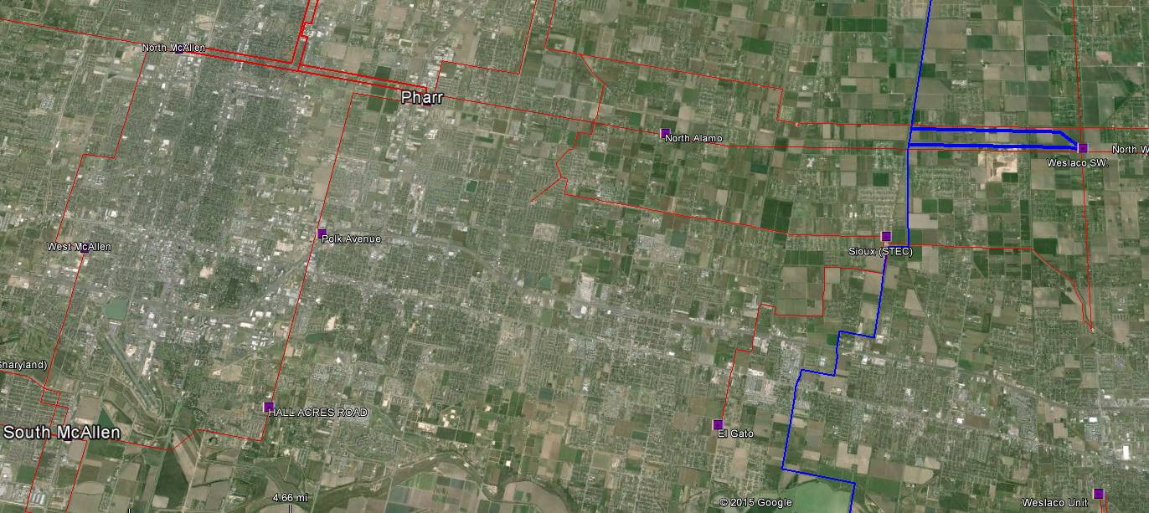
X
Option 5 -- Weslaco 345kV Station
Cut in the North Edinburg – Palmito 345kV Line into Weslaco 138kV Station
(Separate ROW, 3 Miles Each)
Expand Weslaco with Dual 345/138kV Autotransformers

Slide 18
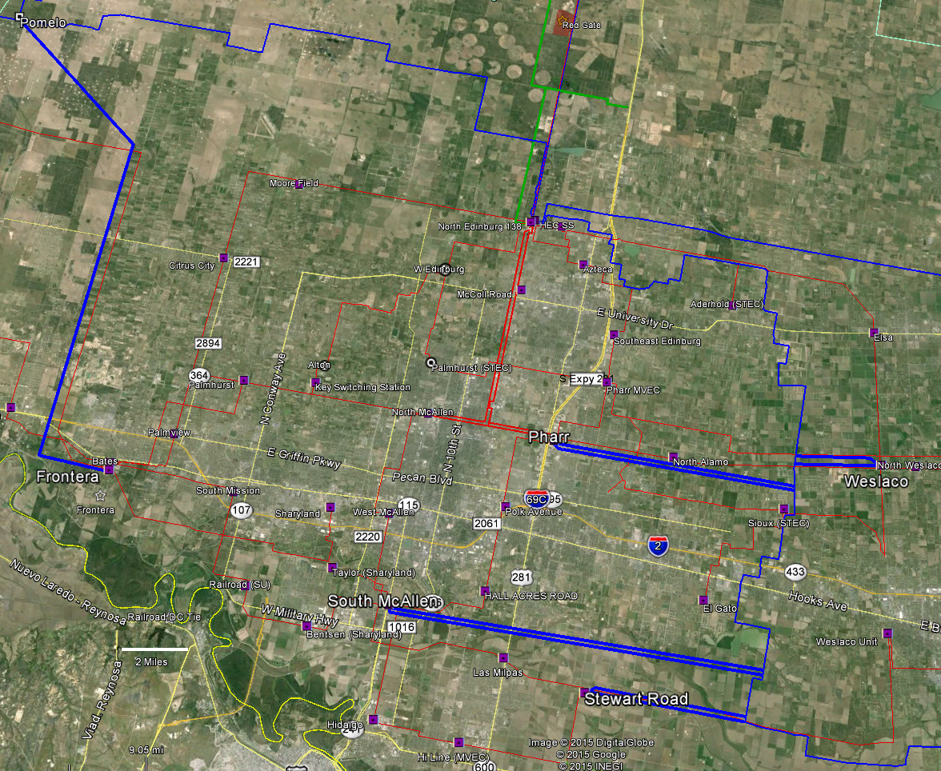
Summary of Options
Notes:
Take questions here ?

Slide 19
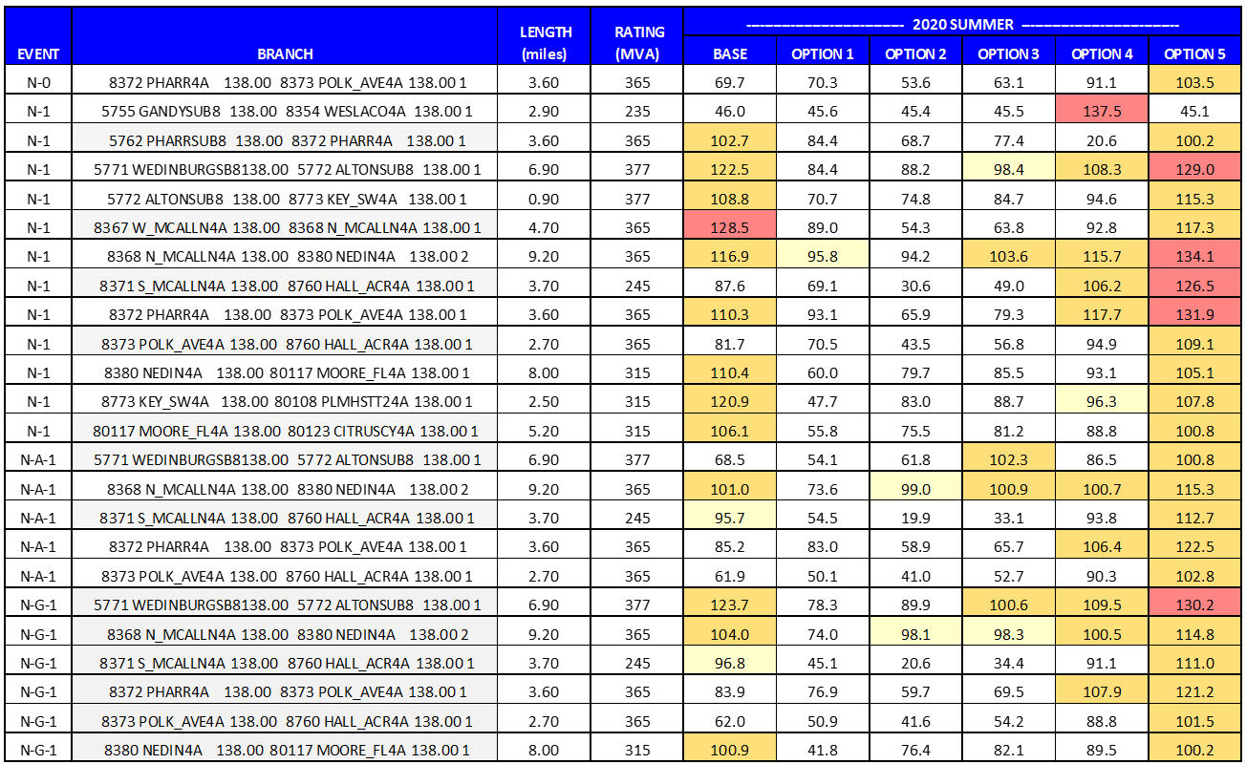
Single Station Results
(2020 Summer On-Peak)
Max ---> 129% 96% 99% 104% 138% 134%
Overloading in 2020
Notes:
Option1 and 2 are ‘maginally’ adequate
Option3 is a close second
Option 4 & 5 are not viable as single station option

Slide 20
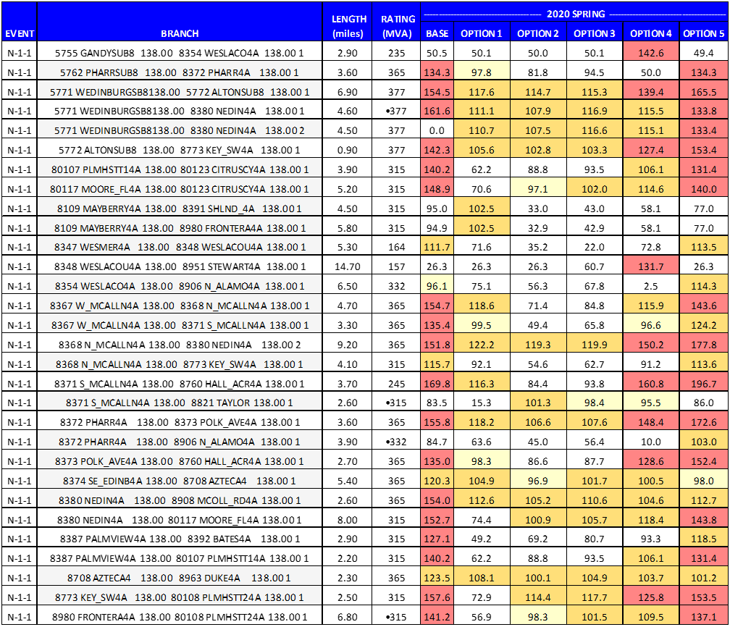
Single Station Results (N-1-1)
(2020 Spring Off-Peak)
Max --> 170% 122% 119% 119% 161% 197%
N-1-1 Overloading in 2020
Notes:
Option1 ,2, and 3 best performing under maintenance + outage condition (in an off-peak case)
Option4 & 5 no help

Slide 21
To accommodate planned maintenance plus outage conditions (N-1-1)
The West Valley needs:
1) a strong source on the Southside, and
2) a strong source on the Eastside

Slide 22
Two Station Options Evaluated
(with 138kV Upgrade1 and 2)
Option 2-1: South McAllen and Frontera 345 kV Stations
Option 3-1: Stewart Road and Frontera 345 kV Stations
Option 4-1: Pharr and Frontera 345 kV Stations
Option 5-1: Weslaco and Frontera 345 kV Stations

Slide 23
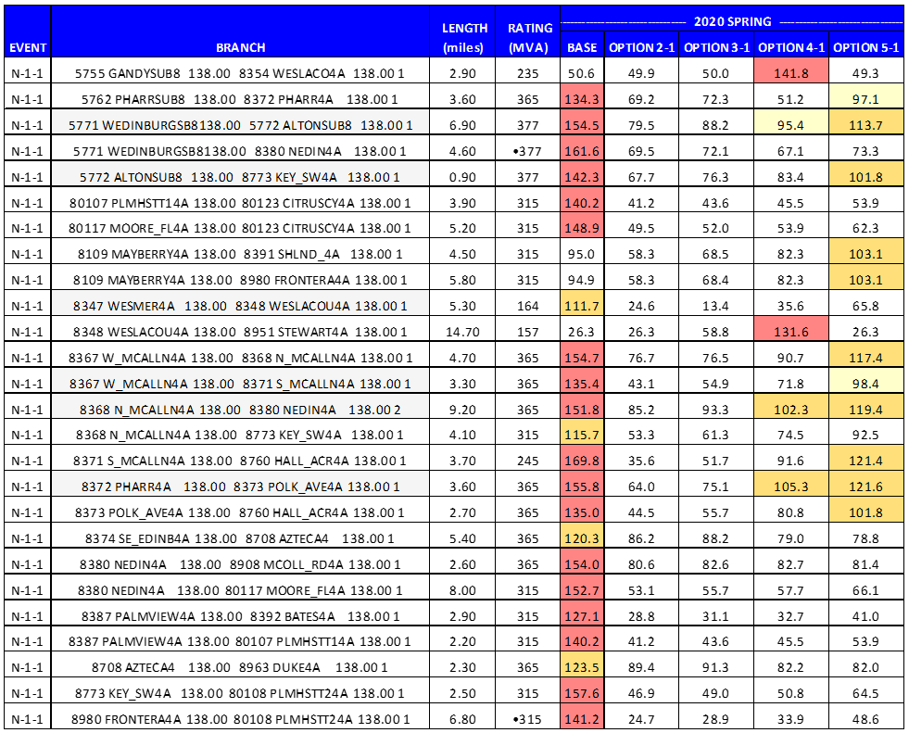
Two Station Results (N-1-1)
Max --> 89% 93% 142% 122%
Option 2-1 and 3-1 Perform Best in 2020
What about load growth Performance?

Slide 24
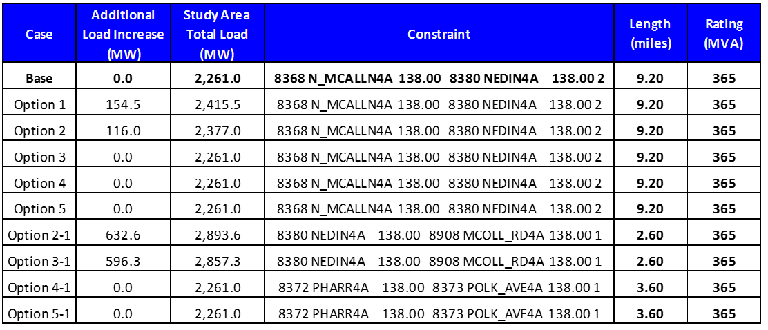
Load Growth Senstivity Analysis
Single and Dual Station Options
Single Station Results:
Option 3,4, & 5 do not provide any support for additional load growth in the West Valley.
Option 1 & 2 support about 6% West Valley load growth.
Dual Station Results:
Option 2-1 and Option 3-1 support about a 27% West Valley load growth.

Slide 25
Cost Estimates
Option | Description | Cost (USD)
Option 1 | Construct a new 345 kV terminal at the Frontera 138 kV substation with a single 345/138 kV autotransformer. Construct a new 23 mile 345 kV line from Frontera to Pomelo substation. In addition, loop in the McColl Road to North McAllen 138 kV line into Pharr 138 kV substation, and loop in the North Edinburg to Palmhurst 138 kV line into West Edinburg 138 kV substation | 91.1M
Option 2 | Construct a new 345 kV terminal at the South McAllen 138 kV substation with double 345/138 kV autotransformers. Construct 12 miles of new 345 kV line in and out of South McAllen from the North Edinburg to Loma Alta 345 kV line. In addition, loop in the McColl Road to North McAllen 138 kV line into Pharr 138 kV substation, and loop in the North Edinburg to Palmhurst 138 kV line into West Edinburg 138 kV substation | 97.2M
Option3 | Construct a new 345 kV terminal at the Stewart Road 138 kV substation with double 345/138 kV autotransformers. Construct 5 miles of new 345 kV line in and out of Stewart Road from the North Edinburg to Loma Alta 345 kV line. In addition, loop in the McColl Road to North McAllen 138 kV line into Pharr 138 kV substation, and loop in the North Edinburg to Palmhurst 138 kV line into West Edinburg 138 kV substation | 70.1M
Option2-1 | Combined Option 2 and Option 1 | 178.2M
Option3-1 | Combined Option 3 and Option 1 | 151.1M
Recommendation
Both Option 2-1 and 3-1 resolve P1,P3,P6, and P7 issues and allows the West Valley load to increase about 27% beyond this 2020 analysis.
Option 3-1 is $27.0 M less that Option 2-1.
Based on the analysis and evaluation of options in this Regional Planning Group (RPG) submission, American Electric Power Service Corporation (AEPSC), on behalf of American Electric Power Texas Central Company (AEP-TCC) and Electric Transmission Texas (ETT), proposes and is seeking Electric Reliability Council of Texas (ERCOT) endorsement of the following project:
Option 3-1 ($151M):
Expand the Stewart Road 138 kV Station with two (2) new 345 kV lines terminals and two (2) 345/138 kV autotransformers.
Cutin two (2) new 345 kV transmission lines, about 5 miles each from the North Edinburg to Loma Alta 345 kV line.
Expand the existing Frontera 138 kV Station with one (1) new 345 kV line terminal and one (1) 345/138 kV autotransformer.
Construct a new 345 kV transmission line, approximately 23 miles from the Frontera 345kV station to the planned Pomelo station.
Expand the existing West Edinburg 138 kV substation to accommodate two (2) new 138 kV line terminals.
Cutin the North Edinburg to Palmhurst 138 kV line, about 1000ft, into the West Edinburg 138 kV Station.
Expand the Pharr 138 kV Station to accommodate two (2) new 138 kV line terminals.
Cutin the McColl Road to North McAllen 138kV line into the Pharr 138kV Station, Double Circuit, two (2) miles.

Slide 26
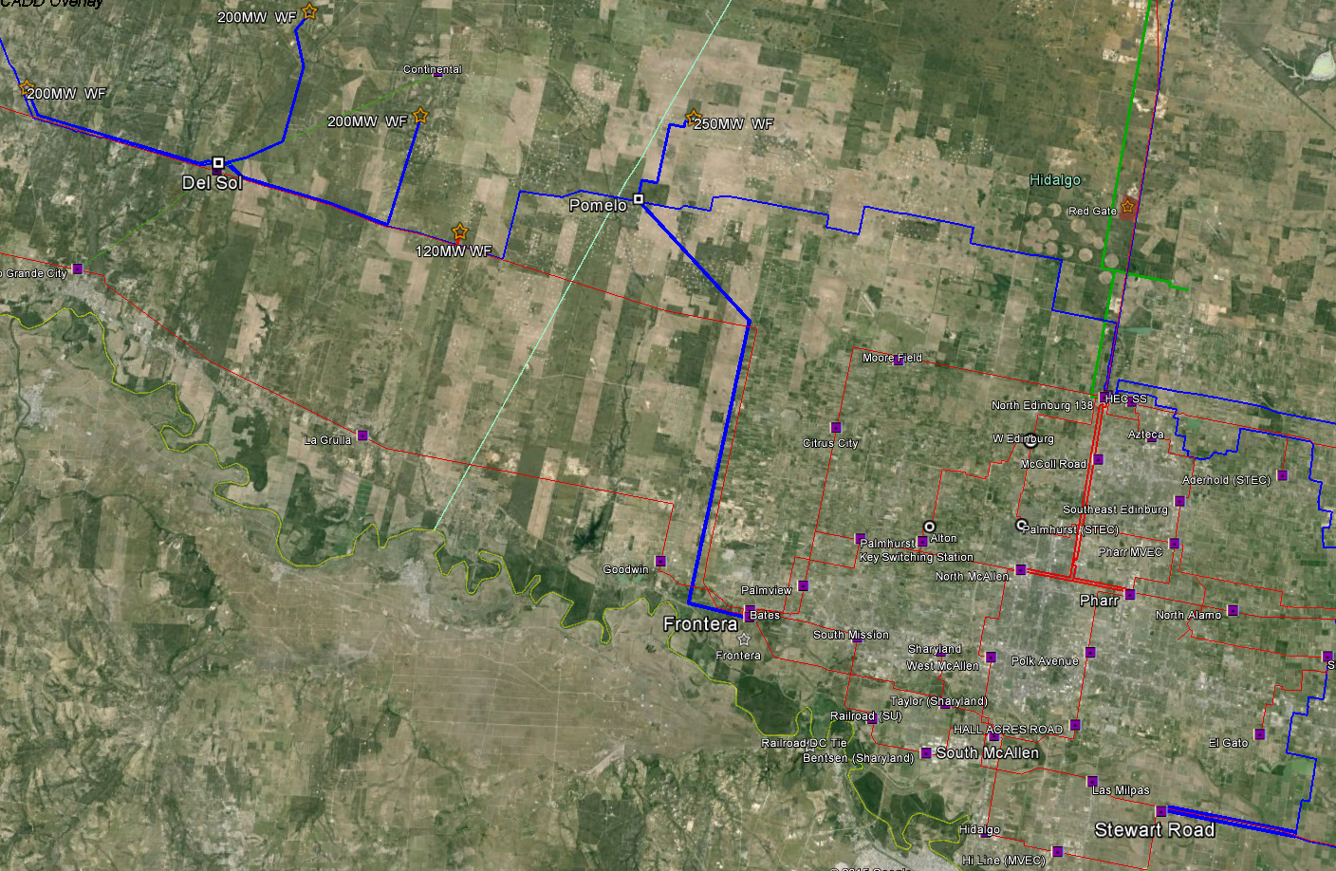
970MW of Wind Generation will be connecting in this area of the system by the end of 2016
Additional 730MW connecting to the Laredo area system by the end of 2016
800MW of renewable generation under study and not yet commited to interconnection
The Pomelo – Frontera 345kV line will provide another path for this generation for loss of the Pomelo – North Edinburg 345kV line.
However, This line will provide another path for only 250MW of wind generation for loss of the Del Sol – Pomelo 345kV line.
Update Since this Study was Performed

Slide 27
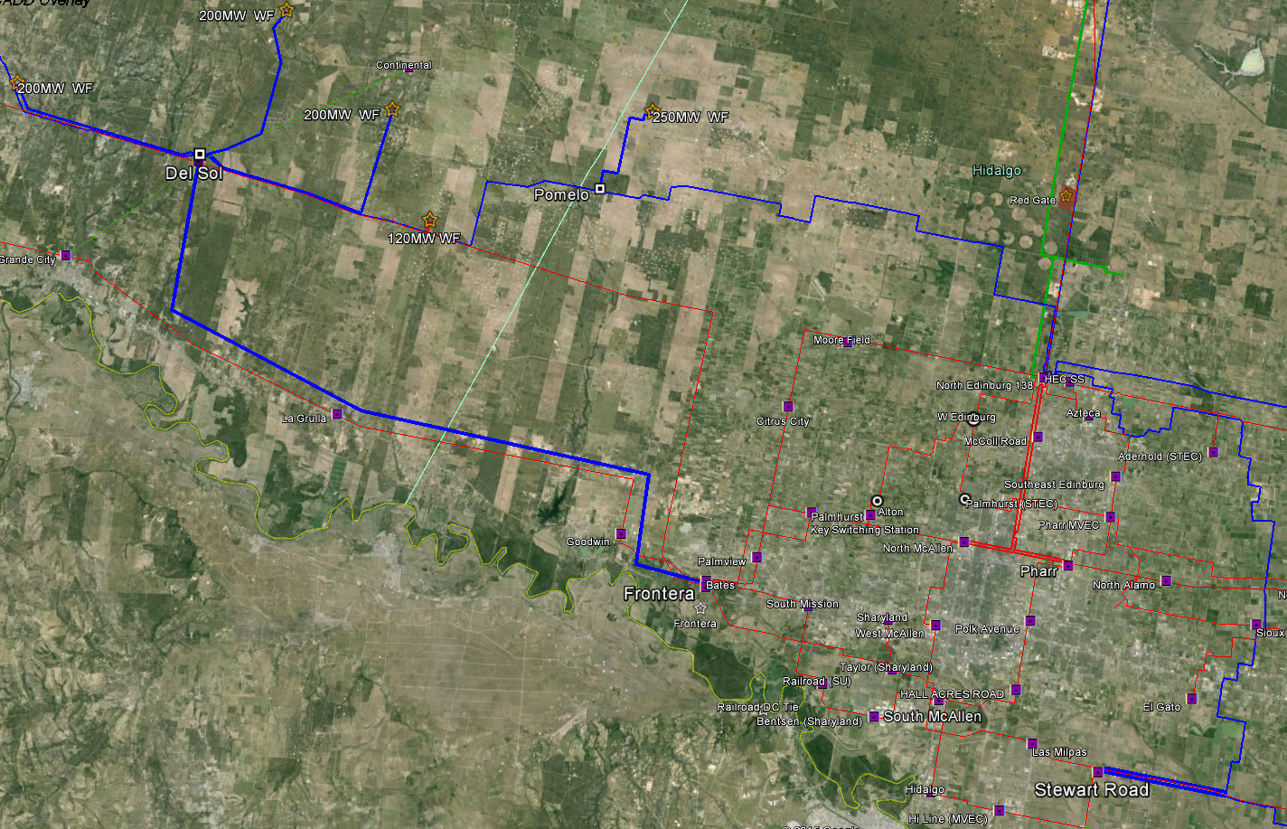
Something for ERCOT Staff to consider while performing the Independent Study:
A Del Sol – Frontera 345kV line (33 miles) would provide wind generation paths to the West Valley load for loss of the Del Sol – Pomelo 345kV line.

Slide 28
Thank You
Dan Lyons
Supervisor, Planning & Engineering
American Electric Power

