Slide 1
Information Technology Report
Dave Pagliai
Manager, IT Support Services

Slide 2
Incident Report Highlights
Service Availability – June/July
Retail Market IT systems met all SLA targets
Incidents & Maintenance – June/July
06/05/15 – Find Transaction for historic searches (greater than 1 year) unavailable
06/18/15 – Find Transaction for historic searches (greater than 1 year) unavailable
06/25/15 – MIS Find ESIID and Find Transaction slow response times
07/01/15 – NAESB Issue (15:25 – 15:34)
Market Participants may have received NAESB processing errors or experienced delays in Retail transaction processing until approximately 19:00, when the transaction backlog was cleared and normal processing resumed
From 07/1/15 at 15:25 until 07/2/15 at approximately 15:30, ERCOT erroneously sent reject responses indicating duplication (DUP) for a small subset of LSEs
07/12/15 – Planned Maintenance (Commercial Systems Site Failover – Retail processing, MarkeTrak, Retail API)
Supplemental AMS Interval Data Report Issue
No impacts to report posting in June
Permanent fix implemented in R3 Production release (week of 06/22/15)

Slide 3
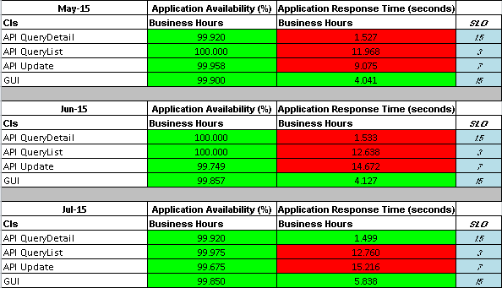
MarkeTrak Performance

Slide 4
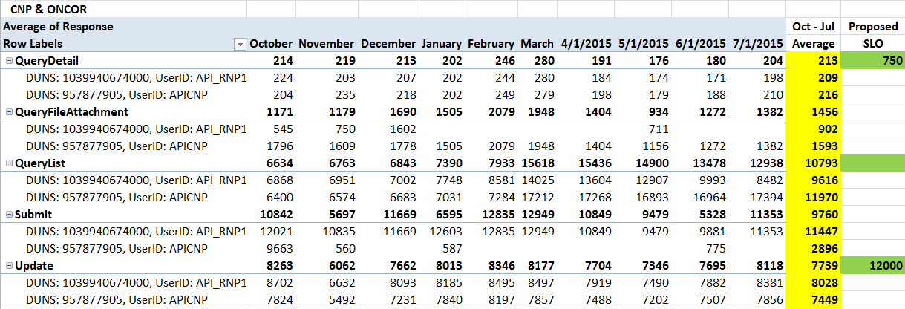
MarkeTrak Performance

Slide 5
Premature Transitioning of MarkeTrak Issues
ERCOT’s MarkeTrak application prematurely transitioned issues of all subtypes
This occurred on February 4 , 11, and 24, 2015
Investigation determined that a database parameter was getting changed by the MarkeTrak application
On February 24, ERCOT implemented a system change in an attempt to prevent the impact of the database parameter change, should it reoccur
No re-occurrence of the issue since 02/24/15
Vendor root cause investigation:
Unable to reproduce the issue under multiple scenarios
No other customers have reported this issue
Vendor suggests considering an upgrade of their product
TDTWG has questions regarding the possibility of an upgrade (support roadmap, user base of currently running version, features of new version, etc.)
ERCOT has initiated discussions with the vendor to address TDTWG’s questions regarding an upgrade path
ERCOT presented details of vendor discussions at 07/13/15 MTTF and 07/14/15 TDTWG
ERCOT presented details of vendor discussions at 08/04/15 RMS

