Slide 1
SMT Update To AMWG
August 17, 2015

Slide 2
Review SMT Patching Events and Schedule

Slide 3
SMT Patching Events and Schedule
Completed installation of new SMT infrastructure May 9th, 2015
Conducted health check and patch verification on newly installed infrastructure
Identified all patches needed for new SMT infrastructure and developed plan to implement
Completed weekly patch maintenance for dates 7/5/15 - completed, 7/12/15 - completed, 7/19/15 - completed, 7/26/15 - completed, and 8/2/15 – completed. This activity completes a baseline full cycle of all necessary patches
Defined ongoing monthly maintenance to be conducted the third Sunday of every month.
Will conduct the first monthly patch maintenance on September 20th, 2015
Will conduct additional patch maintenance as required for items that are identified as critical

Slide 4
SMT Issues Observed in July 2015

Slide 5
SMT Issues Observed In July 2015
July 16, 17 and 18, 2015
On Thursday July 16 an issue was identified that users were not receiving temporary passwords at registration or password resets
SMT Support determined the issue was with the SMT Security Web Application
On Friday July 17 a 50 minute outage was taken to restart the Security Web Application
On Saturday July 18 a 3 hour unplanned maintenance outage was taken to implement a permanent fix
July 26, 2015
On Sunday July 26 SMT experienced and outage of all services
SMT Support determined the issue was with the flash drive storage system
The issue was repaired Sunday evening July 26 concluding a 12.5 hour outage

Slide 6
SMT Disaster Recovery Exercise Plan

Slide 7
SMT Disaster Recovery Plan
Friday August 21, 2015 8:00 P.M. CST until Saturday August 22, 2015 12:01 P.M. CST outage of SMT services.
Saturday August 22, 2015 8:01 A.M. CST ROR and Third Party FTPS Folders for LSE Interval Data will become available for download utilizing the SMT Disaster Recovery environment.
Saturday August 22, 2015 12:01 P.M. CST until Friday August 28, 2015 8:00 P.M. CST all SMT services available utilizing SMT Disaster Recovery environment.
Friday August 28, 2015 8:00 P.M. CST until Saturday August 29, 2015 12:01 P.M. CST outage of SMT services.
Saturday August 29, 2015 8:01 A.M. CST ROR and Third Party FTPS Folders for LSE Interval Data will become available for download utilizing the SMT Production environment.
Saturday August 29, 2015 12:01 P.M. CST all SMT services available utilizing SMT Production environment.

Slide 8
Status Update of AMWG Change Requests

Slide 9
Status of AMWG Change Requests
Delivered | To Be Delivered Zero $$ | Approved Awaiting Project Packaging | AMWG Reporting Options Under Review | RMS Approved Awaiting Prioritization | JDOA Estimated Awaiting AMWG Review | Tabled RMS | AMWG Delayed | Awaiting RMS Review | Pushed Back as Defect
2013 002 | 2013 014 | 2013 015 | 2013 001 | 2015 021 | 2015 040 | 2014 018 | 2015 029 |  | 2015 022
2013 005 | 2015 024 | 2015 019 | 2013 003 | 2015 042 | 2015 041 |  | 2015 030
2013 006 |  | 2015 020 | 2013 004 |  |  |  | 2015 031
2013 007 |  | 2015 023 | 2013 008 |  |  |  | 2015 032
2013 009 |  | 2015 025 | 2013 010 |  |  |  | 2015 033
2013 012 |  | 2015 026 | 2013 011 |  |  |  | 2015 034
2013 013 |  | 2015 027 |  |  |  |  | 2015 038
2013 016 |  | 2015 028
2013 017 |  | 2015 035
 |  | 2015 036
 |  | 2015 037
 |  | 2015 039
Total 9 | Total 2 | Total 12 | Total 6 | Total 2 | Total 2 | Total 1 | Total 7 | Total 0 | Total 1

Slide 10
AMWG Change Requests
AMWG Change Request | AMWG CR Document | Status | Categorization and Estimated Delivery Date | Estimated Cost
AMWG CR 2013 001 – Report for AMWG Data Monitoring – Data Completeness Measurements |  | Estimate Complete & RMS Approved 3/3/15 | Reporting Options Under Review | Small (20-40)
AMWG CR 2013 002 – Reports for AMWG Data Monitoring – Data Timeliness Measurements |  | Implemented | Q2 2014 Delivered | Included in Maintenance Contract
AMWG CR 2013 003 – Reports for AMWG Data Monitoring – Measurement of Percentage of Actual Meter Reads |  | Estimate Complete & RMS Approved 3/3/15 | Reporting Options Under Review | Small (20-40)
AMWG CR 2013 004 – Reports for AMWG Data Monitoring – Measurement of Estimates |  | Estimate Complete & RMS Approved 3/3/15 | Reporting Options Under Review | Medium (40-60)
AMWG CR 2013 005 – Reports for AMWG Data Monitoring – Number of SMT Help Desk Tickets Monthly by Ticket Type |  | Implemented | Q2 2014 Delivered | Included in Maintenance Contract
AMWG CR 2013 006 – Reports for AMWG Data Monitoring – Availability of SMT API |  | Implemented | Q2 2014 Delivered | Included in Maintenance Contract
AMWG CR 2013 007 – Reports for AMWG Data Monitoring – Availability of SMT FTPS |  | Implemented | Q2 2014 Delivered | Included in Maintenance Contract
AMWG CR 2013 008 – Reports for AMWG Data Monitoring – Average Time to Deliver HAN Messages |  | Estimate Complete & RMS Approved 3/3/15 | Reporting Options Under Review | Small (20-40)
AMWG CR 2013 009 – Reports for AMWG Data Monitoring – Number of Accounts by Type |  | Implemented | Q2 2014 Delivered | Included in Maintenance Contract
AMWG CR 2013 010 – Reports for AMWG Data Monitoring – Number of Reports Requested by GUI (Portal) and Number of FTPS Accesses |  | Estimate Complete & RMS Approved 5/6/15 | Reporting Options Under Review | Medium (40-60)

Slide 11
AMWG Change Requests (Cont.)
AMWG Change Request | AMWG CR Document | Status | Categorization and Estimated Delivery Date | Estimated Cost
AMWG CR 2013 011 – Average Time from HAN Provision Request to Meter Ready Status |  | Estimate Complete & RMS Approved 3/3/15 | Reporting Options Under Review | Small (20-40)
AMWG CR 2013 012 – Bypass redundant screen for Users with only one meter when accessing HAN device information |  | Implemented | Q4 2014 Delivered | Included in Third-Party
AMWG CR 2013 013 – Timeout on SMT takes user to “incorrect login” screen |  | Implemented | Q4 2014 Delivered | Included in Third-Party
AMWG CR 2013 014 – Allow SMT user to toggle between 15-Minute Reads and Daily Reads without having to reset the date range |  | Designed | 2015 Next Release | Included in Usability
AMWG CR 2013 015 – Expand Daily Usage Graph to show 35 days of daily usage on the SMT GUI |  | Estimate Complete & RMS Approved 3/3/15 | 2 Important Awaiting Packaging | Medium (40-60)
AMWG CR 2013 016 – Capability for RORs to grant access to vendors on their behalf to the ROR’s customers via API (energy usage, HAN messaging , and HAN provisioning) and FTPS files |  | Implemented | Q3 2014 Delivered | Included in Maintenance Contract
AMWG CR 2013 017 – REP API for Energy Usage on SMT (Backfill of Historical Usage Data for Existing Customers- “Interim”) | See Below CR 2013 017 Permanent | Implemented Interim | Q4 2013 Delivered | Included in SMT Work In Process
AMWG CR 2013 017 – REP API for Energy Usage on SMT (Subscription for New Customer Historical Usage – “Interim”) | See Below CR 2013 017 Permanent | Implemented Interim | Q2 2014 Delivered | Included in Maintenance Contract
AMWG CR 2013 017 – REP API for Energy Usage on SMT – Permanent Solution to Replace Interim Solution |  | JDOA Estimate To Begin After New Infrastructure Refresh Complete | Awaiting Evaluation of New SMT Infrastructure to Determine if any Additional Work is Needed to meet CR Requirements | Will Be Estimated After New Infrastructure Implemented in Q1 2015
AMWG CR 2014 018 – Add Generation Data to the SMT Portal View |  | JDOA Estimate Completed | RMS Tabled 6/2/15 RMS Tabled 8/4/15 | Medium (40-60) Graph and Table Small (20-40) Table Only

Slide 12
AMWG Change Requests (Cont.)
AMWG Change Request | AMWG CR Document | Status | Categorization and Estimated Delivery Date | Estimated Cost
AMWG CR 2015 019 – Relocate Various SMT User Guides from the Authenticated Site to the Unauthenticated Site |  | JDOA Estimate Completed | 2 Important Awaiting Packaging | Small (20-40)
AMWG CR 2015 020 – Add Customer Type in the Customer Information Section in the View / Edit Agreement Page |  | JDOA Estimate Completed | 3 Nice to Have Awaiting Packaging | Medium (40-60)
AMWG CR 2015 021 – Improve REP of Record Search Criteria During the Customer Registration Process |  | Estimate Complete & RMS Approved 5/6/15 | Awaiting AMWG Prioritizatoin | Medium,(40-60)
AMWG CR 2015 022 – Keep Selected ROR Visible During Customer Registration |  | JDOA Estimate Completed | Push Back as Defect | Small (20-40)
AMWG CR 2015 023 – Allow Entry of Multiple ESIIDs During Customer Registration Process |  | JDOA Estimate Completed | 3 Nice to Have Awaiting Packaging | High (60-120)
AMWG CR 2015 024 – Third Party Access Renew Energy Data Agreement After One Year |  | JDOA Estimate Completed | 1 Critical Awaiting Delivery in 2015 | 0 Dollar
AMWG CR 2015 025 – Third Party User Experience Add Identifying Data Fields in the Report Request Status Page |  | JDOA Estimate Completed | 2 Important Awaiting Packaging | High (60-120)
AMWG CR 2015 026 – SMT Functionality Display Portal Message when Report Can Not be Displayed in the SMT Portal Page |  | JDOA Estimate Completed | 2 Important Awaiting Packaging | Minor (0-20)
AMWG CR 2015 027 – SMT Functionality Allow Specific Date Entry on the Export Report Screen |  | JDOA Estimate Completed | 3 Nice to Have Awaiting Packaging | Small (20-40)
AMWG CR 2015 028 – SMT Functionality Allow ESIIDs to be Copied and Pasted into the ESIID Box on the Usage Page |  | JDOA Estimate Completed | 3 Nice to Have Awaiting Packaging | Minor (0-20)
AMWG CR 2015 029 – This Party Allow Third Parties to Utilize an API for On Demand Data Requests |  | Estimate Complete & RMS Approved | AMWG Delayed | High (60-120)

Slide 13
AMWG Change Requests (Cont.)
AMWG Change Request | AMWG CR Document | Status | Categorization and Estimated Delivery Date | Estimated Cost
AMWG CR 2015 030 – Support multiple RORs during CSV file meter upload |  | JDOA Estimate Completed | AMWG Delayed | High (60-120)
AMWG CR 2015 031 – Allow only current ROR for account registration validation and meter add validation |  | JDOA Estimate Completed | AMWG Delayed | High (60-120)
AMWG CR 2015 032 – Support SFTP protocol for SMT integration |  | Investigation Complete | AMWG Delayed | High (60-120)
AMWG CR 2015 033 – Provide user id and password rules up front on UI registration page |  | IBM Re-estimate with Hardcode vs Roll Over | AMWG Awaiting new Estimate | Medium (40-60)
AMWG CR 2015 034 – Display the day of the week in addition to the date on usage reports |  | JDOA Estimate Completed | AMWG Delayed | Medium (40-60)
AMWG CR 2015 035 - Provide a customer-selected option to receive a monthly usage report via email |  | Estimate Complete & RMS Approved | 2 Important Awaiting Packaging | Medium (40-60)
AMWG CR 2015 036 – Rename Overview tab to Home |  | Estimate Complete & RMS Approved | 2 Important Awaiting Packaging | Minor (0-20)
AMWG CR 2015 037 – Remove SMT Demo from Private Site for REPs, TDSPs, and Third Parties |  | Estimate Complete & RMS Approved | 2 Important Awaiting Packaging | Minor (0-20)
AMWG CR 2015 038 – Provide a “Hold” capability on Third Party accounts to reactivate usage until the Third Party has integrated with FTPS and API |  | JDOA Estimate Completed | AMWG Delayed | High (60-120)
AMWG CR 2015 039 – Provide more detail for Third Party Agreement Invitation Error Messages |  | Estimate Complete & RMS Approved | 2 Important Awaiting Packaging | Medium (40-60)
AMWG CR 2015 040 – Improve SMT Administration Functionality for TDSPs, RORs, Third Parties, and Businesses |  | JDOA Estimate Completed | JDOA Estimate Complete Awaiting AMWG Review | 5 Functions Small, Small, Zero, Medium, High

Slide 14
AMWG Change Requests (Cont.)
AMWG Change Request | AMWG CR Document | Status | Categorization and Estimated Delivery Date | Estimated Cost
AMWG CR 2015 041 – Allow Enrollment for New Customer 12 Month History for Third Parties |  | RMS Approved for Cost Estimation | JDOA Estimate Complete | Medium (40-60)
AMWG CR 2015 042 – Automate Machine to Machine Consumption of Third Party Agreement Information |  | RMS Approved 8/4/15 | Awaiting AMWG Prioritization | Med / High (80)

Slide 15
Rough Order Of Magnitude (ROM) Estimate of Effort Classification
Change Type | ROM
MINOR | 0 – 20 K
SMALL | 20 – 40 K
MEDUIM | 40 – 60 K
HIGH | 60 – 120 K
VERY HIGH | Over 120 K
These are rough order of magnitudes and do not include project ramp-up and testing effort (SIT & UAT) and only assumes unit testing.
Actual estimates could vary significantly depending on requirements.
Ramp-up and testing would be 20 to 40% of the overall effort
Overall project cost will vary based on efficiency gains from packaging like functionality

Slide 16
ACTION ITEMS FOR AMWG CRs
Work slated for completion in 2015. There are no true zero dollar change request enhancements. Only bug fixes will be addressed in 2015.
AMWG CR 2015 024 Third Party access renew energy data agreement after one year
Browser usability issue with logout scenarios in which users are required to clear their cache to login again to SMT
Browser usability issue with double clicking login or enter keys causing an invalid request error on SMT
Simplification of ROR search for new customer SMT registration
Prioritize AMWG CR 2015 042 (1 Critical, 2 Important or 3 Nice to Have)
Prioritize AMWG CR 2015 021 (1 Critical, 2 Important or 3 Nice to Have)
Review AMWG CR 2015 040 as five separate functions with estimates
Discuss AMWG CR 2015 041 approved by RMS 8/4/15 and AMWG reviewed estimate in July

Slide 17
AMWG CR 2015-040 Broken into Five Separate Functions with Estimates
17
17

Slide 18
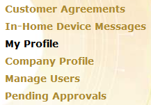
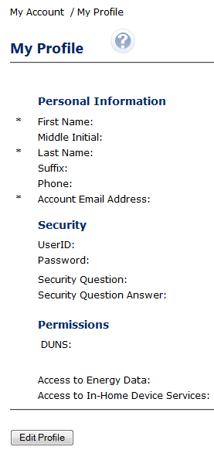
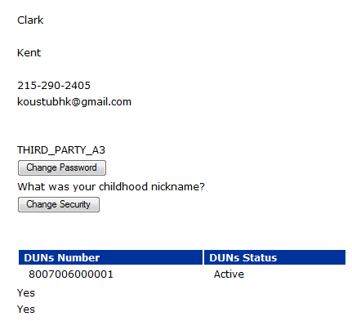
AMWG CR 2015-040
Created Date - Small
Business Requirement
Show “Created date” on Profile Page for following types of user
- REP
- TDSP
- REG
- NRC

Slide 19
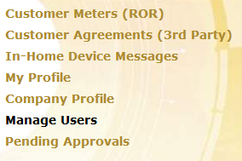
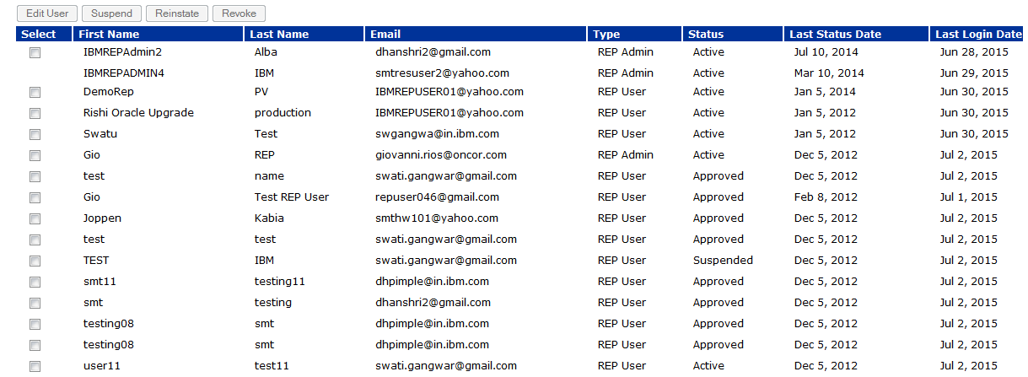
AMWG CR 2015-040
Suspend and Last Login Dates - Small
Business Requirement
Add user access “suspend date”, regardless if suspension is due to lack of use or performed by the user Administrator
Add “last use date” of a user
It will be available only for the user-type
- REP
- TDSP
- REG
- NRC

Slide 20
AMWG CR 2015-040
User ID - Zero
User-ID already exist
Business Requirement
Provide “user ID” in the user profile
For following types of User
- REP
- TDSP
- REG
- NRC
User-ID already exist

Slide 21
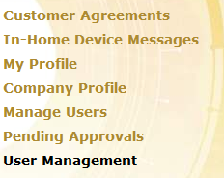
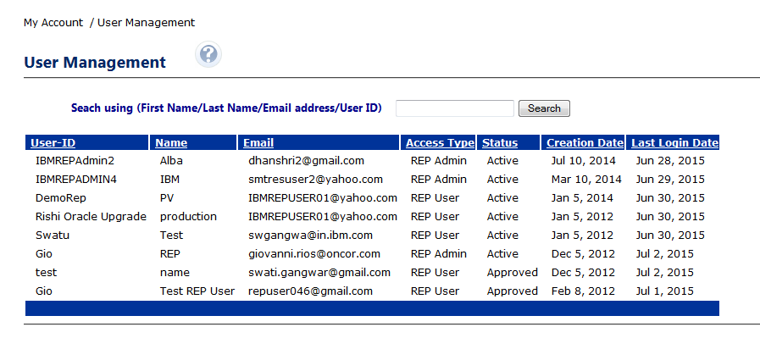
AMWG CR 2015-040
Administrative Reports - Medium
Business Requirement
Add capability to produce Administrator-related reports containing the following information:
a. User ID
b. Name
c. Email address
d. Access type
e. Account status
f. Account creation date
g. Last login date
Provide search functionality based on user first name, last name, email address, or user ID
Alphabetize the administrator user list
Allow for the administrator user list to be sorted by column

Slide 22
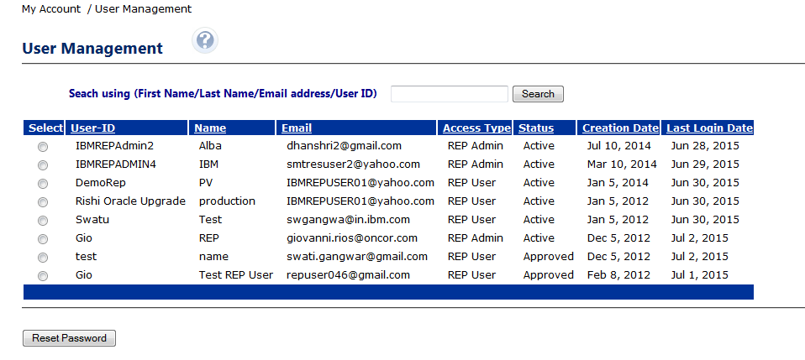
AMWG CR 2015-040
Reset Passwords - High
Business Requirement
Allow business administrators to re-set user passwords

Slide 23
AMWG CR 2015-041
23
23

Slide 24
AMWG CR 2015-041
Medium
Business Requirement
Ability for 3rd Party users to request Enrollment reports.
Current Process for RORs
Currently RORs have to call the help-desk to raise a request which goes through several manual validation and setup steps delaying the request provisioning.
Recommendation
Allow an UI self-help interface for REP and 3rd Party users to request reports and automate the backend setup activities.
Prerequisite
REPs and 3rd Parties must have completed FTP setup with SMT.

Slide 25
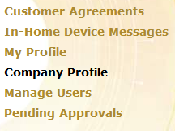
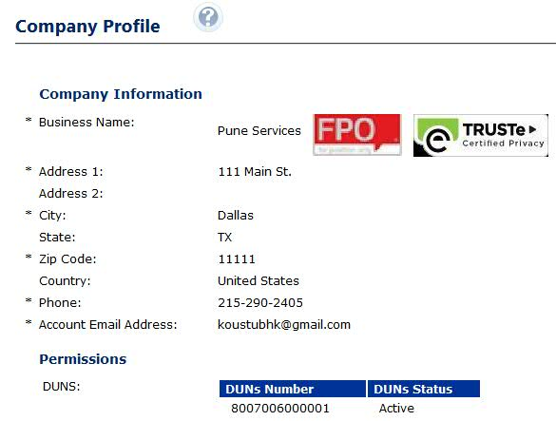
AMWG CR 2015-041
Business Requirement
Self Enrollment Report for 3rd Party
For 3rd Parties the Enrollment Report will be generated for all newly accepted agreements within last 24 hours

Slide 26
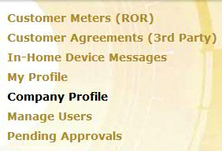
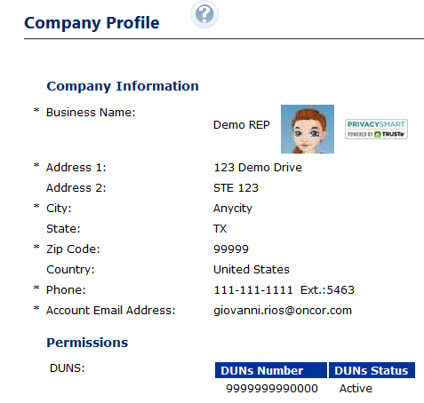
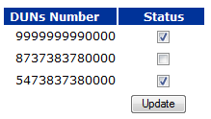
AMWG CR 2015-041
Business Requirement
Self Enrollment Report for REP
For REPs the Enrollment Report will be generated for all newly acquired customers (via Switch or Move In) within last 24 hours for the selected DUNS.

Slide 27
Q&A Monthly SMT Reports to AMWG Data Through July 2015

