Slide 1
SMT Update To AMWG
JULY 2015

Slide 2
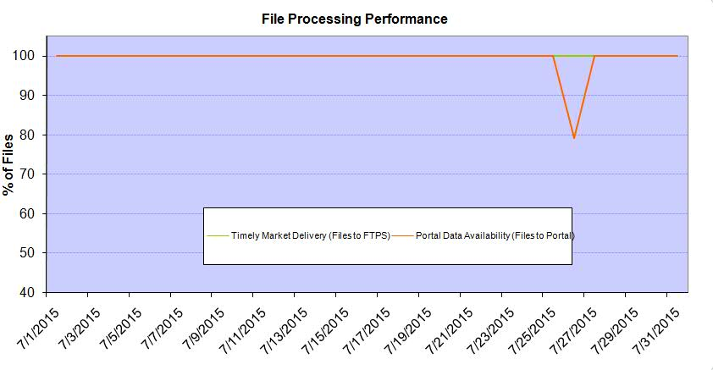
Monthly SMT Data Timelines AMWG CR 2014 002 End to End File Processing Completeness – JUL 2015
% Timely Market Delivery - % of files posted to market (FTPS) by 11:00pm out of # of files received by SMT by 11:00pm.
% Portal Data Availability - % of files loaded to the database for data availability on portal by 6:00am next day for the files received by 11:00pm
* A LSE file includes usage data for up to 50,000 ESIIDs.
Observed Anomalies:
07/26 – SMT services were down due to flash storage issue after planned outage completion
2

Slide 3
SMT API and FTPS Services Availability – JUL-2015
The service availability is measured as a percentage of number of minutes the service was available out of the total number of minutes in a month, excluding planned outages.
Observed Anomalies:
Mar-Apr 2015: SMT outage and subsequent recovery/catch-up impacted API availability. FTPS was available for most of the part except on 03/21-03/22 for 36 hours.
26 Jul 2015: Services were unavailable for 12 hours due to Flash storage issue
Notes:
3

Slide 4
SMT Number of Accounts by Type AMWG CR 2014 009 – JUL 2015
Registered Users | ONC | CNP | AEPN | AEPC | TNMP | TOTAL
Active Residential Accounts | 30899 | 19684 | 2066 | 5247 | 2169 | 60065
Active Residential English Accounts | 30760 | 19546 | 2062 | 5145 | 2163 | 59676
Active Residential Spanish Accounts | 139 | 138 | 4 | 102 | 6 | 389
Non Active Residential Accounts | 14862 | 10671 | 1195 | 2419 | 533 | 29456
Total Residential Accounts | 45761 | 30355 | 3261 | 7666 | 2702 | 89521
TDSP User | 454 | 40 | 11 | 15 | 2 | 522
TDSP Admin | 4 | 4 | 4 | 4 | 3 | 19
Small Business User | 73 | 31 | 0 | 1 | 1 | 106
Small Business Admin | 2163 | 1116 | 64 | 219 | 61 | 3704
Total Agreements | 282 | 356 | 1 | 0 | 0 | 639
Energy Data Agreements | 189 | 59 | 1 | 0 | 0 | 249
Han Device Agreements | 93 | 296 | 0 | 0 | 0 | 389
Han Service Agreements | 0 | 1 | 0 | 0 | 0 | 1
IN SMT
ESI IDs | 3441366 | 2361696 | 196843 | 849979 | 199098 | 7048982
Meters | 3369854 | 2361364 | 197689 | 850165 | 198892 | 6977964
HAN Devices | 3928 | 5097 | 150 | 265 | 31 | 9471
Acknowledgement | 0 | 0 | 0 | 0 | 0
Pending | 0 | 4 | 0 | 0 | 0
Meter Ready | 604 | 27 | 44 | 116 | 23
Provisioned | 3324 | 5066 | 106 | 149 | 8
HAN Messages (MTD) | 0 | 0 | 0 | 0 | 0 | 0
HAN Messages (YTD) | 8 | 20 | 0 | 0 | 0 | 28
HAN Messages (Cumulative) | 299 | 7384 | 0 | 0 | 0 | 7683
Simple Text Messages | 91 | 2918 | 0 | 0 | 0
Load Control Messages | 79 | 2655 | 0 | 0 | 0
Pricing Messages | 89 | 49 | 0 | 0 | 0
Cancellation Messages | 40 | 1762 | 0 | 0 | 0
Supplemental – (Friends)
Total Agreements | 1501 | 1193 | 72 | 79 | 52 | 2897
Accepted Agreements | 682 | 465 | 34 | 27 | 16 | 1224
Pending Agreements | 6 | 0 | 0 | 0 | 0 | 6
Revoked Agreements | 209 | 224 | 9 | 7 | 6 | 455
Expired Agreements | 578 | 477 | 29 | 45 | 30 | 1159
Terminated Agreements | 26 | 27 | 0 | 0 | 0 | 53
 | TDSPs | REP | NRC | Regulatory | Third Party
Registered Entities | 5 | 98 | 3612 | 2 | 66
Registered Users | 522 | 795 | 106 | 7 | 5
Registered Admins | 19 | 156 | 3623 | 3 | 61
HAN Messages Sent By | 292 | 7383

Slide 5
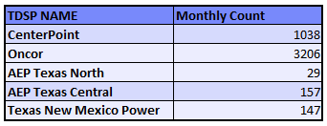
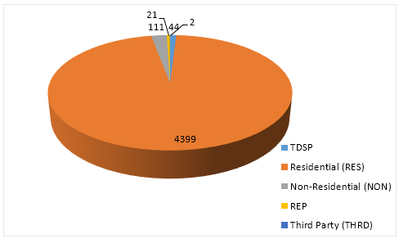
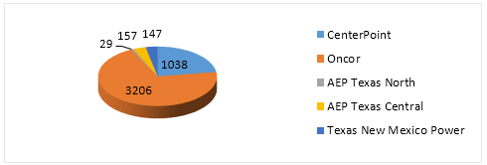
SMT ODR Details – JUL 2015
Total ODR Requests TDSP wise statistics:
Total ODR Requests User type statistics:

