Slide 1

Settlement Stability
2015 Q2 Update to COPS
Austin J. Rosel
ERCOT
COPS
08/12/2015

Slide 2
PR 8.2 (2) – Settlement stability – protocol revisions
8.2 ERCOT Performance Monitoring
(c) Settlement stability:
(i) Track number of price changes changes “after-the-fact” ;
(ii) Track number and types of disputes submitted to ERCOT and their disposition;
(iii) Report on compliance with timeliness of response and disposition to disputes;
(iv) Other Settlement metrics; and
(v) Availability of Electric Service Identifier (ESI ID) consumption data in conformance with
Settlement timeline;
(g) Uplift: ERCOT shall calculate and post the sum of all charges allocated to load for all Qualified Scheduling Entities (QSEs) for each month and year-to-date due to each of the following:
(i) The RUC Capacity-Short Charge, as described in Section 5.7.4.1, RUC Capacity-Short Charge;
(ii) The RUC Decommitment Charge, as described in Section 5.7.6, RUC Decommitment Charge;
(iii) The Load-Allocated Reliability Must Run Amount per QSE, as described in Section 6.6.6.5, RMR Service Charge;
(iv) The Load-Allocated Voltage Support Service Amount per QSE, as described in Section 6.6.7.2, Voltage Support Charge;
(v) The Load-Allocated Black Start Service Amount per QSE, as described in Section 6.6.8.2, Black Start Capacity Charge;
(vi) The Load-Allocated Emergency Energy Amount per QSE, as described in Section 6.6.9.2, Charge for Emergency Power Increases;
(vii) The Load-Allocated Real-Time Revenue Neutrality Amount per QSE, as described in Section 6.6.10, Real- Time Revenue Neutrality Allocation; and
(viii) The total of the ERCOT System Administration Charge;

Slide 3
8.2(c)(i) Track number of price changes
Reporting Period: 2015 Q2
Operating Day | # of Corrected Settlement Point Prices |  |  |  | # of Intervals Affected
 | DASPP | RTSPP | RTRMPR | ORDC Adders | DASPP | RTSPP | RTRMPR | ORDC Adders
6/24/2015 | - | 13892 | 11316 | 44 | - | 23 | 23 | 23
6/25/2015 | - | 12684 | 10332 | 37 | - | 21 | 21 | 21
Notes:
Price corrections for ODs 6/24/2015 and 6/25/2015 were due a data error (mean and standard deviation ).This data error was caught and corrected before prices were final for initial settlement.

Slide 4
8.2(c)(ii) Track number and types of disputes submitted
YEAR | 2015
QUARTER | Q1
Row Labels | Denied | Granted | Granted w/Exc. | Open | Total Submitted
Congestion Revenue Rights-RTM | 1 |  |  |  | 1
Energy-DAM | 1 |  |  |  | 1
Energy-RTM | 10 | 7 |  | 4 | 21
Emergency Operations-RTM | 9 | 7 | 1 |  | 17
Grand Total | 21 | 14 | 1 | 4 | 40

Slide 5
8.2(c)(iii) Compliance with timeliness of response to disputes
YEAR | 2015
QUARTER | Q1
Row Labels | TRUE-UP | Grand Total
Congestion Revenue Rights-RTM | 100% | 100%
Energy-DAM | 100% | 100%
Energy-RTM | 100% | 100%
Emergency Operations-RTM | 100% | 100%
Grand Total | 100% | 100%

Slide 6
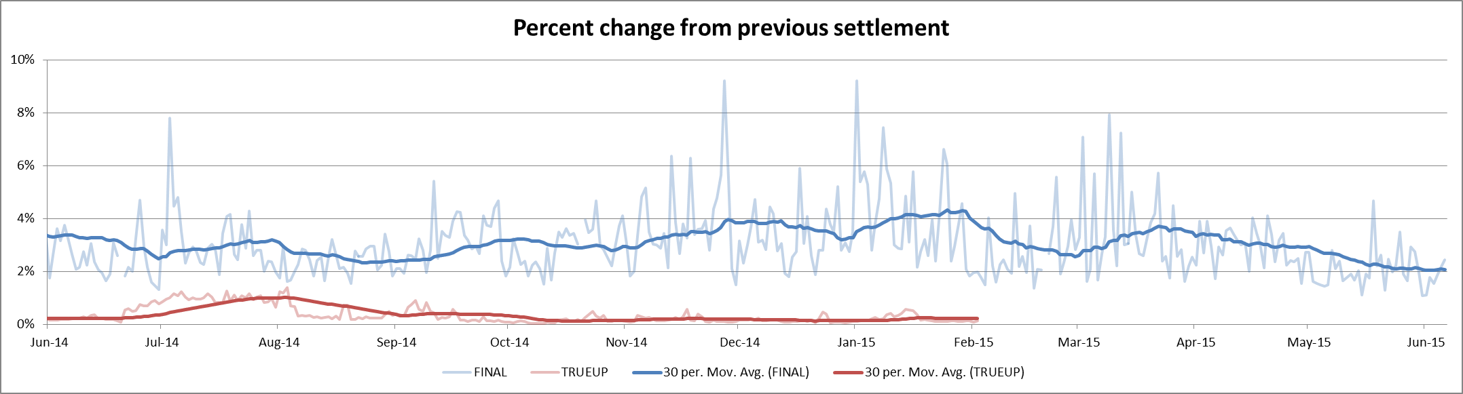
8.2(c)(iv) Other Settlement metrics
NOTE: ERS Final settlement data is not represented in graph.
Average percent change per year
Year | Final | True Up
2011 | 3.65% | 0.42%
2012 | 2.56% | 0.41%
2013 | 2.83% | 0.34%
2014 | 3.18% | 0.32%
2015 | 3.03% | -

Slide 7
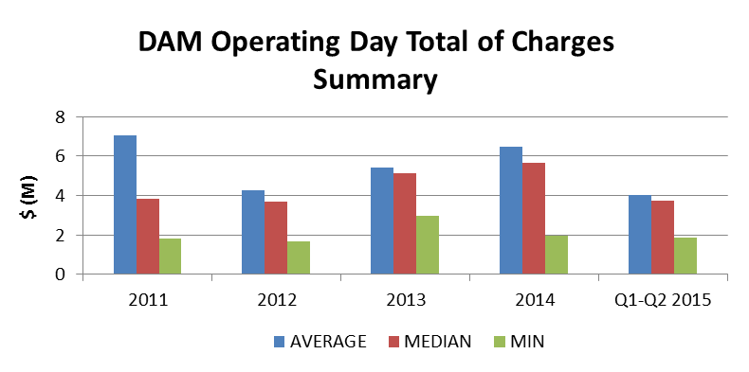
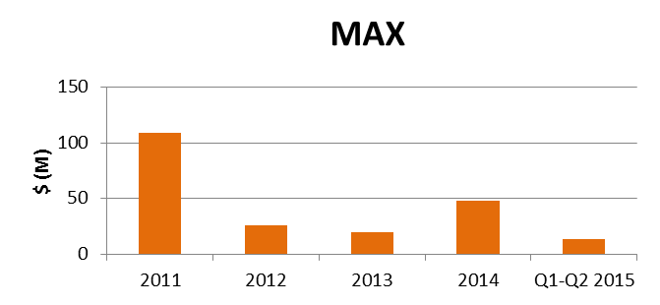
8.2(c)(iv) Other Settlement metrics
 | 2011 | 2012 | 2013 | 2014 | 2015 Q1-Q2
AVERAGE | $7,055,904.22 | $4,286,346.35 | $5,414,301.61 | $6,459,143.69 | $4,028,470.442
MEDIAN | $3,852,717.78 | $3,672,953.94 | $5,110,481.46 | $5,656,482.98 | $3,754,247.89
MIN | $1,811,707.78 | $1,696,086.15 | $2,960,302.19 | $1,964,947.00 | $1,861,583.65
MAX | $108,685,088.18 | $26,214,367.20 | $19,450,091.88 | $47,932,135.66 | $13,685,366.65
NOTE: “Total of Charges” represents the sum of statements that are a net charge to the Market Participant (i.e., the amount due to ERCOT)

Slide 8
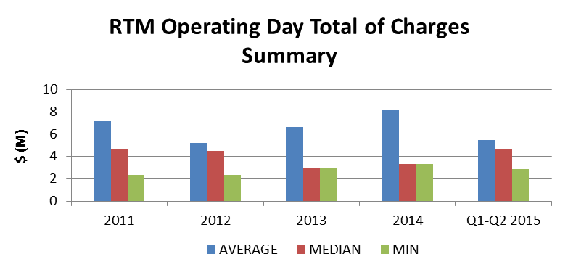
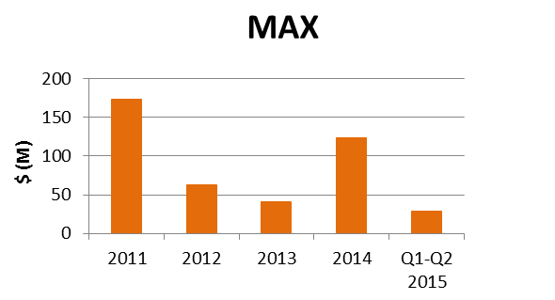
8.2(c)(iv) Other Settlement metrics
 | 2011 | 2012 | 2013 | 2014 | 2015 Q1-Q2
AVERAGE | $7,186,401 | $5,192,011 | $6,612,028 | $8,214,292 | $5,452,651.96
MEDIAN | $4,687,817 | $4,507,284 | $5,967,530 | $7,154,186 | $4,684,276.54
MIN | $2,381,712 | $2,338,942 | $2,977,312 | $3,318,333 | $2,901,691.39
MAX | $173,658,750 | $63,344,855 | $40,524,460 | $123,682,311 | $29,079,298.95
NOTE: “Total of Charges” represents the sum of statements that are a net charge to the Market Participant (i.e., the amount due to ERCOT)

Slide 9
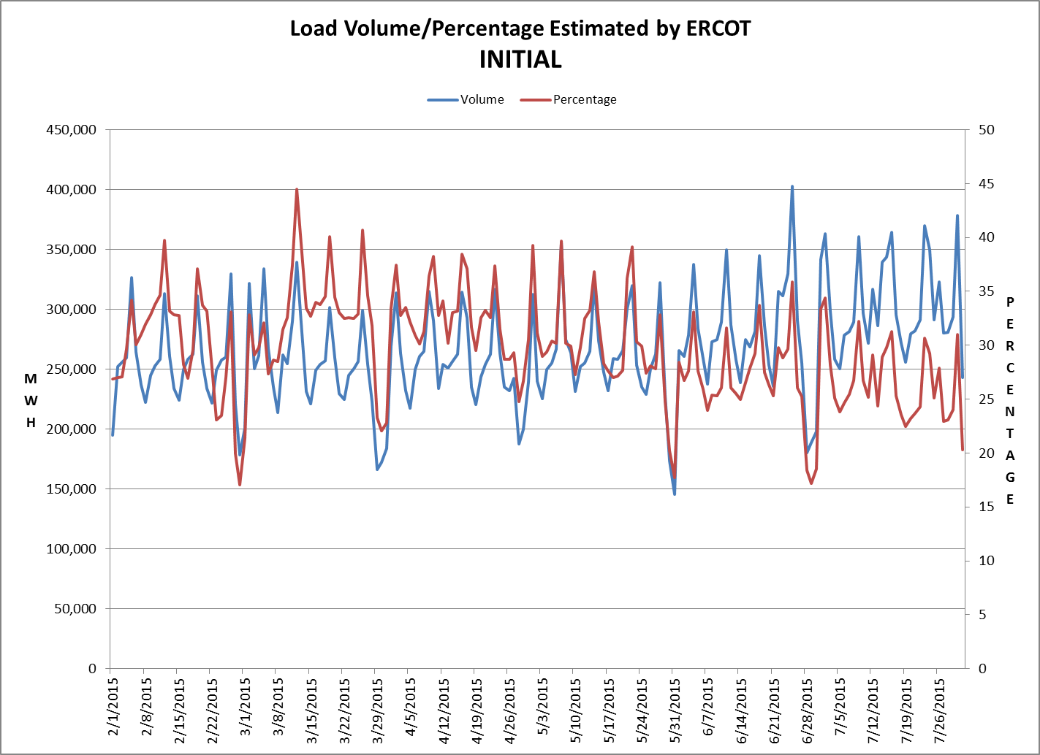
8.2(c)(v) Availability of ESIID consumption data

Slide 10
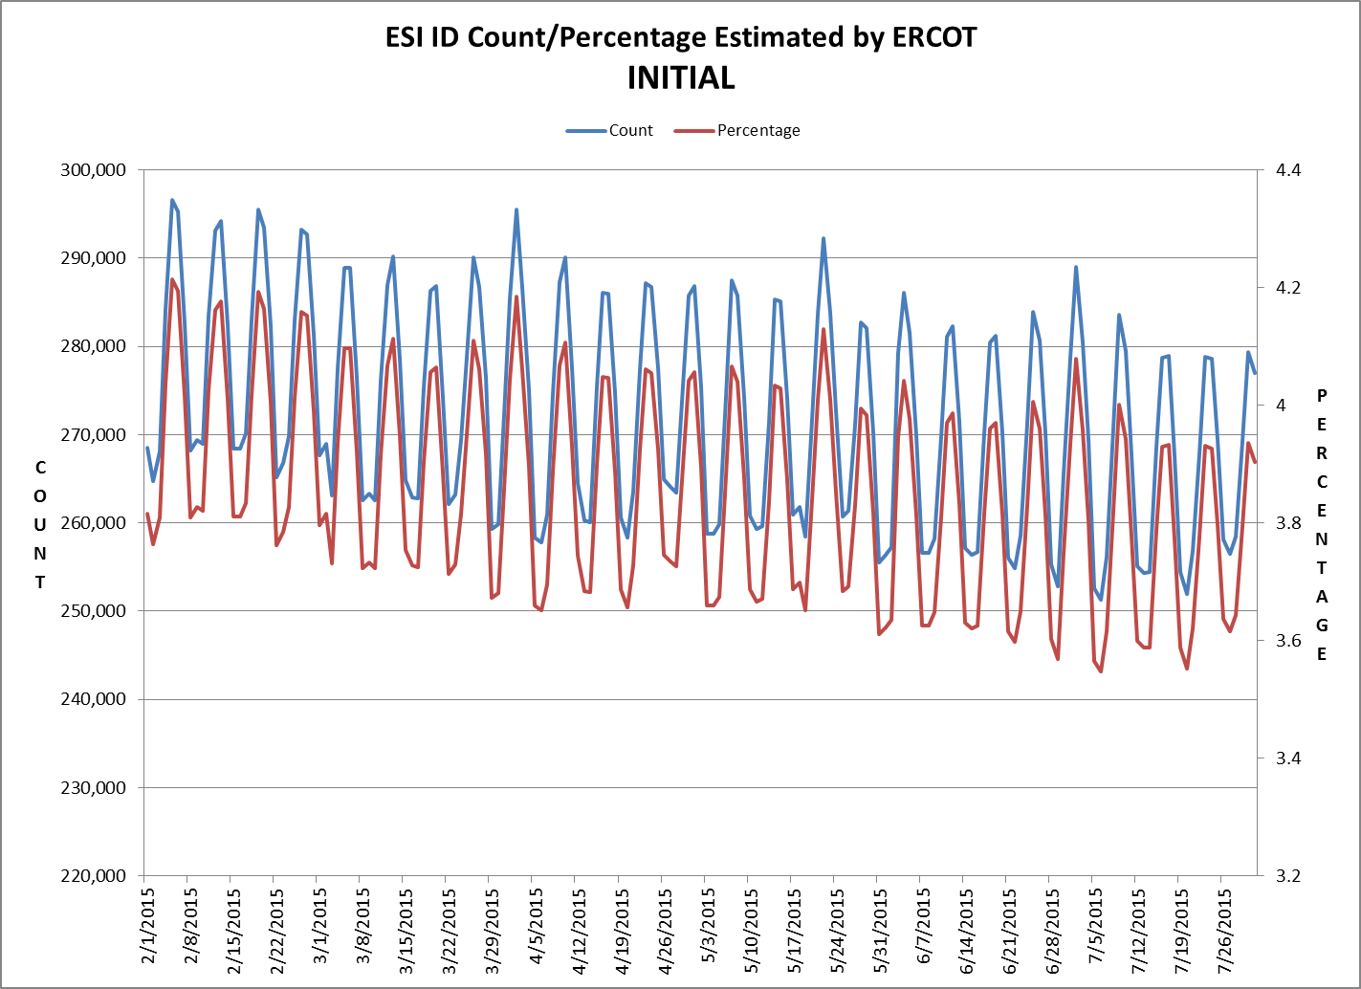
8.2(c)(v) Availability of ESIID consumption data

Slide 11
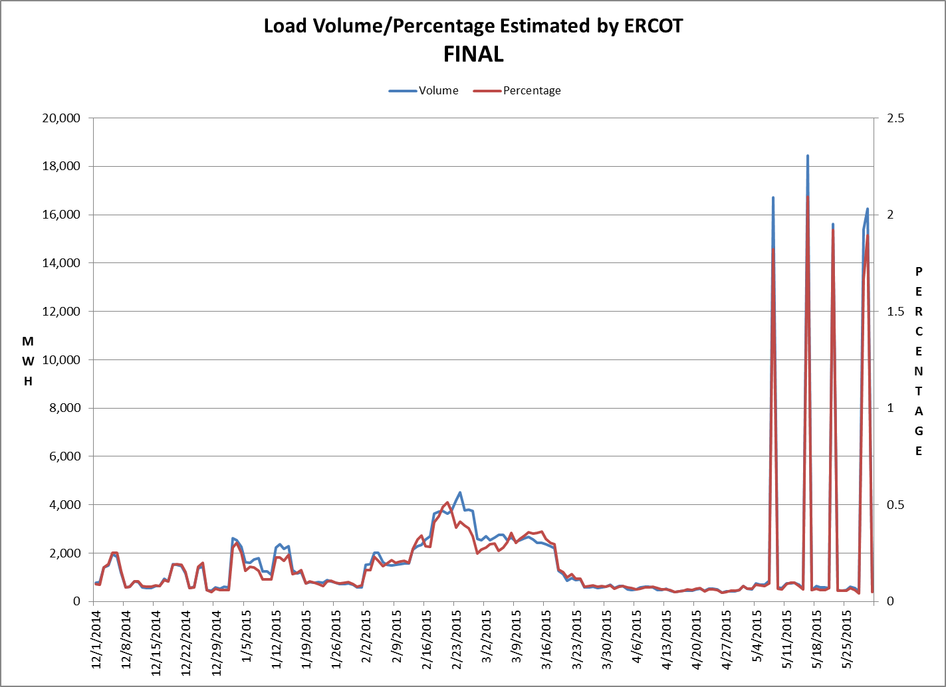
8.2(c)(v) Availability of ESIID consumption data

Slide 12
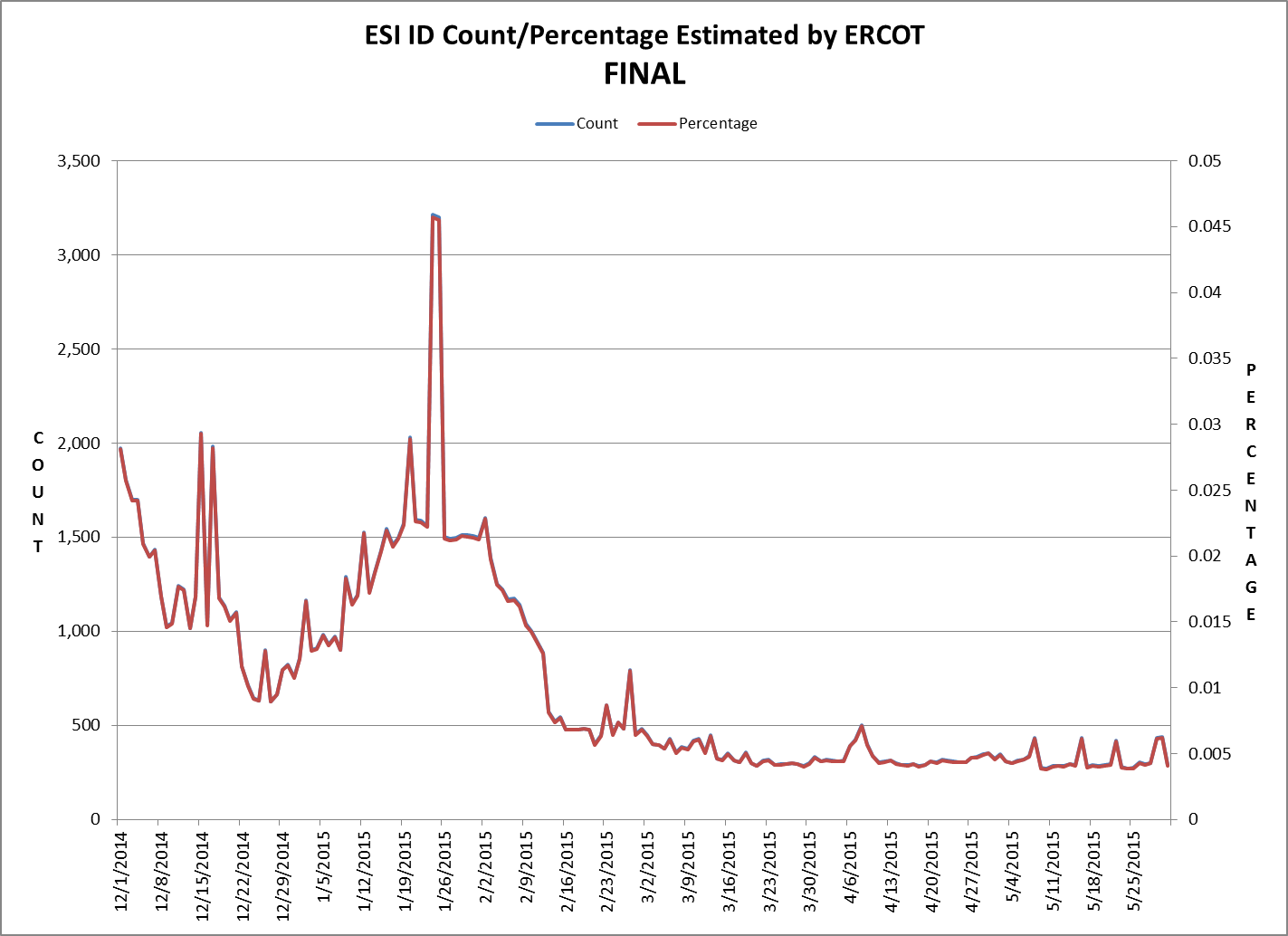
8.2(c)(v) Availability of ESIID consumption data

Slide 13
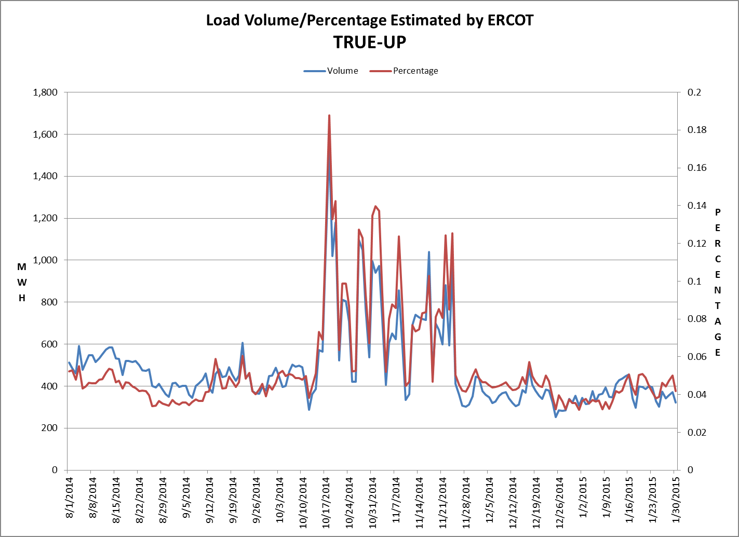
8.2(c)(v) Availability of ESIID consumption data

Slide 14
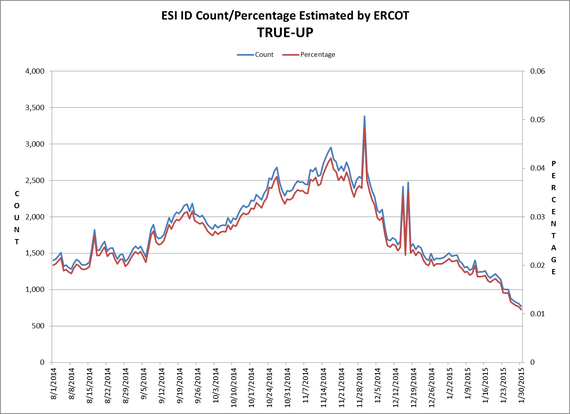
8.2(c)(v) Availability of ESIID consumption data

Slide 15
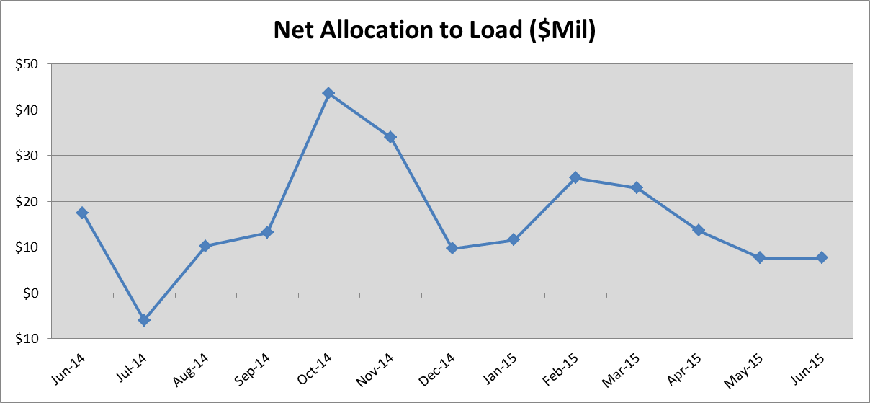
8.2(g) Net Allocation to Load (Board Report)

