Slide 1
SAWG Update to WMS
August 5th, 2015
Brandon Whittle

Slide 2
Report Releases
Draft – LTRA Summary Tables
Housekeeping
None

Slide 3
CDR
PUN Capacity Forecasting – ERCOT drafted an NPRR and is expected to file it for the September PRS.
Potential Coal Unit Requirements - ERCOT is working on an RFI for impacts of environmental restrictions on Coal resources. The RFI is here and ERCOT is currently welcoming feedback (Contact Pete Warnken pete.warnken@ercot.com ) This survey may be released with the CDR, but at this time it is not going to be factored in directly to the CDR.

Slide 4
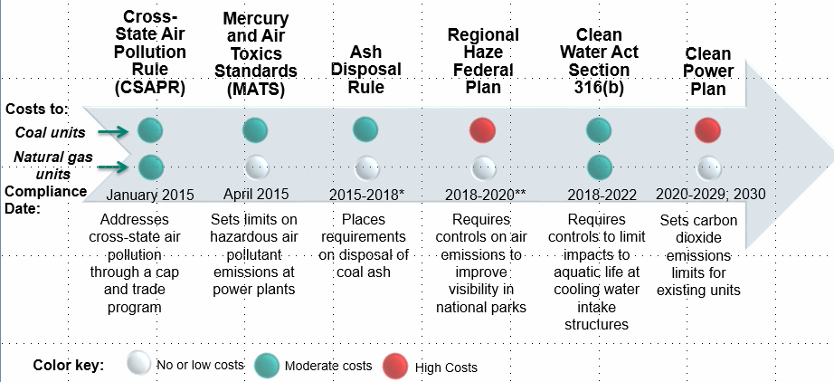
EPA Update
ERCOT delivered this update on effects of environmental policy change.

Slide 5
RT Co-op General Plan
No Change
ERCOT provide Concept Paper
Get written comments on concept paper
ERCOT and MPs discuss the Concept Paper and comments received and make policy cuts at focused SAWG meetings
Get help from WMS and/or TAC on sticky policy cuts
ERCOT write draft NPRRs
a. RT Co-optimization
b. Multi-Interval SCED
6) Market Participants provide comments on draft NPRRs
7) ERCOT and MPs discuss framework of Cost Benefit Analysis
8) ERCOT provide numbered NPRRs with preliminary Impact Analysis
9) Complete CBA

Slide 6
RT Co-Optimization
New Whitepaper released – Written comments requested for 9/23 meeting.

Slide 7
Multi-Interval RTM
No Change
Readiness Study is under review at ERCOT, Resources have begun to assemble and prepare for the study
No significant progress expected until 2016

Slide 8
Next Meeting – August 26th, 2015
Expected Agenda Items
Review of LTRA data
RT Co-optimization discussion

