Slide 1
Create Valley Weather Zone
Project Concept
9 July, 2015

Slide 2
Project Concept
Background
This project intends to create a new Weather Zone that will contain the Valley area which is currently in the South Weather Zone. We believe that it is necessary to have greater visibility for the Valley in order to better monitor this area’s characteristics.
Benefits
Creating a separate Weather Zone for the Valley will provide improved monitoring and analysis for the area.

Slide 3
Project Concept
Assumptions and Constraints
Protocol Section 18.2.5 requires that ERCOT work with the appropriate TAC subcommittee in the identification of Weather Zones; this needs to be initiated.
This change will impact multiple systems and processes:
LFC
STNET
CIM Importer
State Estimator
Short-term load forecast
MTLF

Slide 4
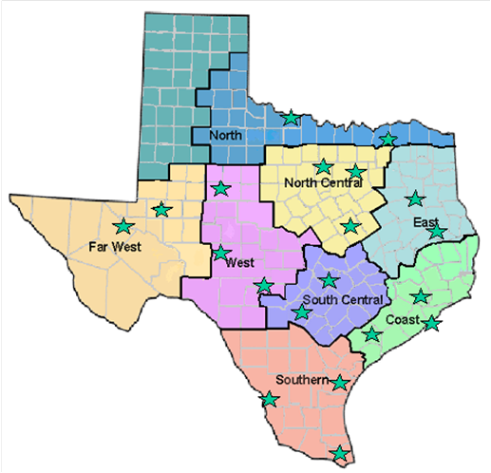
Mapping of Texas Counties to ERCOT Weather Zones

Slide 5
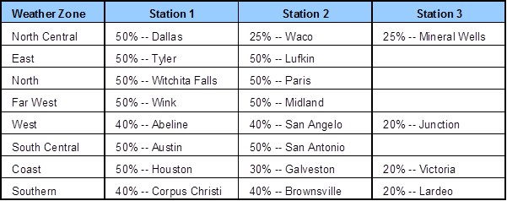
Weather Stations and Station Weights by Zone

