Slide 1

Update to RMS
August 4th, 2015

Slide 2

RMGRR129 – Revision to Customer Rescission Completion Timeline
Timely execution of a customer rescission after completion of a switch transaction.
Gaining CR submits timely Rescission MT
Losing CR is provided two (2) Business Days to ‘agree’ and transition the Rescission MT
Losing CR shall submit the appropriate back-dated Move-In transaction (BDMVI) within another (2) days of the TDSP updating the MT status to “ready to receive”
UPDATE –
TAC had remanded RMGRR129 for further discussion due to concerns with effective date upon approval.
RMGRR129 has been posted with TF comments calling for an effective date of October 1, 2015

Slide 3
RMGRR Draft – Clarification of Inadvertent Gain Valid/Invalid Reject Reasons
Minimize confusion of valid reject reasons to improve the resolution time for Inadvertent Gain MarkeTraks.
Previous language stated “ The customer has entered in multiple, valid contracts regarding the same ESI ID(s)”
CRs are interpreting and rejecting MTs utilizing the approved valid reject/unexecutable reason (c) “Losing CR has confirmed Customer’s intent to change REPs”
This leads to various MTs being rejected and the gaining CR with balances for which they may not be able to collect.
Proposed changes will minimize “bad actor” behavior and “gaming” of the system by customers.

Slide 4
Inadvertent Gain (IAG) Training
Thank you for your participation
Participants | Austin | Houston | Dallas | TOTAL
 | May 12th | May 15th | June 12th
Classroom | 25 | 20 | 30 | 75
WebEx | 20 | 27 | 31 | 78
TOTAL | 45 | 47 | 61 | 153
REPs | 19 | 33 | 40 | 92
TDSPs | 15 | 8 | 18 | 41
ERCOT & PUCT | 11 | 6 | 3 | 20

Slide 5
Inadvertent Gain (IAG) Training
Here is who we reached …
Overall Participation
Segment Representation | Austin | Houston | Dallas
Competitive Retailers | 11 | 19 | 19
TDSPs | all | all | all
ERCOT & PUCT
Overall Participation | TOTAL
REP attendees | 74
TDSP attendees | 29
ERCOT & PUCT attendees | 14
Competitive Retailers | 36
TDSPs | all
ERCOT & PUCT

Slide 6
Inadvertent Gain (IAG) Training Post-survey Results
What did participants like about the training?
  The open and interactive forum
  Ability to ask questions with market SMEs available to answer
  Live ERCOT demonstration of MT tool – report features
  Variety of instructors/SME offering the open forum
How may the training be enhanced to make it more effective?
  Provide a brief review quiz after each section to reinforce the key points
  More interaction with participants
  Review and provide examples for each valid/invalid reject reasons
  Streamline some of the “cookbook” training “step by step” examples
  Provide more of the complex “unhappy path” examples in detail
  Recommend the on-line training module for IGLs as a prerequisite for the classroom training

Slide 7
MarkeTrak Serena Upgrade
  While discussing the root cause of the premature transitioning of the Inadvertent subtypes, it was noted ERCOT’s MarkeTrak version is currently 5 major / 9 minor releases behind the current version available.
  Latest major release occurred in January 2015
  Upgrades typically occur every 1 – 1 ½ years
  Serena continues to support all past versions
  Functionality of the latest version includes improved API support
  MTTF Recommendation
  Based on the information provided by ERCOT,
  No sense of urgency in performing an upgrade of the tool at this time
  Current version to remain
  Proposed upgrade be reviewed in 6 -12 months to determine impact and feasibility (via TDTWG)
  Possibly align upgrade with proposed Retail Market Test Environment

Slide 8
MarkeTrak Documentation
http://www.ercot.com/services/client_svcs/mktrk_info/index.html
http://www.ercot.com/content/meetings/rms/keydocs/2014/0110/08.__RMS_MarkeTrak_Task_Force_20140104.ppt
http://www.ercot.com/content/meetings/rms/keydocs/2014/0603/07.__RMS_MarkeTrak_Task_Force_20140603.ppt
http://www.ercot.com/content/meetings/rms/keydocs/2014/1028/07.__RMS_MarkeTrak_Task_Force_20141028.ppt
http://www.ercot.com/content/meetings/rms/keydocs/2015/0106/09.__RMS_MarkeTrak_Task_Force_20150106.ppt
http://www.ercot.com/committees/board/tac/rms/marketraktf/index.html
http://www.ercot.com/content/committees/board/tac/rms/marketraktf/keydocs/2014/PR010_03_training_FINAL.ppt
http://www.ercot.com/content/wcm/training_courses/97/MarkeTrak_Detailed_Training_102014.ppt
http://www.ercot.com/committees/board/tac/rms/marketraktf/MarkeTrak SubTypes Quick Reference 20150510 v2
Link to IAG/Rescission training: http://www.ercot.com/committees/board/tac/rms/marketraktf/index.html/MarkeTrak IAG Training
    User Guide
    Bulk Insert Templates
    MarkeTrak Workflows
    MarkeTrak Tips and Tricks
    MarkeTrak API WSDL/XSD
    Also direct link from MarkeTrak tool

Slide 9
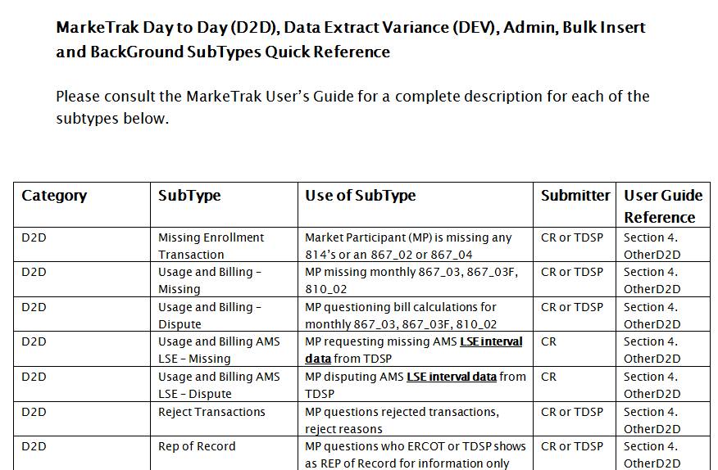
MarkeTrak Documentation
http://www.ercot.com/committees/board/tac/rms/marketraktf/MarkeTrak SubTypes Quick Reference 20150510 v2

Slide 10

Sunsetting of Task Force -anticipated for December 2015!!!

Slide 11

Questions
Next Meeting:
Monday, August 24th 1:00 – 4:00 pm
WebEx only
Agenda Items:
RMGRR Draft – Clarification of Inadvertent Gain Valid Reject Reasons
ERCOT API SLA Metrics

