Slide 1
Antitrust Admonition
Kathy Scott
July 23, 2015

Slide 2
Introductions
Kathy Scott
July 23, 2015

Slide 3
Improving Third Party Access to SMT Workshop
Goals and Steps
  Goal – Improve Third Party access to Advanced Metering energy data and HAN devices
  How -
    Conduct a series of workshops to discuss potential improvements and a conceptual plan to accomplish those improvements
    Level set governance, rules, boundaries and criteria that short term, mid term and long term enhancements must follow – Completed in Workshop 1 Day 1
    Level set the potential processes to be utilized to promote and possibly implement short term and mid term improvements – Completed in Workshop 1 Day 2 (the long term improvement process is not yet known)
    Define potential short term and mid term enhancements to the existing solution
    Define a conceptual long term strategy for potential future improvements
    Create a plan outlining the possible short, mid and long term improvements

Slide 4
Improving Third Party Access to SMT Workshop Rules of Engagement
  Ask questions during the speakers presentations and participate interactively during the workshop
    There are no bad questions
  Use the microphones provided in the room
  Mute cell phones
  Take unrelated discussions outside of the room
  Limit side bar discussions
  Restrooms are located around the corner just past the elevators

Slide 5
Agenda Day 1
1. Antitrust Admonition |  | 1:00PM
2. Introductions | K Scott
3. Examine the Texas competitive market structure and governance influences on 3rd Party access to customer data and in-home devices | E Kent/ J Schatz
4. Understand data ownership and data privacy rules, laws, and security policies | Michele Gregg
5. Review the Texas competitive market management and improvement process | Kathy Scott
6. Assess the differences between strategies for the Texas’ competitive market versus another non-regulated state regarding third party access to customer data | Mark Smith
7. Study Green Button and Green Button Connect in the Texas market versus other regulated states | Donny Helm/ Andrea OFlaherty
8. Adjourn |  | 5:00PM

Slide 6
Texas Competitive
Market & Governance
Esther Kent – CenterPoint Energy
John Schatz – TXU Energy
July 23, 2015

Slide 7
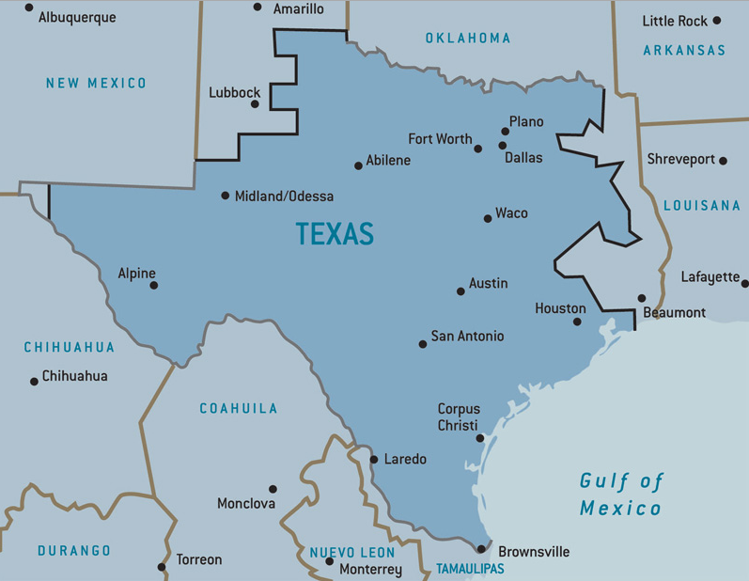
ERCOT Region

Slide 8
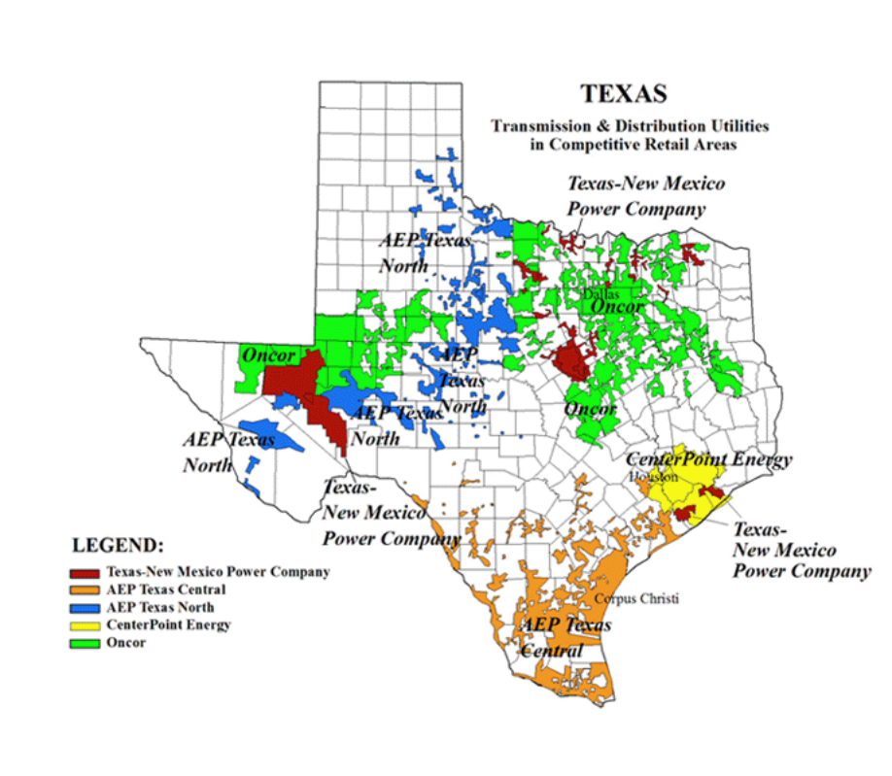
Competitive Areas w/in ERCOT

Slide 9
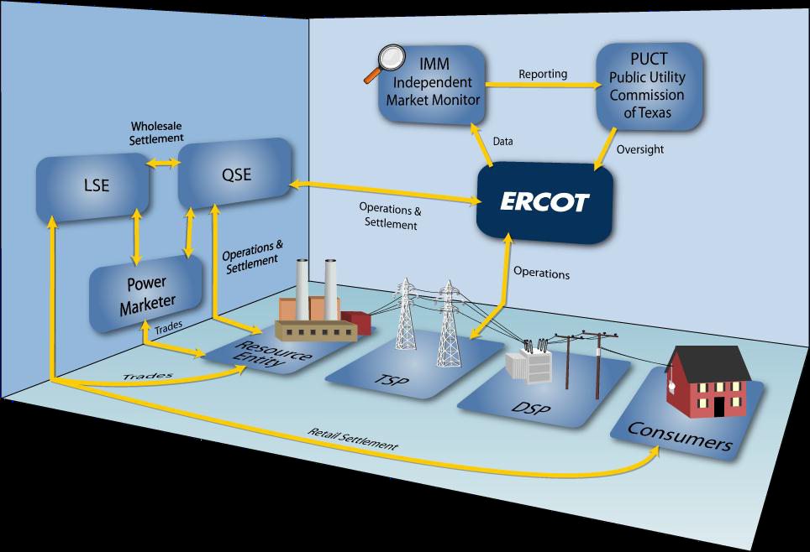
Electric Reliability Council of Texas (ERCOT) Market Design

Slide 10
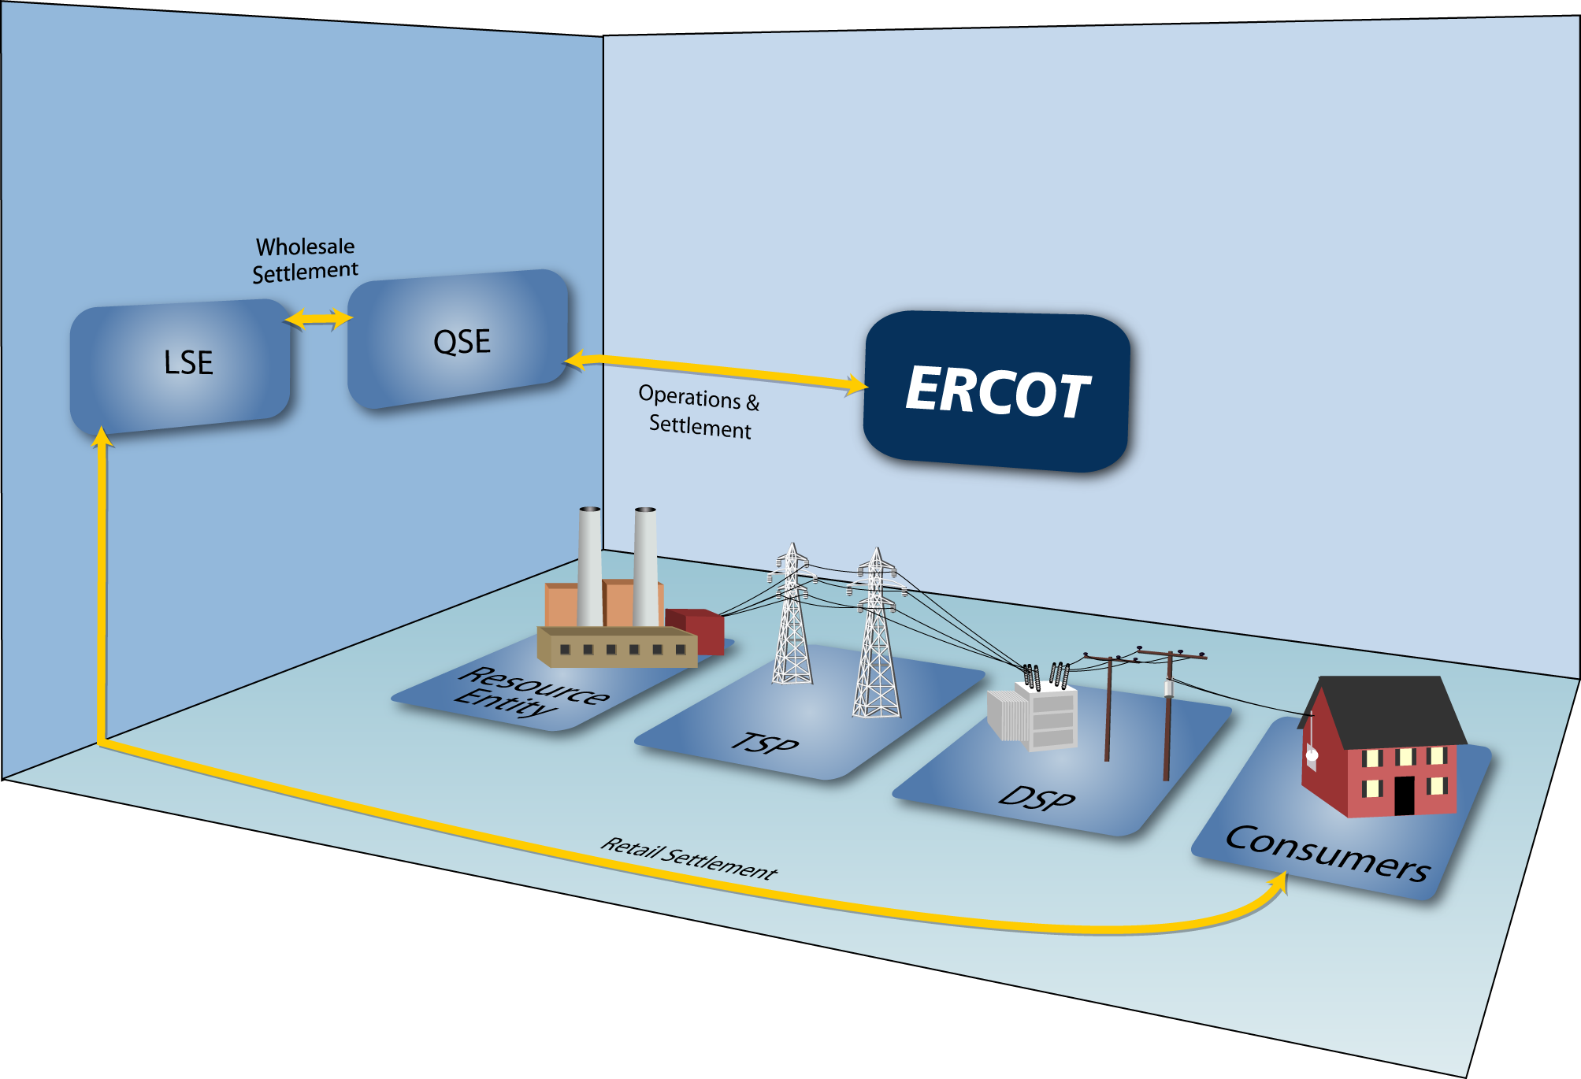
ERCOT Market Design (Retail)
Retail Transactions
Retail Transactions
Point to Point Retail Transactions
Billing / Customer Service

Slide 11





TDSPs/TDU/MOU/EC own and maintain the distribution lines and meters.
The TDSP/TDU’s are paid by the REP of Record (ROR) for their Retail Customer’s electric consumption and discretionary service charges associated to the premise.
MOU/EC payment arrangements may be different depending upon REP of Record and MOU/EC Billing Agreement(s)
Retail
Customer
Retail Electric Provider
Retail Customers’ have their Choice of over 170 certified Retail Electric Providers (REPs) in the Texas Market
Generation facilities can be owned by Qualified Scheduling (QSEs) or Load Serving Entities (LSEs)

Slide 12
Certified Market Participants at ERCOT
Certified REPs/CRs: Total of (173)
Certified TDUs/TDSPs –Total of (7 )
  American Electric Power Texas Central (AEP TCC)
  American Electric Power Texas North (AEP TNC)
  CenterPoint Energy (CNP)
  Oncor
  Sharyland McAllen
  Sharyland Utilities (SU)
  Texas New Mexico Power (TNMP)
Certified MOU/EC – Total of (1)
  Nueces Electric Cooperative

Slide 13
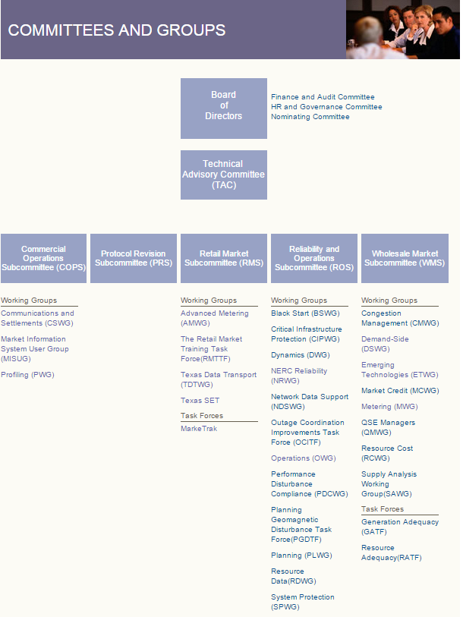
ERCOT Committees & Groups

Slide 14

SMT Governance
AMWG
RMS
JDOA
PUCT

Slide 15
Advance Meter Working Group (AMWG)
  Reports to the Retail Market Subcommittee (RMS),
  Serves as the forum for addressing topics related to advanced metering systems in ERCOT such as data monitoring, issue identification and resolution, as well as, identifying improvement opportunities related to advanced meter data using the defined change control process.
  Created March 2013 when the Advanced Metering Implementation Team (AMIT) was sunsetted and the technology identified in original requirements for SMT was implemented (except 3rd party)
  Created to provide an avenue to follow technology advances and provide feedback on market and customer needs pertaining to Smart Meter Texas, Third Party Access, Service Level Agreements, Technological advances etc.
  2015 AMWG Co Chairs are John Schatz with TXU Energy and Esther Kent with CenterPoint Energy
  Participants include Retail Electric Providers, Transmission & Distribution Service Providers (TDSPs), Public Utility Commission of Texas (PUCT) Staff, Electric Reliability Council of Texas (ERCOT) Staff and 3rd Party Service Providers, Consumer Groups.

Slide 16
Retail Market Subcommittee (RMS)
RMS serves as a forum for issue resolution in regards to retail market matters directly affecting ERCOT and ERCOT protocols. The RMS is also responsible for monitoring Public Utility Commission (PUCT) rulings as they apply to retail markets and retail market participants
Members include Retail Electric Providers, Transmission & Distribution Service Providers (TDSPs), Electric Reliability Council of Texas (ERCOT) Staff, Consumer Groups

Slide 17
Joint Development & Operation Agreement (JDOA)
As part of AMS settlement, TDSPs were required to have a portal for customers to access meter data. A very long list of requirements was developed by the Texas Market. Collectively the TDSPs recommended a single data repository and portal, to which the Texas Market and PUC strongly supported. Thus the formation of the JDOA
Members are Donny Helm (Oncor), Jeff Stracener, Greg Filipkowski (AEP), Bobby Roberts (TNMP) and Esther Kent (CNP)
Operations Manager is Andrea O’Flaherty-Brown
Manages funding for SMT

Slide 18
Public Utility Commission (PUCT)
The Public Utility Commission of Texas regulates the state's electric, telecommunication, and water and sewer utilities, implements respective legislation, and offers customer assistance in resolving consumer complaints.
Their stated mission is ‘We protect customers, foster competition, and promote high quality infrastructure.’
http://www.puc.texas.gov/

Slide 19
Governing Documents
1. Public Utility Regulatory Act (PURA)
https://www.puc.texas.gov/agency/rulesnlaws/statutes/Pura11.pdf
2. Electric Substantive Rules
http://www.puc.texas.gov/agency/rulesnlaws/subrules/electric/Electric.aspx
3. Rates & Tariffs
http://www.puc.texas.gov/industry/electric/rates/

Slide 20
Texas Data Ownership Laws, Rules & Data Access Assumptions
Presented by Michele Gregg
July 23, 2015

Slide 21
State of Texas Regulations
Texas Deregulation (PURA §39.101)
Section 39.101
    Retail customer protections include:
      Customer consumption and credit information privacy
      Accurate metering and billing
Texas Advanced Metering (PURA §39.107)
Section 39.107
    All Meter Data shall belong to the customer
    Includes all data from advanced meters and meter information networks
    Includes data used to calculate charges, historical load data, and any other proprietary customer information
    Allows customers to authorize data be provided to retail electric providers

Slide 22
More State Regulations
Texas Advanced Metering Disclosure Prohibition (PURA §39.107)
Section 39.107
    Requires the PUC to prohibit an electric utility from selling, sharing, or disclosing information from an advanced metering system or meter information network
    Includes information used to calculate charges, historical load data, and any other customer information.
    Requires the PUC to allow an electric utility to share information with an affiliated corporation, or other third-party entity, if the information is to be used only for:
      the purpose of providing electric utility service to the customer
      other customer-approved services

Slide 23
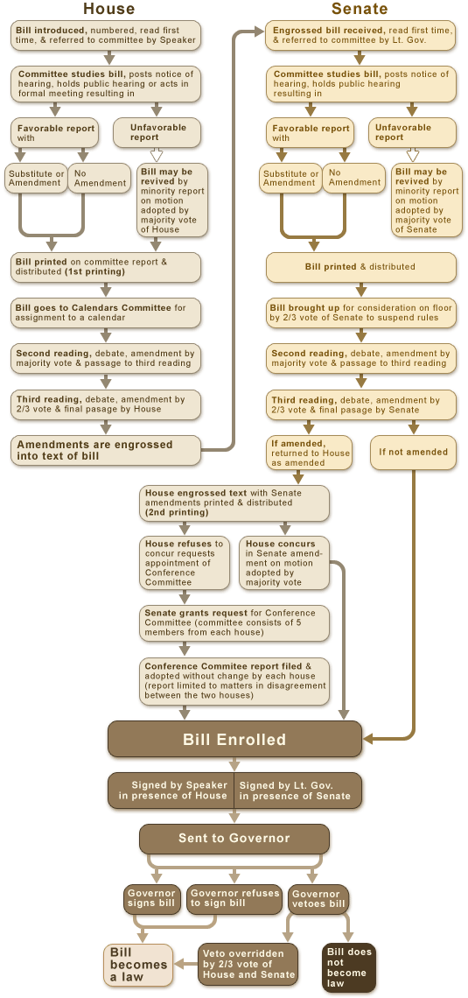

Slide 24
Texas PUC Rules
Advanced Metering (TAC 25.130)
AMS Features:
  Provides direct, real-time access to customer usage data to the customer and the customer’s REP, provided that:
    hourly data must be transmitted to the utility’s web portal on a day-after basis
    as soon as practicable 15-minute IDR data must be made available on the electric utility’s web portal
    Access to Meter Data:
      Read-only access must be provided to the customer, the customer’s REP, and other entities authorized by the customer
      Access to the customer’s advanced meter data includes:
        meter data used to calculate charges for service
        historical load data
        any other proprietary customer information.
      Access must be convenient and secure
      Data must be made available no later than the day after it was created
      Allows a customer to authorize his/her data to be available to an entity other than his/her REP of Record

Slide 25
More PUC Rules
Privacy of Advanced Metering System Information (TAC 25.44 & TAC 25.500
  TAC 25.44 is included in the Customer Service & Protection section of Electric Substantive Rules
  TAC 25.500 is included in the Customer Protection Rules for Retail Service section of Electric Substantive Rules
  Implemented new PURA provisions passed by the Legislature in 2013
  Reinforces prohibitions on electric utilities from:
    selling, sharing, or disclosing information from an advanced metering system or meter information network
    Includes data used to calculate charges for service, historical load data, and any other customer information
  Provides an exception for affiliates of the utility or third parties only if the information is to be used solely for the purpose of:
    Providing electric utility service to the customer
    Other customer-approved services

Slide 26
Provisions in PUC-Approved Third Party Design
Key Provisions Approved:
SmartMeterTexas (SMT) is the conduit for customer information
Customer must opt-in rather than opt-out
Customer can grant or revoke access to a third party of their choice at any time
Customer must accept or reject the Access Agreement through electronic authorization prior to information being provided to Third-Party
Agreement lengths vary in duration and customer can choose length
Process is driven by security & customer data privacy with verification through SMT
Disclosures are provided to the customer that they control and manage their agreements with third parties, that third parties are not regulated by a state agency and that customers should read and understand third party privacy policies before accepting an agreement

Slide 27
Texas Competitive Market Management and Improvement Process
Kathy Scott
July 23, 2015

Slide 28

I Have an Idea to Make Smart Meter Texas (SMT) Processes Better!
Is there a specific group or listserv?
Who should I Call or Email ?
I need to get this out to the Texas market before I forget IT!!!
I Need HELP, Please!!!

Slide 29
AMWG Issue Process:
The Advanced Metering Working Group (AMWG) considers and discuss ideas, suggestions or process improvements by receiving “Issues” from Market Participants (MPs), MPs also includes 3rd Parties.
What is the “Issues Process”?
  It is the market approved formal process where issues are identified by Market Participants and documented on an “AMWG Issues Tracking form” to be reviewed and discussed by the Advanced Metering Working Group (AMWG)
  Market Participants , especially the submitter of the Issue, is required to be available for the AMWG meeting either in person or via web-conference to address any questions or provide clarifications concerning their issue to AMWG.
  Issues brought forth through this process may be used by the AMWG representatives to develop the necessary AMWG Change Request Form.

Slide 30
Advanced Metering Working Group’s Change Request Governance:
The Advanced Metering Working Group (AMWG) reports to the Retail Market Subcommittee (RMS).
  The RMS is responsible for:
    Monitoring Advanced Metering System (AMS) issues,
    Supporting the development and maintenance of Advanced Metering guidelines and/or Change Requests used to monitor operational aspects and performance of Smart Meter Texas.
In comparison to other Market Revision/Change Requests, AMWG Change Requests do not require Technical Advisory Committee (TAC) or Board approval.
  Normally Market Revision/Change Requests and Protocols go to TAC and the Board because they are funded through ERCOT’s fees and therefore, ERCOT has a fiduciary responsibility whereas AMWG change requests are not currently funded by ERCOT but through the TDSPs and that’s the reason the governance goes from RMS to the JDOA (TDSPs) rather than to TAC and the Board

Slide 31
AMWG Change Request Form
What is a Change Request Form:
  Change Request Forms provide an historical record of the AMWG discussions that may include market cost benefit, what issue is being resolved by the change request, reports that provide the number of customers affected and/or functionality to be displayed along with attributes.
  All Change Requests are reviewed by the Advanced Metering Working Group to determine if a “consensus” recommendation can be reached to move the Change Request forward to the Retail Market Subcommittee (RMS) for consideration.
  If there is a consensus recommendation “Change Request(s)” will be presented to RMS for their voting consideration during their monthly scheduled meeting.

Slide 32
AMWG Change Request Form
RMS will review all Change Request Forms recommended by AMWG, RMS may vote to Approve, Table or Reject each Change Request (s) presented by AMWG Leadership.
  If Approved by RMS, the Change Request is forwarded to the Joint TDSPs for their Approval to permit the SMT Development Oversight Team to create Cost estimates that includes Timeline to implement Change Request.
  If Table by RMS, the Change Request may be returned to AMWG for additional research, market benefits or analysis.
  If Reject by RMS, the Change Request is no longer considered by RMS and/or discussed by AMWG

Slide 33
Approval Process for Change Requests with Cost/Implementation Estimates
RMS Approved Change Request(s) with Cost and Timeline to Implement Estimates are provided back to AMWG for review, discussion and again to gain consensus to move forward to RMS for their voting consideration.
RMS Approved AMWG Change Request(s) now includes storyboard(s), scope of work and estimated cost and timeline to implement is re-considered by RMS for their final approval.
  If Approved by RMS, the Change Request is forwarded to the Smart Meter Texas (SMT) Joint TDSPs for their “Final” Approval to schedule, which may be considered as a bundle of work that is included as a SMT Project or SMT system upgrade .
  If the Joint TDSPs Approved the AMWG Change Request, then the SMT Development Oversight Project Team establishes the priority of the approved AMWG Change Request and will facilitate detailed design, development, testing, and implementation.

Slide 34
Approval Process for Change Request(s) with Cost/Implementation Estimates
  If Tabled by RMS, the Change Request may be returned to AMWG for additional research, analysis or business case justification.
  If Rejected by RMS, the Change Request is no longer considered by RMS or discussed by AMWG, however,
    If an AMWG Change Request is not approved (rejected), the Market Participant can request that the AMWG Change Request be implemented as long as the Market Participant agrees to the prepay of the entire cost of implementing such AMWG Change Request to the Joint TDSPs and as long as implementing the AMWG Change Request does not adversely affect operations of the SMT for other Market Participants.

Slide 35
Joint TDSPs’ Evaluation Process for All Change Requests
Joint TDSPs will reject any Change Request that may negatively impact SMT’s data security and data integrity.
Joint TDSPs will reject any Change Request that jeopardizes SMT’s system reliability and system performance.

Slide 36
AMWG Key Links:
AMWG Issue Tracking Request Form:
  http://www.ercot.com/content/committees/board/tac/rms/amwg/keydocs/2013/AMWG_Issue_Tracking_Request_Form.doc
AMWG Change Request Form:
  http://www.ercot.com/content/committees/board/tac/rms/amwg/keydocs/2013/AMWG_Change_Request_Form.doc
SMT AMWG Status Updates 06/16/15:
  http://www.ercot.com/content/wcm/key_documents_lists/55949/SMT_AMWG_Status_Update_6_16_2015v1.pptx

Slide 37
Assess the differences between strategies for the Texas’ competitive market versus other competitive states regarding third party access to customer data.
Mark A. Smith, Principal Smart Energy
Reliant, an NRG company
July 23, 2015

Slide 38
Data Access Comparison
Texas – Reliant / Smart Meter Texas
  Reliant serves customers in the competitive regions of Texas
Northeast – NRG Home / PPL Energy
  PPL Energy serves about 1.4 million customers in 29 counties in central and eastern Pennsylvania within the PJM Competitive Retail Market
  NRG Home serves customers in Connecticut, District of Columbia, Illinois, Maryland, Massachusetts, New Jersey, New York, Delaware, Ohio, and Pennsylvania.

Slide 39
Interval Usage Data Access – Available Data (SMT vs. PPL)

Slide 40
PPL Interval Usage Data Access
Customer Portal (My Account) – Free Access
  Available charts include:
    Daily Energy Use and Weather
    Total Daily Energy Use
    Average Daily Energy Use and Hourly Energy.
    Trends by billing cycle, month and week.
    Print the charts or export the data into Excel format.
  Analyze My Bill
Supplier Portal – Free Access
  Used by EGS’s (REPs), EDI Vendors and Service providers
  Registration is required
EDI Files (3rd party must be EDI authorized in PPL) - Free
  814 Historical Usage, or 814 Historical Interval Usage Requests
  867 HU/HIU response
Manual LOA requests (business) – Paid Access, not used by NRG Home

Slide 41
PPL Manual LOA required information (business accounts)
Companies or individuals authorized to receive the information.
Where PPL Electric Utilities should send the information
An expiration date. A release with no expiration date will be considered a one-time authorization. PPL Electric Utilities will respond to such authorizations only once.
The customer account numbers in body of the letter or on a separate attachment. Attachments must be signed and dated by the customer.
The letter must be signed and dated by the customer, with the individual’s printed name and title.
Submitter must confirm that they understand the fee structure and that they will accept the invoicing for the type of data requested.
  Historical Monthly Usage $5 per account; Up to four years of history
  Historical Interval Usage $150 per account; Up to twelve months of history

Slide 42
PPL Supplier Portal
Access to customer account, billing and usage information.
Access is provided for registered parties:
  Electric Generation Supplier (EGS)
  Broker / Consultant
  EDI provider
  Other

Slide 43
Account View (LOA submit)
To search for an account number, the EGS or 3rd party must know the name of the customer as it appears on the customer’s PPL electric bill at a minimum, verify a letter of authorization, select the Proof of ID the customer supplied, and attest that the use of the tool was from Marketing Activities at a Public Venue
The account number can then be retrieved using a variety of search choices, ultimately returning the account number, which can then be used to obtain further customer information

Slide 44
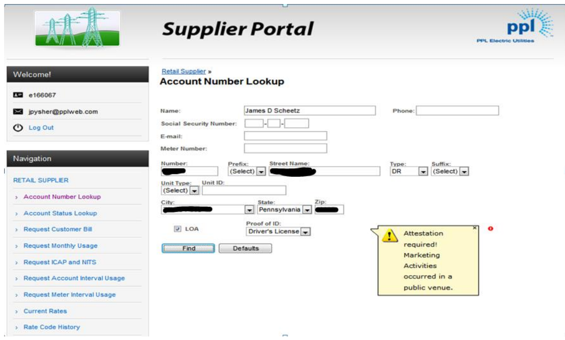
Account View (LOA submit)
https://www.pplelectric.com/~/media/pplelectric/at%20your%20service/docs/general-supplier-reference-information/2014supplierconference.pdf?la=en pg 148

Slide 45
PPL Request Meter Interval Usage
Provides individual meter interval usage for all meters assigned to an account number
Provides the one year minus three days of data
Excel export capabilities
One account number at a time can be entered

Slide 46
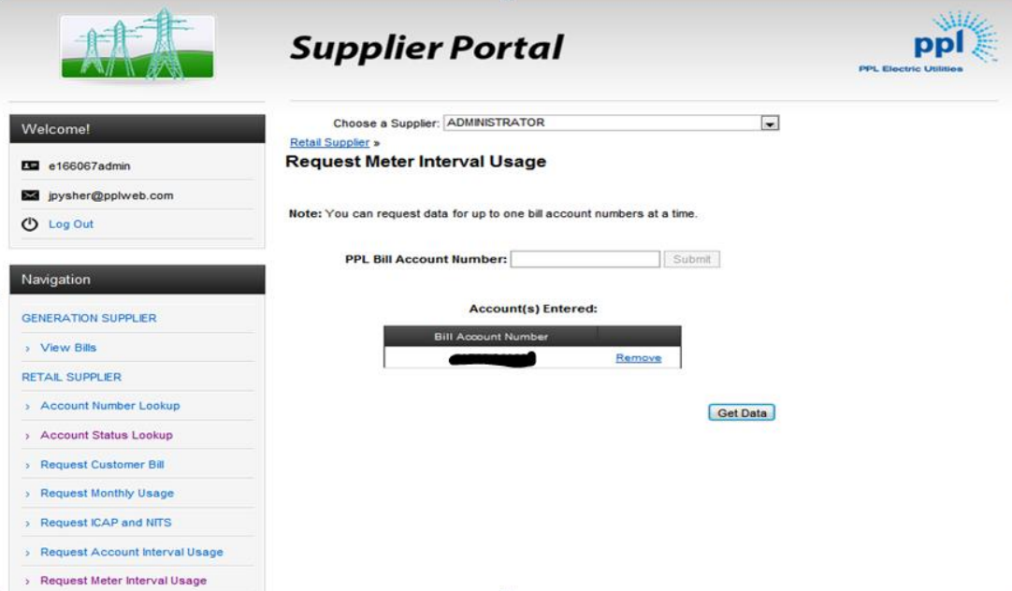
Account number entry

Slide 47
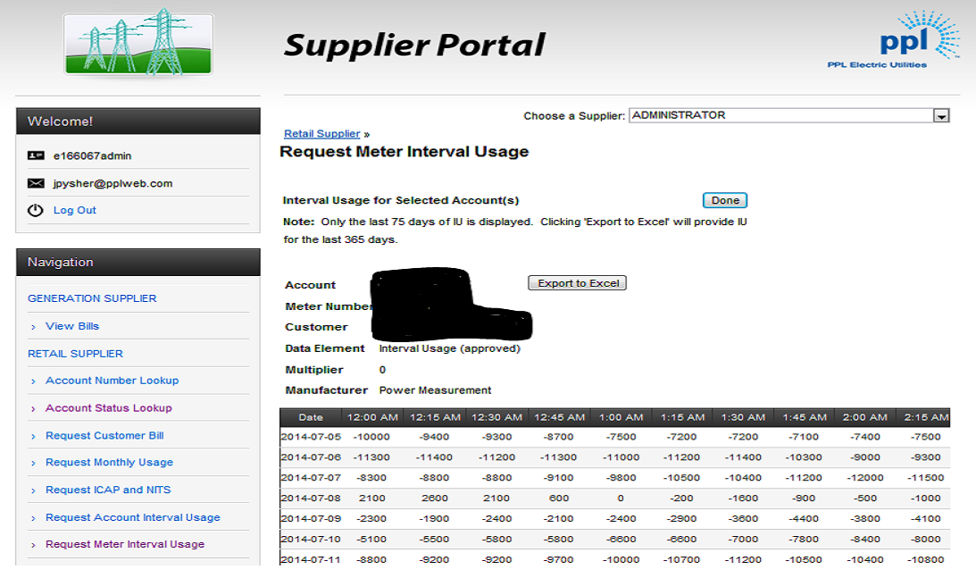
Interval Usage

Slide 48
PPL Third Party Data Access Observations
Explicit or attested LOA appears to be the only means of obtaining customer usage data as a 3rd party.
There appears to be no means of creating an ongoing data agreement with the customer as a third party (Green Button Connect or SMT 3rd party agreement)
Data access appears to predominately be manual (up to 10 accounts at a time) with the exception of EDI – suppliers can access all interval usage from PPL via EDI if they choose

Slide 49
Smart Meter Texas, Data Access
Registered Access
  Customer (friends and family as well)
  REP (acting as Rep of Record)
  Third Parties
    REP
    Service Provider

Slide 50
Smart Meter Texas
Third Party Access Agreement
Customers must explicitly grant Third Parties access to their usage data
SMT enables this authorization through several automated business processes that capture the customer’s permission within SMT.

Slide 51
SMT Energy Data Agreement
A customer may accept, reject or allow the invitation to expire (30 days).
Agreement | Description
Energy Data Agreement | Authorizes a Third Party to access a Customer’s energy usage data, meter information, and premise information The term of the agreement may be for a one time access or for a duration of 1 month up to 1 year The agreement may include all of the ESIIDs in the Customer’s account or just specific ESIIDs A Customer may enter into an unlimited number of Energy Data Agreements

Slide 52
Smart Meter Texas, Third Party Data Access Interfaces
Interfaces
  Web Portal
    Simple, user friendly, browser-based point of access to account and customer data.
  FTPS
    Any usage reports requested by a Third Party on the SMT web portal or through usage APIs will be sent by SMT to the Third Party’s FTPS folder and stored for ten (10) days
    A Third Party may schedule daily or monthly Customer usage reports that will be sent to the Third Party’s FTPS folder
  API
    Provides a machine to machine communications channel for Third Parties to interact with SMT
    Third parties must go through a testing procedure to validate that their system is communicating correctly using the SMT API
    There are four different categories of APIs available: usage APIs, re-branding API, agreement invitation APIs, and HAN APIs.

Slide 53
Smart Meter Texas, Third Party Data Access Observations
Best Practices
  System infrastructure that allows for use of automated permissioning and API/FTPS systems for automation
  Also, allows for manual web portal functionality
  Allows for scalable data access
  Assures customers data privacy
Enhancement Opportunities
  Capability to allow a customer to accept an agreement without the need to create an SMT account?
  Future support for Green Button Connect functionality?
  Others? Discuss

Slide 54
Appendices

Slide 55
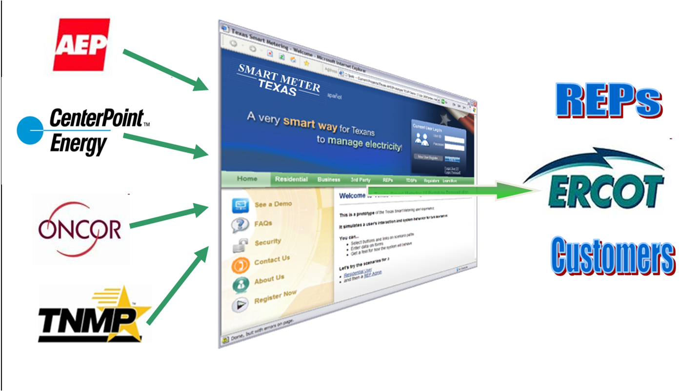
SMART METER TEXAS™

Slide 56
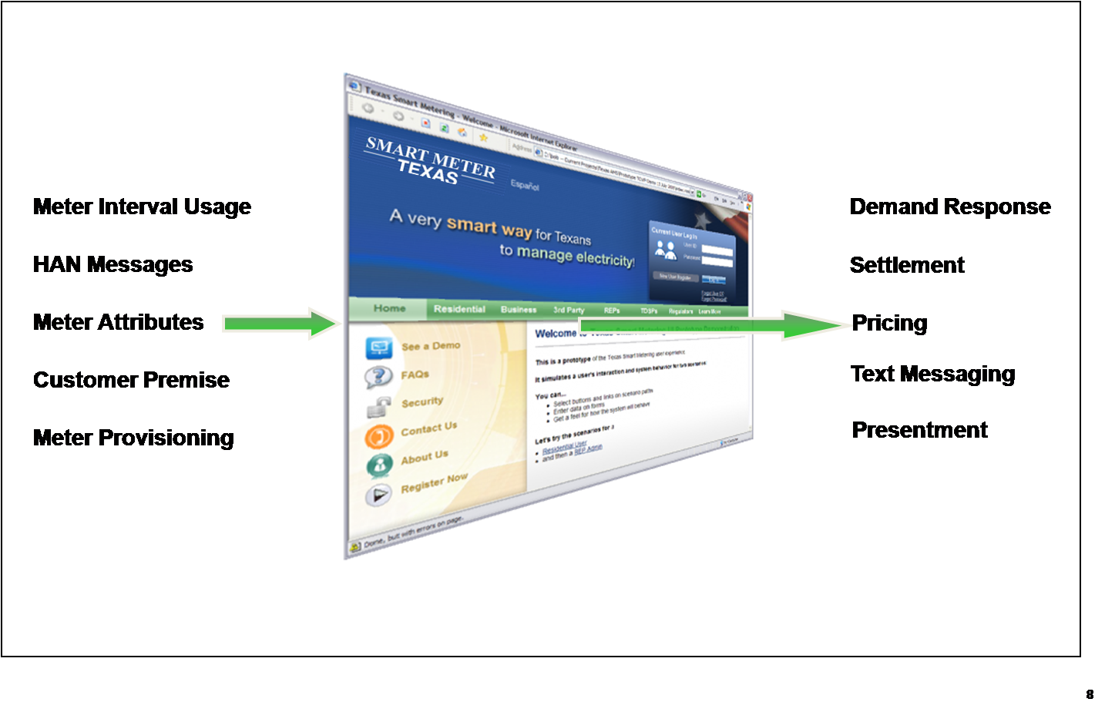
SMART METER TEXAS™
Smart Meter Data provided in a 15-minute, day after basis
500 + Million data points per day
Service for Customers, REPs, 3rd Parties
Standard tool for all Utilities in ERCOT Joining of In Home Devices for Customers, REPs, and 3rd Parties

Slide 57
Terms
Supplier or Electric Generation Supplier (EGS) - A person or corporation, generator, broker, marketer, aggregator or any other entity licensed by the PUC that sells electricity to customers, using the transmission or distribution facilities of an electric distribution company (EDC).

Slide 58
Study Green Button and Green Button Connect
Presented by Donny Helm and Andrea OFlaherty
Date 7/23/15
58

Slide 59

Advanced Metering System (AMS) – The Players
Retail Electric Providers
Third-Parties
Daily 15 Minute Settlement Transactions and Market Transactions
TDSP IT System
ERCOT
( Monthly Meter Readings and Daily 15 Minute VEE Data )
Optional Path
for Retail
Electric
Provider
HAN Services
Market Transactions
Meter / HAN Services (thru Oncor system) and Daily 15 Minute VEE Meter Data
Meter / HAN Services
( Daily and 15 Minute Meter Data)
Historic Daily 15 Minute VEE Meter Data and limited Meter / HAN Services
SMART METER TEXAS
Host (IBM)
Consumers (X 3 million)
Daily and 15 Minute Meter Data
Perform HAN Transactions
59

Slide 60


Green Button Model
(Download My Data & Connect My Data)
Data Custodian
Third Party
Third Party Registration
Web Service Provider
Web Service Consumer
Automated Transfer
Web Portal
One-time Authorization
Web Portal
Retail Customer
User (Browser)

Slide 61


Green Button Model
(Data Custodians as they relate to Retail Customers and Third-Parties)
Green Button Model
Third-Party + REPs as Third Party
Third Party
(Count - ???)
Web Service Consumer
Data Custodian
Web Portal
Energy Data
(LSE File Format)
– w/o Pricing Information
Data Custodian
(TDSPs - 4)
Data Custodian
(SMT)
Energy Data
(LSE File Format)
– w/o Pricing Information
Data Custodian
(REPs – 100+)
Third Party – Account Registration ???
Web Service Provider
Web Service Provider
Web Service Provider
On-Demand Energy Read
Automated Transfer ???
One-time Authorization ???
Web Portal
Web Portal
Home Area Network (HAN)
Provisioning
SEP 1.0 Transactions
Web Portal
Retail Customer – Account Registration
Home Area Network (HAN)
Provisioning
SEP 1.0 Transactions
Green Button Download My Data – with Pricing Information
Retail
Customer
–
Account Registration
Retail Customer
User (Browser)

Slide 62

Green Button Model
(How it is integrated in the Texas Market)
Green Button Model
Third-Party + REPs as Third Party
Smart Meter Texas – Third Party Account Registration
Third Party
(Count - ???)
Third Party “On Behalf of” REP
Home Area Network (HAN) Device – Provisioning & SEP 1.0 Transactions
Web Service Consumer
Energy Data (LSE File Format) – w/o Pricing Information
Data Custodian
Green Button Energy Data (FTP Only) – w/o Pricing Information
Web Portal
Energy Data
(LSE File Format)
– w/o Pricing Information
Data Custodian
(TDSPs - 4)
Data Custodian
(SMT)
Energy Data
(LSE File Format)
– w/o Pricing Information
Data Custodian
(REP – 100+)
Third Party – Account Registration ???
Web Service Provider
On-Demand Energy Read
Web Service Provider
Web Service Provider
Automated Transfer ???
One-time Authorization ???
Web Portal
Web Portal
Home Area Network (HAN)
Provisioning
SEP 1.0 Transactions
Web Portal
Retail Customer – Account Registration
Home Area Network (HAN)
Provisioning
SEP 1.0 Transactions
Green Button Download My Data – with Pricing Information
Retail
Customer
–
Account Registration
Third Party Agreements Smart Meter Texas manages HAN and Energy agreements initiated by the Third Party and authorized by the User. The Utility (e.g. TDSPs or REPs) are not involved with this process.
On-Demand Energy Read
Retail Customer
Retail Customer – Account Registration
User (Browser)
Green Button Download My Data – w/o Pricing Information
Energy Data (CSV Format) – w/o Pricing Information
Home Area Network (HAN) Device - Provisioning

Slide 63
Customer Account Registration Processes
Energy Service
Requirements
(Customer Validation – Premise Assigned)
Smart Meter Texas
Requirements
(Customer – Premise Validation)
Who You Are
Who You Are
First Name
Last Name
Email Address
Home Phone Number
Mobile Phone Number
Address
First Name
Last Name
Email Address
Phone Number
What You Know
What You Know
Account Number
Social Security Number
Driver’s License Number
Tax ID
Date of Birth
Security Information
User ID
Electric Retail Provider
ESIID
Meter Number
63

Slide 64
Third-Party Account Registration Processes
Green Button Process
(Validation ???)
Smart Meter Texas Process
(DUNS Validation)
OAuth2 Dynamic Client ***
User Interface Only
Application Description
Application Status
Application Type
Application Use
Phone Number
Authorization URI
Third-Party Notify URI
URI Redirect for Third-Party Landing Page
URI of Third-Party’s Web Page
Client Secret
Logo URI
Client Name
Client URI
Re-Direct URI
Terms of Service URI
Policy URI
Software ID
Software Version
Contacts
Token Endpoint Authorization Method
Scope
Grant Types
Business Name
Address
City
State
Zip Code
Country
Phone Number
Account Email Address
DUNS Number
Company URL
Privacy Policy URL
Upload Company Logo
TRUSTe PRIVACYSMART Seal
Upload PRIVACYSMART Logo
Note: No Third-Party lists are maintained for customer use

Slide 65
Third-Party – Customer Agreement Processes
Green Button Process
Smart Meter Texas Process
Customer Required to have an Energy Services Agreement
Customer Required to have a Web Account with Energy Service Provider or Smart Meter Texas Portal
Authorization between a Customer and Third-Party is completed through a web service and web site process
Energy information would have pricing information if Third-Party relationship is with the Energy Service Provider
Customer Required to have an Energy Services Agreement
Customer Required to have a Web Account with Smart Meter Texas Portal
Authorization between a Customer and Third-Party is completed through an e-mail agreement and web site process
Agreements can be secured for both energy data or home-area-network (HAN) services
Energy information does not include pricing data

