Slide 1
SMT Update To AMWG
July 22, 2015

Slide 2
Review SMT Patching Events and Schedule

Slide 3
SMT Patching Events and Schedule
Completed installation of new SMT infrastructure May 9th, 2015
Conducted health check and patch verification on newly installed infrastructure
Identified all patches needed for new SMT infrastructure and developed plan to implement
Began weekly patch maintenance for dates 7/5/15 - completed, 7/12/15 - completed, 7/19/15 - completed, 7/26/15, and 8/2/15 in order to complete a baseline full cycle of all necessary patches
Defined ongoing monthly maintenance to be conducted the third Sunday of every month.
Will conduct the first monthly patch maintenance on September 20th, 2015
Will conduct additional patch maintenance as required for items that are identified as critical

Slide 4
Discuss SMT Issues Observed

Slide 5
SMT Issues Observed
SMT Implemented ROR as Third Level of Security for Customer Registration Q3 2013
Difficulty in selecting correct ROR due to REPs with multiple DUNs listed with similar names
Unable to select correct ROR due to completely different name in ERCOT system because of dba situation
Customer’s Experiencing Their Meter Being Dropped from Their SMT Account
Bug introduced by a TDSP in late 2014 sending SWI versus MVO – This has been corrected
Bug introduced by Third Party release in November 2014 causing SWI to remove meter – This has been corrected
REP process sending SWI versus MVO initiation – Issue ongoing today

Slide 6
Status Update of AMWG Change Requests

Slide 7
Status of AMWG Change Requests
Delivered | To Be Delivered Next Release Zero $$ | Approved Awaiting Project Packaging | AMWG Tabled Awaiting Reporting Options | AMWG Approved Awaiting Categorization | JDOA Estimated Awaiting AMWG Review | Tabled RMS | Tabled AMWG | Awaiting RMS Review | Pushed Back as Defect
2013 002 | 2013 014 | 2013 015 | 2013 001 | 2015 021 | 2015 040 | 2014 018 | 2015 029 | 2015 042 | 2015 022
2013 005 | 2015 024 | 2015 019 | 2013 003 |  | 2015 041 |  | 2015 030
2013 006 |  | 2015 020 | 2013 004 |  |  |  | 2015 031
2013 007 |  | 2015 023 | 2013 008 |  |  |  | 2015 032
2013 009 |  | 2015 025 | 2013 010 |  |  |  | 2015 033
2013 012 |  | 2015 026 | 2013 011 |  |  |  | 2015 034
2013 013 |  | 2015 027 |  |  |  |  | 2015 038
2013 016 |  | 2015 028
2013 017 |  | 2015 035
 |  | 2015 036
 |  | 2015 037
 |  | 2015 039
Total 9 | Total 2 | Total 12 | Total 6 | Total 1 | Total 2 | Total 1 | Total 7 | Total 1 | Total 1

Slide 8
AMWG Change Requests
AMWG Change Request | AMWG CR Document | Status | Categorization and Estimated Delivery Date | Estimated Cost
AMWG CR 2013 001 – Report for AMWG Data Monitoring – Data Completeness Measurements |  | Estimate Complete & RMS Approved 3/3/15 | Tabled Awaiting Reporting Tool Options | Small (20-40)
AMWG CR 2013 002 – Reports for AMWG Data Monitoring – Data Timeliness Measurements |  | Implemented | Q2 2014 Delivered | Included in Maintenance Contract
AMWG CR 2013 003 – Reports for AMWG Data Monitoring – Measurement of Percentage of Actual Meter Reads |  | Estimate Complete & RMS Approved 3/3/15 | Tabled Awaiting Reporting Tool Options | Small (20-40)
AMWG CR 2013 004 – Reports for AMWG Data Monitoring – Measurement of Estimates |  | Estimate Complete & RMS Approved 3/3/15 | Tabled Awaiting Reporting Tool Options | Medium (40-60)
AMWG CR 2013 005 – Reports for AMWG Data Monitoring – Number of SMT Help Desk Tickets Monthly by Ticket Type |  | Implemented | Q2 2014 Delivered | Included in Maintenance Contract
AMWG CR 2013 006 – Reports for AMWG Data Monitoring – Availability of SMT API |  | Implemented | Q2 2014 Delivered | Included in Maintenance Contract
AMWG CR 2013 007 – Reports for AMWG Data Monitoring – Availability of SMT FTPS |  | Implemented | Q2 2014 Delivered | Included in Maintenance Contract
AMWG CR 2013 008 – Reports for AMWG Data Monitoring – Average Time to Deliver HAN Messages |  | Estimate Complete & RMS Approved 3/3/15 | Tabled Awaiting Reporting Tool Options | Small (20-40)
AMWG CR 2013 009 – Reports for AMWG Data Monitoring – Number of Accounts by Type |  | Implemented | Q2 2014 Delivered | Included in Maintenance Contract
AMWG CR 2013 010 – Reports for AMWG Data Monitoring – Number of Reports Requested by GUI (Portal) and Number of FTPS Accesses |  | Estimate Complete & RMS Approved 5/6/15 | Tabled Awaiting Reporting Tool Options | Medium (40-60)

Slide 9
AMWG Change Requests (Cont.)
AMWG Change Request | AMWG CR Document | Status | Categorization and Estimated Delivery Date | Estimated Cost
AMWG CR 2013 011 – Average Time from HAN Provision Request to Meter Ready Status |  | Estimate Complete & RMS Approved 3/3/15 | Tabled Awaiting Reporting Tool Options | Small (20-40)
AMWG CR 2013 012 – Bypass redundant screen for Users with only one meter when accessing HAN device information |  | Implemented | Q4 2014 Delivered | Included in Third-Party
AMWG CR 2013 013 – Timeout on SMT takes user to “incorrect login” screen |  | Implemented | Q4 2014 Delivered | Included in Third-Party
AMWG CR 2013 014 – Allow SMT user to toggle between 15-Minute Reads and Daily Reads without having to reset the date range |  | Designed | 2015 Next Release | Included in Usability
AMWG CR 2013 015 – Expand Daily Usage Graph to show 35 days of daily usage on the SMT GUI |  | Estimate Complete & RMS Approved 3/3/15 | 2 Important Awaiting Packaging | Medium (40-60)
AMWG CR 2013 016 – Capability for RORs to grant access to vendors on their behalf to the ROR’s customers via API (energy usage, HAN messaging , and HAN provisioning) and FTPS files |  | Implemented | Q3 2014 Delivered | Included in Maintenance Contract
AMWG CR 2013 017 – REP API for Energy Usage on SMT (Backfill of Historical Usage Data for Existing Customers- “Interim”) | See Below CR 2013 017 Permanent | Implemented Interim | Q4 2013 Delivered | Included in SMT Work In Process
AMWG CR 2013 017 – REP API for Energy Usage on SMT (Subscription for New Customer Historical Usage – “Interim”) | See Below CR 2013 017 Permanent | Implemented Interim | Q2 2014 Delivered | Included in Maintenance Contract
AMWG CR 2013 017 – REP API for Energy Usage on SMT – Permanent Solution to Replace Interim Solution |  | JDOA Estimate To Begin After New Infrastructure Refresh Complete | Awaiting Evaluation of New SMT Infrastructure to Determine if any Additional Work is Needed to meet CR Requirements | Will Be Estimated After New Infrastructure Implemented in Q1 2015
AMWG CR 2014 018 – Add Generation Data to the SMT Portal View |  | JDOA Estimate Completed | RMS Tabled 6/2/15 | Medium (40-60) Graph and Table Small (20-40) Table Only

Slide 10
AMWG Change Requests (Cont.)
AMWG Change Request | AMWG CR Document | Status | Categorization and Estimated Delivery Date | Estimated Cost
AMWG CR 2015 019 – Relocate Various SMT User Guides from the Authenticated Site to the Unauthenticated Site |  | JDOA Estimate Completed | 2 Important Awaiting Packaging | Small (20-40)
AMWG CR 2015 020 – Add Customer Type in the Customer Information Section in the View / Edit Agreement Page |  | JDOA Estimate Completed | 3 Nice to Have Awaiting Packaging | Medium (40-60)
AMWG CR 2015 021 – Improve REP of Record Search Criteria During the Customer Registration Process |  | Estimate Complete & RMS Approved 5/6/15 | Awaiting AMWG Categorization | Medium,(40-60)
AMWG CR 2015 022 – Keep Selected ROR Visible During Customer Registration |  | JDOA Estimate Completed | Push Back as Defect | Small (20-40)
AMWG CR 2015 023 – Allow Entry of Multiple ESIIDs During Customer Registration Process |  | JDOA Estimate Completed | 3 Nice to Have Awaiting Packaging | High (60-120)
AMWG CR 2015 024 – Third Party Access Renew Energy Data Agreement After One Year |  | JDOA Estimate Completed | 1 Critical Awaiting Delivery in 2015 | 0 Dollar
AMWG CR 2015 025 – Third Party User Experience Add Identifying Data Fields in the Report Request Status Page |  | JDOA Estimate Completed | 2 Important Awaiting Packaging | High (60-120)
AMWG CR 2015 026 – SMT Functionality Display Portal Message when Report Can Not be Displayed in the SMT Portal Page |  | JDOA Estimate Completed | 2 Important Awaiting Packaging | Minor (0-20)
AMWG CR 2015 027 – SMT Functionality Allow Specific Date Entry on the Export Report Screen |  | JDOA Estimate Completed | 3 Nice to Have Awaiting Packaging | Small (20-40)
AMWG CR 2015 028 – SMT Functionality Allow ESIIDs to be Copied and Pasted into the ESIID Box on the Usage Page |  | JDOA Estimate Completed | 3 Nice to Have Awaiting Packaging | Minor (0-20)
AMWG CR 2015 029 – This Party Allow Third Parties to Utilize an API for On Demand Data Requests |  | Estimate Complete & RMS Approved | AMWG Tabled | High (60-120)

Slide 11
AMWG Change Requests (Cont.)
AMWG Change Request | AMWG CR Document | Status | Categorization and Estimated Delivery Date | Estimated Cost
AMWG CR 2015 030 – Support multiple RORs during CSV file meter upload |  | JDOA Estimate Completed | AMWG Tabled 5/19/15 | High (60-120)
AMWG CR 2015 031 – Allow only current ROR for account registration validation and meter add validation |  | JDOA Estimate Completed | AMWG Tabled 5/19/15 | High (60-120)
AMWG CR 2015 032 – Support SFTP protocol for SMT integration |  | Investigation Complete | AMWG Tabled 5/19/15 Get Further Info | High (60-120)
AMWG CR 2015 033 – Provide user id and password rules up front on UI registration page |  | IBM Re-estimate with Hardcode vs Roll Over | AMWG Tabled 5/19/15 for new Estimate | Medium (40-60)
AMWG CR 2015 034 – Display the day of the week in addition to the date on usage reports |  | JDOA Estimate Completed | AMWG Tabled 5/19/15 | Medium (40-60)
AMWG CR 2015 035 - Provide a customer-selected option to receive a monthly usage report via email |  | Estimate Complete & RMS Approved | 2 Important Awaiting Packaging | Medium (40-60)
AMWG CR 2015 036 – Rename Overview tab to Home |  | Estimate Complete & RMS Approved | 2 Important Awaiting Packaging | Minor (0-20)
AMWG CR 2015 037 – Remove SMT Demo from Private Site for REPs, TDSPs, and Third Parties |  | Estimate Complete & RMS Approved | 2 Important Awaiting Packaging | Minor (0-20)
AMWG CR 2015 038 – Provide a “Hold” capability on Third Party accounts to reactivate usage until the Third Party has integrated with FTPS and API |  | JDOA Estimate Completed | AMWG Tabled 5/19/15 | High (60-120)
AMWG CR 2015 039 – Provide more detail for Third Party Agreement Invitation Error Messages |  | Estimate Complete & RMS Approved | 2 Important Awaiting Packaging | Medium (40-60)
AMWG CR 2015 040 – Improve SMT Administration Functionality for TDSPs, RORs, Third Parties, and Businesses |  | JDOA Estimate in Process | JDOA Estimate Complete Awaiting AMWG Review | High (60-120)

Slide 12
AMWG Change Requests (Cont.)
AMWG Change Request | AMWG CR Document | Status | Categorization and Estimated Delivery Date | Estimated Cost
AMWG CR 2015 041 – Allow Enrollment for New Customer 12 Month History for Third Parties |  | AMWG Tabled in April Un Tabled for July | JDOA Estimate Complete Awaiting AMWG Review | Medium (40-60)
AMWG CR 2015 042 – Automate Machine to Machine Consumption of Third Party Agreement Information |  | Awaiting RMS Aug | Awaiting RMS Aug | Med / High (80)

Slide 13
Rough Order Of Magnitude (ROM) Estimate of Effort Classification
Change Type | ROM
MINOR | 0 – 20 K
SMALL | 20 – 40 K
MEDUIM | 40 – 60 K
HIGH | 60 – 120 K
VERY HIGH | Over 120 K
These are rough order of magnitudes and do not include project ramp-up and testing effort (SIT & UAT) and only assumes unit testing.
Actual estimates could vary significantly depending on requirements.
Ramp-up and testing would be 20 to 40% of the overall effort
Overall project cost will vary based on efficiency gains from packaging like functionality

Slide 14
Storyboard and Costs Estimates AMWG CR 2015 040 and AMWG CR 2015 041

Slide 15
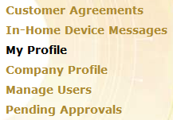
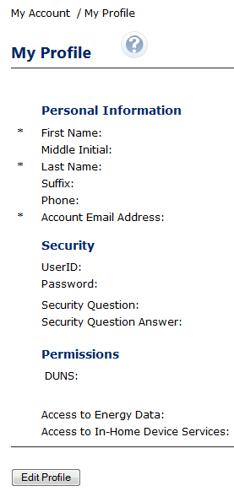
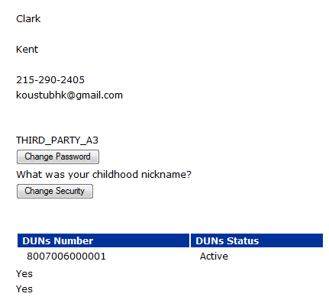
AMWG CR 2015-040
High
Business Requirement
Show “Created date” on Profile Page for following types of user
- REP
- TDSP
- REG
- NRC

Slide 16
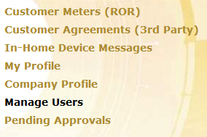
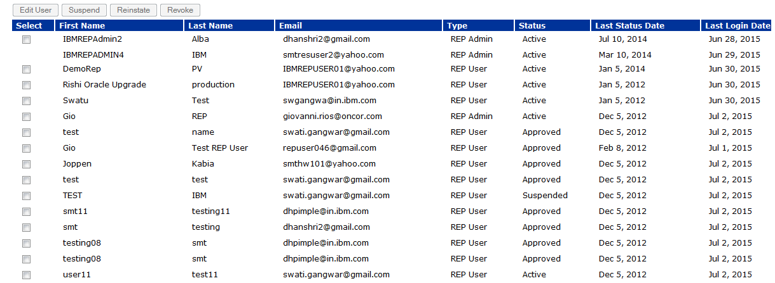
AMWG CR 2015-040
Business Requirement
Add user access “suspend date”, regardless if suspension is due to lack of use or performed by the user Administrator
Add “last use date” of a user
It will be available only for the user-type
- REP
- TDSP
- REG
- NRC

Slide 17
AMWG CR 2015-040
User-ID already exist
Business Requirement
Provide “user ID” in the user profile
For following types of User
- REP
- TDSP
- REG
- NRC
User-ID already exist

Slide 18
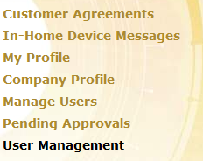
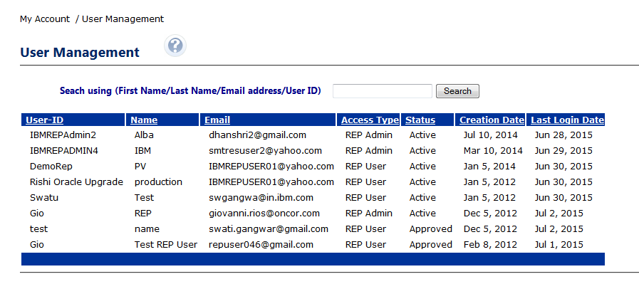
AMWG CR 2015-040
Business Requirement
Add capability to produce Administrator-related reports containing the following information:
a. User ID
b. Name
c. Email address
d. Access type
e. Account status
f. Account creation date
g. Last login date
Provide search functionality based on user first name, last name, email address, or user ID
Alphabetize the administrator user list
Allow for the administrator user list to be sorted by column

Slide 19
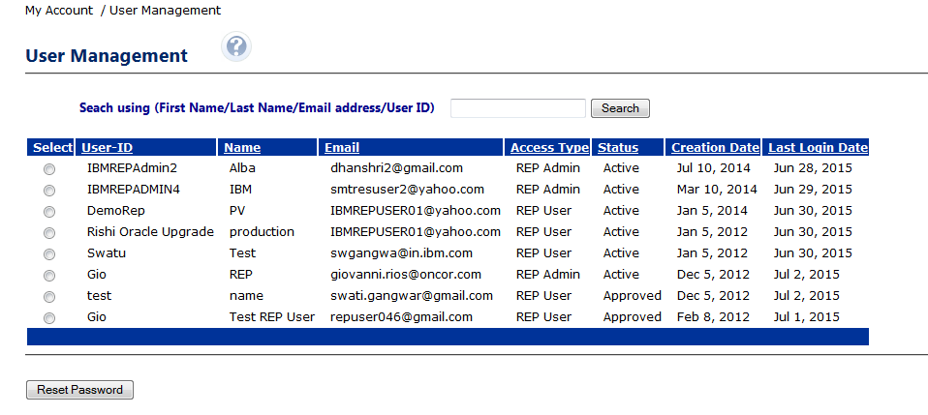
AMWG CR 2015-040
Business Requirement
Allow business administrators to re-set user passwords

Slide 20
AMWG CR 2015-041
Medium
Business Requirement
Ability for 3rd Party users to request Enrollment reports.
Current Process for RORs
Currently RORs have to call the help-desk to raise a request which goes through several manual validation and setup steps delaying the request provisioning.
Recommendation
Allow an UI self-help interface for REP and 3rd Party users to request reports and automate the backend setup activities.
Prerequisite
REPs and 3rd Parties must have completed FTP setup with SMT.

Slide 21
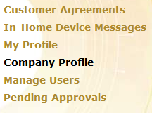
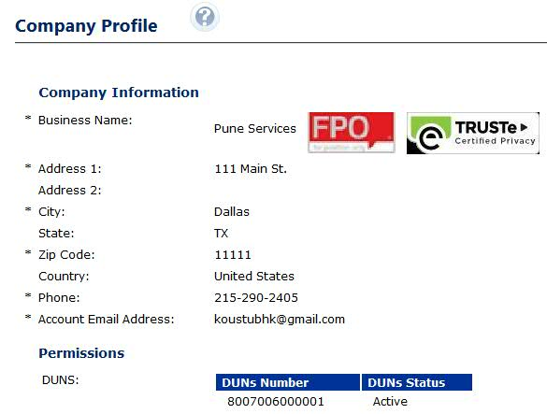
AMWG CR 2015-041
Medium
Business Requirement
Self Enrollment Report for 3rd Party
For 3rd Parties the Enrollment Report will be generated for all newly accepted agreements within last 24 hours

Slide 22
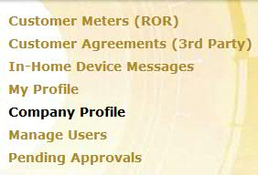
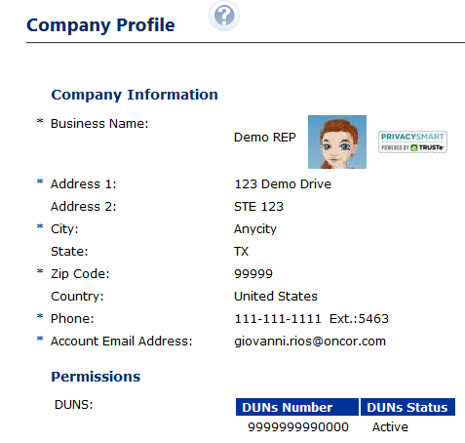
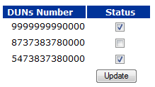
AMWG CR 2015-041
Medium
Business Requirement
Self Enrollment Report for REP
For REPs the Enrollment Report will be generated for all newly acquired customers (via Switch or Move In) within last 24 hours for the selected DUNS.

Slide 23
Reporting Options for SMT

Slide 24
Reporting solution options for different needs
# | Use Cases | Required Features | Complexity | Most fit-for-purpose options (recommended) | Ballpark TCO (through 12/2018)
1 | Basic operational reporting: AMWG CRs 2013-01 through 2013-10, SMT adoption statistics, file & data availability, service availability, HAN/ODR/Green Button/Ad hoc API request details | Simple reports (exel, html documents) accessible via a web URL to be viewed any time Scheduled delivery to a distribution list through e-mail Ability to add/update/delete distribution list Simple numerical/text reports, no sophisticated graphs/dashboards etc. | Basic | Custom development to make reports available through SMT portal to specific types of users only | $300k-$400k through Dec-2018
2 | Option 1 + portal usage analytics: All of the above mentioned in #1 and portal usage statistics such as – number of users every day/week/month/hour of day, use of browsers/OS, repeating users, geographical locations, API/ODR/report usage, page response time measurement etc. | All of the above mentioned in #1 Portal analytics dashboard | Moderate | Custom development + Google analytics | $500k-$800k + license costs < few hundred dollars
3 | Option 2 + custom querying capabilities: All of the above mentioned in #1 & #2, and ability for certain type of users to develop custom queries as needed based on data structure | All of the above mentioned in #1 & #2 Easy to use UI interface for users to develop custom queries/reports for certain types of users | Advanced | Custom implementation of COTS reporting packages such as Crystal Reports, Hyperion, Oracle OBIEE, Cognos etc. Requires additional hardware and software procurement and licenses | $1.5M+

Slide 25
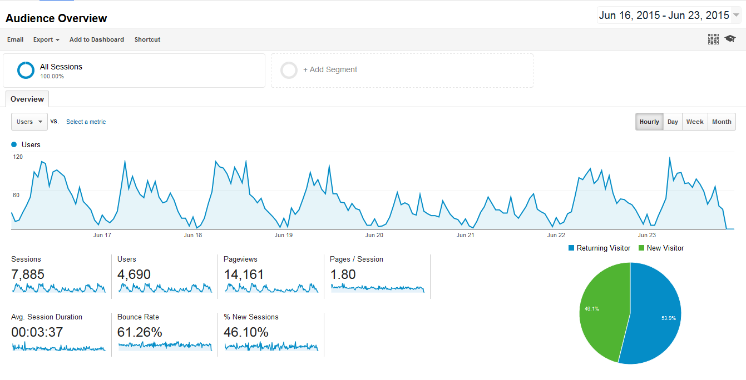
Appendix – Google Analytics Sample Dashboard screenshots Portal access stats for given period
Sessions - Total number of Sessions within the date range. The period time a user is actively engaged with the SMT Portal
Users - Users that have had at least one session within the selected date range. Includes both new and returning users. Pageviews - The total number of pages viewed. Repeated views of a single page are counted. Pages/Session - The average number of pages viewed during a session. Repeated views of a single page are counted. Avg. Session Duration - The average length of a Session. Bounce Rate - Bounce Rate is the percentage of single-page visits (i.e. visits in which the person left your site from the entrance page without interacting with the page).

Slide 26
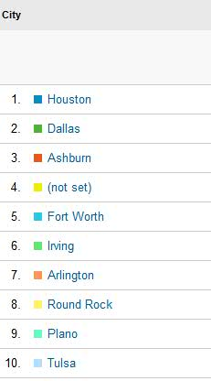
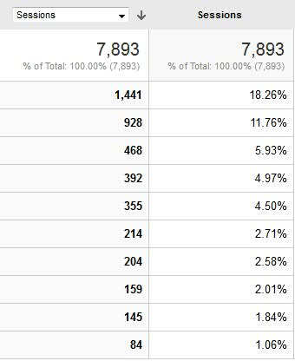
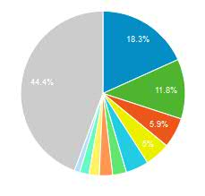
Appendix – Google Analytics Sample Dashboard screenshots Geographical access points

Slide 27
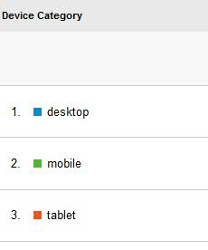
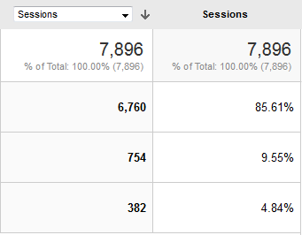
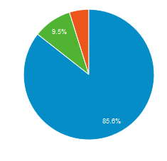
Appendix – Google Analytics Sample Dashboard screenshots Types of devices used

Slide 28
Continuation of Categorization of SMT RMS Approved AMWG CRs

Slide 29
Q&A Monthly SMT Reports to AMWG Data Through June 2015

