Slide 1
2015 RTP Update
RPG Meeting
July 21, 2015

Slide 2
2015 RTP update
Reliability analysis for the contingencies where load shed is not allowed is complete for the 2018, 2020, and 2021 summer peak base cases
G-1+N-1 and X-1+N-1 contingencies are being studied for 2018 minimum load and 2016 summer peak base cases
Contingency | 2015 RTP Base Cases
 | 2016 summer peak | 2018 min load | 2018 summer peak | 2020 summer peak | 2021 summer peak
** Set 1 (P0, P1, P7) | Completed * | Completed | Completed | Completed | Completed
** Set 2 (P2, P4, P5) | Completed * | Completed | Completed | Completed | Completed
** Set 3 (P3 G-1, P6.2 X-1) | In progress | In progress | Completed | Completed | Completed
* Constraint management plan such as, but not limited to, tap setting and shunt adjustment need to be developed
** Set 1: P0 (N-0), P1 (breaker-to-breaker N-1), and P7 (multiple circuit on a single pole)
Set 2: P2 (segment outage, bus outage, internal breaker fault) , P4 (fault with stuck breaker), and
P5 (fault with non-redundant relay failure) where load shedding is not allowed.
Set 3: P3 (Generator outage + N-1), P6.2 (Transformer Outage + N-1)

Slide 3
2015 RTP update
Secure 2018, 2020 and 2021 summer peak base cases and list of preliminary projects were posted in the MIS
The 2015 RTP scope has been updated and posted in the MIS
Location: https://mis.ercot.com/pps/tibco/mis/Pages/Grid+Information/RegionalPlanning >> 2015 Regional Transmission Plan Postings

Slide 4
Transmission equipment upgrades (2018, 2020, and 2021 summer peak base cases)
Upgrade needs identified by kV | 69 | 138 | 345 | 2015 RTP | Previously Identified*
Line Addition | 2 | 8 | 1 | 11 | 2
Line Upgrade | 12 | 27 | - | 39 | 13
Transformer Addition | - | 3 | 8 | 11 | 4
Transformer Upgrade | - | 3 | 2 | 5 | 1
Reactive Additions (Capacitor, Reactor, STATCOM) | - | 8 | 1 | 9 | -
Other Upgrades (Terminal Equipment, Bus tie breaker) | - | 5 | - | 5 | 2
* Projects identified in the 2014 RTP which were needed in 2015 RTP

Slide 5
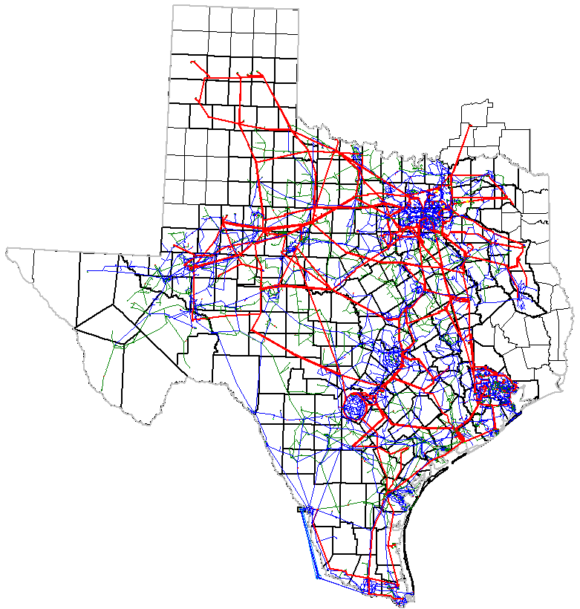
2015 RTP Reliability Projects
2015 RTP Reliability Projects
 | Project Description
1) | TNMP Flat Top TNMP 138kV project* a). Tap existing Barilla-Solstice 138kV line b). Convert Flat Top TNP- Barilla Draw Tap 69 kV to 138kV c). Convert Barilla Draw Tap-TNMP IH 20 69 kV to 138kV d). New 138/69kV transformer at TNMP IH 20
2) | Ben Davis-Murphy 138kV line upgrade
3) | Bosque Switch–Olsen 138kV line terminal equipment upgrade*
4) | Firewheel-Apollo 138kV line upgrade
5) | Trinidad SES- Oak Grove Tap 138kV line upgrade*
6) | Seagoville Switch-Crandall POI 138kV line upgrade
7) | Liggett Switch - Hackberry 138kV double circuit upgrade*
8) | Killeen Switch-Belton 138kV line upgrade*
9) | Northwest Carrollton-Lake Pointe TNP 138kV line upgrade*
10) | Hicks Switch 345/138kV transformer addition*
15
18
10
11
17
9
32
16
4
19
2
6
30
14
5
3
7
13
12
20
33
8
34
28
42
23
1
29
35
25
39
22
52
26
38
27
36
24
45
21
44
43
40
41
31
48
46
47
54
*Projects identified in previous RTP Studies
37
51
50
53
345-kV new additions/upgrades , 138-kV new additions
138-kV upgrades, 69-kV projects not shown
49

Slide 6
2015 RTP Reliability Projects
15
18
10
11
17
9
 | Project Description
11) | Corinth-Highlands TNP 138kV line upgrade
12) | Holt Switch-North Andrews 138kV Line upgrade
13) | Addition of second 345/138kV transformer at Twin Buttes*
14) | Addition of second 345/138kV transformer at Vealmoor
15) | Addition of shunt reactor at Clayton 345kV station
16) | Whitney 138kV bus tie upgrade
17) | Carrollton Northwest 138kV breaker upgrade
18) | Vernon 138kV capacitor bank addition
19) | Cedar Crest Switch 138kV breaker upgrade*
20) | Trinidad to Winkler 138kV line upgrade
21) | Addition of shunt capacitor at Jones Creek
22) | Obrien-Clodine 138kV line upgrade
23) | Stryker Creek-Douglas 138kV line upgrade*
32
16
4
19
2
6
30
14
5
3
7
13
12
20
33
8
34
28
42
23
1
29
35
25
39
22
52
26
38
27
36
24
45
21
44
43
40
*Projects identified in previous RTP Studies
41
31
48
46
47
54
37
51
50
53
345-kV new additions/upgrades , 138-kV new additions
138-kV upgrades, 69-kV projects not shown
49

Slide 7
2015 RTP Reliability Projects
 | Project Description
24) | Addition of second shunt capacitor at Velasco 138kV station
25) | Hardy-North Side 138-kV line upgrade
26) | Clodine-Barker 138-kV line upgrade*
27) | Switched shunts at MaGill and Bay City 138kV stations
28) | Stryker Creek to Nacogdoches 138-kV line upgrades*
29) | Addition of third 345/138-kV transformer at Zenith*
30) | Tri Country-Parkway 138kV Line Upgrade
31) | Fayette River Pump-Weimar 138 kV Line Addition
32) | Flatonia-Hallettsville 138kV line upgrade
33) | Hamwolf-Medical Center 138kV Line Upgrade
34) | Addition of shunt capacitor at Milton 138kV station
35) | George West 138/69kV transformer upgrade*
36) | Crystal- Carrizo 138kV line upgrade
37) | Cross Valley Project 345/138kV transformer addition*
15
18
10
11
17
9
32
16
4
19
2
6
30
14
5
3
7
13
12
20
33
8
34
28
42
23
1
29
35
25
39
22
52
26
38
27
36
24
45
21
44
43
40
41
31
48
46
47
54
*Projects identified in previous RTP Studies
37
51
50
53
345-kV new additions/upgrades , 138-kV new additions
138-kV upgrades, 69-kV projects not shown
49

Slide 8
2015 RTP Reliability Projects
 | Project Description
38) | Escondido-Eagle Pass 138kV line upgrade*
39) | Escondido-Brackettville 138kV line addition*
40) | Melon Creek-Tatton 138kV line upgrade and 138/69 kV transformer addition
41) | Valero-Champlin-Sagan-Weil Trc 138 kV line upgrades, 138 kV line addition, and 138/69 kV transformer addition
42) | Oaks 138/69kV transformer upgrade
43) | George West-George West Switching Station 138kV line addition
44) | Three River-Beeville-Tuleta 138kV line upgrade
45) | Normanna- Beeville 138kV line upgrade
46) | Addition of shunt capacitor at Bessel 138 kV substation
47) | North Hill-Zia 345kV line addition
48) | Koch Up River Road 138/69kV transformer upgrade
49) | Addition of STATCOM at Pharr 138kV station
50) | Addition of second 345/138kV transformer at South McAllen
51) | Addition of 345/138kV transformer at Molina
15
18
10
11
17
9
32
16
4
19
2
6
30
14
5
3
7
13
12
20
33
8
34
28
42
23
1
29
35
25
39
22
52
26
38
27
36
24
45
21
44
43
40
41
31
48
46
47
54
37
*Projects identified in previous RTP Studies
51
50
53
345-kV new additions/upgrades , 138-kV new additions
138-kV upgrades, 69-kV projects not shown
49

Slide 9
2015 RTP Reliability Projects
 | Project Description
52) | Miguel 345/138kV transformer upgrades
53) | Addition of second 345/138kV transformer at Palmito
54) | Fayette River Pump-Fayette Plant 138kV line upgrade
15
18
10
11
17
9
32
16
4
19
2
6
30
14
5
3
7
13
12
20
*Projects identified in previous RTP Studies
33
8
34
28
42
23
1
29
35
25
39
22
52
26
38
27
36
24
45
21
44
43
40
41
31
48
46
47
54
37
51
50
53
345-kV new additions/upgrades , 138-kV new additions
138-kV upgrades, 69-kV projects not shown
49

Slide 10
Next steps
Case conditioning
Other reliability studies
(e.g. sensitivity, short circuit, cascading, multiple element outage (P6, EE), long-lead time equipment, constraint management plan, etc.)
Initial start cases, and contingency list ready
2015 RTP Report
Set 1 (P1, P7),
Set 2 (P2, P4, P5) contingency analysis for the base cases
Economic case preparation and analysis
Set 3* (P3: G-1+N-1, part of P6: X-1+N-1) contingency analysis for the base cases
Green box: complete
Yellow box: in progress
* 2018 min load and 2016 summer peak
base case studies are in progress

