Slide 1
SMT Update To AMWG
JUNE 2015

Slide 2
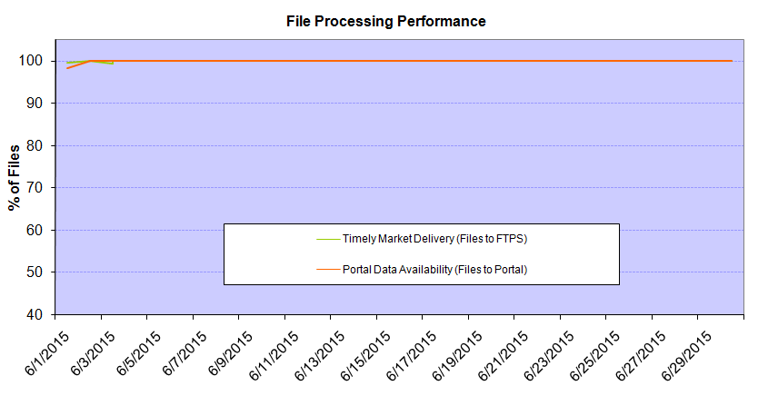
Monthly SMT Data Timelines AMWG CR 2014 002 End to End File Processing Completeness – JUN 2015
% Timely Market Delivery - % of files posted to market (FTPS) by 11:00pm out of # of files received by SMT by 11:00pm.
% Portal Data Availability - % of files loaded to the database for data availability on portal by 6:00am next day for the files received by 11:00pm
* A LSE file includes usage data for upto 50,000 ESIIDs. The master files are also considered for above metrics.
Observed Anomalies:
06/01 -06/03 – Post infrastructure refresh stability issue. SMT NAESB server inconsistency in file processing between 06/01 and 06/03
2

Slide 3
SMT API and FTPS Services Availability – JUN-2015
The service availability is measured as a percentage of number of minutes the service was available out of the total number of minutes in a month excluding planned outages.
Mar-Apr 2015: SMT outage and subsequent recovery/catch-up impacted API availability. FTPS was available for most of the part except on 03/21-03/22 for 36 hours.
Notes:
3

Slide 4
SMT Number of Accounts by Type AMWG CR 2014 009 – JUN 2015
Registered Users | ONC | CNP | AEPN | AEPC | TNMP | TOTAL
Active Residential Accounts | 30322 | 19130 | 2101 | 5234 | 2105 | 58892
Active Residential English Accounts | 30182 | 19002 | 2097 | 5133 | 2098 | 58512
Active Residential Spanish Accounts | 140 | 128 | 4 | 101 | 7 | 380
Non Active Residential Accounts | 14323 | 10473 | 1144 | 2308 | 535 | 28564
Total Residential Accounts | 44645 | 29603 | 3245 | 7542 | 2640 | 87456
TDSP User | 437 | 40 | 11 | 15 | 2 | 505
TDSP Admin | 3 | 4 | 4 | 4 | 3 | 18
Small Business User | 70 | 31 | 0 | 1 | 1 | 103
Small Business Admin | 2118 | 1085 | 64 | 216 | 60 | 3624
Total Agreements | 169 | 343 | 1 | 0 | 0 | 513
Energy Data Agreements | 77 | 46 | 1 | 0 | 0 | 124
Han Device Agreements | 92 | 296 | 0 | 0 | 0 | 388
Han Service Agreements | 0 | 1 | 0 | 0 | 0 | 1
IN SMT
ESI IDs | 3437177 | 2355428 | 196915 | 848266 | 194734 | 7032520
Meters | 3365338 | 2355397 | 197772 | 848449 | 194567 | 6961523
HAN Devices | 3858 | 5181 | 153 | 271 | 39 | 9502
Acknowledgement | 0 | 0 | 0 | 0 | 0
Pending | 0 | 2 | 0 | 0 | 0
Meter Ready | 673 | 63 | 45 | 119 | 31
Provisioned | 3185 | 5116 | 108 | 152 | 8
HAN Messages (MTD) | 0 | 0 | 0 | 0 | 0 | 0
HAN Messages (YTD) | 8 | 20 | 0 | 0 | 0 | 28
HAN Messages (Cumulative) | 299 | 7384 | 0 | 0 | 0 | 7683
Simple Text Messages | 91 | 2918 | 0 | 0 | 0
Load Control Messages | 79 | 2655 | 0 | 0 | 0
Pricing Messages | 89 | 49 | 0 | 0 | 0
Cancellation Messages | 40 | 1762 | 0 | 0 | 0
Supplemental – (Friends)
Total Agreements | 1471 | 1182 | 70 | 78 | 52 | 2853
Accepted Agreements | 671 | 462 | 34 | 26 | 16 | 1209
Pending Agreements | 10 | 3 | 0 | 0 | 0 | 13
Revoked Agreements | 206 | 220 | 9 | 7 | 6 | 448
Expired Agreements | 560 | 470 | 27 | 45 | 30 | 1132
Terminated Agreements | 24 | 27 | 0 | 0 | 0 | 51
 | TDSPs | REP | NRC | Regulatory | Third Party
Registered Entities | 5 | 98 | 3532 | 2 | 65
Registered Users | 505 | 742 | 103 | 6 | 5
Registered Admins | 18 | 155 | 3543 | 3 | 60
HAN Messages Sent By | 292 | 7383

Slide 5
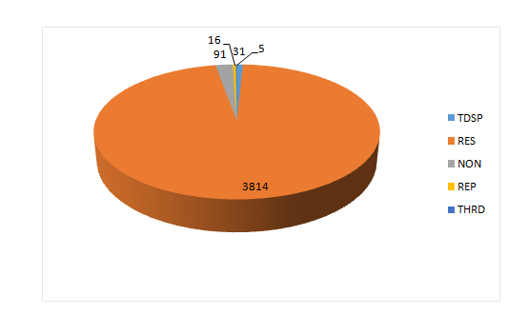
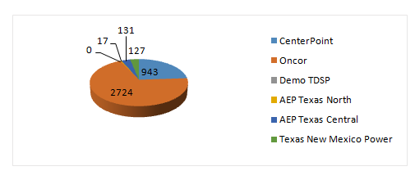
SMT ODR Details AMWG CR 2015 – JUN 2015
Total ODR Requests TDSP wise statistics:
Total ODR Requests User type statistics:
TDSP NAME | Monthly Count
CenterPoint | 943
Oncor | 2724
Demo TDSP | 0
AEP Texas North | 17
AEP Texas Central | 131
Texas New Mexico Power | 127
TDSP | 31
RES | 3814
NON | 91
REP | 16
THRD | 5

