Slide 1

Prospects for Wind Energy in ERCOT
Michael Goggin
Senior Director of Research
American Wind Energy Association
July 13, 2015

Slide 2
Overview
-Current cost and performance data for wind, and why it is important to use region-specific, real-world data for modeling assumptions
-Wind Vision projections, including future wind cost and performance, wind deployment, and benefits
-Wind energy’s value in hedging against fuel price uncertainty
-EPA’s Clean Power Plan will drive significant demand for wind energy
-Integration issues are manageable, and transmission continues to be key

Slide 3
Current wind cost and performance data
DOE/Lawrence Berkeley National Laboratory Annual Market Report data
-PPA price: $21.91/MWh average for PPAs signed in 2013 in Interior, $25.59/MWh nationally (similar in forthcoming updated data for 2014)
-Capacity factor: 2013 output for 2012 installed projects for Interior region: 38.1% (significantly higher in updated data)
-Installed costs: for 2012-13 wind projects in Interior: $1,755/kW (significantly lower in updated data)
These are averages, and many recent projects are far better:
Mammoth Plains (OK) PPA of $19/MWh and assumed 57% capacity factor
Need to use real-world market data for ERCOT for modeling assumptions
EIA’s assumption of $80/MWh for ERCOT wind is 2x reality

Slide 4
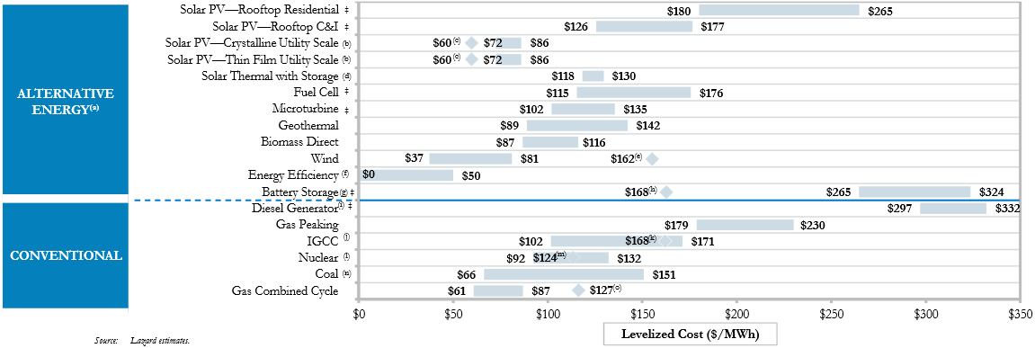
Wind costs
Year | Average Wind Purchase Price, $/MWh
2009 | $68.19
2010 | $61.08
2011 | $45.54
2012 | $38.40
2013 | $25.59
-DOE/LBNL Annual Report: 60% decline in wind purchase prices over last four years (includes incentives):
-Lazard 2014: Wind lowest cost energy source (excludes incentives)

Slide 5
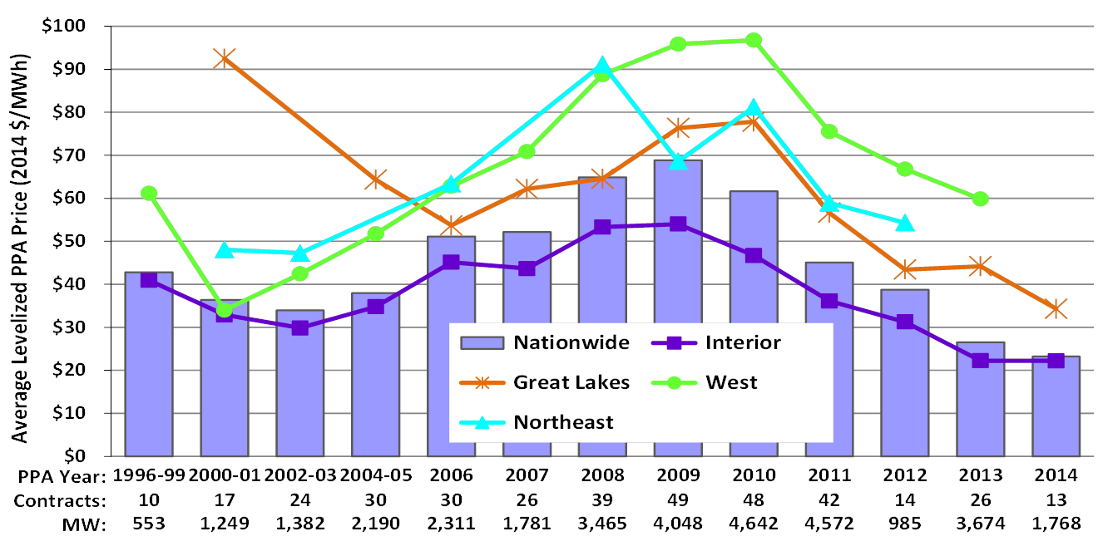
Wind PPA prices continue to fall
Source: Ryan Wiser, “A Peek Into This Year’s Draft Wind Technologies Market Report,” May 2015

Slide 6
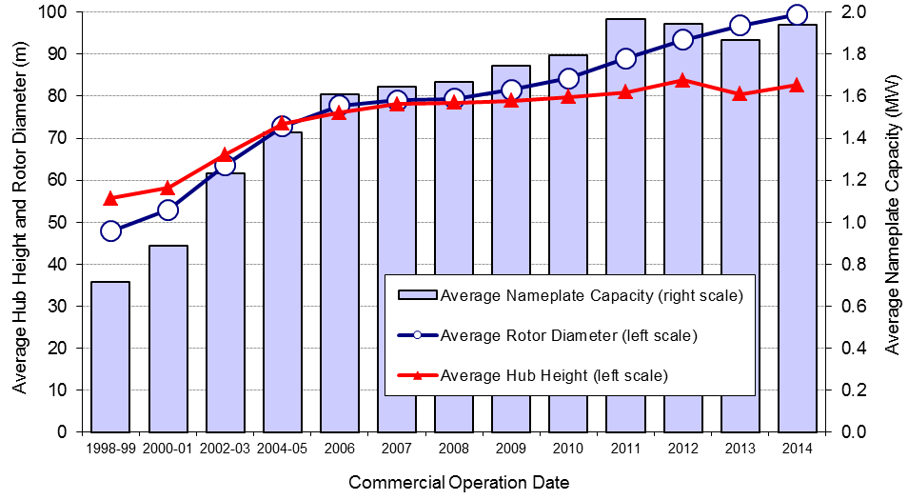
Factors driving lower costs
-Technological improvements
-Longer blades: Going from 80m to 100m diameter rotor increases swept area 56%
-Economies of scale
-Domestic manufacturing
-Supply and demand
Source: Ryan Wiser, “A Peek Into This Year’s Draft Wind Technologies Market Report,” May 2015

Slide 7
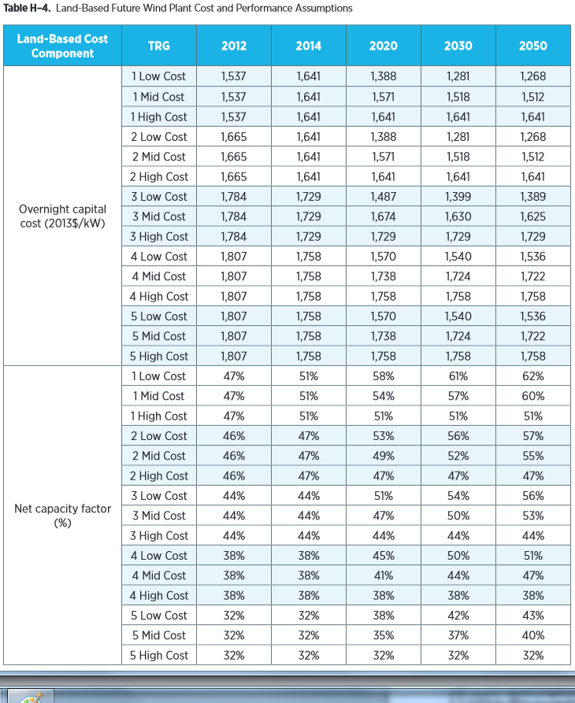
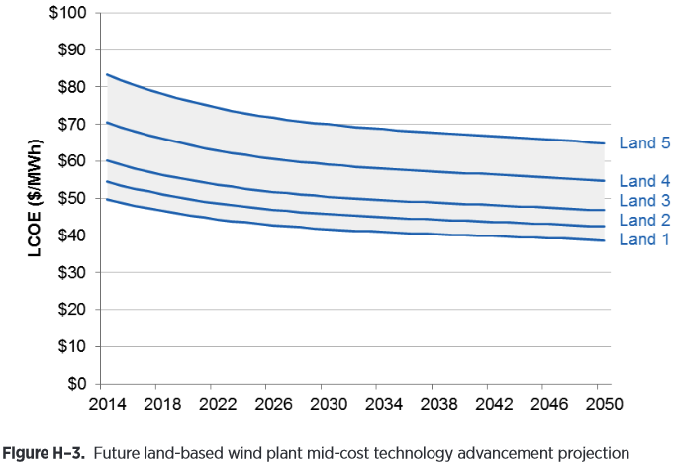
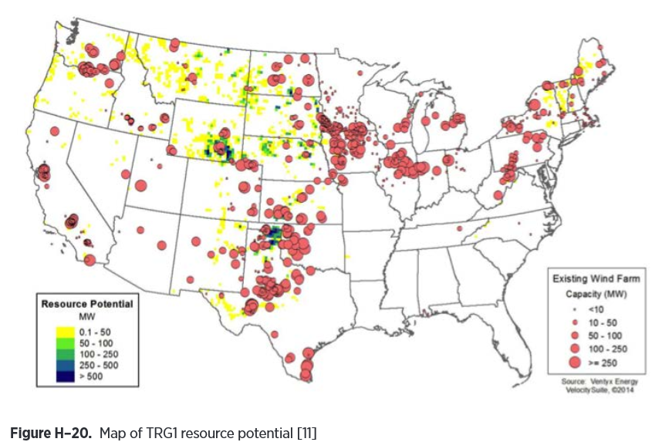
Wind Vision cost and performance projections for Tiered Resource Groups
-ERCOT has some of the only Tier 1 wind resources in U.S.; much of the rest of the state is covered by Tiers 2-3

Slide 8
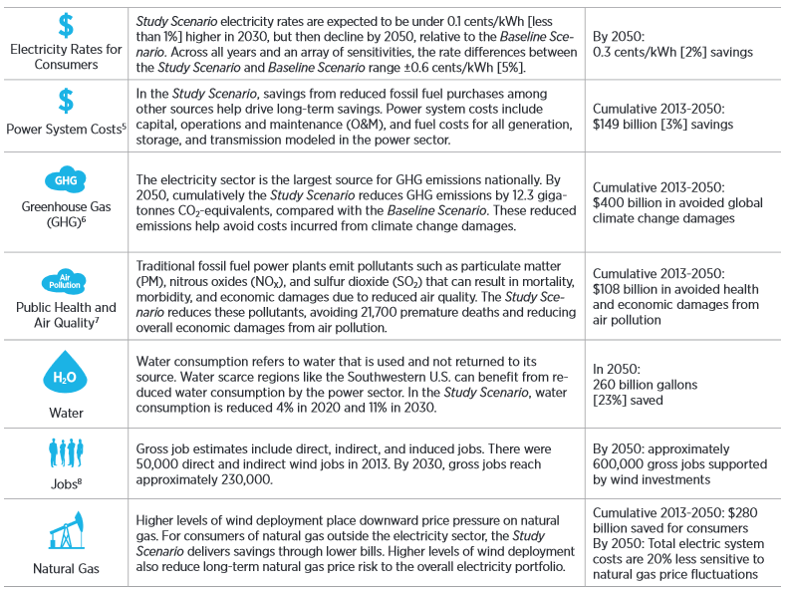
Wind Vision national impacts
Wind Vision: 10% of electricity demand from wind in 2020 and 20% in 2030

Slide 9
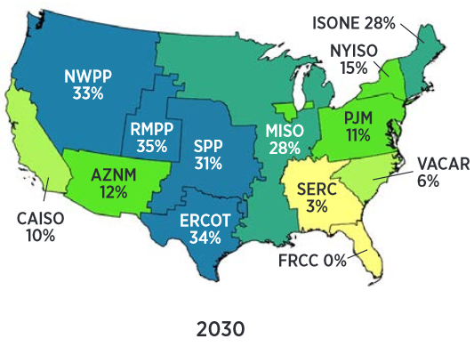
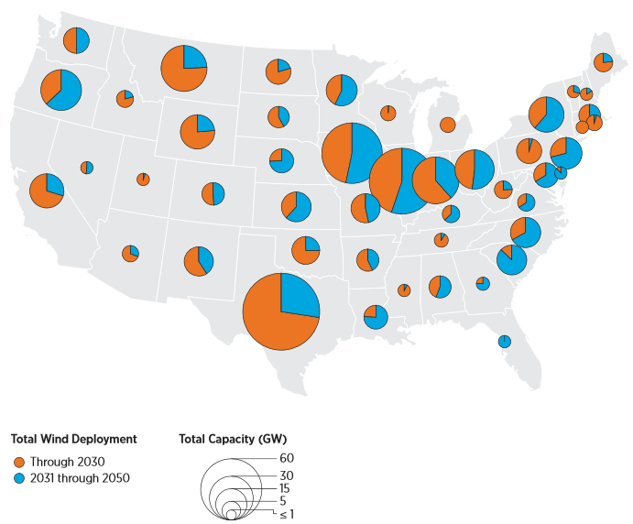
Wind Vision Texas impacts
-Texas reaches 28% wind by 2020 (111 TWh), 38% (168 TWh) by 2030
-Total emissions savings of 60 million metric tons by 2020, 81 million metric tons by 2030
-Total water savings of 54 billion gallons in 2020, 90 billion gallons in 2030

Slide 10
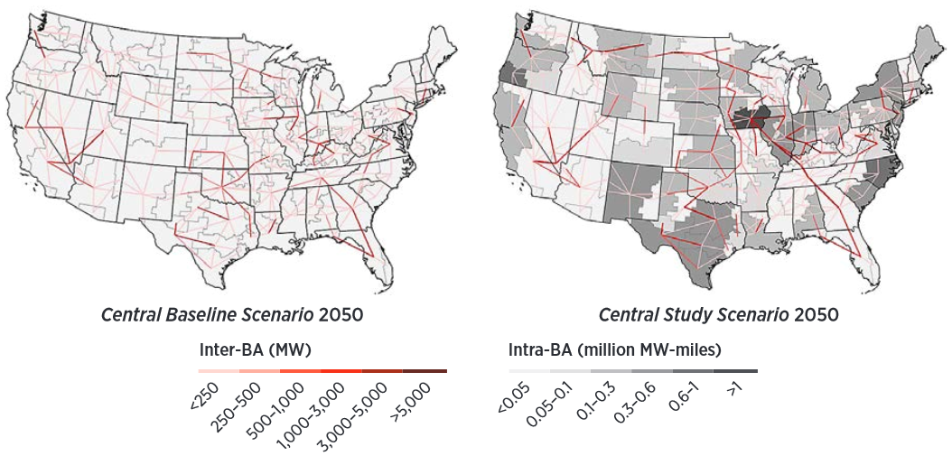
Wind Vision transmission need
National transmission need is an average of:
-350 circuit miles/year between 2014 and 2020
-890 miles/year between 2013 and 2030
-1,050 miles/year between 2031 and 2050.
For comparison, NERC reports that 21,800 circuit miles are planned with in service dates before 2023. Total incremental transmission spend for 2020-2030 roughly equals total spending on transmission last year by all EEI members.

Slide 11
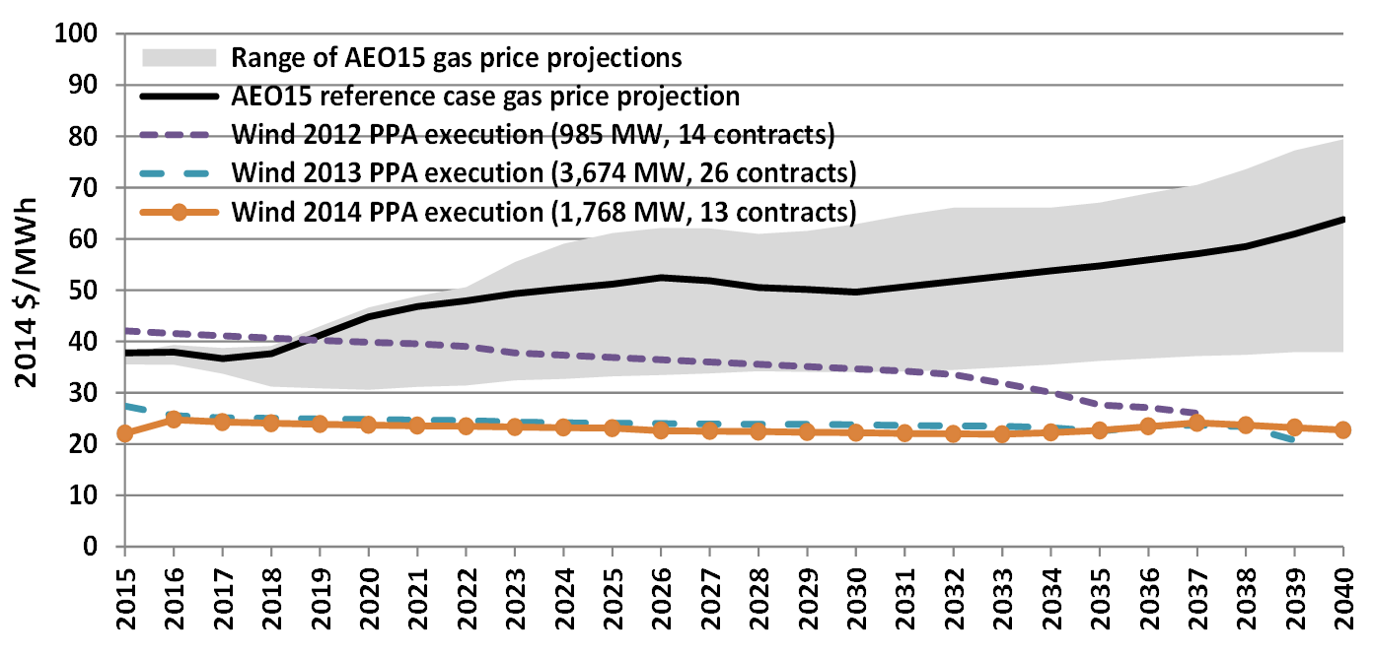
Value of stably-priced wind
LBNL: Recent wind PPAs versus EIA gas price projections
Source: Ryan Wiser, “A Peek Into This Year’s Draft Wind Technologies Market Report,” May 2015

Slide 12
Synapse: Value of wind for electricity price hedging in New England

Slide 13
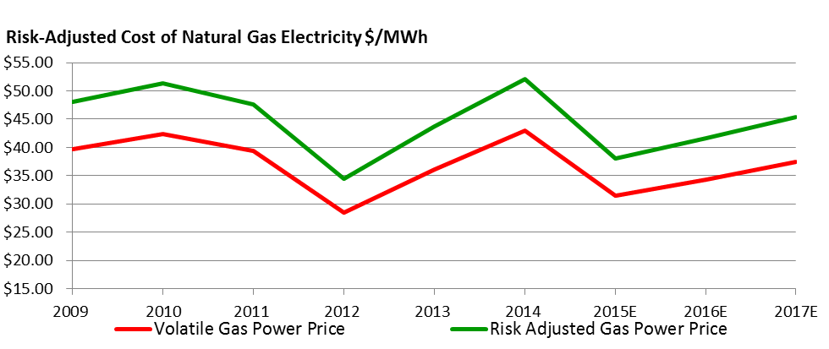
AWEA analysis based on fixed-rate mortgage premiums
Ratepayers view the value of a stably-priced resource relative to the cost of natural gas price uncertainty as equal to 21% of the fuel price, or $0.97/MMBtu, or $5-10/MWh.

Slide 14
Key takeaways from EIA’s May 2015 Clean Power Plan report
• Wind energy is the lowest-cost CPP compliance solution: Wind energy accounts for more than half of EIA’s lowest cost compliance mix, with significant wind deployment in nearly all regions. Recent declines in the cost of wind energy, coupled with wind’s valuable role in protecting against increases in the price of natural gas, make wind energy the lowest cost compliance option for nearly all regions.
• Wind provides compliance flexibility: Using zero-emission wind energy provides states with valuable flexibility that allows far less drastic changes to the power system than using a resource with some emissions. As a result, the regions that used the most wind energy saw the fewest coal plant retirements.
• Wind is a “no regrets” CPP solution: Wind energy is the most economical compliance choice across a wide range of scenarios in EIA’s analysis, indicating states, utilities, and grid operators can begin planning for significant wind additions now.

Slide 15
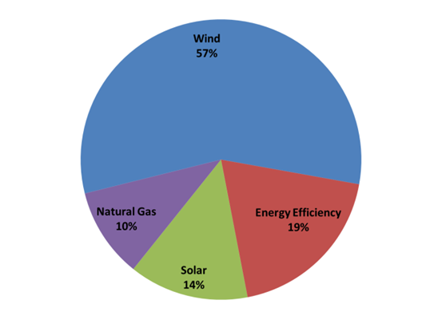
EIA: Wind accounts for more than half of lowest cost compliance mix in 2030

Slide 16
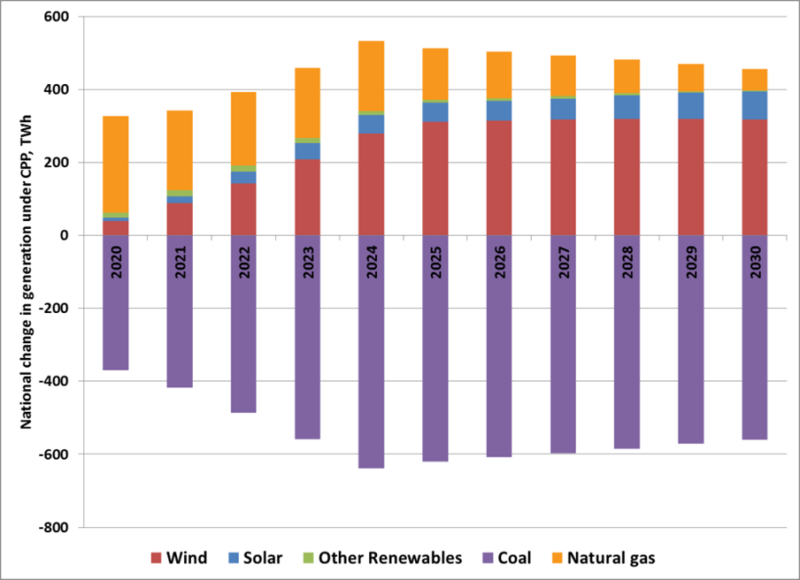
Wind generation quickly increases in the early 2020s under the CPP

Slide 17
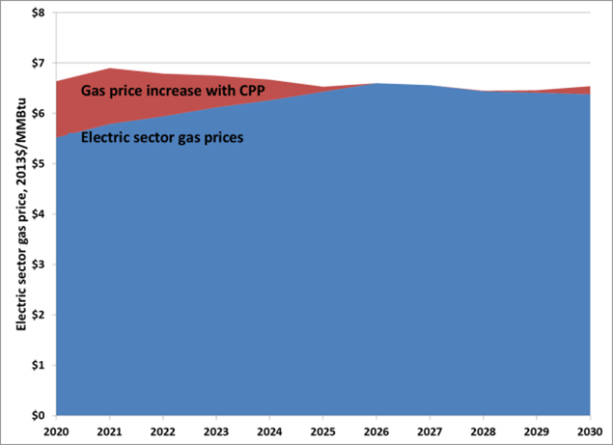
Wind energy moderates spike in gas prices from CPP demand

Slide 18
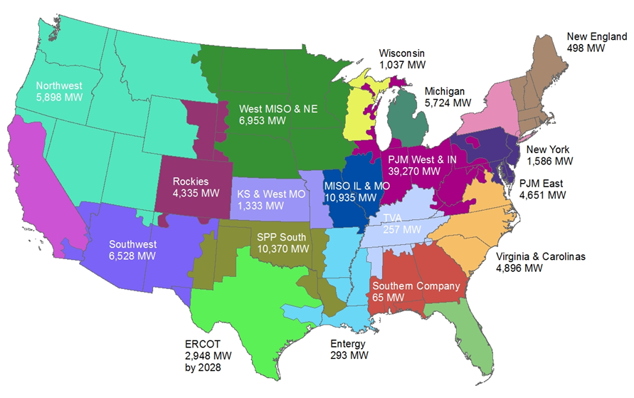
Nearly all regions see major wind deployment by 2025 under EIA’s low-cost CPP compliance
-EIA uses unusual assumptions for ERCOT. AWEA analysis sees several times more wind driven by CPP in Texas.

Slide 19
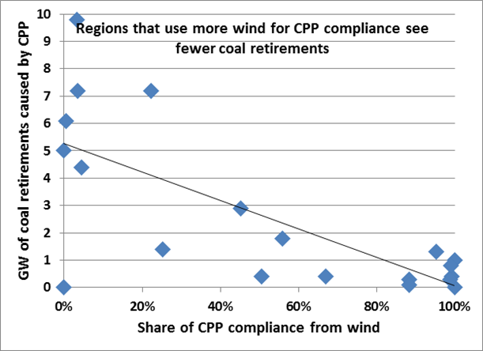
Zero-emission wind energy provides states with compliance flexibility

Slide 20
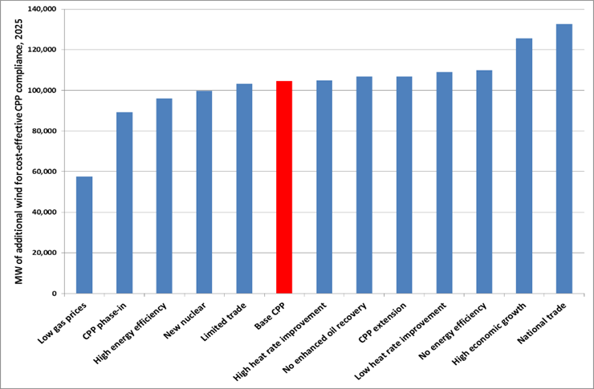
Wind is a “no regrets” compliance solution

Slide 21
EIA’s analysis may be conservative
• EIA assumes installed wind costs that are 15-20% higher than today’s costs, let alone future wind costs.
• Technological improvements such as taller towers and longer blades are making wind development increasingly cost-effective in all regions of the country.
• Flawed EIA assumptions for ERCOT on wind costs, wind capacity value, and need for new capacity led to low wind build.
-EIA assumes wind energy costs around $80/MWh in ERCOT, even though recent data indicate actual costs of around half that amount.
-EIA’s model retires 15-17 GW of coal and gas steam fired generators in ERCOT, and assumes 15 GW of load growth by 2030, both of which create a large need for capacity that may not actually materialize.
-EIA assumes wind has an abnormally low capacity value in ERCOT by assuming that Texas wind generation has an output correlation of .89, which is much higher than the assumption for virtually all other regions and ignores geographic diversity benefits of recent wind additions. Because wind’s capacity value is calculated using correlation and current level of deployment, marginal capacity value is much lower than that found by ERCOT ELCC analysis.

Slide 22
Wind integration
• Wind integration costs are low, lower than integration costs for conventional generation. Calculation
using ERCOT data:
• Some critics have falsely claimed wind PTC distorts market clearing prices. Wind almost never sets clearing price so wind’s impact on clearing price is the same with or without PTC. Wind setting clearing price due to congestion is rare localized event that has been almost entirely eliminated with transmission, typically minimal to zero impact on other generation because happens in wind-only sections of grid.
• Low marginal cost wind does reduce power prices, just like any other low marginal cost resource (coal, nuclear). During most hours impact is small because most of the supply curve is relatively flat.
Reserve need | Total annual cost (million $) | % of total reserve cost | Cost per electric bill
Conventional power plant failures | $239.690 | 67% | 76 cents
Wind | $13.740 | 4% | 4 cents
Conventional and demand deviations | $103.359 | 29% | 33 cents

Slide 23
Wind plants can now provide all essential reliability services provided by conventional generation, in some cases better than conventional generation. Choice of which resources provide these services should be based on economics.
Reliability service | Wind | Conventional generation
Ride-through | –Excellent voltage and frequency ride-through per FERC Order 661A requirements – Power electronics electrically separate wind turbine generators from grid disturbances, providing them with much greater ability to remain online through disturbances | – Many cannot match wind’s capabilities or meet Order 661A ride-through requirements
Reactive and voltage control | – Wind turbine power electronics provide reactive and voltage control equivalent to that of conventional generators – Power electronics can provide reactive power and voltage control even when the wind plant is not producing power – Because reactive needs are location- specific on grid, 661A approach of providing reactive in locations where it is needed is more efficient than blanket requirement | - Conventional generation provides this service.
Active power control | – Can provide extremely fast response in seconds, far faster than conventional generation – Like other generators, wind will provide this response when it is economic to do so - Xcel Energy sometimes uses its wind plants to provide some or all of its frequency-responsive automatic generation control | – Like wind, many baseload generators do not provide active power control for economic reasons, though they technically can

Slide 24
Frequency response | –Adding wind can help system frequency response by causing conventional generation to be dispatched down -Wind can provide frequency response, but it is typically more costly for it to do so than for other resources as it requires curtailing wind generation in advance -A market-based solution would procure frequency response from the lowest cost resources | – Changes in conventional generator operating procedures have greatly reduced frequency response – Only 70-75 percent of generators have governors that are capable of sustaining frequency response for more than one minute, and about half of conventional generators have controls that may withdraw sustained frequency response for economic reasons - NERC: “Only 30 percent of the units on-line provide primary frequency response. Two-thirds of the units that did respond exhibit withdrawal of primary frequency response.” So, “Only 10 percent of units on-line sustain primary frequency response.” - The cost of providing and sustaining frequency response is very low for a conventional generator, so a market-based solution would incentivize the needed frequency response at low cost
Inertial response | –Can provide with no lost production by using power electronics and the inertia of the wind turbine rotor; this capability is commercially available but not widely deployed because there is no payment for any resource to provide this service | - Conventional generation provides this service.
Increased operating reserves, integration cost | – Very small impact on total reserve need and integration cost | - Contingency reserve needs and costs are quite large

Slide 25
Wind integration – emerging issues
• Wind providing Automatic Generation Control. Done today on Xcel’s Colorado system, can be cost-effective during hours when wind was going to be curtailed anyway.
• If needed, market for primary frequency response can help to provide price signals so lowest cost resources provide the service.
• Short circuit ratio/weak grid limits in Panhandle can be addressed with turbine control settings, series compensation settings, grid upgrades, synchronous condensers and reactive devices.
• Transmission will continue to be key for integration, fuel diversity and consumer protection, meeting Clean Power Plan.

