Slide 1
Argus Forward Curves ERCOT – Austin Texas 22 July 2015

Slide 2
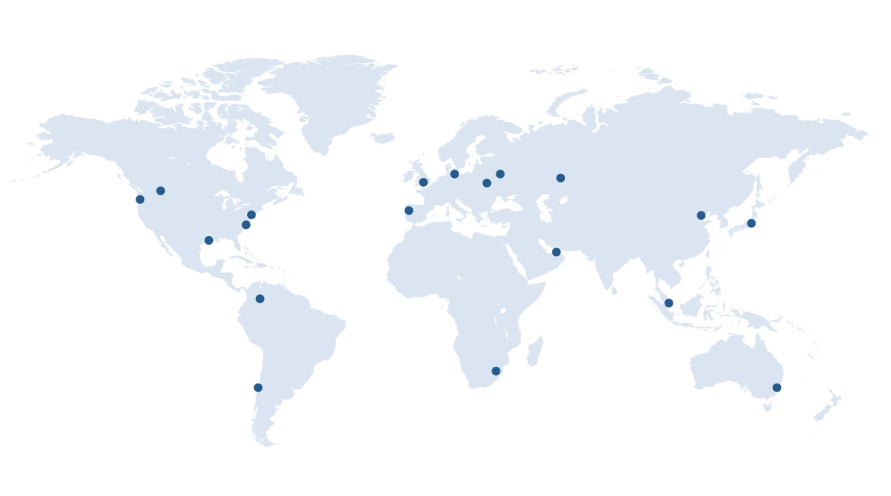
Argus Media
Argus Founded in 1970
Staff of over 700 worldwide, 20 offices globally
Cover all global energy markets and extensively used in indexation of physical and financial contracts
Crude, refined products, biofuels, natural gas, LPG, electricity, emissions, coal, fertilizer, biomass, freight, metals, petrochemicals…

Slide 3
Argus In Natural Gas and Power
Argus is the leading natural gas and power price reporting agency service in Europe
Argus launched North America natural gas and power cash market products and services in 2009
Argus cash market methodologies fully comply with FERC price-reporting requirements and enforces a strict code of ethics that prohibits staff from trading energy and stock in energy companies
Argus operates a comprehensive compliance program, backed by regular audits from a full-time compliance officer

Slide 4
What Are Forward Curves
Forward Curves are the market’s current assessment of the value of a commodity for a specified delivery schedule sometime in the future
The current Forward Curve value is the value for which supply/demand is presently balanced for a given commodity for a given delivery period at some time in the future
Forward curves are not a current prediction of future “cash” or physical market values; not to be confused with fundamental forecasts; rather they are the market’s current fair market value, given current market conditions and forward risk premiums

Slide 5
Argus Forward Curve Products - Advantages
Argus receives market data from multiple sources across the entire market
Argus is independent; does not participate in commodity markets
Monthly granularity, “no gaps”
Product tested & calibrated with market participants
Argus is independent; does not participate in commodity markets
Argus Forward Curves team works closely with Argus editorial
Monthly granularity, “no gaps”
Argus developed proprietary models and algorithms for calculating forward curves in illiquid markets
Forward curves team consists of industry professionals
What it is
Daily risk data service

Slide 6
Argus North American Forward Curves
Key Features & Advantages
Daily price assessments - end of day; Reflects market value as of 2:30 pm EST, in alignment with Nymex settlement prices
Independent and transparent market-appropriate methodology
Delivery options include: Email, API, FTP data feed and third-party delivery options
Applications
Forward Curve Validation
Mark-to-market Accounting
Credit Margining
Project Planning
Structured Transactions
Deal Valuation
Capital Expenditures
Project Finance
Scenario Analysis

Slide 7
Argus North American Forward Curves
Companies Using Argus Forward Curve Products
Independent Power Producers
Independent System Operator (ISOs)
Retail Electric & Natural Gas Providers
Proprietary Trading Companies
Electricity Coops
Government Agencies
Municipals Utilities & Investor Owned Utilities
Oil and Gas Producers
End Users; Manufacturing Companies Consultants
Wholesale and Retail Brokers

Slide 8
Argus ERCOT Forward Curves
Argus Electricity ERCOT Forward Curves – Eight Locations
Trading Hubs – North, South, Houston, West
Load Zones – North, South, Houston, West
Fixed Prices & NYMEX Heat Rates (Bid, Mid, & Offer)
84 Months Forward
On Peak, Off peak, 7x24, 2x16, 7x8
Argus Electricity ERCOT Forward Curves – Hourly Prices
4 Trading Hubs – North South, Houston, West
Prompt year plus a Minimum of 2 years forward
Balance of the Month hourly pricing
5x16, 2x16, 7x8 & 7x24 - hourly pricing

Slide 9
Fixed Price Forward Curves – Mid-Points
 | www.argusmedia.com
Close of Business: | 07/01/15 |  | FORWARD MID MARKET POWER CURVES
Market | ERCOT | ERCOT | ERCOT | ERCOT | ERCOT | ERCOT | ERCOT | ERCOT | ERCOT | ERCOT | ERCOT | ERCOT
Location/Zone: | North Zone | North Zone | North Zone | Houston Zone | Houston Zone | Houston Zone | South Zone | South Zone | South Zone | West Zone | West Zone | West Zone
On Peak/Off Peak: | On Peak | Off Peak | RTC | On Peak | Off Peak | RTC | On Peak | Off Peak | RTC | On Peak | Off Peak | RTC
Monthly Curves:
Aug-15 | 44.20 | 25.75 | 34.05 | 45.40 | 25.50 | 34.50 | 44.55 | 25.60 | 34.15 | 44.00 | 25.40 | 33.80
Sep-15 | 30.60 | 22.10 | 26.05 | 32.75 | 22.85 | 27.45 | 31.90 | 22.50 | 26.90 | 30.55 | 20.60 | 25.25
Oct-15 | 29.25 | 21.10 | 24.95 | 31.30 | 22.60 | 26.70 | 31.15 | 22.35 | 26.50 | 29.70 | 20.70 | 24.95
Nov-15 | 28.30 | 22.05 | 24.85 | 29.25 | 22.70 | 25.60 | 28.75 | 22.35 | 25.20 | 27.35 | 21.00 | 23.85
Dec-15 | 28.30 | 23.15 | 25.60 | 28.40 | 23.80 | 25.95 | 27.70 | 23.45 | 25.45 | 28.05 | 20.75 | 24.20
Jan-16 | 30.80 | 24.85 | 27.40 | 30.45 | 25.40 | 27.60 | 31.00 | 24.85 | 27.50 | 32.60 | 24.35 | 27.90
Feb-16 | 32.10 | 25.15 | 28.50 | 31.45 | 25.60 | 28.45 | 32.15 | 25.15 | 28.55 | 32.80 | 24.70 | 28.60
Mar-16 | 32.00 | 24.10 | 28.05 | 33.25 | 24.65 | 28.95 | 33.90 | 24.35 | 29.10 | 31.20 | 21.60 | 26.35
Apr-16 | 32.90 | 24.30 | 28.30 | 37.20 | 24.85 | 30.60 | 34.65 | 24.55 | 29.25 | 33.90 | 21.80 | 27.45
May-16 | 29.85 | 22.95 | 26.05 | 32.65 | 23.35 | 27.55 | 32.75 | 23.75 | 27.80 | 26.95 | 21.50 | 23.95
Jun-16 | 35.75 | 23.70 | 29.60 | 39.05 | 24.20 | 31.50 | 37.30 | 23.75 | 30.40 | 33.35 | 23.20 | 28.20
Jul-16 | 40.75 | 25.55 | 32.10 | 41.80 | 26.15 | 32.90 | 41.20 | 25.65 | 32.35 | 41.70 | 26.05 | 32.80
Aug-16 | 52.65 | 27.35 | 39.85 | 54.05 | 28.00 | 40.90 | 53.20 | 27.45 | 40.20 | 53.70 | 27.95 | 40.70
Sep-16 | 32.75 | 24.20 | 28.20 | 37.15 | 24.75 | 30.55 | 34.35 | 24.25 | 28.95 | 32.35 | 23.70 | 27.75
Oct-16 | 30.40 | 22.65 | 26.15 | 32.10 | 23.65 | 27.45 | 33.40 | 23.75 | 28.10 | 32.10 | 22.30 | 26.70
Nov-16 | 31.05 | 23.35 | 26.95 | 30.45 | 24.05 | 27.05 | 31.45 | 24.35 | 27.65 | 30.30 | 22.80 | 26.30
Dec-16 | 30.95 | 24.80 | 27.60 | 30.80 | 25.05 | 27.65 | 31.70 | 25.40 | 28.25 | 30.60 | 22.60 | 26.20

Slide 10
ERCOT Hourly Forward Curves – West Trading Hub Weekdays, On-Peak, 5X16
 | ERCOT West Zone Trade Hub |  |  | www.argusmedia.com
 |  |  |  | Close of Business: |  | 7/1/2015
 | Hour Ending: | 7 | 8 | 9 | 10 | 11 | 12 | 13 | 14 | 15 | 16 | 17 | 18 | 19 | 20 | 21 | 22 | 23 | 24 |  | Block
WEEKDAYS - ON PEAK (5x16)
Jul-15 | (Bal Mo) | 20.70 | 22.00 | 23.25 | 25.15 | 27.25 | 29.15 | 33.05 | 37.10 | 43.75 | 54.35 | 59.50 | 44.75 | 40.85 | 35.45 | 31.10 | 29.40 |  |  |  | 34.80
Aug-15 |  | 22.25 | 22.55 | 23.55 | 25.55 | 28.50 | 32.90 | 37.05 | 43.25 | 58.15 | 92.45 | 114.65 | 60.90 | 40.70 | 35.90 | 34.20 | 30.95 |  |  |  | 43.95
Sep-15 |  | 15.75 | 15.55 | 16.10 | 16.75 | 17.35 | 28.95 | 31.45 | 35.15 | 40.30 | 51.00 | 57.20 | 39.85 | 33.80 | 31.85 | 30.40 | 27.30 |  |  |  | 30.55
Oct-15 |  | 22.85 | 22.85 | 22.50 | 23.20 | 23.55 | 25.60 | 27.00 | 29.70 | 35.10 | 44.90 | 49.85 | 36.75 | 30.75 | 30.45 | 26.65 | 23.80 |  |  |  | 29.70
Nov-15 |  | 39.85 | 34.30 | 27.45 | 25.90 | 24.90 | 23.45 | 22.90 | 22.45 | 22.55 | 22.60 | 23.85 | 35.05 | 34.90 | 28.85 | 25.50 | 22.85 |  |  |  | 27.35
Dec-15 |  | 34.95 | 31.35 | 28.50 | 27.20 | 26.85 | 25.50 | 24.40 | 23.75 | 23.25 | 22.90 | 23.35 | 36.10 | 37.20 | 30.05 | 27.35 | 26.00 |  |  |  | 28.05
Jan-16 |  | 51.00 | 43.60 | 33.90 | 31.55 | 30.05 | 28.00 | 26.95 | 26.05 | 25.50 | 25.30 | 26.20 | 34.25 | 42.50 | 34.60 | 31.75 | 28.85 |  |  |  | 32.50
Feb-16 |  | 56.60 | 44.90 | 34.25 | 32.25 | 30.60 | 27.90 | 26.15 | 25.30 | 24.50 | 24.20 | 24.95 | 29.60 | 45.50 | 37.75 | 32.20 | 27.95 |  |  |  | 32.80
Mar-16 |  | 40.95 | 38.20 | 30.60 | 28.90 | 28.35 | 27.15 | 26.25 | 26.40 | 27.40 | 27.75 | 29.15 | 29.85 | 36.10 | 41.30 | 33.75 | 26.25 |  |  |  | 31.15
Apr-16 |  | 27.60 | 26.95 | 26.55 | 27.60 | 29.00 | 29.80 | 30.90 | 33.85 | 38.15 | 45.95 | 51.40 | 42.55 | 35.00 | 32.00 | 35.55 | 29.00 |  |  |  | 33.85
May-16 |  | 20.20 | 20.40 | 20.85 | 21.85 | 22.70 | 24.25 | 25.35 | 27.75 | 31.60 | 38.05 | 42.50 | 33.55 | 27.45 | 25.00 | 25.95 | 23.25 |  |  |  | 26.90
Jun-16 |  | 20.70 | 21.40 | 22.55 | 23.80 | 25.45 | 27.00 | 29.80 | 33.70 | 42.20 | 56.70 | 62.75 | 47.50 | 34.05 | 30.15 | 28.40 | 26.90 |  |  |  | 33.30
Jul-16 |  | 25.40 | 26.40 | 27.95 | 29.65 | 31.75 | 37.10 | 40.90 | 46.10 | 52.35 | 64.20 | 72.40 | 54.45 | 45.10 | 39.30 | 37.70 | 35.60 |  |  |  | 41.65

Slide 11
Argus Forward Curve Methodologies
http://www.argusmedia.com/Methodology-and-Reference

Slide 12
ARGUS Risk Management Forward Curves Houston, TX Date: July 22, 2015 Jay Pruett Business Development Risk Management Products Jay.Pruett@Argusmedia.com 713-429-6351
Illuminating the markets

