Slide 1

2016 Model Data Assumptions
Doug Murray
ERCOT
Sr. Planning Analyst
LTSA Scenario Development Workshop
July 14, 2015

Slide 2
Outline
Capital Cost Projections
Fuel Price Projections
Emission Price Projections
Retirement Assumptions

Slide 3
Capital Cost Assumptions ($/kW)
Thermal plant costs increase at 2.4% annually (2015 EIA AEO)

Slide 4
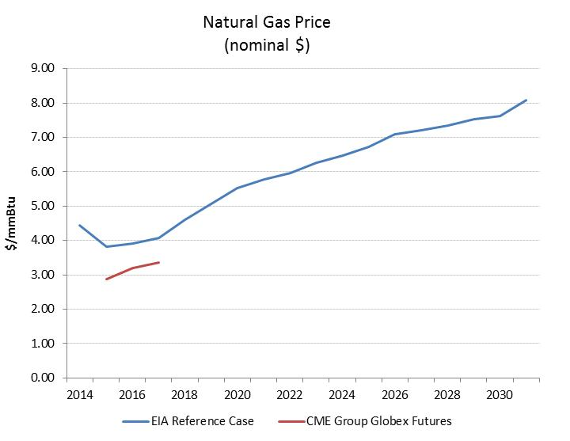
Natural Gas Price Assumptions
2015 EIA AEO reference price assumptions

Slide 5
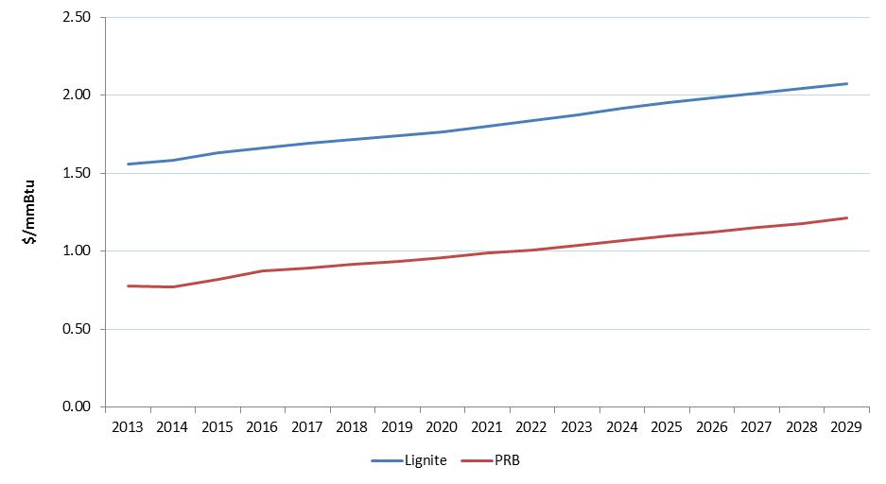
Coal Price Assumptions

Slide 6
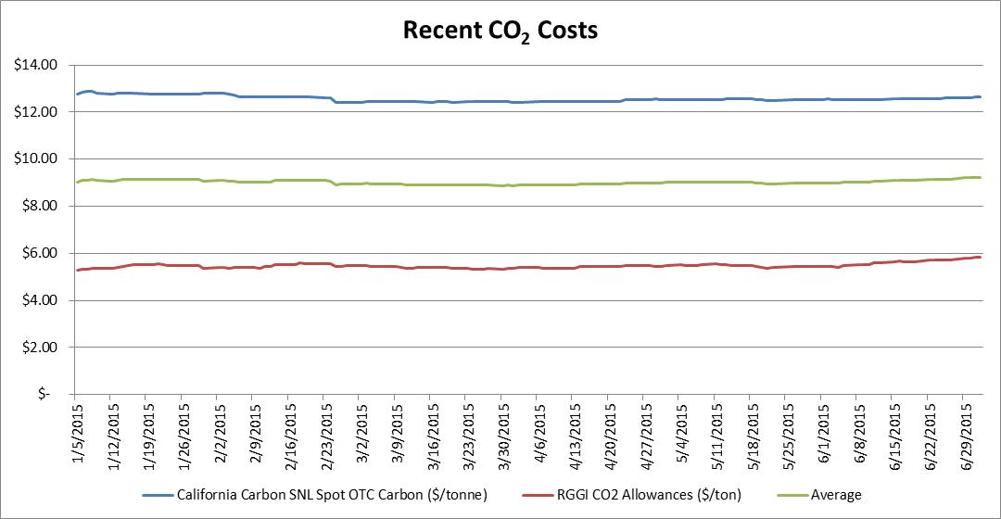
Emission Price Assumptions
CO2 Costs ($/ton)
  Will increase costs at……?

Slide 7
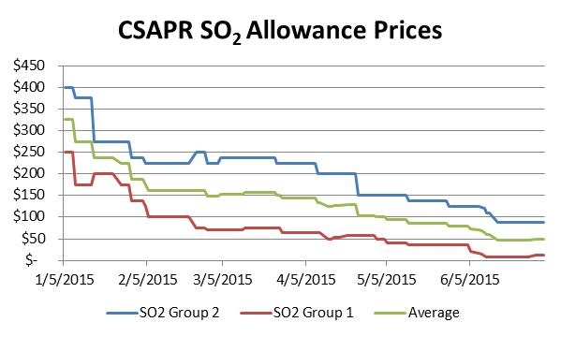
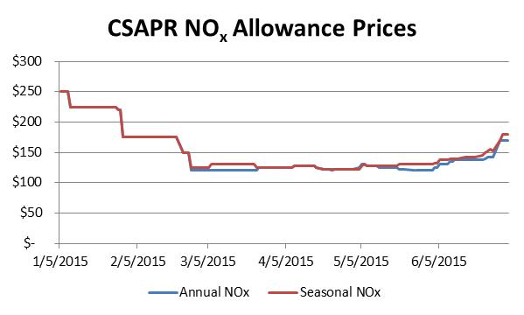
Emission Price Assumptions
Current CSAPR Prices ($/ton)

Slide 8
Retirement Process – Fixed by Age
    Nuclear – 60 years
    Coal – 55 years
    All gas units – 50 years
    Wind – 25 years
  Are these appropriate ages to consider plants for retirement?

Slide 9
Retirement Process - Economic
Age, efficiency, profit margins are considered
Each category was broken into different groups and each group was given a value from 1-6 depending on number of groups
  Age: <10 yrs (1), 10-20 yrs (2), 20-30 yrs (3), 30-40 yrs (4), >40 yrs (5)
  Efficiency: <6 MMBtu (1), 6-7.5 MMBtu (2), 7.5-9 MMBtu (3), 9-10.5 MMBtu (4), 10.5-12 MMBtu (5), >12 MMBtu (6)
  Profit margins: >25% (1), 10-25% (2), 0-10% (3), -10-0% (4), -10- (-25)% (5), <-25% (6)
UPLAN results will be used to determine profit margin values
Each unit was given a total score (sum of values for each category)
  ∑ = A (Wa) + E (We) + P (Wp)
  Retirement decision: if the unit’s total score was higher than 1 standard deviation above the mean of the sum of all units scores

Slide 10

Questions

