Slide 1

Efficiency’s Impact on Long Term Demand
Doug Lewin,
Executive Director
July 14, 2015

Slide 2
Key Points
GDP and electric demand have decoupled.
Reasons:
  Structural changes (e.g., manufacturing moving overseas)
  Efficiency (e.g., building energy codes, appliance standards, utility programs, etc.)
Energy intensity will continue to decrease and electric demand will grow at smaller amounts.
Clean Power Plan could accelerate trends.
Notes:
Efficiency has bigger impact than structural changes.

Slide 3
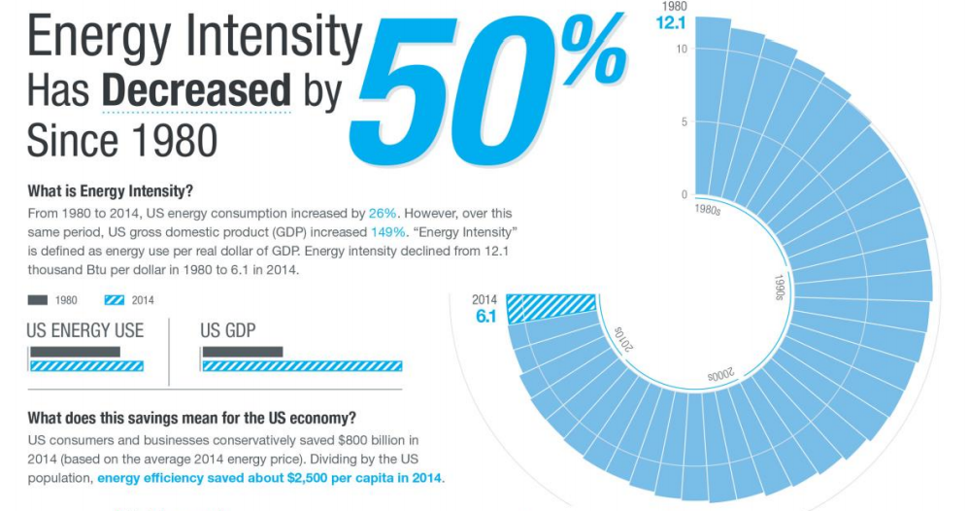
Efficiency’s Impact on Demand
Source: ACEEE

Slide 4
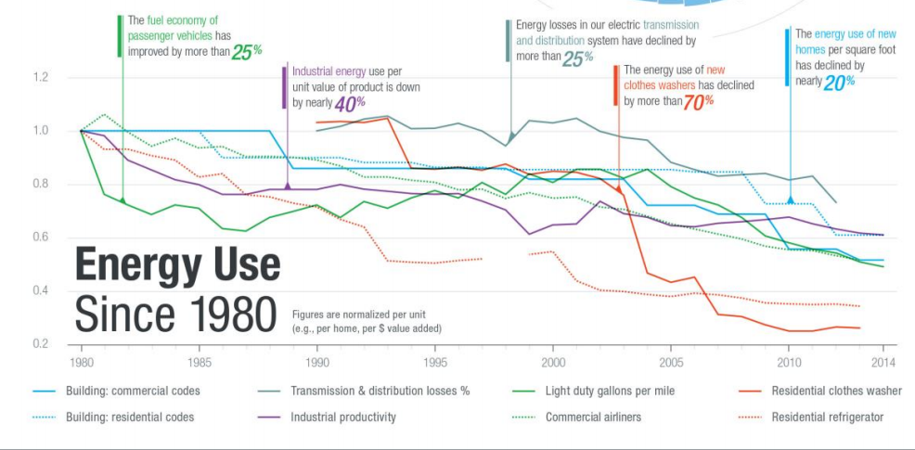
Source: ACEEE

Slide 5
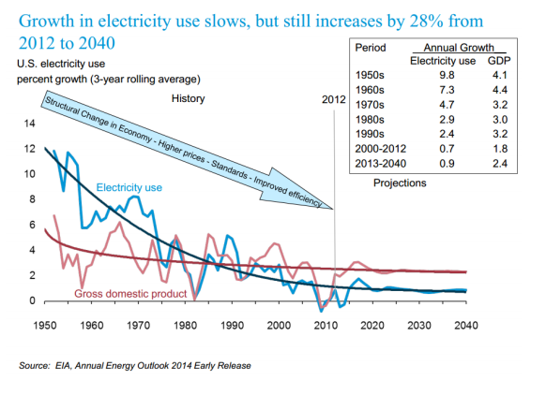
Decoupling GDP from Electric Demand

Slide 6
Factors to Consider
Clean Power Plan suggest increase from .19% of retail sales from EE to 1.5% by 2030.
  Without EE, costs of compliance higher, and more coal plants closed.
  How much of EE goal can we meet with competitive markets or other efforts currently underway?
Building Energy Codes cause buildings to use far less than existing buildings.
Appliance standards and new technologies drive massive change (e.g., refrigerators, HVAC, lighting, plug loads, etc.)

Slide 7
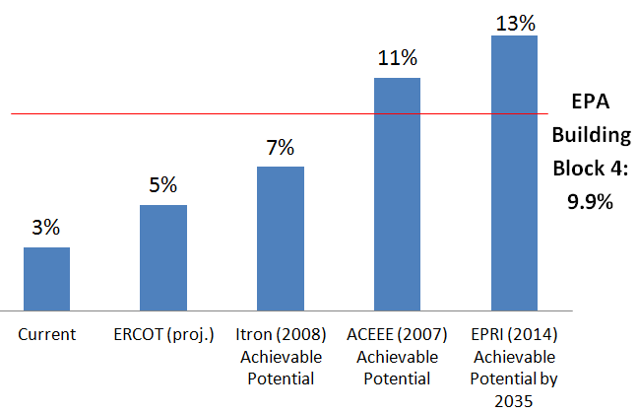
Texas’ Potential
Note: EPA’s 10% is over 15 years, while Itron’s 7% is over 10 years and EPRI’s is 13% over 20 years.
Notes:
The last potential study done by the PUCT (in 2008) showed achievable potential of nearly 7%, and that was for the programs as they existed in 2007, and was for only 10 years. Programs now are far larger and more sophisticated, and many technologies have come a long way since then (e.g. LED lighting).
Similarly, a more recent study (2012) for Austin Energy showed achievable potential of 9.8%, almost exactly the same number suggested by EPA. Austin Energy, however, spends 5x per capita what the rest of the state does and the 9.8% was incremental to Austin’s existing programs, suggesting the far smaller state programs would have significantly more achievable potential. An ACEEE study produced in 2007 showed 11% achievable potential statewide.
The definition of achievable includes economic potential -- in a way that returns economic benefits to all customers.
What gets us there: Lighting, HVAC, refrigeration, plug loads

Slide 8
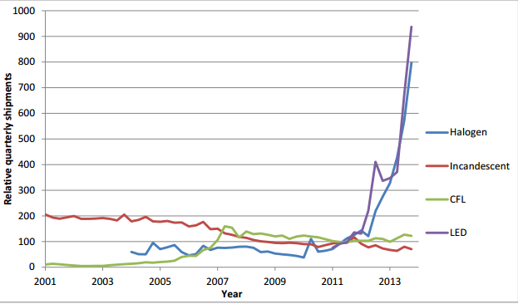
Lighting
Massive increase in shipments for high efficiency lights.
LEDs use 80-90% less than incan-descents.
Source: Lawrence Berkeley Lab

Slide 9
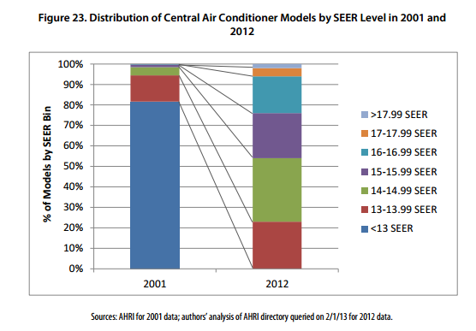
HVAC
Pre-2002, 80% of ACs were <13.
By 2012, 80% were >13.
This year, min. became 14.
Each increase in SEER correlates to 5-10% less energy usage from AC
Source: Appliance-standards.org

Slide 10
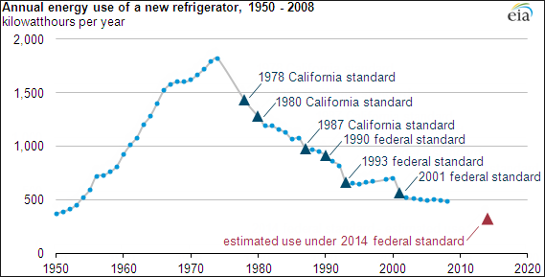
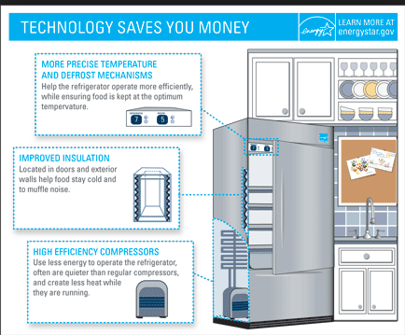
Refrigerators
70% reduction since 70’s. Next standard = additional 40% reduction from current levels.

Slide 11
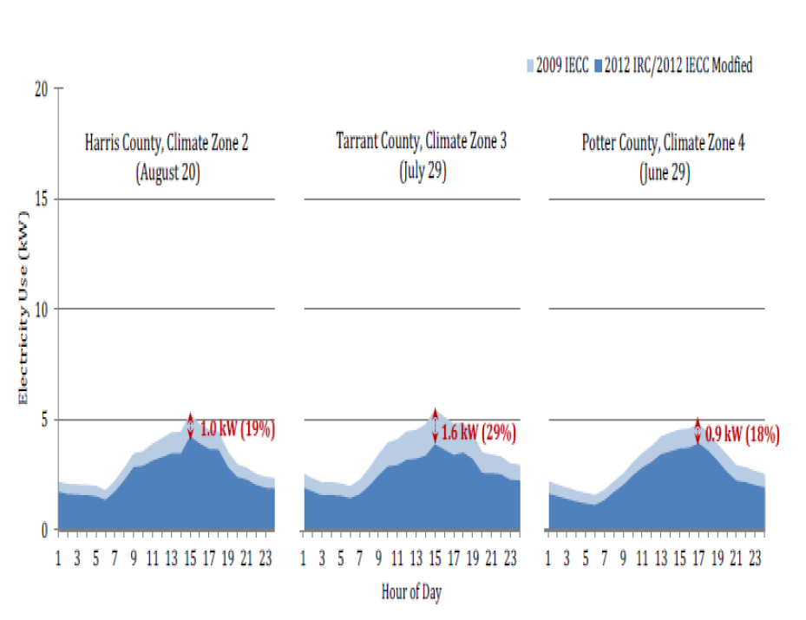
Building Energy Codes
15% savings overall, 18-29% at peak
In effect in half of largest cities.
Statewide adoption of similar code effective Sept. 1, 2016
Source: Texas A&M Energy Systems Laboratory

Slide 12
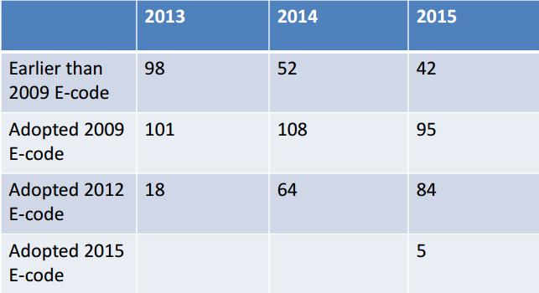
Building Energy Codes
Just 2 years ago, nearly half of largest 200 cities had not adopted 2009 E-Code.
Now more than 80% and nearly half are above 2009.
Source: Survey of cities done by SPEER.

Slide 13

Other big trends to consider
Integrated Efficiency: Combination of EE, DR, DG, and Storage
Deeper retrofits: beyond quick payback
Net zero homes and buildings

Slide 14
More big trends to consider
Internet of Things: connected thermostats, appliances
  Full smart meter deployment in competitive areas
Resiliency: EE and DG/CHP as way to weather storms
Deeper retrofits: beyond quick payback
Increasing sophistication of EE financing and involvement of capital markets
  PACE and WHEEL
  Increasing use of equipment leasing for efficiency use of EE and DG

Slide 15
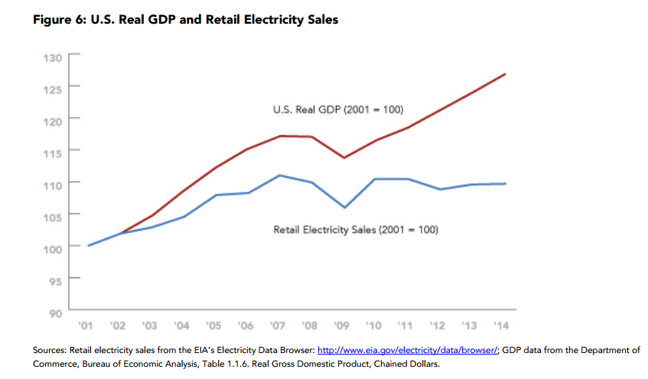
In Conclusion: Trend is Accelerating
Decoupling trend is even more pronounced since last two recessions.
Note the disconnect of last four years. This decoupling appears to be accelerating.
Begs a question: why do we assume positive load growth?
Notes:
Building Energy Codes: Currently 30% more efficient than 2006 in half of largest Texas cities.
Appliance Standards: Driving changes in lighting, HVAC, refrigeration, plug loads, and more.
Competitive Retail Energy Services: thermostats
Clean Power Plan
Financing programs
ESCOs
Industrial EE

Slide 16
Conclusions
GDP and electric seem to be completely decoupled.
Efficiency is a major, if often overlooked, force.
Codes, standards, and programs have major impact.
Accurate accounting of energy efficiency is essential part of planning.
ERCOT has expertise to do this well.
It’s hard to see the absence of something, but negawatts can and should be counted similarly to megawatts.
Notes:
Ercot has expertise to do this kind of forecasting and modeling and do it well

Slide 17
Thank you.
Contact info:
Doug Lewin
512-279-0753
Dlewin@EEPartnership.org
www.eepartnership.org

