Slide 1
Long-Term Load Forecasting
Calvin Opheim
ERCOT
Manager, Forecasting & Analysis
LTSA Scenario Development Workshop
July 14, 2015

Slide 2
Outline of Today’s Presentation
Forecasting Framework
Model Data Input
LTSA Load Forecasting Scenarios

Slide 3
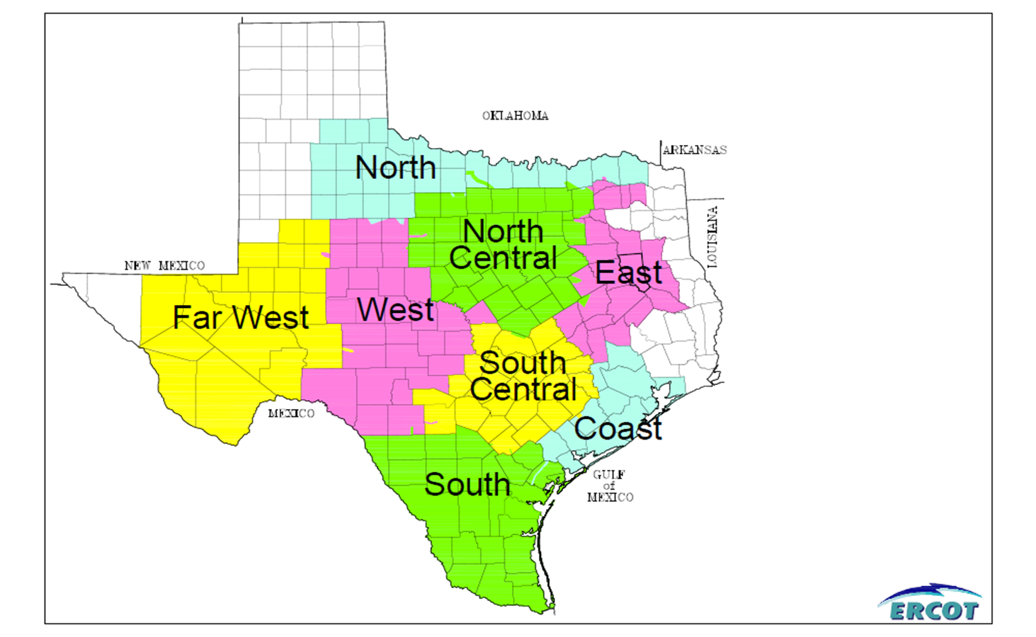
Weather Zones

Slide 4
Forecasting Framework
Premise Models
Forecasted premise counts are used as the driver of future demand/energy growth
Daily Energy Models
Hourly Models
Allocate daily energy forecast into a hourly forecast
Ensemble Approach
Developing a suite of forecast methods for further study

Slide 5
Model Data Input
Load Values
ERCOT uses hourly load values
Result is an 8,760 hour load forecast for each year

Slide 6
Model Data Input
Weather Data
Cooling Degree Days
Heating Degree Days
Calculated for the entire day, part of a day (like morning, afternoon, evening, and night)
May also include values from a previous day(s)
Two or three weather stations located in each weather zone

Slide 7
Model Data Input
Calendar
Month
Season
Day of the week
Holidays
Daylight minutes

Slide 8
Model Data Input
Monthly Economic Measures
Non-farm employment
Population
Housing stock
Households
Other measures (GDP, GSP, etc)
Data Availability
County level
Counties are mapped into a weather zone
Growth Driver in Demand and Energy Models

Slide 9
Model Data Input
Monthly Premise Count by Customer Class
Instead of using economic measures, use the actual number of premises for each customer class
Customer class is determined by the load profile assignment
Three classes
Residential (includes lighting)
Commercial
Industrial
Requires a Premise Forecast
Requires Average Use per Premise per Customer Class

Slide 10
Model Data Input – Premise forecast
Monthly Economic Measures
Non-farm employment
Population
Housing stock
Households
Other measures (GDP, GSP, etc)
Premise Forecast
ERCOT also uses the monthly economic data to forecast the number of premises within a customer class

Slide 11
Model Data Input
The number of premises is used as an input in the Demand and Energy forecast model(s)
The average use per premise is also included as input
Both of the above are combined into a weighted premise index variable which is used in the Demand and Energy forecast model(s)

Slide 12
LTSA - Load Forecast Scenarios

Slide 13
Scenarios
Created by post forecast adjustments
ERCOT’s official Long-Term Load Forecast output is adjusted outside of the model to reflect the load as defined by the scenario
Base scenario is referred to as Current Trends
Current Trends scenario would include the following adjustments to ERCOT’s official Long-Term Load Forecast
Increased load in the Coast weather zone for LNG of ~ 700 MW
Adjustments for Energy Efficiency and Demand Response
Possible load reduction in North Central weather zone

Slide 14
Scenarios
Variables available in scenario development
Premise growth rate
Economic variables growth rate (Economic vendor developed scenarios)
Energy Efficiency, Demand Response, Price Responsive Load MW
Roof-top PV MW
LNG or other large industrial MW
etc ..
Goal is to capture a wide range of possible future load levels

Slide 15
Questions

