Slide 1

Establishing Accurate Power Generation Cost Assumptions for ERCOT Planning
Colin Meehan – Director, Regulatory and Public Affairs

Slide 2
Understanding the Potential for Rapid Growth of New Technologies is Important
ERCOT has experienced this with both natural gas and wind energy
  Natural gas grew an average of 3,679 MW per year from 1999-2004
  Wind capacity has grown grew an average of 1,400 MW since 2006 and is expected to add 5,500 MW of new capacity by 2017
The LTSA guides the six-year planning process by:
  Providing a long-term view of system reliability needs
  Identify system needs that will take longer than six years to resolve.
Solar development, particularly in west Texas present an opportunity to provide low-cost electricity to larger load zones during peak hours.
  Understanding the timing of development will be critical to the six-year planning process
Source: EIA Electric Power Annual

Slide 3
Capital Cost Assumptions Substantially Impact Modeling Outcomes
Mature Technologies
Innovative Technologies
Conventional modeling uses historical cost data to develop capital cost assumptions
  EIA
  ICF
  Brattle
This approach works well with mature generation technologies (boilers, turbines, etc.)
  Can be updated to reflect incremental technology improvements in cooling technology, conversion efficiency, etc.
Prior to 2006 no innovative technologies achieved meaningful market penetration
Accurately modeling capital costs of new generation technologies is critical to a forward looking forecast
Innovative (as opposed to incremental) technologies experience a rapid cost decline in early stages
  Using historical costs in this situation leads to poor future planning value
PV cost reductions are still driven by both panel efficiency improvements and BOC improvements

Slide 4
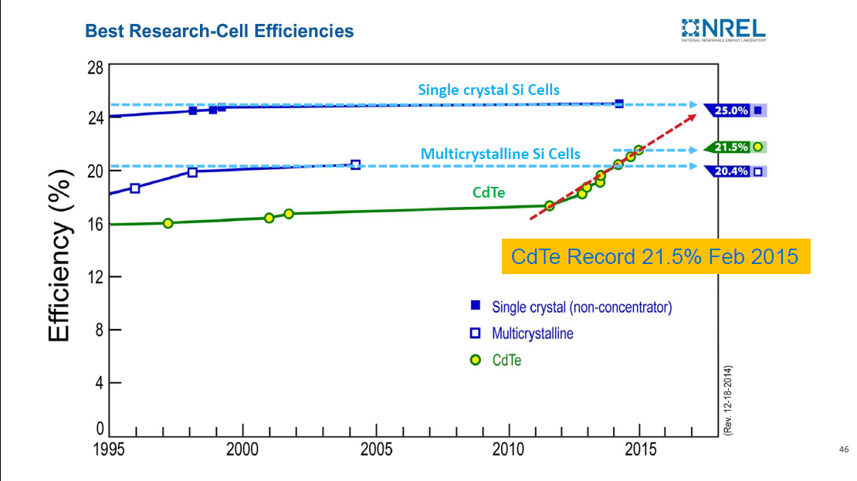
Solar Module Efficiency Continues to Drive Cost Reductions
Source: NREL Best Research-Cell Efficiencies
Notes:
Si has a physical theoretical efficiency limit at ~25%, CdTe at ~30-35%

Slide 5
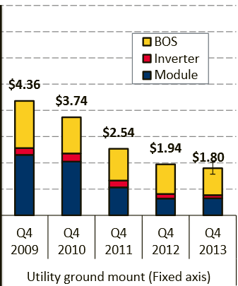
Balance of System Cost Reductions Lead to Continued Reductions
In 2008 67% of a project’s total cost was in the PV Module, in 2012 68% of total cost resides in BOS
BoS is expected to yield further cost reductions over the next several years
“By 2017, we'll be under $1.00 per watt fully installed on a tracker in the western United States.” – Jim Hughes, CEO of First Solar
Source: NREL : “Photovoltaic System Pricing Trends, 2014 Edition”

Slide 6
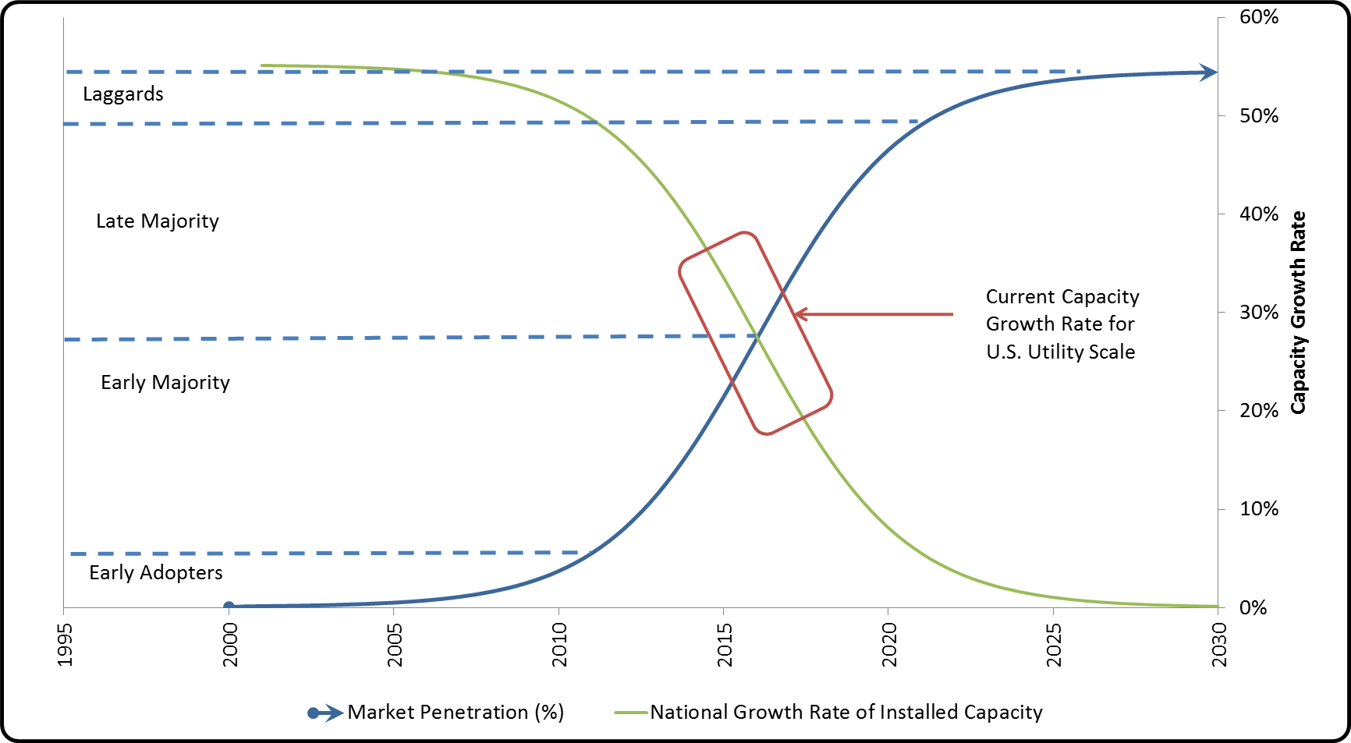
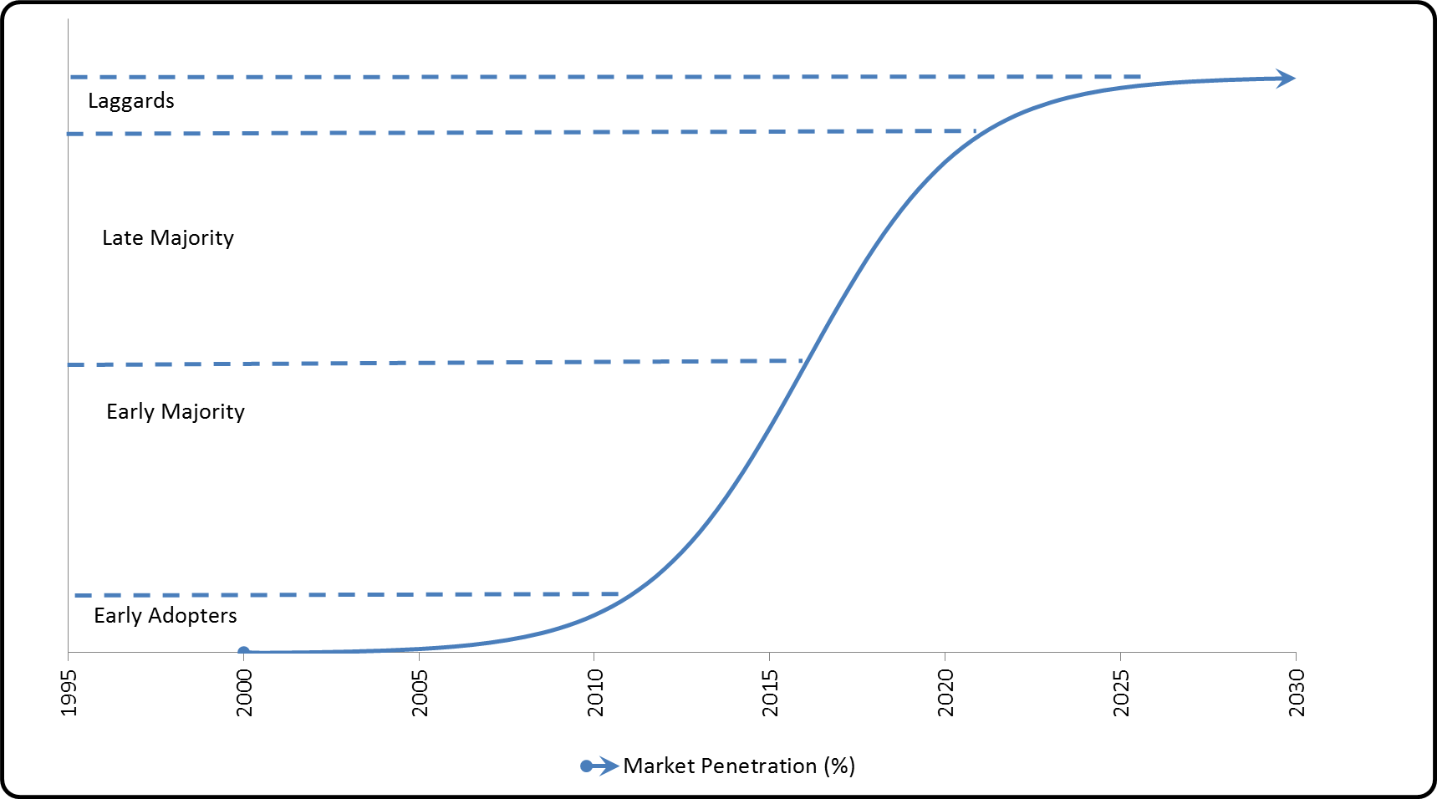
Using Technology Lifecycle Analysis to Understand Cost Expectations
ILLUSTRATIVE: NOT AN ACTUAL FORECAST

Slide 7
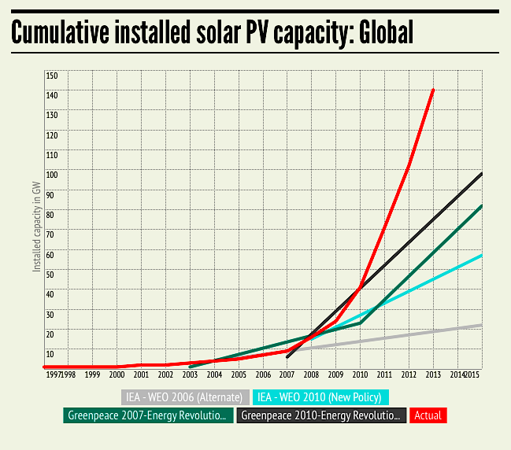
Most Accurate PV Growth Projections Come from a Surprising Source

Slide 8
Rate of Change may be Linear but Actual Change Should be Polynomial
Sources: ERCOT 2014 LTSA, SEIA/GTM Research U.S. Solar Market Insight 2014 Year in Review

Slide 9

Large Scale Solar Power Plants Provide Valuable Grid-Support Services
  Critical for Managing Grid Reliability & Stability
Regulates power factor and plant voltage/VAR controls Reactive Power Capability
Curtails active power when necessary Active Power Regulation
Limits the ramp rate from variations in irradiance Ramp Rate Control
Prevents faults and other disturbances Ride Through Capability
Monitors, tracks, and reacts to changes in grid frequency Frequency Droop Control
Notes:
This is reiteration of the features that make a PV plant grid friendly.

Slide 10
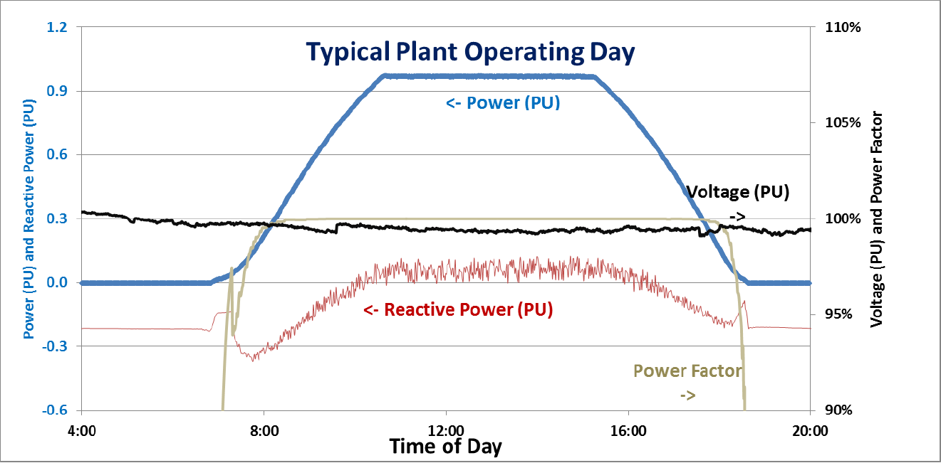
Example of Reactive Power Support

Slide 11
Recommendations
Grid management capabilities of utility-scale PV should be reflected in assumption to the extent those capabilities are modeled
Model assumptions should reflect current state of technology based on up to date information
Recognize that different technologies are at different points in their lifecycle
  Expected costs over time should reflect this fact
Hardwired growth-rate “governors” reduce our ability to understand and plan for future conditions
  Should be removed or expanded to reflect past experience (i.e. 3,000-5,000 MW per year technology expansion in ERCOT)

Slide 12
TAKING ENERGY FORWARD
partnering with you to uncover solutions to your energy needs.
Colin Meehan
Director, Regulatory and Public Affairs
Colin.meehan@firstsolar.com

