Slide 1
COMMUNICATIONS AND SETTLEMENTS WORKING GROUP (CSWG)
July 2015 Update to COPS

Slide 2
COPMPGRR039 – CSWG in consensus to recommend approval as submitted
Removes old invoices in the Commercial Operations Guide to align with the single daily invoice which has been in effect for years.
CSWG will verify that the Settlement Calendar also reflects these changes
http://www.ercot.com/content/wcm/key_documents_lists/56537/039COPMGRR_01_Commercial_Operations_Market_Guide_Clean_up_of_Old_Invoices_052715.doc

Slide 3
Distributed Generation Threshold
Market Notice drafted by ERCOT, endorsed by CSWG, and presented to TAC by COPS
Posted to COPS and CSWG meeting pages
DER Workshop did not impact communication plan
An NPRR to be submitted by ERCOT to remove trigger language
DG web page redesign is on hold pending DER Task Force organization and discussion
http://www.ercot.com/content/wcm/key_documents_lists/62341/Draft_DG_Registration_Threshold_Market_Notice.docx

Slide 4
ERCOT reporting Nodal Protocol 8.2 – Settlement Stability
Load Allocated charges will be referred to as a group rather than enumerated, and described as Uplifts
CSWG will review to ensure alignment among COPMGRR039, Protocol 8.2 and the Dispute Tool on the MIS
CSWG desires that posting requirements be explicit for CODE/MODE and performance metrics tracked

Slide 5
Late Posting of CODE/MODE
Concerns
ERCOT response
CODE/MODE not mentioned since 2011 in Extract Report Incident Log
No market notices for Late posting received
Market expectation is with 48 hours of finalizing data for Settlement statements
No late posting since then! See “Extract Report Incident Log”
  Notice_Extracts_Wholesale exploder
  Posting is driven by approval of a Settlement Statement

Slide 6
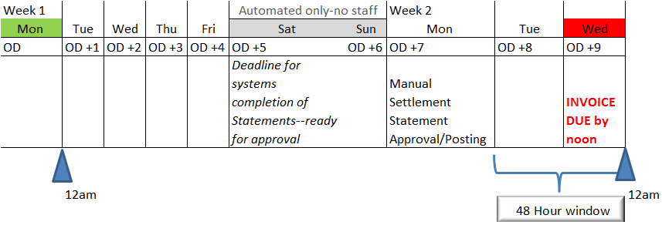
Extracts may be considered timely yet post AFTER invoices are due
From the Settlement Extract User Guide: “The extracts are generated dynamically and key off of STATEMENT SCHEDULE when status is changed to 'A' for settlement type ‘RTM’ or ‘DAM’ and posts no later than 48 hours of the statement posting deadline.”
Are Market Participants comfortable with this?

Slide 7
Nodal Settlement Handbook
on the CSWG main page with its new title
Next CSWG Meeting
August 24, 2015 ERCOT Met Center,
Rm 168 at 9:30am

