Slide 1
Settlement Stability
2015 Q1 Update to COPS- DRAFT
Blake Holt
ERCOT
COPS
07/15/2015

Slide 2
PR 8.2 (2) – Settlement stability – protocol revisions
8.2 ERCOT Performance Monitoring
(c) Settlement stability:
(i) Track number of price changes changes “after-the-fact” ;
(ii) Track number and types of disputes submitted to ERCOT and their disposition;
(iii) Report on compliance with timeliness of response and disposition to disputes;
(iv) Other Settlement metrics; and
(v) Availability of Electric Service Identifier (ESI ID) consumption data in conformance with
Settlement timeline;
(g) Uplift: ERCOT shall calculate and post the sum of all charges allocated to load for all Qualified Scheduling Entities (QSEs) for each month and year-to-date due to each of the following:
(i) The RUC Capacity-Short Charge, as described in Section 5.7.4.1, RUC Capacity-Short Charge;
(ii) The RUC Decommitment Charge, as described in Section 5.7.6, RUC Decommitment Charge;
(iii) The Load-Allocated Reliability Must Run Amount per QSE, as described in Section 6.6.6.5, RMR Service Charge;
(iv) The Load-Allocated Voltage Support Service Amount per QSE, as described in Section 6.6.7.2, Voltage Support Charge;
(v) The Load-Allocated Black Start Service Amount per QSE, as described in Section 6.6.8.2, Black Start Capacity Charge;
(vi) The Load-Allocated Emergency Energy Amount per QSE, as described in Section 6.6.9.2, Charge for Emergency Power Increases;
(vii) The Load-Allocated Real-Time Revenue Neutrality Amount per QSE, as described in Section 6.6.10, Real- Time Revenue Neutrality Allocation; and
(viii) The total of the ERCOT System Administration Charge;

Slide 3
8.2(c)(i) Track number of price changes
Reporting Period: 2015 Q1
Operating Day | # of Corrected Settlement Point Prices |  |  |  | # of Intervals Affected
 | DASPP | RTSPP | RTRMPR | ORDC Adders | DASPP | RTSPP | RTRMPR | ORDC Adders
03/25/2015 | 0 | 1196 | 985 | 2 | 0 | 2 | 2 | 2
03/30/2015 | 0 | 0 | 362 | 0 | 0 | 0 | 2 | 0
Notes:
Price corrections for OD 3/25/2015 were due to the Tech Refresh Project production cutover.
Price corrections for OD 3/30/2015 were due to an MMS application outage.

Slide 4
8.2(c)(ii) Track number and types of disputes submitted
YEAR | 2015
QUARTER | Q1
Row Labels | Denied | Granted | Granted w/Exc. | Open | Total Submitted
Congestion Revenue Rights-RTM | 1 |  |  |  | 1
Energy-DAM | 1 |  |  | 2 | 3
Energy-RTM | 2 | 6 |  |  | 8
Emergency Operations-RTM | 9 | 7 | 1 |  | 17
Grand Total | 13 | 13 | 1 | 2 | 29
** Proposed changes are highlighted in red. Numbers are hypothetical.

Slide 5
8.2(c)(iii) Response compliance and disposition of disputes (timeliness)
YEAR | 2015
QUARTER | Q1
Row Labels | TRUE-UP | Grand Total
Congestion Revenue Rights-RTM | 100% | 100%
Energy-DAM | 100% | 100%
Energy-RTM | 100% | 100%
Emergency Operations-RTM | 100% | 100%
Grand Total | 100% | 100%

Slide 6
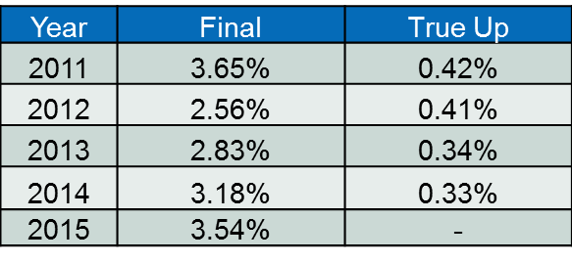
8.2(c)(iv) Other Settlement metrics
NOTE: ERS Final settlement data is not represented in graph.
Average percent change per year

Slide 7
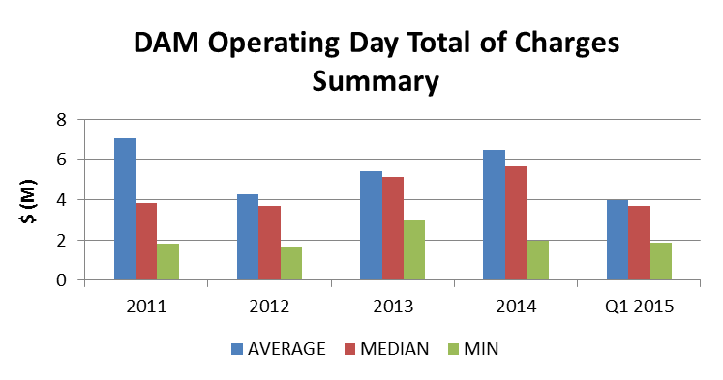
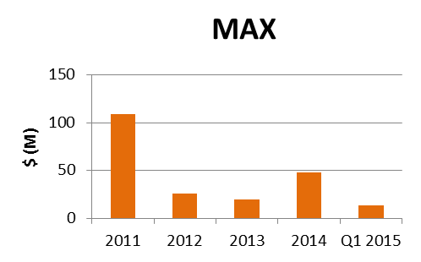
8.2(c)(iv) Other Settlement metrics
 | 2011 | 2012 | 2013 | 2014 | Q1 2015
AVERAGE | $7,055,904.22 | $4,286,346.35 | $5,414,301.61 | $6,459,143.69 | $3,995,466.30
MEDIAN | $3,852,717.78 | $3,672,953.94 | $5,110,481.46 | $5,656,482.98 | $3,696,393.00
MIN | $1,811,707.78 | $1,696,086.15 | $2,960,302.19 | $1,964,947.00 | $1,861,583.65
MAX | $108,685,088.18 | $26,214,367.20 | $19,450,091.88 | $47,932,135.66 | $13,685,366.65
NOTE: “Total of Charges” represents the sum of statements that are a net charge to the Market Participant (i.e., the amount due to ERCOT)

Slide 8
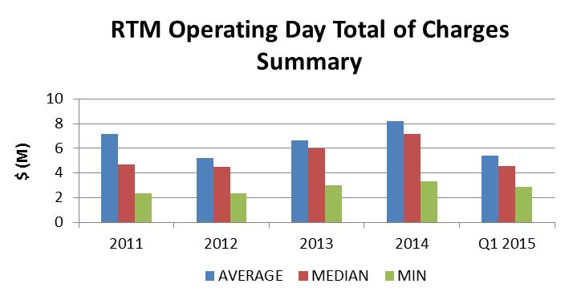
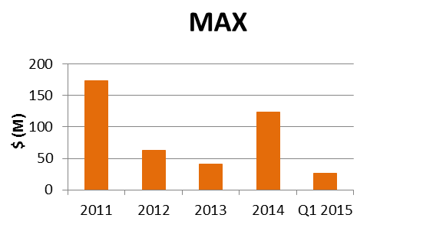
8.2(c)(iv) Other Settlement metrics
 | 2011 | 2012 | 2013 | 2014 | Q1 2015
AVERAGE | $7,186,401 | $5,192,011 | $6,612,028 | $8,214,292 | $5,384,332
MEDIAN | $4,687,817 | $4,507,284 | $5,967,530 | $7,154,186 | $4,578,659
MIN | $2,381,712 | $2,338,942 | $2,977,312 | $3,318,333 | $2,901,691
MAX | $173,658,750 | $63,344,855 | $40,524,460 | $123,682,311 | $26,337,706
NOTE: “Total of Charges” represents the sum of statements that are a net charge to the Market Participant (i.e., the amount due to ERCOT)

Slide 9
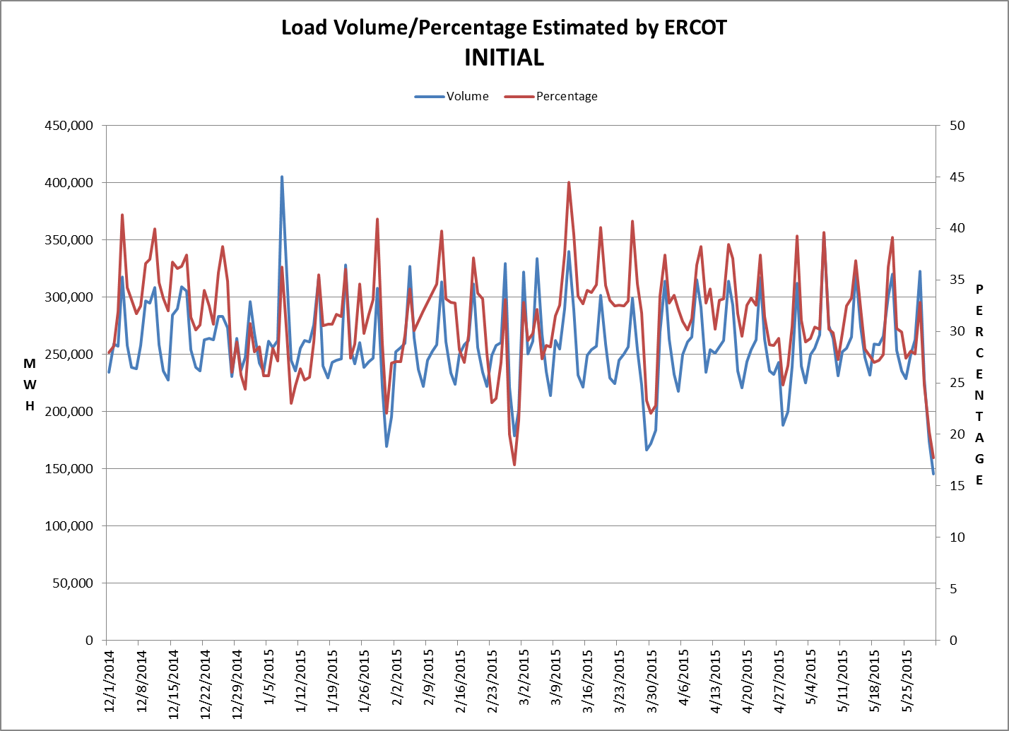
8.2(c)(v) Availability of ESIID consumption data

Slide 10
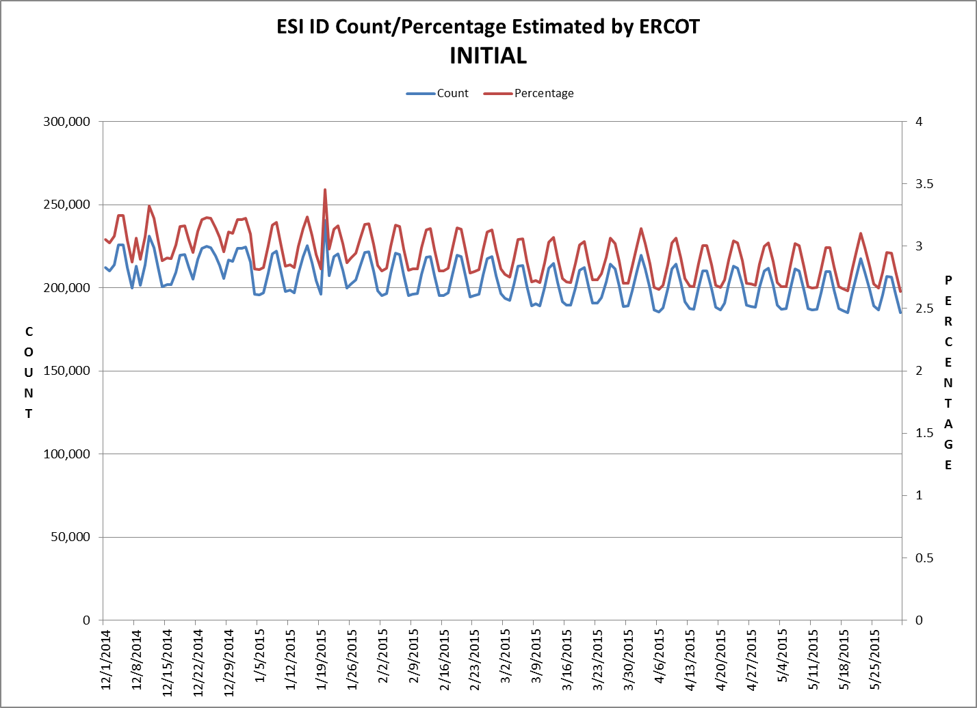
8.2(c)(v) Availability of ESIID consumption data

Slide 11
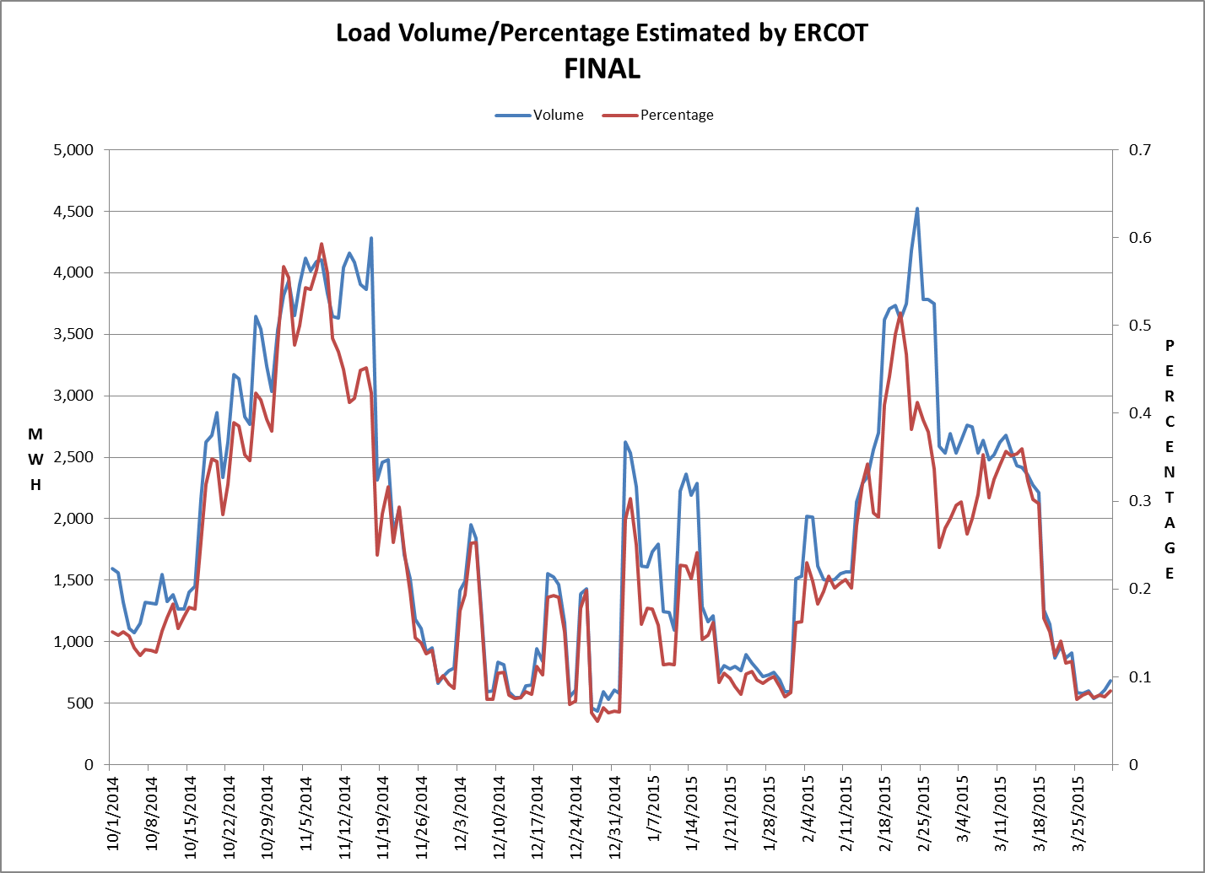
8.2(c)(v) Availability of ESIID consumption data

Slide 12
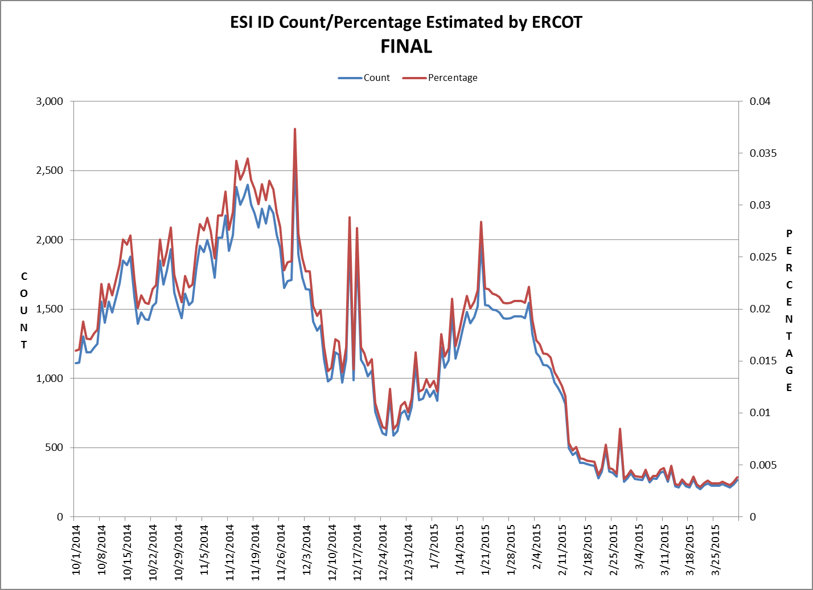
8.2(c)(v) Availability of ESIID consumption data

Slide 13
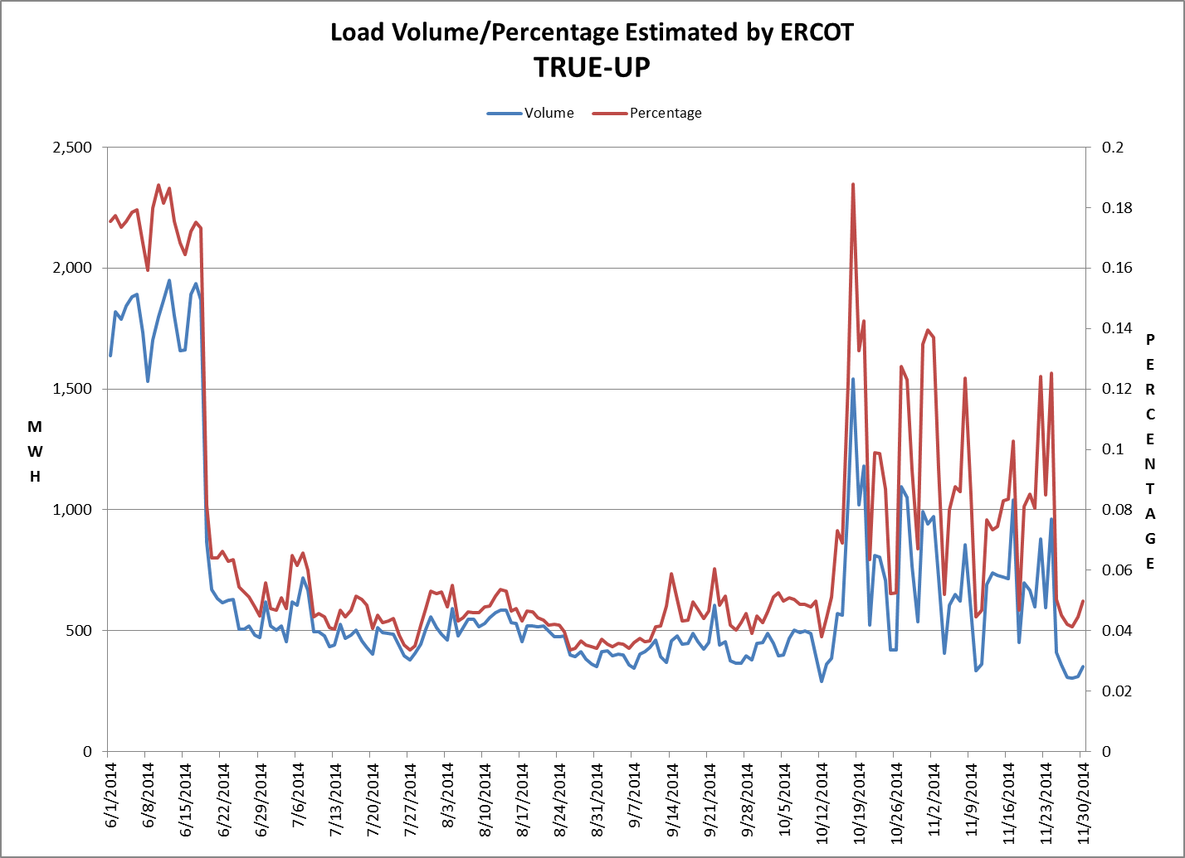
8.2(c)(v) Availability of ESIID consumption data

Slide 14
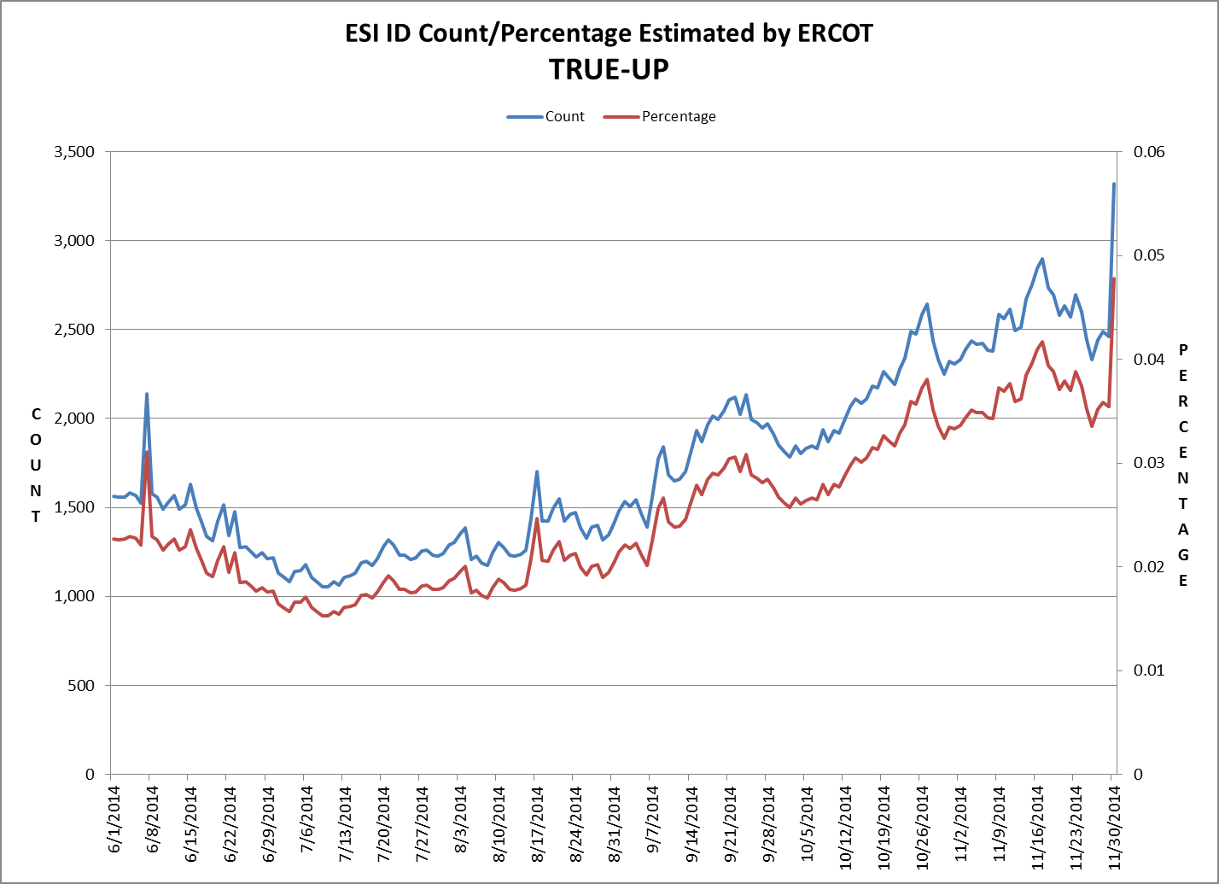
8.2(c)(v) Availability of ESIID consumption data

Slide 15
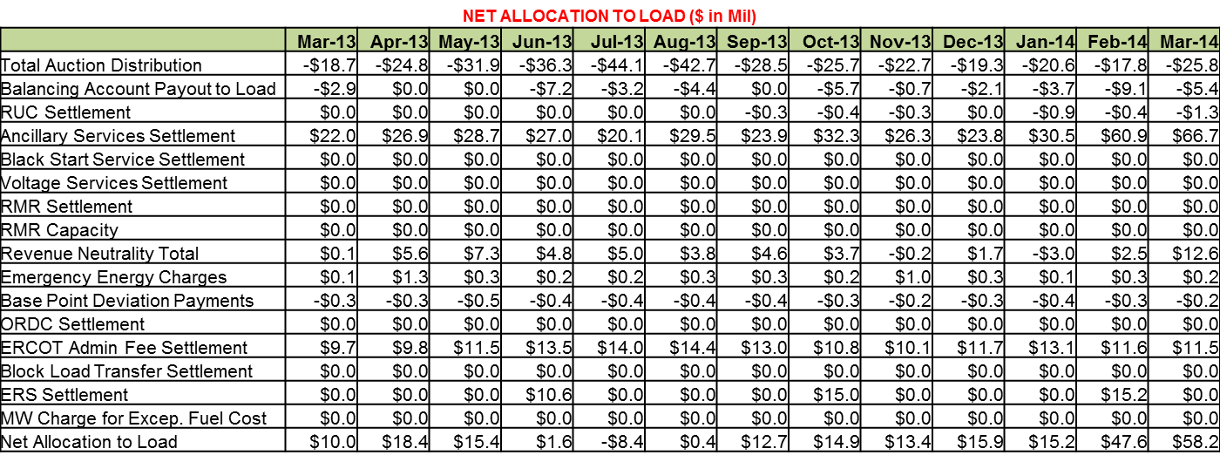
8.2(g) Net Allocation to Load (Board Report)
** Numbers are for an earlier time-period and are in place as a format example only.

