Slide 1
Overview of Environmental Regulations Potentially Affecting Power Industry
Susana M. Hildebrand, P.E.
Presented to LTSA, ERCOT
July 13, 2015
Confidential

Slide 2
Upcoming Regulations
National Ambient Air Quality Standards
Ozone (2015)
Sulfur Dioxide (2010)
Transport (Beyond CSAPR)
Regional Haze
Greenhouse Gas Regulation

Slide 3
Ozone: Final rule to be signed by October 1, 2015
Potential Action:
EPA may lower the ozone standard to 65 or 70 ppb.
Potential Consequences:
Potentially more nonattainment areas in Texas:
San Antonio
Austin-Round Rock
Northeast Texas (Gregg, Harrison, Rusk, Smith, Upshur)
Waco
(In addition to Houston and Dallas)
Harder to permit: new build or modification of existing
Existing facilities may need to upgrade/add-on NOx controls
Timeline
Designations by October 2017 (affecting permitting)
Attainment dates ranging from 2020-2037

Slide 4
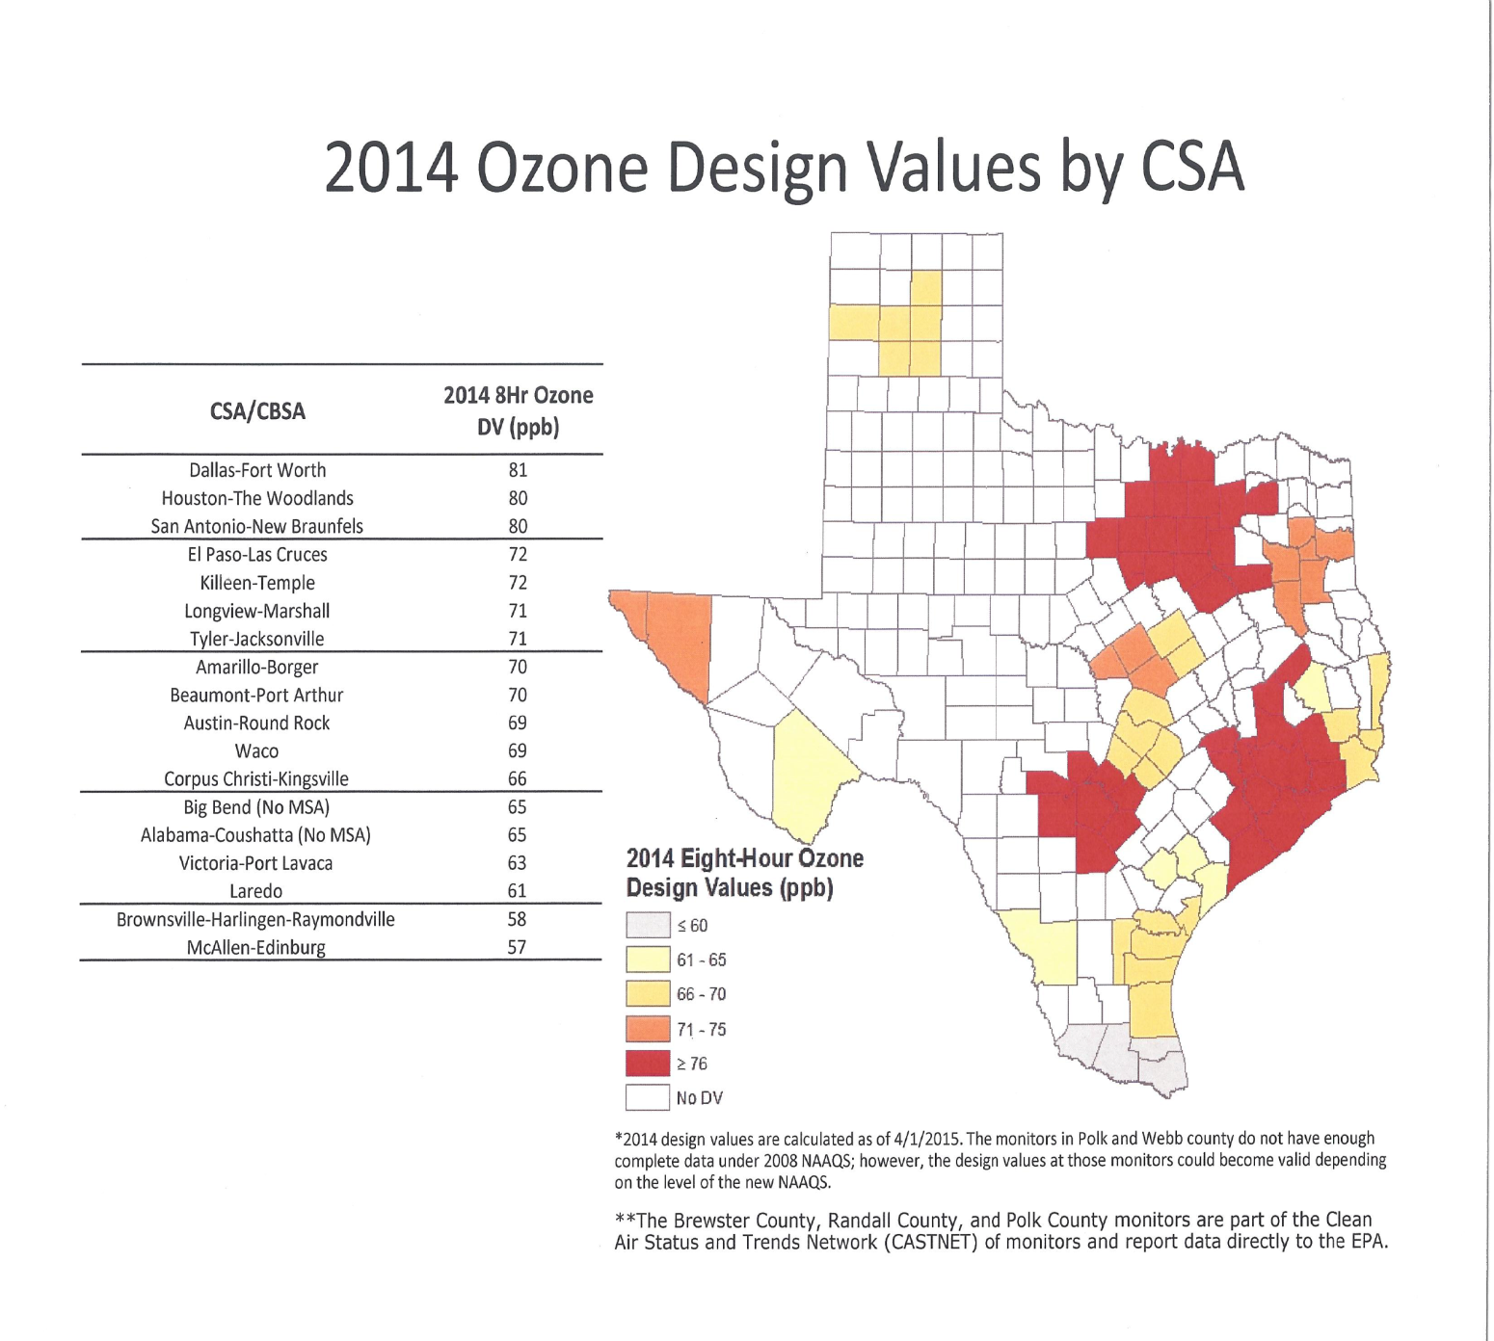
Potential Ozone Nonattainment Areas
Source: TCEQ

Slide 5
Sulfur Dioxide Designations
Potential Action :
EPA may designate areas with large SO2 sources as nonattainment
Potential Consequences:
Harder to permit: new build or modification of existing
Existing facilities may need to upgrade/add-on SO2 controls
Timeline
Attainment Designations in three groups:
by July 2016 for areas surrounding large sources (>16,000 tpy): Big Brown, Coleto Creek, Harrington, Limestone, Monticello, Twin Oaks, San Miguel, Sandow, Sandy Creek, W.A. Parish, Martin Lake, and Tolk
by December 2017: areas not monitored must be modeled for designation
by December 2020: other monitored areas (three years of data)
Attainment date: five years after designation

Slide 6
Transport (CSAPR and Beyond)
CSAPR
In effect as of Jan 1, 2015
Oral arguments – Feb 25, 2015
Next Transport Rule (Reference: EPA Memo 1/2015)
Applies CSAPR “1% screening threshold”
For 2008 Ozone standard: 0.76 ppb.
EPA’s preliminary air quality modeling analysis implicates Texas:
For contribution to exceedance: Harford, Maryland; Suffolk, New York
For interfering with maintenance of standard: Allegan, Michigan; Saint Charles, Missouri; Camden, New Jersey; Gloucester, New Jersey; Philadelphia, Pennsylvania; and Sheboygan, Wisconsin
At an April 2015 EPA/state workshop, EPA indicated that modeling data updated for 2017 will be issued in summer 2015 and that a transport FIP is anticipated for proposal in late 2015.

Slide 7
Regional Haze
SIP Submission required every 10 years
First Planning Period (2008 – 2018)
On December 17, 2014, EPA published notice of its partial disapproval of Texas State Implementation Plan revision regarding Regional Haze. EPA also proposed a FIP that would establish sulfur dioxide emission limitations for 14 Texas units
EPA’s estimated costs: ~$2 Billion
Under a consent decree, EPA must finalize the FIP by December 9, 2015. If final rule is consistent with proposal:
Scrubber Upgrades by 2018
New Scrubbers by 2020 (note that this requirement is beyond the first planning period)
2018 and beyond
TCEQ must submit a new RH SIP revision in 2018 for the next ten year period and every 10 years until 2064.

Slide 8
EPA Projections on New Scrubber "Retrofit" Costs
New scrubber ‘retrofits’ at 7 units
Unit | Capital cost ($ million)
Big Brown 1 | $256
Big Brown 2 | $259
Monticello 1 | $251
Monticello 2 | $254
Luminant subtotal | $1,020
Coleto Creek | $262
Tolk 171B | $243
Tolk 172B | $253
Total Texas | $1,778
+ Scrubber upgrades at 7 additional units
Luminant: Martin Lake 1, 2, & 3 Monticello 3, Sandow 4
Others: Limestone 1 & 2
EPA estimates reflect capital costs for new scrubbers alone of ~$1.8 billion;
control requirements for all 14 units "at a cost over $2 billion… these costs would invariably be passed on to consumers…"¹
¹ TCEQ statement, November 24, 2014
Source: EPA Proposed FIP, November 24, 2014

Slide 9
Carbon Dioxide Regulation

Slide 10
Clean Air Act Section 111: NSPS proposals for EGUs (Proposal Date)
Under §111(b)
New Units (1/2014)
Has not commenced construction at the time of proposal
Modified or Reconstructed Units (6/2014)
Modified: Makes a physical or operational change and increase hourly maximum emission rate
Reconstructed: Defined as spending more than 50% of the cost to replace the facility
Under §111(d)
Existing Sources (6/2014)

Slide 11
Important Definitions
Standard of Performance: a standard for emissions of air pollutants which reflects the degree of emission limitation achievable through the application of the best system of emission reduction which (taking into account the cost of achieving such reduction and any nonair quality health and environmental impact and energy requirements) the Administrator determines has been adequately demonstrated.
Stationary Source: any building, structure, facility, or installation which emits or may emit any air pollutant
Existing Source: any stationary source other than a new source

Slide 12
NSPS CAA Section 111
Section 111(b) (New sources)
Requires EPA to issue NSPS for categories of sources that are determined to cause, or contribute significantly to, air pollution which can reasonably be anticipated to endanger public health or welfare.
EPA may distinguish among classes, types, and sizes within categories of sources.
Performance-based standards based on Best System of Emission Reduction (BSER)
Apply to any affected source constructed, reconstructed, or modified after the date of proposal (beginning upon promulgation).

Slide 13
Proposed Standard of Performance for New Sources
Applicability:
219,000 MWh net electric output
One-third of potential output to the grid
Coal
BSER = partial carbon capture and sequestration
Standard of performance: 1,100 lbs CO2/MWh
Natural Gas Turbines
BSER = NGCC
Standards of performance
1,000 lbs CO2/MWh if heat input > 850 MMBtu/h
1,100 lbs CO2/MWh if heat input < 850 MMBtu/h
Includes simple cycle turbines and CHP

Slide 14
NSPS proposals for Modified or Reconstructed EGUs
Modified Utility Boilers and IGCC Units
>2,000 MMBTU/hr
Best historical emission rate less 2%, no lower than 1,900 lb CO₂/MWh
≤2,000 MMBTU/hr
Best historical emission rate less 2%, no lower than 2,100 lb CO₂/MWh
Modified NGCC
1,000 lb CO₂/MWh >850 MMBTU/hr
Reconstructed Utility Boilers and IGCC
>2,000 MMBTU/hr
1,900 lb CO₂/MWh
≤2,000 MMBTU/hr
2,100 lb CO₂/MWh

Slide 15
NSPS proposals for Modified or Reconstructed EGUs
Additionally, EPA proposed that “an existing source that becomes subject to requirements under CAA section 111(d) will continue to be subject to those requirements even after it undertakes a modification or reconstruction.”
In other words, a modified or reconstructed EGU that meets its emission limit of not less than 1900-2100 lbs CO₂/MWh must still be counted in demonstrating compliance with the 111(d) limit.

Slide 16
NSPS CAA Section 111
Section 111(d) (Existing Sources)
States must submit a §110-like (SIP-like) plan for existing sources for any air pollutant:
for which there is no NAAQS; and
that is not emitted from a source category regulated under Section 112,
(where)
A standard would apply if the unit were a new unit
In other words, EPA must promulgate a 111(b) NSPS for new sources in order to regulate existing sources under 111(d)

Slide 17
Proposed Standard of Performance for Existing EGUs
State-by-state GHG Emission Rate
EPA claims the four “block” plan provides “flexibility”
EPA claims differentiated state goals allow for consideration of each state’s unique circumstances
Interim (2020 – 2029) and Final Goals (2030)
States must submit plans by June 30, 2016
May request a one-year extension if certain commitments are made
May request a two-year extension if working on multi-state

Slide 18
Four Building Blocks
Block 1 -
Heat Rate improvement at the source of 6%
HR $=\frac{Heat Input}{Electricity Produced}$
Block 2 –
“Environmental” Dispatch
Replace carbon intensive (coal-fueled) generation by increasing NGCC operation to 70%
Block 3
Replace carbon intensive (coal-fueled) generation with increased renewables
Block 4
Reduce carbon intensive (coal-fueled) generation through demand-side efficiency improvements

Slide 19
EPA Assumes Dramatic Redispatch of Texas Fleet in 111(d)
Texas Emission Rate (EPA formula lb CO₂/MWh)
2012 Texas Baseline
1,292
Includes existing renewables
Block 1
Heat rate improvements
49
- 4% (6% efficiency improvement at coal units)
Block 2
Re-dispatch of fleet
258
- 20% (70% CCGT utilization)¹
Block 3
More renewables, nuclear
124
- 10% (20% RPS + some nuclear)
Block 4
Demand-side reductions
70
- 5% (end-user energy efficiency 1.5% /yr improvement)
2030 Texas Target
791 39% total reduction
EPA’s proposal calls for a 39% reduction in the Texas emission rate (per the 111(d) formula).

Slide 20
Emissions Rate Formula
NGCC gen.
+
Coal gen.
+
OG gen.
+
“other” gen.
+
Nuclear gen.
+
Renewable gen.
+
Energy efficiency gen.
(NGCC gen. x NGCC em. Rate)
+
(coal gen. x coal em. rate)
+
(OG gen. x OG em. Rate)
+
“other” emissions
Source: Sidley Austin

Slide 21
Texas Electricity Generation: 2012
A walkthrough of EPA’s Calculation
Coal generation: 138.7 MMWh
Emissions rate: 2,239 lbs CO₂/MWh
NGCC generation: 148.0 MMWh
Emissions rate: 837 lbs CO₂/MWh
OG steam generation: 20.9 MMWh
Emissions rate: 1,377 lbs CO₂/MWh
“Other” Generation: 35.0 MMWh
Emissions rate: 667.9 lbs CO₂/MWh
2012 fossil fuel emissions rate:
1,420 lbs CO₂/MWh
Source: EPA Technical Support Document, Sidley Austin

Slide 22
Texas Emissions Rate: Block 1
Heat Rate Improvement
6% reduction in coal emissions rate
2,239 lbs CO2/MWh x 0.94 = 2,104 lbs CO₂/MWh
Emissions Rate:
1,420 lbs CO2/MWh → 1,366 lbs CO₂/MWh
Source: Sidley Austin

Slide 23
Texas Emissions Rate: Block 2
“Environmental Re-Dispatch”
2012 NGCC Capacity Factor: 45%
Adjustment to 70% Capacity Factor:
NGCC generation: 148.0 MMWh → 230.9 MMWh
Coal generation: 138.7 MMWh → 66.7 MMWh
OG steam generation: 20.9 MMWh → 10.1 MMWh
Adjustment for NGCC under construction:
0 MW
Emissions Rate:
1,366 lbs CO₂/MWh → 1,083 lbs CO₂/MWh
Source: Sidley Austin

Slide 24
Texas Emissions Rate: Block 3a
Nuclear Capacity:
2012 Generation: 38.4 MMWh
New capacity: 0 MW
At risk capacity: 290 MW (~6% of total nuclear capacity)
Projected generation at 90% capacity:
2.29 MMWh
Source: Sidley Austin

Slide 25
Texas Emissions Rate: Block 3b
Renewable Capacity
2012 generation: 34.0 MMWh
Regional RPS goal: 20%
Projected 2020 renewable generation:
46.8 MMWh (~8% growth beginning in 2017)
Projected 2030 renewable generation:
86.0 MMWh (20% total generation)
Emissions Rate:
1,083 lbs CO₂/MWh → 861 lbs CO₂/MWh
Source: Sidley Austin

Slide 26
Texas Emissions Rate: Block 4
Demand side energy efficiency
2012 adjusted sales: 392.5 MMWh
State generation as percent of sales: 98.12%
2030 energy efficiency potential: 9.91%
Emissions rate:
Overall emissions rate change:
861 lbs CO₂/MWh → 791 lbs CO₂/MWh
1,420 lbs CO₂/MWh → 791 lbs CO₂/MWh
Source: Sidley Austin

Slide 27
Summary of Texas Emissions
Rate Reductions
State Baseline Emissions
Block 1: Heat Rate Improvements at Coal-Fired EGUs (6% emissions reduction)
Block 1:
1,420 lbs CO2/MWh → 1,366 lbs CO₂/MWh
Block 2:
1,366 lbs CO2/MWh → 1,083 lbs CO₂/MWh
Block 3
1,083 lbs CO2/MWh → 861 lbs CO₂/MWh
Block 4
861 lbs CO2/MWh → 791 lbs CO₂/MWh
Total Reductions
1,420 lbs CO2/MWh → 791 lbs CO₂/MWh
Block 2a: Increased generation at existing NGCC facilities (minimum 70% capacity)
Block 2b: Increased generation at new NGCC facilities (additional capacity to substitute for other fossil fuels)
Block 3a: Changes in nuclear generation capacity (new capacity; avoided retirement)
Block 3b: Increased renewable energy capacity (based on regional averaging of renewable portfolio standards)
Block 4: Reduced generation through demand-side energy efficiency improvements (1.5% annual electricity savings)
State-Specific Targets
Source: Sidley Austin

Slide 28
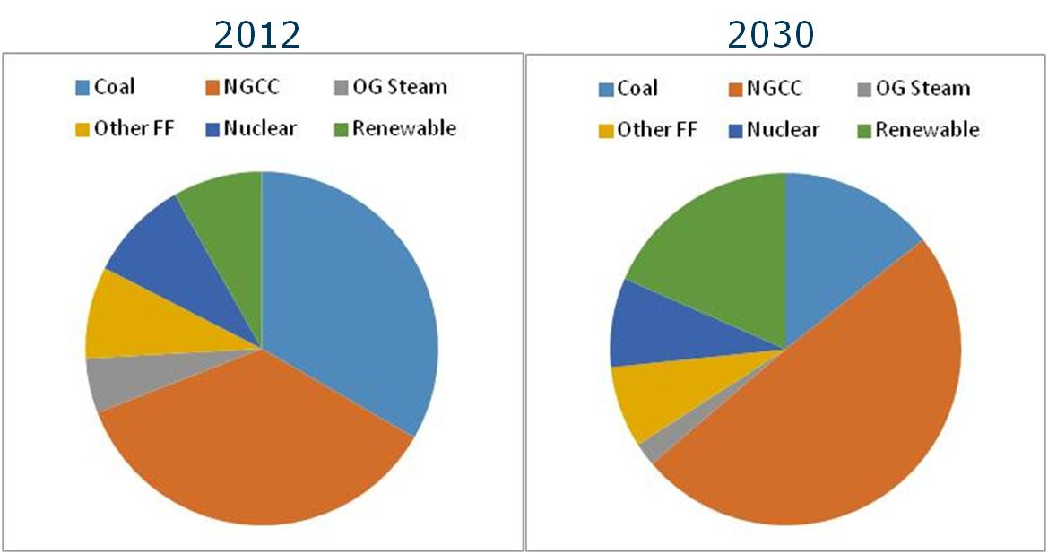
Texas Energy Mix: 2012-2030
Generation shift includes existing sources plus increased renewables
Source: Sidley Austin

Slide 29
EPA Assumptions Yield Differentiated State Impacts
Carbon Emission Rate Target by State in 2030
Pounds of CO₂ per MWh
Simple average = 991
EPA’s 2030 state targets vary widely; Texas is 20% more stringent than average

Slide 30
EPA Assumptions Yield Differentiated State Impacts
Carbon Emission Reductions, 2020 vs. 2012
Millions of tons of CO₂ per year (reductions by 2020 relative to 2012 baseline)
Texas called upon to provide 18% of total U.S. CO₂ reductions, despite being only 11% of 2012 CO₂ emissions.
Majority of annual CO₂ reductions ‘frontloaded’ to 2020 despite 2030 target.
Notes:
These are huge reductions by 2020 (all of block 1-3) thus front-loaded

Slide 31
Block 2: State Impacts of EPA’s Assumed Re-Dispatch
EPA’s Assumed Reduction in Coal Generation for Top 15 Coal States
Million MWh less than 2012 baseline
% of 2012
52%
5%
10%
7%
1%
16%
11%
0%
23%
33%
22%
91%
1%
34%
34%
Texas provides largest share of reductions in coal generation; 19% of U.S. total
Source: Derived from EPA worksheet: “20140602tsd state goal data computation” changes in coal dispatch (Block 2)

Slide 32
Block 3: State Impacts of EPA’s Assumed Increases in Renewable Energy (RE)
EPA’s Assumed Changes in RE for Top 10 RE States
Million MWh/yr by 2030
86
41
2012 RE
Increase in RE
Decrease in RE
20
40
60
80
100
Texas is assumed to increase from 34 million MWh in 2012 to 86 million MWh in 2030 (+153%); California increase = 37%; Iowa and Minnesota decrease
Source: Balanced Energy for Texas, July 2013. Depicts top 10 states based upon 2012 renewable generation, excluding existing hydro resources.

Slide 33
Interim Goals
EPA provides an Interim Goal that is applicable from 2020- 2029.
This goal is calculated as follows:
Blocks 1 and 2 by 2020
Blocks 3 and 4 assume a percentage change per year beginning in 2017 through 2030
Interim Goal: 853 lbs CO2/MWh
Final Goal: 791 lbs CO2/MWh

Slide 34
Next Actions
All three Section 111 rules are at the Office of Management and Budget (WH) for review. EPA’s regulatory docket anticipates that these regulations will be signed on or around August 2015.
EPA plans to propose a Federal Plan for implementing 111(d) that would apply to sources where the state does not submit a plan or the state plan is inadequate.
Proposal expected in August 2015
Adoption expected in Summer 2016
Once EPA has finalized the rule packages, legal challenges will likely commence

Slide 35
Questions?

