Slide 1
Electric vehicle and Energy storage:
Growth potentials
LTSA Scenario Development Workshop July 13, 2015
Mike Legatt, Ph.D.
Principal Human Factors Engineer Principal Investigator, Electric Vehicle/Grid Integration (512) 248-4232 Michael.Legatt@ercot.com
Marina Dultra
Intern Electric Vehicle/Grid Integration
Megan Germann
Former intern Electric Vehicle/Grid Integration

Slide 2
Battery Technologies

Slide 3
Lithium Ion Batteries
Source: Energy Thought Summit

Slide 4
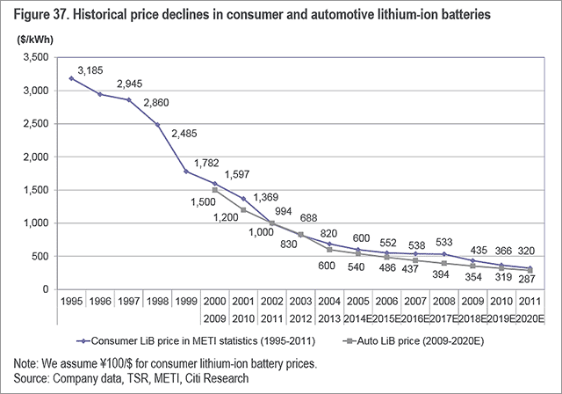
Economies of scale for batteries
Source: Citi

Slide 5
Battery manufacture sites
Source: Clean Energy Manufacturing Analysis Center

Slide 6
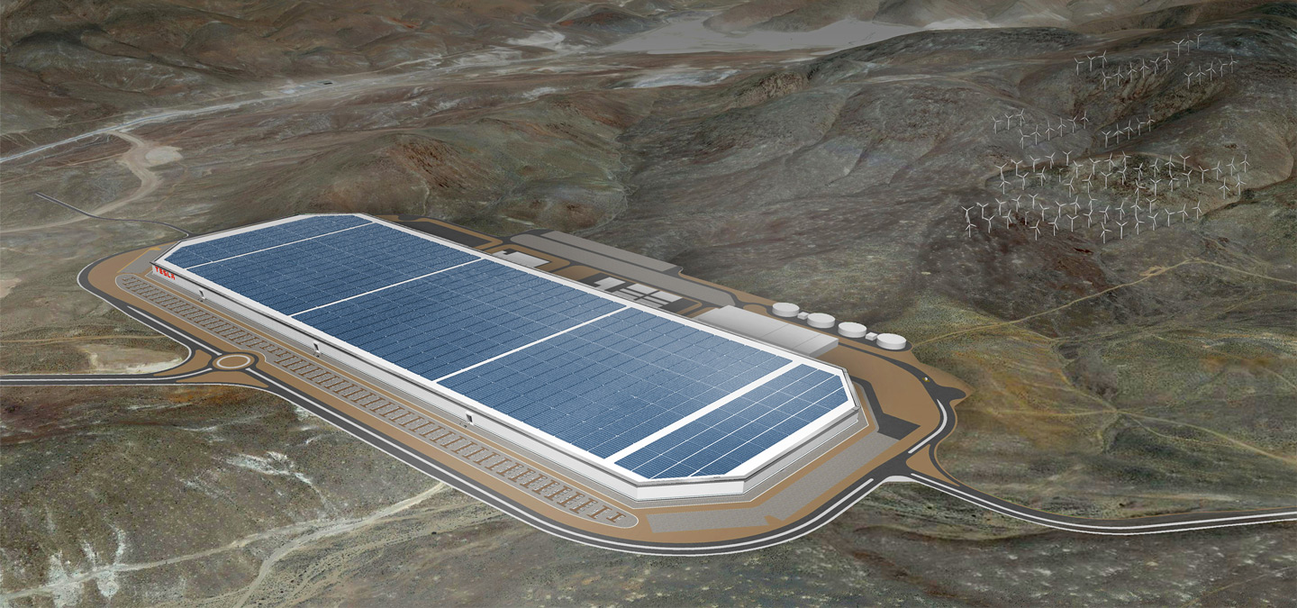
Growing battery production
Source: Tesla
Notes:
Gigafactory manufacturing capacity projected to outdo Asia with 35GWh. Local production reduces cost.

Slide 7
Growing battery demand
Source: Clean Energy Manufacturing Analysis Center

Slide 8
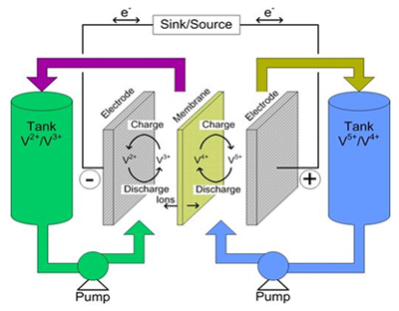
Innovations in Batteries
Source:
Sources: Tank Two, Battery University, Nature Communications
Notes:
String cell batteries
Nano-scaling on batteries
Samsung: Silicon carbide-free graphene growth on silicon for lithium-ion battery with high volumetric energy density, 1.8x on first power cycle, 1.5x after 200 cycles.
New batteries that don’t’ use rare earth metals
“My battery” idea – project better place and battery / component ownership

Slide 9
Electric Vehicles

Slide 10
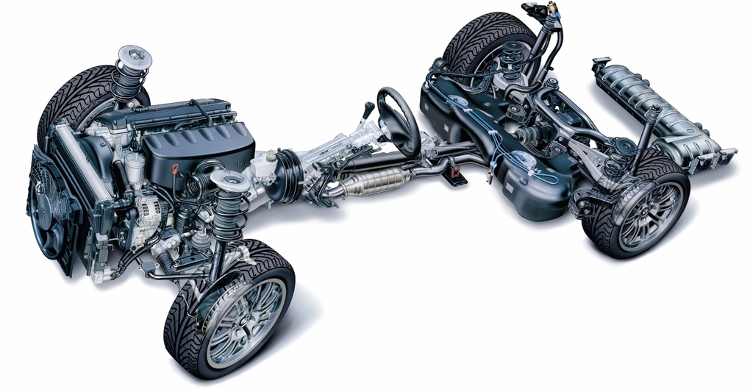
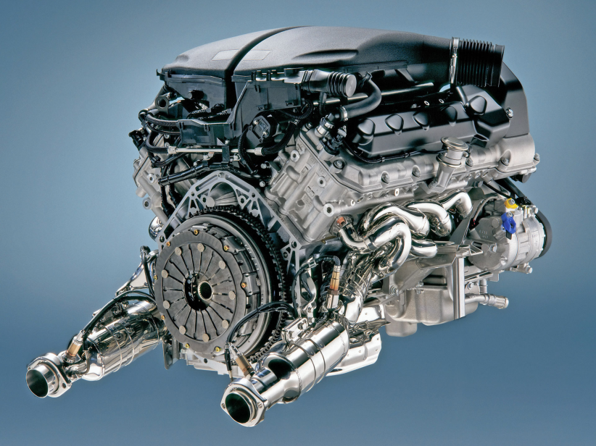
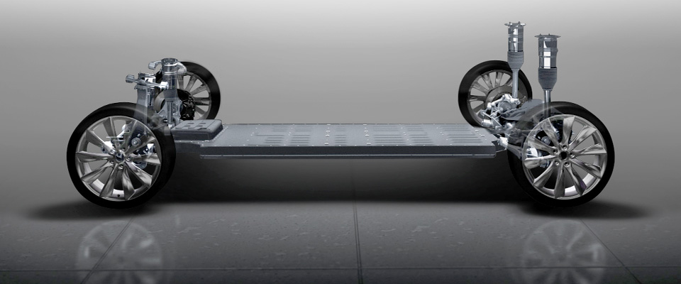
Simpler drive trains
Sources: Tuttle Consulting, BMW, Tesla Motors
Notes:
BMW i5 – twin turbo V8 with 8-speed transmission and Tesla S chassis. Roughly same 0-60 speeds
Plus talk about Tesla Frunk

Slide 11
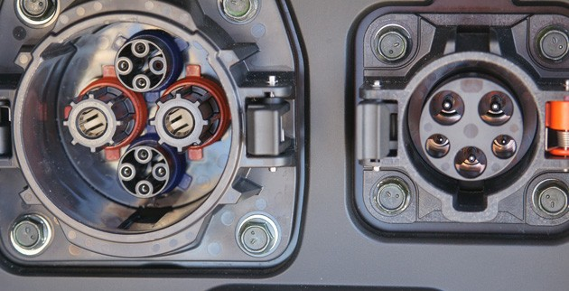
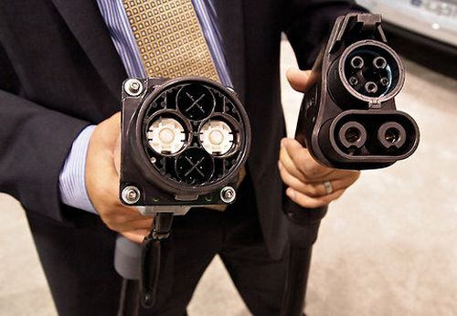
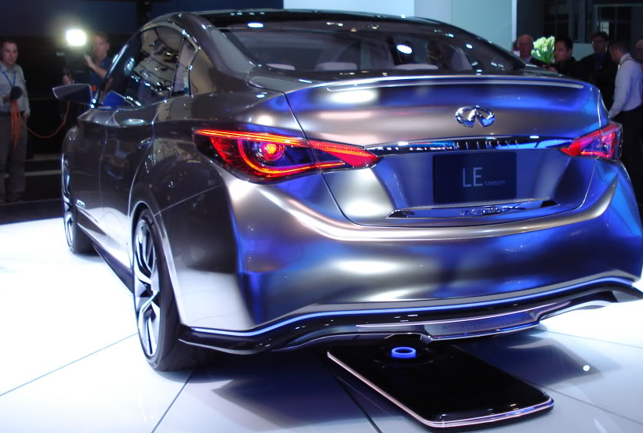
Plug-in charging
Sources: SAE, CHAdeMO alliance, GreenCarReports, Infiniti
Notes:
Mention study that gas pump most germy component

Slide 12
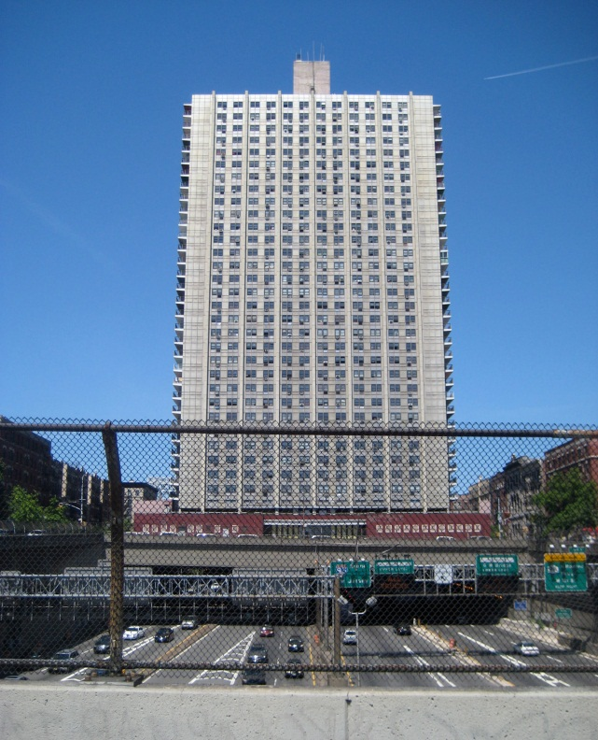
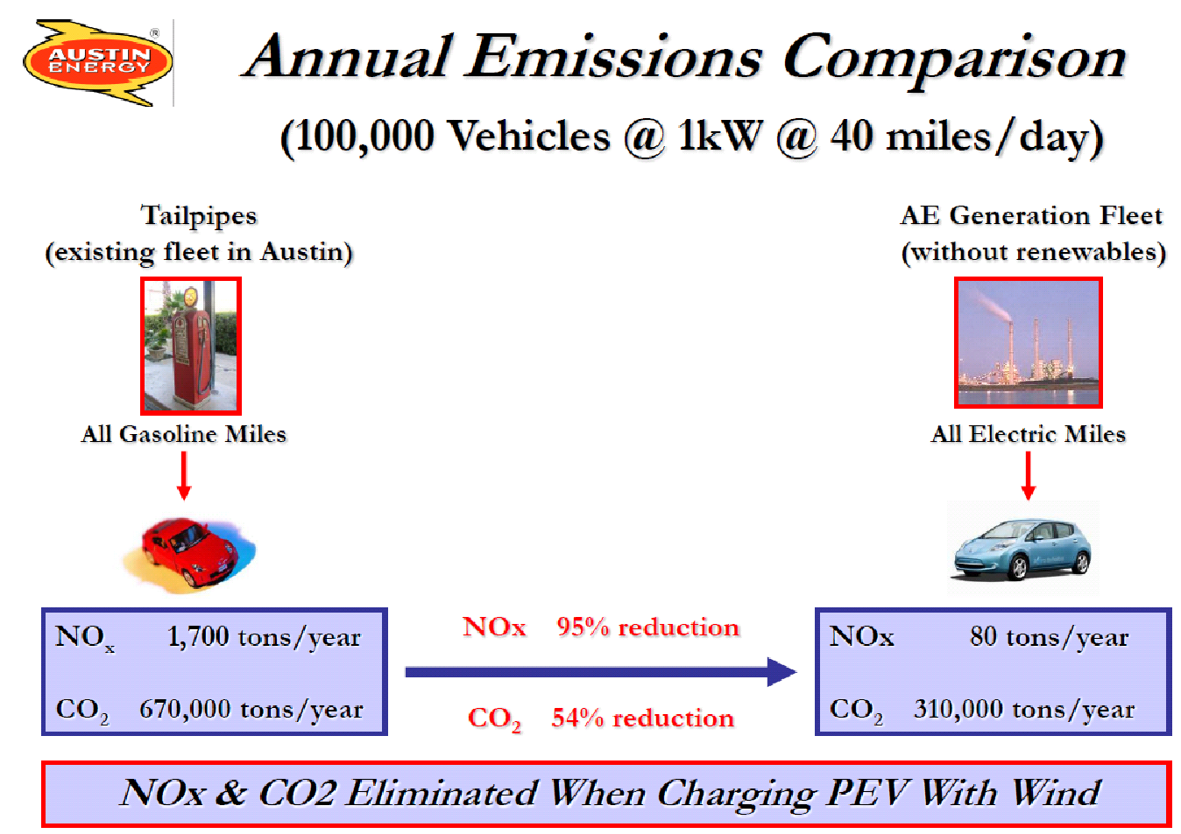
Emissions Differences
For those focused on CO₂ & NO_{X}, significantly fewer emissions per mile driven off grid average power
Slightly higher SO₂ emissions per mile
Reduced UFPM emissions + greater distance from population
Scaling of emissions monitoring and mitigation from millions of cars to hundreds of power plants
Controllable EV charging could offset intermittent renewables
Sources: Austin Energy, Flickr
Notes:
Brown & Guenther's Bridge Apartments (1963)
Followed 8000 residents between 1974 and 1991
PM₁₀ exposure significantly reduces life expectancy, even when accounting for age, sex, tobacco use, education, occupational exposure and BMI.
Higher CO and PM₁₀ levels measured on lower floors, closer to major roadways²

Slide 13
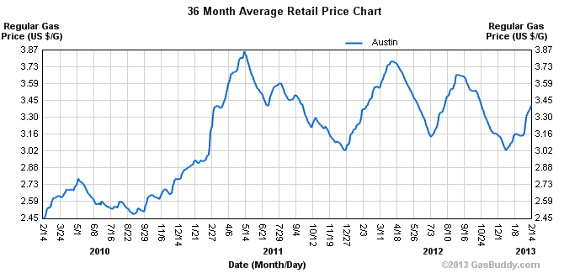
Energy Source Stability
Cost per mile generally lower: 2-4¢ vs 10-15 ¢ per mile
Less volatility in energy prices as compared to gasoline prices
Fewer parts to maintain
Battery replacements expensive, but less than new vehicle
In eREVs, no relationship required between engine and wheel rotation
Primary expense (battery) costs continuing to decrease, new innovations may lead to lower costs
Source: Austin Energy

Slide 14
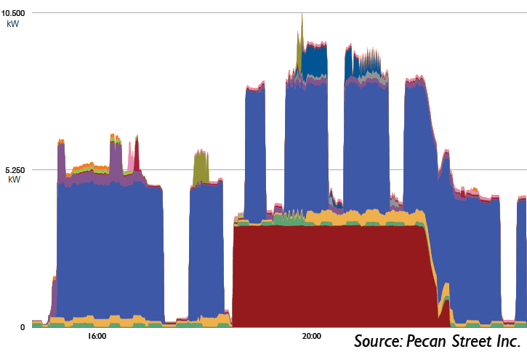
When you charge matters
HVAC EV
Notes:
Highlight this is a 1st gen Volt or Leaf.. Now Leaf 6.6kW, Tesla 7.2+ kW, etc

Slide 15
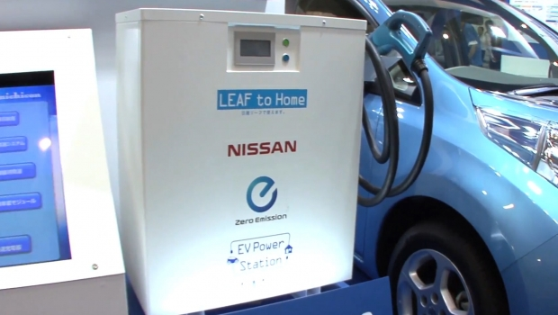
Vehicle to grid / home integration

Slide 16
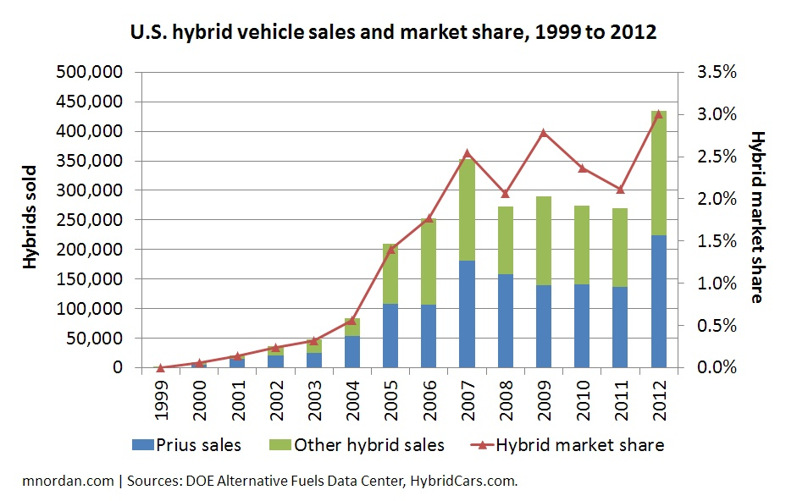
Early hybrids: Adoption trends
Source: Wikimedia

Slide 17
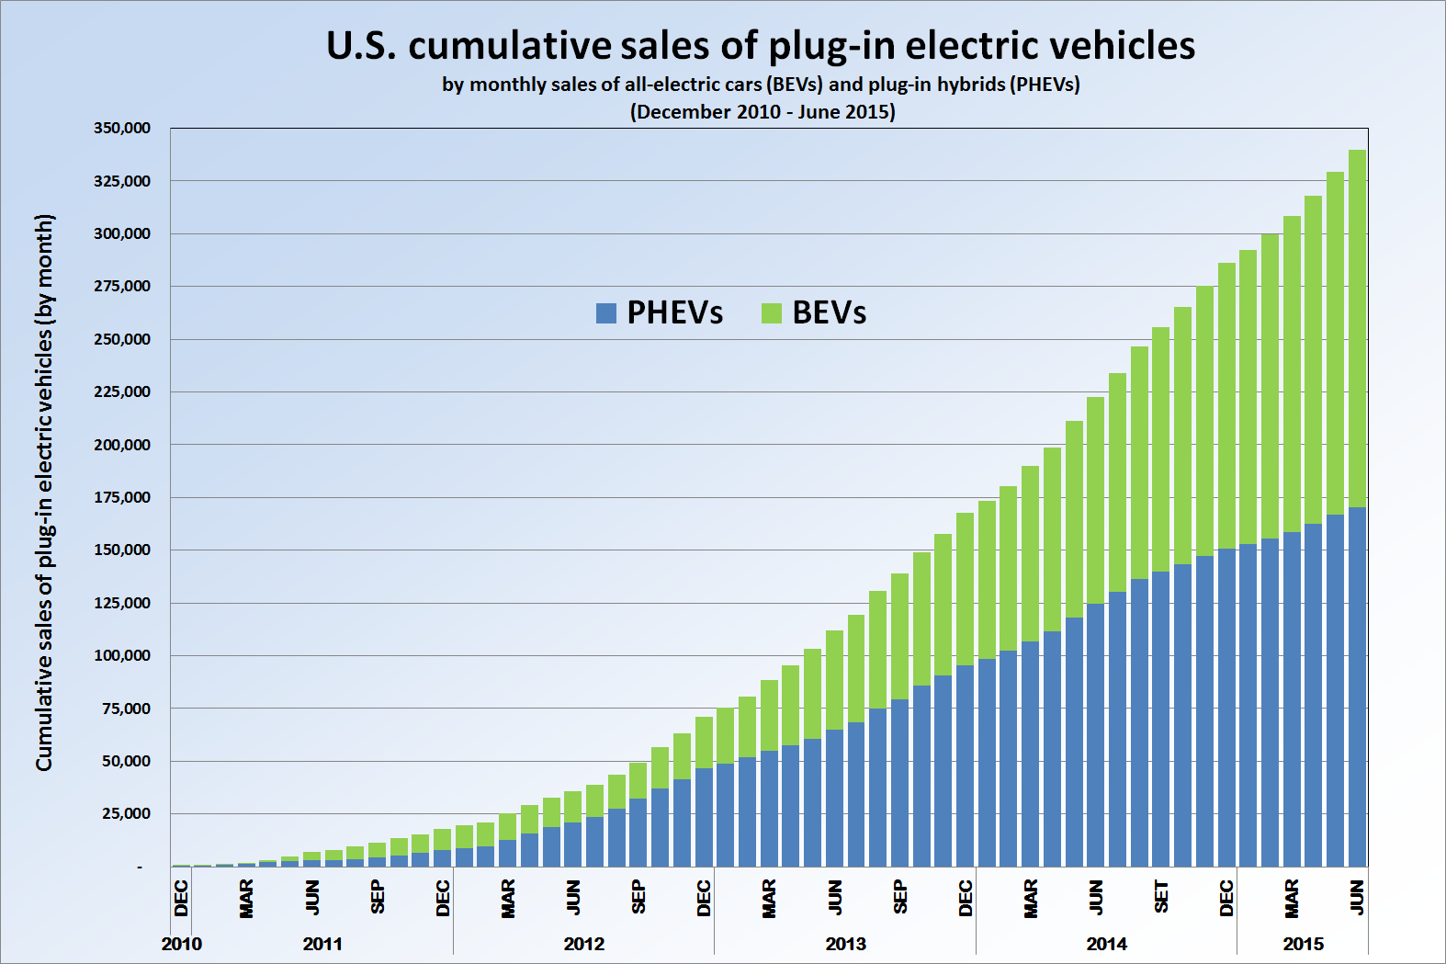
Faster sales growth of sales
Source: Wikimedia
Notes:
“Ten years ago people thought that electric cars would never make it, they thought electric cars were like a golf cart, something slow, bulky, not very attractive,” he says. “Now they see the [Renault] Zoe, the [Nissan] Leaf, the Teslas etc and they think electric cars can be fun. They see Formula E and see the cars can be very powerful and go very fast. The idea that electric cars are normal cars, which is a big revolution from 10 years ago, has taken place.

Slide 18
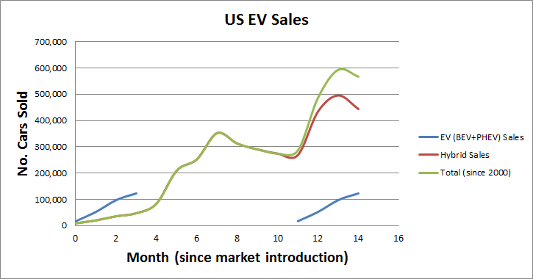
Faster sales growth of sales
Notes:
“Ten years ago people thought that electric cars would never make it, they thought electric cars were like a golf cart, something slow, bulky, not very attractive,” he says. “Now they see the [Renault] Zoe, the [Nissan] Leaf, the Teslas etc and they think electric cars can be fun. They see Formula E and see the cars can be very powerful and go very fast. The idea that electric cars are normal cars, which is a big revolution from 10 years ago, has taken place.

Slide 19
Energy Storage

Slide 20
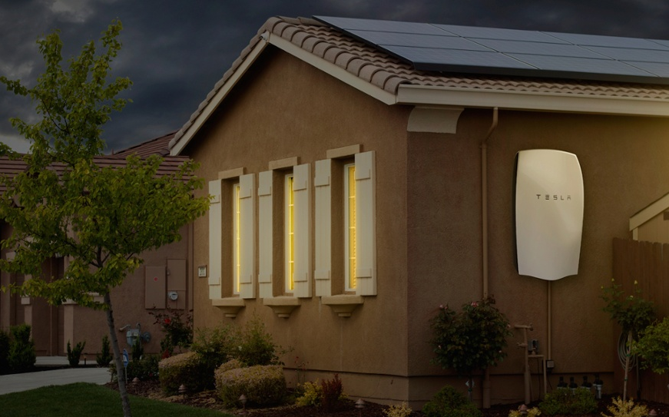
Overview…
Source: CleanTechnica

Slide 21
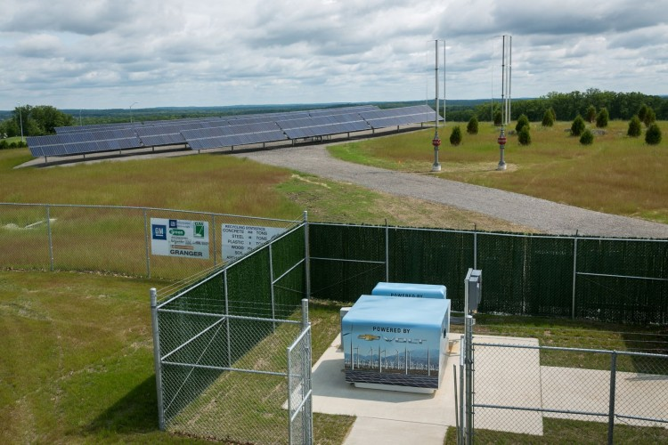
Reuse of old EV batteries
Source: Inside EVs
Notes:
Scrap Volt battery covers used for animal protection (bat houses, nesting boxes for endangered ducks, etc). Much of the plastics recycled from the BP oil spill
A data center in Milford, Mich. at GM Enterprise Data center
74 kW ground-mounted solar, 2x 2kW wind turbines, five 1st-gen Volt battery packs to create net zero energy use on an annual basis. Also provides 4h emergency power
When battery at “end of useful battery life” on a volt, still has 80% capacity
NREL research confirms that after being used to power a car, a Li-ion battery retains approximately 70% of its initial capacity

