Slide 1

Overview of Environmental Regulations and Drought Impacts in the ERCOT Region
Dana Lazarus
Planning Analyst, ERCOT
July 13, 2015

Slide 2
Environmental Regulations

Slide 3
Environmental Regulations
Mercury and Air Toxics Standards (MATS)
Regional Haze Federal Plan
Clean Water Act Section 316(b)
Ash Disposal Rule
Clean Power Plan
Cross-State Air Pollution Rule (CSAPR)
There are several proposed and recently finalized environmental regulations that could impact grid reliability in ERCOT:
Costs to:
Coal units
Natural gas units
Compliance Date:
January 2015
April 2015
2015-2018*
2018-2020**
2018-2022
2020-2029; 2030
Addresses cross-state air pollution through a cap and trade program
Sets limits on hazardous air pollutant emissions at power plants
Places requirements on disposal of coal ash
Requires controls on air emissions to improve visibility in national parks
Requires controls to limit impacts to aquatic life at cooling water intake structures
Sets carbon dioxide emissions limits for existing units
Color key:
No or low costs
Moderate costs
High Costs
*Longer timeframes for facilities required to close. Does not include the proposed Steam Electric Effluent Limitation Guidelines (ELG) rule.
**Subject to timing of final rule

Slide 4
Cross-State Air Pollution Rule
Mercury and Air Toxics Standards (MATS)
Regional Haze Federal Plan
Clean Water Act Section 316(b)
Ash Disposal Rule
Clean Power Plan
Cross-State Air Pollution Rule (CSAPR)
Addresses cross-state air pollution through a cap and trade program
Costs to:
Coal units
Natural gas units
Compliance Date:
January 2015
April 2015
2015-2018*
2018-2020**
2018-2022
2020-2029; 2030
Status | Compliance Requirements | Next Milestone
Final rule | Purchase allowances, upgrade controls, or reduce production to comply | Litigation pending at U.S. Court of Appeals
Color key:
No or low costs
Moderate costs
High Costs
*Longer timeframes for facilities required to close. Does not include the proposed Steam Electric Effluent Limitation Guidelines (ELG) rule.
**Subject to timing of final rule

Slide 5
Mercury and Air Toxics Standards
Mercury and Air Toxics Standards (MATS)
Regional Haze Federal Plan
Clean Water Act Section 316(b)
Ash Disposal Rule
Clean Power Plan
Cross-State Air Pollution Rule (CSAPR)
Sets limits on hazardous air pollutant emissions at power plants
Several units in ERCOT have compliance extensions to April 2016
Costs to:
Coal units
Natural gas units
Compliance Date:
January 2015
April 2015
2015-2018*
2018-2020**
2018-2022
2020-2029; 2030
Status | Compliance Requirements | Next Milestone
Final rule | Install control technologies to comply (e.g., activated carbon injection) | Case sent back to U.S. Court of Appeals
Color key:
No or low costs
Moderate costs
High Costs
*Longer timeframes for facilities required to close. Does not include the proposed Steam Electric Effluent Limitation Guidelines (ELG) rule.
**Subject to timing of final rule

Slide 6
Ash Disposal Rule
Mercury and Air Toxics Standards (MATS)
Regional Haze Federal Plan
Clean Water Act Section 316(b)
Ash Disposal Rule
Clean Power Plan
Cross-State Air Pollution Rule (CSAPR)
Regulates disposal of coal ash in impoundments and landfills
Steam-Electric Effluent Limitation Guidelines is related rulemaking
Costs to:
Coal units
Natural gas units
Compliance Date:
January 2015
April 2015
2015-2018*
2018-2020**
2018-2022
2020-2029; 2030
Status | Compliance Requirements | Next Milestone
Final rule | Requirements for siting, design, post-closure care, groundwater monitoring, etc. | Compliance
Color key:
No or low costs
Moderate costs
High Costs
*Longer timeframes for facilities required to close. Does not include the proposed Steam Electric Effluent Limitation Guidelines (ELG) rule.
**Subject to timing of final rule

Slide 7
Regional Haze
Mercury and Air Toxics Standards (MATS)
Regional Haze Federal Plan
Clean Water Act Section 316(b)
Ash Disposal Rule
Clean Power Plan
Cross-State Air Pollution Rule (CSAPR)
Requires controls on air emissions to improve visibility in national parks
Costs to:
Coal units
Natural gas units
Compliance Date:
January 2015
April 2015
2015-2018*
2018-2020**
2018-2022
2020-2029; 2030
Status | Compliance Requirements | Next Milestone
Proposed rule | Certain coal-fired units would be required to upgrade or install scrubbers | Final rule (projected Dec. 2015)
Color key:
No or low costs
Moderate costs
High Costs
*Longer timeframes for facilities required to close. Does not include the proposed Steam Electric Effluent Limitation Guidelines (ELG) rule.
**Subject to timing of final rule

Slide 8
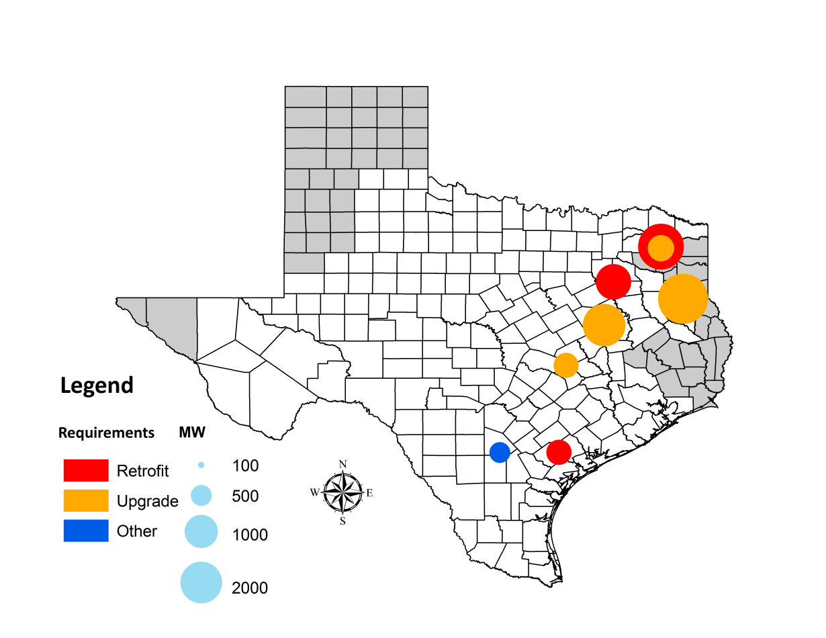
Regional Haze Affected Units in ERCOT
Monticello 3
Monticello 1, 2
Big Brown 1, 2
Martin Lake 1, 2, 3
Sandow 4
Limestone 1, 2
San Miguel
Coleto Creek

Slide 9
Cooling Water Intake Structures Rule
Mercury and Air Toxics Standards (MATS)
Regional Haze Federal Plan
Clean Water Act Section 316(b)
Ash Disposal Rule
Clean Power Plan
Cross-State Air Pollution Rule (CSAPR)
Requires controls to limit impacts to aquatic life at cooling water intake structures
Costs to:
Coal units
Natural gas units
Compliance Date:
January 2015
April 2015
2015-2018*
2018-2020**
2018-2022
2020-2029; 2030
Status | Compliance Requirements | Next Milestone
Final rule | Install or upgrade modified traveling screens and fish return systems | Compliance
Color key:
No or low costs
Moderate costs
High Costs
*Longer timeframes for facilities required to close. Does not include the proposed Steam Electric Effluent Limitation Guidelines (ELG) rule.
**Subject to timing of final rule

Slide 10
Clean Power Plan
Mercury and Air Toxics Standards (MATS)
Regional Haze Federal Plan
Clean Water Act Section 316(b)
Ash Disposal Rule
Clean Power Plan
Cross-State Air Pollution Rule (CSAPR)
Sets carbon dioxide emissions limits for existing sources
EPA separately proposed emissions limits for new/modified sources
Costs to:
Coal units
Natural gas units
Compliance Date:
January 2015
April 2015
2015-2018*
2018-2020**
2018-2022
2020-2029; 2030
Status | Compliance Requirements | Next Milestone
Proposed rule | Uncertain, but likely to result in significant reductions in output from coal units | Final rule (projected mid-summer 2015)
Color key:
No or low costs
Moderate costs
High Costs
*Longer timeframes for facilities required to close. Does not include the proposed Steam Electric Effluent Limitation Guidelines (ELG) rule.
**Subject to timing of final rule

Slide 11
Ozone National Ambient Air Quality Standards
Mercury and Air Toxics Standards (MATS)
Regional Haze Federal Plan
Clean Water Act Section 316(b)
Ash Disposal Rule
Clean Power Plan
Cross-State Air Pollution Rule (CSAPR)
Would tighten the national ozone standard
Not shown in timeline; potential impacts would begin in early/mid 2020s
Costs to:
Coal units
Natural gas units
Compliance Date:
January 2015
April 2015
2015-2018*
2018-2020**
2018-2022
2020-2029; 2030
Status | Compliance Requirements | Next Milestone
Proposed rule | Potential requirements for additional emissions controls; tightening of CSAPR | Final rule (projected Oct. 2015)
Color key:
No or low costs
Moderate costs
High Costs
*Longer timeframes for facilities required to close. Does not include the proposed Steam Electric Effluent Limitation Guidelines (ELG) rule.
**Subject to timing of final rule

Slide 12
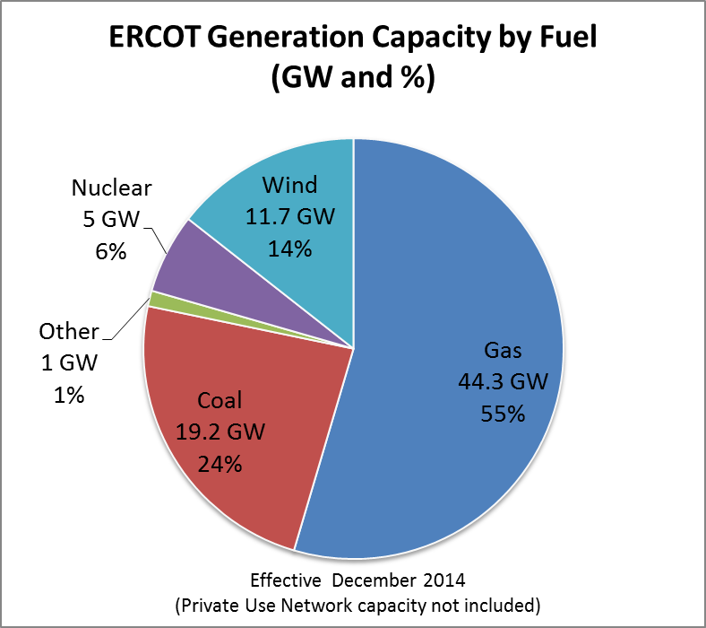
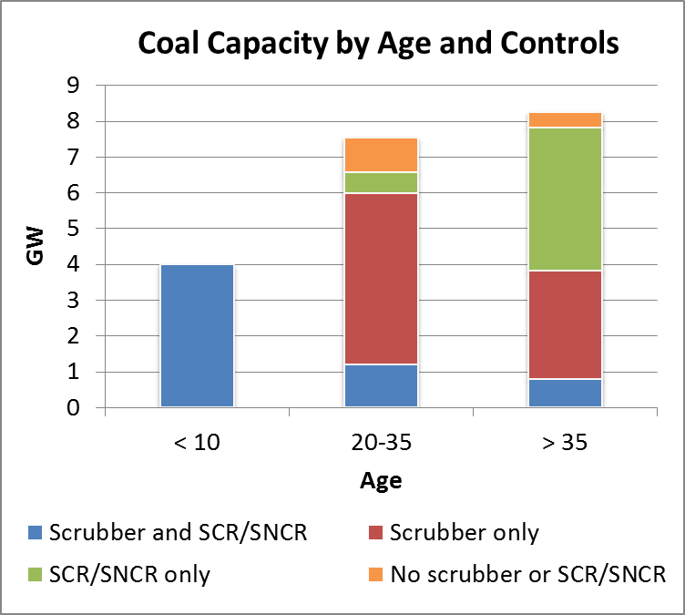
Current ERCOT Fleet
SCR = Selective catalytic reduction
SNCR = Selective non-catalytic reduction

Slide 13
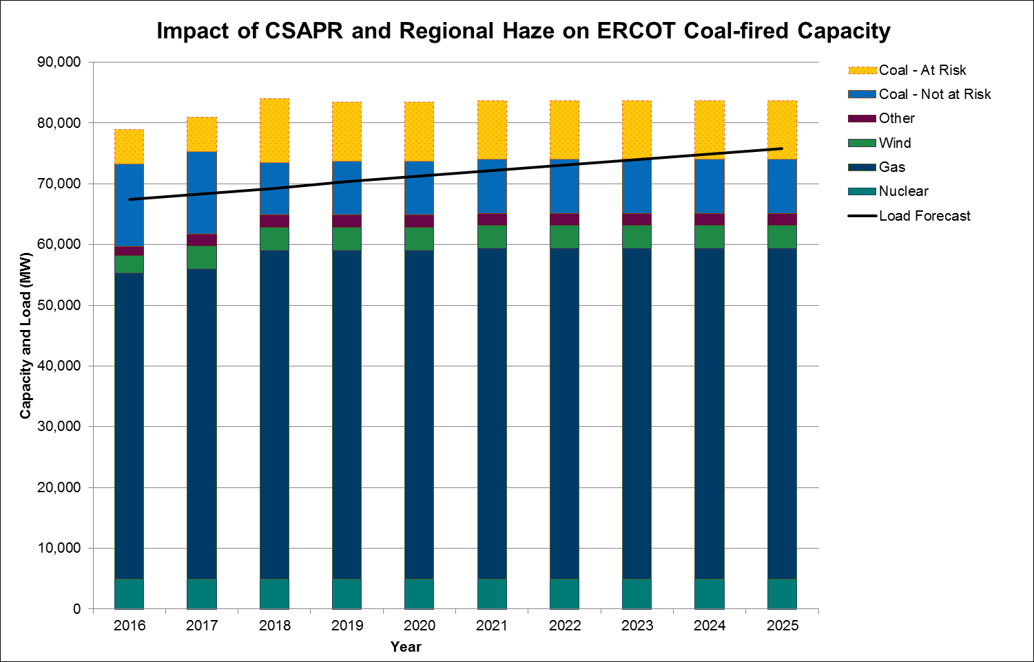
Capacity at Risk from CSAPR and Regional Haze

Slide 14
Drought Risk

Slide 15
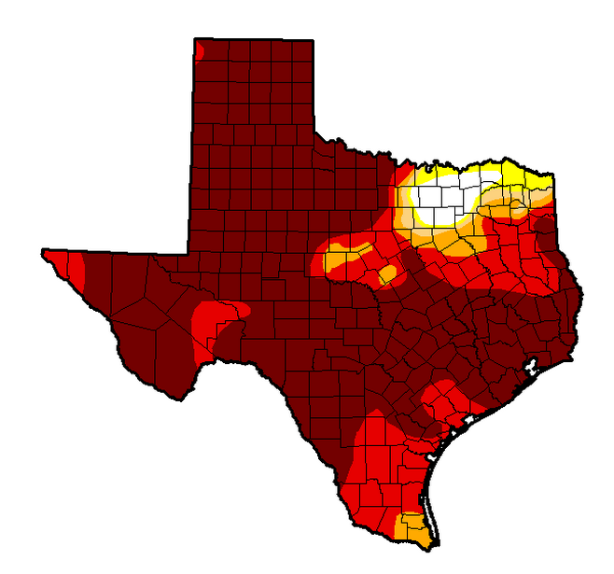
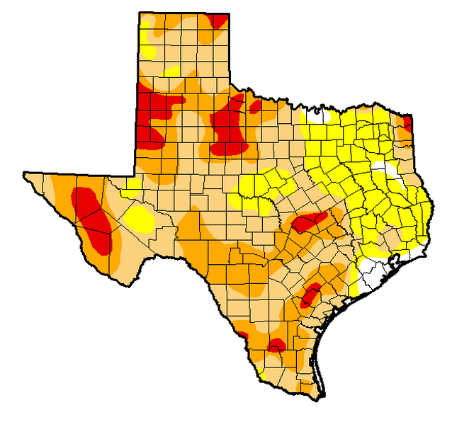
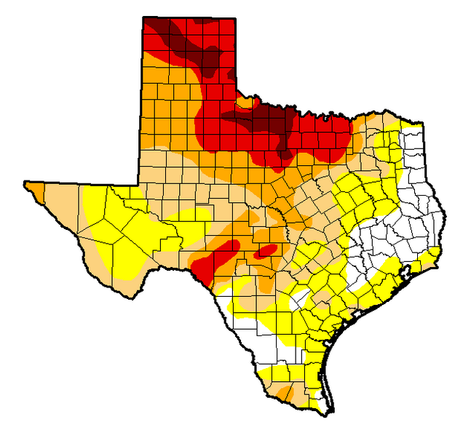
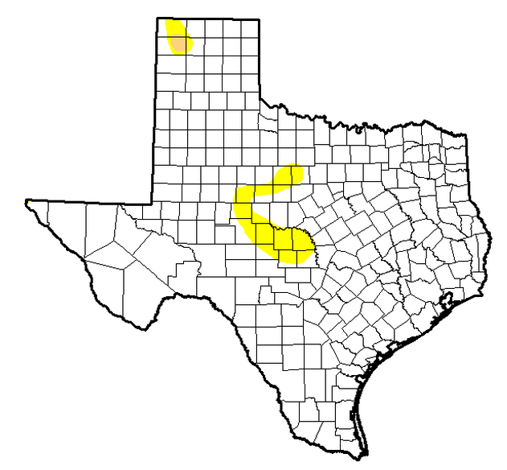
Historical versus Current Drought Conditions
July 2011
July 2012
96% of the state
in moderate or worse drought
77% of the state
in moderate or worse drought
July 2014
July 2015
60% of the state
in moderate or worse drought
0.2% of the state
in moderate or worse drought
Maps from National Drought Mitigation Center

Slide 16
Water Use in Texas by Use Type (2010)
Adapted from TWDB 2010 Water Use Survey Estimates

Slide 17
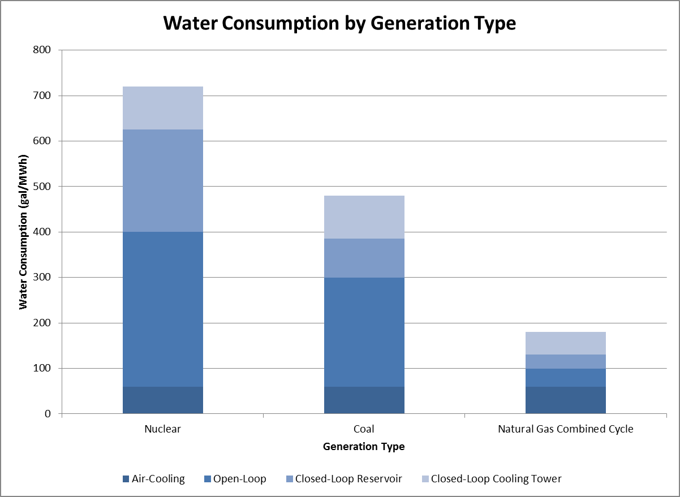
Water Consumption by Generation Type
Technologies consuming small or negligible amounts of water:
Natural gas combustion turbine
Wind turbine
Photovoltaic solar
Adapted from Stillwell et al. 2009, “Energy-Water Nexus in Texas”

Slide 18
Drought Risk Factors
Risk
MW and Cooling Technology
Source Redundancy (additional Supply)
MWh Produced
Reservoir and Basin Level
Rainfall
Reservoir Demand
Reservoir Temperature
Reservoir Storage
Intake or Critical Level

Slide 19
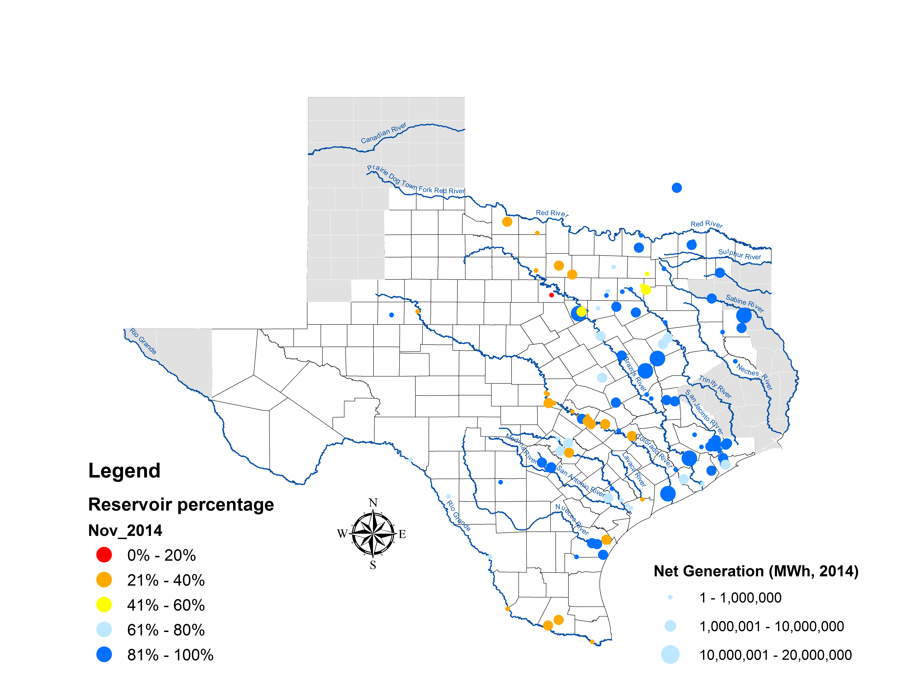
Reservoir Storage during 2011-2014 Drought

Slide 20
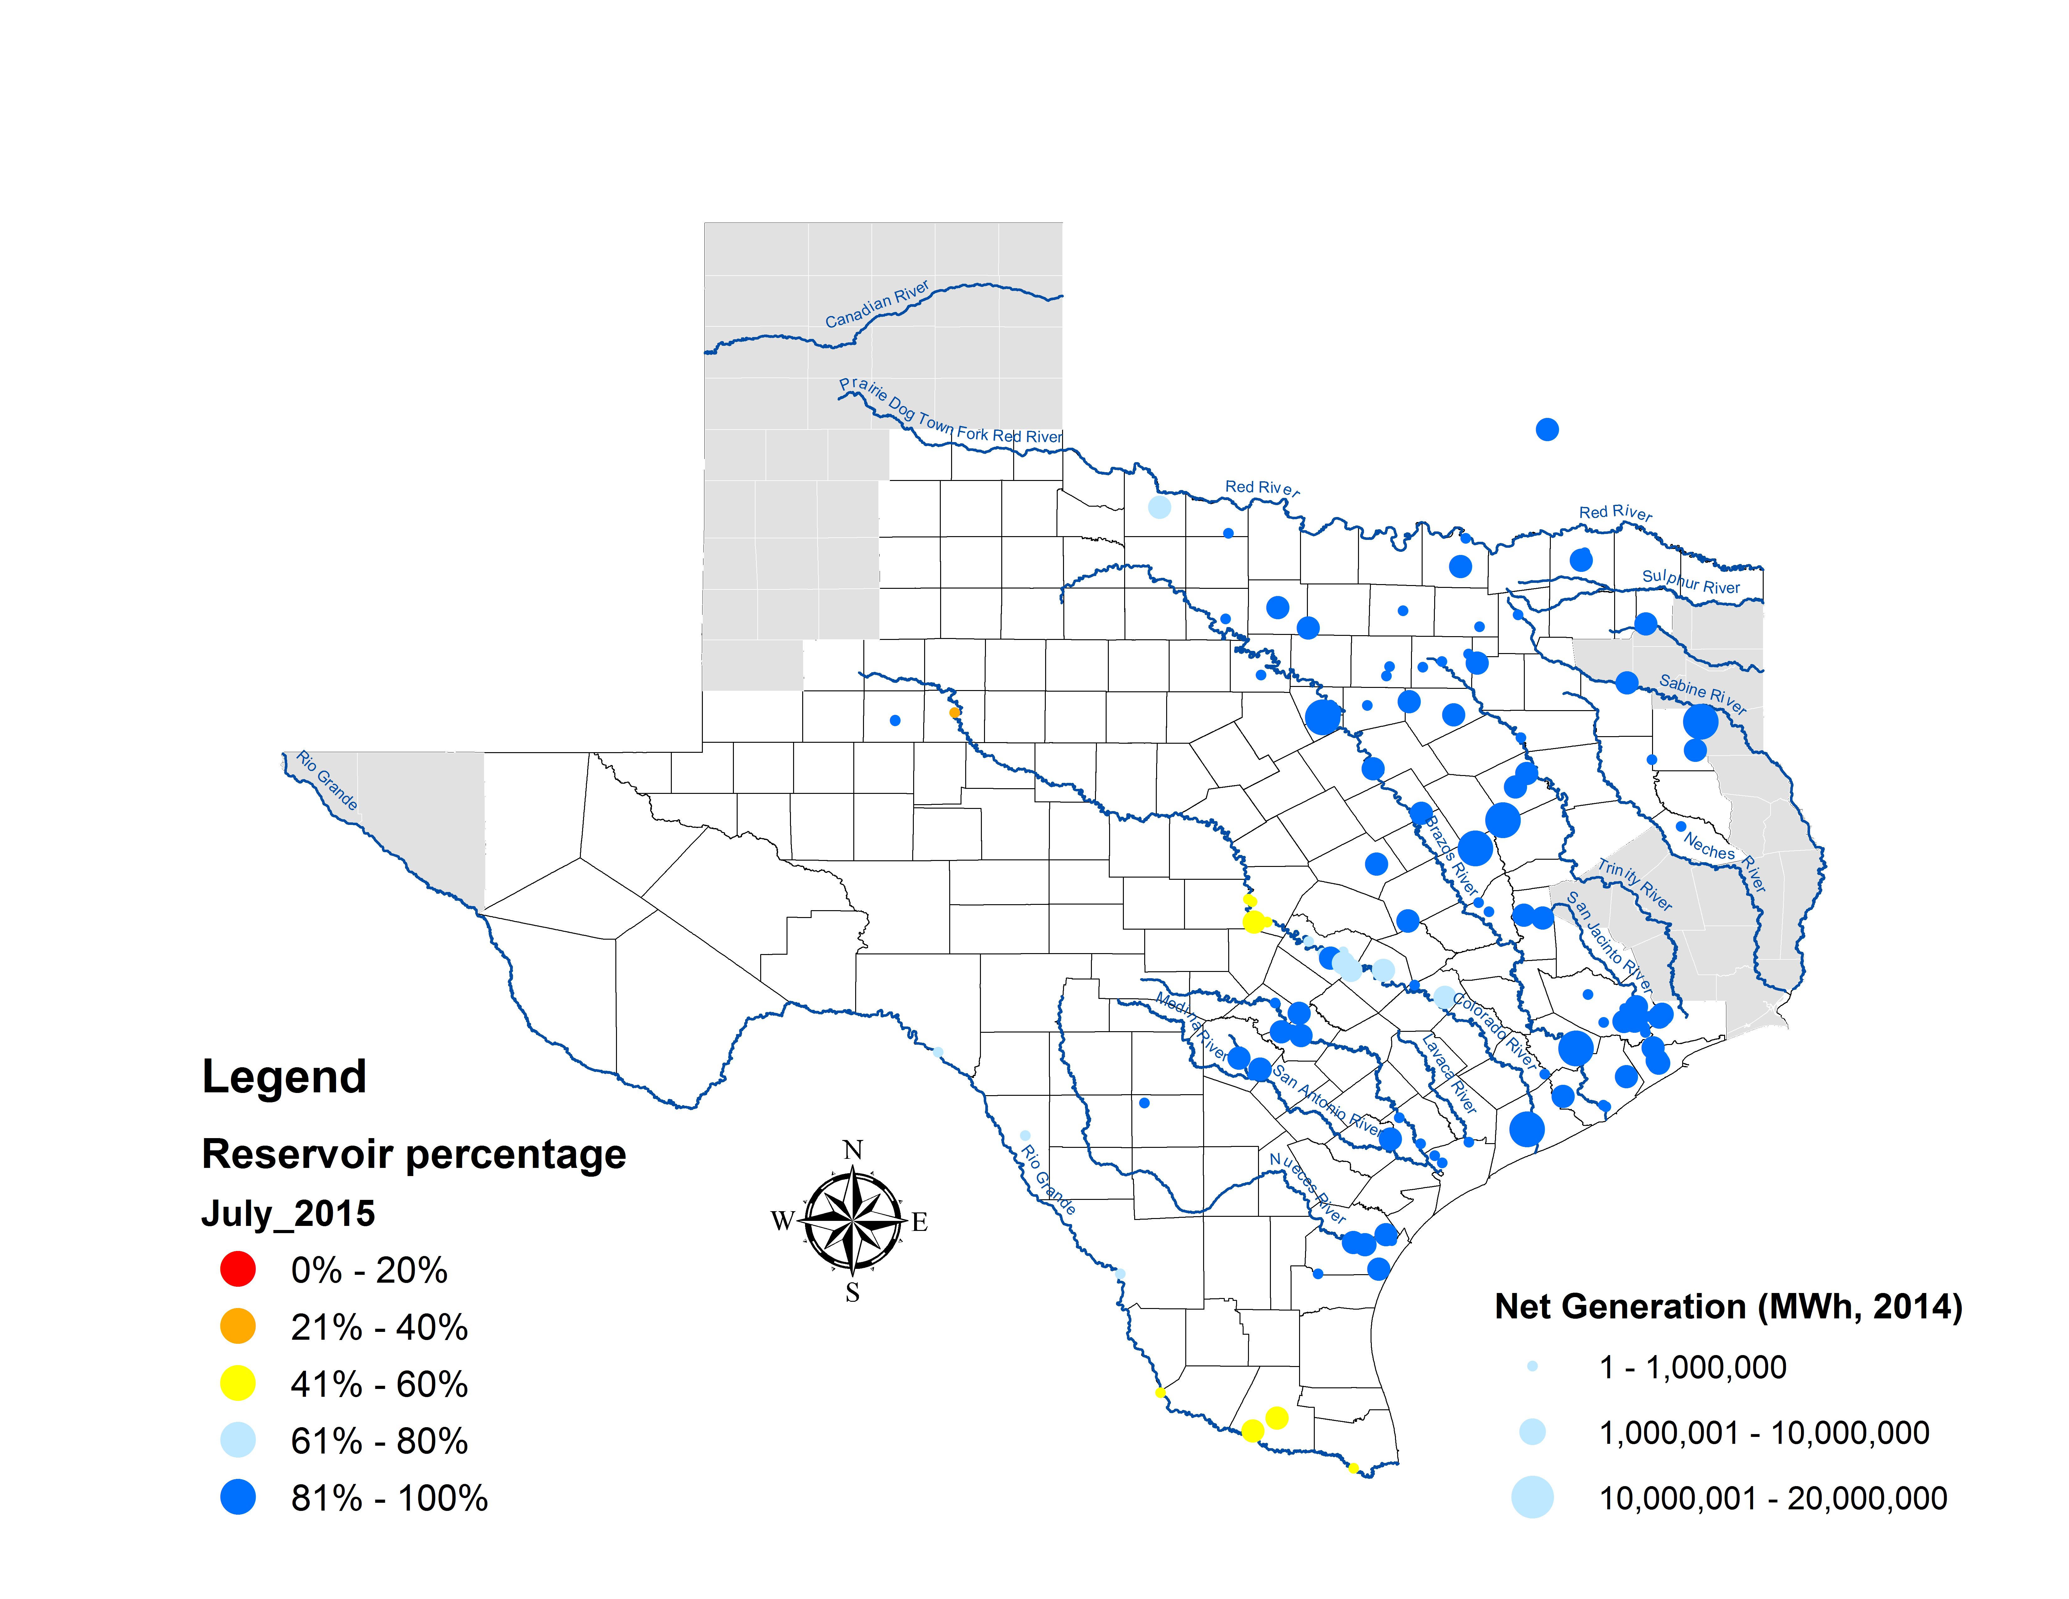
Current Reservoir Storage

Slide 21

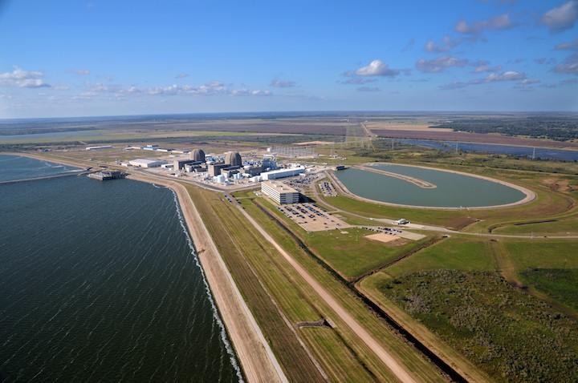
CREZ Reactive Study
Questions?

