Slide 1
Review of Aging Projects
Additional Materials
July 16, 2015

Slide 2
NOGRR084 - Daily Grid Operations Summary Report

Slide 3
NOGRR084 – Daily Grid Operations Summary Report
Extensive gray-boxes in the Nodal Operating Guide

Slide 4
NPRR181 – FIP Definition Revision

Slide 5
NPRR181 - FIP Definition Revision
Section 2.1

Slide 6
NPRR210 - Wind Forecasting Change to P50, Sync with PRR841

Slide 7
NPRR210 - Wind Forecasting Change to P50, Sync with PRR841
Section 5.7.4 (2)

Slide 8
NPRR256 - Add Non-Compliance Language to QSE Performance Standards, Sync with PRR787

Slide 9
NPRR256 - Add Non-Compliance Language to QSE Performance Standards, Sync with PRR787
Section 8.1.1.4.1 (6)(c)

Slide 10
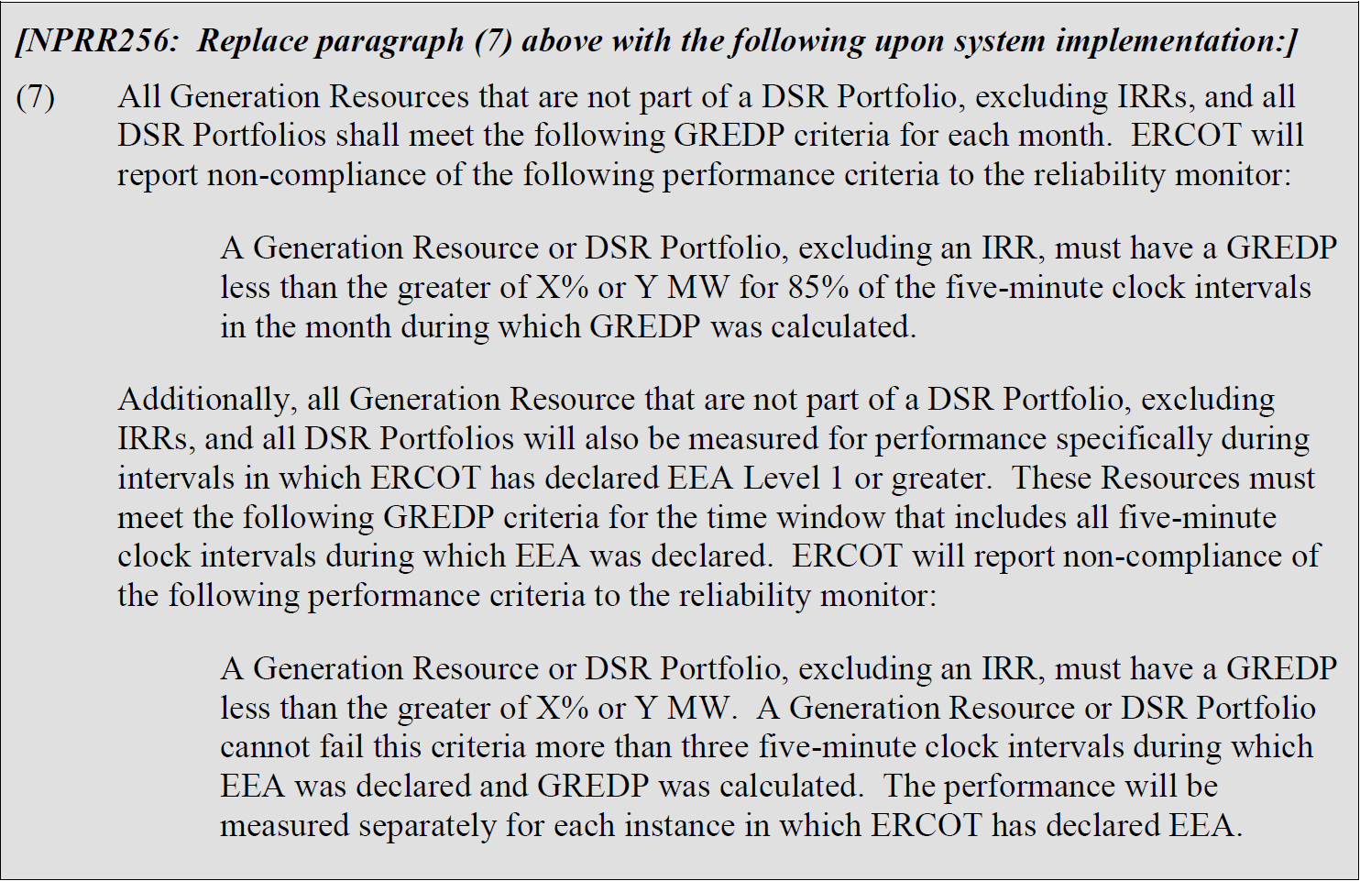
NPRR256 - Add Non-Compliance Language to QSE Performance Standards, Sync with PRR787
Section 8.1.1.4.1 (7)

Slide 11
NPRR272 - Definition and Participation of Quick Start Generation Resources

Slide 12
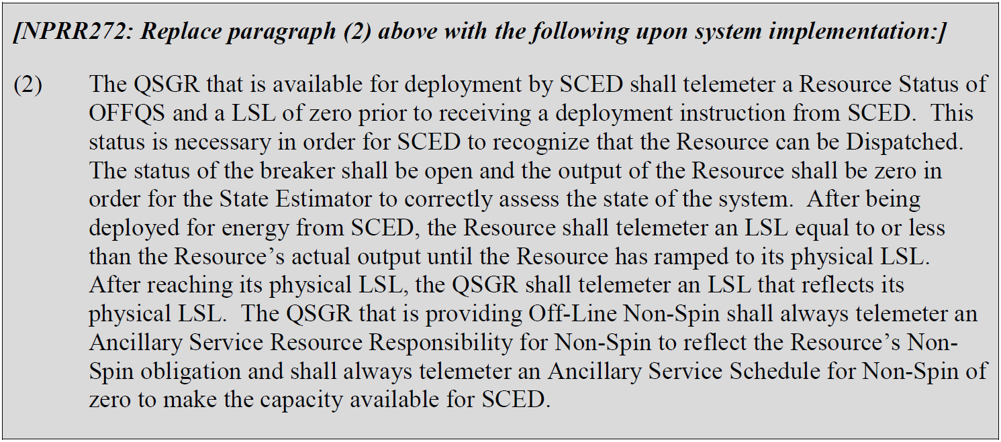
NPRR272 - Definition and Participation of Quick Start Generation Resources
Section 3.8.3

Slide 13
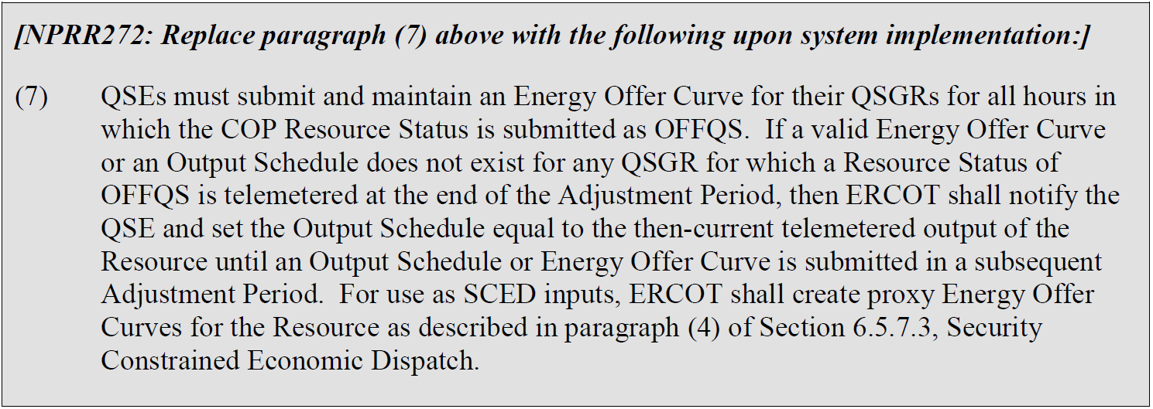
NPRR272 - Definition and Participation of Quick Start Generation Resources
Section 3.8.3 and Section 3.9.1

Slide 14
NPRR285 – Generation Resource Base Point Deviation Charge Corrections

Slide 15
NPRR285 - Generation Resource Base Point Deviation Charge Corrections
Section 6.5.7.4 (e)

Slide 16
NPRR327- State Estimator Data Redaction Methodology

Slide 17
NPRR327 - State Estimator Data Redaction Methodology
Section 3.20

Slide 18
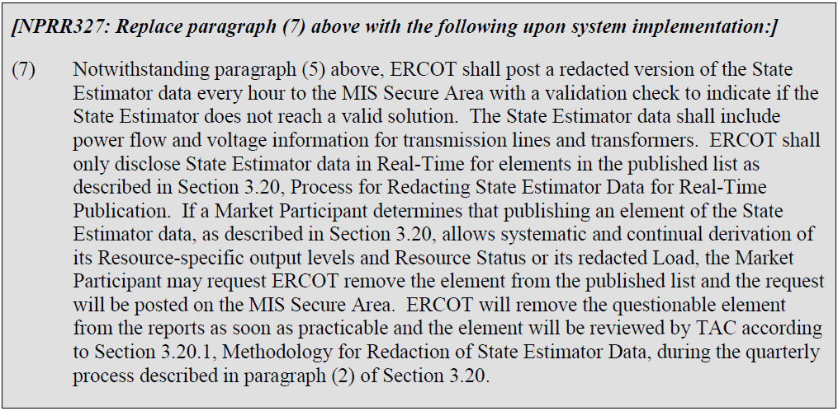
NPRR327 - State Estimator Data Redaction Methodology
Section 3.20

Slide 19
NPRR455 - CRR Shift Factors Report

Slide 20
NPRR455 - CRR Shift Factors Report
Section 7.5.3.1 (2)

Slide 21
NPRR484 - Revisions to Congestion Revenue Rights Credit Calculations and Payments

Slide 22
NPRR484 - Revisions to Congestion Revenue Rights Credit Calculations and Payments
Extensive gray-boxes in the Nodal Protocols

Slide 23
NPRR493 - Half-Hour RUC Clawback

Slide 24
NPRR493 - Half-Hour RUC Clawback
Section 2.1 and Section 5.7.2

Slide 25
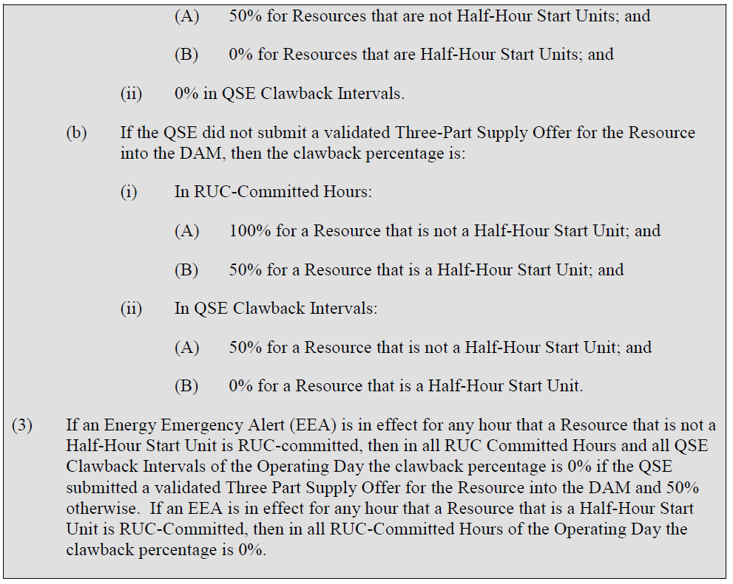
NPRR493 - Half-Hour RUC Clawback

Slide 26
NPRR515 - Day-Ahead Market Self-Commitment of Generation Resources

Slide 27
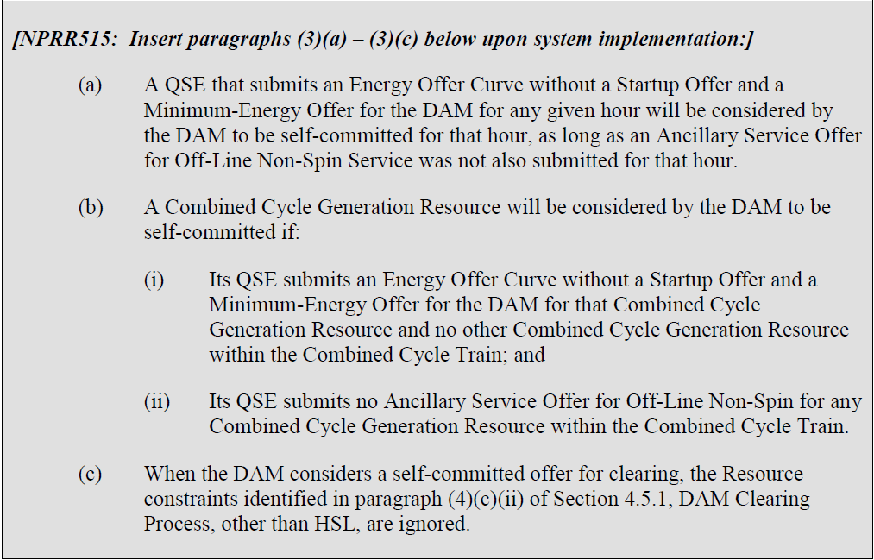
NPRR515 - Day-Ahead Market Self-Commitment of Generation Resources
Section 4.4.9.1

