Slide 1

LTSA Scenario Workshop

Slide 2
Outline
Overview
Drivers
Scenarios
2014 LTSA results

Slide 3
Drivers used in 2014 LTSA
Drivers | Brief Description
Economic Conditions | US and Texas economy, regional and state-wide population, oil & gas, and industrial growth, LNG export terminals, urban/suburban shifts, financial market conditions and business environment
Environmental Regulations and Energy Policies | Environmental regulations including air emissions standards (e.g., ozone, MATS, CSAPR), GHG regulations, water regulations (e.g., 316b), and nuclear safety standards; energy policies include renewable standards and incentives (incl. taxes/financing), mandated fuel mix, solar mandate, and nuclear re-licensing.
Alternative Generation Resources | Capital cost trends for renewables (solar and wind), technological improvements affecting wind capacity factors, caps on annual capacity additions, storage costs, other DG costs, and financing methods.
Natural Gas and Oil Prices | Gas prices are a function of total gas production, well productivity, LNG exports, industrial gas demand growth, and oil prices. Oil prices are dependent on global supply and demand balance, spread of horizontal drilling technologies. Oil and gas prices will affect drilling locations within Texas.

Slide 4
Drivers used in 2014 LTSA
Drivers | Brief Description
Transmission Regulation and Policies | New policies around transmission build-out, interconnections to neighboring region and cost recovery
Generation Resource Adequacy Standards | Economically-determined versus mandated reserve margins and flexible resource requirements
End-Use/New Markets | End use technologies, efficiency standards and incentives, demand-response, changes in consumer choices, DG growth, increase interest in microgrids
Weather and Water Conditions | May affect load growth, environmental regulations and policies, technology mix, average summer temperatures, frequency of extreme weather events, water costs

Slide 5
The 2014 LTSA Scenarios
Current Trends
High Economic Growth
Stringent Environmental Regulations/Solar Mandate
Global Recession
High Natural Gas Prices
Low Global Oil Prices
Water Stress
High System Resiliency
LNG Export Growth
High Efficiency/Distributed Generation

Slide 6
1. Scenario: Current Trends
Economic Growth
Migration to TX along I-35 corridor
Growth in south Texas
Industrial growth in Houston, I-35, Midland/Odessa, Valley
~1.5% load growth – high growth in near term then tapering off in long-term
LNG growth based on permits existing – needs review
Oil production rates follow trend in recent EIA projections for Texas
Story:
Same old, same old. The recent population and economic growth in Texas continues in the near future, fueled largely by the continued growth of the oil and gas sector and the relative robust Texas economy compared to the rest of the U.S. World oil prices high enough to keep increasing oil production in the short-term, keeping domestic natural gas prices relatively low. With low gas prices, several LNG export terminals are built between 2014 and 2024. Modest wind growth continues based on economics without production tax credits. Capital costs for solar continues to decline at a slower rate than recent history. No required reserve margin is set for ERCOT and the environmental regulations continues to be moderate, with no explicit federal carbon tax or required national cap and trade, but greenhouse gas emissions become regulated beyond 2016.
Transmission Regulation /Policy
Policy set to reduce constraints
Increased DC-tie capacity with neighboring region
Higher reliability standards are set by NERC to avoid load shedding
Generation Resource Adequacy
No reserve margin set for ERCOT
Maintain energy-only market
Economic retirements continues based on economics
Environmental Regulation
MATS and 316B are implemented by 2016
CSAPR Hybrid
Greenhouse gas regulation set with flexibility
No other major changes in environmental regulations
End-Use
Increased need for ancillary services
Increase penetration of demand response
Increasing distributed generation
Alternative Generation
Solar: 1000 MW / year
Wind capacity addition limit: 3,000 MW/yr
Capacity factor wind – rely on historical data from ERCOT
Capital cost wind ~$2,000/kW
Capital cost solar ~4.4% reduction/year
Overall renewable growth driven by economic entry
No production tax credit beyond 2013
No change to existing investment tax credit policy
Implications for ERCOT:
Continued modest economic and therefore load growth in Texas.
Growth in oil production and population across the state leads to new transmission needs
Continued increased renewables leading to reliability (inertia) issues
No major generation retirements triggered by stringent environmental regulations.
Weather / Water
No drought situation, but water supply continues to be a concern to existing and new generators.
No specific increase in electricity consumption due to drought conditions.
Gas/Oil Prices
EIA reference case or best available gas and oil price forecasts

Slide 7
Current Trends Scenario Highlights
Conditions existing today will generally continue into the future
ERCOT’s basecase load forecast with the addition of small amounts LNG
Natural gas prices increase slowly but are generally considered low
No major changes to environmental regulations
Trends in capital cost for new resources are increasing at GDP with the exception of Solar PV which is declining thru the planning period
Modest increase in penetration of demand response
No specified reserve margin, generator additions for conventional and renewable resources are by economics only
No PTC

Slide 8
Current Trends Scenario Results

Slide 9
2. Scenario: Global Recession
Economic Conditions
Net population growth in Texas ~1%
Urbanization with growth concentrated in the major cities
No industrial growth
Capital for new generation difficult to obtain
Little to no GDP growth or net load growth
Story:
Low energy prices threaten the Texas economy. Load growth is limited, resource expansion is limited to gas-fired plants and continued subsidized renewables. Stimulus programs help create incentives for consumers to replace old appliances and increase conservation. Coal plants that rely on coal by rail retire due to lower energy margins.
Transmission Regs/Policies
Same as assumed under Current Trends
Transmission faces lower construction cost per mile
Environ. Regs. / Energy Policy
Continuing modest environmental regulations, no significant changes from assumptions under Current Trends
Government incentives continue for high efficiency appliances
Continued subsidies for renewables (PTC/ITC)
Gen Resource Adequacy Standards
Retiring of coal plants due to low energy margins
System inertia issues increase
Alt Gen Resources
Lower oil/gas prices
Limited development of wind and solar due to low energy prices
Nuclear re-licensing
Slower solar cost decline due to reduced global demand
Implications for ERCOT:
Slow load growth
Growth in urban areas greater than in rural areas
Limited generation development, predominantly gas-fired, subsidized renewables
Import/export issues between urban areas will need to be addressed
Stability issues continue to increase due to low system load
End - Use
Customers are more cost conscious, thus more conservation
Limited growth of new technologies that are still high costs, such as storage
Low load growth due to increased efficiency and changed customer behavior
Gas/Oil Prices
Lower prices (~$1/mmbtu lower than assumptions under Current Trends)
Less oil exploration and production
No LNG development
Weather / Water
Same as under Current Trends – no drought conditions, but limited water supply for new generation

Slide 10
Global Recession Highlights
Natural gas price is low
Scenario includes PTC and ITC
No Reserve Margin
Solar capital costs decline slower
Lowest reserve margin of all scenarios – 9% in 2029

Slide 11
Global Recession Scenario Results

Slide 12
3. Scenario: High Economic Growth
Economic Conditions
High Texas GDP growth
High population growth (2.5%/yr)
Pro-business environment
Industrial growth concentrated in Houston, I-35 corridor, Midlands/Odessa, Lower Rio Grand Valley
Higher LNG exports than under Current Trends
Capital is available to support new generation and transmission
Story:
Higher economic growth than under Current Trends. Growth occur throughout Texas driven in large part by oil and gas sector and related upstream and downstream industries.
Transmission Regs/Policies
Same as under Current Trends
Higher cost for Transmission (for both materials and labor)
Gen Resource Adequacy Standards
Likely to impose a resource adequacy requirement
Environ. Regs/Energy Policy
Continued modest environmental regulations, no significant changes from assumptions under Current Trends
U.S. more focused on developing domestic energy sources
Implications for ERCOT:
High load growth
High urban growth
High industrial growth, concentrated through I-35 corridor, Midlands/Odessa, and Lower Rio Grand Valley
Higher costs for new generation and transmission due to high commodity prices
Potential challenges with generation portfolios keeping pace with load profile changes
End-Use
Growth of household income
However, more energy-efficient new homes
Overall efficiency gains are similar as under Current Trends
Fast adoption of new demand-side technologies
Alt. Gen. Resources
Renewables are economic and growth occur due to higher gas prices
More technological improvement than under Current Trends for renewables and storage
Cap on annual wind capacity growth
Weather / Water
Higher water costs, but does not limit growth (e.g., potentially more dry cooling for new generation)
Oil/Gas Prices
Higher (but still relatively low) gas prices than under Current Trends (~$1.5/mmbtu higher than in Current Trends)
Same oil prices as under Current Trends

Slide 13
High Economic Growth Scenario Highlights
High load forecast
Capital cost change
  Increase CT and CC capital cost by 25%
  Solar starts from 3000 $/kW in 2013 and decreases 5% every year;
  All the other technologies the same as in Current Trends
LNG Medium assumption
Gas price is 1.5 $/MMBtu higher than in Current Trends
13.75% reserve margin target

Slide 14
High Economic Growth Scenario Results

Slide 15
4. Scenario: High Efficiency/Distributed Generation
Economic
Same as under Current Trends
Additional growth in clean technologies
Story:
Economic growth good enough to allow new investments in efficiency and distributed generation. Customers increase acceptance of EE/DG technologies which leads to widespread market adoption
Transmission Reg.
Same as under Current Trends
Gen Resource Adequacy Standards
Same as under Current Trends
Environ. Regs/Energy Policy
Increase stringency in building codes, with more net zero buildings
Government provides more incentives for building retrofits to increase efficiency
Increase in appliance standards increase
More attractive DR programs/pricing
End – Use Customer Acceptance
More high efficiency homes and buildings built
Efficiency gains are above those under Current Trends, thus lower net load growth
Higher installation DG
Higher DR participation
More options for microgrids, smart appliances, etc.
Alt. Gen. Resources
Capital cost for wind and solar technologies and CHP decrease faster than under Current Trends
Improved storage technology and lower cost
Implications for ERCOT:
Lower net load growth compared to under Current Trends
More market-based programs for demand response
Widespread of distributed generation creates some operational challenges
Gas Price / Oil Price
Higher gas prices than under Current Trends: also higher resulting wholesale electricity prices
Weather / Water
Above average summer temperatures
Greater water stresses and higher water costs than under Current Trends.

Slide 16
High EE and DG Highlights
High natural gas price
High amounts of EE, DR and DG

Slide 17
High EE and DR Scenario Results

Slide 18
5. Scenario: High Natural Gas Prices
Economic Conditions
GDP growth slightly higher than under Current Trends
Population growth ~2.3%/yr
Pro-business environment
Higher LNG exports than under Current Trends
Reduced Industrial growth (downstream facilities)
Increased gas exploration in Texas
Story:
Natural gas prices are high, but are below global natural gas prices – thus still continued LNG export as under Current Trends.
No impediments to LNG exports
High gas prices also reduce the downstream industrial growth compared to under Current Trends
Increase in renewable development compared to under Current Trends, due to higher gas and wholesale energy prices
Transmission Regs / Policies
Same as under Current Trends
Gen Res Adequacy Standards
Same as under Current Trends
Environm. Regs / Energy Policy
Modest environmental regulation, same as in under Current Trends
No regulatory impediments to LNG exports
Lower coal plant retirements due to higher energy margin
Implications for ERCOT:
High load growth
High urban growth
Reduced downstream industrial growth (in the Houston, Corpus, and coastal areas)
End - Use
Motivate high energy efficiency at a higher rate than current trends.
Alt. Gen Resources
Renewables are more economic and thereby more growth than under Current Trends
Annual limit on wind development
More technological improvements for renewables
Weather / Water
Same as under Current Trends
Increased water costs which contribute to the higher cost of producing natural gas
Gas Prices / Oil Prices
Natural gas prices $3.50/mmbtu above Current Trends by 2020
Oil prices same as under Current Trends

Slide 19
High Natural Gas Prices Highlights
Lower solar and storage costs than under Current Trends
Gas price is 3.5 $/MMBtu higher than under Current Trends
High EE and DG as under Stringent Environmental scenario, DR growth additional 3% every year than under Current Trends

Slide 20
High Natural Gas Scenario Results

Slide 21
6. Scenario: Stringent Environmental Regulations
Economic Conditions
Moderate economic growth – (some limits on oil & gas development)
Less oil and gas production than under Current Trends
Less LNG exports than under Current Trends
Population growth same as under Current Trends at ~1.5%/yr, in the I-35 corridor and Houston areas but decrease in the Valley (Midland) area
Increase in industrial production of alternative energy and efficiency-related technologies
Story:
Aggressive action on mitigating environmental impacts of energy sector, including electric generation and oil & gas sectors
Higher gas, oil, electricity prices, and lower solar, wind, storage costs.
Assumes more DC ties with neighboring regions and the development of concentrated solar regions that will require solar-CREZ lines to and from west Texas.
Higher electricity prices drive more adoption of energy efficiency and customer-sited solar PV.
Uncertain development of new nuclear & geothermal
Oil Prices
Higher oil prices than under Current Trends
But growth in oil exploration and development limited by stringent environmental regulations
Enviro Regs / Energy Policies
Federal greenhouse gas emission standard implemented
Federal standard of 25% renewable / energy efficiency
More stringent ozone standard implemented
Toxic emissions standards implemented
Some limits on drilling and associated disposal wells
Government imposes some water usage limits, raising cost of water
More dry cooling for natural gas generators
Moderate carbon tax / price materializes
Increase nuclear safety concerns than under Current Trends
Transmission Regs
More DC ties such as Tres Amigas / El Paso / Cross Wind
Solar CREZ to west Texas to take advantage of Pecos / Brewster / El Paso
Potential ties w/ Mexico
Implications for ERCOT:
Challenge in matching generator w/ load
Reserve & integrate issues
Potential need for new ancillary services to provide faster & flexible resources
More transmission for solar CREZ
Need to develop rules for integrating storage & distributed generation
Need to address issues associated with adding DC ties to neighboring regions (including NERC and FERC-related issues)
End – Use Customers / Policies
Continued stringent building code – 10% improvement every 3 years
More onsite solar penetration –
  1000 MW by 2022
  3000 MW by 2032
Existing buildings retrofits – 20% improvement in existing buildings efficiency
Alt. Generation Resources
Continued PTC/ITC through 2020, reducing over time
Continued decrease capital costs for solar: 3-5% /yr
Wind capacity factors increase due to technological improvements
Cap on annual wind generation
Increased development of storage due to cost reductions for batteries & compressed air
More financing mechanism are available (e.g.: real estate investment trusts, property-assessed clean energy financing, and others]
Weather & Water
More extremes helps convince public and politicians to take action
Higher water costs than under Current Trends, increasing dry-cooling for new generators
Natural Gas Prices
Moderate increase than under Current Trends
Same amount of LNG exports as under Current Trends

Slide 22
Stringent Environmental Scenario Highlights
ERCOT’s Current Trends load forecast was adjusted for increased EE and 2,400 MW of Solar DG by 2029
Current Trends NG forecast was increased by $1.50/mmBtu in each year
Costs for SO2, NOx, and CO2 were added
  CO2 costs ranged from $25/ton in 2018 to $61/ton in 2029
  At these CO2 costs ERCOT exceeds current GHG emission levels goals for both 2020 and 2030
PTC and ITC were added to Wind and Solar expansion
Demand response was increased an additional 3% per year over Current Trends amounts
DC Ties were increased by 3,000 MW to represent new connections to external ERCOT markets
This scenario will be analyzed with Kermit

Slide 23
Stringent Environmental Scenario Results

Slide 24
8. Scenario: High LNG Export
Economic Conditions
High economic growth in Texas, especially industrial growth at gulf coast,
High growth in oil & gas exploration
High growth in manufacturing near border & ports
Growth in immigration to Texas
Story:
Very healthy global economy drives high demand for natural gas. Oil & gas exploration in Texas remain high. Abundant natural gas supply spurs large export and industrial growth in Texas.
Transmission Regulations
Same as Current Trends
Environmental Regulations
Environmental regulations conducive to continued growth in oil & gas production
[Other environmental regulations are same as in Current Trends]
Other policies are conducive to LNG export
Resource Adequacy Standards
Could deviate from Current Trends if additional growth from the LNG exports drive faster demand growth than naturally supported by market entry.
Implications for ERCOT:
High electricity load growth on the coast & dry gas basins
Transmission improvements needed to serve new industrial load and oil & gas load
Pressure on resource adequacy [due to uncertainties around how to meet the fast growing electric demand]
End - Use
More potential for industrial demand response
Same as Current Trends for non-industrial demand response
More CHP [due to high NG supply]
Alternative Generation
Same as Current Trends
Natural Gas & Oil Prices
$10/MMBtu price difference with the rest of world
High oil prices $100+/barrel
[Domestic natural gas price could be equal/higher/lower than in Current Trends]
Weather / Water
Technology improvement in oil & gas production
Technological improvements alleviate additional pressure on water supply

Slide 25
High LNG Export Highlights
Load forecast between High Economic Growth and Current Trends scenarios
Added 4.1 bcf/d LNG from 2018 and additional 5.7 bcf/d from 2019, the total is around 3840 MW flat load

Slide 26
High LNG Export Scenario Results

Slide 27
9. Scenario: High System Resiliency
Economic Conditions
Same as in Current Trends
Companies are more willing to locate in Texas due to perceived highly reliable electricity system
Story:
[“Black swan” events on the grid occur more regularly across the US, impacting system reliability]
Northeast-type events (e.g. blackouts, storms) occur in ERCOT, Rio Grande Valley blackout,
West Texas load growth continues
Houston import constraints + challenging reliability events occur
Regulators have major concerns, generation and load see high risk
[Value of resilience and system flexibility is broadly recognized and stakeholders are more willing to invest in infrastructure to ensure greater resiliency]
Trans Regs
CREZ concept applied to load centers
[Legislative direction or PUCT mandate to increase system resiliency and flexibility beyond traditional planning criteria]
[Increased reliability standards applied to transmission planning]
Environmental Regs / Energy Policy
[Environmental regs and renewables] are the same as in Current Trends
[Limitations on] generation development near load centers
Res Adequacy
Regulators’ desire for a more robust fleet leads to required reserve margin and/or centralized capacity market
Alt. Gen
Same as in Current Trends
[Perceived reliability issues could result in increased distributed generation and higher backup gen / cogen at the customers]
Implications for ERCOT:
Highly reliable system would drive more load growth
Reduced congestion risk would lead to greater generation buildout
System will be able to support major power transfers within ERCOT during highly variable conditions (weather, wind, growth…)
Highly reliable & flexible system as a result
[Be able to serve spikes in load growth]
End Use
Same as Current Trends
Gas / Oil Prices
Same as Current Trends
Weather / Water
Same as Current Trends

Slide 28
High System Resiliency Highlights
DC Ties were increased by 3,000 MW to represent new connections to external ERCOT markets as under Stringent Environmental Scenario
Included a 13.75% reserve margin target
DR growth is 5% every year as under String Environmental Scenario

Slide 29
High System Resilience Scenario Results

Slide 30
10. Scenario: Water Stress
Economic Conditions
[Moderate decline in population and economic growth with higher impacts on localities with water intensive industry]
Increased water and electricity prices
Productivity and job losses in agriculture
Potential negative impact on oil & gas extraction
Impact on local economy
Story:
The rate of population and economic growth moderately declines, due to sustained [multi-year] drought conditions.
Sustained drought conditions impact water-intensive generation resources (nuclear/coal/steam units), and lead to significant increase [over those in Current Trends] in renewables and storage, dry cooling [on thermal generation], and transmission expansion.
Transmission Regs
More DC ties to neighboring regions
Potentially increase in transmission into high solar regions [possibly solar CREZ]
Increase in transmission due to policy/ regulatory changes resulting from drought
Enviro Regs / Energy Policies
Required drought management plans and water conservations
Stringent requirements on power generation water use leads to dry cooling
Tax breaks for drought resistant generation
[Other environmental regs are same as Current Trends]
Gen Res Adequacy Standards
Mandated reserve margin and increased operating reserves
Demand response [plays a larger role than in Current Trends]
Alt. Generation Resources
Continued investments in renewables, storage, and dry-cooling [with continued federal PTC/ITC continues]
Policy incentives for dry-cooling retrofits?]
Development of co-location desalination and power plants
[Renewable costs same as Current Trends]
Implications for ERCOT:
Derating units due to water resource limitations and generation retirements lead to challenges in meeting demand
Potential need for new ancillary services to meet the needs of integrating new renewable energy generation
More transmission [will be needed for expansion of renewables [over those in Current Trends]
[Seriously consider] more interconnections outside ERCOT.
End – Use Customer / Policies
Increase the development of demand-side management tools [increases EE penetration beyond those in the Current Trends]
Greater market penetration of time-of-use rates and water smart devices
Natural Gas and Oil Prices
Moderate increase in natural gas prices relative to in Current Trends [$1 – 2/MMBtu]
Moderate impact on local oil production, but prices are set internationally [at the same price as Current Trends]
Weather & Water
More drought than in the Current Trends
Hot summers
Limited water supply

Slide 31
Water Stress Highlights
High natural gas price
New thermal additions are dry cooled only
Includes PTC / ITC
Increased DC ties
Reserve margin set to 13.75%

Slide 32
Water Stress Scenario Results

Slide 33
Scenario summaries – Generation and Load (2029)
Inputs | Stringent Environmental | LNG Export Growth | High System resiliency | Current Trends | Water Stress | Global Recession | High EE/DG Growth | High Economic Growth | High Natural Gas Price
NG (%) | 57 | 56 | 52 | 51 | 50 | 46 | 46 | 45 | 43
Coal (%) | 4 | 23 | 27 | 25 | 26 | 28 | 28 | 28 | 27
Wind (%) | 18 | 9 | 9 | 9 | 9 | 13 | 10 | 10 | 12
Solar (%) | 8 | 5 | 3 | 6 | 7 | 3 | 7 | 8 | 9
Nuclear (%) | 11 | 9 | 9 | 8 | 8 | 9 | 9 | 9 | 9
Other (%) | 1.6 | 0.4 | 0.4 | 0.4 | 0.3 | 0.4 | 0.4 | 0.4 | 0.4
Reserve Margin (%) | 13.52 | 13.05 | 13.91 | 12.77 | 13.69 | 9.07 | 14.6 | 15.11 | 15.71
Peak load¹ (GW) | 87 | 95 | 90 | 87 | 87 | 82 | 82 | 93 | 89
Total energy (GWh) | 503 | 489 | 489 | 476 | 503 | 438 | 448 | 489 | 489
Natural Gas Price ($/MMbtu) | 7.85 | 6.35 | 6.35 | 6.35 | 7.85 | 6.63 | 7.85 | 7.85 | 9.85
Renewable Tax Credits | Yes | No | No | No | Yes | Yes | No | No | No
DC Ties (MW) | 4120 | 1120 | 1120 | 1120 | 1120 | 1120 | 1120 | 1120 | 1120
Reserve Margin Mandate (%) | - | - | - | - | 13.75 | - | - | 13.75 | -
1 – Coincidental ERCOT normal weather peak load

Slide 34
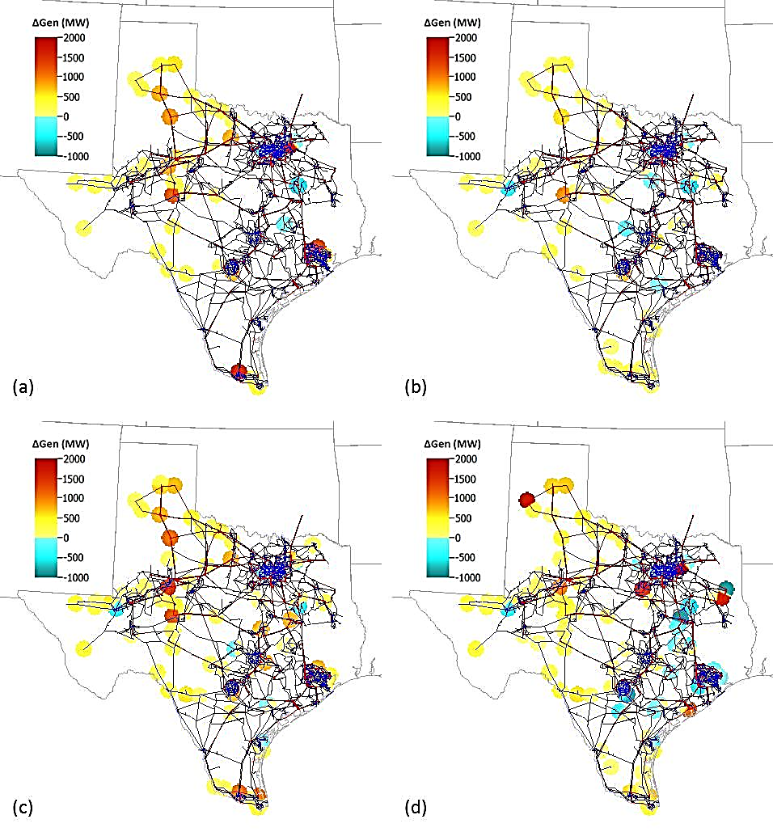
(a) Current Trends, (b) Global Recession, (c) High Economic Growth, and (d) Stringent Environmental scenarios.
Change in available generation by 2029

Slide 35
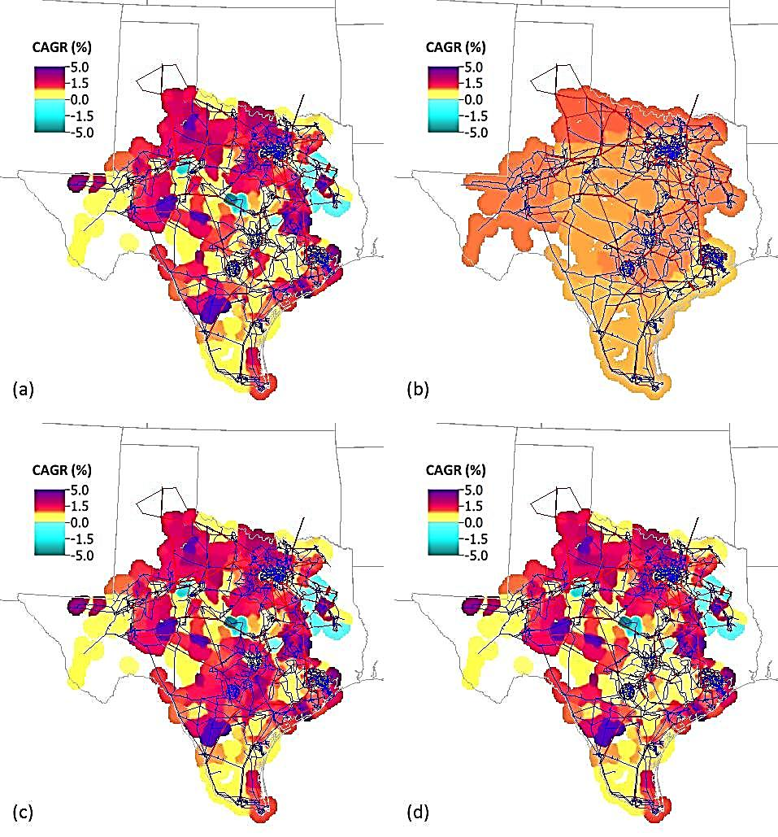
(a) Current Trends, (b) Global Recession, (c) High Economic Growth, and (d) Stringent Environmental scenarios.
Load growth rates by 2029

Slide 36
Significant Reliability Projects from 2014 LTSA
Index | Weather Zone | Project Name (Conceptual) | Current Trends |  | Global Recession |  | High Economic Growth |  | Stringent Environmental
 |  |  | 2024 | 2029 | 2024 | 2029 | 2024 | 2029 | 2024 | 2029
1 | North Central | West Roanoke project
2 | North Central | Rockhill project
3 | North Central | Fort Worth project
4 | North Central | Nevada project
5 | West South | Hamilton - Lobo 345-kV line
6 | South | New 345-kV path from La Palma to Loma Alta

Slide 37
Significant Congestion from 2014 LTSA
Scenario | Current Trends |  | Global Recession |  | High Economic Growth |  | Stringent Environmental
Constrained element | 2024 | 2029 | 2024 | 2029 | 2024 | 2029 | 2024 | 2029
Zenith - TH Wharton
Kiamichi Energy Facility - Kiowa Switch
Big Brown SES - Jewett
Hutto Transformer
Panhandle Interface |  |  | -
Kendall - Highway 46 |  |  |  |  |  |  |  | -
Kendall Transformer | - |  | -
Bracken - Highway 46 | - |  | - |  |  |  |  | -
Calaveras - Pawnee Switching Station |  |  |  |  |  |  | - | -
San Miguel Transformer |  |  |  |  |  |  | - | -
Richland Chambers - Big Brown SES | - |  |  | - | - |  |  | -
Austrop - Sandow Switch |  |  |  |  |  |  | - | -
Oklaunion - Riley |  |  |  |  |  |  | - | -
Gilleland Transformer | - | - | -
Morgan Creek SES - Tonkawa Switch | - |  | - | -
Code | Congestion
 | High
 | Medium
 | Low

