Slide 1
Project Update and Summary of Project Priority List (PPL) Activity
July 16, 2015

Slide 2
2015 Project Update – Agenda
  Project Portfolio Update p. 3-8
    Recent/Upcoming Project Highlights
    2015 Release Targets
    2016 Release Targets
    2015 Project Spending Update
    EMS Upgrade “Chill”
  Appendix
    Project Portfolio Gantt Chart p. 9-17
Location of Project Priority List (PPL): http://www.ercot.com/services/projects/index

Slide 3
Recent / Upcoming Project Highlights
2015 June Release – 6/13/2015 Complete
  CMM Release
    NPRR559, NPRR597, NPRR601, NPRR639
2015 June Release – Week of 6/22/2015 Complete
  2015 Market System Enhancements
    NPRR626, NPRR665, NPRR645, Max Shadow Price OBD
  NPRR543 – Message for Confirmed E-Tags
  SCR774(b) – Enhancement to Outage Scheduler and Reports
  SCR775 – Posting Results of Real-Time Data in a Display Format
2015 August Release – Week of 8/17/2015 In Flight
  SCR771 – ERCOT System Change Allowing Independent Master QSE to Represent Split Generation Resources
Note: Projected Go-Live dates are subject to change.
Please watch for market notices as the effective dates approach.

Slide 4
2015 Release Targets – Board-Approved NPRRs / SCRs / xGRRs
February 2/2 – 2/12 | March 3/23 – 3/27 | June |  | August 8/17 – 8/21 | September 9/21 – 9/25 | December 12/7 – 12/11
NPRR500 SCR772 | SCR778 SCR779 | NPRR559 NPRR597 NPRR601 NPRR639 | NPRR543 NPRR626 NPRR645 NPRR665 SCR774(b) SCR775 OBD (Shadow Price Caps) | SCR771 | NPRR553 NPRR573 NPRR588 NPRR589(b) NPRR615 NPRR698 | NPRR419 NPRR495 NPRR556 NPRR573 RMGRR126 RRGRR003
2 | 2 | 11 |  | 1 | 5 | 5
6/13 (CMM)
6/22 – 6/26
E
E
P
E
P
P
NS
NS
I
NS
NS
Late May
2015 TBD Items (and month they became “TBD”)
Aug 2014 | Oct 2014 | Dec 2014 | Jan 2015 | Feb 2015 | Mar 2015 | Apr 2015 | Jun 2015
NOGRR084 | NPRR327 H | NPRR272, SCR777 H | NPRR210, NPRR664 | NPRR493 | NPRR256 | NPRR568-ph2, NPRR644 | NPRR686
Go-live dates can differ from Protocol effective dates – Please refer to market notices for more details
Red Text: New additions and target release changes
NPRR589(b) – S&B portion
SCR774(b) – Addition of Comments field
Strike-Through Text: Previous target release changes
Release targets are subject to change
(a), (b), etc. indicates multiple phases
Project Status Codes: NS = Not Started, I = Initiation, P = Planning, E = Execution, H = On Hold

Slide 5
2016 Release Targets – Board-Approved NPRRs / SCRs / xGRRs
February Dates TBD | March Dates TBD | June Dates TBD | August Dates TBD | September Dates TBD | December Dates TBD
NPRR495 NPRR515 NPRR617 NPRR680 | NPRR620 NPRR662 NPRR679 NPRR683 | NPRR493 NPRR519 |  | NPRR219 NPRR439 SCR783 | NOGRR084 NPRR210 NPRR256 NPRR272 NPRR484(1b) NPRR484(2) SCR777 SCR781
4 | 4 | 2 | 0 | 3 | 8
NS
NS
NS
NS
NS
NS
NS
NS
NS
NS
I
NS
I
NS
NS
NS
NS
NS
NS
H
P
Go-live dates can differ from Protocol effective dates – Please refer to market notices for more details
Red Text: New additions and target release changes
NPRR484(Ph1b) – Remaining Phase 1 items
NPRR484(Ph2) – S&B portion of NPRR
Strike-Through Text: Previous target release changes
Release targets are subject to change
(a), (b), etc. indicates multiple phases
Project Status Codes: NS = Not Started, I = Initiation, P = Planning, E = Execution, H = On Hold

Slide 6
2015 Project Spending Update
2015 project budget = $21.65M
Reason: Minor Capital, Program Control and Common Infrastructure projects were re-allocated to areas who use those funds

Slide 7
EMS Upgrade “Chill” – Official Notice
The EMS Upgrade project has been in-flight since 2012 and is scheduled for go-live in May 2016. Key dates:
  Operating Day Testing November 2015 – January 2016
  Close Loop Testing March – May 2016
  Cutover May 2016
In the months leading up to go-live, changes that impact EMS will need to be limited to urgent items only
In general, revision requests impacting EMS with the following characteristics will not be impacted:
  Go-live by December 2015
  Go-live after July 2016
ERCOT has reviewed the “in-flight” and “not started” PPL items that have EMS impacts
  See next slides for impacts to market-requested items

Slide 8
EMS Upgrade “Chill” – Official Notice
Items impacting EMS system that go-live before the chill:
Items impacting EMS system that go-live after the chill:
Component of 2015 Outage Scheduler Enhancements Project

Slide 9
EMS Upgrade “Chill” – Official Notice
Items impacting EMS system that need to move to accommodate EMS Upgrade go-live target:
  NONE !
Items impacting EMS system that do not have a go-live target:
Many of these items are part of the “aging revision requests” discussion to be held at the end of the 7/16 PRS meeting
Delivery targets for these items will need to take into account the EMS chill window

Slide 10
Business Integration Update – Appendix
  Appendix
    6/30/2015 Project Gantt
      In-flight items sorted by Project End Date
      “On Hold” projects listed separately
      “Not Started” items sorted by Project Start Date

Slide 11
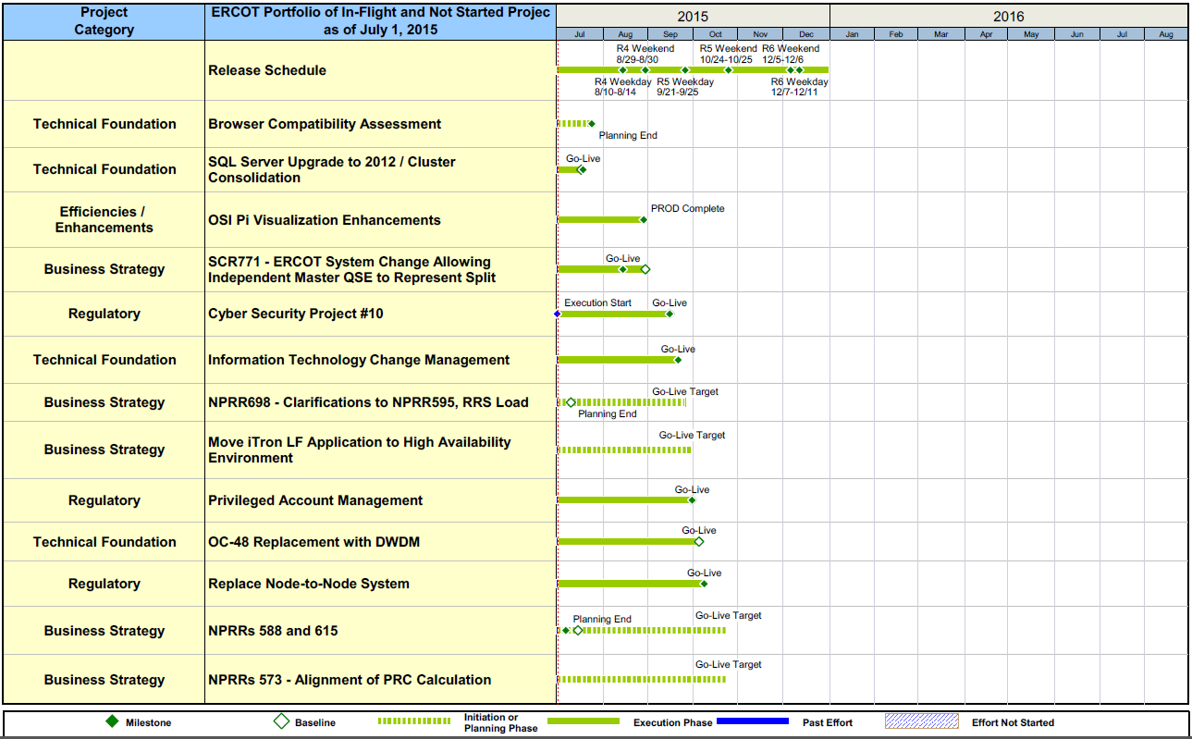
Project Portfolio Status – as of 6/30/2015

Slide 12
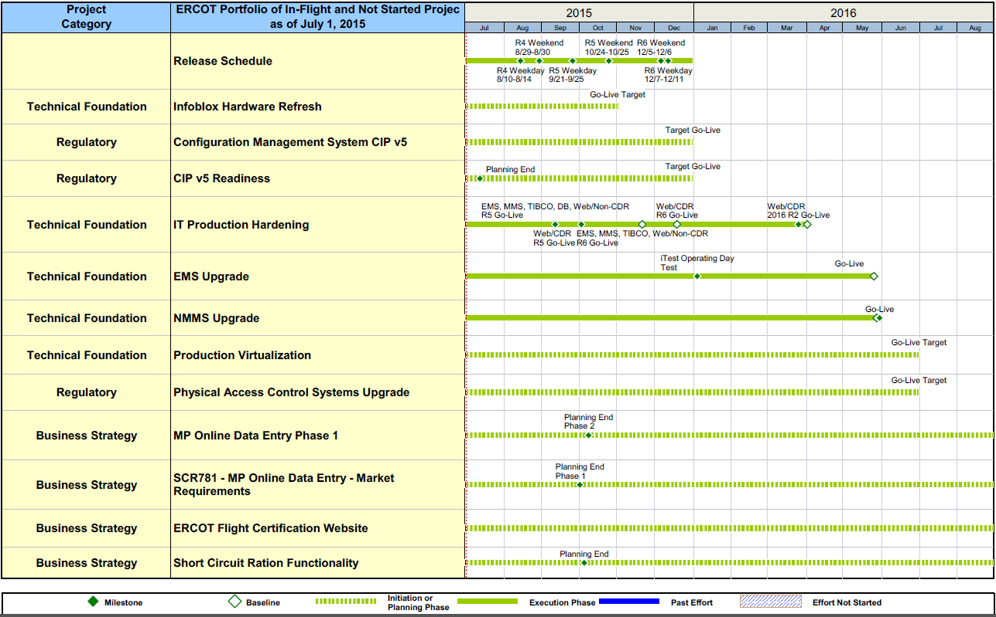
Project Portfolio Status – as of 6/30/2015

Slide 13
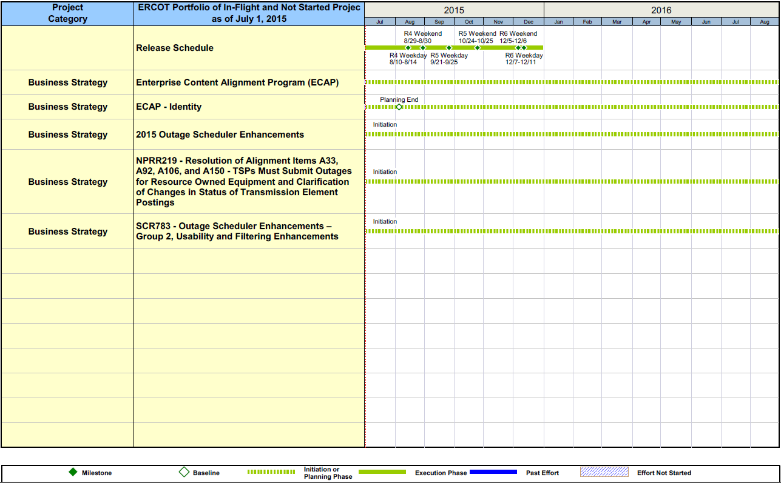
Project Portfolio Status – as of 6/30/2015

Slide 14
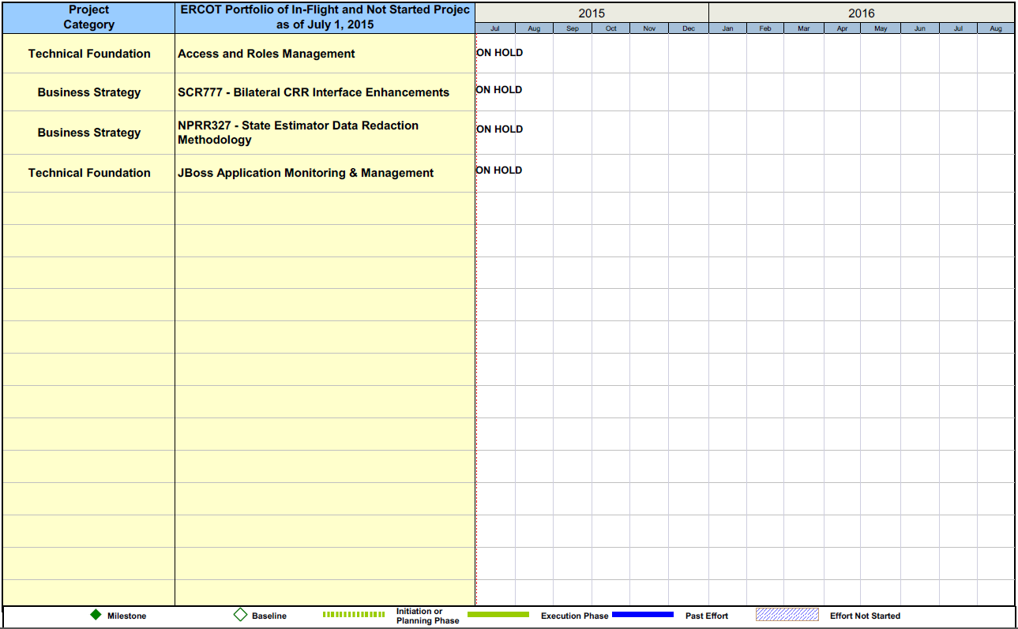
Project Portfolio Status – as of 6/30/2015

Slide 15
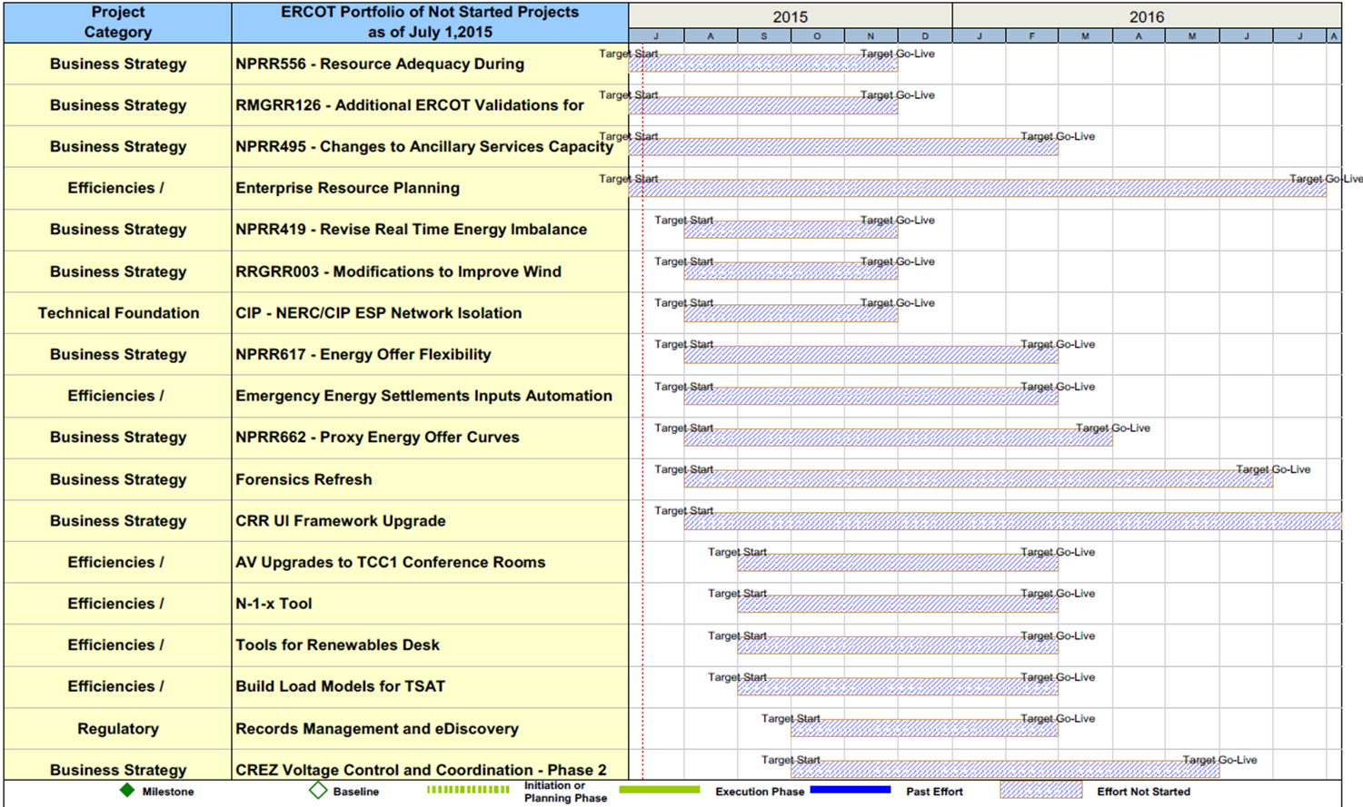
Project Portfolio Status – as of 6/30/2015

Slide 16
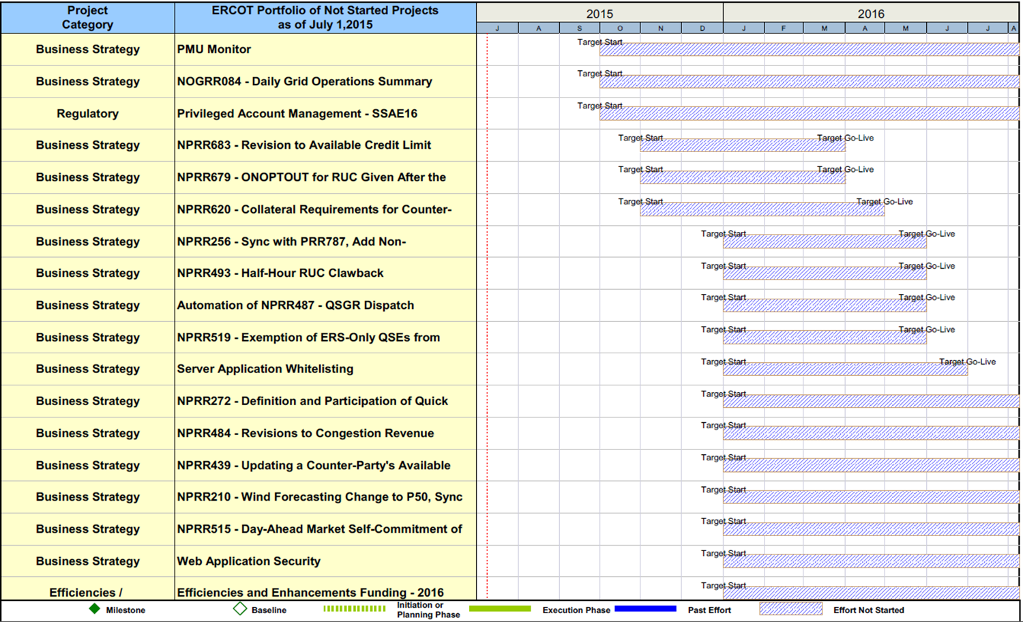
Project Portfolio Status – as of 6/30/2015

Slide 17
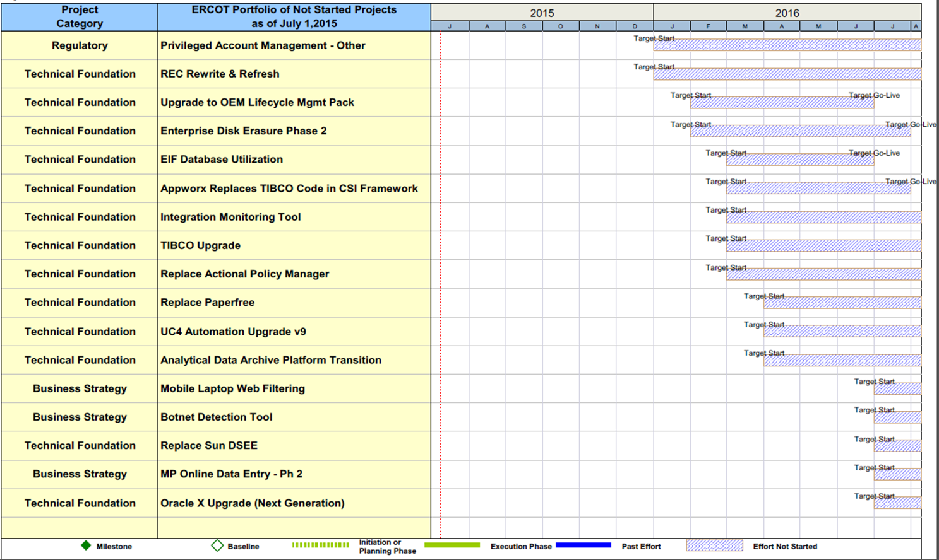
Project Portfolio Status – as of 6/30/2015

