Slide 1
MISUG Update to COPS
July 15, 2015

Slide 2
MISUG Projects on the Aging Projects List
NOGRR084 – Daily Grid Operations Report and NPRR455 – CRR Shift Factors were listed on ERCOT’s Aging Projects List
NOGRR084
ERCOT staff is currently working with PWG and OWG to craft language for a subsequent revision. MISUG supports on-going efforts to publish the information referenced in this NOGRR.
NPRR455
Sponsor for this NPRR should be engaged to provide updated support at PRS
CMWG may also want to weigh in on the need for this report

Slide 3
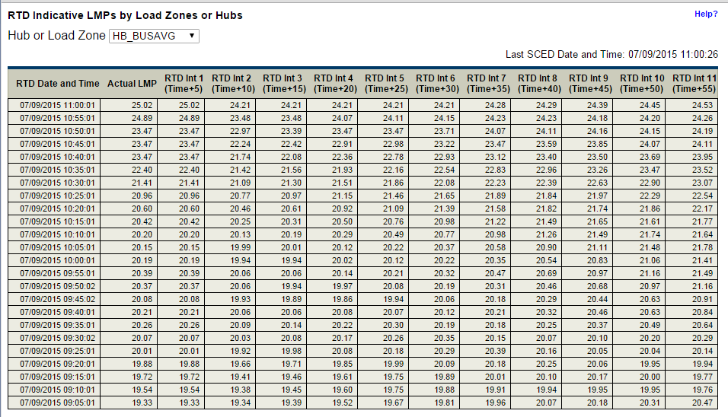
SCR775 – Dashboard for Indicative LMPs
The dashboard specified in SCR775 went live in the last week of June
http://www.ercot.com/content/cdr/html/rtd_ind_lmp_lz_hb.html

Slide 4
External Web Services (EWS) Modification
MISUG is facilitating a discussion to improve the EWS
EWS Survey
A survey has been distributed to all members of the MISUG mailing list as well as all attendees from the EWS workshops
We would like to get feedback from as many users and user types as would like to participate
While no deadline was indicated, we would like to have responses by the end of July
We will be sending a reminder and communicating the deadline
Streaming solution ideas
ERCOT has proposed bringing more information on possible data streaming solutions post-R4 implementation

Slide 5
NOGRR084 – Daily Grid Operations Report
ERCOT is working with OWG/ROS to update gray-boxed language for NOGRR084
Last round of comments in progress
Next Steps
On the OWG agenda for July 23rd meeting

Slide 6
Reports to be Automated
Reports to be Discontinued has been completed
Next Phase: Reports to be Automated
There are currently 16 reports being produced manually for data
Report frequencies are daily, monthly, or event driven
ERCOT is in the process of identifying SCRs and NPRRs necessary to automate these reports

Slide 7
Reports to be Automated
Report Name | Description | Frequency
Net Dependable Capability Test Report | Net dependable real power capability testing for resources | Monthly
Reactive Capability Test | Reactive testing for generation resources | Monthly
Hydro Responsive Testing | Record of when hydro responsive test was received at ERCOT and results. | Event
Governor Test Results | Report of generation resources governor speed tests received from generation entities. | Event
Constant Frequency Control Report | Attestation that QSEs have the capability to operate in constant frequency control mode | Yearly
Generic Transmission Limits | Posting of GTL effective in any ERCOT application. | Daily
ROS System Operations Report | Monthly synopsis of several items pertaining to real-time operations.. | Monthly
CSA Report for CRs | Information needed by CRs to audit their CSA's ownership. | Monthly
Retail Performance Measures | Compliance tracking against ERCOT Retail Protocols | Quarterly
Customer Billing Contact Information & ESIID Counts by Rep | Provides compliance with CBCI that includes ESIID counts | Monthly
IAG RMS Report | Trending data on Inadvertent Gain issues | RMS meetings
ESIIDs Excercising Option | ESIIDs that have exercised provider option to not be affiliated with the AREP | Ad-Hoc
Monthly Transaction Summary | Month-end Retail Transaction Volumes | Monthly
Operations Overview | Details regarding previous month’s Reliability & Commercial Operations. | Monthly
ERCOT Monthly Financials | Statement of Financial Position, Statement of Activities, and Statement of Cash Flows | Monthly
QSEs in ERCOT Region | List of QSEs in ERCOT Region | Monthly

Slide 8
Next MISUG Meeting
Tuesday, July 28, 2015
9:30 AM – Noon
ERCOT MET Center Rm 101 and WebEx

