Slide 1
Constraint Management Plans (CMPs) An Ops Planning Perspective
Nitika Mago
Operations Planning, ERCOT

Slide 2
Agenda
An Introduction to Constraint Management Plans
What/Why, Types
Overview of the Annual CMP Review Process
What/Why, When, Who’s involved
Study Case, Contingency Definitions
Criteria Used in Studies
2015 Review Summary
Initial Details – kick off, case used, case changes
Highlights of the Review
A Pick-list of plans

Slide 3
What are CMPs? Why are CMPs needed?
Set of pre-defined actions executed in response to system conditions
To prevent or to resolve one or more thermal or non-thermal transmission security violations or to optimize transmission.
Typically developed in cases where studies indicate economic dispatch alone may be unable to resolve a transmission security violation

Slide 4
Common Types of CMPs
Remedial Action Plans (RAPs)
may be relied upon for allowing additional use of transmission system in SCED
are modeled in CIM.
constrained element must have a 15-minute rating >= its normal & emergency rating
must not include load shed.
Mitigation Plans (MPs)
shall not be used to manage constraints in SCED
must be implemented in a timeframe that will not result in loss of the constrained element/facility
may include load shed.
Pre-Contingency Action Plans (PCAPs)
may be implemented in anticipation of a contingency
must not include load shed.
Temporary Outage Action Plans (TOAPs)
Temporary CMP, live & die with an outage.
shall not be used to manage constraints in SCED
must be implemented in a timeframe that will not result in loss of the constrained element/facility
may include load shed.

Slide 5
Agenda
An Introduction to Constraint Management Plans
What/Why, Types
Overview of the Annual CMP Review Process
What/Why, When, Who’s involved
Study Case, Contingency Definitions
Criteria Used for selection
2015 Review Summary
Initial Details – kick off, case used, case changes
Highlights of the Review
A Pick-list of plans

Slide 6
Overview of Annual CMP Review Process
Objective
Generate a set of CMPs to address anticipated reliability issues in the upcoming year.
Scope
Existing CMPs
CMPs proposals (may include plans emanating from system planning studies)
Time Frame for Review
March to May
Participants
All Market Participants
Study Case
SSWG Planning Cases are relied upon (Summer Peak)
Load & Generation in this case are analyzed and may be altered as necessary to build a scenario that is reflective of (extreme) peak conditions anticipated in the upcoming Summer season.

Slide 7
Overview of Annual CMP Review Process
Contingency
For CMP replication purposes
Operations Contingency (Breaker-to-Breaker) are overlaid on the planning case.
For CMP viability (i.e. N-1 studies post CTG & CMP action; to ensure no new violation is created)
A blend of contingencies posted by SSWG are used.
Criteria for CMP Selection
Approval Process (applicable for CMPs that meet the Activate criteria)
Coordinated process involves soliciting review & approval from all involved TSPs and REs as applicable.

Slide 8
Agenda
An Introduction to Constraint Management Plans
What/Why, Types
Overview of the Annual CMP Review Process
What/Why, When, Who’s involved
Study Case, Contingency Definitions
Criteria Used in Studies
2015 Review Summary
Initial Details – kick off, case used, case changes
Highlights of the Review
A Pick-list of plans

Slide 9
2015 Review Highlights
Kick Off
March 11, 2015

Slide 10
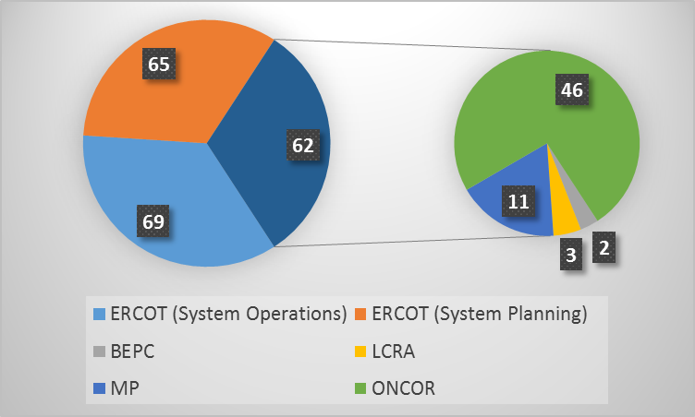
2015 Review Highlights
Submittals
Reviewed 196 Proposals
Submitters included

Slide 11
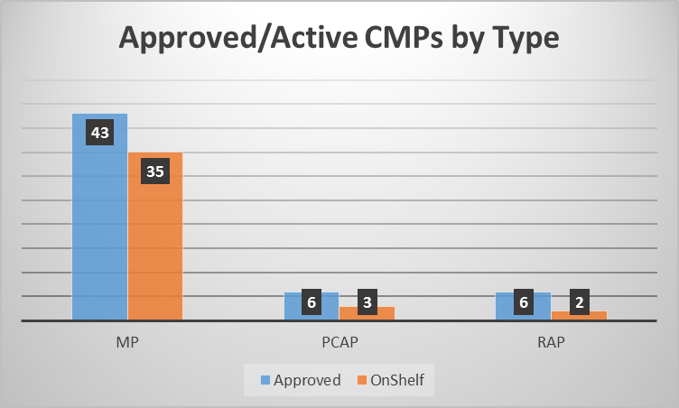
2015 Review Highlights
Approvals
Approved 55 CMPs
(21 Existing, 11 New)
Removed 25 CMP
On-Shelf 40 CMPs
9 N-1 (3 Existing, 8 New)
31 N-i related CMPs

Slide 12
A Pick-list of Approved CMPs
Type | ID | Document | Contingency | TSP/MP | Note
MPs | MP_2013_29 | Alice (ALICE) 138-69 kV transformer.doc | XALI89 | AEP | Maintain
MPs | MP_2014_49 | Edison_Orsted_SSR_.doc | Multiple | ETT/AEP | Maintain
MPs | MP_2013_07 | Eskota Sw 138-69 kV Autotransformer.docx | XESK89 | ONCOR | Maintain
MPs | MP_2012_07 | FormosaAuto 21 and 22_hi EXPORT.docx | XFO2R89 or XFO3R89 | N/A | Maintain
MPs | MP_2012_08 | FormosaAuto 21and22_hi-IMPORT.docx | XFO2R89 or XFO3R89 | N/A | Maintain
MPs | MP_2014_01 | Lon Hill - Smith 69kV line (LON_HI_SMITH1) rev 2.doc | SORNLON8, DLONOR58 | AEP | Maintain
MPs | MP_2010_22 | Minerva 138,69 kV Autotransformer.doc | XMNR89T1 | ONCOR | Maintain
MPs | MP_2013_27 | Monticello Area.doc | MNSES gen OFFLINE | AEP, ONCOR | Maintain
MPs | MP_2014_25 | MP_BigLakeAuto_XBGL89_XBG2L89.docx | XBGL89 or XBG2L89 | AEP | Maintain
MPs | MP_2014_53 | MP_Bruni_Auto_138kV_69_XF.docx | SLAQLOB8 | STEC, AEP | Maintain
MPs | MP_2015_08 | MP_Forest_Hill_138_69_kV_XF.docx | XFHL89 | ONCOR | New
MPs | MP_2015_02 | MP_Fort_Lancaster_-_Mesa_View_Switch_138kV_line.docx | SFTLMES8 | AEP | New
MPs | MP_2015_05 | MP_Hillsboro_138_69_kV_XF.docx | XHL2S89 | ONCOR | New
MPs | MP_2015_08 | MP_Hutto_-_Rnd_Rck_Gabriel_138kV_Double_Circuit_Line_rev.docx | DHUTGAB8 | ONCOR | New
MPs | MP_2015_07 | MP_Permian_Basin_138_69_kV_Autotransformer.docx | XPB2S89 or XPB1S89 | ONCOR | New
MPs | MP_2014_22 | MP_Turtle_Creek_to_Uvalde_OR_Crystal_City_69kV.doc | SLA_UVA9 or SCRYTUR9 | AEP | Maintain
MPs | MP_2014_30 | MP_WillsPoint_XTRL89.docx | XTRL89 | ONCOR | Maintain
MPs | MP_2015_09 | MP_Wink_138_69_kV_XF_OR_Wink_TNMP_Wink_138kV_LN.docx | XWI2N89 or SWINWIN8 | TNMP | New
MPs | MP_2015_02 | SLIVGIL9_MP.doc | SLIVGIL9 & DGILFR89 | LCRA | New
MPs | MP_2014_52 | SRULASP9_MP.doc | SRULASP9, SHSKRUL9, SGILROC9 | AEP, BEPC | Maintain
MPs | MP080214-0 | SSIGSAN8_MP.doc | SSIGSAN8 | AEP | Maintain
MPs | MP_2011_08 | Valley Import.doc | Multiple | AEP, STEC, BPUB, SHARYLAND | Maintain
MPs | MP_2015_01 | XAND189_MP_rev2.doc | XAND189 | ONCOR | New
PCAPs | PCAP_2010_02 | DBIGKEN5_PCAP.doc | DBIGKEN5 | AEP | Maintain
PCAPs | PCAP_2013_03 | Elgin Switch (ELGSW) 138 69 kV Autotransformer.doc | XELG89 | ONCOR | Maintain
PCAPs | PCAP_2014_01 | FREER to LOBO 69kV.doc | SSANALI9 | ONCOR | Maintain
PCAPs | PCAP_2010_01 | LCRA Fort Mason - Yellow Jacket 138 kV Circuit.doc | SFORYLJ8 | AEP | Maintain
PCAPs | PCAP_2013_01 | LOBO to San Miguel 345kV Line or Lobo 345,138 kV Autotransformer.doc | SLOBSAN5 or XLOB58 | AEP | Maintain
RAPs | RAP_2012_01 | Allen Sw. - RoyseMonticello Double-Circuit 345 kV Line.docx | DALNRYS5 | ONCOR | Maintain
RAPs | RAP_2012_05 | Baytown Autotransformers AT1 and AT2.doc | SBTECH25 or SBTECHB5 | CALPINE | Maintain
RAPs | RAP_2012_04 | Lewisville Switch -Autotransformer 2.doc | XLWS58 | BEPC | Maintain
RAPs | RAP_2015_07 | RAP_Navarro_Limestone_Plant_345_kV_Double_Circuit_Lines.docx | DNAVLEG5 | ONCOR | New
RAPs | RAP_2015_06 | RAP_Salem_-_Fayette_Power_Plant_345kV_line.docx | SSALFPP5 | LCRA | New
RAPs | RAP_2015_08 | RAP_Salem_-_Fayette_Power_Plant_345kV.docx | DSALFA58 | LCRA | New

Slide 13
2015 Review Highlights
Completion
June 1, 2015

Slide 14
Agenda
An Introduction to Constraint Management Plans
What/Why, Types
Overview of the Annual CMP Review Process
What/Why, When, Who’s involved
Study Case, Contingency Definitions
Criteria Used in Studies
2015 Review Summary
Initial Details – kick off, case used, case changes
Highlights of the Review
A Pick-list of plans

Slide 15
Questions?
Nitika Mago nmago@ercot.com 512-248-6600

