Slide 1
ERCOT Renewable Regions
Bill Blevins
Manager Operations Planning
ERCOT

Slide 2
ERCOT is divided into Seven Solar and Wind Regions
North
South
East(SPP Counties)
West
Panhandle
Coast
Houston(No Solar or Wind installations)

Slide 3
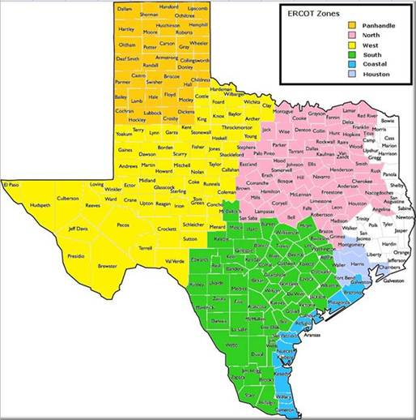
Renewable Regions Map

Slide 4
Zone Map used in GIS status report
South |  | Houston | West |  | Panhandle |  | East(SPP counties) | Coastal | North
Atascosa | Karnes | Chambers | Andrews | Knox | Armstrong | Ochiltree | Bowie | Aransas | Anderson | Johnson
Austin | Kendall | Fort_Bend | Archer | Loving | Bailey | Oldham | Camp | Brazoria | Angelina | Kaufman
Bandera | Kerr | Galveston | Baylor | Lynn | Briscoe | Parmer | Cass | Calhoun | Bell | Lamar
Bastrop | Kimble | Harris | Borden | Martin | Carson | Potter | Gregg | Cameron | Bosque | Lampasas
Bee | Kinney | Montgomery | Brewster | Menard | Castro | Randall | Hardin | Kenedy | Brazos | Leon
Bexar | La_Salle | Waller | Callahan | Midland | Childress | Roberts | Harrison | Kleberg | Brown | Limestone
Blanco | Lavaca |  | Clay | Mitchell | Cochran | Sherman | Jasper | Matagorda | Cherokee | Madison
Brooks | Lee |  | Coke | Nolan | Collingsworth | Swisher | Jefferson | Nueces | Collin | McLennan
Burleson | Live_Oak |  | Coleman | Pecos | Crosby | Wheeler | Liberty | Refugio | Comanche | Mills
Burnet | Llano |  | Concho | Presidio | Dallam |  | Marion | San_Patricio | Cooke | Montague
Caldwell | Mason |  | Cottle | Reagan | Deaf_Smith |  | Morris | Willacy | Coryell | Nacogdoches
Colorado | Maverick |  | Crane | Reeves | Dickens |  | Newton |  | Dallas | Navarro
Comal | McCulloch |  | Crockett | Runnels | Donley |  | Orange |  | Delta | Palo_Pinto
DeWitt | McMullen |  | Culberson | Schleicher | Floyd |  | Panola |  | Denton | Parker
Dimmit | Medina |  | Dawson | Scurry | Gray |  | Polk |  | Eastland | Rains
Duval | Milam |  | Ector | Shackelford | Hale |  | Sabine |  | Ellis | Red_River
Edwards | Real |  | El_Paso | Sterling | Hall |  | San_Augustine |  | Erath | Robertson
Fayette | Starr |  | Fisher | Stonewall | Hansford |  | San_Jacinto |  | Falls | Rockwall
Frio | Travis |  | Foard | Sutton | Hartley |  | Shelby |  | Fannin | Rusk
Gillespie | Uvalde |  | Gaines | Taylor | Hemphill |  | Trinity |  | Franklin | San_Saba
Goliad | Victoria |  | Garza | Terrell | Hockley |  | Tyler |  | Freestone | Smith
Gonzales | Washington |  | Glasscock | Terry | Hutchinson |  | Upshur |  | Grayson | Somervell
Guadalupe | Webb |  | Hardeman | Throckmorton | Lamb |  | Walker |  | Grimes | Stephens
Hays | Wharton |  | Haskell | Tom_Green | Lipscomb |  |  |  | Hamilton | Tarrant
Hidalgo | Williamson |  | Howard | Upton | Lubbock |  |  |  | Henderson | Titus
Jackson | Wilson |  | Hudspeth | Val_Verde | Moore |  |  |  | Hill | Van_Zandt
Jim_Hogg | Zapata |  | Irion | Ward | Motley |  |  |  | Hood | Wise
Jim_Wells | Zavala |  | Jeff_Davis | Wichita |  |  |  |  | Hopkins | Wood
 |  |  | Jones | Wilbarger |  |  |  |  | Houston
 |  |  | Kent | Winkler |  |  |  |  | Hunt
 |  |  | King | Yoakum |  |  |  |  | Jack
 |  |  |  | Young

