Slide 1
ERCOT Frequency Control Report
May 2015
ERCOT
June 24, 2015

Slide 2
Ercot frequency control
BAL-001 CPS 1 & 2 Performance, RMS 1 and Frequency Profile

Slide 3
Notes:
Done. ERCOTcps1&2Month31DAYS May 2015.xls

Slide 4
Notes:
Done. ERCOTcps1&2Month31DAYS May 2015.xls

Slide 5
Notes:
Done. ERCOTcps1&2Month31DAYS May 2015.xls

Slide 6
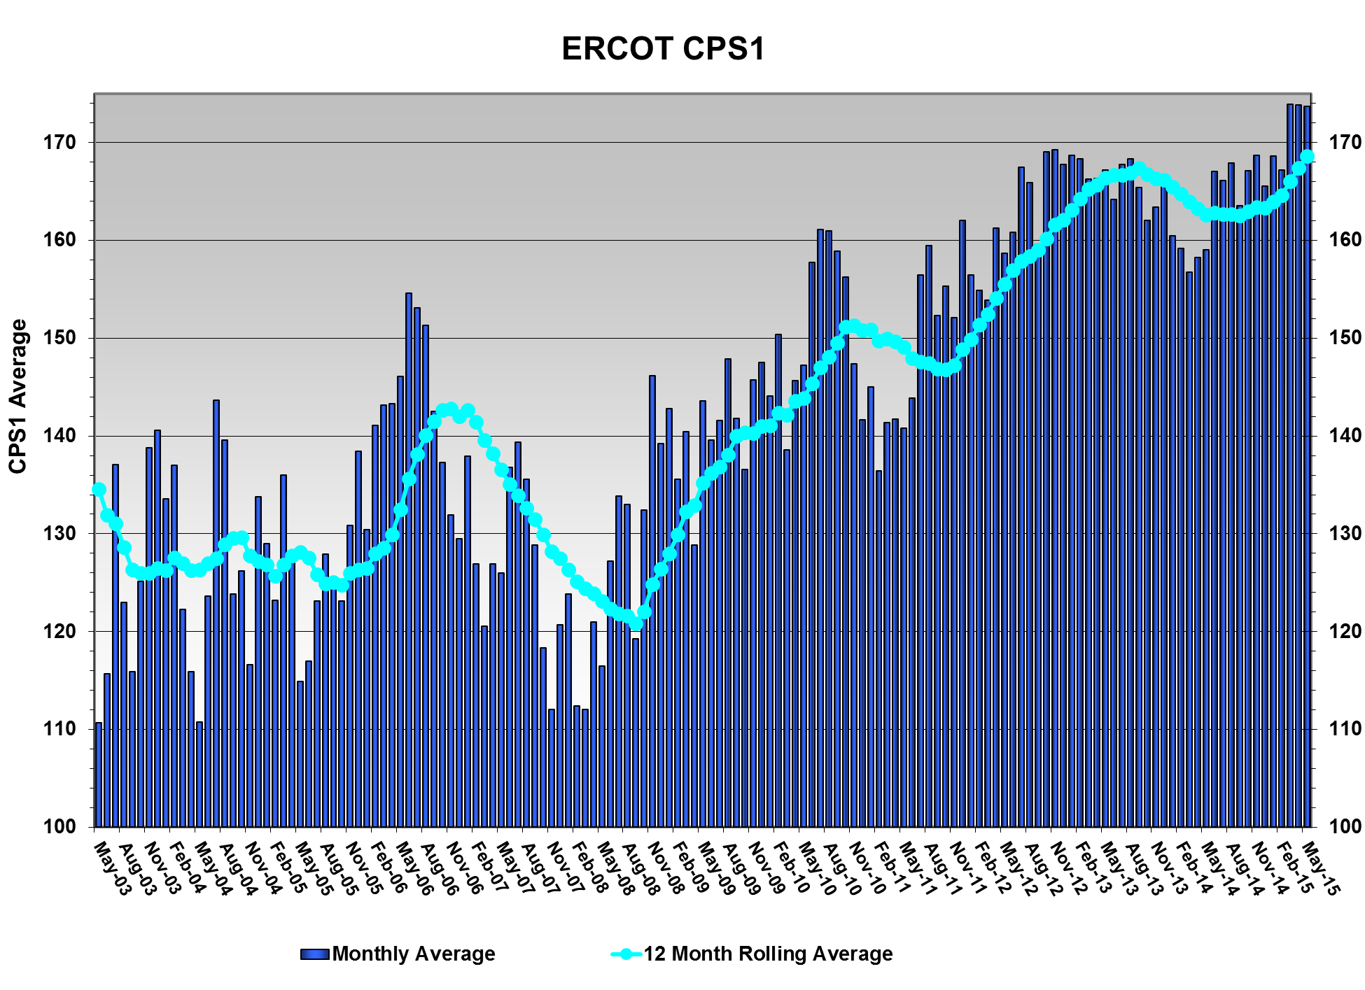
CPS1 12 Month Rolling Average = 168.59
Notes:
Done. ERCOT CPS1 and CPS2 historical_May15

Slide 7
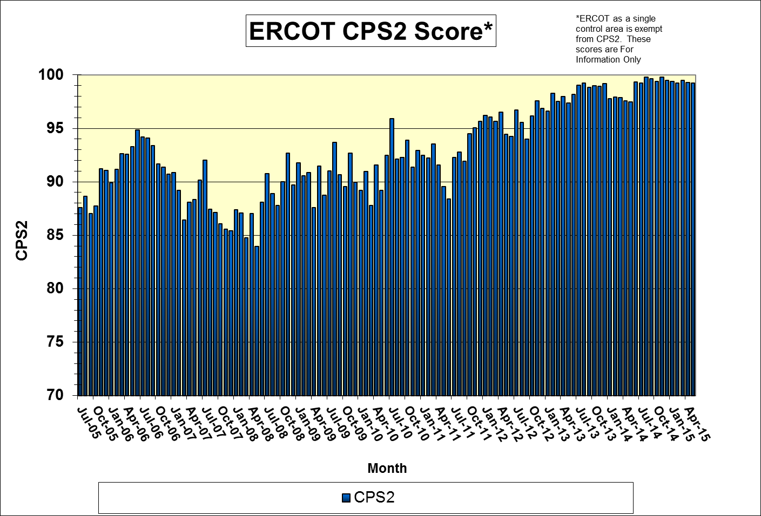
Notes:
Done. ERCOT CPS1 and CPS2 historical_May15

Slide 8
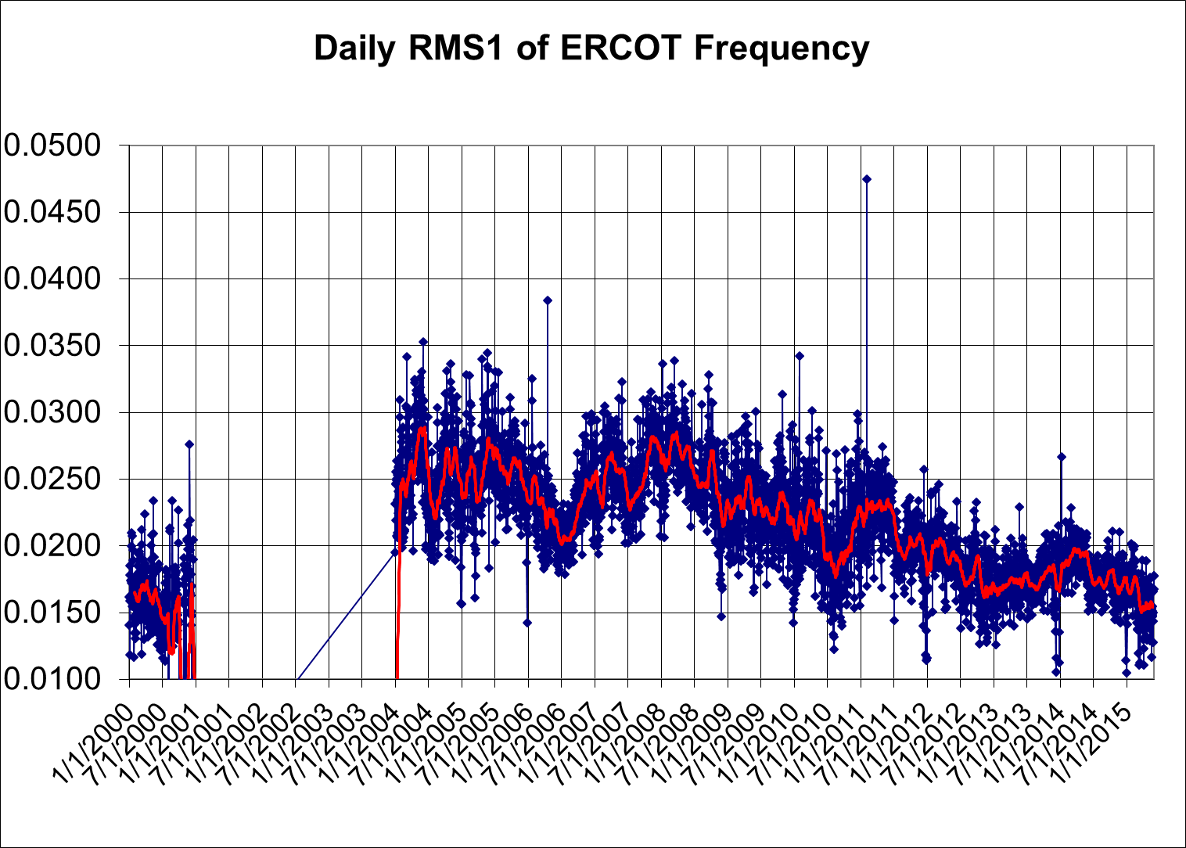
Notes:
Done. Frequency History ERCOT_May15.xls

Slide 9
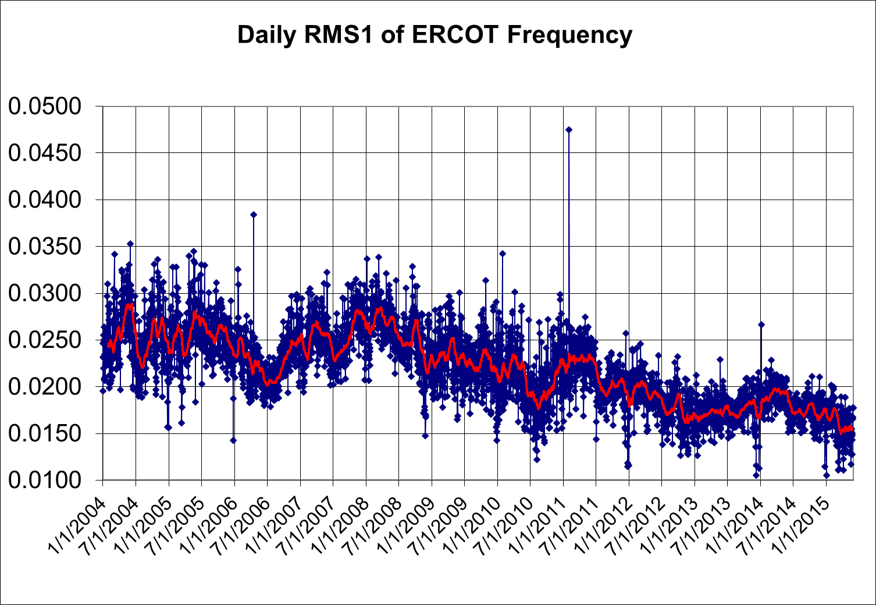
Notes:
Done. Frequency History ERCOT_May15.xls

Slide 10
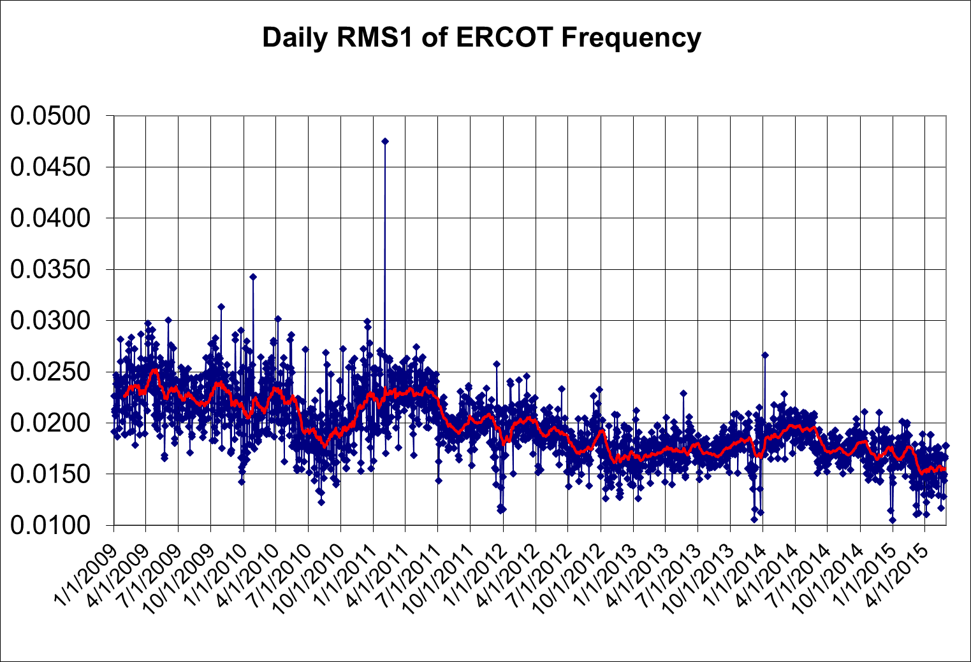
Notes:
Done. Frequency History ERCOT_May15.xls

Slide 11
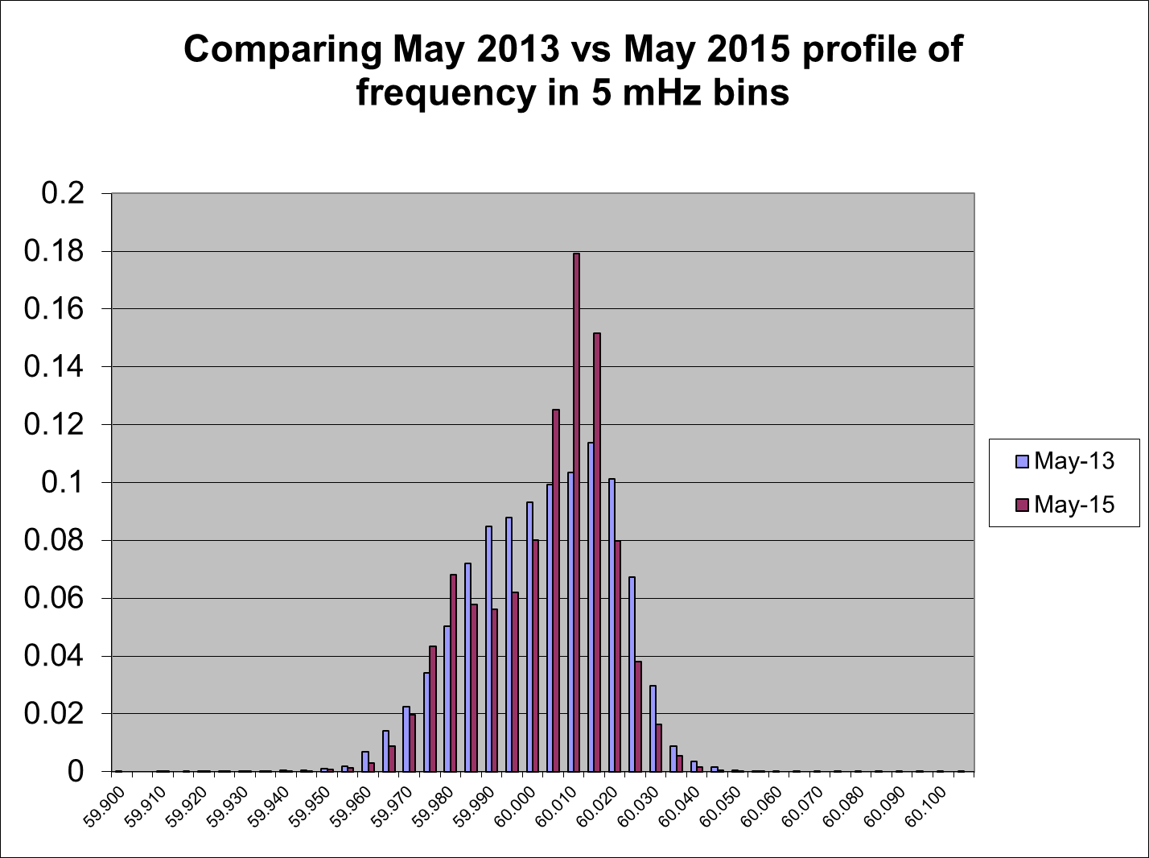
Notes:
Done. Comparison of ERCOT Frequency Monthly 2013 vs Same Month in 2015_May15.xls

Slide 12
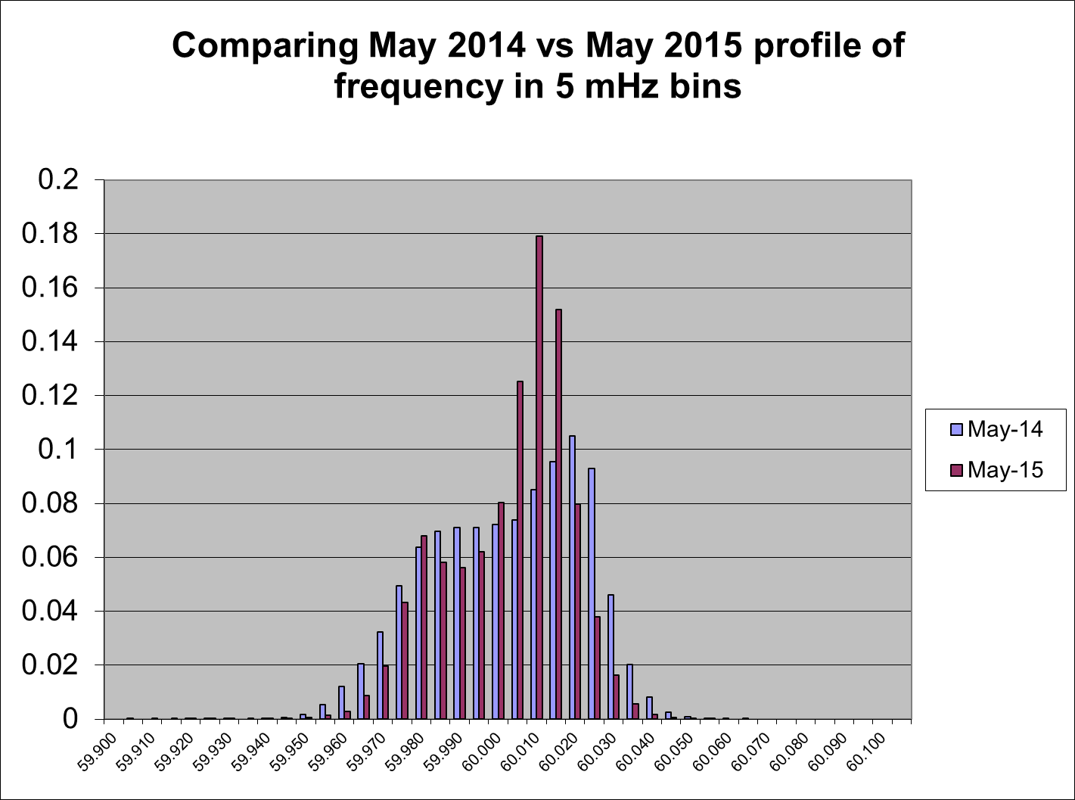
Notes:
Done. Comparison of ERCOT Frequency Monthly 2014 vs Same Month in 2015_May15.xls

Slide 13
ERCOT Time error and time correction
Time Error History

Slide 14
Time Error Corrections
Four slow Time Error Corrections were executed in May.

Slide 15
Notes:
ERCOTcps1&2 NRGTexasSCPS1&2with31DayTEReport_May15

Slide 16
Time Correction History
Notes:
Done. TimeCorrections Log_May15.xlsx

Slide 17
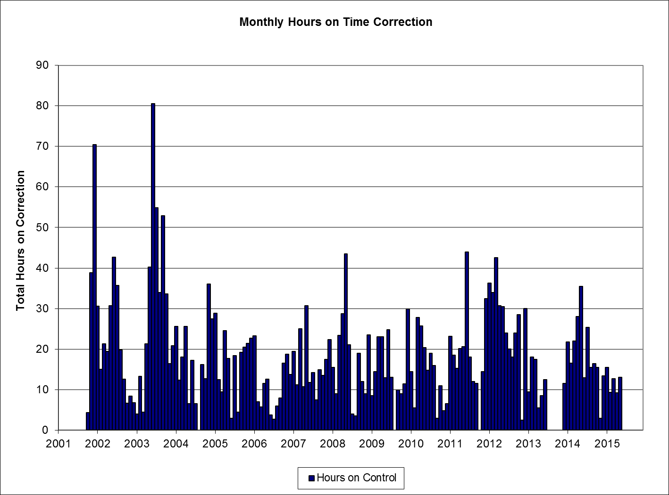
Notes:
Done. TimeCorrections Log_May15.xlsx

Slide 18
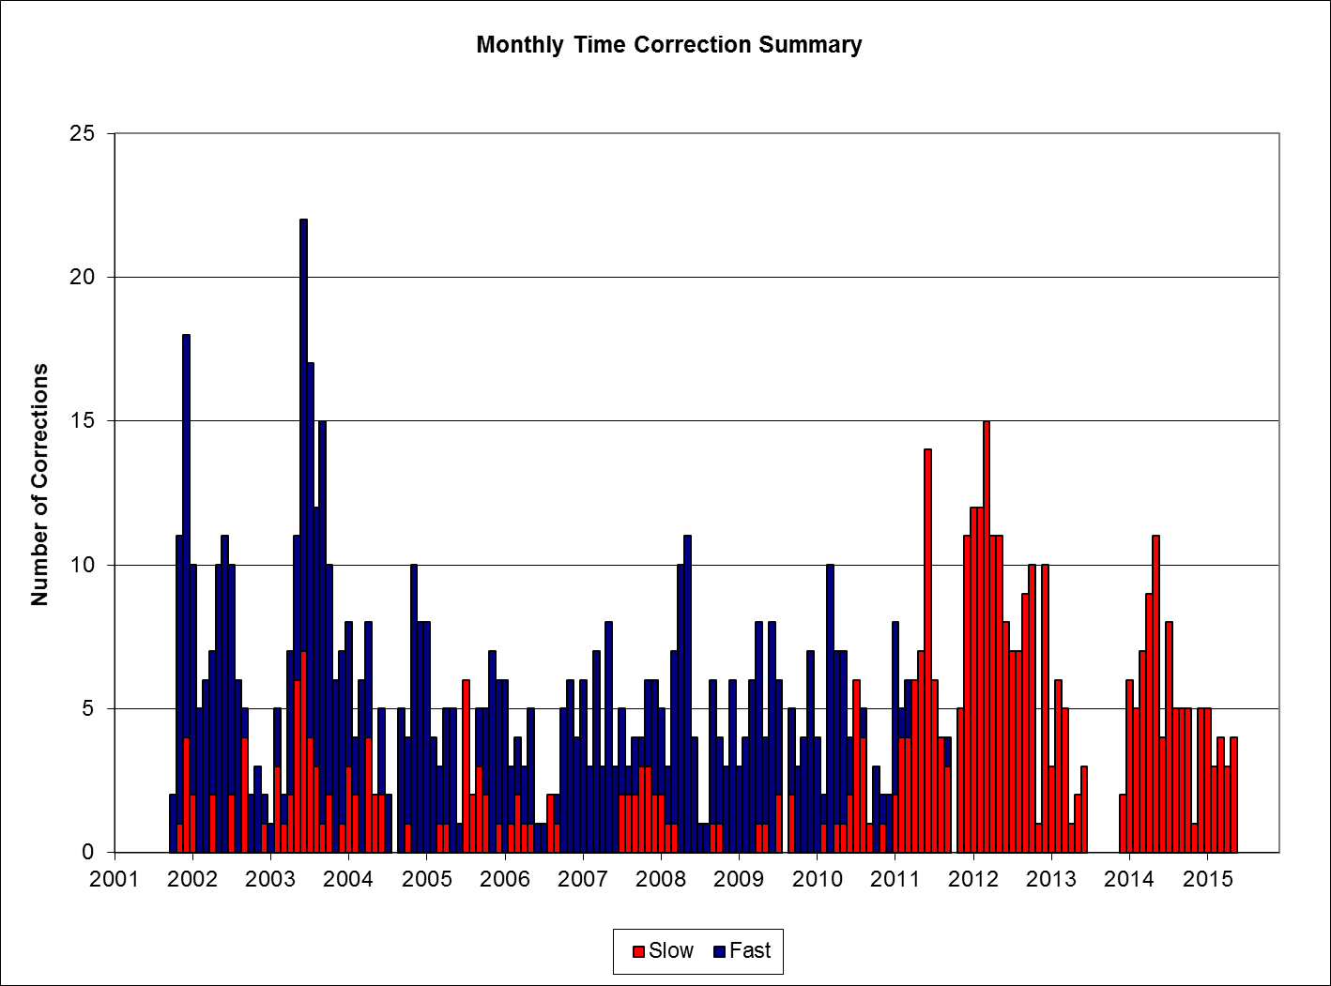
Notes:
Done. TimeCorrections Log_May15.xlsx

Slide 19
Ercot primary frequency response performance
BAL-003-1 Interconnection Frequency Response and Bias Measure.

Slide 20
ERCOT Primary Frequency Response – BAL-003-1
2016 Bias and Frequency Response Measure
R1 Present Interconnection Minimum Frequency Response Requirement: -471 MW/0.1 Hz
Using the Median Measure
Notes:
Done. ERCOT_2016_FRS_FORM_1.10_ERCOT_Interconnection

Slide 21
ERCOT Primary Frequency Response – BAL-003-1
2016 Bias and Frequency Response Measure
R1 Present Interconnection Minimum Frequency Response Requirement: -471 MW/0.1 Hz
Using the Median Measure
Notes:
Done. ERCOT_2016_FRS_FORM_1.10_ERCOT_Interconnection

Slide 22
Ercot total energy and wind production
Total ERCOT Energy and Total Energy Production from Wind Resources.

Slide 23
Notes:
Done. ERCOT Total Load and Total Wind Generation 2008 through Present_May15

Slide 24
Notes:
Done. ERCOT Total Load and Total Wind Generation 2008 through Present_May15

Slide 25
Notes:
Done. ERCOT Total Load and Total Wind Generation 2008 through Present_May15

