Slide 1
TDTWG Update to RMS
June 2, 2015

Slide 2
Meeting Update
MarkeTrak API Performance Metrics Review
ERCOT continues work with CenterPoint and Oncor to refine/revise the MT API performance metrics Service Level Objectives (SLOs).
Current efforts are comparing the API capabilities between November 2014 – February 2015 to establish a baseline SLO.
ERCOT’s focus is on QueryList, QueryDetail, and Update since these are the most frequently used API functions.
Notes:
2

Slide 3
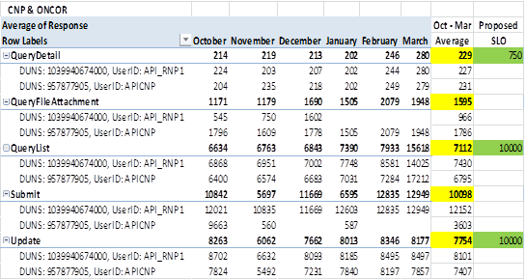
Meeting Update
MarkeTrak API Performance SLO
Proposed SLOs (currently in review by ERCOT/CNP/Oncor):
Notes:
3

Slide 4
ERCOT Retail Test Environment
TDTWG finalized the Draft System Change Request (SCR) which proposes a new ERCOT Retail Test Environment (RTE) .
The new RTE provides a stand-alone testing environment for Retail MPs that will:
Mimic the Production (“Prod”) environment functionality in addition to the current Certification (“Cert”) environment
Provides flexibility & availability for ad-hoc testing
Reduces overall risk to the Retail Market by allowing MPs to fully test internal projects (system changes, etc.) before going live in Production.
TDTWG is requesting RMS to endorse Draft SCR to move forward in the governance process.

Slide 5
NAESB Upgrade Update
NAESB accepted ERCOT’s first Minor Correction file (MC15006) to incorporate new transaction codes into NAESB standards.
Another MC file (MC15013) was submitted to correct code descriptions altered by MC15006, and will be reviewed by NAESB at the next Executive Committee meeting on June 24.
At the May TDTWG, the cost benefit of a NAESB upgrade was brought in question. Therefore, ERCOT has committed to review the driving factor behind implementing a new NAESB version and will bring a potentially revised recommendation to TDTWG in June.

Slide 6
Next TDTWG Meeting:
WEBEX ONLY
Wednesday, June 10, 2015
2:00pm - 4:00pm
http://www.ercot.com/committees/board/tac/rms/tdtwg/index.html
.

