Slide 1
SMT Update To AMWG
MAY, 2015

Slide 2
Monthly SMT Data Timelines AMWG CR 2014 002 End to End File Processing Completeness – MAY 2015
% Timely Market Delivery - % of files posted to market (FTPS) by 11:00pm out of # of files received by SMT by 11:00pm.
% Portal Data Availability - % of files loaded to the database for data availability on portal by 6:00am next day for the files received by 11:00pm
* A LSE file includes usage data for upto 50,000 ESIIDs. The master files are also considered for above metrics.
Observed Anomalies:
05/01 – SMT FTP Server Certificate Keystore issue
05/26 -05/29 – SMT WPG server inconstant in file processing on May 26th & 29th
05/31 – SMT Database Archiver issue
2

Slide 3
SMT API and FTPS Services Availability – MAY-2015
The service availability is measured as a percentage of number of minutes the service was available out of the total number of minutes in a month excluding planned outages.
Notes:
3

Slide 4
SMT Number of Accounts by Type AMWG CR 2014 009 – MAY 2015
Registered Users | ONC | CNP | AEPN | AEPC | TNMP | TOTAL
Active Residential Accounts | 29872 | 18557 | 2126 | 5262 | 2021 | 57838
Active Residential English Accounts | 29735 | 18435 | 2122 | 5165 | 2015 | 57472
Active Residential Spanish Accounts | 137 | 122 | 4 | 97 | 6 | 366
Non Active Residential Accounts | 13660 | 10181 | 1098 | 2155 | 535 | 27424
Total Residential Accounts |  |  |  |  |  | 85262
TDSP User | 429 | 40 | 11 | 15 | 2 | 497
TDSP Admin | 3 | 4 | 4 | 4 | 3 | 18
Small Business User | 61 | 30 | 0 | 1 | 1 | 93
Small Business Admin | 2062 | 1061 | 63 | 212 | 55 | 3531
Total Agreements | 161 | 334 | 1 | 0 | 0 | 495
Energy Data Agreements | 68 | 39 | 1 | 0 | 0 | 108
Han Device Agreements | 92 | 295 | 0 | 0 | 0 | 387
Han Service Agreements | 0 | 0 | 0 | 0 | 0 | 0
IN SMT
ESI IDs | 3430428 | 2348598 | 196820 | 846224 | 191666 | 7013736
Meters | 3358141 | 2348565 | 197686 | 846415 | 191529 | 6942336
HAN Devices | 3812 | 5041 | 151 | 271 | 30 | 9305
Acknowledgement | 0 | 0 | 0 | 0 | 0
Pending | 0 | 2 | 0 | 0 | 0
Meter Ready | 869 | 101 | 45 | 121 | 22
Provisioned | 2943 | 4938 | 106 | 150 | 8
HAN Messages (MTD) | 0 | 0 | 0 | 0 | 0 | 0
HAN Messages (YTD) | 8 | 19 | 0 | 0 | 0 | 27
HAN Messages (Cumulative) | 299 | 7383 | 0 | 0 | 0 | 7682
Simple Text Messages | 91 | 2917 | 0 | 0 | 0
Load Control Messages | 79 | 2655 | 0 | 0 | 0
Pricing Messages | 89 | 49 | 0 | 0 | 0
Cancellation Messages | 40 | 1762 | 0 | 0 | 0
Supplemental – (Friends)
Total Agreements | 1430 | 1163 | 70 | 77 | 50 | 2790
Accepted Agreements | 666 | 455 | 34 | 26 | 15 | 1196
Pending Agreements | 0 | 0 | 0 | 0 | 0 | 0
Revoked Agreements | 193 | 217 | 9 | 7 | 6 | 432
Expired Agreements | 549 | 467 | 27 | 44 | 29 | 1116
Terminated Agreements | 22 | 24 | 0 | 0 | 0 | 46
 | TDSPs | REP | NRC | Regulatory | Third Party
Registered Entities | 5 | 96 | 3443 | 2 | 52
Registered Users | 497 | 704 | 93 | 6 | 3
Registered Admins | 18 | 151 | 3453 | 3 | 49
HAN Messages Sent By | 291 | 7383

Slide 5
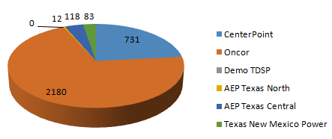
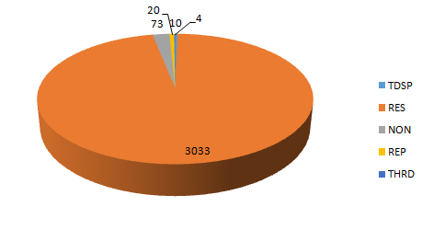
SMT ODR Details AMWG CR 2015 – MAY 2015
Total ODR RequestsTDSP wise statistics:
Total ODR Requests User type statistics:
TDSP NAME | Monthly Count
CenterPoint | 731
Oncor | 2180
Demo TDSP | 0
AEP Texas North | 12
AEP Texas Central | 118
Texas New Mexico Power | 83
USER TYPE | Monthly Count
TDSP | 10
RES | 3033
NON | 73
REP | 20
THRD | 4

