Slide 1
Project Update and Summary of Project Priority List (PPL) Activity
June 11, 2015

Slide 2
2015 Project Update – Agenda
Project Portfolio Update p. 3-5
Recent/Upcoming Project Highlights
2015 Release Targets
2015 Project Spending Update
2016/2017 Project Budgets
EMS Upgrade “Chill”
Appendix
Project Portfolio Gantt Chart p. 7-14
Location of Project Priority List (PPL): http://www.ercot.com/services/projects/index

Slide 3
Recent / Upcoming Project Highlights
2015 June Release – 6/13/2015 In Flight
CMM Release
NPRR559, NPRR597, NPRR601, NPRR639
2015 June Release – Week of 6/22/2015 In Flight
2015 Market System Enhancements
NPRR626, NPRR665, NPRR645, NPRR598, Max Shadow Price OBD
NPRR543 – Message for Confirmed E-Tags
SCR774(b) – Enhancement to Outage Scheduler and Reports
SCR775 – Posting Results of Real-Time Data in a Display Format
Note: Projected Go-Live dates are subject to change. Please watch for market notices as the effective dates approach.

Slide 4
2015 Release Targets – Board-Approved NPRRs / SCRs / xGRRs
February 2/2 – 2/12 | March 3/23 – 3/27 | June |  | August 8/10 – 8/14 | September 9/21 – 9/25 | December 12/7 – 12/11
NPRR500 SCR772 | SCR778 SCR779 | NPRR559 NPRR597 NPRR601 NPRR639 | NPRR543 NPRR589(b) NPRR598 NPRR626 NPRR645 NPRR665 SCR774(b) SCR775 OBD (Shadow Price Caps) | SCR771 | NPRR553 NPRR573 NPRR588 NPRR589(b) NPRR595 NPRR615 NPRR698 | NPRR419 NPRR495 NPRR556 RMGRR126 RRGRR003
2 | 2 | 11 |  | 1 | 6 | 5
6/13 (CMM)
6/22 – 6/26
E
E
E
E
E
E
E
E
E
E
E
E
E
I
P
E
P
P
NS
NS
NS
NS
NS
Late May
2015 TBD Items (and month they became “TBD”)
Aug 2014 | Oct 2014 | Dec 2014 | Jan 2015 | Feb 2015 | Mar 2015 | Apr 2015
NOGRR084 | NPRR327 H | NPRR272, SCR777 H | NPRR210, NPRR664 | NPRR493 | NPRR256 | NPRR568-ph2, NPRR644
Go-live dates can differ from Protocol effective dates – Please refer to market notices for more details
Red Text: New additions and target release changes
NPRR589(b) – S&B portion
SCR774(b) – Addition of Comments field
Strike-Through Text: Previous target release changes
Release targets are subject to change
(a), (b), etc. indicates multiple phases
Project Status Codes: NS = Not Started, I = Initiation, P = Planning, E = Execution, H = On Hold

Slide 5
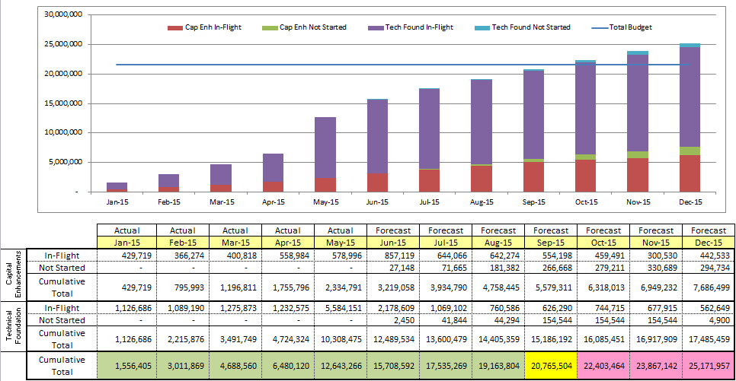
2015 Project Spending Update
2015 project budget = $21.65M
Reason: Minor Capital, Program Control and Common Infrastructure projects were re-allocated to areas who use those funds

Slide 6
2016 / 2017 Project Budgets
On 6/9/2015, the Board approved ERCOT’s 2016/2017 budget request that included additional project funds for a data center hardware refresh
$20M for data center hardware refresh (each year)
“PPL” funds remain consistent with recent years
$4M for revision requests (each year)
~$2M for regulatory (each year)
Remaining project funds ($14M-$16M each year) for:
Internal Enhancements
Other Tech Foundation (software upgrades, etc.)

Slide 7
EMS Upgrade “Chill” – Initial Notice
The EMS Upgrade project has been in-flight since 2012 and is scheduled for go-live in May 2016. Key dates:
Operating Day Testing November 2015-January 2016
Close Loop Testing March-May 2016
Cutover May 2016
In the months leading up to go-live, changes that impact EMS will need to be limited to urgent items only
In general, revision requests impacting EMS with the following characteristics will not be impacted:
Go-live by December 2015
Go-live after June 2016
ERCOT is reviewing the “in-flight” and “not started” items on the PPL for more detailed discussion in July
Preliminary results show limited impact on market-requested items

Slide 8
Business Integration Update – Appendix
Appendix
5/31/2015 Project Gantt
In-flight items sorted by Project End Date
“On Hold” projects listed separately
“Not Started” items sorted by Project Start Date

Slide 9
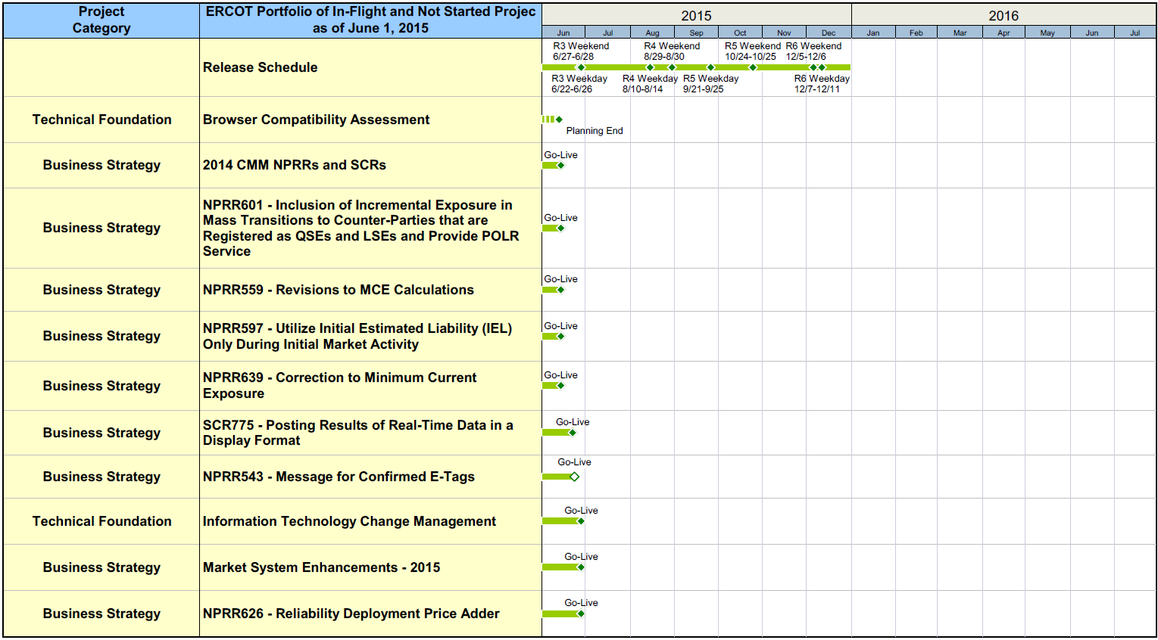
Project Portfolio Status – as of 5/31/2015

Slide 10
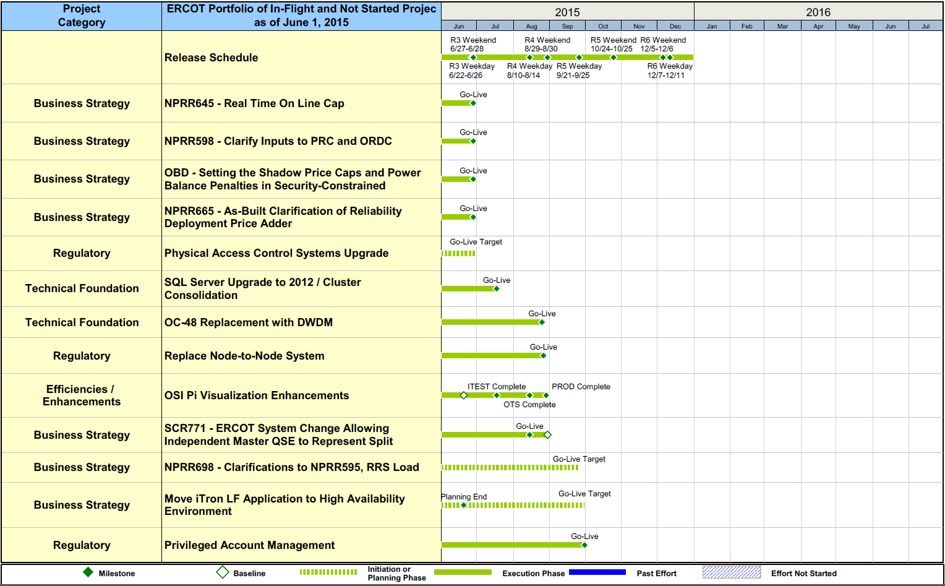
Project Portfolio Status – as of 5/31/2015

Slide 11
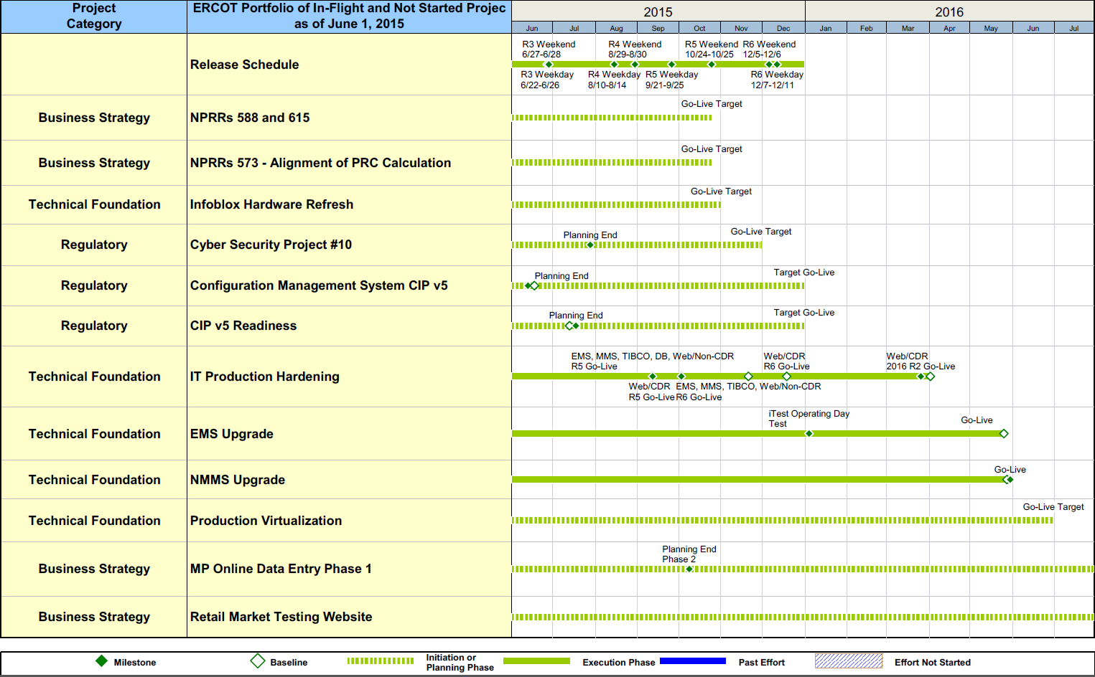
Project Portfolio Status – as of 5/31/2015

Slide 12
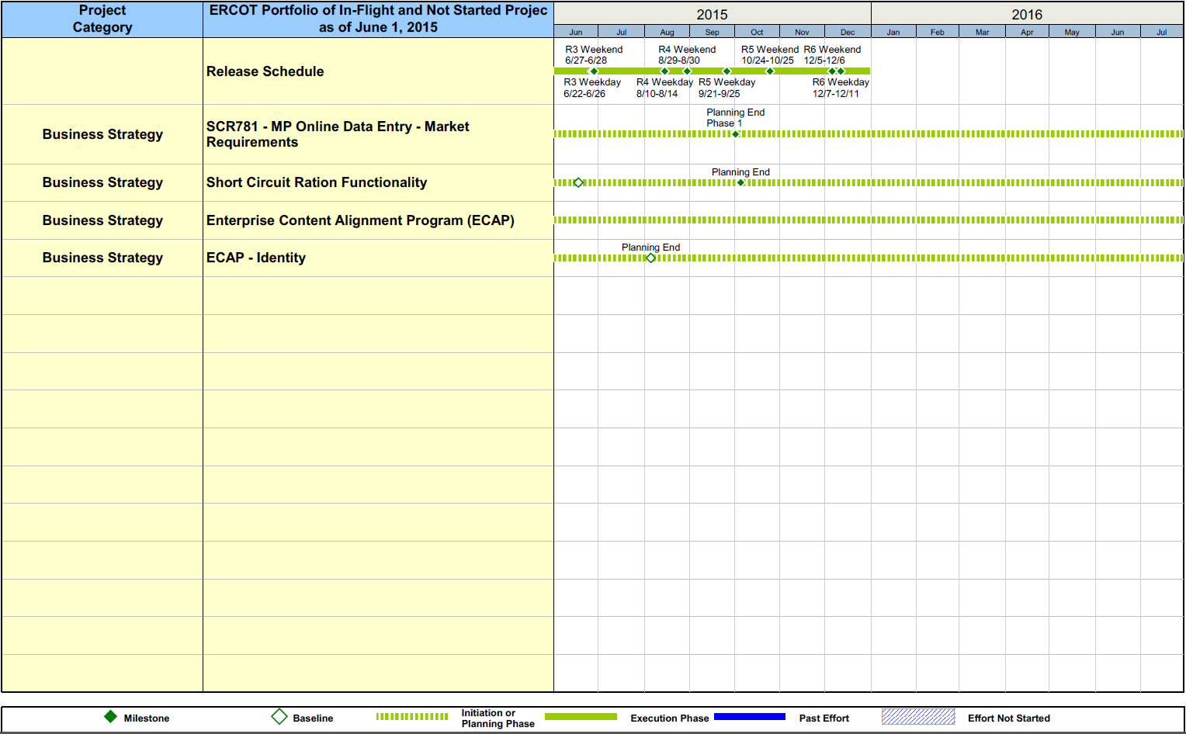
Project Portfolio Status – as of 5/31/2015

Slide 13
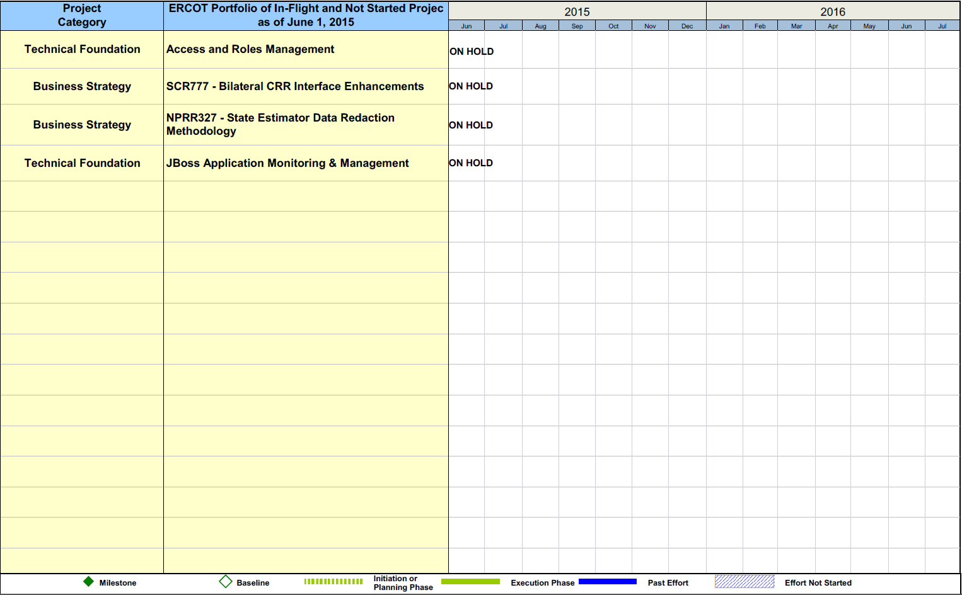
Project Portfolio Status – as of 5/31/2015

Slide 14
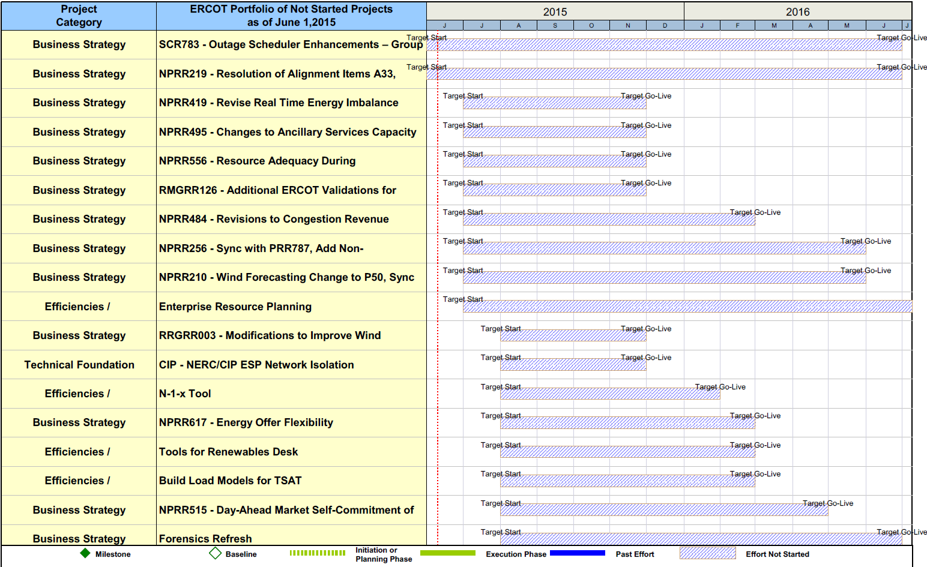
Project Portfolio Status – as of 5/31/2015

Slide 15
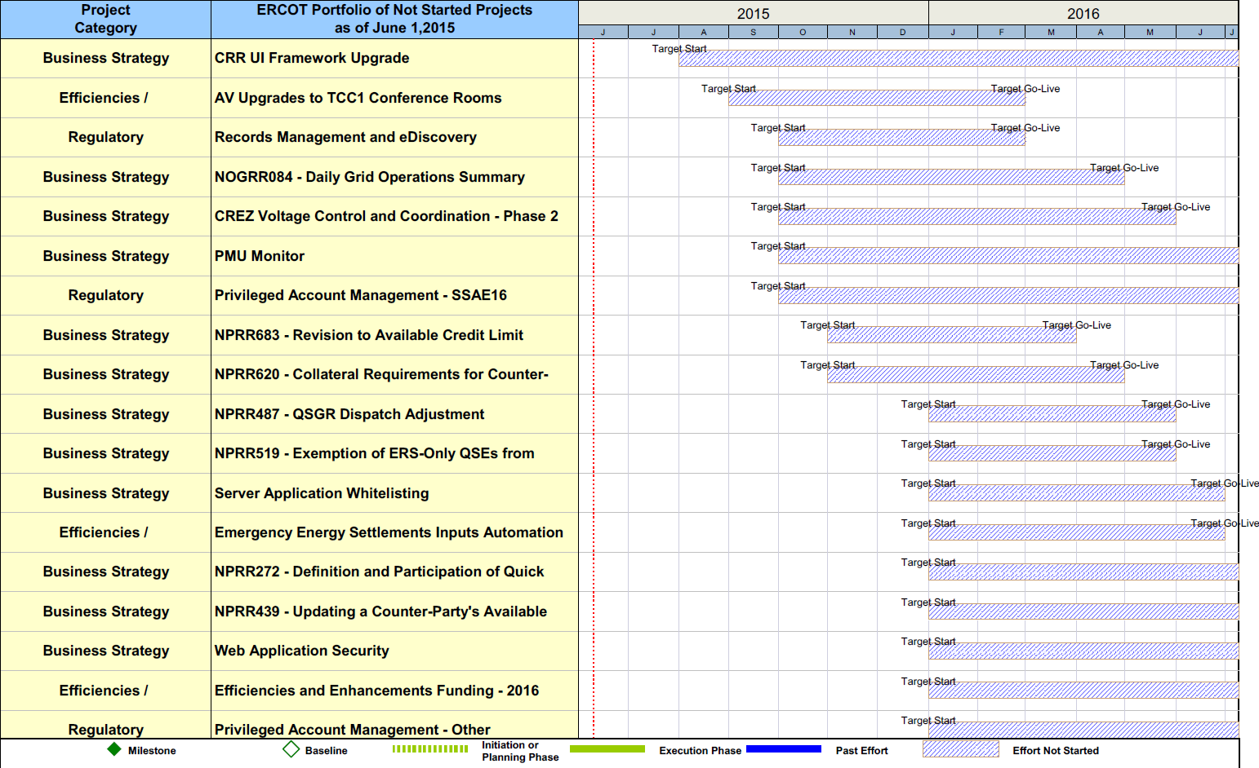
Project Portfolio Status – as of 5/31/2015

Slide 16
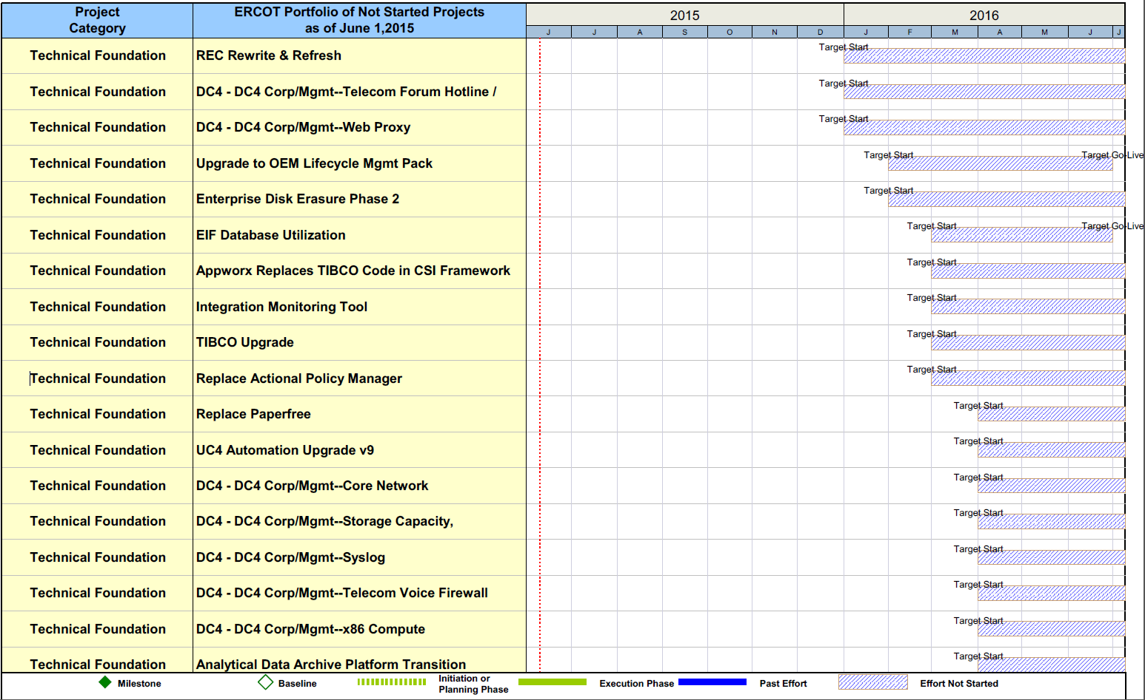
Project Portfolio Status – as of 5/31/2015

