Slide 1
Information Technology Report
Dave Pagliai
Manager, IT Support Services

Slide 2
Incident Report Highlights
Service Availability – May
  Retail Market IT systems met all SLA targets
Incidents & Maintenance – May
  05/15/15 – Find ESIID slow response (72 minutes)
MarkeTrak
  API QueryList response time increased after a database upgrade in March
  ERCOT has a support case open with the vendor and is currently testing their recommended fix of the issue
Supplemental AMS Interval Data Report Issue
  No impacts to report posting in May
  A long term solution has been developed and released to ERCOT’s test environment, and is scheduled for R3 Production release (late June)

Slide 3
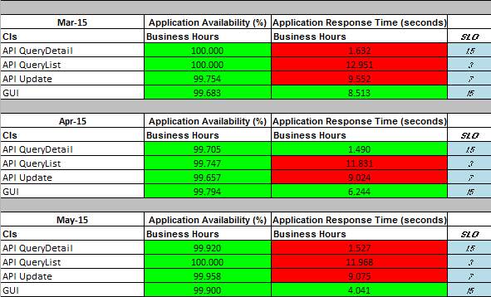
MarkeTrak Performance

Slide 4
Premature Transitioning of MarkeTrak Issues
ERCOT’s MarkeTrak application prematurely transitioned issues of all subtypes
  This occurred on February 4 , 11, and 24, 2015
  Investigation determined that a database parameter was getting changed by the MarkeTrak application
  On February 24, ERCOT implemented a system change in an attempt to prevent the impact of the database parameter change, should it reoccur
  No re-occurrence of the issue since 02/24/15
  Vendor root cause investigation:
    Unable to reproduce the issue under multiple scenarios
    No other customers have reported this issue
  Vendor suggests considering an upgrade of their product
  TDTWG has questions regarding the possibility of an upgrade (support roadmap, user base of currently running version, features of new version, etc.)
  ERCOT has initiated discussions with the vendor to address TDTWG’s questions regarding an upgrade path
  ERCOT will present details of vendor discussions at TDTWG before bringing to RMS

