Slide 1
Energy and commodity price benchmarking and market insights

Slide 2
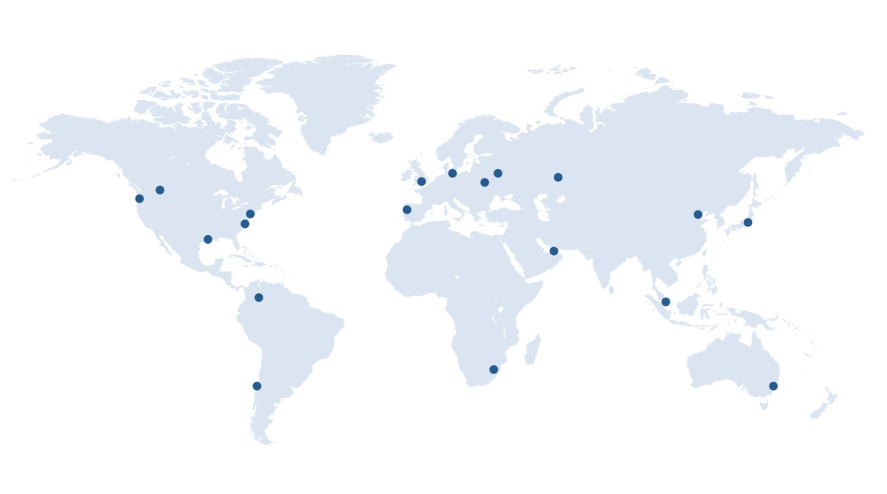
Argus Media
Argus Founded in 1970
Staff of over 700 worldwide, 20 offices globally
Cover all global energy markets and extensively used in indexation of physical and financial contracts
Crude, refined products, biofuels, natural gas, LPG, electricity, emissions, coal, fertilizer, biomass, freight, metals, petrochemicals…

Slide 3
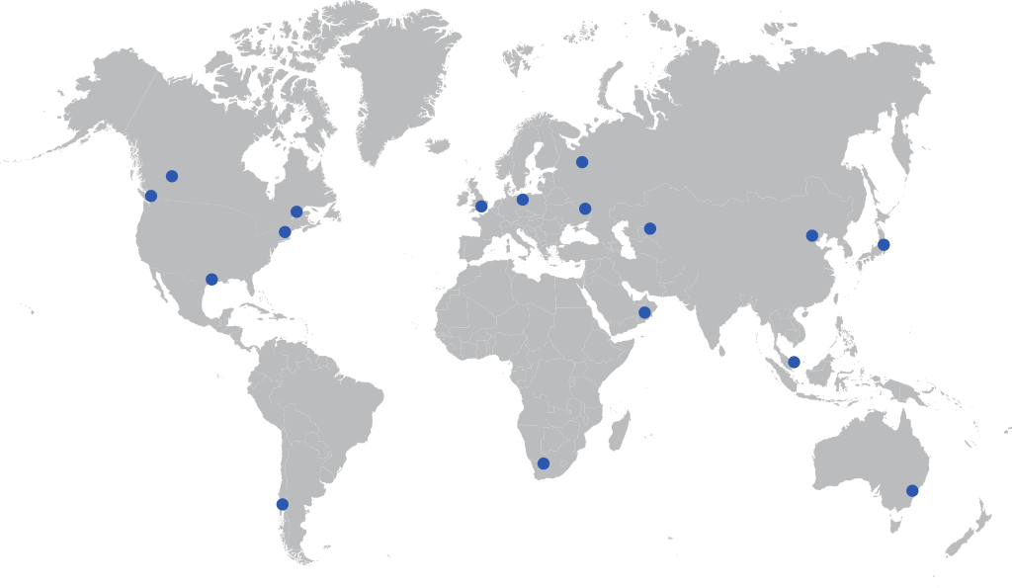
London
Houston
Washington
Moscow
Singapore
New York
Tokyo
Sydney
Astana
Johannesburg
Kiev
Beijing
Dubai
Santiago
Berlin

Slide 4
Argus in natural gas and power
Argus is the leading natural gas and power price reporting agency service in Europe
Argus launched North America natural gas and power cash market products and services in 2009
Argus cash market methodologies fully comply with FERC price-reporting requirements and enforces a strict code of ethics that prohibits staff from trading energy and stock in energy companies
Argus operates a comprehensive compliance program, backed by regular audits from a full-time compliance officer

Slide 5
Argus Forward Curve Products - Advantages
Argus is independent; does not participate in commodity markets
Monthly granularity, “no gaps”
Product tested & calibrated with market participants
Argus receives market data from multiple sources across the entire market
What it is
Daily risk data service
Who’s it for
All market participants

Slide 6
Argus North American Forward Curves
What are Forward Curves
Forward Curves are the market’s current assessment of the value of a commodity for a specified delivery schedule sometime in the future
The current Forward Curve value is the value for which supply/demand is presently balanced for a given commodity for a given delivery period at some time in the future
Forward curves are not a current prediction of future “cash” or physical market values; rather they are the market’s current fair market value, given current market conditions and forward risk premiums
Do not confuse projected/forecasted future spot prices with Forward Curves (Fundamentals-driven companies that produce future commodity pricing models typically produce expected future spot prices, NOT Forward Curves)

Slide 7
Argus North American Forward Curves
Key Features & Advantages
Daily price assessments - end of day; Reflects market value as of 2:30 pm EST, in alignment with Nymex settlement prices
Independent and transparent market-appropriate methodology
Approximately 3500 power broker quotes received each day
Delivery options include: Email, FTP data feed and third-party delivery options
Applications
Forward Curve Validation
Mark-to-market Accounting
Credit Margining
Project Planning
Structured Transactions
Deal Valuation
Capital Expenditures
Project Finance
Scenario Analysis

Slide 8
Argus North American Forward Curves
Companies Using Argus Forward Curve Products
Independent Power Producers
Independent System Operator (ISOs)
Retail Electric & Natural Gas Providers
Proprietary Trading Companies
Electricity Coops
Government Agencies
Municipals Utilities & Investor Owned Utilities
Oil and Gas Producers
End Users; Manufacturing Companies Consultants
Wholesale and Retail Brokers

Slide 9
Argus ERCOT Forward Curves
Argus Electricity ERCOT Forward Curves – Eight Locations
Trading Hubs – North, South, Houston, West
Load Zones – North, South, Houston, West
Fixed Prices & NYMEX Heat Rates
84 Months Forward
On Peak, Off peak, 7x24, 2x16, 7x8
Argus Electricity ERCOT Forward Curves – Hourly Prices
4 Trading Hubs – North South, Houston, West
Prompt year plus a Minimum of 2 years forward
Balance of the Month hourly pricing
5x16, 2x16, 7x8 & 7x24 - hourly pricing

Slide 10
Argus Forward Curve Methodologies
http://www.argusmedia.com/Methodology-and-Reference

Slide 11
ARGUS Risk Management Forward Curves Houston, TX Date: June 17, 2015 Jay Pruett Business Development Risk Management Products Jay.Pruett@Argusmedia.com 713-429-6351
Illuminating the markets

