Slide 1
Regulation Bias Analysis post SCR-773
PDCWG Meeting 09/10/2014

Slide 2
Discussion Points
Current GTBD Parameters
Metric to measure Regulation bias and performance
Regulation Deployed comparison (June to August)
Total Regulation (net) Deployed comparison
Regulation Deployed 15-minute interval comparison by each hour for 2012, 2013 and 2014 months
Regulation Exhaustion Rate
Regulation bias for consecutive 5-min interval
Summary

Slide 3
Metric to measure SCR-773 performance
Trend and monitor the regulation deployed by hour
Set target of 50 MW for total regulation deployed by hour for peak hours (HE 14 to HE 18)
Set target of 85% for the number of intervals where regulation deployment was both up and down (zero crossing) for peak hours (HE 14 to HE 18)
Track the Regulation exhaustion rate for all hours (not to exceed <1.2% )
Using a 50MW filter, target 15 occurrences or less per month for regulation bias of six or more consecutive 5 minute intervals for peak hours (HE 14 to HE 18).

Slide 4
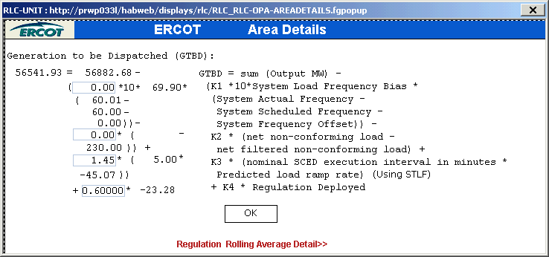
Current GTBD Parameters

Slide 5
Regulation Deployed Comparisons
Metric 1
Trend and monitor the regulation deployed by hour

Slide 6
Regulation Deployed comparison - Table

Slide 7
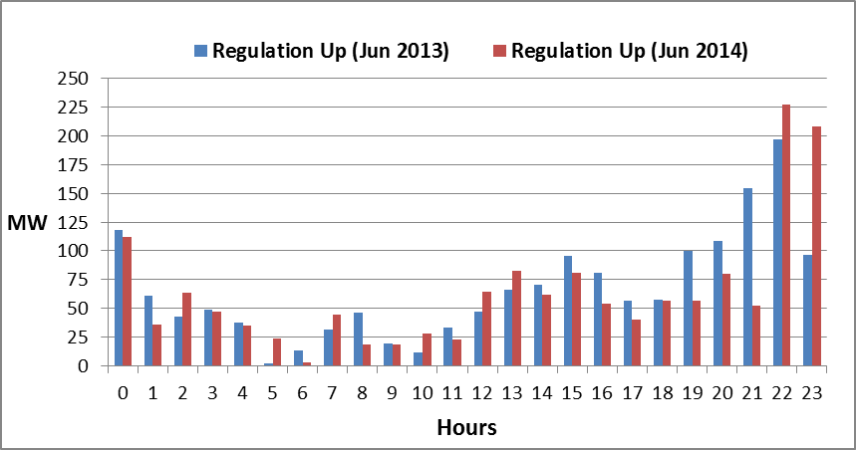
Hourly Regulation-Up Deployed Monthly comparison - Chart

Slide 8
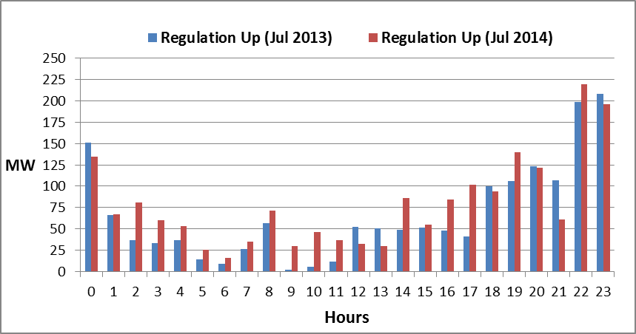
Hourly Regulation-Up Deployed Monthly comparison - Chart

Slide 9
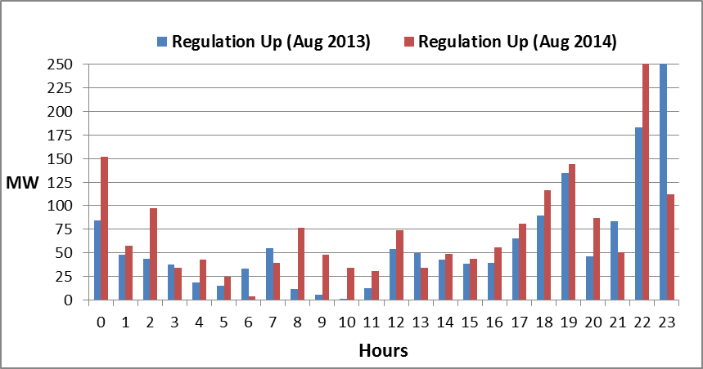
Hourly Regulation-Up Deployed Monthly comparison - Chart

Slide 10
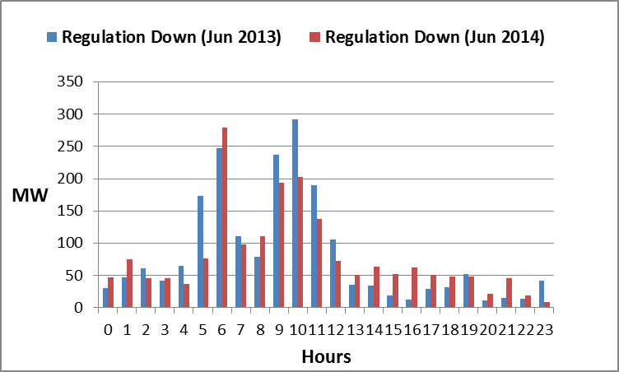
Hourly Regulation-Down Deployed Monthly comparison - Chart

Slide 11
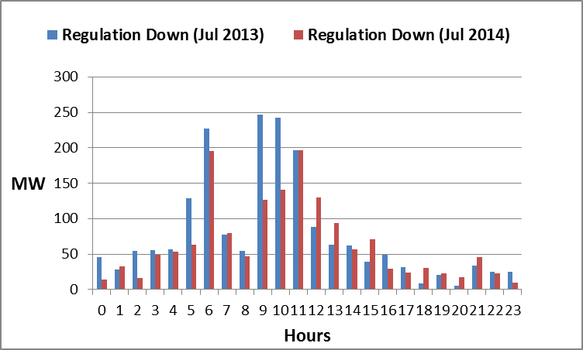
Hourly Regulation-Down Deployed Monthly comparison - Chart

Slide 12
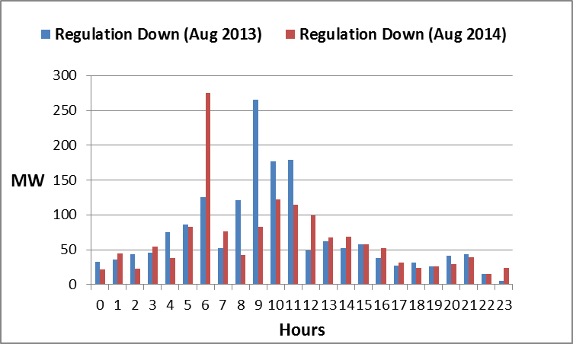
Hourly Regulation-Down Deployed Monthly comparison - Chart

Slide 13
Total Regulation Deployed Comparisons
Metric 2
Set target of 50 MW for total regulation deployed by hour for peak hours (HE 14 to HE 18)

Slide 14
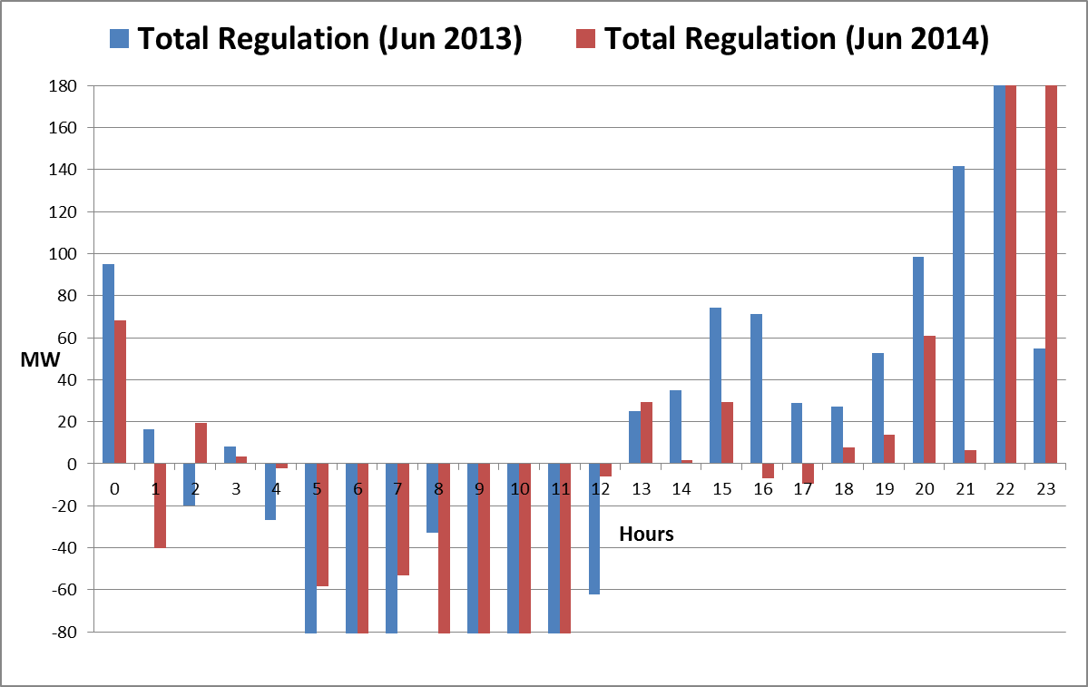
Hourly Total-Regulation Deployed Monthly comparison - Chart
Shut-Down Period

Slide 15
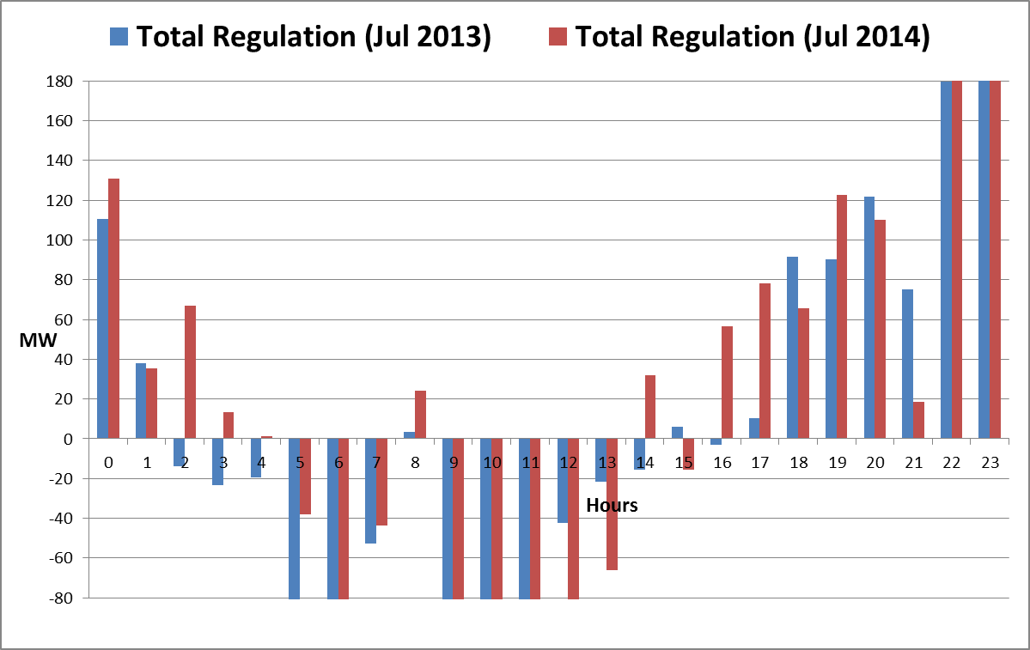
Hourly Total-Regulation Deployed Monthly comparison - Chart
Shut-Down Period
Peak Hours

Slide 16
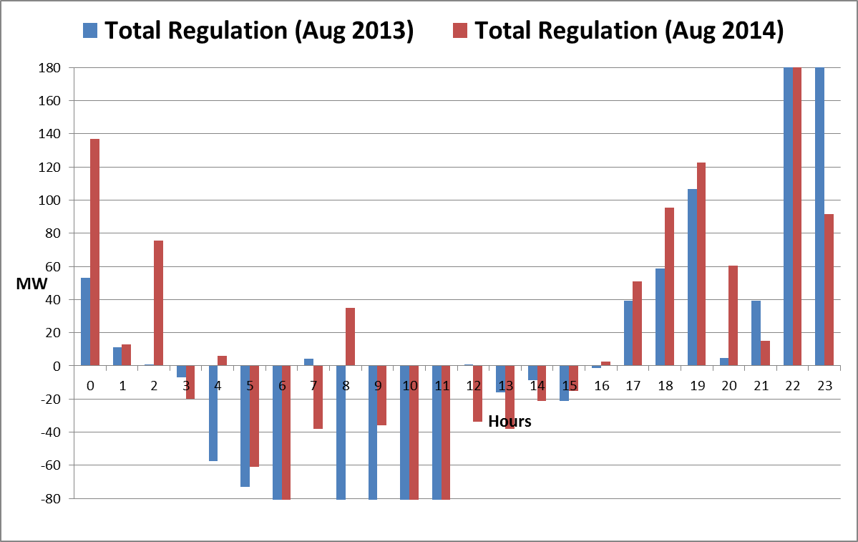
Hourly Total-Regulation Deployed Monthly comparison - Chart
Start-Up Hours
Peak Hours

Slide 17
15-Minute intervals where both Reg-Up/Down were deployed
Metric 3
Set target of 85% for the number of intervals where regulation deployment was both up and down (zero crossing) for peak hours (HE 14 to HE 18)

Slide 18
Regulation Deployed 15-Minute Interval Comparison – by hours

Slide 19
Regulation Exhaustion Rate
Metric 4
Track the Regulation exhaustion rate for all hours (not to exceed <1.2% )

Slide 20
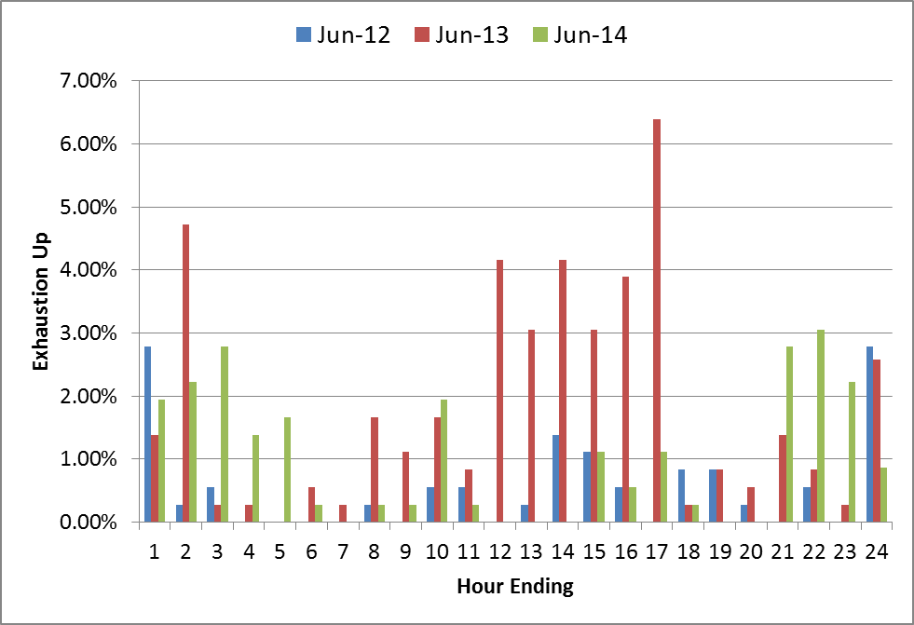
Regulation-Up Exhaustion Rate – by hours
0.57% | 1.84% | 1.04%

Slide 21
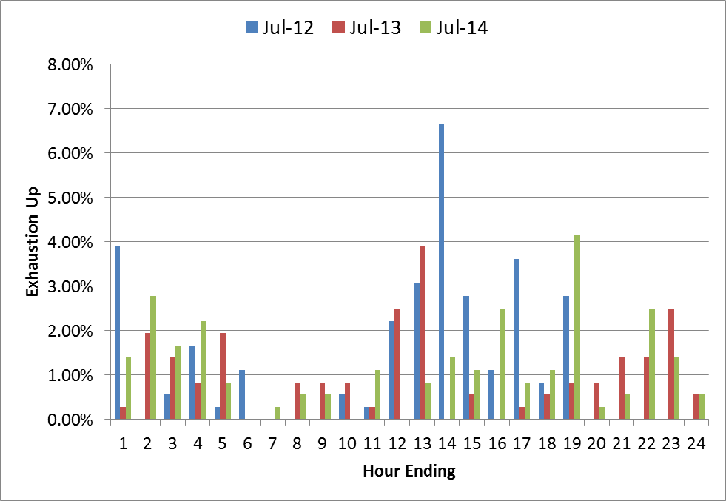
Regulation-Up Exhaustion Rate – by hours

Slide 22
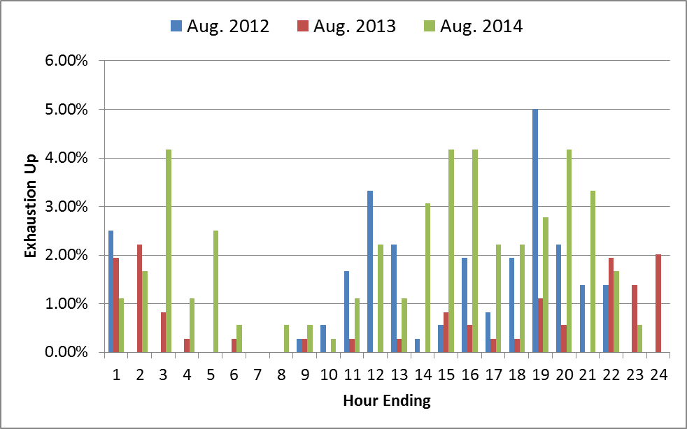
Regulation-Up Exhaustion Rate – by hours
1.09% | 0.64% | 1.89%

Slide 23
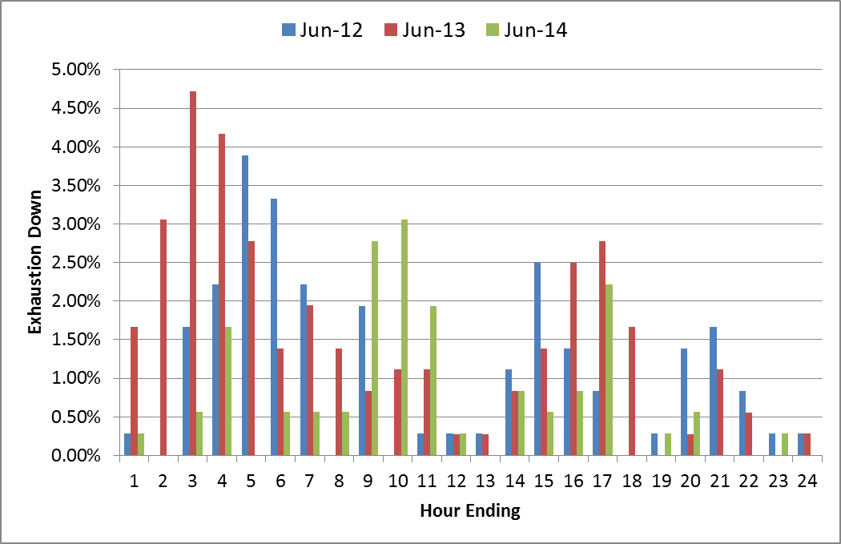
Regulation-Down Exhaustion Rate – by hours
1.12% | 1.51% | 0.74%

Slide 24
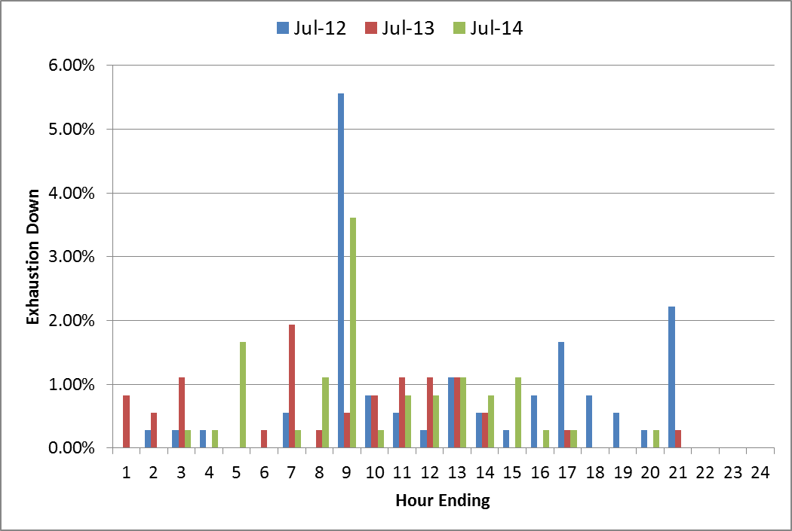
Regulation-Down Exhaustion Rate – by hours
0.71% | 0.45% | 0.54%

Slide 25
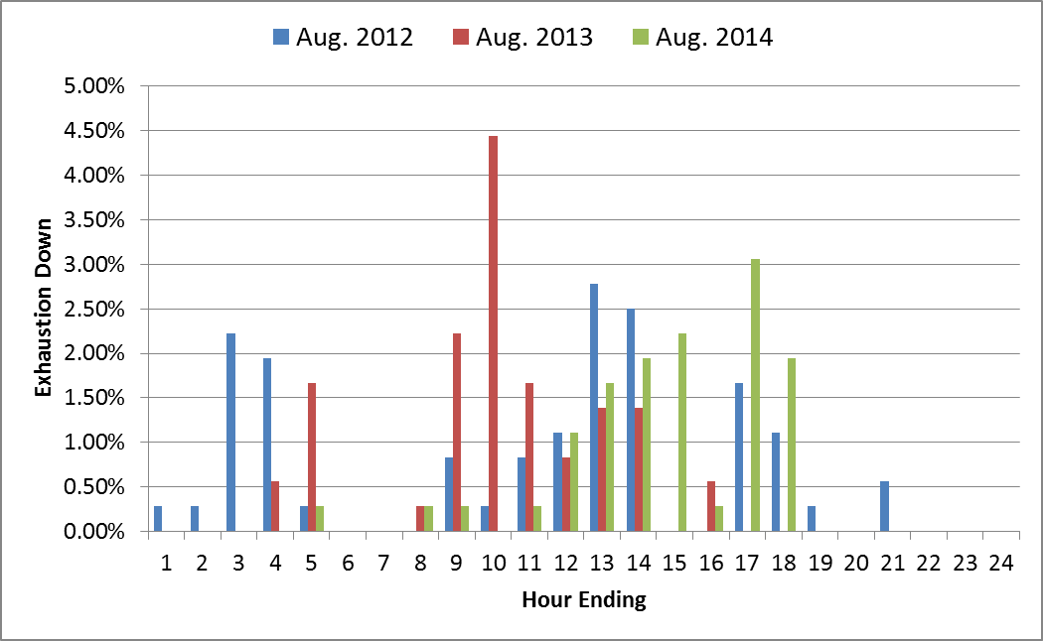
Regulation-Down Exhaustion Rate – by hours
0.71% | 0.63% | 0.56%

Slide 26
Stats on Reg-Up Bias for consecutive 5-min intervals
Metric 5
Using a 50MW filter, target 15 occurrences or less per month for regulation bias of six or more consecutive 5 minute intervals for peak hours (HE 14 to HE 18*).

Slide 27
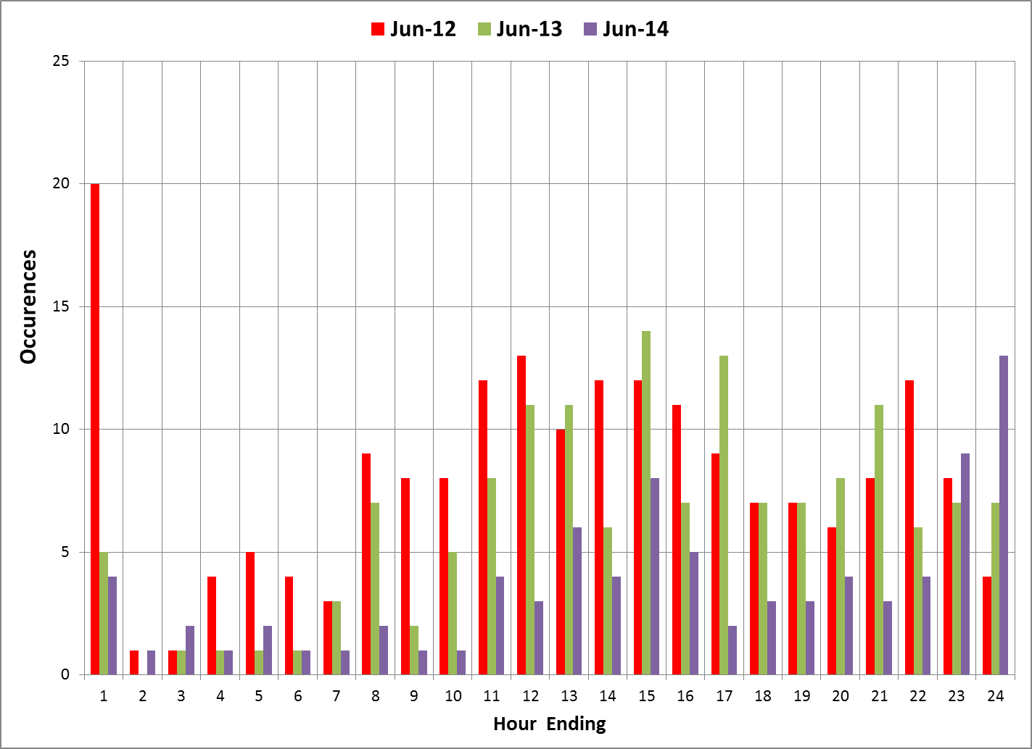
Reg-Up Bias for six Consecutive 5 min intervals (50 MW filter)

Slide 28
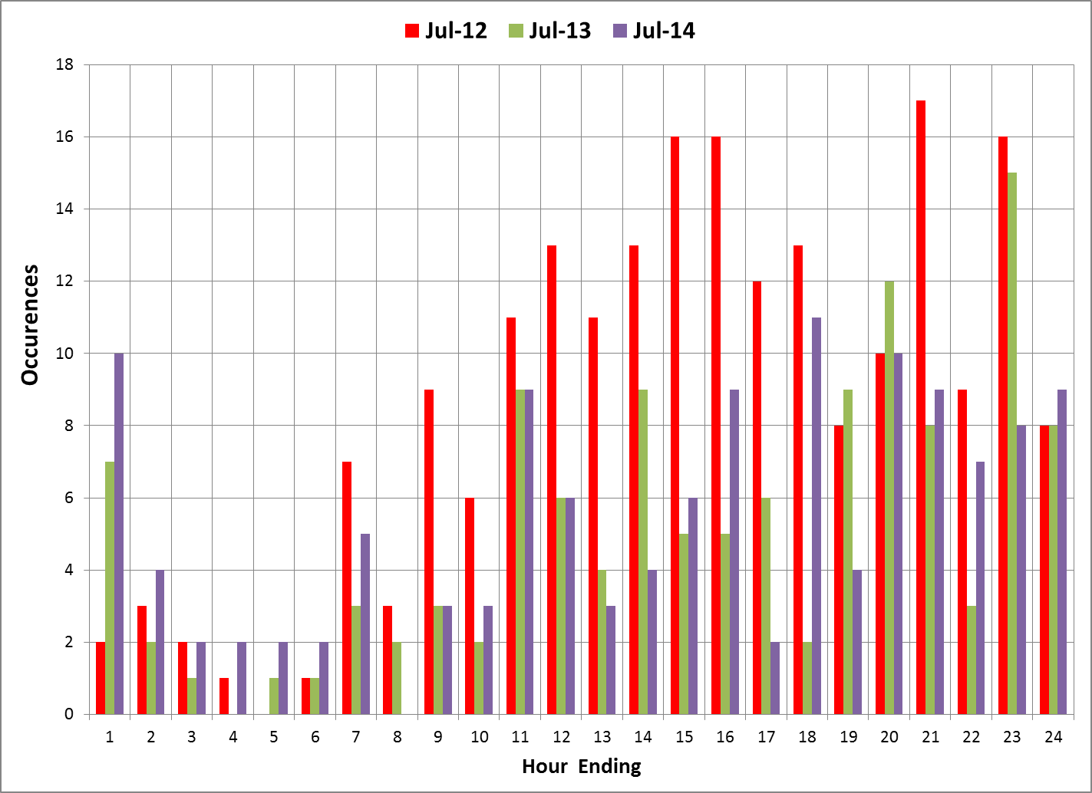
Reg-Up Bias for six Consecutive 5 min intervals (50 MW filter)

Slide 29
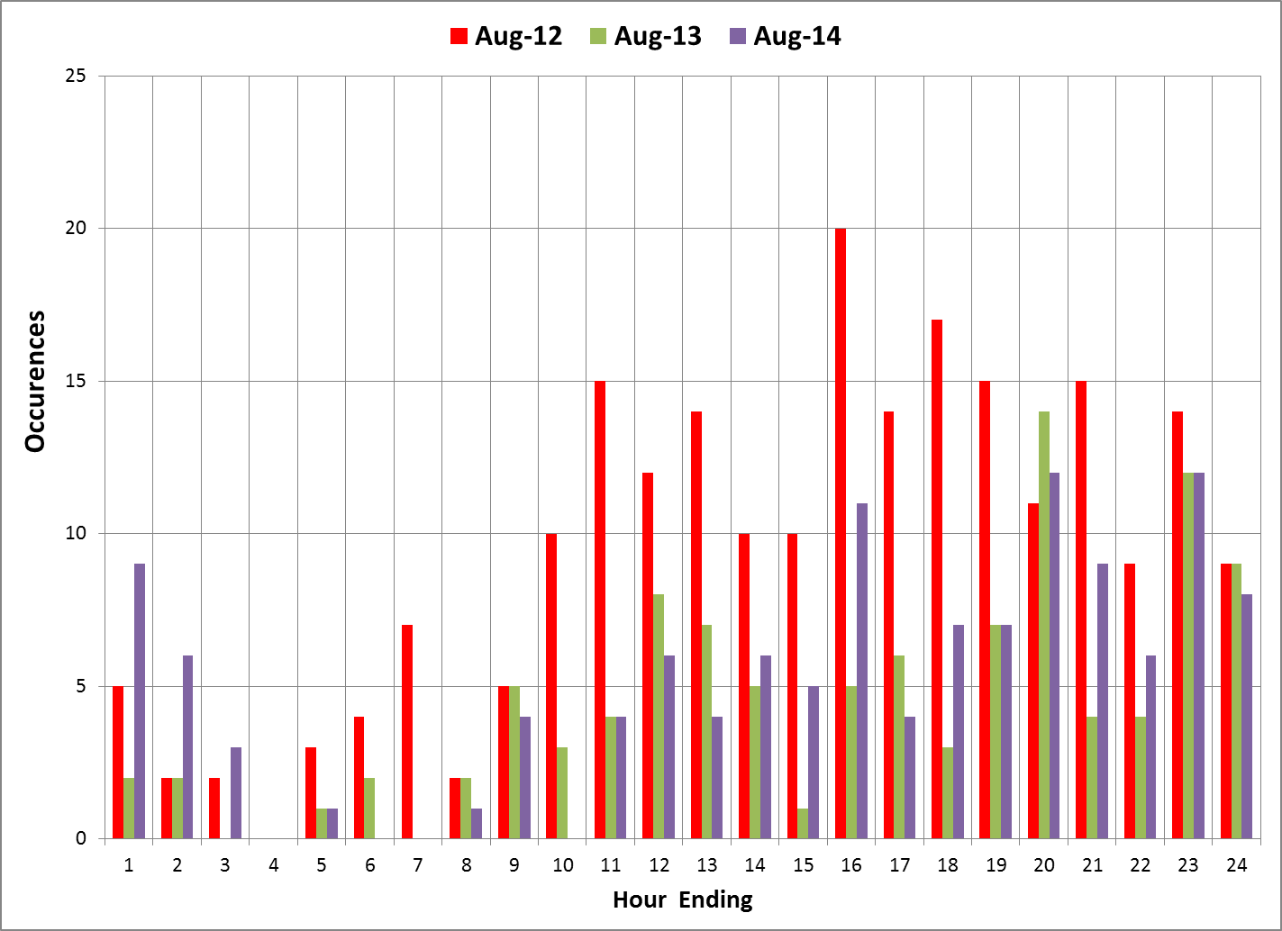
Reg-Up Bias for six Consecutive 5 min intervals (50 MW filter)

Slide 30
Questions??

Slide 31
Appendix

Slide 32
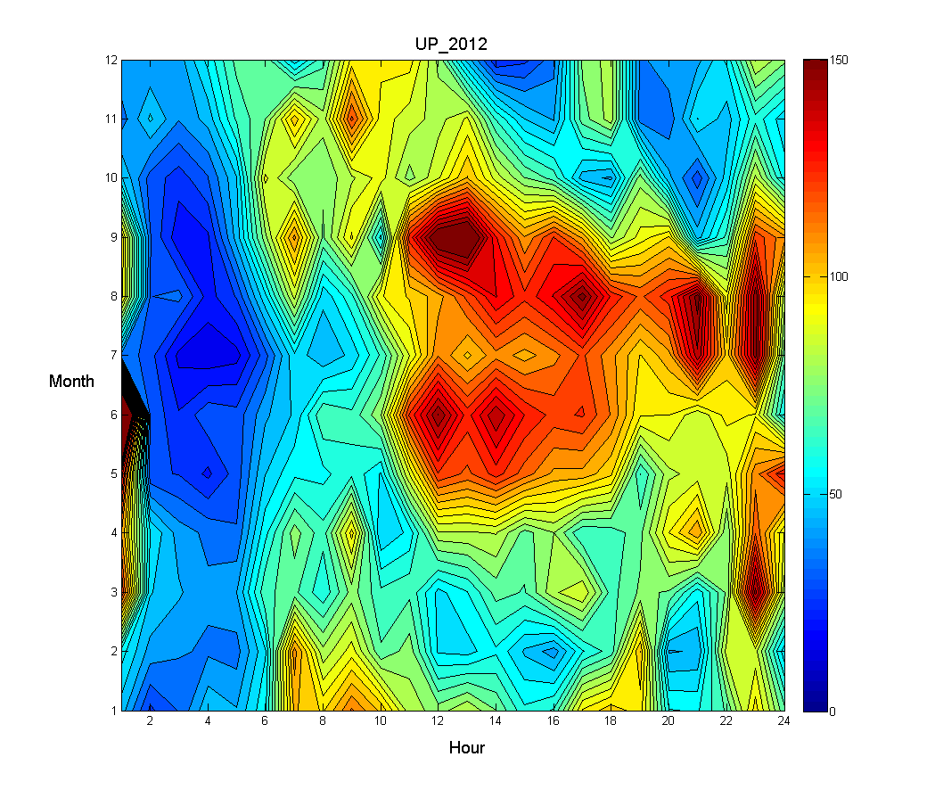
Regulation-Up Deployed by hours

Slide 33
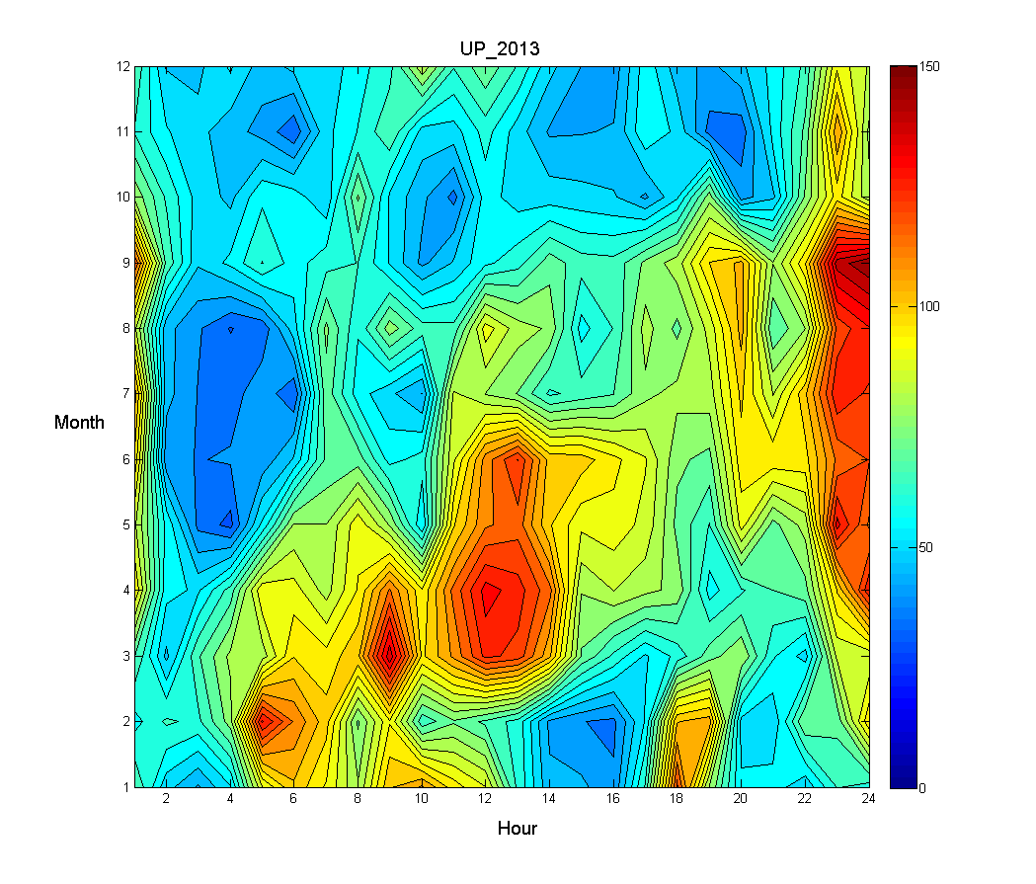
Regulation-Up Deployed by hours

Slide 34
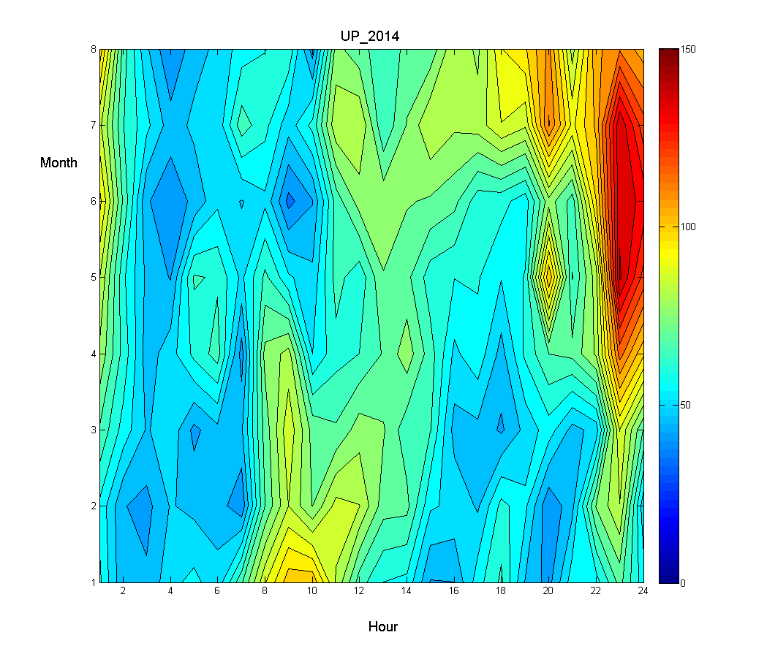
Regulation-Up Deployed by hours

Slide 35
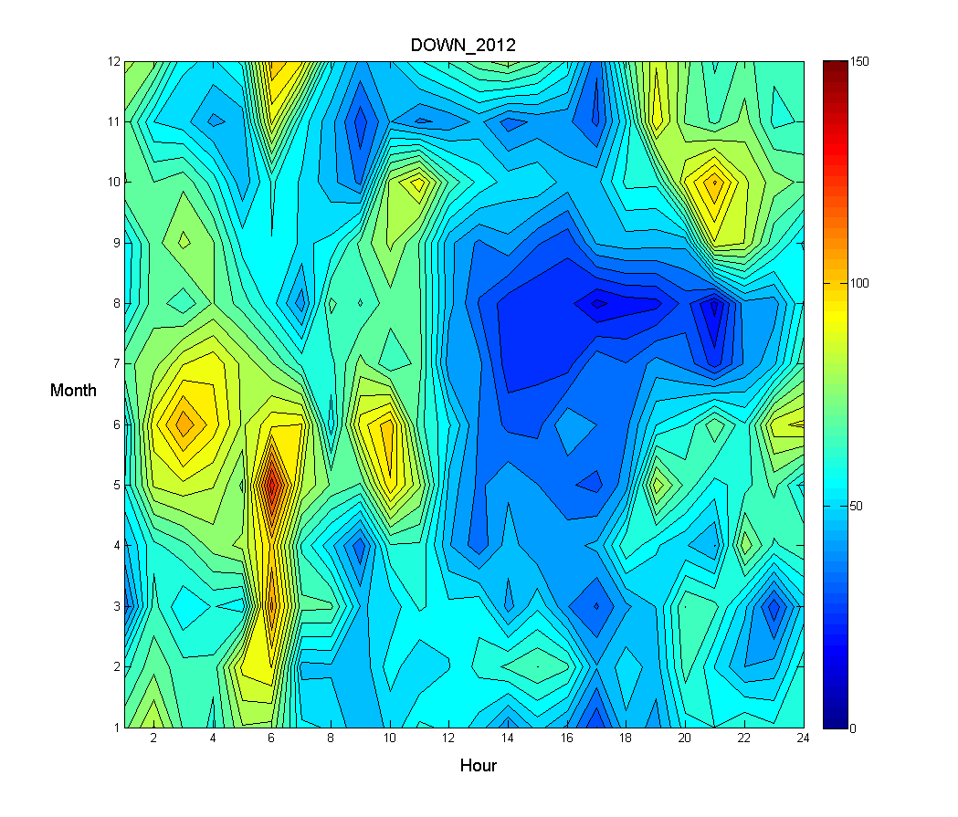
Regulation-Down Deployed by hours

Slide 36
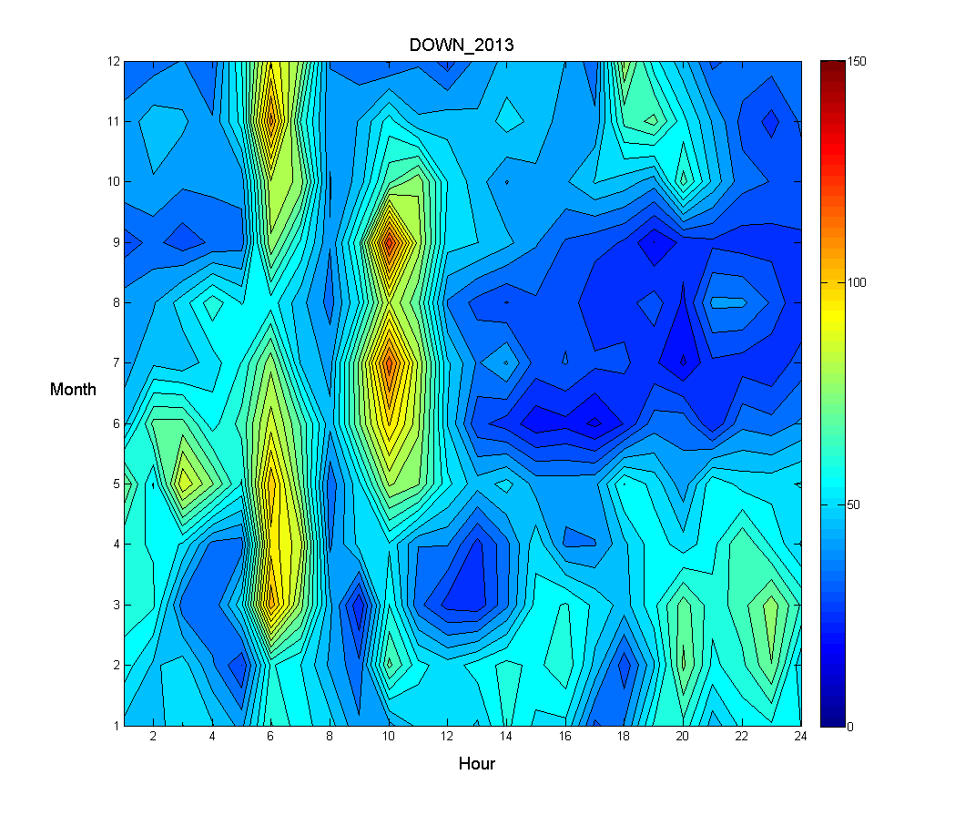
Regulation-Down Deployed by hours

Slide 37
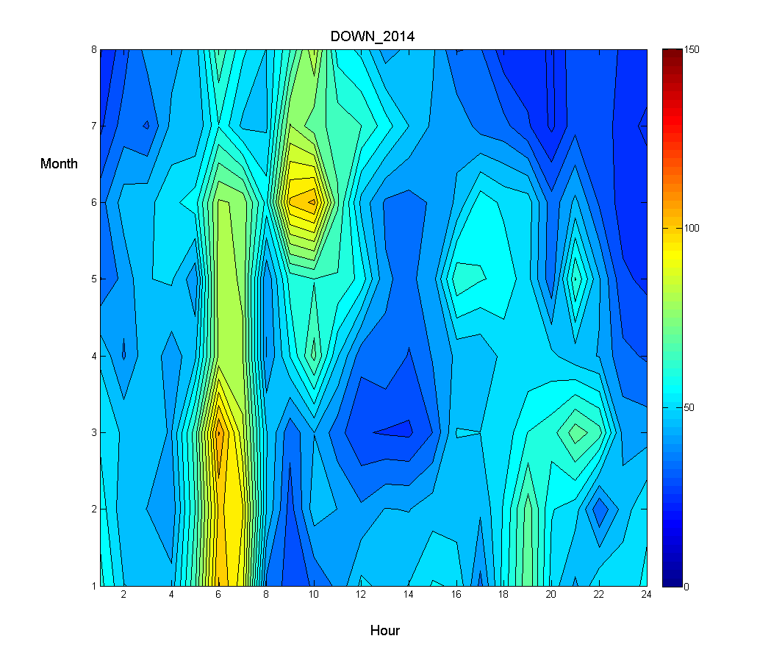
Regulation-Down Deployed by hours

