Slide 1
Regulation Bias Analysis post SCR-773
PDCWG Meeting 08/26/2013

Slide 2
Discussion Points
Current GTBD Parameters (implemented on May 23, 2013)
Regulation Deployed comparison (Up to August 20th)
Regulation Deployed 15-minute interval comparison
Ongoing effort to improve Regulation Bias

Slide 3
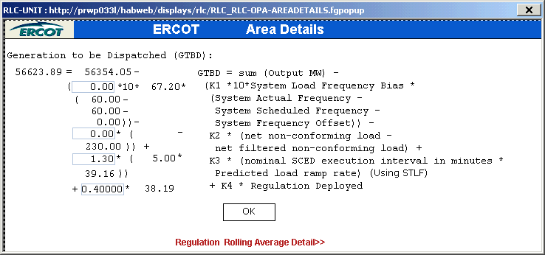
Current GTBD Parameters

Slide 4
Regulation-Up Deployed Monthly comparison - Table

Slide 5
Hourly Regulation-Up Deployed Monthly comparison - Chart

Slide 6
Hourly Regulation-Up Deployed Monthly comparison - Chart

Slide 7
Hourly Regulation-Up Deployed Monthly comparison - Chart

Slide 8
Regulation-Down Deployed Monthly comparison- Table

Slide 9
Hourly Regulation-Down Deployed Monthly comparison - Chart

Slide 10
Hourly Regulation-Down Deployed Monthly comparison - Chart

Slide 11
Hourly Regulation-Down Deployed Monthly comparison - Chart

Slide 12
Hourly Total-Regulation Deployed Monthly comparison - Chart

Slide 13
Hourly Total-Regulation Deployed Monthly comparison - Chart

Slide 14
Hourly Total-Regulation Deployed Monthly comparison - Chart

Slide 15
Regulation Deployed 15-Minute Interval Comparison - Chart

Slide 16
Ongoing effort to improve Regulation Bias
Continue tuning Generation To Be Dispatched and LFC Regulation parameter
Continue to follow-up with Resources that are causing Regulation Deployment during Start-Up and Shut-Down
  So far contacted several entities, some has already mitigated this Startup issue and more entities to be contacted about the improper shut-down
  ERCOT will also provide guidance on ERCOT’s expectation during Start-Up and Shut-Down in 2014 Operations Seminar

Slide 17
Questions??

