Slide 1
Update to RMS
June 2, 2015

Slide 2
RMGRR131 – Guidelines for Notification of Invoice Dispute – VOTE
The revision will align the Retail Market Guide with current market practices.
Today, most CRs utilize the MarkeTrak tool to submit an 810 invoice dispute.
Usage & Billing SubType
Other
The Retail Market Guide currently outlines a formal dispute process by sending an email to a designated TDSP address with a spreadsheet attachment

Slide 3
RMGRR – Guidelines for Notification of Invoice Dispute - continued
Benefits
Allows Market Participants the ability to manage, track, and acknowledge receipt of invoice disputes
More timely resolution of invoice disputes due to reporting and workflow management capabilities within the MarkeTrak tool
Allows Market Participants to track resolution of invoice disputes to ensure adherence to Service Level Agreements (SLA)
Provides all Market Participants with full transparency into ‘State’ of invoice dispute (In Progress, Pending Complete, etc)
Continued discussions on clarifying language for timelines on MarkeTrak dispute process

Slide 4
Inadvertent Gain (IAG) Training Roadshow – LAST STOP ---- REMINDER
Register via ERCOT’s Learning Management System (LMS) if planning to attend in person
WebEx details are listed at ERCOT> Services> Training> Course Catalog
Registration via LMS is still being accepted for the last training class
Dallas, Oncor , Debbie McKeever – deborah.mckeever@oncor.com
Friday, June 12th , 9:30 am – 4 pm

Slide 5
Inadvertent Gain (IAG) Training
Thank you for your participation
Austin – May 12th
25 classroom participants/ 20 WebEx participants
20 REPs (10 different REP companies)
15 TDSPs (all TDSP companies)
11 ERCOT & PUC
Houston – May 15th
20 classroom participants/ 27 WebEx participants
33 REPs (20 different REP companies)
8 TDSPs (all TDSP companies)
6 ERCOT & PUC

Slide 6
Inadvertent Gain (IAG) Training Post-survey
Surveys will be sent this week to Austin and Houston participants soliciting feedback on the training.
Inadvertent Gain (IAG) Training Agenda
Inadvertent Gain/Loss Overview
Causes of IAS & Impacts to customer experience
Prevention of IAS
IAS Resolution Process Walkthrough
Reconciliation & Verification Process
Customer Rescission Walkthrough
ERCOT Live Demonstration & Customized Reports
Market Challenge

Slide 7
MarkeTrak Documentation
http://www.ercot.com/services/client_svcs/mktrk_info/index.html
http://www.ercot.com/content/meetings/rms/keydocs/2014/0110/08.__RMS_MarkeTrak_Task_Force_20140104.ppt
http://www.ercot.com/content/meetings/rms/keydocs/2014/0603/07.__RMS_MarkeTrak_Task_Force_20140603.ppt
http://www.ercot.com/content/meetings/rms/keydocs/2014/1028/07.__RMS_MarkeTrak_Task_Force_20141028.ppt
http://www.ercot.com/content/meetings/rms/keydocs/2015/0106/09.__RMS_MarkeTrak_Task_Force_20150106.ppt
http://www.ercot.com/committees/board/tac/rms/marketraktf/index.html
http://www.ercot.com/content/committees/board/tac/rms/marketraktf/keydocs/2014/PR010_03_training_FINAL.ppt
http://www.ercot.com/content/wcm/training_courses/97/MarkeTrak_Detailed_Training_102014.ppt
http://www.ercot.com/committees/board/tac/rms/marketraktf/MarkeTrak SubTypes Quick Reference 20150510 v2
Link to IAG/Rescission training: http://www.ercot.com/services/training/course/128#materials/MARKET IAG Training Final 20150511 v2 10 15am
User Guide
Bulk Insert Templates
MarkeTrak Workflows
MarkeTrak Tips and Tricks
MarkeTrak API WSDL/XSD
Also direct link from MarkeTrak tool

Slide 8
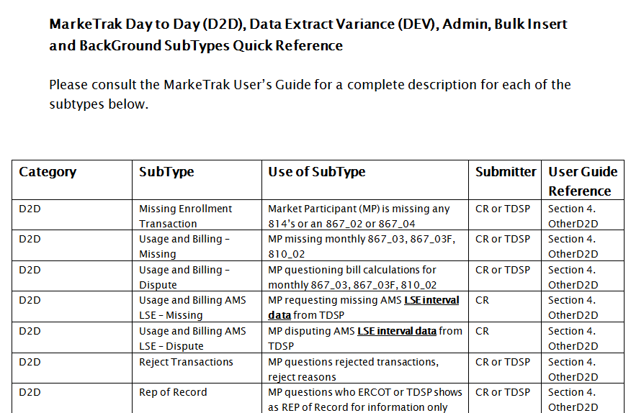
MarkeTrak Documentation
http://www.ercot.com/committees/board/tac/rms/marketraktf/MarkeTrak SubTypes Quick Reference 20150510 v2

Slide 9
Sunsetting of Task Force - VOTE

Slide 10
Questions
Any future MarkeTrak issues should be referred to TDTWG
TDTWG Next Meeting:
Wednesday, June 10th 2:00 – 4:00 pm
WebEx only

