Slide 1
Market Credit Working Group update to the Wholesale Market Subcommittee
06/03/2015

Slide 2
MCWG update to WMS
Joint meeting of MCWG and CWG on Wednesday, May 20
9 NPRRs reviewed for credit impacts
All NPRRs had no credit impact
NPRR680 improves physical AS hedging flexibility
NPRR692 cleans up DAM parameter posting

Slide 3
MCWG update to WMS
NPRR702 Flexible Accounts, Payment of Invoices, and Disposition of Interest on Cash Collateral
Used to pay or receive ERCOT invoices in a timely manner and reduce wire fees
Separate from a cash collateral account; Does not accrue interest
Invoices will be paid on the Invoice due date
Flexible Accounts must be funded by noon on the invoice due date for invoices to be paid by flexible account
Any over payments will be returned after communication with the Market Participant

Slide 4
MCWG update to WMS
ERCOT has identified some issues with NPRR 484/554 Phase 1b and Phase 2 that may need further clarifications.
Methodology to account for deferred payment of CRR Awards for future period
Mechanism for prepayment of deferred auction invoices
Accounting and payment of unpaid CRRs when a Counter-Party leaves the market voluntarily or by default
Pre/post implementation transition issues
ERCOT has identified potential solutions:
For each Long Term Auction Sequence (LTAS), split Auction results transactions by operating month
Create separate invoices for each month of each Long Term Auction Sequence

Slide 5
MCWG update to WMS
Credit Protocols Clarifications and Corrections
ERCOT working on a draft NPRR to correct discrepancies in credit related Protocol language
20 clean up items identified
Example:
Protocol Ref. | Description | Rationale
16.11.4.1(2) | CRRA flag for CRR activity other than FCE deleted. | CRRA flag was temporary pending finalization of CFTC rules.
16.11.4.1(2) | Apply SAF to DARTNET in MCE calculation | As-built alignment
16.11.4.1(2) | DARTNET is defined as the absolute value of net DAM clearings. The abs function is applied to DARTNET | As-built alignment
16.11.4.1(2) | “Calendar days” changed to “Operating Days” and d subscript changed to od | Protocol consistency
16.11.4.1(2) | Move Potential Uplift (PUL) from EAL to TPE calculation | PUL is only computed at the Counter-Party level

Slide 6
Update on NPRR638
Significant concerns have been identified in the NPRR638 methodology by reviewing detailed modeling results
MCWG met 3 times in May to analyze results and attempt triage
April 22 MCWG/CWG: Concerning behavior identified
May 1 CRIM: ‘Peeled the onion’ on volatility & Lookback (MAX func)
May 13 CRIM: Volume and pricing data analyzed separately
May 20 MCWG/CWG: White flag
Summary of issues:
Seasonality not observed
Using historical prices to predict future prices will introduce some degree of anomaly; highly sensitive to Resource Node prices
Separating MW positions from pricing outcomes produces nonsensical results that are not representative of actual Market Participant behavior or credit risk
Not limited to lookback (MAX function)
Excessive complexity

Slide 7
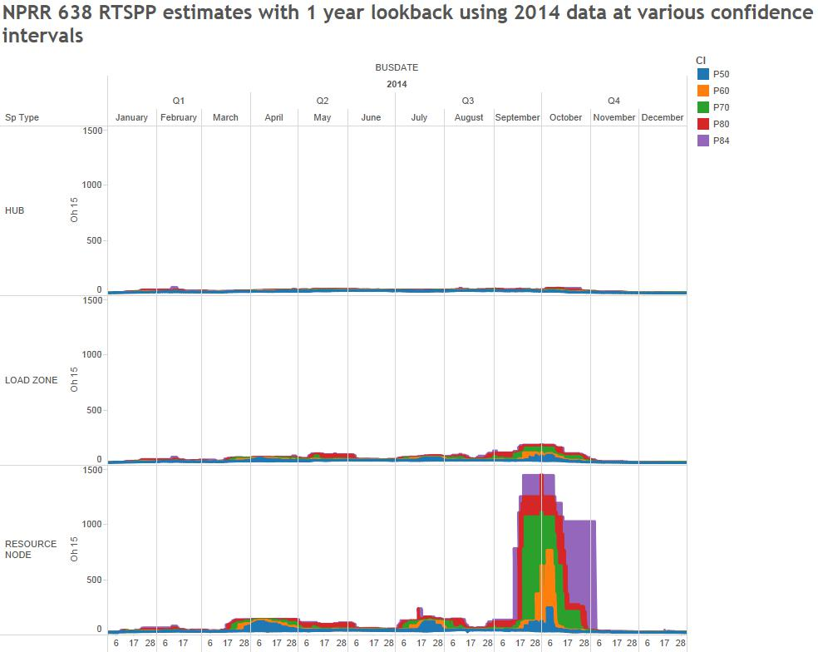
Update on NPRR638

Slide 8
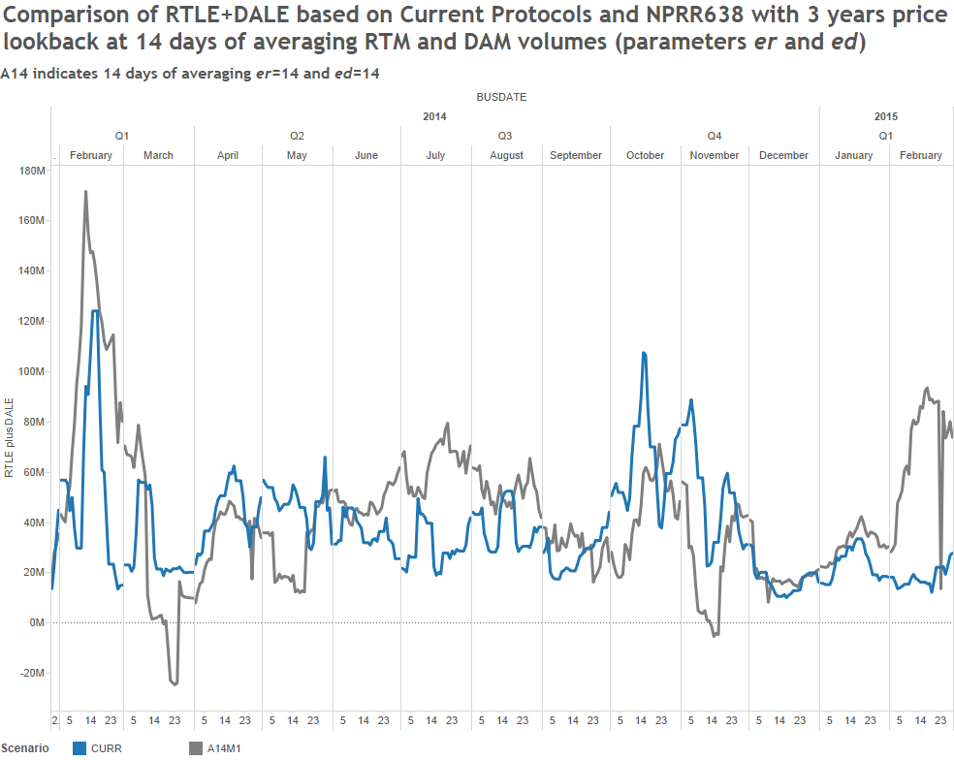
Update on NPRR638

Slide 9
Update on NPRR638
As a result, MCWG/CWG hit the pause button on NPRR638
What are we trying to accomplish?
What are the objectives?
What concerns are we trying to address?
MCWG/CWG will investigate the objectives and explore other ideas
Utilize forward curves?

