Slide 1
NPRR638 Update
Mark Ruane
Director, Settlements, Retail and Credit
TAC
June 25, 2015
ERCOT Public

Slide 2
NPRR638 Update
NPRR638, Revisions to Certain Price Components of EAL, revises the Real-Time Liability Extrapolated (RTLE) and Day-Ahead Liability Extrapolated (DALE) factors used in the calculation of Counter-Party Estimated Aggregate Liability (EAL).
The NPRR replaces recent invoice prices used the current calculation with Settlement Point specific prices computed as the P84 of a price set including Interval prices looking back one week relative to the Operating Day, and forward three weeks relative to the operating day over the past three years.
The goal of NPRR638 is that calculated credit exposures will reflect some degree of seasonality with a forward bias, i.e. increasing before time periods that have historically had high prices. Current exposure calculations lag seasonal price movements.
ERCOT Public

Slide 3
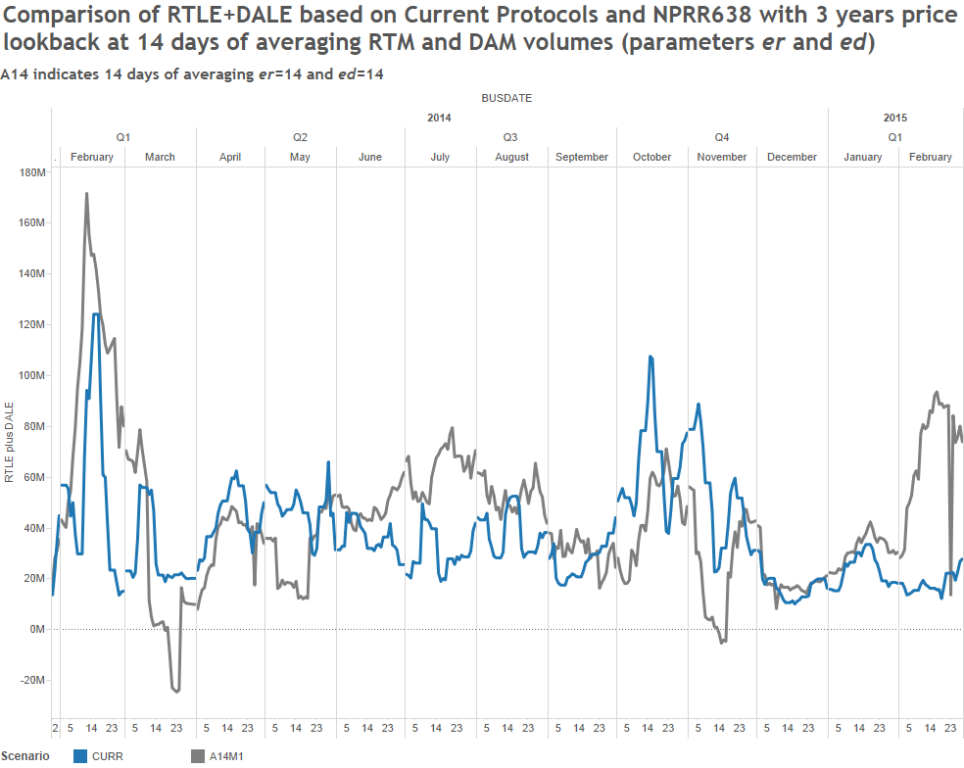
NPRR638 Update
ERCOT Public

Slide 4
NPRR638 Update
CWG / MCWG have reviewed NPRR638 language along with estimated back-testing results and noted several concerns:
Potential difficulty in shadowing the calculation
Complexity
Separation of price and volume components of exposure will lead to inaccuracies
Counter-Parties with both load and generation show very high volatility in exposure
In light of these concerns, CWG / MCWG are investigating other means of addressing issues in current methodology. These might include:
Marking exposure based on forward ERCOT market price curves
Formula-based Seasonal Adjustment Factor
ERCOT Public

Slide 5
NPRR638 Update
Questions
ERCOT Public

