Slide 1

MetrixIDR
Five-Minute Modeling
Electric Reliability Council of Texas
February 2015

Slide 2
Overview
Five-Minute Modeling Pre-Process
  Filtering the data
  Smoothing the data (TOU Parameters)
Five Minute Module Base Framework
  Level Model
  Ramp Rate Model
  Day Ahead Model
  Blending Issues
Other Modeling Considerations
  Cross Day Bias
  Forecast Overrides

Slide 3
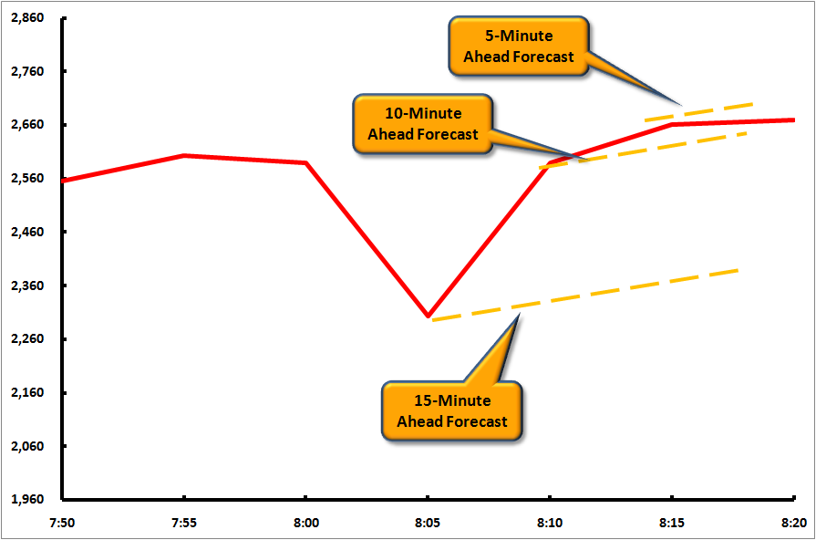
Load Noise Creates Forecast Instability

Slide 4
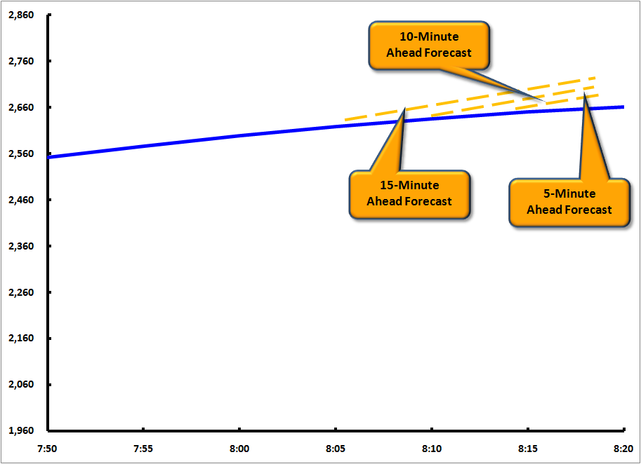
Goal is Forecast Stability

Slide 5
Eliminating Data Outliers
The first task is to eliminate data outliers
MetrixIDR has two main methods for eliminating data outliers:
  Meter Validation Parameters
    Comprehensive set of validation options
    Validation is not model dependent, i.e., how well the data are validated is not dependent upon the selected model’s performance
    Typically the more preferred of the two methods
  Modified Kalman Filter
    Validation is model dependent

Slide 6
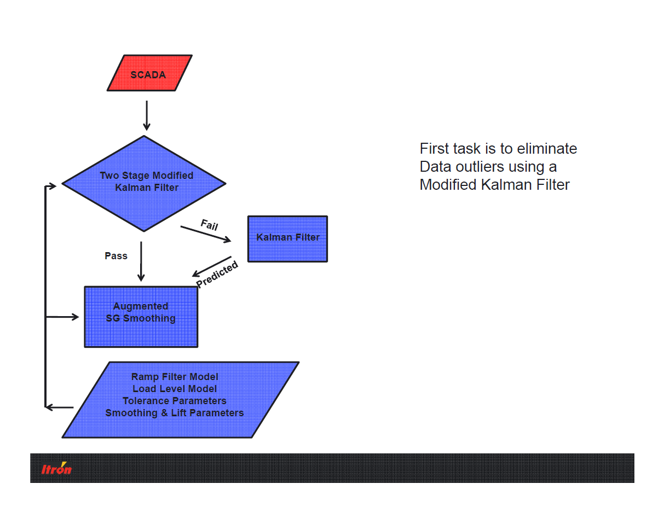
Eliminating Data Outliers

Slide 7
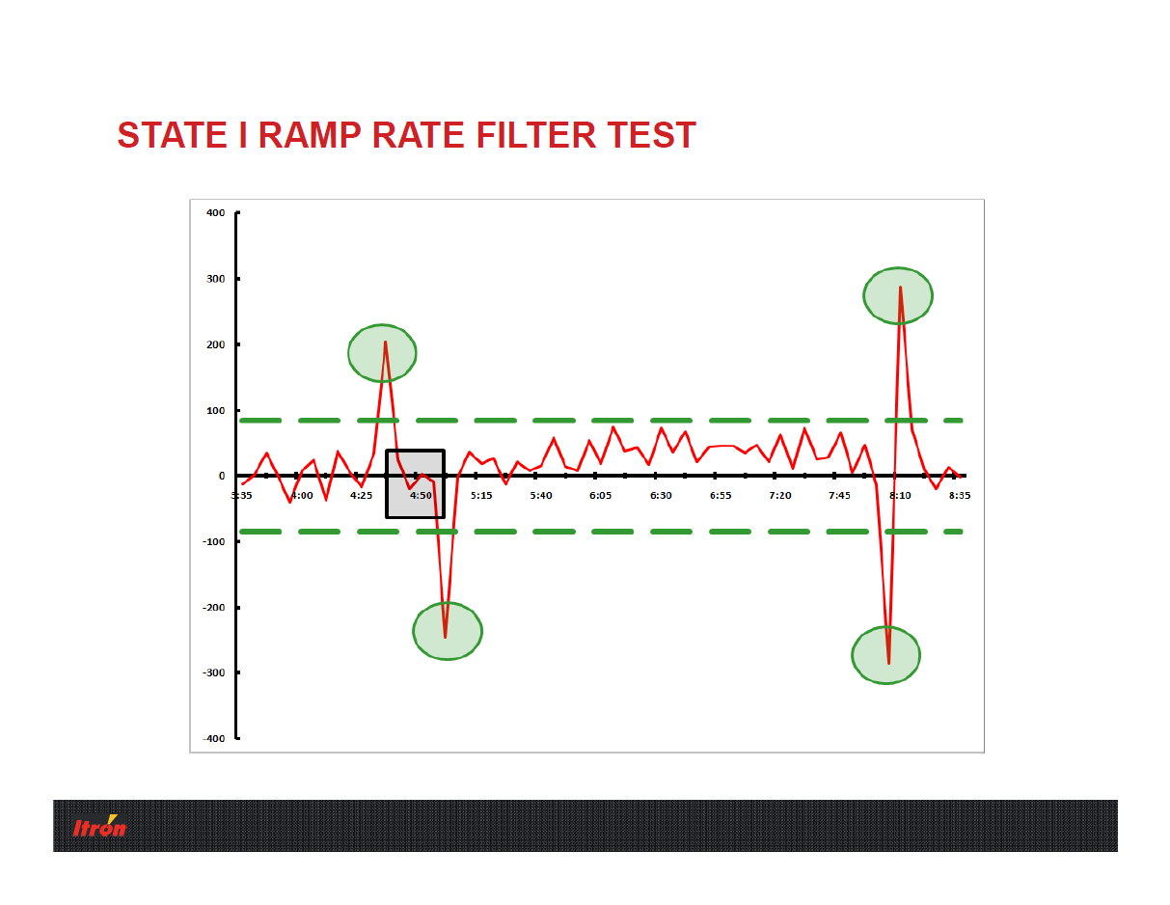

Slide 8
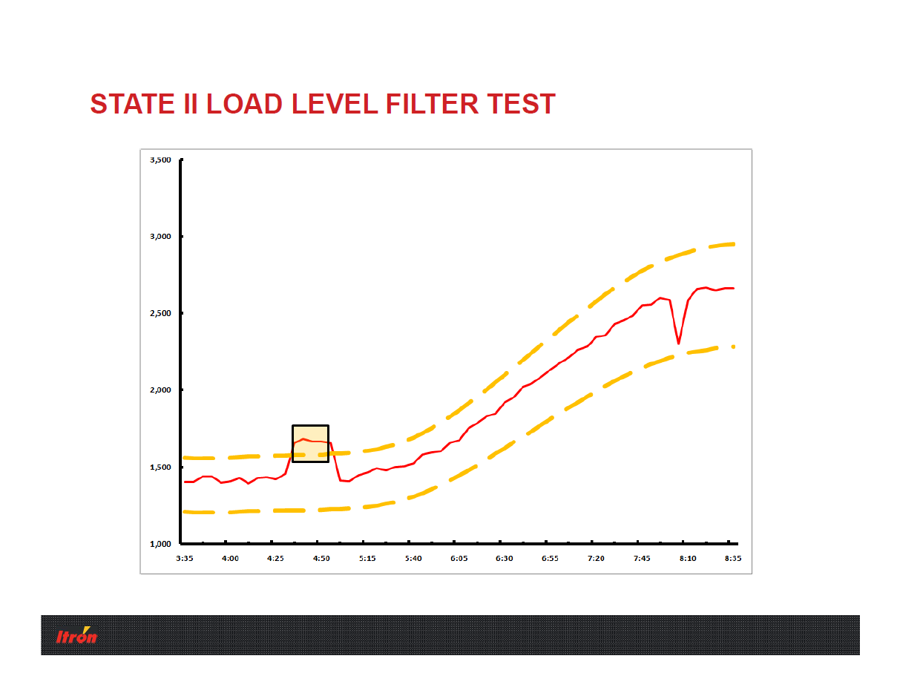

Slide 9
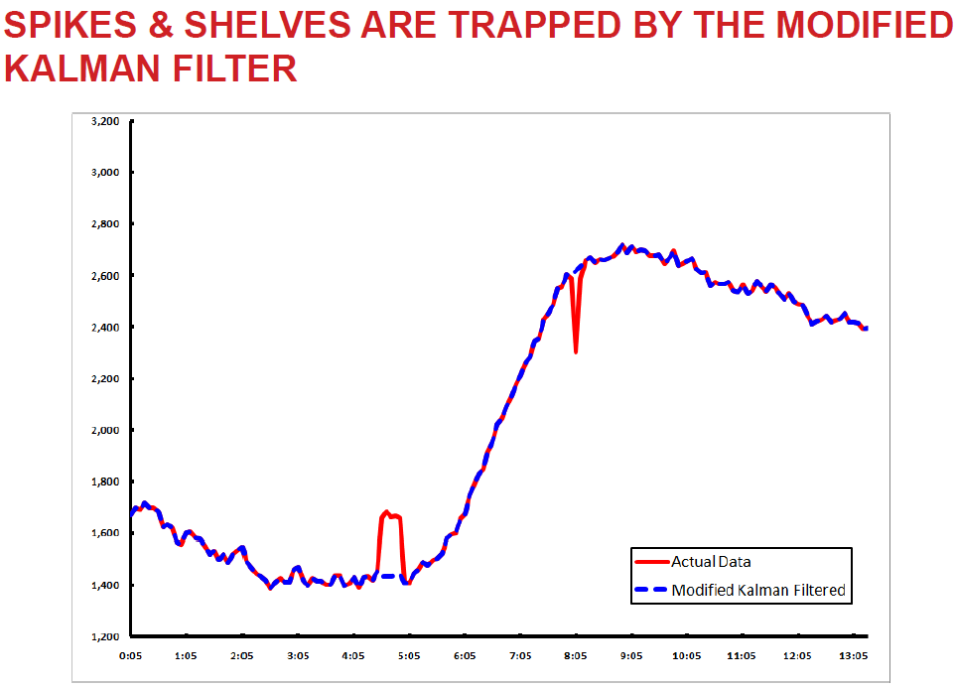

Slide 10
Smooth the Data
The second task is to smooth the data using an Augmented Savitsky-Golay (SG) Filter to dampen random measurement noise
  Removes unnecessary movements in the forecast horizon
  Estimating with smoothed data allows for smooth coefficients

Slide 11
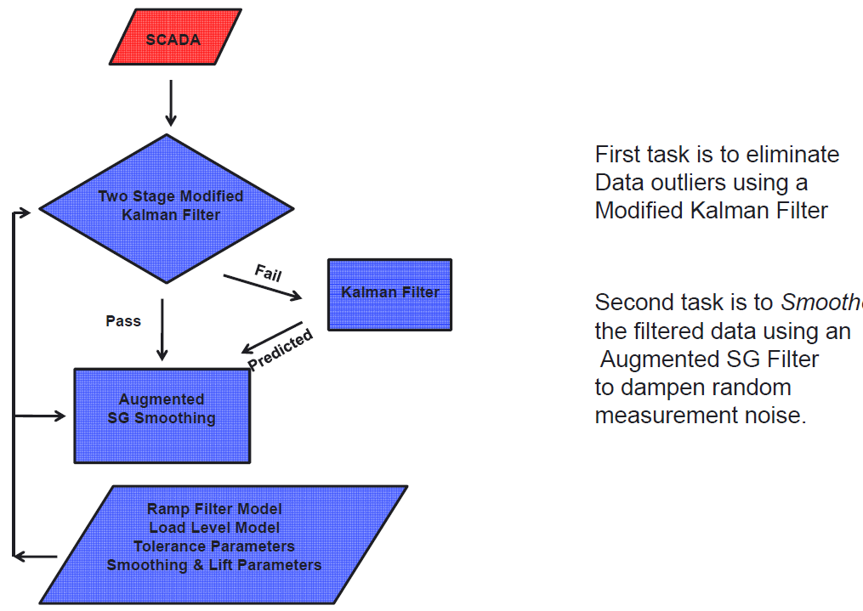

Slide 12
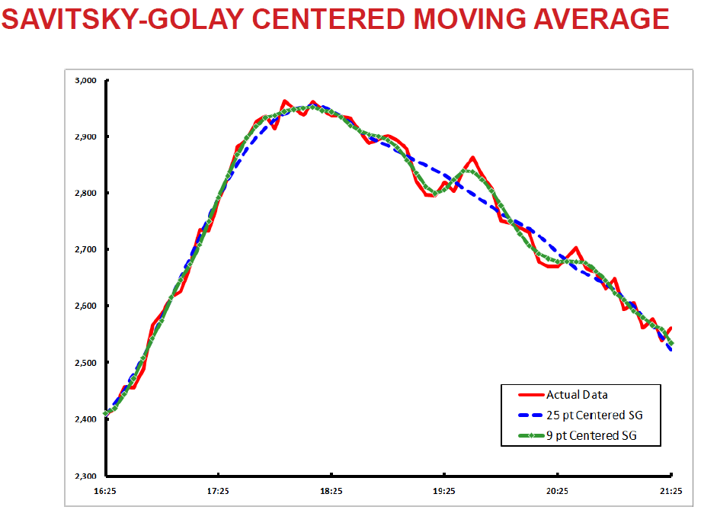

Slide 13
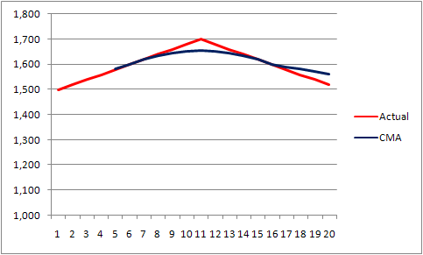
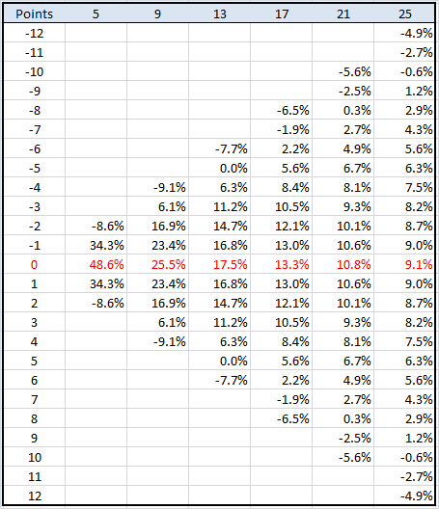
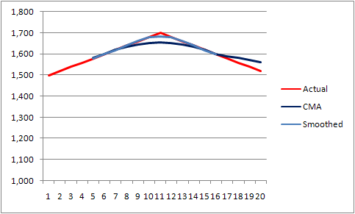
Smoothing Parameters
Savitsky-Golay Weights capture bends in the moving average process
13

Slide 14
Smoothing Parameters Issue
The issue with smoothing is smoothing parameters create bias at the end of the actual data series because the smoothing is “centered”

Slide 15
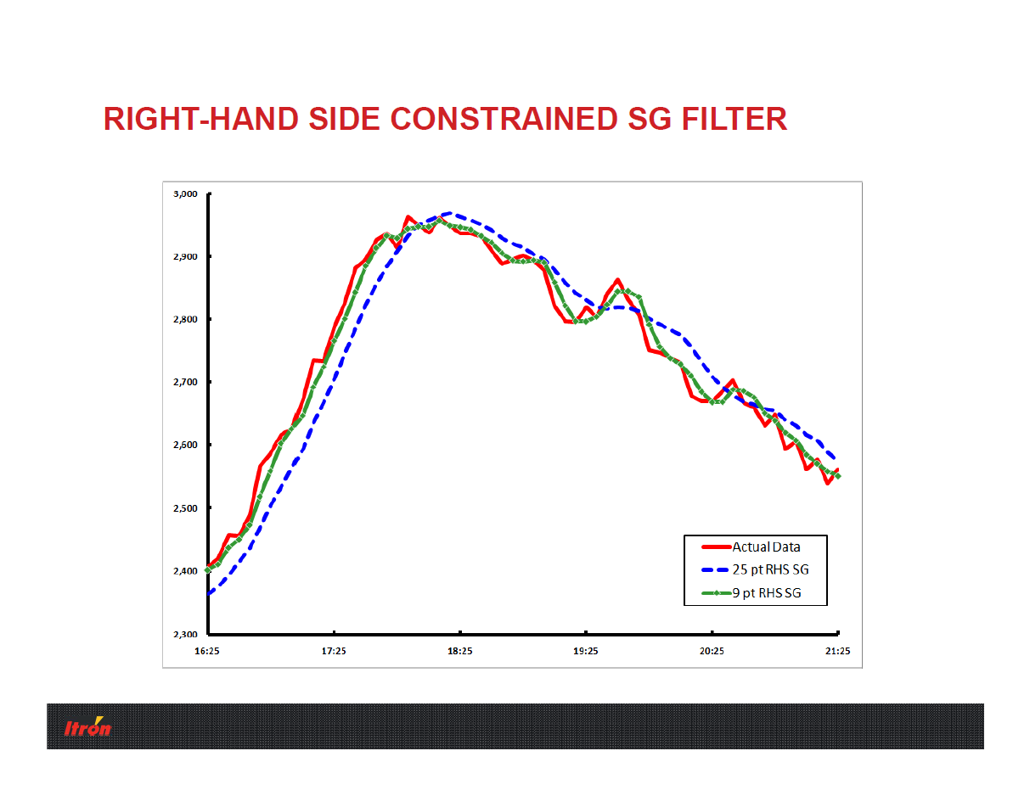

Slide 16
Smoothing Parameters Lift
Enabling “Lift” essentially applies a ratio using polynomial weights and observations from previous intervals to compute future intervals

Slide 17
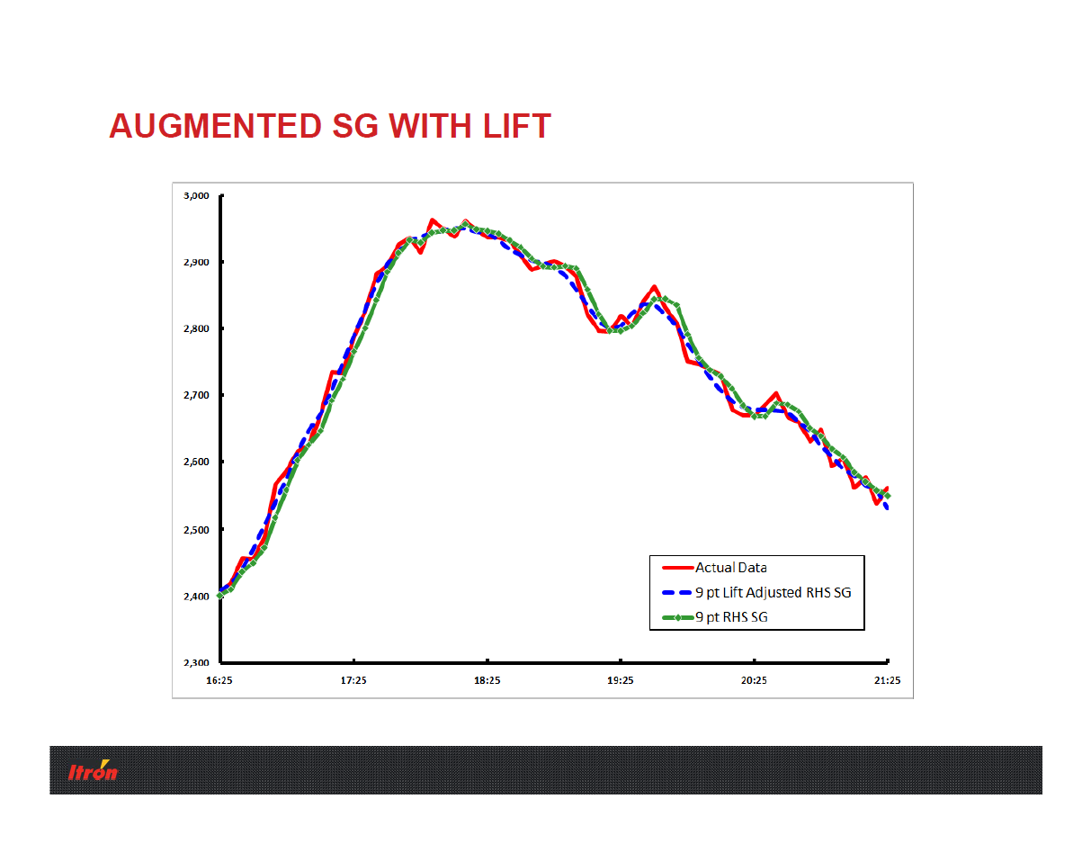

Slide 18
Smoothing Parameters Lift
Lift
Only applied interval where a full centered moving average cannot be calculated.
Examples:
No DOW, Lift Days = 1
Obtain average correction factors between the smoothed series without future values and the actual using only the prior day (Lift Days = 1, No DOW), same time interval and correct the current day intervals.
DOW, Lift Days = 2
Obtain average correction factors based on the same time interval, same day of the week in the prior two weeks (Lift Days = 2, Yes DOW).
18

Slide 19
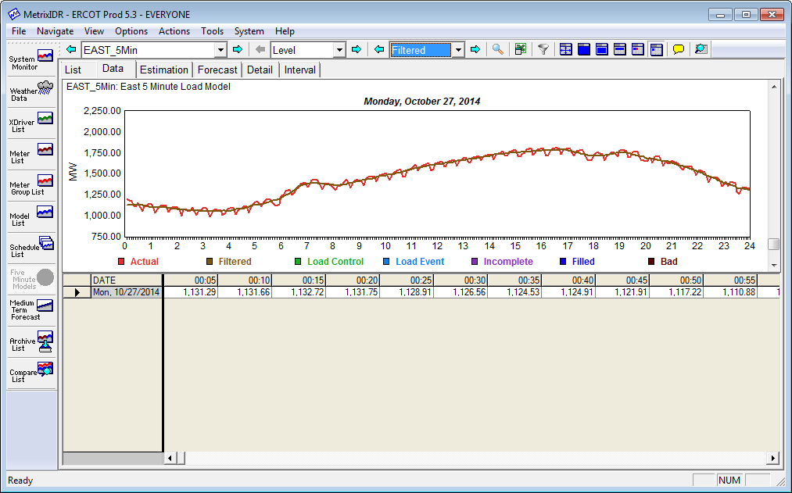
Viewing the Smoothed Data
Smoothed, “filtered” data cuts through the noise
19

Slide 20
Overview
Five-Minute Modeling Pre-Process
  Filtering the data
  Smoothing the data (TOU Parameters)
Five Minute Module Base Framework
  Level Model
  Ramp Rate Model
  Day Ahead Model
  Blending Issues
Other Modeling Considerations
  Cross Day Bias
  Forecast Overrides

Slide 21
Advantages to Five-Minute Modeling Framework
Level Model
  Focus on very short term
  Tends to be autoregressive
Ramp Model
  Focus on changes and ramp periods of time
Day Ahead Model
  Captures all possible variables
  Provides shape for the day
Blending
  Allows for different focuses based on time of use

Slide 22
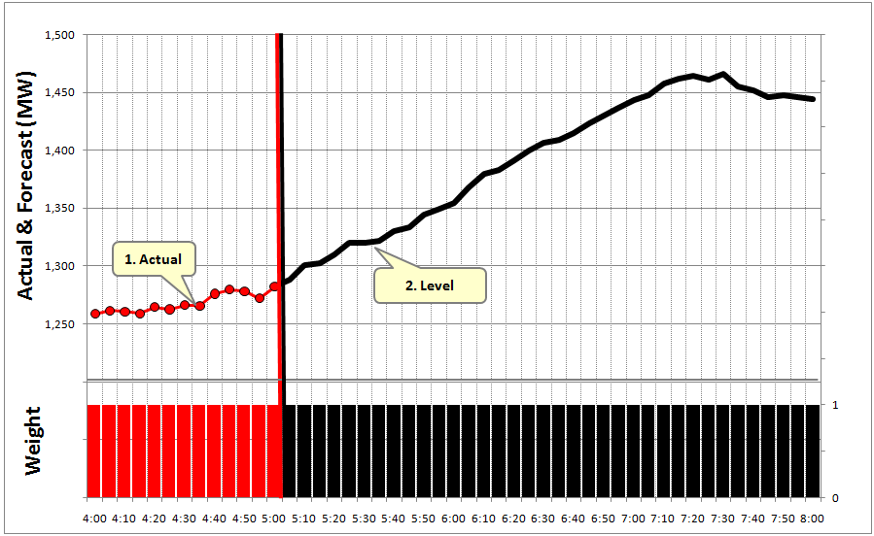
Framework: Level Model
Y is Load (MW)
Y_{t} = f (Y_{t-1},X_{t})
Other X variables help model as a fine adjustment to the lag relationship
Issues:
Very short-term
Lag Loads should dominate the model effect
Lag Loads are needed to launch the forecast off the last actual
Autoregressive models tend to perform poorly in the long term

Slide 23
Load Space Example
7:15am
6:15am
5:15am
4:15am
23

Slide 24
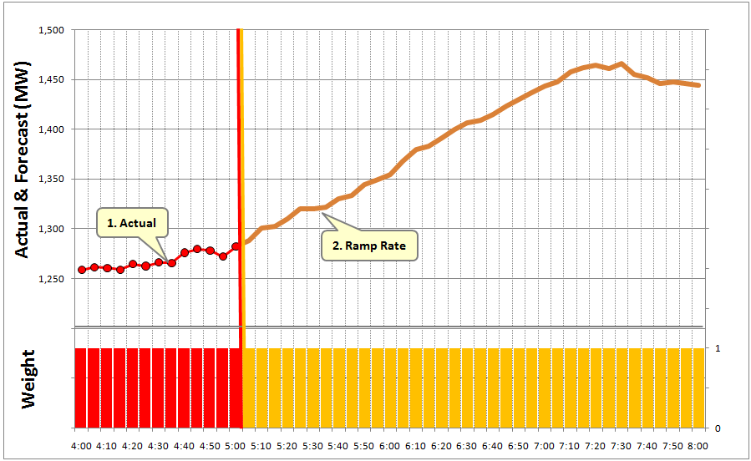
Framework: Ramp Model
Y is change in Load
(MW)
Y_{t} = f (Y_{t-1},X_{t}) or
Y_{t} = f (X_{t})
X variables are used to define the varying shape through the year
Issues:
Ramp rate forecast continues from Level forecast or last actual value
Stability is based on movement of the last actual value
Autoregressive variables tend to be weaker
Autoregressive variables create a Y_{t} = f (Y_{t-1}, Y_{t-2}) relationship
24

Slide 25
Ramp Rate Space Example
5:15am
6:15am
7:15am
4:15am
25

Slide 26
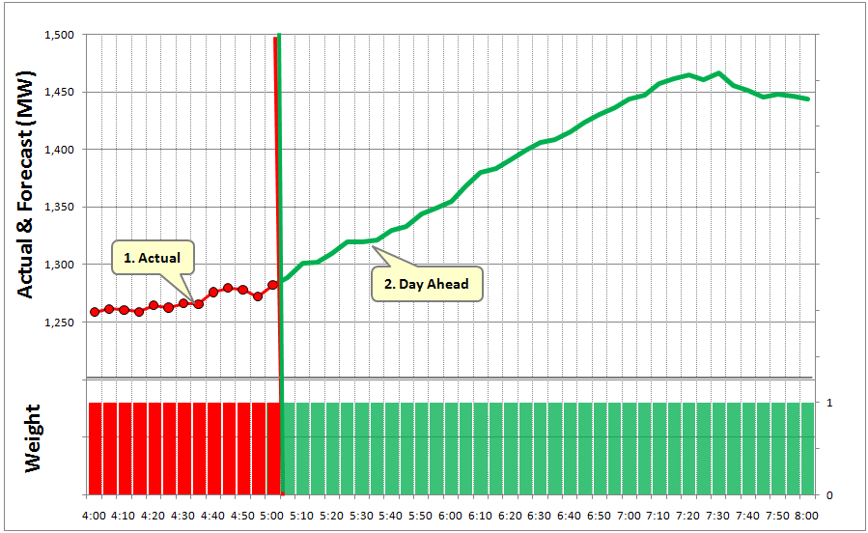
Framework: Day Ahead
Y is Load (MW)
Y_{t} = f (X_{t})
X variables are used to define both the level and shape for the day
Issues:
Day Ahead models tend to be stable throughout the day
Typically used for next day forecasting, but may contain current day components as well
26

Slide 27
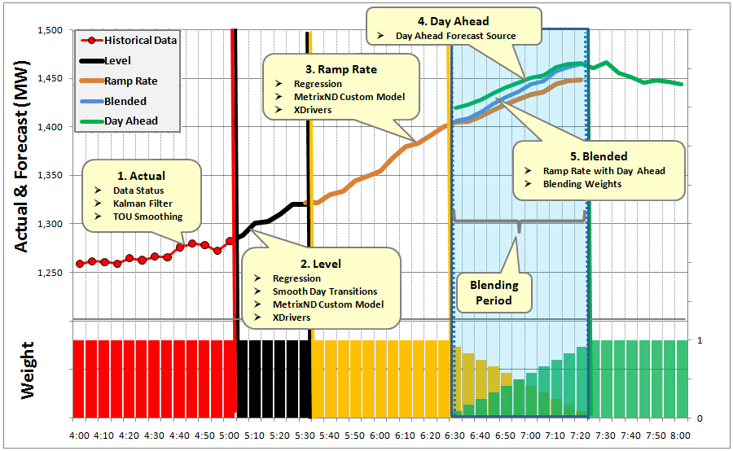
Level + Ramp Rate + Day Ahead Forecast
27

Slide 28
Model Issues
Y Variable
  Should I smooth Y before estimation?
Level Model
  How many periods should I lag?
  How long should this model be applied?
Ramp Model
  Do I need lag variables?
  How do I capture seasonal shapes?
  How long should this model be applied?
Day Ahead Model
  What is the original purpose of the Day Ahead Model?
  How far in the future should the model be applied?

Slide 29
Overview
Five-Minute Modeling Pre-Process
  Filtering the data
  Smoothing the data (TOU Parameters)
Five Minute Module Base Framework
  Level Model
  Ramp Rate Model
  Day Ahead Model
  Blending Issues
Other Modeling Considerations
  Cross Day Bias
  Forecast Overrides

Slide 30

Cross Day Bias Adjustment
The Cross Day Bias Adjustment is a post-forecast adjustment
Once MetrixIDR completes the five-minute forecast, MetrixIDR will adjust the forecast based on a historical set of adjustment factors
Step 1: Calculate Forecast Errors
Step 2: Average Errors
Step 3: Calculate the Bias
Step 4: Apply the Bias
Use Centered Moving Average
Use Adjustment Weights
30

Slide 31
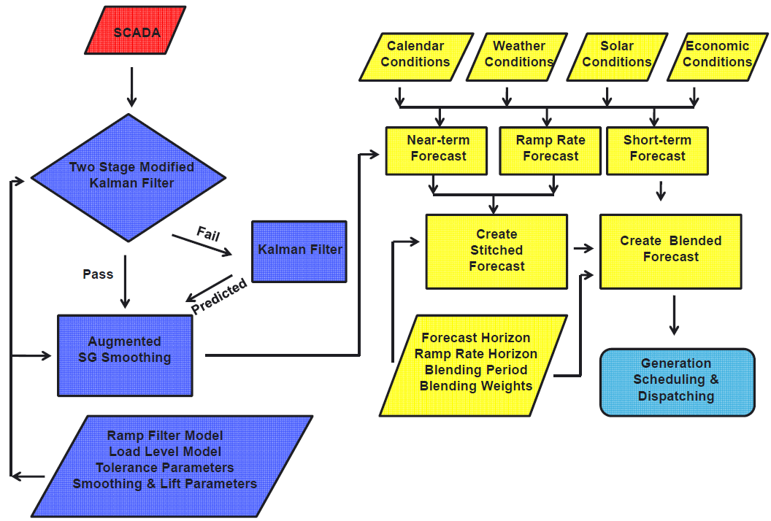

Slide 32
Itron San Diego
12348 High Bluff Drive, Suite 210
San Diego, CA 92130
858 724 2620
858 724 2690

