Slide 1
NPRR638 Back-casting Updated and Supplementary Results
CWG/MCWG
Suresh Pabbisetty, ERP, CQF, CSQA.
ERCOT Public
May 20, 2015

Slide 2
Updated Prototype - Fixes
CWG/MCWG asked ERCOT to evaluate the NPRR638 back-casting model to better understand the resulting values and volatilities.
ERCOT staff evaluated the model and determined that:
Certain Operating Days prices had been dropped from the input data, thereby causing excess volatility.
The model code included an incorrect statement type for DAM, which resulted in an incorrect calculation of DAM ancillary service and other non-energy amounts.
In case of 3 year price lookback price estimates, an incorrect price file was used due to a hardcoding issue (identified after CRIM meeting on 5/13/2015)
Model was updated to fix these issues.
ERCOT Public

Slide 3
Updated Prototype Shortfalls
Prices do not include replacement of historic price caps with current price caps.
Prices prior to June 2014 do not include Operating Reserve Price Adders.
Very minimal validation has been performed due to time and resource constraints. Results shall be viewed as indicative only.
The prototype is limited to calculation and comparison of RTLE+DALE values only.
Impact of NPRR638 on MCE and overall TPE is out of scope for this prototype. A significant proportion of Counter-Parties’ collateral requirements continue to be driven by MCE.
ERCOT Public

Slide 4
Updated Prototype - Scenarios
The prototype was executed for volumetric analysis as detailed below with ldq (Day Ahead look-back) at 1 and lrq (Real Time look- back) at 1, 3, 5, 7, and 10 days:
01/28/2014 through 12/31/2014 for 1-year look-back with 2014 prices substituted for 2013.
01/28/2014 through 02/28/2015 for 3-year look-back using prices from 2011 through 2015.
The prototype was executed for exposure analysis for the following scenarios:
RTLE+DALE with 5-, 7-, 9-, 12- and 14-day averaging of RTM and DAM volumes (parameters er and ed)
Historical price horizons of one and three years
Price confidence level fixed at P84
Selection for traders-only, load-only, generation-only and both generation and load
ERCOT Public

Slide 5
Updated Prototype - Observations
Observations on updated results of MAX lookback scenarios
Volumetric exposure is highly sensitive to lookback days
CRIM has also noted that MAX lookback results in misalignment of long and short positions for Counter-Parties with both load and generation
As expected, RTLE and DALE increase with increase in price confidence levels
The exposure volatility is greatest for Counter-Parties with both load and generation
A higher (>60%) concentration of imbalance volume is also concentrated with this category
Volatility of Resource Node settlement point prices causes generators to receive materially greater credits than load is charged
ERCOT Public

Slide 6
Updated Prototype - Observations
Volatility reduced as number of averaging days increases from 5 through 14.
As designed, RTLE+DALE exposure follows historic price patterns
Data from past 4 years indicate that ERCOT market-wide exposure is relatively high during winter and shoulder months
Using only 1 year of price lookback could result in skewed exposure as size of statistical sample is not large enough
P84 discards only top 3 prices of tail end
This could result in very high exposures
Using 3 years of price lookback could result in shaping the exposure to match the risk
During winter (February) and shoulder months (September and October)
New exposure is ramped up during June, July and August
ERCOT Public

Slide 7
Updated Prototype - Results
Price Analysis
ERCOT Public

Slide 8
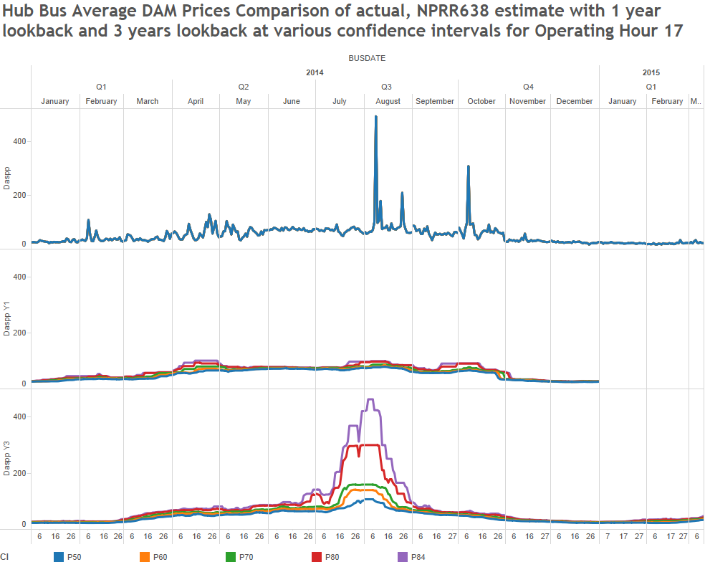
Updated Prototype - Results
ERCOT Public

Slide 9
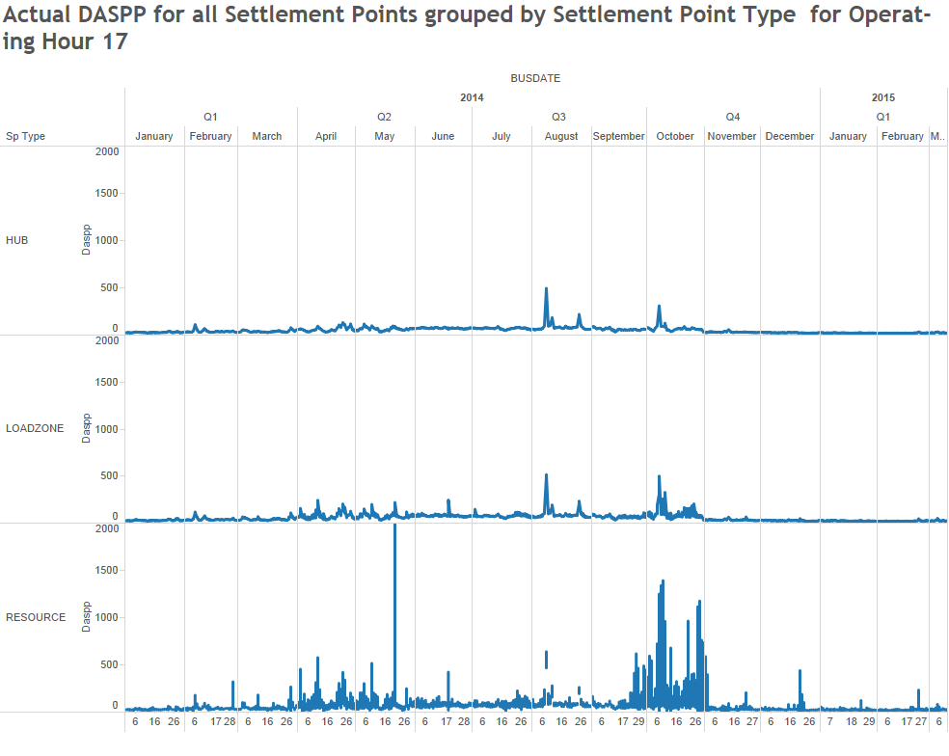
Updated Prototype - Results
ERCOT Public

Slide 10
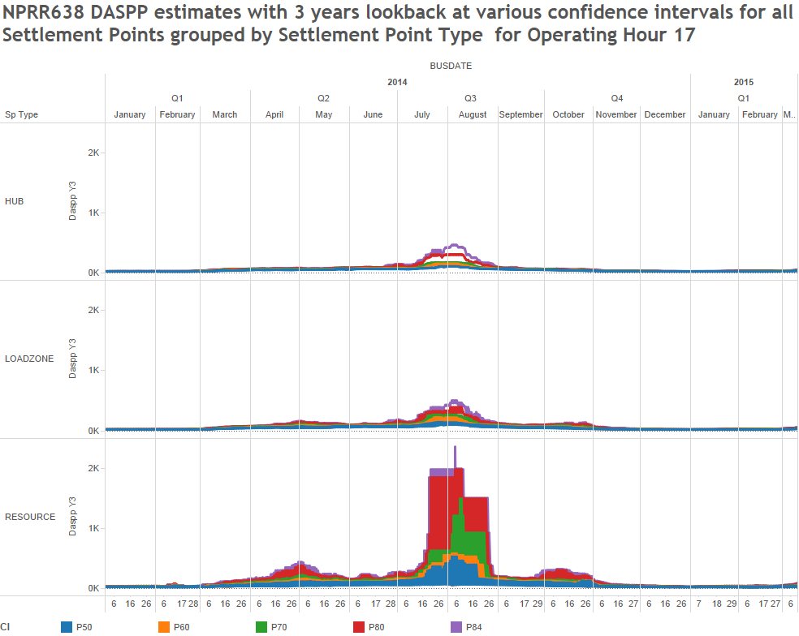
Updated Prototype - Results
ERCOT Public

Slide 11
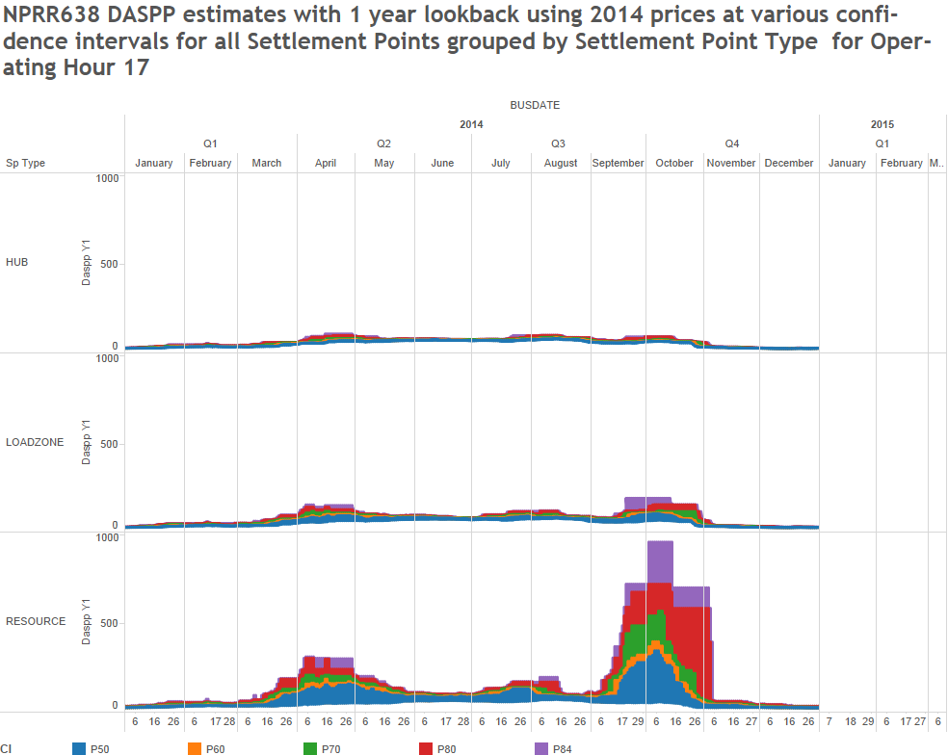
Updated Prototype - Results
ERCOT Public

Slide 12
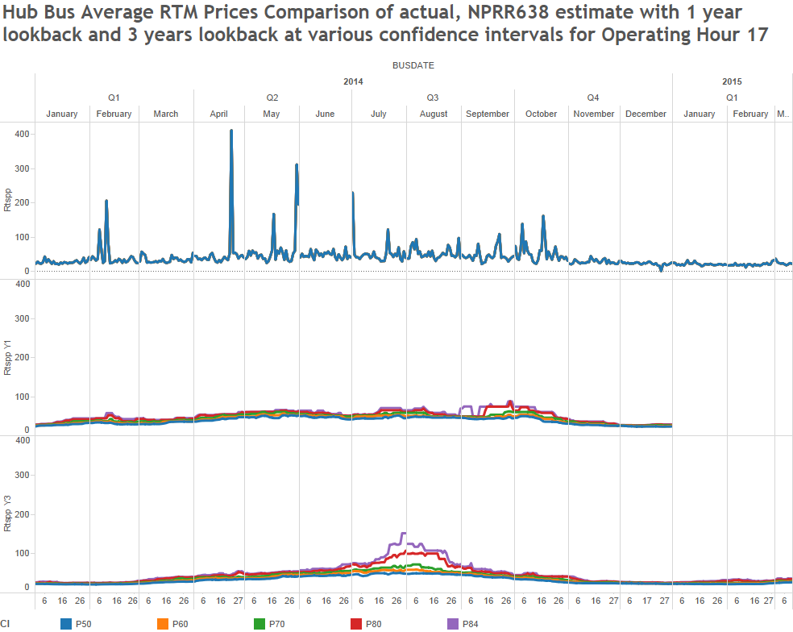
Updated Prototype - Results
ERCOT Public

Slide 13
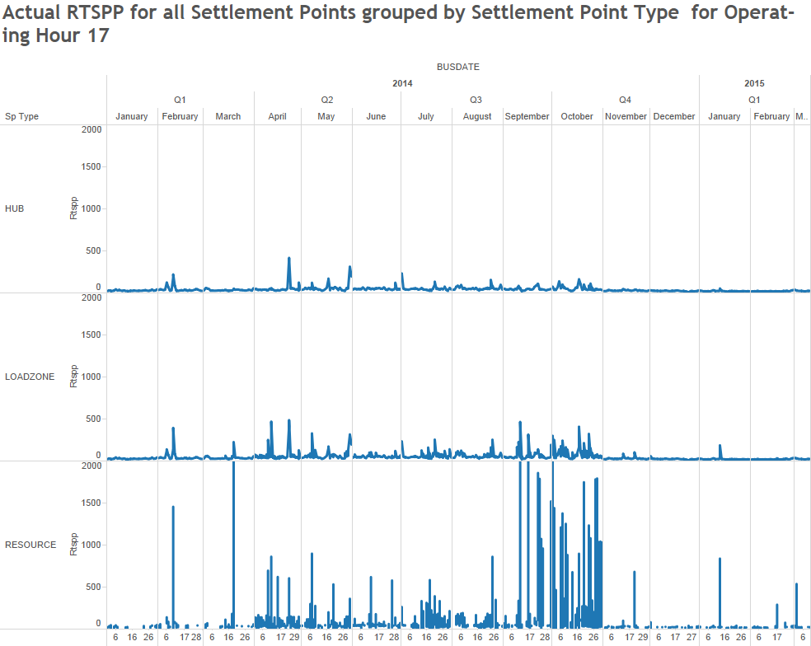
Updated Prototype - Results
ERCOT Public

Slide 14
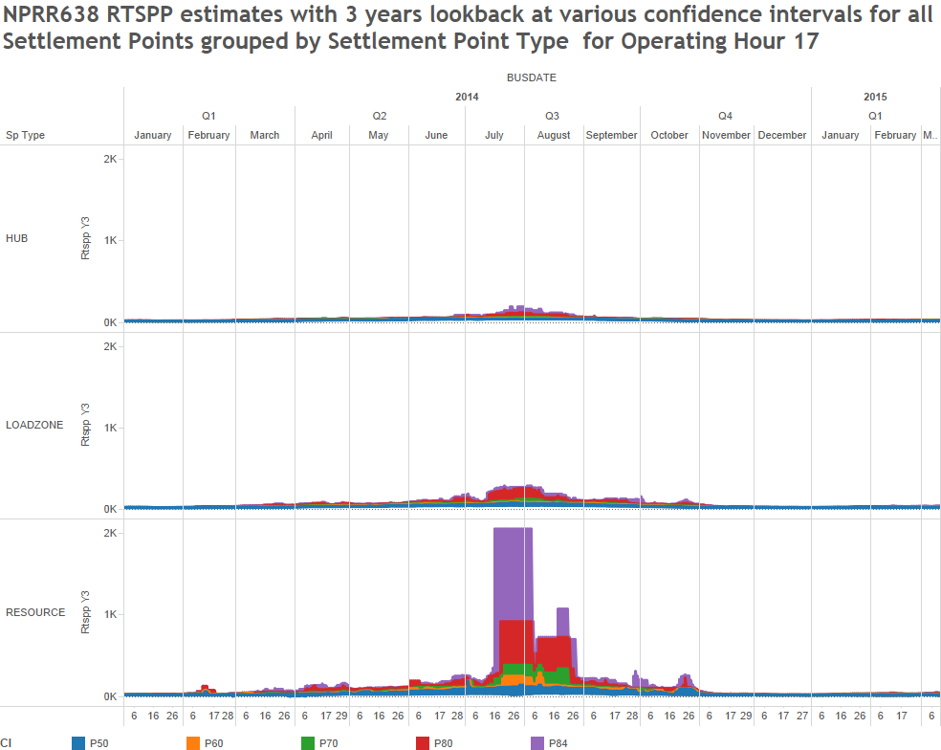
Updated Prototype - Results
ERCOT Public

Slide 15
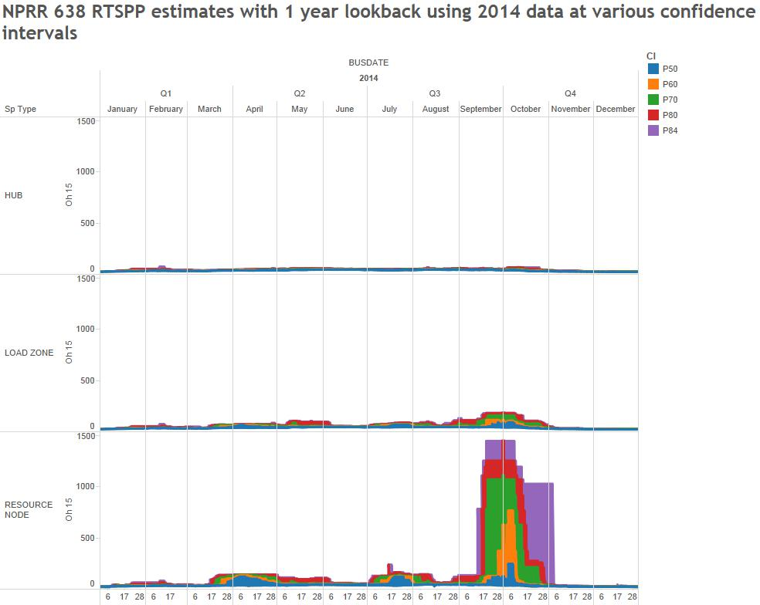
Updated Prototype - Results
ERCOT Public

Slide 16
Updated Prototype - Results
Volume Analysis
ERCOT Public

Slide 17
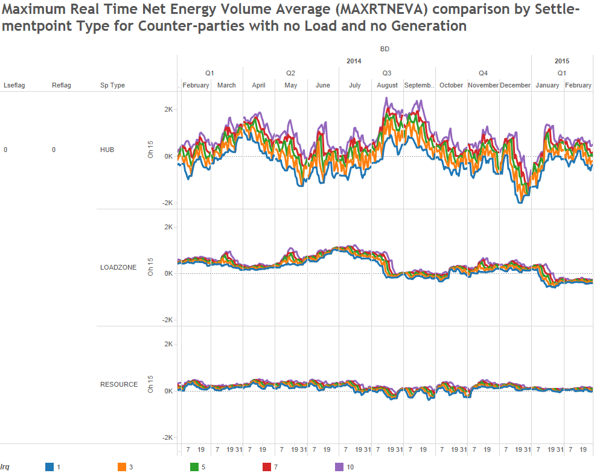
Updated Prototype - Results
No Load or Generation
ERCOT Public

Slide 18
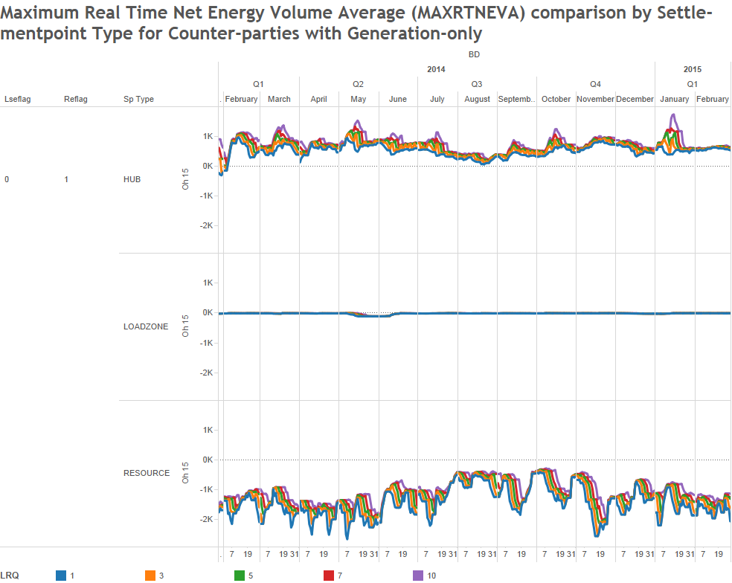
Updated Prototype - Results
Generation Only
ERCOT Public

Slide 19
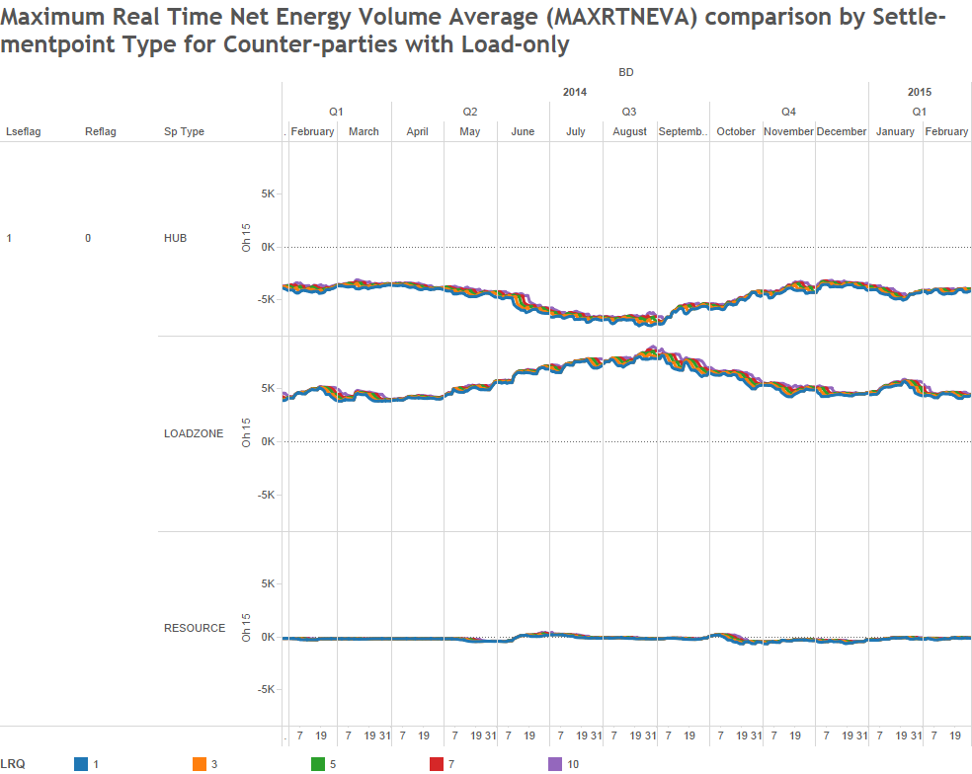
Updated Prototype - Results
Load Only
ERCOT Public

Slide 20
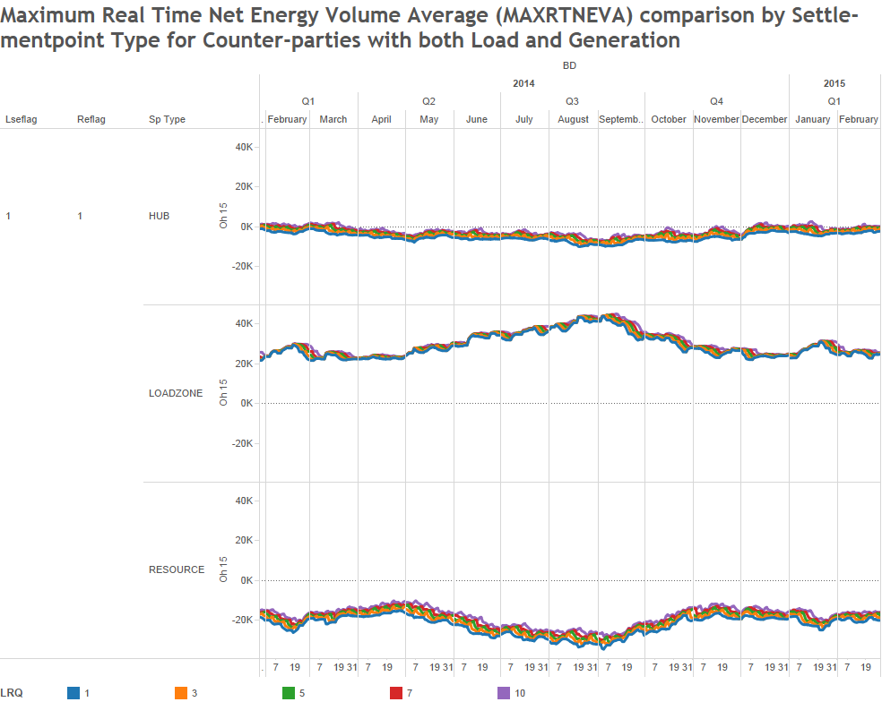
Updated Prototype - Results
Load + Generation
ERCOT Public

Slide 21
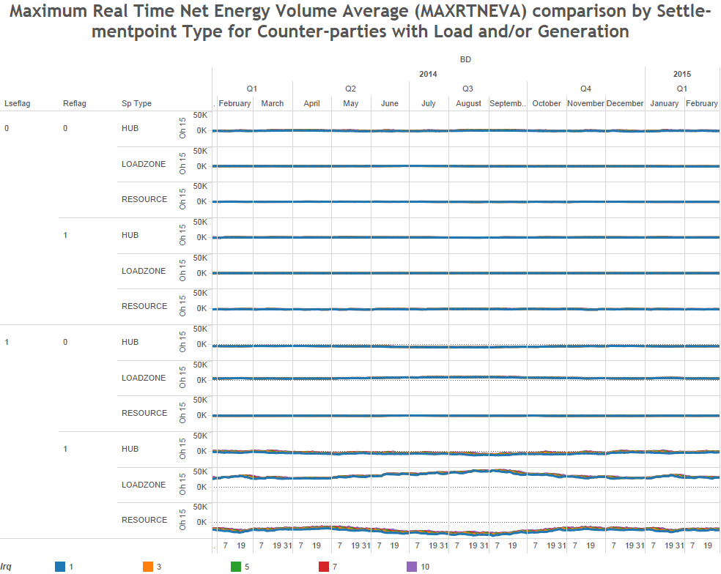
Updated Prototype - Results
No Load or Generation
Generation Only
Load Only
Load + Generation
ERCOT Public

Slide 22
Updated Prototype - Results
Exposure Analysis
3 years price lookback
ERCOT Public

Slide 23
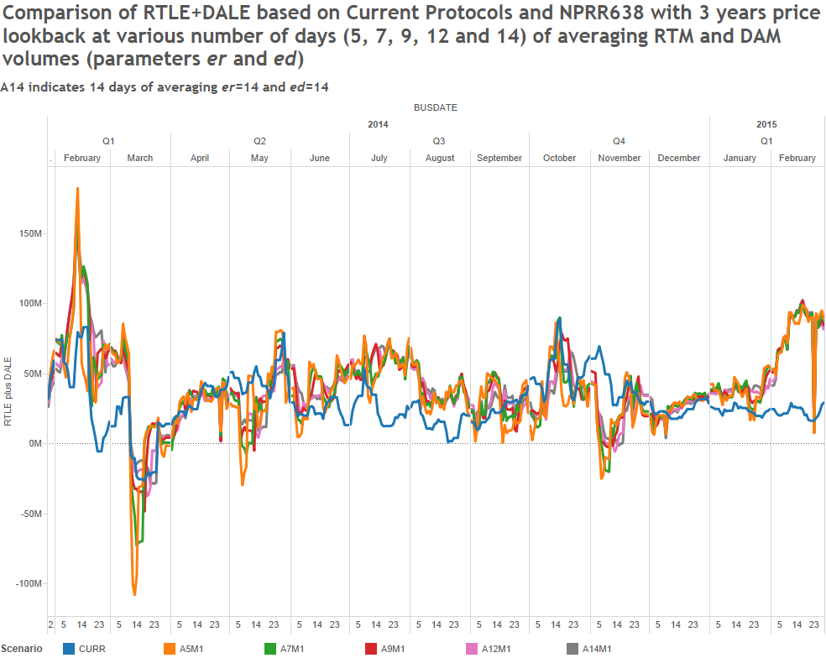
Updated Prototype - Results
ERCOT Public

Slide 24
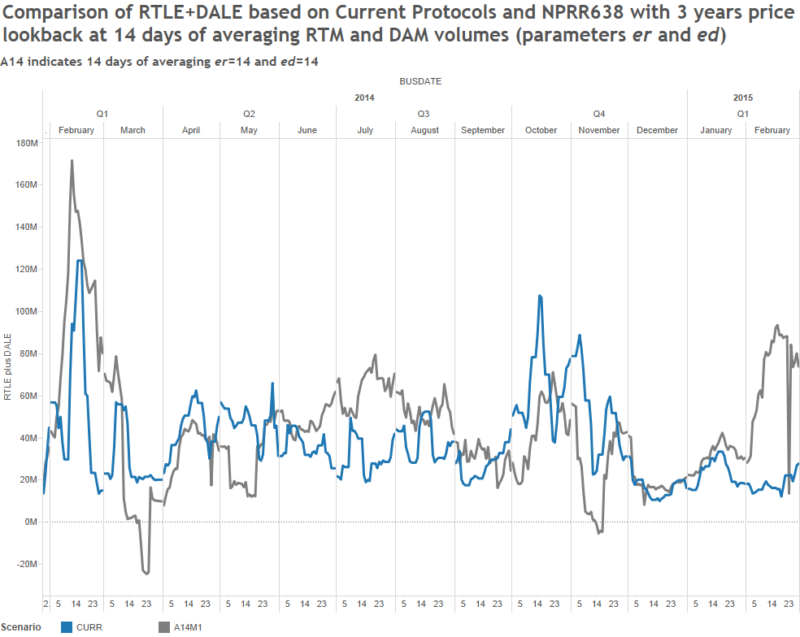
Updated Prototype - Results
ERCOT Public

Slide 25
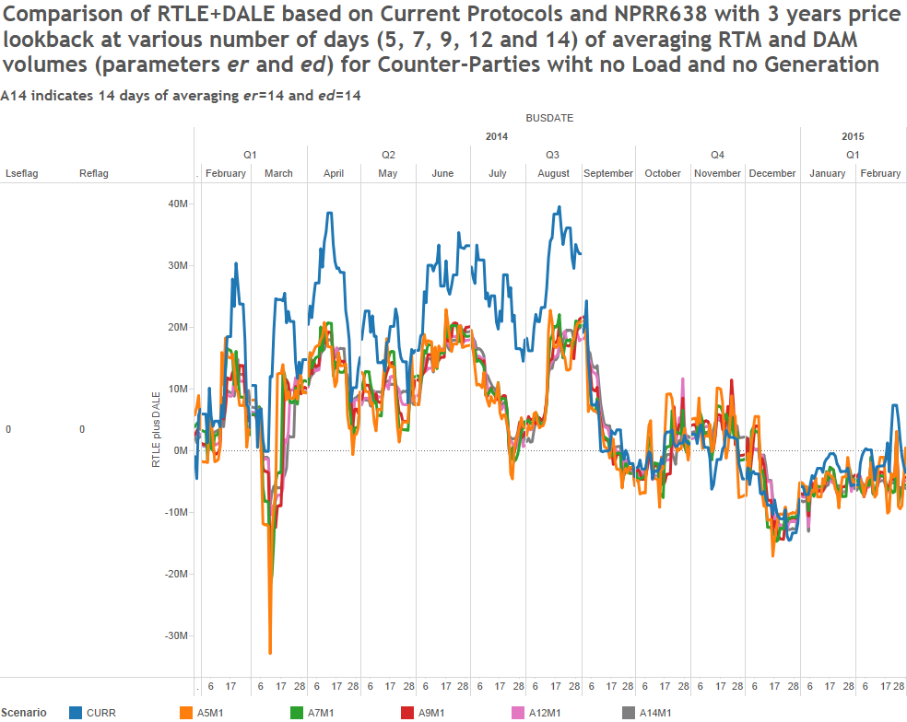
Updated Prototype - Results
No Load or Generation
ERCOT Public

Slide 26
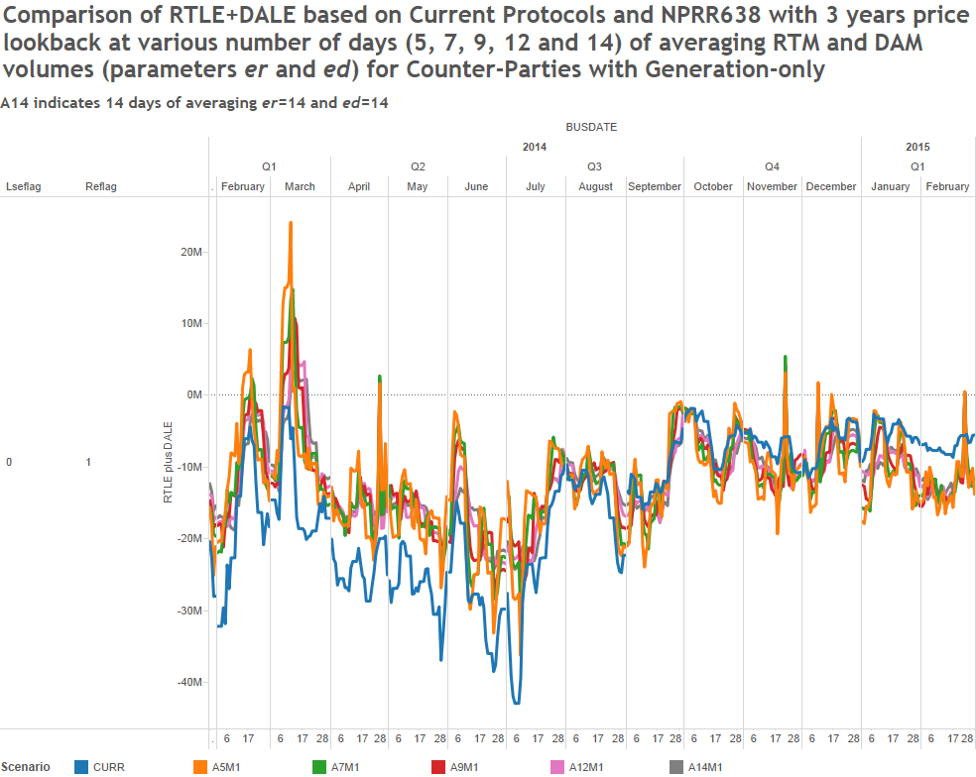
Updated Prototype - Results
Generation Only
ERCOT Public

Slide 27
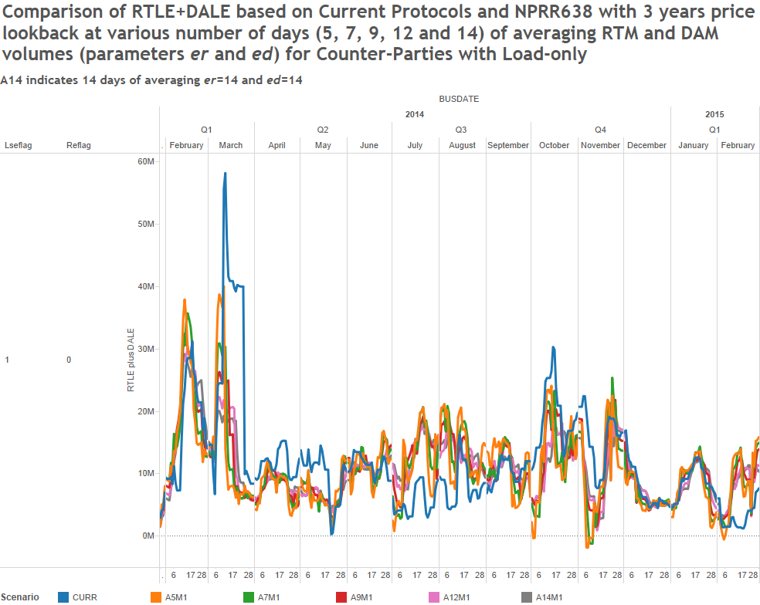
Updated Prototype - Results
Load Only
ERCOT Public

Slide 28
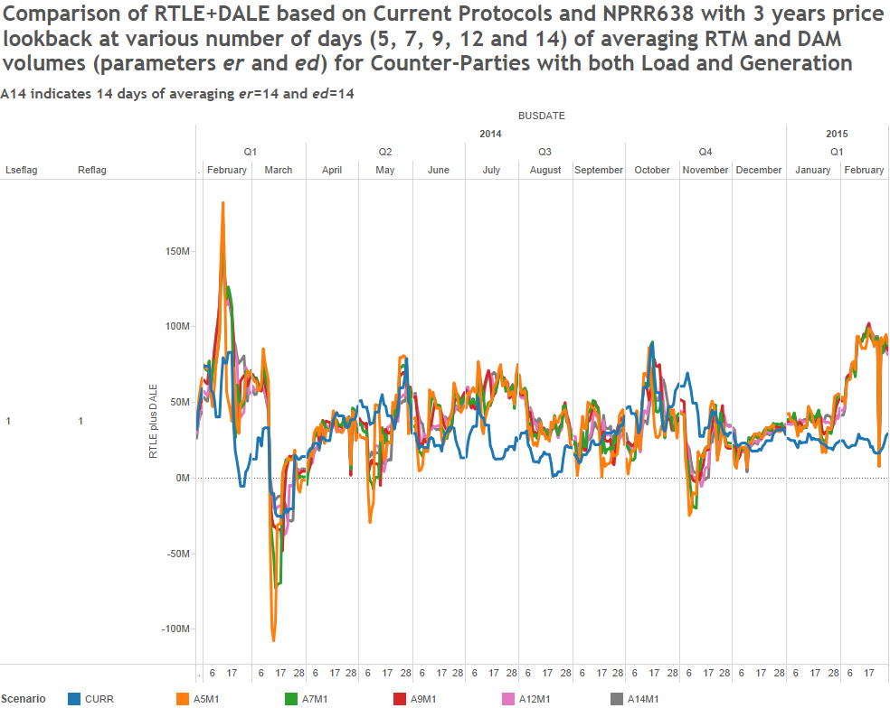
Updated Prototype - Results
Load + Generation
ERCOT Public

Slide 29
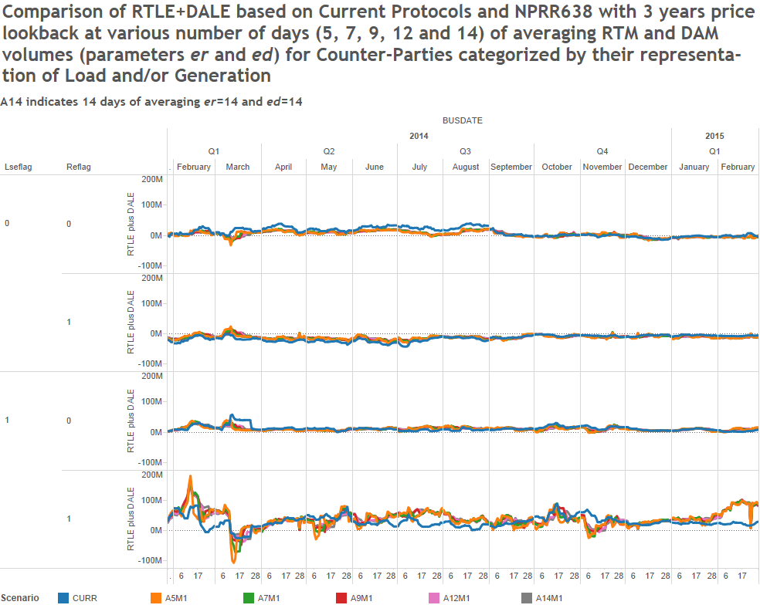
Updated Prototype - Results
No Load or Generation
Generation Only
Load Only
Load + Generation
ERCOT Public

Slide 30
Updated Prototype - Results
Exposure Analysis
1 year price lookback
ERCOT Public

Slide 31
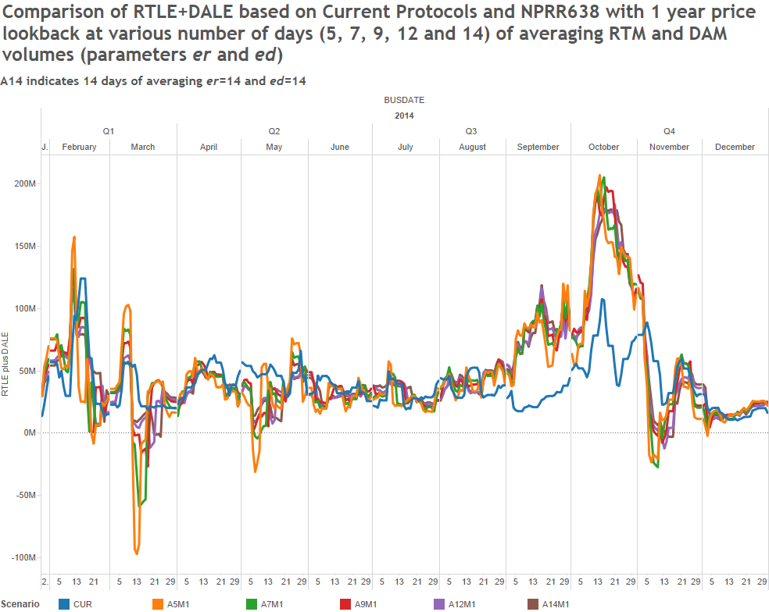
Updated Prototype - Results
ERCOT Public

Slide 32
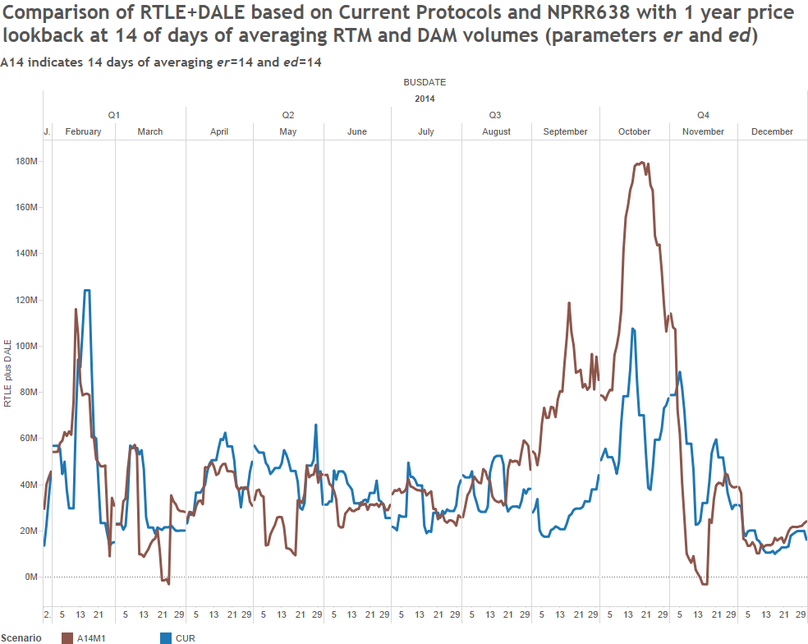
Updated Prototype - Results
ERCOT Public

Slide 33
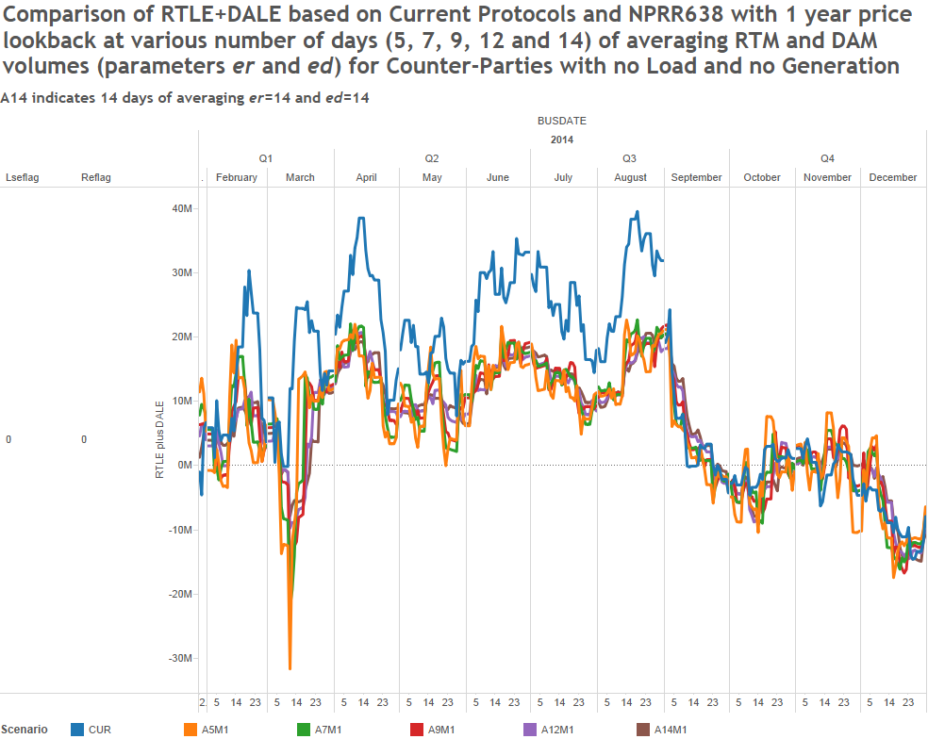
Updated Prototype - Results
No Load or Generation
ERCOT Public

Slide 34
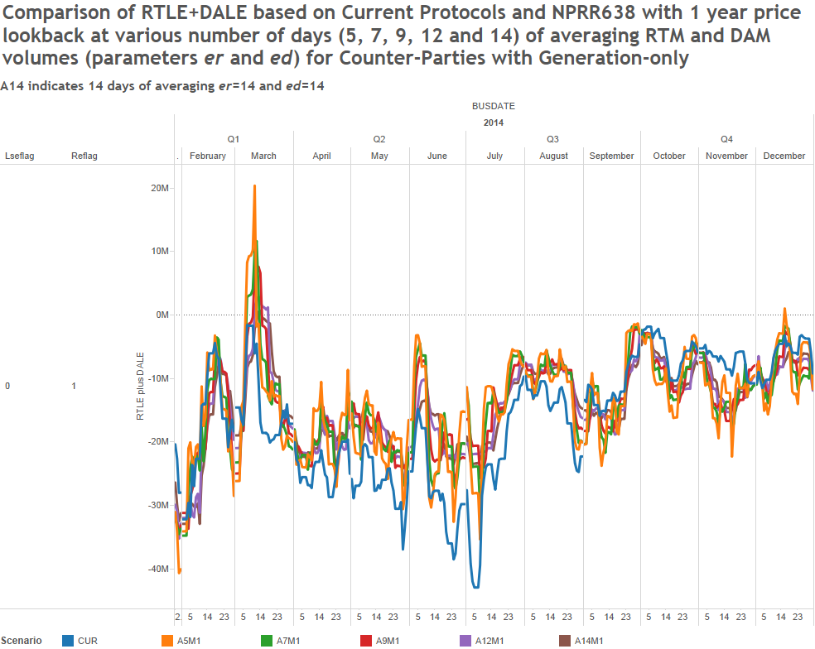
Updated Prototype - Results
Generation Only
ERCOT Public

Slide 35
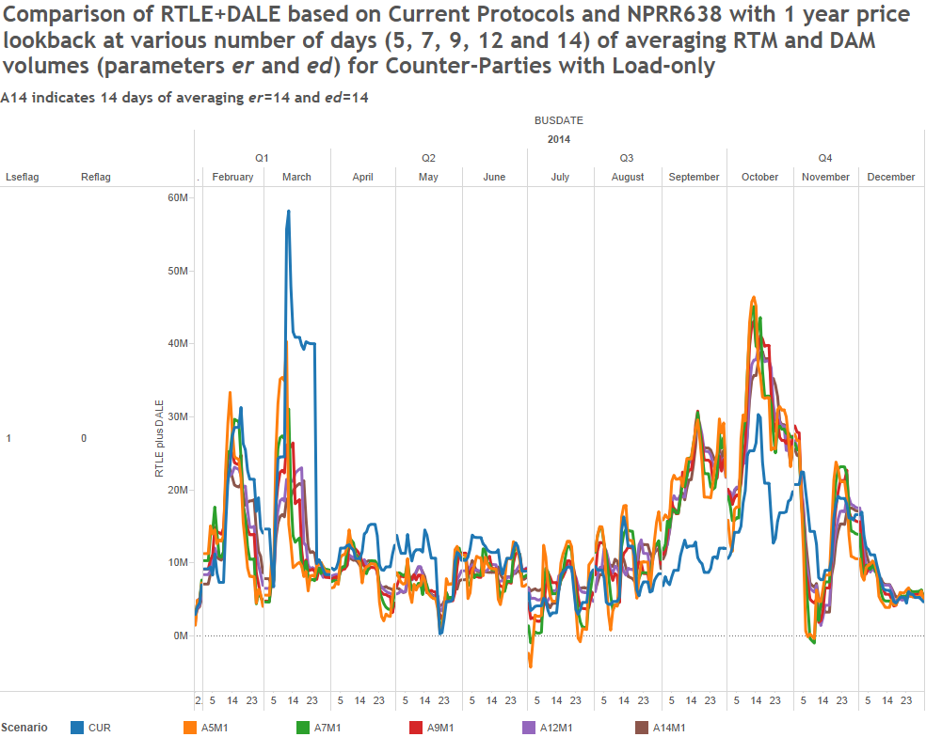
Updated Prototype - Results
Load Only
ERCOT Public

Slide 36
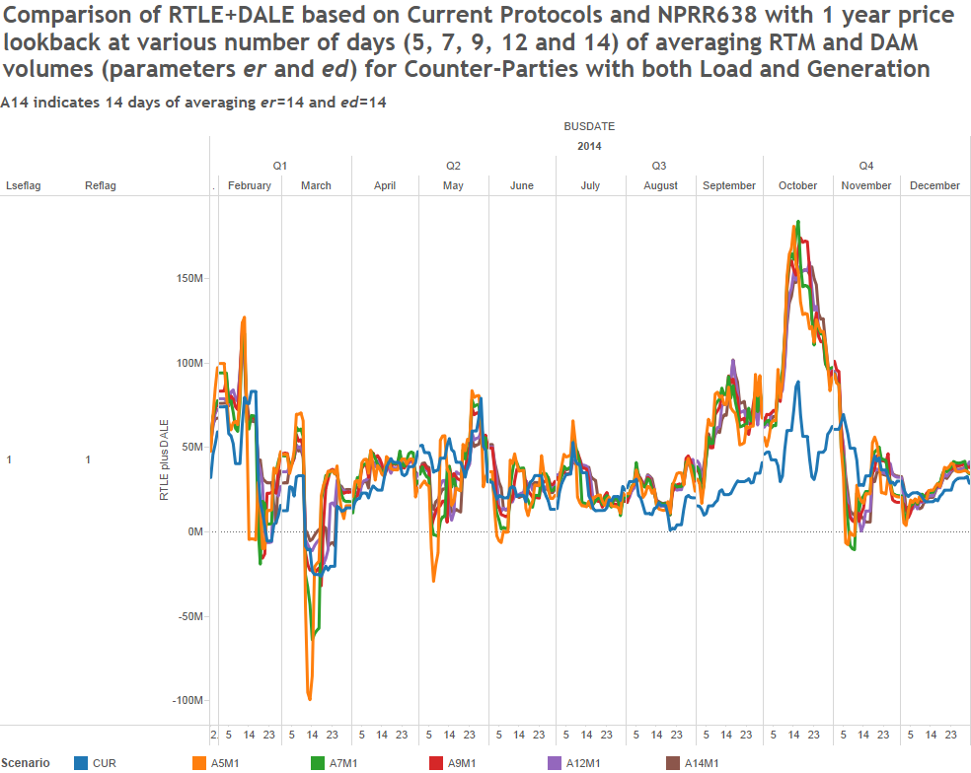
Updated Prototype - Results
Load + Generation
ERCOT Public

Slide 37
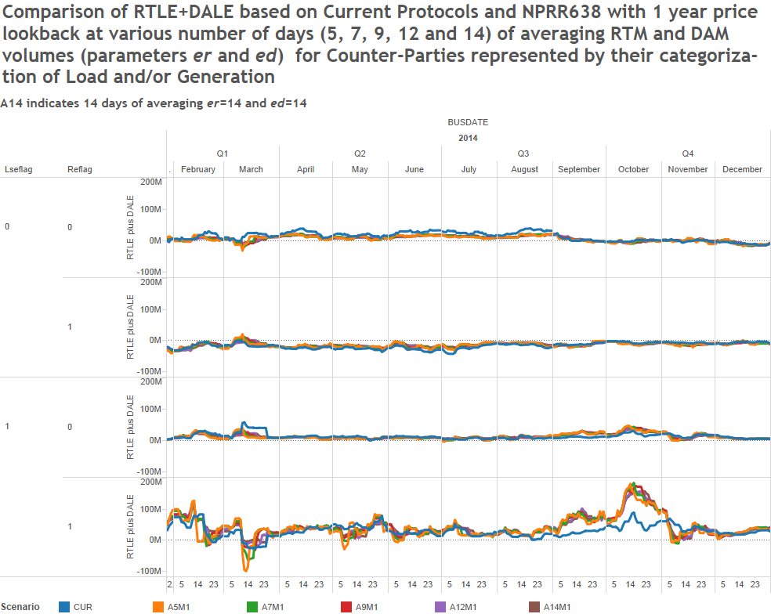
Updated Prototype - Results
No Load or Generation
Generation Only
Load Only
Load + Generation
ERCOT Public

Slide 38
Questions
ERCOT Public

