Slide 1

ERCOT Monthly Operational Overview (April 2015)
ERCOT Public
May 15, 2015

Slide 2
Grid Planning & Operations

Slide 3
Summary – April 2015
Operations
The peak demand of 45,242 MW on April 9th was greater than the mid-term forecast peak of 44,561 MW of the same operating period. In addition, it was less than the April 2014 actual peak demand of 48,464 MW. The instantaneous peak load on April 9th was 45,497 MW.
Day-ahead load forecast error for April was 2.41%
ERCOT issued one notification
  One advisory due to the Voltage Security Assessment Tool (VSAT) being unavailable (4/24)
Planning Activities
252 active generation interconnection requests totaling 61,718 MW, including 24,557 MW of wind generation as of April 30, 2015. One additional request yet a decrease of 1,682 MW from March 31, 2015.
13,060 MW wind capacity in commercial operations on April 30, 2015.
Notes:
Emergency Notices:
Apr 24 2015 21:30:19 CST – ERCOT issued an Advisory due to ERCOTs Voltage Security Assessment Tool was unavailable from 20:42-21:19.

Slide 4
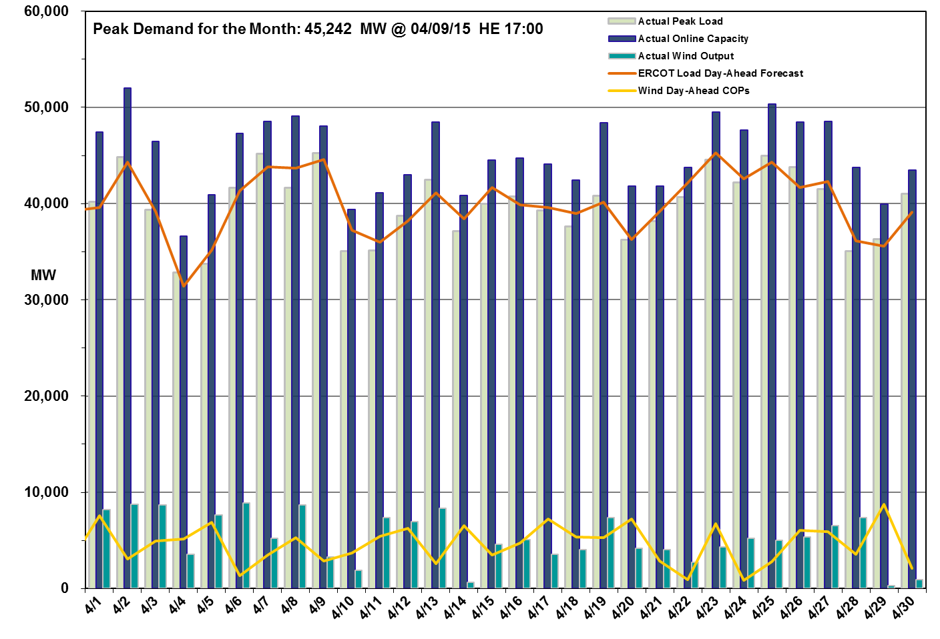
Daily Peak Demand: Hourly Average Actual vs. Forecast, Wind Day-Ahead COPs & On-line Capacity at Peak – April 2015

Slide 5
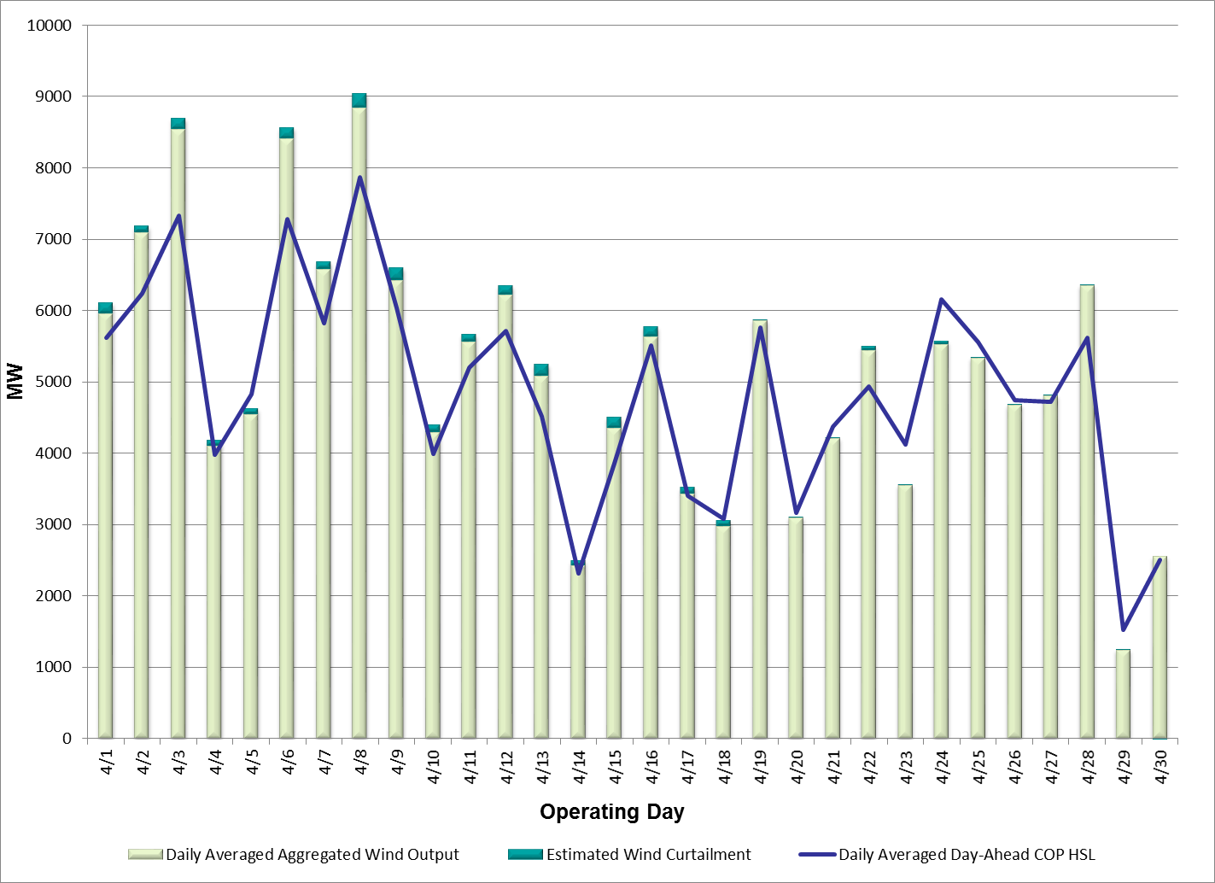
Actual Wind Output plus Curtailments vs. Wind Day-Ahead COPs for
All Hours – April 2015
% of Hours when Estimated Uncurtailed Wind Output
>= COP HSLs (Target = 50%)
57%
Note: QSEs must use the AWST 50% probability of exceedance forecast as the HSL in their COPs

Slide 6
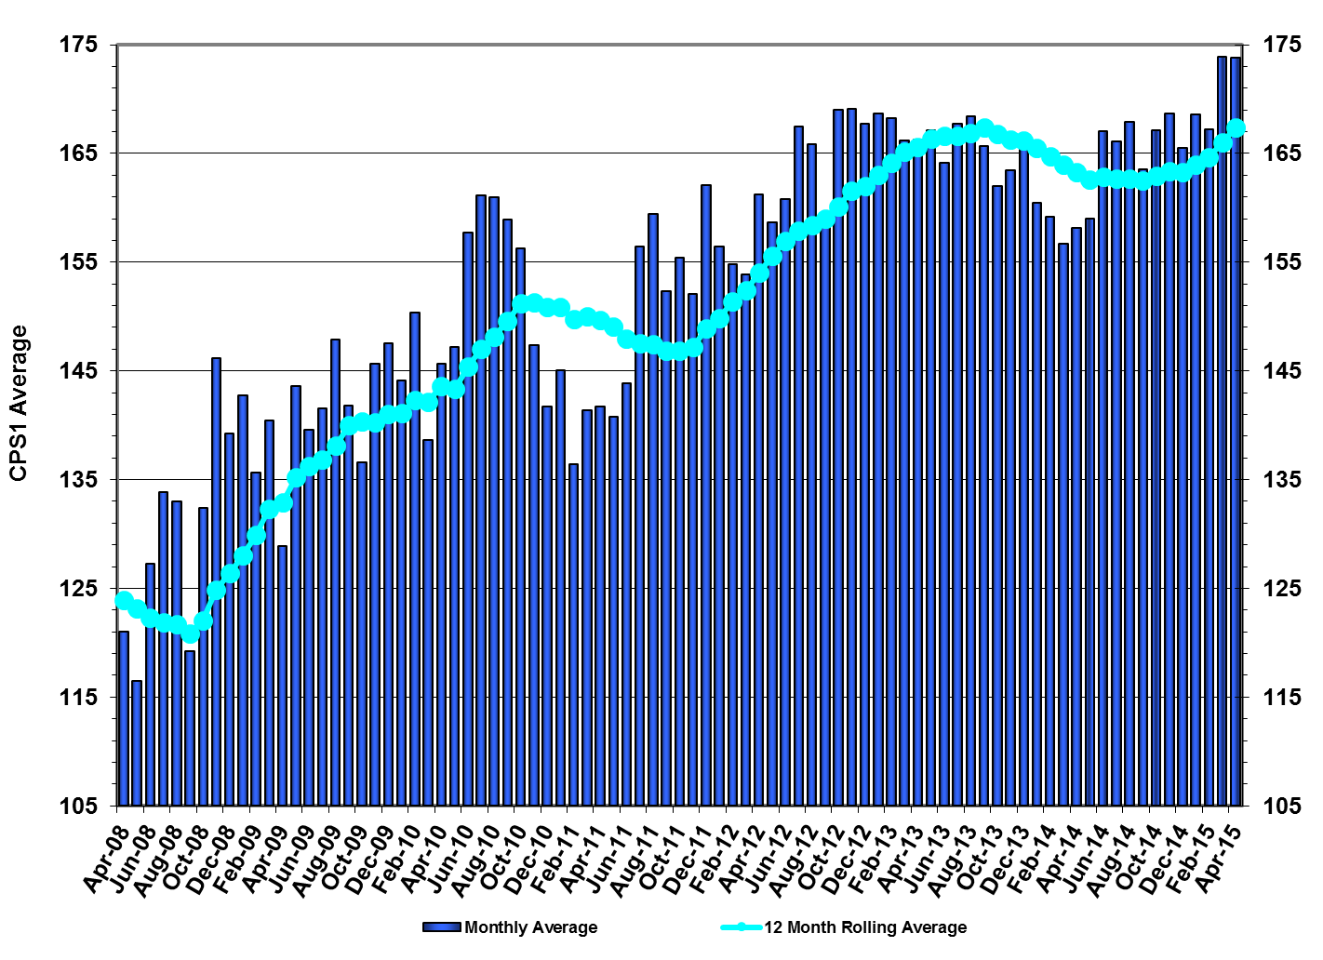
ERCOT’s CPS1 Monthly Performance – April 2015
CPS1 12 Month Rolling Average = 167.37%
Notes:
The ERCOT February 2015 CPS1 score was 167.20% and the 12 Month Rolling Average was 164.63%.

Slide 7
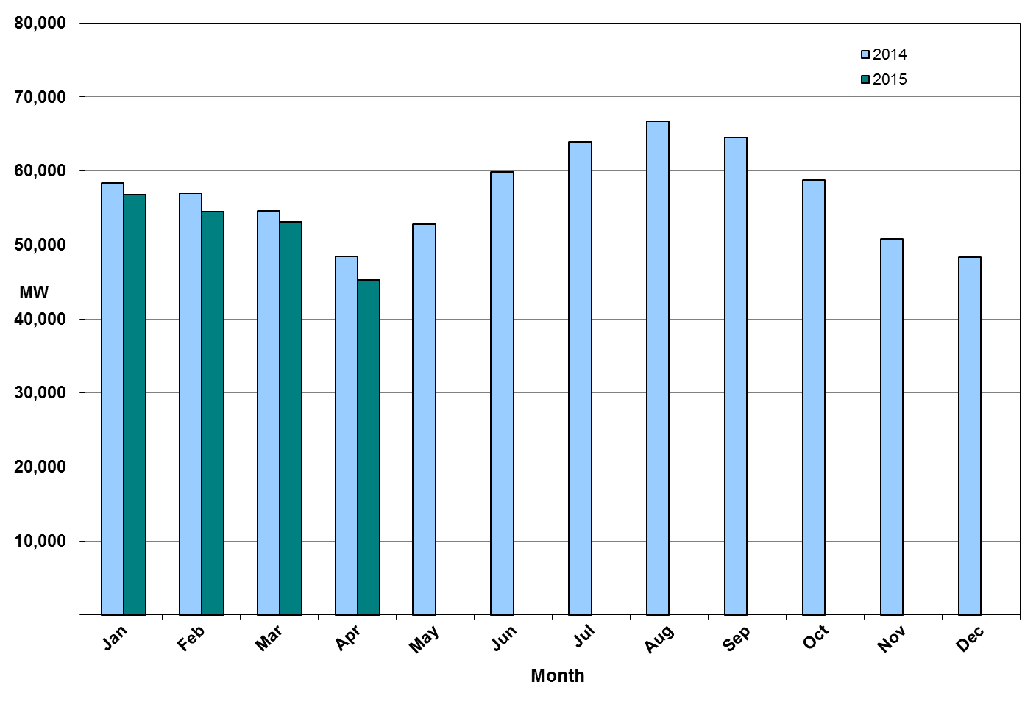
Monthly Peak Actual Demand – April 2015
Notes:
Monthly peak demand is based on Settlements EPS meter data.
April 15 Peak Interval occurred at HE 17:00 on 04/09/15: 45,229 MW
April 14 Peak Interval occurred at HE 18:00 on 4/28/14: 48,464 MW.
ERCOT Summary page has April 2014 peak from 2014 Annual ERCOT Demand & Energy report.

Slide 8
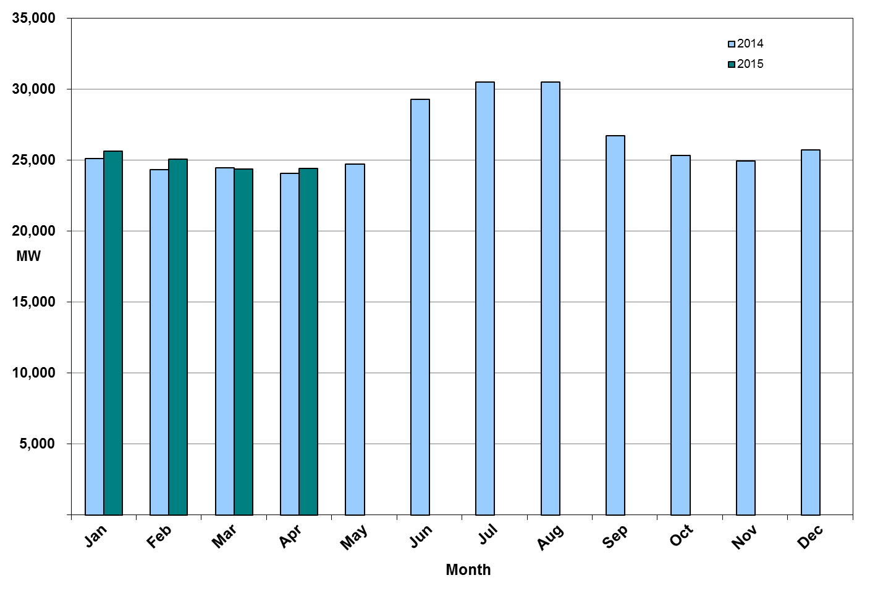
Monthly Minimum Actual Demand – April 2015
Notes:
Monthly minimum demand is based on Settlements EPS meter data.
March 15 Minimum Interval occurred at HE 05:00 on 03/29/15: 24,516 MW.
March 14 Minimum Interval occurred at HE 04:00 on 03/31/14: 24,466MW.

Slide 9
Day-Ahead Load Forecast Performance – April 2015
Mean Absolute Percent Error (MAPE) for ERCOT Mid-Term Load Forecast (MTLF) Run at 14:00 Day Ahead
 | 2012 MAPE | 2013 MAPE | 2014 MAPE | 2015 MAPE | April 2015 MAPE
Average Annual MAPE | 3.02 | 2.86 | 2.83 | 3.26 | 2.41
Lowest Monthly MAPE | 2.51 | 2.07 | 2.15 | 2.41 | Lowest Daily MAPE | 0.68 Apr – 9
Highest Monthly MAPE | 3.49 | 3.50 | 3.70 | 3.81 | Highest Daily MAPE | 4.41 Apr – 30
Notes:
Day-Ahead weather and model forecast accuracies vary from day to day which is why ERCOT uses multiple weather forecasts and load forecast models.
April 16 MAPE Error: The selected day-ahead forecast had a MAPE of 4.41%. This higher than normal MAPE was primarily caused by primarily due to temperature forecast error.

Slide 10
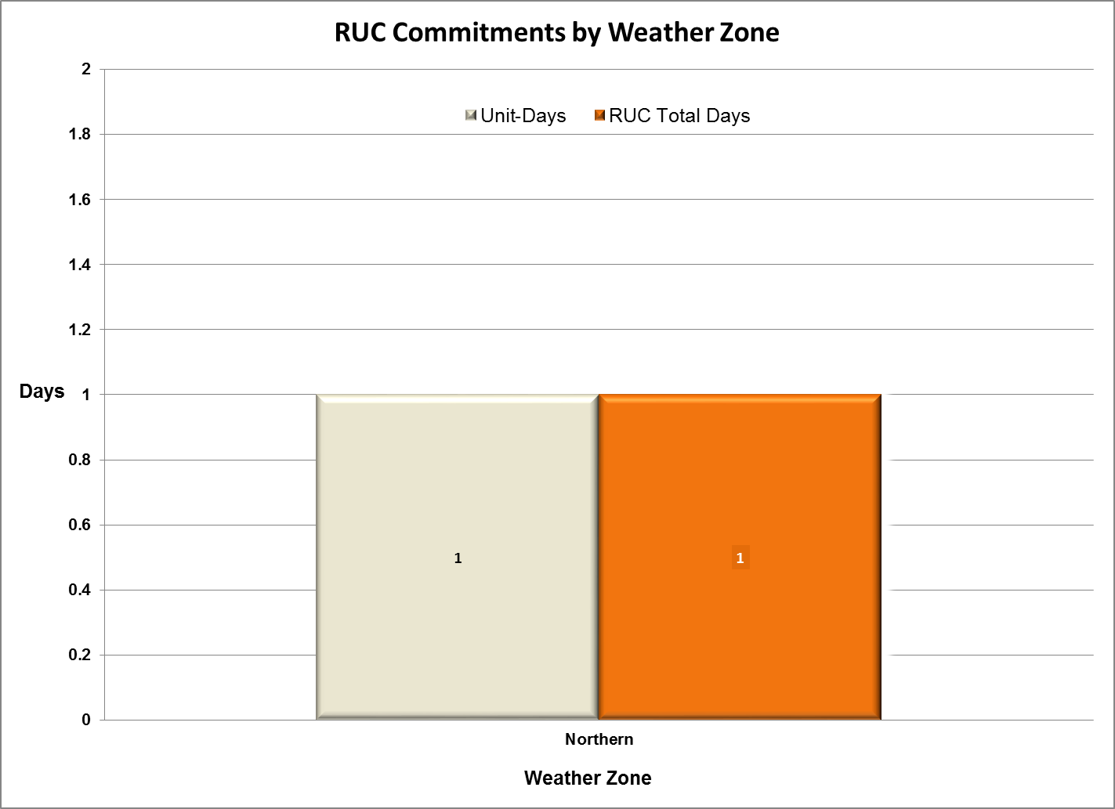
Reliability Unit Commitment (RUC) Capacity by Weather Zone
April 2015
Notes:
Unit-Days: The overall number of RUC requests. If there were multiple units RUCed on a single day, each of those units is counted as a RUC request.
RUC Total Days: The number of calendar days units were RUCed.

Slide 11
Generic Transmission Constraints (GTCs) – April 2015
GTCs | Feb 14 Days GTCs | Dec 14 Days GTCs | Mar 15 Days GTCs | Apr 15 Days GTCs | Last 12 Months Total Days (Apr14 – Mar15)
North – Houston | 0 | 0 | 0 | 0 | 0
West – North | 0 | 0 | 0 | 0 | 0
Valley Import | 2 | 0 | 0 | 0 | 4
SOP110 | 0 | 0 | 0 | 0 | 1
ZO_AJO | - | - | 9 | 17 | 26
GTC: A transmission flow limit more constraining than a Transmission Element’s normal limit established to constrain flow between geographic areas of the ERCOT Transmission System that is used to enforce stability and voltage constraints that cannot be modeled directly in ERCOT’s transmission security analysis applications.
Note: This table lists how many times a constraint has been activated to avoid exceeding a GTC limit, it does not imply an exceedance of the GTC occurred.
Notes:
The West – North GTC/GTC was retired at the end of April.
The AJO_ZO GTC was effective as of Feb 27th. An OCN was issued on this date to notify the market of the new GTC. The AJO_ZO GTC was entered into the EMS as a manual constraint beginning February 27th up until it was submitted into the Network Operations Model on the April 11th database load. The name has since been changed to ZO_AJO.
Details of OCN:
Feb 27 2015 17:11:55 CST
An OCN has been issued due to ERCOT developing a new Generic Transmission Constraint due to a local voltage stability issue in South Texas near Ajo. Further details associated with this GTC are being posted to the MIS Secure Area at this time.

Slide 12
Advisories and Watches – April 2015
One advisory due to VSAT being unavailable
  Issued on 4/24
Notes:
Emergency Notices:
Apr 24 2015 21:30:19 CST – ERCOT issued an Advisory due to ERCOTs Voltage Security Assessment Tool was unavailable from 20:42-21:19.

Slide 13
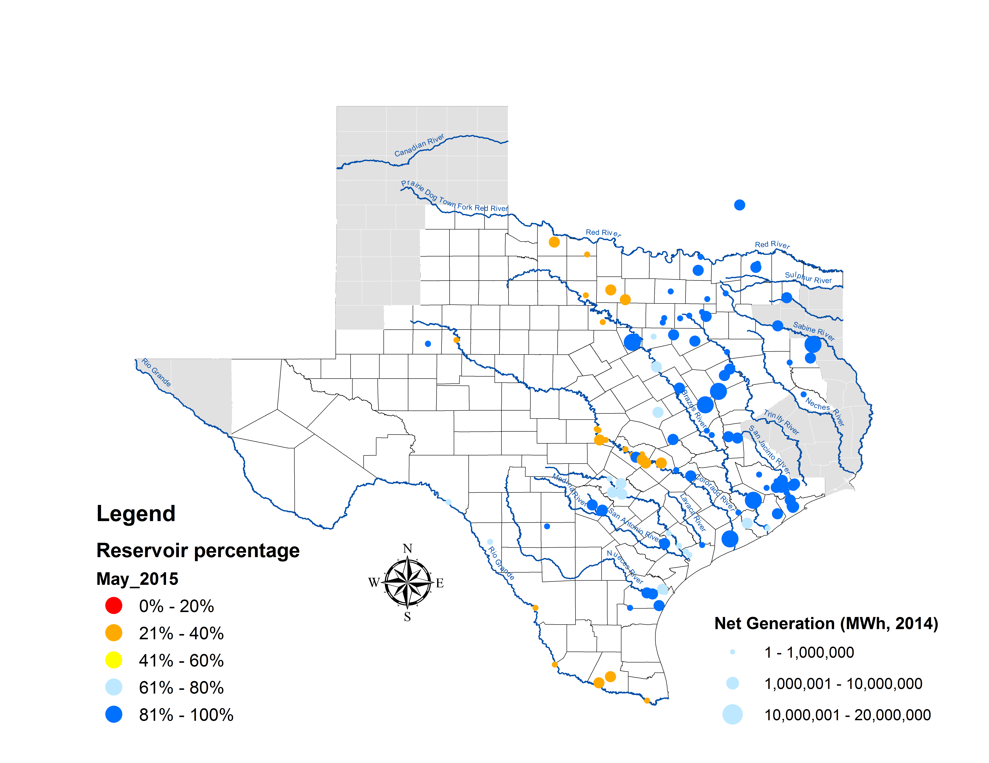
Lake Levels Update – May 1, 2015

Slide 14
Planning Summary – April 2015
ERCOT is currently tracking 252 active generation interconnection requests totaling 61,718 MW. This includes over 24,557 MW of wind generation.
ERCOT is currently reviewing proposed transmission improvements with a total cost of $820.5 Million.
Transmission Projects endorsed in 2015 total $189.8 Million.
All projects (in engineering, routing, licensing, and construction) total approximately $6.15 Billion.
Transmission Projects energized in 2015 total about $32.8 Million.

Slide 15
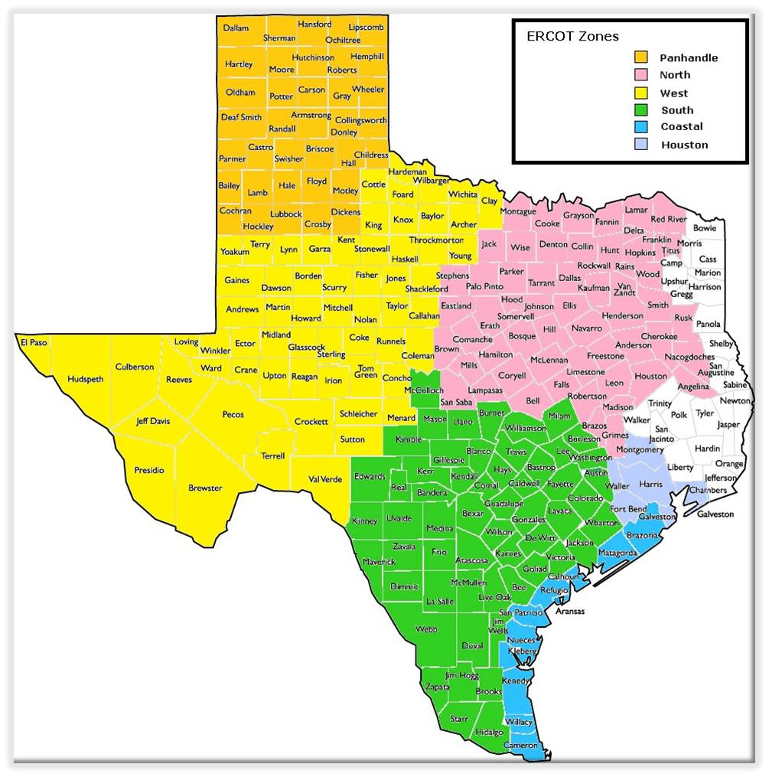
Cumulative Installed MW Capacity of Interconnection Requests by Zone – April 2015

Slide 16
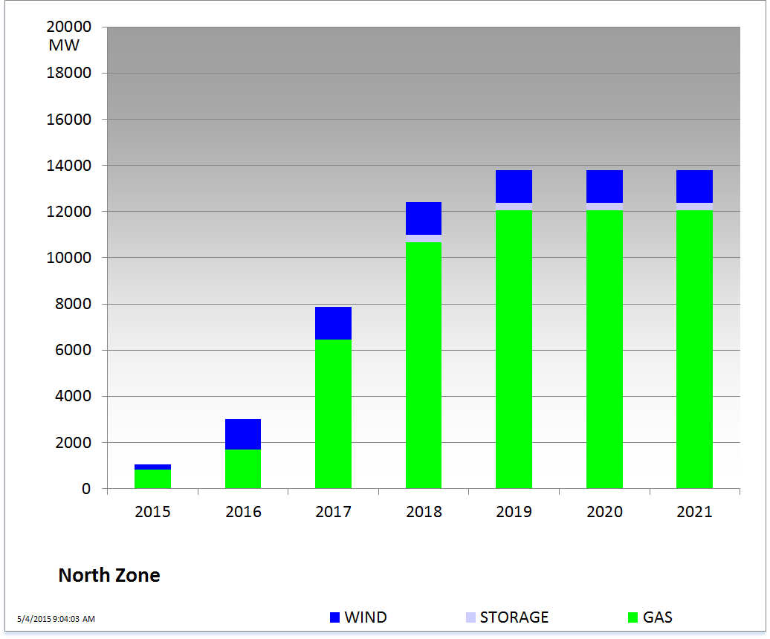
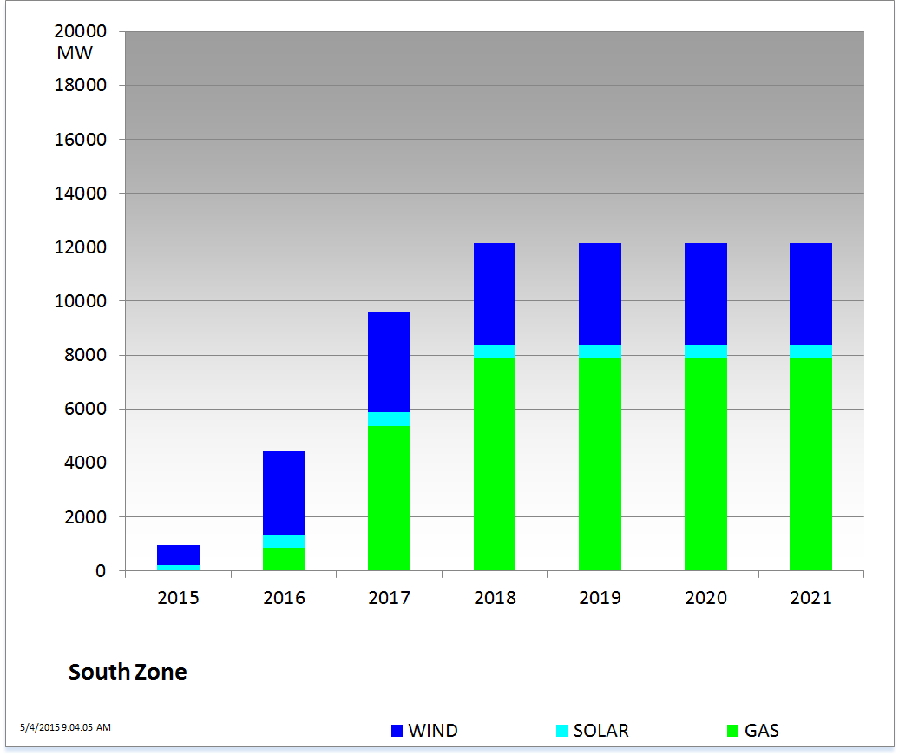
Cumulative Installed MW Capacity of Interconnection Requests by Zone – April 2015

Slide 17
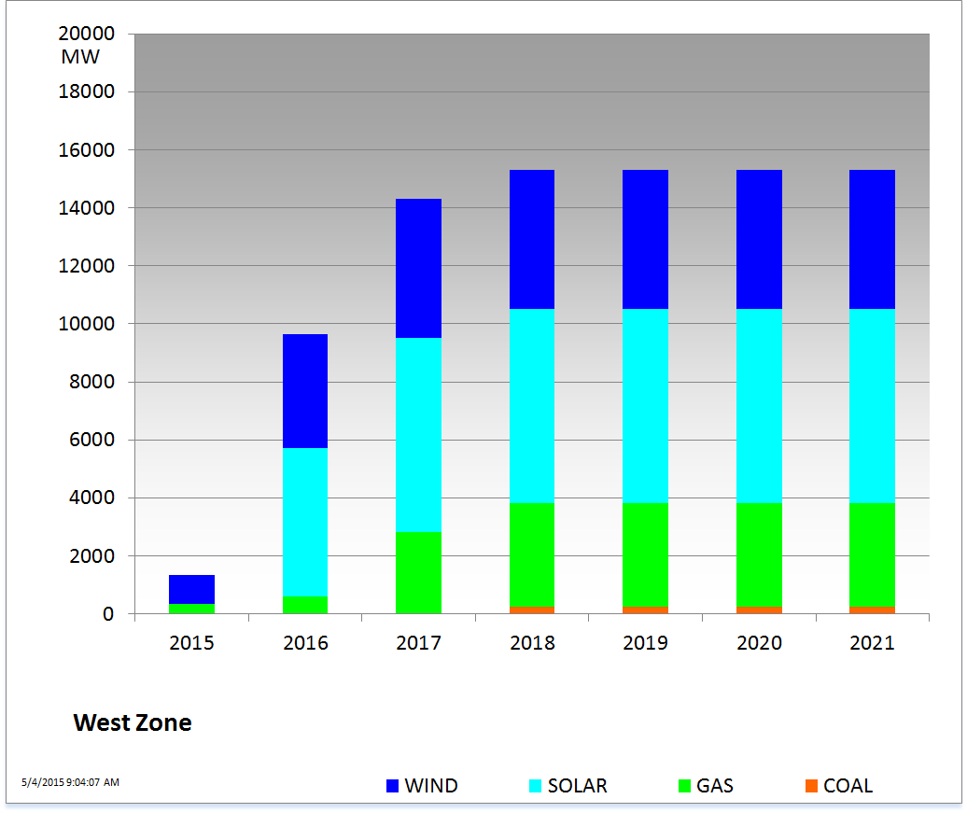
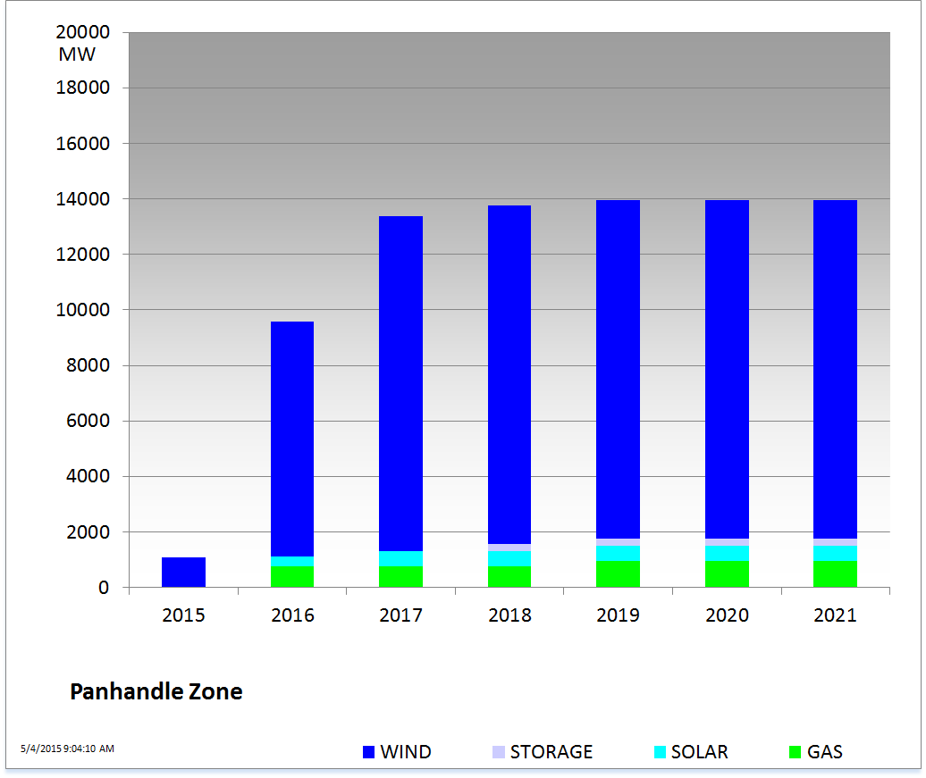
Cumulative Installed MW Capacity of Interconnection Requests by Zone – April 2015

Slide 18
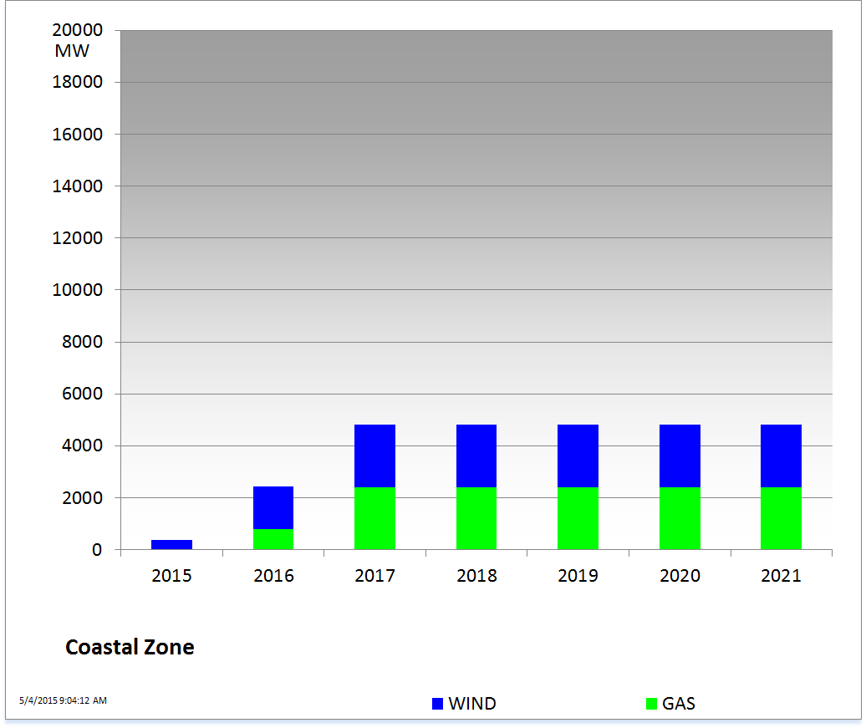
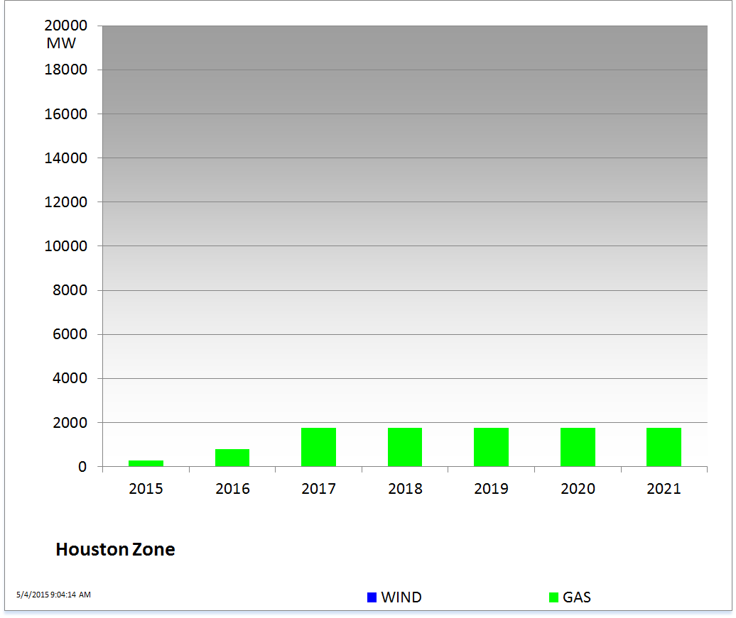
Cumulative Installed MW Capacity of Interconnection Requests by Zone – April 2015

Slide 19
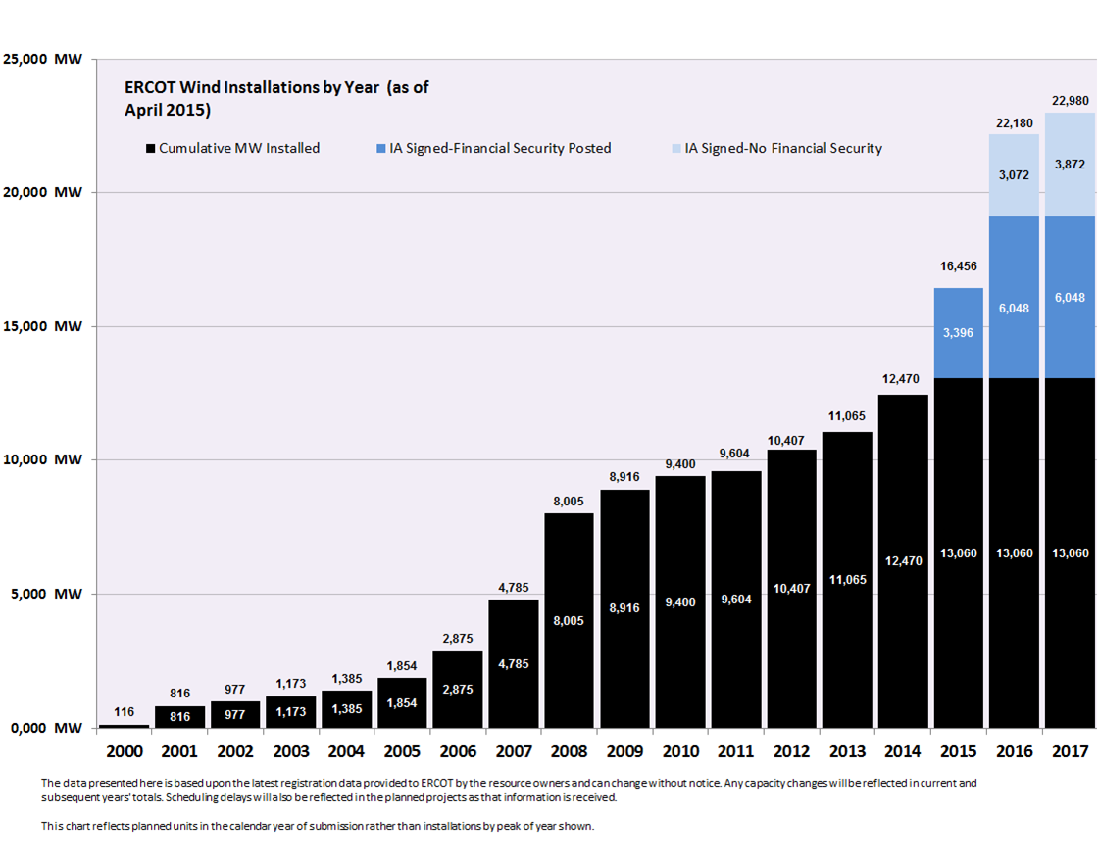
Wind Generation – April 2015

Slide 20
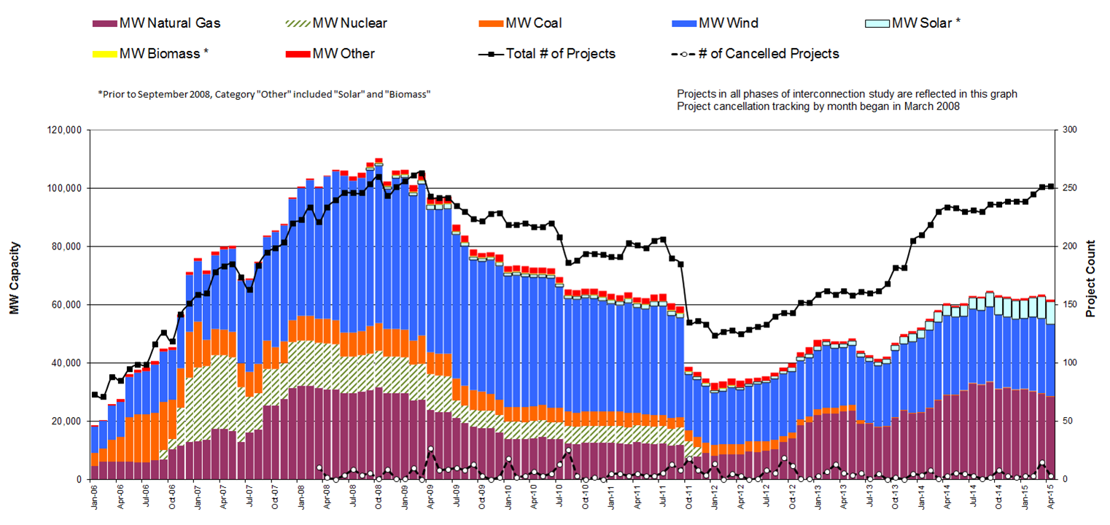
Generation Interconnection Activity by Fuel – April 2015

Slide 21
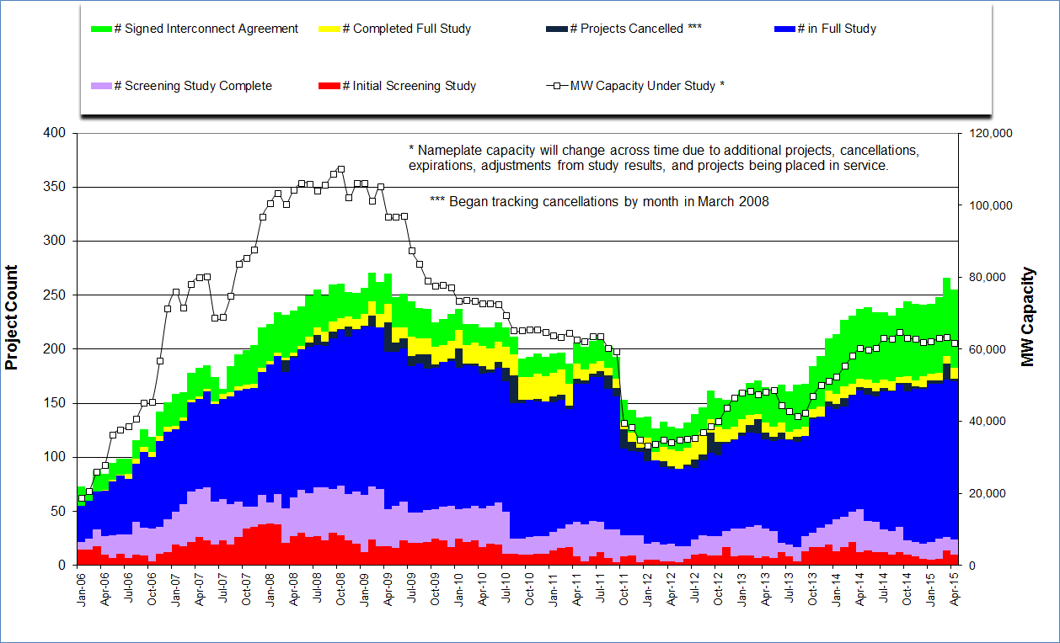
Generation Interconnection Activity by Project Phase – April 2015

Slide 22
Market Operations

Slide 23
Day-Ahead Schedule (Hourly Average) – April 2015

Slide 24
Day-Ahead Electricity And Ancillary Service Hourly Average Prices –
April 2015

Slide 25
Day-Ahead Vs Real-Time Load Zone SPP (Hourly Average) – April 2015

Slide 26
Day-Ahead Vs Real-Time Hub Average SPP (Hourly Average) – April 2015

Slide 27
DRUC Monthly Summary (Hourly Average) – April 2015

Slide 28
HRUC Monthly Summary – April 2015

Slide 29
Non-Spinning Reserve Service Deployment – April 2015
Deployment Start Time | Deployment End Time | Deployment Duration (Hours) | Max Deployment (MW) | Reason
04/13/2015 11:32:51 AM | 04/13/2015 01:00:00 PM | 1.45 | 118 | Voltage Support
04/14/2015 08:40:41 AM | 04/14/2015 04:00:00 PM | 7.32 | 61 | Voltage Support
04/14/2015 04:33:59 PM | 04/14/2015 06:35:01 PM | 2.02 | 59 | Voltage Support
04/14/2015 08:34:35 PM | 04/14/2015 11:00:00 PM | 2.42 | 60 | Voltage Support
04/15/2015 08:23:17 AM | 04/15/2015 01:00:00 PM | 4.61 | 62 | Voltage Support
04/15/2015 09:42:42 PM | 04/15/2015 11:00:00 PM | 1.29 | 61 | Voltage Support
04/16/2015 08:28:42 AM | 04/16/2015 02:00:00 PM | 5.52 | 63 | Voltage Support
04/16/2015 06:23:43 PM | 04/16/2015 11:00:00 PM | 4.60 | 62 | Voltage Support
04/17/2015 08:27:02 AM | 04/17/2015 01:00:00 PM | 4.55 | 61 | Voltage Support
04/27/2015 05:21:58 PM | 04/27/2015 06:00:00 PM | 0.63 | 58 | Voltage Support
04/27/2015 06:10:26 PM | 04/27/2015 11:13:48 PM | 5.06 | 59 | Voltage Support

Slide 30
CRR Price Convergence – April 2015

Slide 31
ORDC Price Adder (Daily Average) – April 2015

Slide 32
ERS Procurement for February 2015 – May 2015
 | BH1 | BH2 | BH3 | NBH
ERS-10 MW Procured | 598.139 | 576.648 | 570.842 | 539.822
ERS-30 MW Procured | 349.356 | 347.416 | 310.620 | 275.695
Total MW Procured | 947.495 | 924.064 | 881.462 | 815.517
Clearing Price | $15.61 | $2.63 | $11.10 | $3.00
BH1 - Business Hours 1 HE 0900 through 1300, Monday thru Friday except ERCOT Holidays
BH2 - Business Hours 2 HE 1400 through 1600, Monday thru Friday except ERCOT Holidays
BH3 - Business Hours 3 HE 1700 through 2000, Monday thru Friday except ERCOT Holidays
NBH - Non-Business Hours All other hours

Slide 33
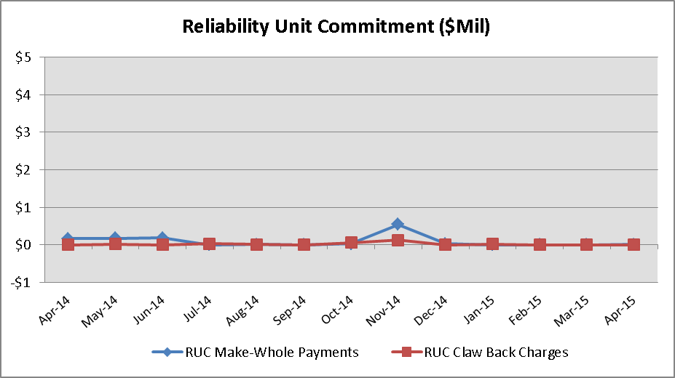
Reliability Services – April 2015
Reliability Unit Commitment (RUC) | $ in Millions
RUC Make-Whole Payments | $0.00
RUC Clawback Charges | $0.00
RUC Commitment Settlement | $0.00
RUC Capacity Short Charges | $0.00
RUC Make-Whole Uplift | $0.00
RUC Commitment Cost Allocation | $0.00
RUC Decommitment Payments | $0.00
RUC Make-Whole Payments remained at $0.00M in April. RUC Clawback Charges were $0.00M.
There was $0.00M allocated directly to load in April 2015, compared to:
$0.00M in March 2015
$0.00M in April 2014

Slide 34
Capacity Services – April 2015
Capacity Services | $ in Millions
Regulation Up Service | $4.21
Regulation Down Service | $2.49
Responsive Reserve Service | $19.73
Non-Spinning Reserve Service | $5.47
Black Start Service | $0.61
Voltage Services - Reactive Power | $0.00
Voltage Services - Lost Opportunity | $0.00
Total Charges | $32.51
Capacity Services costs decreased from last month and from April 2014.
April 2015 cost was $32.51M, compared to:
A charge of $34.23M in March 2015
A charge of $44.12M in April 2014

Slide 35
Energy Settlement – April 2015
Day-Ahead Market Energy Settlement | $ in Millions
Energy Purchases | $313.99
Point to Point Obligation Purchases | $19.39
RMR Day-Ahead Revenue | $0.00
Energy Sales | ($309.53)
Day-Ahead Congestion Rent | $23.85
Day-Ahead Market Make-Whole Payments | ($0.11)
Real-Time Market Energy Settlement | $ in Millions
Energy Imbalance at a Resource Node | ($351.33)
Energy Imbalance at a Load Zone | $495.24
Energy Imbalance at a Hub | ($131.20)
Real Time Congestion from Self Schedules | $0.44
Block Load Transfers and DC Ties | ($1.71)
Impact to Revenue Neutrality | $11.44
Emergency Energy Payments | ($0.06)
Base Point Deviation Charges | $0.18
Real-Time Metered Generation (MWh in millions) | 24.57
Both Day-Ahead Market and Real-Time Market energy settlement activity decreased from last month and from April 2014.

Slide 36
Congestion Revenue Rights (CRR) – April 2015
 | $ in Millions
Annual Auction | ($24.51)
Monthly Auction | ($7.10)
Total Auction Revenue | ($31.61)
Day-Ahead CRR Settlement | ($22.63)
Day-Ahead CRR Short-Charges | $0.76
Day-Ahead CRR Short-Charges Refunded | ($0.76)
Real-Time CRR Settlement | $0.00
Real-Time CRR Short-Charges | $0.00
Real-Time CRR Short-Charges Refunded | $0.00
Total CRR Funding | ($22.63)
Day-Ahead Point to Point Obligations Settlement | $19.39
Real-Time Point to Point Obligation Settlement | ($12.41)
Net Point to Point Obligation Settlement | $6.98
Congestion Revenue Rights settlement payments were fully funded and excess funds were deposited into the CRR Balancing Account Fund.
Point to Point Obligations settled with a net charge of $6.98M compared to a net charge of $0.78M last month.

Slide 37
CRR Balancing Account Fund – April 2015
CRR Balancing Account Fund | $ in Millions
Beginning Balance for the Month | $6.72
CRR Balancing Account Credit Total | $1.98
CRR PTP Option Award Charges | $0.05
Day-Ahead CRR Short-Charges Refunded | ($0.76)
Total Fund Amount | $7.99
ERCOT implemented the rolling CRR Balancing Account Fund beginning with Operating Month December 2014. The month of April 2015 closed with $1,270,628 in excess Day-Ahead congestion rent which was deposited into the Fund.
As of April 2015, the amount available in the CRR Balancing Account Fund is $7,988,176.

Slide 38
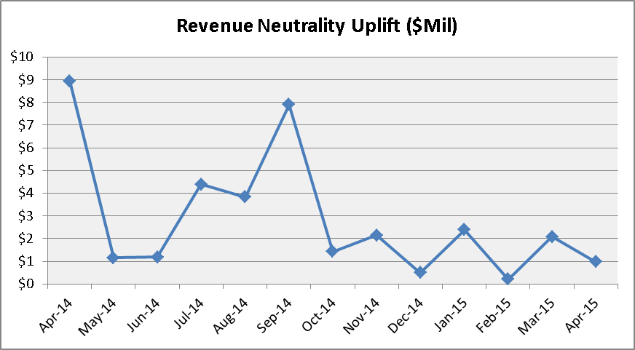
Revenue Neutrality – April 2015
Revenue Neutrality Settlement | $ in Millions
Real-Time Point to Point Obligation Settlement | ($12.41)
Real-Time Point to Point Options and Options with Refund Settlement | $0.00
Real-Time Energy Imbalance Settlement | $12.71
Real-Time Congestion from Self-Schedules Settlement | $0.44
DC Tie & Block Load Transfer Settlement | ($1.71)
Charge to Load | $0.97
Revenue Neutrality charges to load decreased compared to last month and decreased compared to April 2014.
April 2015 was a charge of $0.97M, compared to:
$2.08M charge in March 2015
$8.92M charge in April 2014

Slide 39
Real Time Ancillary Service Imbalance (ORDC) – April 2015
Real Time Ancillary Service Imbalance | $ in Thousands
Real-Time AS Imbalance Payment Amount | ($339.66)
Load Allocated AS Imbalance Revenue Neutrality Amount | $339.65
Total Charges | $339.65
Real-Time Ancillary Service Imbalance Settlements increased from March 2015 to April 2015. Total payments for the month of April 2015 were $339,658 compared to a payment of $297,972 in March 2015.
5 of the 30 days in April had settlement dollars equal to $0 for the day.
All days were settled as a net credit to QSEs representing generation and as a charge to QSEs representing load.
The highest settlement occurred on April 7th. The total Real Time Ancillary Service Imbalance payments on that day were $108,942.

Slide 40
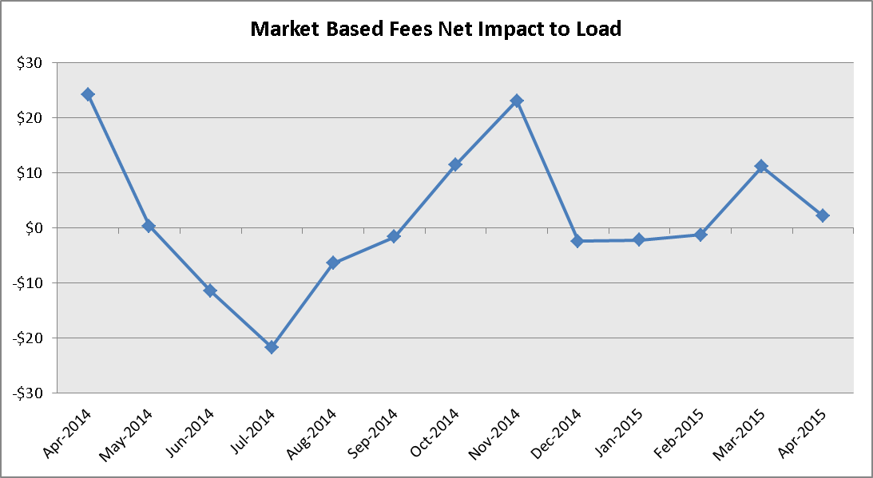
Net Allocation to Load – April 2015
Market-Based Allocation | $ in Millions
CRR Auction Revenue Disbursement Settlement | ($31.61)
Balancing Account Proceeds Settlement | $0.00
Net Reliability Unit Commitment Settlement | $0.00
Ancillary Services Settlement | $32.51
Reliability Must Run Settlement (incl. RMR for Capacity) | $0.00
Real-Time Revenue Neutrality Settlement | $0.97
Emergency Energy Settlement | $0.06
Base Point Deviation Settlement | ($0.18)
ORDC Settlement | $0.34
Total | $2.09
Fee Allocation
ERCOT Administrative Fee Settlement | $11.48
Net Allocated to Load | $13.57
The charge for the net allocation to Load decreased from last month and decreased from April of 2014.
April 2015 was a charge of $13.57M, compared to:
A charge of $22.91M in March 2015
A charge of $35.38M in April 2014

Slide 41
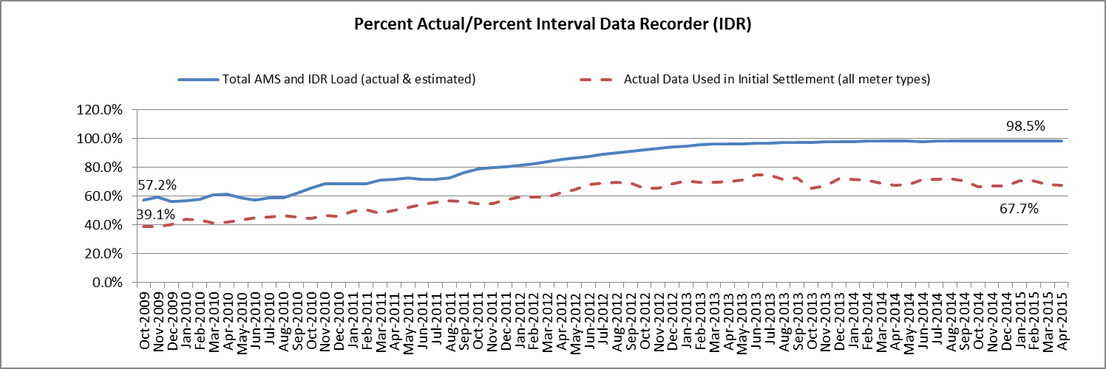
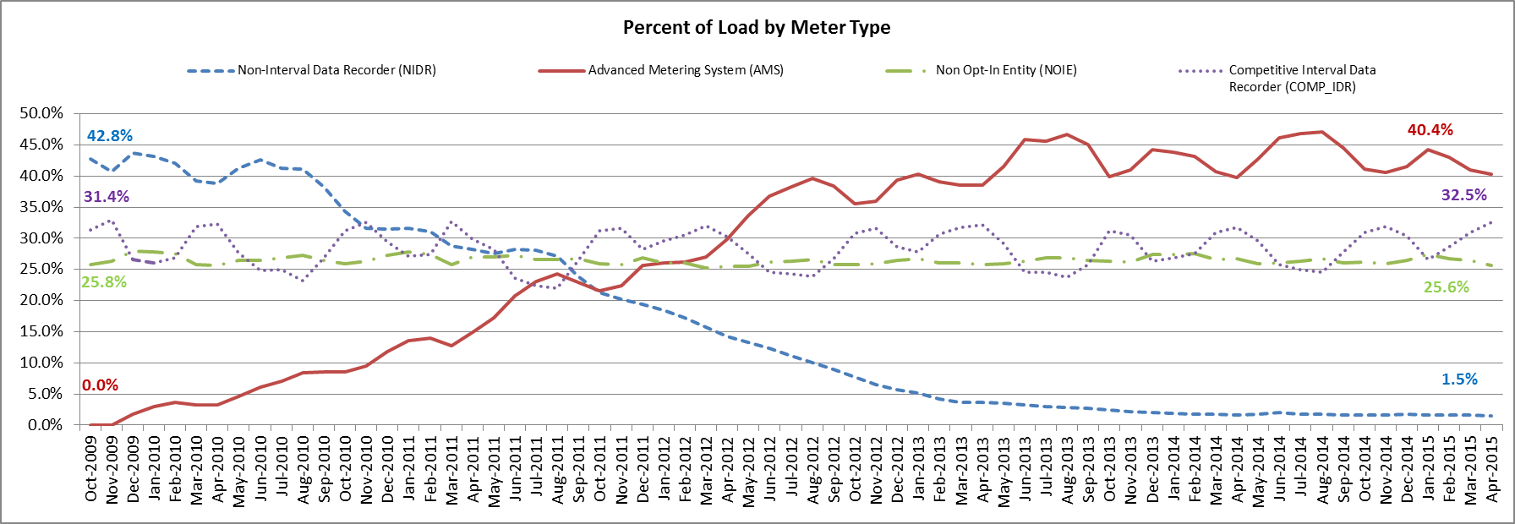
Advanced Meter Settlement Impacts – April 2015
April 2015: At month end, settling 6.7M ESIIDs using Advanced Meter data.
April 2015: 98.5% of the load in ERCOT is settled with 15-min interval data (AMS, Competitive IDR, and NOIE IDR).

Slide 42
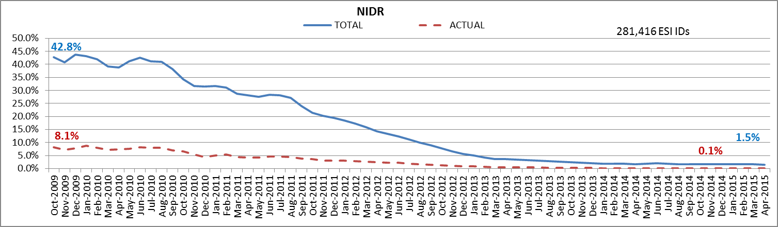
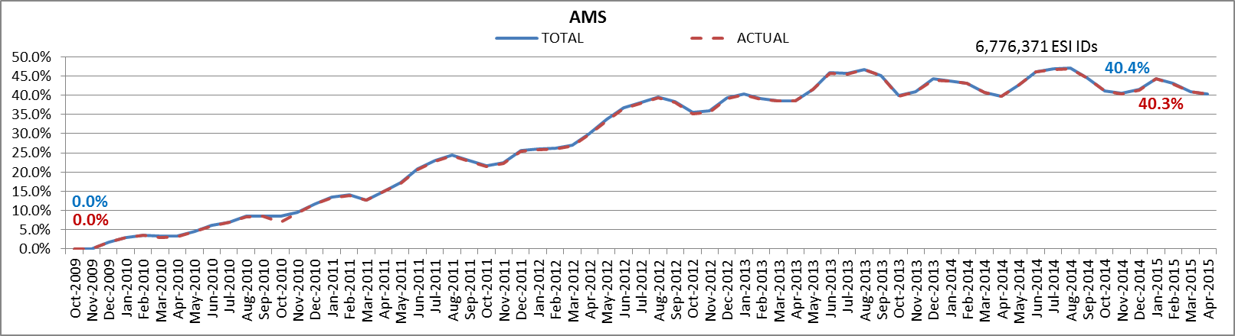
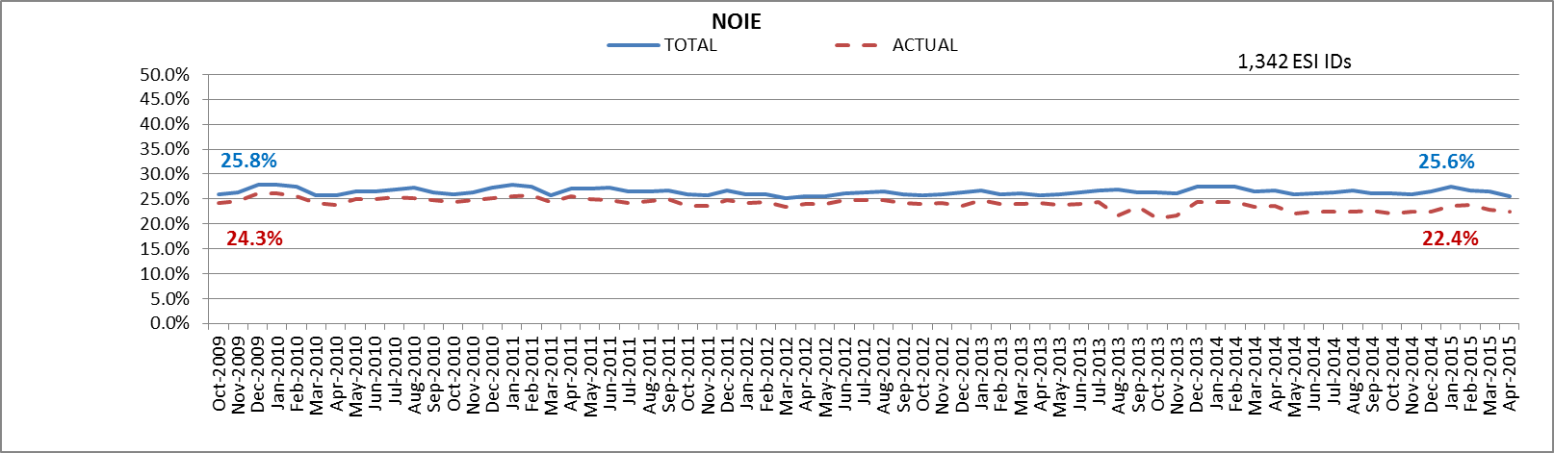
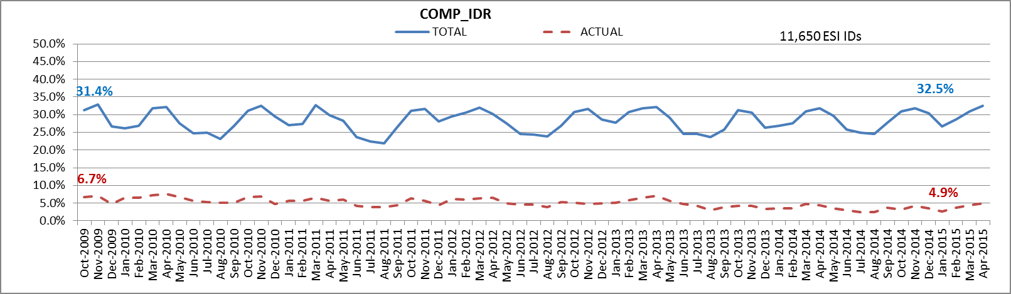
ERCOT Wide Load Volumes by Meter Type – INITIAL Settlement – April 2015

Slide 43
Retail Transaction Volumes – Summary – April 2015
 | Year-To-Date |  | Transactions Received
Transaction Type | April 2015 | April 2014 | April 2015 | April 2014
Switches | 307,531 | 343,953 | 81,255 | 91,983
Acquisition | 0 | 0 | 0 | 0
Move - Ins | 819,672 | 888,592 | 207,932 | 258,649
Move - Outs | 410,231 | 418,923 | 108,275 | 107,956
Continuous Service Agreements (CSA) | 164,630 | 226,461 | 44,247 | 80,184
Mass Transitions | 0 | 0 | 0 | 0
Total | 1,702,064 | 1,877,929 | 441,709 | 538,772

Slide 44
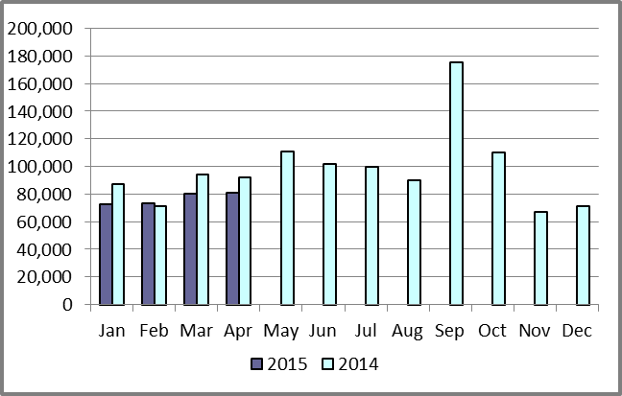
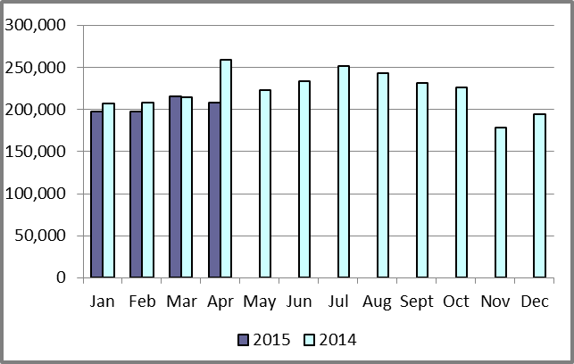
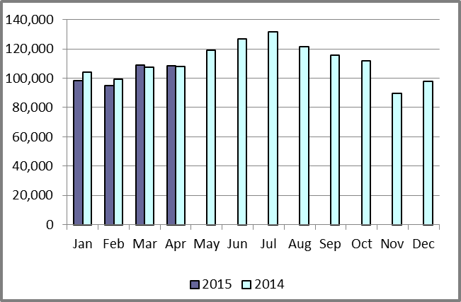
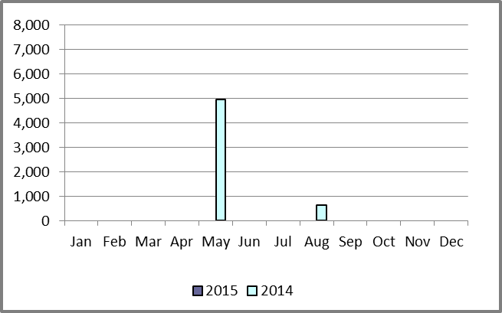
Retail Transaction Volumes – Summary – April 2015
Switches/Acquisitions
Move-Ins
Move-Outs
Mass Transition

Slide 45
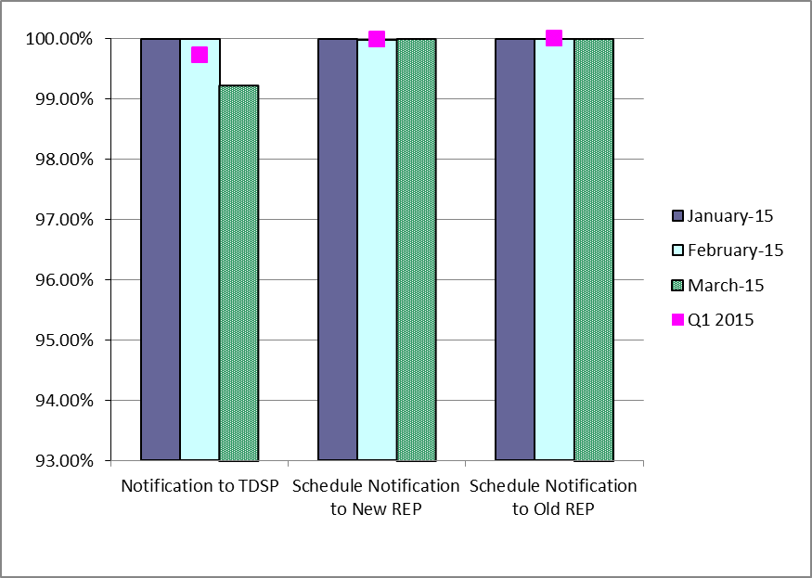
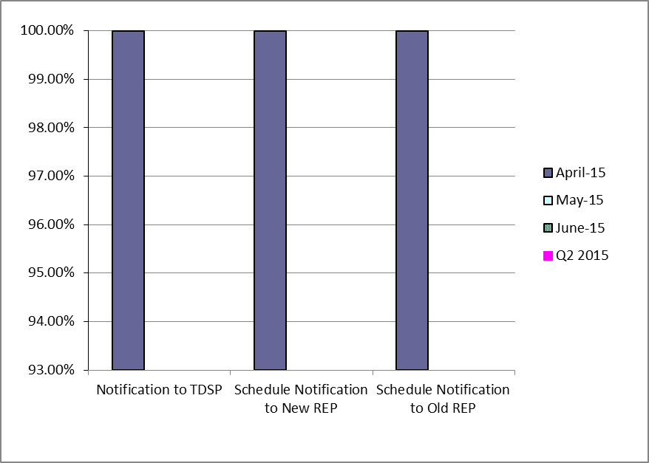
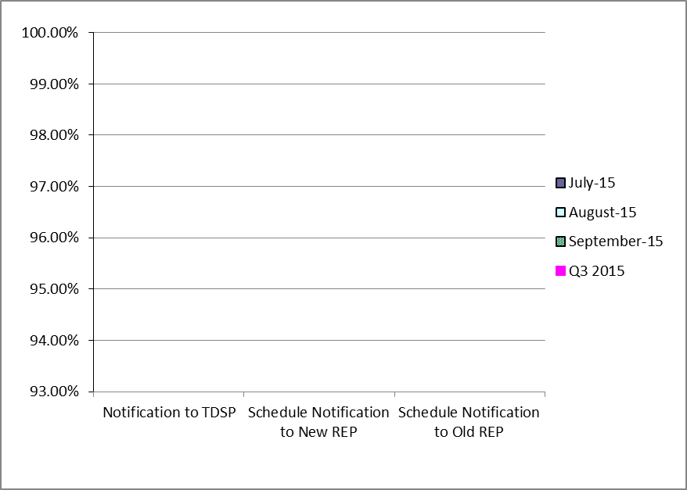
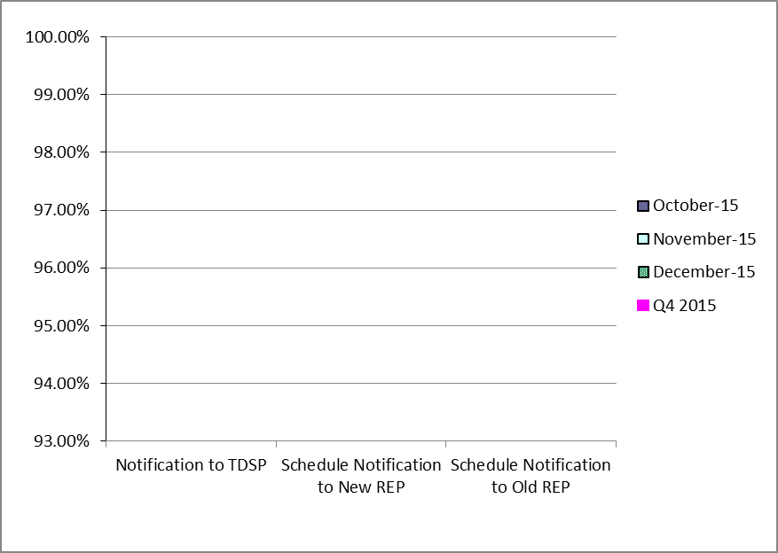
Retail Performance Measures – Switch – April 2015
1st Quarter
2nd Quarter
3rd Quarter
4th Quarter
Notes:
Retail Transaction Performance - Target 98%

Slide 46
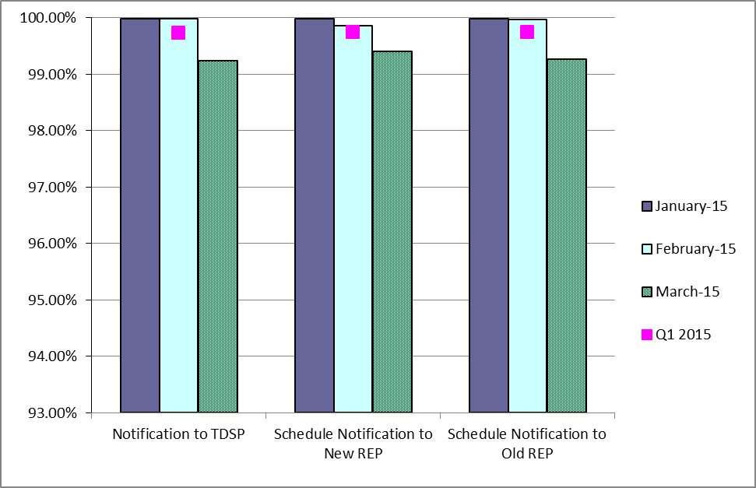
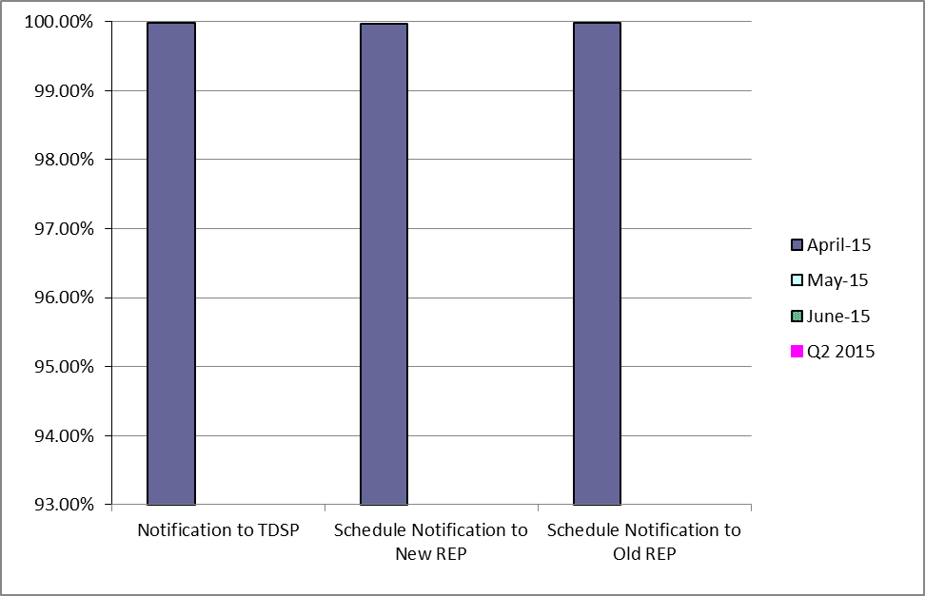
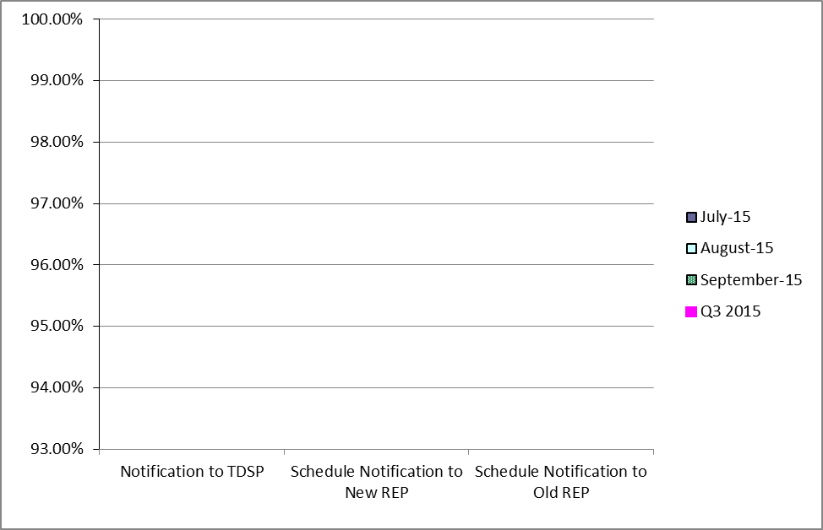
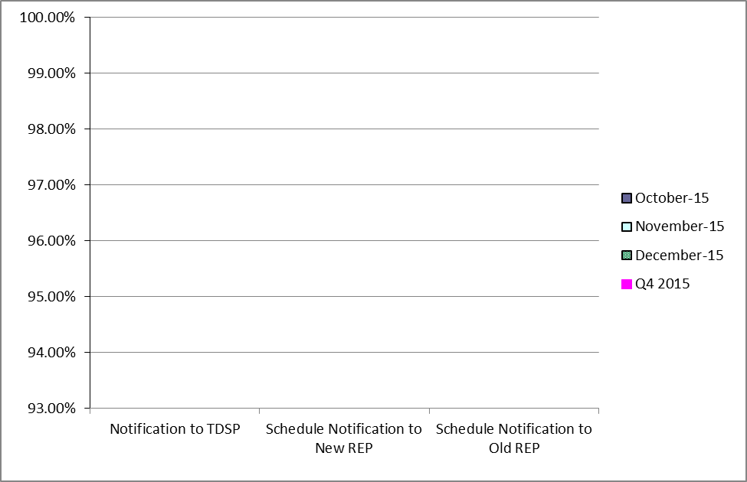
Retail Performance Measures (Same Day Move-In) – April 2015
1st Quarter
2nd Quarter
3rd Quarter
4th Quarter
Notes:
Retail Transaction Performance - Target 98%

Slide 47
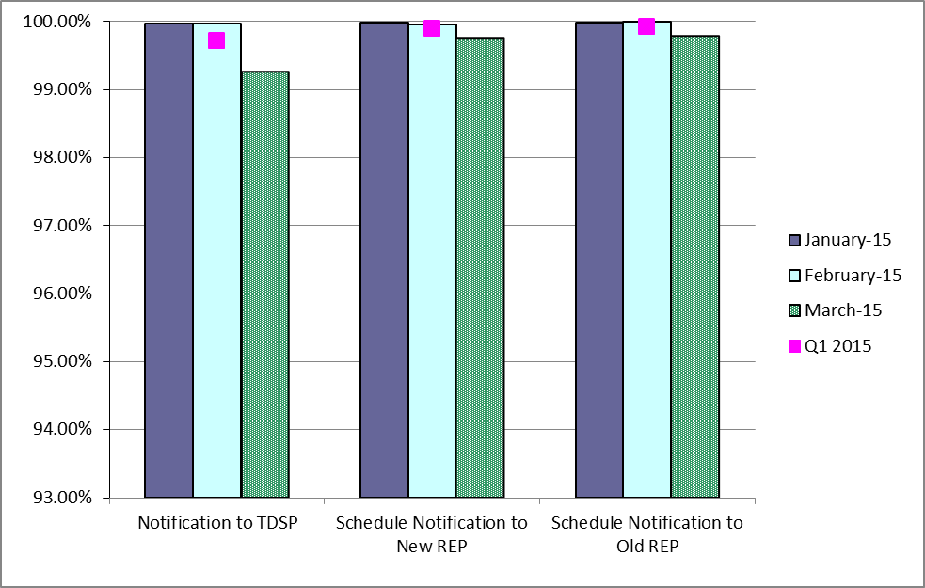
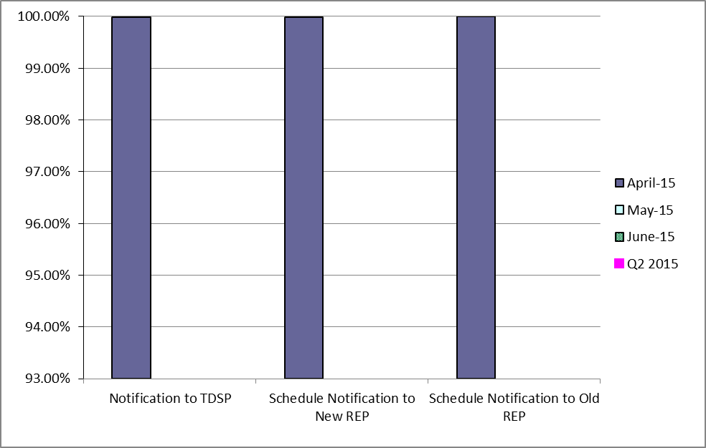
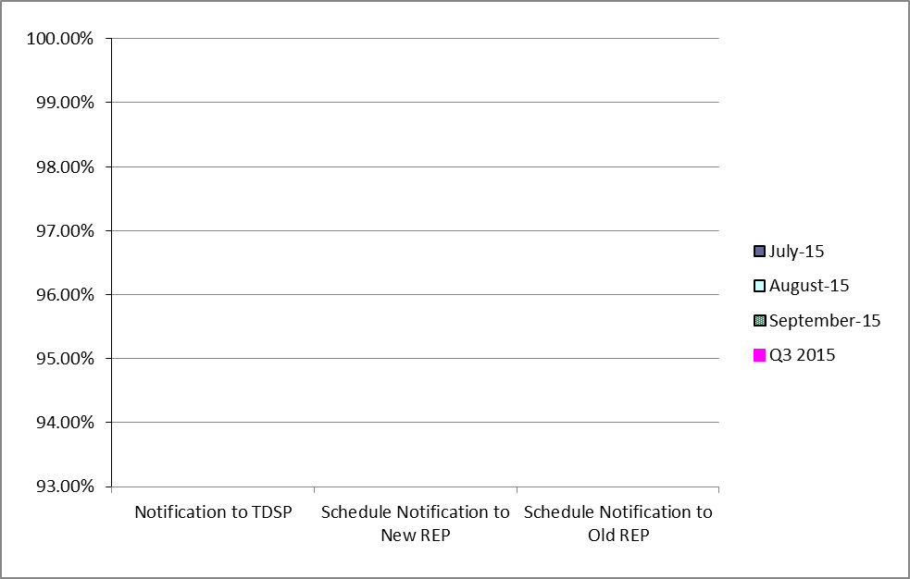
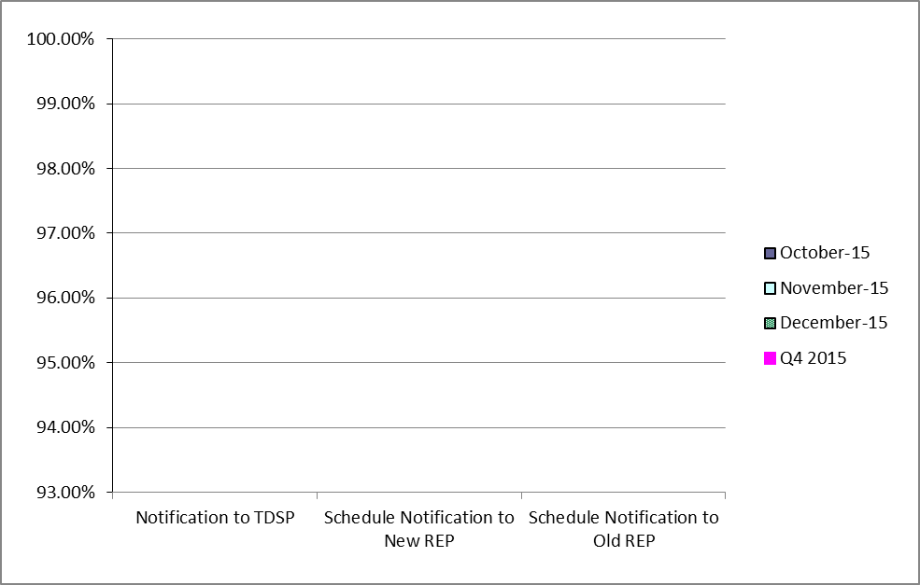
Retail Performance Measures (Standard Move-In) – April 2015
1st Quarter
2nd Quarter
3rd Quarter
4th Quarter
Notes:
Retail Transaction Performance - Target 98%

Slide 48
Projects Report

Slide 49
ERCOT Portfolio Stoplight Report – April 2015

Slide 50
ERCOT Portfolio Stoplight Report – April 2015

Slide 51
ERCOT Portfolio Stoplight Report – April 2015

Slide 52
ERCOT Portfolio Stoplight Report – April 2015

