Slide 1
SMT Update To AMWG
May 19, 2015

Slide 2
Q&A Monthly SMT Reports to AMWG Data Through April 2015

Slide 3
SMT Number of Accounts by Type Report AMWG CR 2014 009
Suggested Report Revisions
Registered Users – No Change
Residential with Meter - Residential Active Accounts
Residential(EN) with Meter – Residential English Active Accounts
Residential(ES) with Meter – Residential Spanish Active Accounts
Residential Without Meter – Residential Non Active Accounts
Total Residential Accounts – No Change
TDSP User – No Change
TDSP Admin– No Change
NRC User – Small Business User
NRC Admin – Small Business Admin

Slide 4
Review CRs Needing Further Discussion, Clarification or Re-Estimation

Slide 5
Rough Order Of Magnitude (ROM) Effort Classification
Change Type | ROM
MINOR | 0 – 20 K
SMALL | 20 – 40 K
MEDUIM | 40 – 60 K
HIGH | 60 – 120 K
VERY HIGH | Over 120 K
These are rough order of magnitudes and do not include project ramp-up and testing effort (SIT & UAT) and only assumes unit testing. Actual estimates could vary significantly depending on requirements.
Ramp-up and testing would be 20 to 40% of the overall effort (needs minimum by in)

Slide 6
AMWG CR 2014-018 Add Generation Data to SMT Portal View Option 3 Estimate Small
6
6

Slide 7
AMWG CR 2014-018 – Add Generation Data to the SMT Portal View
Option 3
Add Generation Data to the Usage Table Only
Usage Graph will NOT display Generation usage data
Usage Table will have two additional columns – Usage (kWh) for Generation and Actual / Estimate for Generation

Slide 8
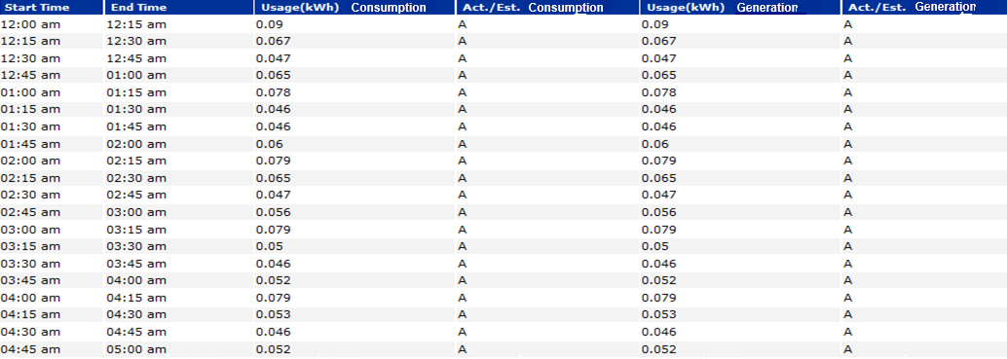
AMWG CR 2014-018 – Add Generation Data to the SMT Portal View
Option 3
Two additional columns – Usage (kWh) for Generation and Act / Est for Generation will be added in the Usage Table
Print
Export Report in CSV
< Previous Day
Next Day >
Two new columns for Generation Usage Data

Slide 9
AMWG CR 2014-018 – Add Generation Data to the SMT Portal View
Functional Rules – Ad hoc Usage Report
The addition of Generation usage data is applicable to ALL entity types – TDSP, REP, Third Party, Business and Residential Customers.
The changes impact UI only

Slide 10
AMWG CR 2014-018 – Add Generation Data to the SMT Portal View
Business Scenarios / Issues
If ESIID does not have generation data, how should it be displayed in the Usage Table?
Analyze whether Zero or N/A should be used to display no generation data.

Slide 11
AMWG CR 2015-24 3rd Party Access – Renew Energy Data Agreement after one year Requirements and Design Assessment
11
11

Slide 12
AMWG CR 2015-29 3rd Party Access functionality. Allow 3rd parties the ability to utilize an API for ODR (On-Demand Read)
12
12

Slide 13
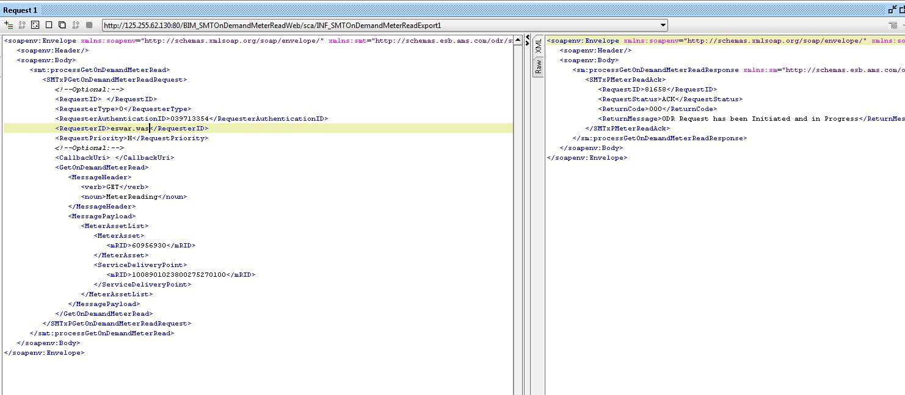
AMWG CR 2015-29 3rd Party Access functionality. Allow 3rd parties the ability to utilize an API for ODR (On-Demand Read)
Business Requirement
Allow 3rd parties the ability to utilize an API for ODR (On Demand Read).
3rd Party ODR request will work like HAN provision and de-provision.
Flow of the Request will be
3rd Party SMT TDSP
SMT 3rd Party

Slide 14
AMWG CR 2015-40 Enhancement of SMT user Administration Functions - Discussion
14
14

Slide 15
AMWG CR 2015-XX Market Suggested SMT Enhancement 3rd Party Agreement Details FTP (Machine to Machine Consumption)
15
15

Slide 16
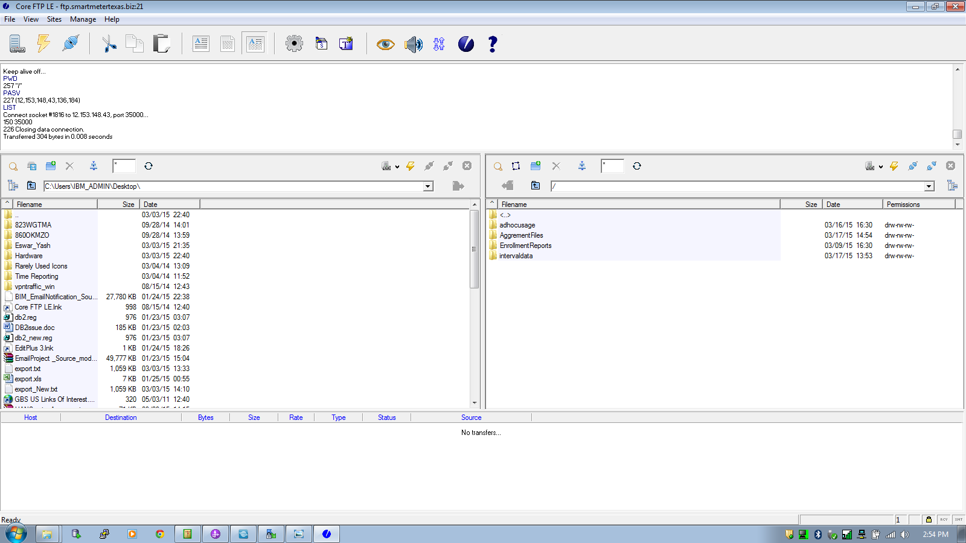
3rd Party Agreement Details FTP (Machine Consumption)
Business Requirement
3rd Party each Agreement action should be maintained in FTP location.
Proposed Solution: Separate folder/dir will be created for Agreement details purpose

Slide 17
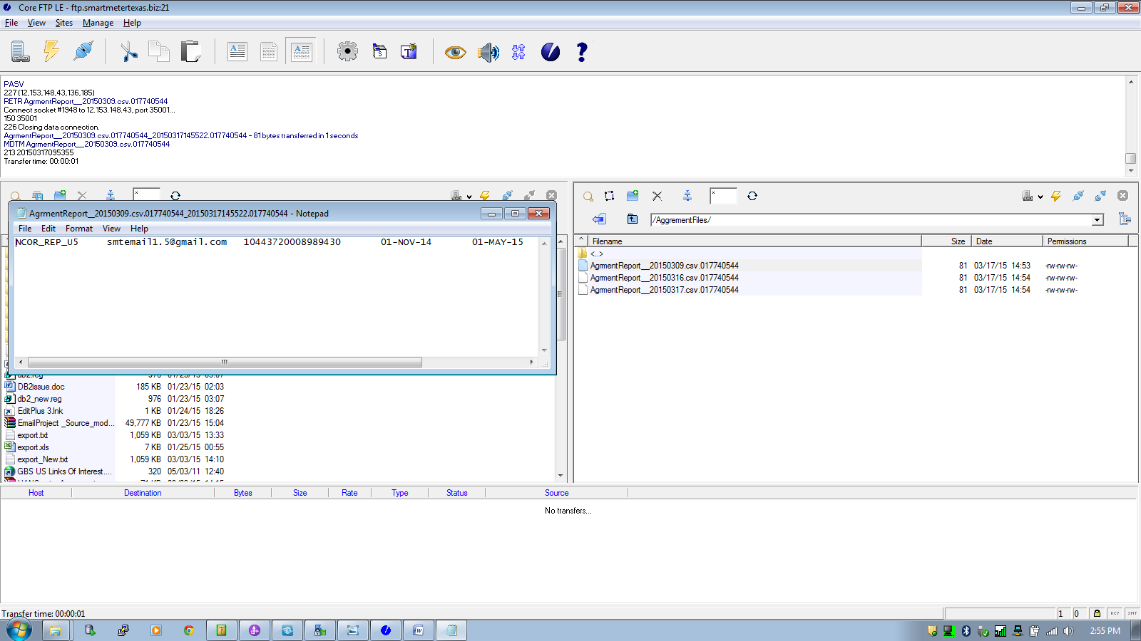
3rd Party Agreement Details FTP (Machine Consumption)
Business Requirement
(cont)
Proposed Solution: File will be created for each action of the 3rd party user.
File will contain –
User-ID
Email-ID
ESIID
Agreement Start-Date
Agreement End-Date
Usage Flag
HAN Flag
Agreement Status

Slide 18
Review AMWG CR Story Boards with Estimates for 2015-030 through 2015-039

Slide 19
SMT Outage and Infrastructure Refresh Status

Slide 20
SMT Outage and Infrastructure Refresh Status
SMT completed the move to the new infrastructure database May 9th, 2015
The move to the new infrastructure database went smoothly and only required a 9 hour outage
SMT is now fully functional on the new production infrastructure
The new SMT disaster recovery environment is in process of being brought online with a target completion date of Thursday May 21st, 2015
A thorough investigation and review of the outage is in process of being conducted
Due diligence is being conducted to review the new infrastructure, processes and procedures to mitigate risks and prevent this type of extenuating outage from occurring in the future
A report is being developed for presentation to RMS in either June or July

Slide 21
Status Update of AMWG Change Requests

Slide 22
Status of AMWG Change Requests
Summary:
39 Total AMWG Change Requests Including
9 AMWG Change Requests Delivered 2014
1 AMWG Change Request Designed and Awaiting Next Release to Implement in 2015
14 RMS Estimate Approved and AMWG Categorized Awaiting Packaging
13 JDOA Estimate Completed Awaiting AMWG Approval and Categorization
1 RMS Tabled
1 AMWG Pushed Back as Potential Defect

Slide 23
Rough Order Of Magnitude (ROM) Estimate of Effort Classification
Change Type | ROM
MINOR | 0 – 20 K
SMALL | 20 – 40 K
MEDUIM | 40 – 60 K
HIGH | 60 – 120 K
VERY HIGH | Over 120 K
These are rough order of magnitudes and do not include project ramp-up and testing effort (SIT & UAT) and only assumes unit testing.
Actual estimates could vary significantly depending on requirements.
Ramp-up and testing would be 20 to 40% of the overall effort
Overall project cost will vary based on efficiency gains from packaging like functionality

Slide 24
AMWG Change Requests
AMWG Change Request | AMWG CR Document | Status | Estimated Delivery Date | Estimated Cost
AMWG CR 2013 001 – Report for AMWG Data Monitoring – Data Completeness Measurements |  | Estimate Complete & RMS Approved 3/3/15 | 2 Important Awaiting Packaging | Small (20-40)
AMWG CR 2013 002 – Reports for AMWG Data Monitoring – Data Timeliness Measurements |  | Implemented | Q2 2014 Delivered | Included in Maintenance Contract
AMWG CR 2013 003 – Reports for AMWG Data Monitoring – Measurement of Percentage of Actual Meter Reads |  | Estimate Complete & RMS Approved 3/3/15 | 2 Important Awaiting Packaging | Small (20-40)
AMWG CR 2013 004 – Reports for AMWG Data Monitoring – Measurement of Estimates |  | Estimate Complete & RMS Approved 3/3/15 | 2 Important Awaiting Packaging | Medium (40-60)
AMWG CR 2013 005 – Reports for AMWG Data Monitoring – Number of SMT Help Desk Tickets Monthly by Ticket Type |  | Implemented | Q2 2014 Delivered | Included in Maintenance Contract
AMWG CR 2013 006 – Reports for AMWG Data Monitoring – Availability of SMT API |  | Implemented | Q2 2014 Delivered | Included in Maintenance Contract
AMWG CR 2013 007 – Reports for AMWG Data Monitoring – Availability of SMT FTPS |  | Implemented | Q2 2014 Delivered | Included in Maintenance Contract
AMWG CR 2013 008 – Reports for AMWG Data Monitoring – Average Time to Deliver HAN Messages |  | Estimate Complete & RMS Approved 3/3/15 | 3 Nice to Have Awaiting Packaging | Small (20-40)
AMWG CR 2013 009 – Reports for AMWG Data Monitoring – Number of Accounts by Type |  | Implemented | Q2 2014 Delivered | Included in Maintenance Contract
AMWG CR 2013 010 – Reports for AMWG Data Monitoring – Number of Reports Requested by GUI (Portal) and Number of FTPS Accesses |  | Estimate Complete & RMS Approved 5/6/15 | Awaiting Categorization | Medium (40-60)

Slide 25
AMWG Change Requests (Cont.)
AMWG Change Request | AMWG CR Document | Status | Estimated Delivery Date | Estimated Cost
AMWG CR 2013 011 – Average Time from HAN Provision Request to Meter Ready Status |  | Estimate Complete & RMS Approved 3/3/15 | 3 Nice to Have Awaiting Packaging | Small (20-40)
AMWG CR 2013 012 – Bypass redundant screen for Users with only one meter when accessing HAN device information |  | Implemented | Q4 2014 Delivered | Included in Third-Party
AMWG CR 2013 013 – Timeout on SMT takes user to “incorrect login” screen |  | Implemented | Q4 2014 Delivered | Included in Third-Party
AMWG CR 2013 014 – Allow SMT user to toggle between 15-Minute Reads and Daily Reads without having to reset the date range |  | Designed | 2015 Next Release | Included in Usability
AMWG CR 2013 015 – Expand Daily Usage Graph to show 35 days of daily usage on the SMT GUI |  | Estimate Complete & RMS Approved 3/3/15 | 2 Important Awaiting Packaging | Medium (40-60)
AMWG CR 2013 016 – Capability for RORs to grant access to vendors on their behalf to the ROR’s customers via API (energy usage, HAN messaging , and HAN provisioning) and FTPS files |  | Implemented | Q3 2014 Delivered | Included in Maintenance Contract
AMWG CR 2013 017 – REP API for Energy Usage on SMT (Backfill of Historical Usage Data for Existing Customers- “Interim”) | See Below CR 2013 017 Permanent | Implemented Interim | Q4 2013 Delivered | Included in SMT Work In Process
AMWG CR 2013 017 – REP API for Energy Usage on SMT (Subscription for New Customer Historical Usage – “Interim”) | See Below CR 2013 017 Permanent | Implemented Interim | Q2 2014 Delivered | Included in Maintenance Contract
AMWG CR 2013 017 – REP API for Energy Usage on SMT – Permanent Solution to Replace Interim Solution |  | JDOA Estimate To Begin After New Infrastructure Refresh Complete | Awaiting Evaluation of New SMT Infrastructure | Will Be Estimated After New Infrastructure Implemented in Q1 2015
AMWG CR 2014 018 – Add Generation Data to the SMT Portal View |  | JDOA Estimate Completed | RMS Tabled and Referred to AMWG | Medium (40-60) Graph and Table Small (20-40) Table Only

Slide 26
AMWG Change Requests (Cont.)
AMWG Change Request | AMWG CR Document | Status | Estimated Delivery Date | Estimated Cost
AMWG CR 2015 019 – Relocate Various SMT User Guides from the Authenticated Site to the Unauthenticated Site |  | JDOA Estimate Completed | 2 Important Awaiting Packaging | Small (20-40)
AMWG CR 2015 020 – Add Customer Type in the Customer Information Section in the View / Edit Agreement Page |  | JDOA Estimate Completed | 3 Nice to Have Awaiting Packaging | Medium (40-60)
AMWG CR 2015 021 – Improve REP of Record Search Criteria During the Customer Registration Process |  | Estimate Complete & RMS Approved 5/6/15 | Awaiting AMWG Categorization | Medium,(40-60)
AMWG CR 2015 022 – Keep Selected ROR Visible During Customer Registration |  | JDOA Estimate Completed | Push Back as Defect | Small (20-40)
AMWG CR 2015 023 – Allow Entry of Multiple ESIIDs During Customer Registration Process |  | JDOA Estimate Completed | 3 Nice to Have Awaiting Packaging | High (60-120)
AMWG CR 2015 024 – Third Party Access Renew Energy Data Agreement After One Year |  | JDOA Estimate Completed | 1 Critical Awaiting Packaging | Medium (40-60)
AMWG CR 2015 025 – Third Party User Experience Add Identifying Data Fields in the Report Request Status Page |  | JDOA Estimate Completed | 2 Important Awaiting Packaging | High (60-120)
AMWG CR 2015 026 – SMT Functionality Display Portal Message when Report Can Not be Displayed in the SMT Portal Page |  | JDOA Estimate Completed | 2 Important Awaiting Packaging | Minor (0-20)
AMWG CR 2015 027 – SMT Functionality Allow Specific Date Entry on the Export Report Screen |  | JDOA Estimate Completed | 3 Nice to Have Awaiting Packaging | Small (20-40)
AMWG CR 2015 028 – SMT Functionality Allow ESIIDs to be Copied and Pasted into the ESIID Box on the Usage Page |  | JDOA Estimate Completed | 3 Nice to Have Awaiting Packaging | Minor (0-20)
AMWG CR 2015 029 – This Party Allow Third Parties to Utilize an API for On Demand Data Requests |  | JDOA Estimate Completed | Awaiting AMWG Review 5/19/15 | High (60-120)

Slide 27
AMWG Change Requests (Cont.)
AMWG Change Request | AMWG CR Document | Status | Estimated Delivery Date | Estimated Cost
AMWG CR 2015 030 – Support multiple RORs during CSV file meter upload |  | JDOA Estimate Completed | Awaiting AMWG Review 5/19/15 | High (60-120)
AMWG CR 2015 031 – Allow only current ROR for account registration validation and meter add validation |  | JDOA Estimate Completed | Awaiting AMWG Review 5/19/15 | High (60-120)
AMWG CR 2015 032 – Support SFTPS protocol for SMT integration |  | JDOA Estimate Completed | Awaiting AMWG Review 5/19/15 | High (60-120)
AMWG CR 2015 033 – Provide user id and password rules up front on UI registration page |  | JDOA Estimate Completed | Awaiting AMWG Review 5/19/15 | Medium (40-60)
AMWG CR 2015 034 – Display the day of the week in addition to the date on usage reports |  | JDOA Estimate Completed | Awaiting AMWG Review 5/19/15 | Medium (40-60)
AMWG CR 2015 035 - Provide a customer-selected option to receive a monthly usage report via email |  | JDOA Estimate In Process
AMWG CR 2015 036 – Rename Overview tab to Home |  | JDOA Estimate Completed | Awaiting AMWG Review 5/19/15 | Minor (0-20)
AMWG CR 2015 037 – Remove SMT Demo from Private Site for REPs, TDSPs, and Third Parties |  | JDOA Estimate Completed | Awaiting AMWG Review 5/19/15 | Minor (0-20)
AMWG CR 2015 038 – Provide a “Hold” capability on Third Party accounts to reactivate usage until the Third Party has integrated with FTPS and API |  | JDOA Estimate Completed | Awaiting AMWG Review 5/19/15 | High (60-120)
AMWG CR 2015 039 – Provide more detail for Third Party Agreement Invitation Error Messages |  | JDOA Estimate Completed | Awaiting AMWG Review 5/19/15 | Medium (40-60)

Slide 28
Continuation of Categorization of SMT RMS Approved AMWG CRs

