Slide 1
Smart Energy Roadmap
Doug Lewin
Executive Director, SPEER
Presentation to AMWG
May, 2015

Slide 2
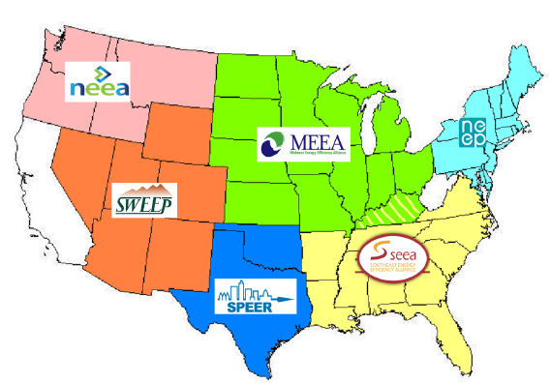
What is SPEER?
Member-based, non-profit organization with mission to increase adoption of energy efficient products, services, and technologies.
Newest regional energy efficiency organization (REEO)
Founded in 2011

Slide 3













































Members

Slide 4
The Smart Energy Roadmap
Follows the Update on Smart Energy in Texas (July 2014)
Roadmap circulated to approx. 100 reviewers including TDUs, REPs, third parties, DR providers, aggregators, brokers, and consultants, etc.
Texas is a leader. Texas can do much more. Roadmap suggests next steps.

Slide 5
Six Key Recommendations
Move SMT to ERCOT
Increase data consistency.
Count customers using data
No one can say with any certainty how many customers use their data.
ERCOT gathers data on time-of-use and peak rebate, but not pre-pay, usage alerts, etc.
Use smart meter data to verify savings
Efficiency from competitive services could contribute to Texas’ compliance with air quality standards.
Verification is difficult, but meters help.
Supported by many REPs, TDUs, and third parties in filings (Project 42786). Support dependent on details yet to be worked out.
Can be done in way that protects proprietary info.
Key questions about third party access and direct customer access remain.
Notes:
property owners, lenders, energy service companies, industry trade associations, local governmental authorities, and others

Slide 6
Recommendations, continued
Make it easier for customers to share data
Numerous third parties reported that sign up was so difficult that they gave up.
Federated access can be done safely and securely.
Educate consumers of smart energy’s potential
No money currently spent by utilities or PUCT.
Create better opportunities for loads in ERCOT market
Market continually evolves and improves
Leverage existing education (PowerToChoose, Power to Save, conservation alerts, etc...)
Meter data allows innovative new ways to enhance competition of the market, if load has a path to participate.
Notes:
property owners, lenders, energy service companies, industry trade associations, local governmental authorities, and others

Slide 7
Considerations for AMWG
AMWG Goal: “Evaluate, support, and contribute to the enhancement of the SMT functionality, usability and reporting (3rd Party access, HAN, ODR).”
Third parties reported that customer sign up was one of biggest impediment to usability.
Work to allow federated access while maintaining security.
Build efforts to count customers and companies using data to increase efficiency.
Upcoming workshops are a great step.

Slide 8
  To see the Roadmap:
  http://eepartnership.org/intelligent-energy-management/
  DLewin@EEPartnership.org
  512-279-0753
  www.eepartnership.org
  Thank you!

