Slide 1
MISUG Update to COPS
May 13, 2015

Slide 2
SCR775 – Indicative LMP Display
ERCOT presented mock-ups that had been discussed with DSWG
A layout and displayed time period were finalized
Implementation is currently slated for 6/26/2015
Drop-down menu changes display data
Table and “Help?” link formatting follow current display style sheets

Slide 3
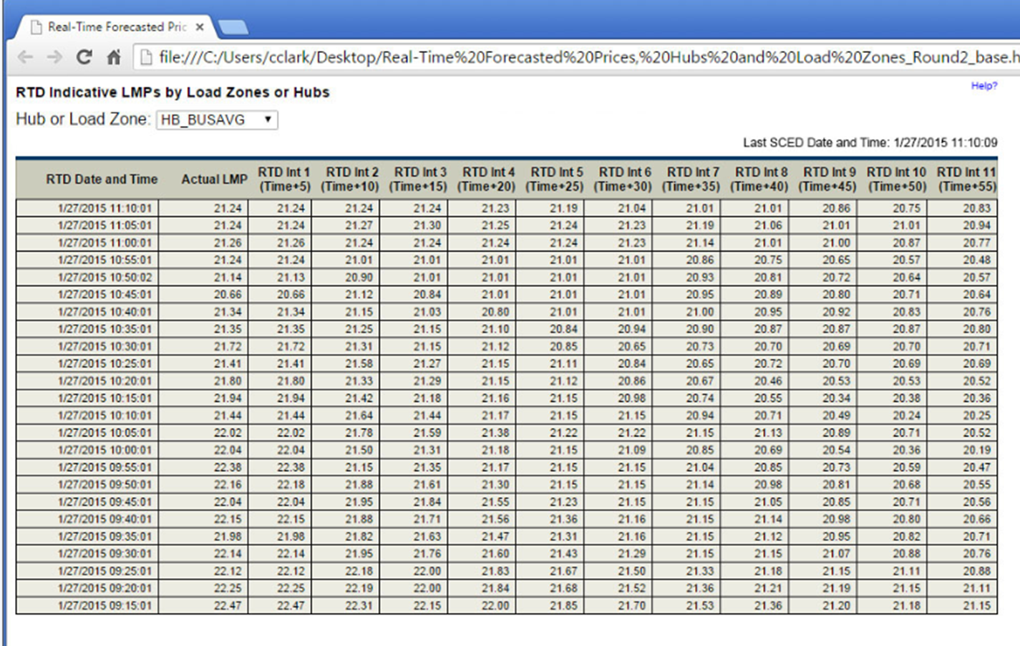
SCR775 – Indicative LMP Display

Slide 4
External Web Services (EWS) Modification Workshop II
Discussed options for providing notifications
Report ID level vs. Document ID level
JMS
Listener
Amazon S3
Streaming solution
Data protection is definitely a concern
Next Steps
ERCOT is working on a demo of a streaming solution that could be used for smaller sets of high-demand data, e.g., LMPs
ERCOT will send out a survey to solicit MP feedback on the best solution for the Market
Results to be tabulated and distributed in a future MISUG meeting
Based on feedback, ERCOT will begin defining a revised EWS interface
MISUG will be used as the means for communicating progress and gathering feedback

Slide 5
NOGRR084 – Daily Grid Operations Report
ERCOT is working with OWG/ROS to update gray-boxed language for NOGRR084
New NOGRR will propose changes to the existing NOGRR084 gray-boxed language
Next Steps
New IA will be created with new price tag

Slide 6
Reports to be Discontinued
MISUG previously reported ERCOT Manual Efforts & Market Report True-Up
15 reports have been recommended for discontinuation/decommissioning
NPRRs, LPRR, NOGRR were submitted to PRS to discontinue these reports
TAC approved, to be implemented: LPGRR054, NOGRR138
Board approved, to be implemented: NPRR654, NPRR655, NPRR657, NPRR661, NPRR659
Board approved, implemented: NPRR658

