Slide 1
Retail Market Overview
to PUCT and OPUC Staff
Retail Market Subcommittee Representatives
May 12, 2014

Slide 2
Agenda
1 | Market Participant Categories and Roles
2 | ERCOT Stakeholder Process
3 | ERCOT as Registration Agent
Break 10:30 - 10:45 a.m.
4 | Customer Enrollments (switching & moving)
5 | Switch Holds
6 | Inadvertent Gains
Lunch Noon – 1:30 p.m.
7 | Mass Transition to POLR
8 | Disconnect for Non-Pay
9 | LITE-UP Texas Low-Income Discount Program
Break 2:45 – 3 p.m.
10 | Meter Tampering
11 | Smart Meter Data: 15-min Interval vs. Monthly Data

Slide 3
Market Participants’
Roles and Responsibilities
2014 - Staff Training Presentation

Slide 4
Retail Electric Provider (REP)
PUCT Subst. Rule 25.5 Definition:
  A person that sells electric energy to Retail Customers in this state. A Retail Electric Provider may not own or operate generation assets.
Responsibilities:
  Negotiates contract(s) with Retail Customer(s), these contracts are generally based upon a variety of competitive services offered by the REP to allow their Customer’s additional Choice to meet their needs.
  Manages Retail Customer’s ESI ID(s), for example:
    Retail Customer’s primary contact for their electrical services such as:
      Switch Provider, Move-In and/or Move-Out Requests,
      Disconnects and Reconnects for Non-Payment,
      Usage and Billing Inquires.
  Provides TDSP(s) with Retail Customer’s Contact information via TX SET 814_PC for power outages and distribution/power line maintenance notifications.
  Makes Payment and/or may Dispute Invoices received from:
    ERCOT for Transmission and Generation services, and
    TDU(s) for ESI ID(s) Usage and Discretionary Service Charges where they are Rep of Record for the invoice period.
  Works with REP and TDU to resolve Inadvertent Gain (IAG) ESI ID(s) in a expedited manner once IAG ESI ID(s) are identified.
  When necessary, will collaborate with PUCT Staff and TDU to assist in resolving Retail Customer’s PUCT complaint.

Slide 5
Transmission and Distribution Service Provider (TDSP) or
Transmission and Delivery Utility (TDU)
PUCT Subst. Rule 25.5 Definition:
  A person or river authority that owns, or operates for compensation in this state equipment or facilities to transmit or distribute electricity, except for facilities necessary to interconnect a generation facility with the transmission or distribution network, a facility not dedicated to public use, or a facility otherwise excluded from the definition of "electric utility", in a qualifying power region certified under the Public Utility Regulatory Act (PURA) §39.152, but does not include a municipally owned utility or an electric cooperative. The TDU may be a single utility or may be separate transmission and distribution utilities.

Slide 6
Transmission and Distribution Service Provider (TDSP) or
Transmission and Delivery Utility (TDU)
Responsibilities:
  Provides usage, actual or estimated, to REP of Record and ERCOT for metered and unmetered premises that are located in TDU’s Service Territory.
    Metered premise(s ) usage is based upon subtracting current meter reading from previous meter reading (Monthly or Final Usage)
    Unmetered premise(s) usage based upon total device(s) kWh usage for the billing period
    Advanced Metering System (AMS) Meters- Total of 96 -15-Minute Interval Usage provided as Daily Consumption to ERCOT and SMT
  Executes Enrollments and Service Order Requests received by the TDU from the requesting Rep of Record, such as:
      Switch Provider, Move-In and/or Move-Out Requests,
      Disconnects and Reconnects for Non-Payment,
      Meter Test and Meter Re-Reads
      Payment Plan Switch Holds
  Invoices:
    REP of Record for ESI ID(s) Usage and Discretionary Service Charges where they are Rep of Record for the service period.

Slide 7
Transmission and Distribution Service Provider (TDSP) or
Transmission and Delivery Utility (TDU)
Responsibilities:
  Provides:
    TX SET Monthly/Final Usage transactions to ERCOT for Market Settlements and ERCOT in-turn forwards these same transactions to the REP of Record.
    Daily 15-Minute Interval Data for all AMS meters are sent to ERCOT for Settlements and also sent to Smart Meter Texas (SMT) for REP of Record daily downloads and Retail Customer’s reviews on the portal.
  Investigates:
    Power Outage(s) reported by Retail Customer or Rep of Record on behalf of Retail Customer along with making repairs to restore services where applicable.
    Tampering or Diversion of Electricity- which may result in TDU applying a Tampering Switch Hold on the ESI ID.
    Stopped Meters or Damaged meters will be replaced by TDU if applicable.
  Assists the Losing and Gaining REPs in resolving an Inadvertent Gain ESI ID once notified by either REP via the MarkeTrak system.
  When necessary, will collaborate with PUCT Staff and REP of Record to assist in resolving Retail Customer’s PUCT complaint.

Slide 8
Electric Reliability Council of Texas (ERCOT) aka “Registration Agent”
PUCT Subst. Rule 25.5 Definition:
  ERCOT: Refers to the independent organization and, in a geographic sense, refers to the area served by electric utilities, municipally owned utilities, and electric cooperatives that are not synchronously interconnected with electric utilities outside of the State of Texas.
  Registration Agent: Entity designated by the commission to administer registration and settlement, premise data, and other processes concerning a customer's choice of retail electric provider in the competitive electric market in Texas.

Slide 9
Electric Reliability Council of Texas (ERCOT) aka “Registration Agent”
Responsibilities:
  Manages the flow of electric power to 23 million Texas Customers - representing 85% of the state's electric load.
  As the Independent System Operator (ISO), ERCOT schedules power on an electric grid that connects 40,500 miles of transmission lines and more than 550 generation units
  Administers Retail Switching for approximately 6.7 million premises in competitive choice areas.
  Performs financial settlement for the competitive wholesale bulk-power market

Slide 10
Electric Reliability Council of Texas (ERCOT) aka “Registration Agent”
Responsibilities:
  Reliability is the Primary focus by:
    Matching generation with demand and
    Operating transmission system within established limits
  Capacity and Energy by:
    Dispatching Energy to follow System Demands,
    Ensuring sufficient Capacity is on-line to meet forecast demands.
  Congestion Management by:
    Keeping Transmission System operating within limits.
  Network Modeling by:
    Predicting how various actions may affect system grid.

Slide 11
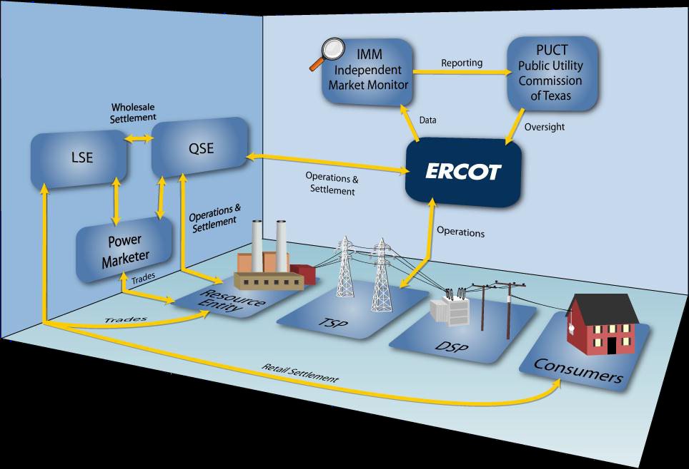
Electric Reliability Council of Texas (ERCOT) Market Design

Slide 12
Municipally Owned Utility (MOU) and Electric Cooperative (EC)
MOU – PUCT Subst. Rule 25.5 Definition:
  Any utility owned, operated, and controlled by a municipality or by a nonprofit corporation whose directors are appointed by one or more municipalities.
EC – PUCT Subst. Rule 25.5 Definition:
  (A) a corporation organized under the Texas Utilities Code, Chapter 161 or a predecessor statute to Chapter 161 and operating under that chapter;
  (B) a corporation organized as an electric cooperative in a state other than Texas that has obtained a certificate of authority to conduct affairs in the State of Texas; or
  (C) a successor to an electric cooperative created before June 1, 1999, in accordance with a conversion plan approved by a vote of the members of the electric cooperative, regardless of whether the successor later purchases, acquires, merges with, or consolidates with other electric cooperatives.

Slide 13
Municipally Owned Utility (MOU)
Electric Cooperative (EC)
  Responsibilities (Very similar to TDSP/TDUs):
  Provides Monthly Usage to ERCOT for Market Settlements and REP of Record for their invoicing, where applicable, for metered and unmetered premises.
  Executes Enrollments and Service Order Requests received from requesting REP of Record.
    Switch Provider, Move-In and/or Move-Out Requests,
    Disconnects and Reconnects for Non-Payment,
    Meter Test and Meter Re-Reads
  Investigates:
    Power Outage(s) and makes repairs where applicable,
    Stopped and/or damaged meters and replaces if applicable
    Tampering/Diversion
  Assists the Losing and Gaining REP in resolving an Inadvertent Gain ESI ID once notified by either REP via the MarkeTrak system.
  When necessary, will collaborate with PUCT Staff and REP of Record to assist in resolving Retail Customer’s PUCT complaint

Slide 14
Municipally Owned Utility (MOU)
Electric Cooperative (EC)
Responsibilities (Differences from TDSP/TDUs):
  Maintains Membership ID Account Number that positively identifies the end-use Retail Customer to the MOU/EC
  Invoices:
    MOU and REP of Record may choose to provide:
      Dual Billing where each party bills the customer for its portion of their services and charges, or
      Consolidated Billing where the CR invoices the Retail Customer, or
      Consolidated Billing where the MOU/EC invoices the Retail Customer.
  Shares Retail Customer’s Name and Contact Information with REP of Record.
  Disconnect for Non-Payment and Reconnect for Non-Payment
    In the event of Dual Billing a MOU/EC may Disconnect Retail Customer’s premise for non-payment of their electric services and discretionary charges.
    In the event of a Disconnect for Non-Payment MOU/EC will also Reconnect for Non-Payment following MOU/EC’s receipt of delinquent charges.

Slide 15
Certified Market Participants at ERCOT
Certified REPs/CRs: Total of 173
Certified TDUs/TDSPs –Total of 6
  American Electric Power (AEP)
  CenterPoint Energy (CNP)
  Oncor
  Sharyland McAllen
  Sharyland Utilities (SU)
  Texas New Mexico Power (TNMP)
Certified MOU/EC – Total of 1
  Nueces Electric Cooperative

Slide 16
Aggregator or Broker
PUCT Subst. Rule 25.5 Definition:
  A person joining two or more customers, other than municipalities and political subdivision corporations, into a single purchasing unit to negotiate the purchase of electricity from retail electric providers. Aggregators may not sell or take title to electricity. Retail electric providers are not aggregators.
Responsibilities:
  Shall register with the Public Utility Commission of Texas (commission) pursuant to PUCT Subst. Rule 25.111 “Registration of Aggregators”
  Joins customers together as a single purchasing unit and negotiates on their behalf for the purchase of electricity service in Texas
  Buyer's agent for customer groups, may not be affiliated with a REP or other seller's agent representing the REP.

Slide 17

Retail Customer(s)
PUCT Subst. Rule 25.5 Definition:
  The separately metered end-use customer who purchases and ultimately consumes electricity.
  Responsibilities as outlined throughout:
    “Division 2. Transmission and Distribution Applicable to All Electric Utilities” and
    “Subchapter R - Customer Protection Rules for Retail Electric Service”
  It Is YOU!!!!!!!!

Slide 18





TDSPs/TDU/MOU/EC own and maintain the distribution lines and meters.
The TDSP/TDU’s are paid by the REP of Record (ROR) for their Retail Customer’s electric consumption and discretionary service charges associated to the premise.
MOU/EC payment arrangements may be different depending upon REP of Record and MOU/EC Billing Agreement(s)
After Deregulation: Several Market Participants
Retail
Customer
Retail Electric Provider
Retail Customers’ have their Choice of over 170 certified Retail Electric Providers (REPs) in the Texas Market
Generation facilities can be owned by Qualified Scheduling (QSEs) or Load Serving Entities (LSEs)

Slide 19
QUESTIONS

Slide 20
Stakeholder Process

Slide 21
ERCOT Stakeholder Process
Stakeholder Structure
Revision Requests and System Change Requests
  Change process flow

Slide 22
Stakeholder Structure

Slide 23
ERCOT Board Of Directors
ERCOT is governed by a Board of Directors made up of representatives from each of the Market Segments, five Unaffiliated Directors, the ERCOT Chief Executive Officer (ERCOT CEO) and the Chair of the Public Utility Commission of Texas (PUCT).
The ERCOT Board of Directors
  Selects ERCOT's CEO.
  Oversees ERCOT operations by setting overall goals and policy direction.
  Approves the organization’s budget.
  Reviews all PRRs, NPRRs, and SCRs as well as any market guide revision requests that have an impact on ERCOT systems or staffing.

Slide 24
Technical Advisory Committee
The Technical Advisory Committee (TAC), with the assistance of the TAC Subcommittees, Working Groups and Task Forces:
  Makes recommendations to the ERCOT Board regarding ERCOT policies and procedures.
  Makes and utilizes such studies or plans as it deems appropriate to accomplish the purposes of ERCOT, the duties of its Subcommittees and the policies of the ERCOT Board.
  Reviews all NPRRs, SCRs, market guide revision requests, and Other Binding Documents.
  Sets the priority of projects approved through the NPRR, SCR and market guide revision processes.

Slide 25
TAC Subcommittees Overview
TAC Subcommittees make recommendations to TAC as they deem appropriate or as required by TAC and perform other duties as directed by TAC.
List of TAC Subcommittees:
  Retail Market Subcommittee (RMS)
  Wholesale Market Subcommittee (WMS)
  Reliability and Operations Subcommittee (ROS)
  Commercial Operations Subcommittee (COPS)
  Protocol Revisions Subcommittee (PRS)

Slide 26
Working Groups & Task Forces
The ERCOT Board, TAC, and each TAC Subcommittee may form Working Groups and Task Forces to assist in carrying out responsibilities.
Working Groups and Task Forces
  Report planned activities or projects and their results to the governing body for review.
  The duration and activities of the Working Groups and Task Forces are limited to tasks assigned by the governing body.
  Working Groups and Task Forces are not voting bodies. The chairs of these bodies must report any recommendations to their respective governing body, including any minority positions.

Slide 27
Retail Market Subcommittee
Forum for issue resolution in regards to retail market matters directly affecting ERCOT and ERCOT Protocols
Monitors PUCT rulings that apply to the retail market and ensures that PUCT requirements are reflected in the Retail Market Guide, Protocols, and Texas Standard Electronic Transaction
RMS Working Groups:
  Advanced Metering Working Group (AMWG)
  Texas Standard Electronic Transaction (Texas SET WG)
  Texas Data Transport (TDTWG)
RMS Task Forces:
  MarkeTrak (MTTF)
  Sharyland Transition Task Force (STTF)

Slide 28
Wholesale Market Subcommittee
Reviews issues related to the operation of the wholesale market in the ERCOT region and makes recommendations for improvement.
Monitors PUCT rulings as they apply to wholesale market.
Provides input into the methodology for determining competitive constraints, changes to ancillary services (AS) and the evaluation of resource adequacy in the ERCOT region
Monitors the AS market operations and management of system congestion.

Slide 29
Reliability & Operations Subcommittee
Develops, reviews and maintains Operating Guides and planning criteria.
Reviews ERCOT reports and procedures related to the reliable operation of the ERCOT System, including:
  Planning assessment
  Blackout restoration procedures
  Coordination of protective relay settings
  Operational communication facilities
  Operating reserve obligations
  Emergency operations
  Abnormal system conditions
  Transmission interconnections to generation
  Coordination of Outage schedules
Reviews PRRs as needed and performs Protocol required reviews of Ancillary Service provisions and commercially significant constraints.

Slide 30
Commercial Operations Subcommittee
Addresses the processes through which ERCOT market data is translated into financial settlements.
Includes the application of load profiles, data aggregation, data extract variances; congestion revenue rights settlements; QSE settlements; invoicing; and dispute resolution.
Integrates the retail variance and wholesale market settlements processes, including dispute resolution.
Addresses the settlements calendar; settlement-related performance metrics and tracking; Market Participant data needs for shadow settlements; and the market's overall needs for data extracts, delivery and presentation.

Slide 31
Protocol Revisions Subcommittee
Responsible for reviewing and recommending action on NPRRs.
PRS reviews each NPRR and accompanying comments and may make recommended language changes when deemed necessary.
PRS forwards its recommendations to TAC.

Slide 32
Protocol, Guide, and System Change Request Process
The Nodal Protocol and System Change Request approval and prioritization processes are defined in Section 21 of the Protocols:
Nodal Protocol Revision Request
(NPRR)
30 Day
Impact Analysis Period
5 Business Days
Market Subcommittee
Language Consideration
(PRS, ROS, WMS, RMS, etc.)
PRS
Impact Analysis Review
&
Prioritization
TAC
Board
PUCT
(approved unless appealed)
Project Priority List (PPL)
System Change Request
(SCR)
ERCOT
Impact Analysis
Market Rules Processing
Guide Revision Request
(xGRR)
14 Day Comment Period
This process allows stakeholders and ERCOT staff to work together to identify cost-effective and efficient solutions.

Slide 33
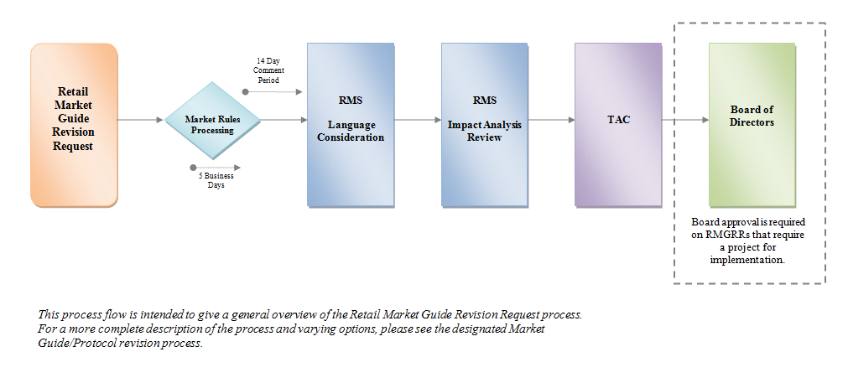
Retail Market Guide Revision Request Process

Slide 34
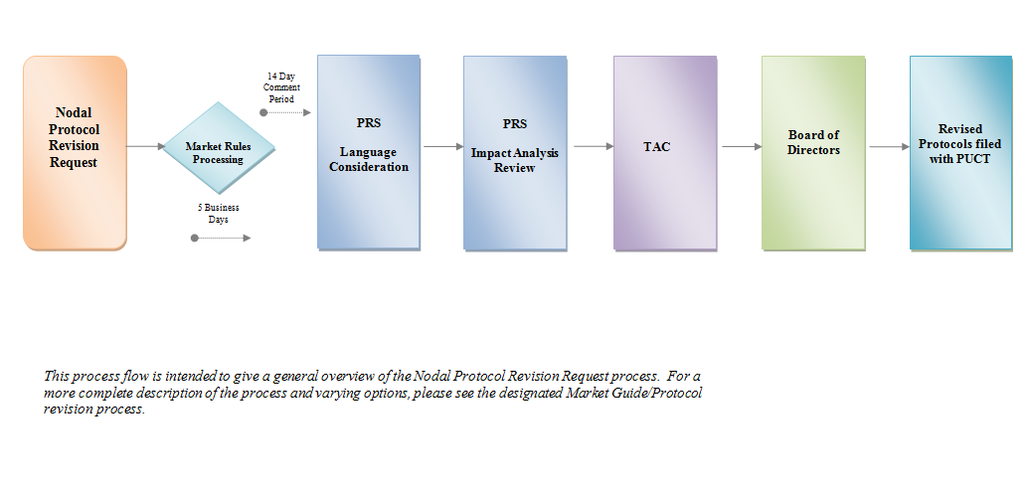
Protocol Revision Request Process

Slide 35
ERCOT as the Registration Agent

Slide 36
Core Retail Functions
The Texas Legislature restructured the Texas electric market in 1999 by unbundling the investor-owned utilities and creating retail customer choice in those areas.
ERCOT assigned four primary responsibilities:
System reliability – planning and operations
Open access to transmission
Retail switching process for customer choice
Wholesale market settlement for electricity production and delivery.

Slide 37
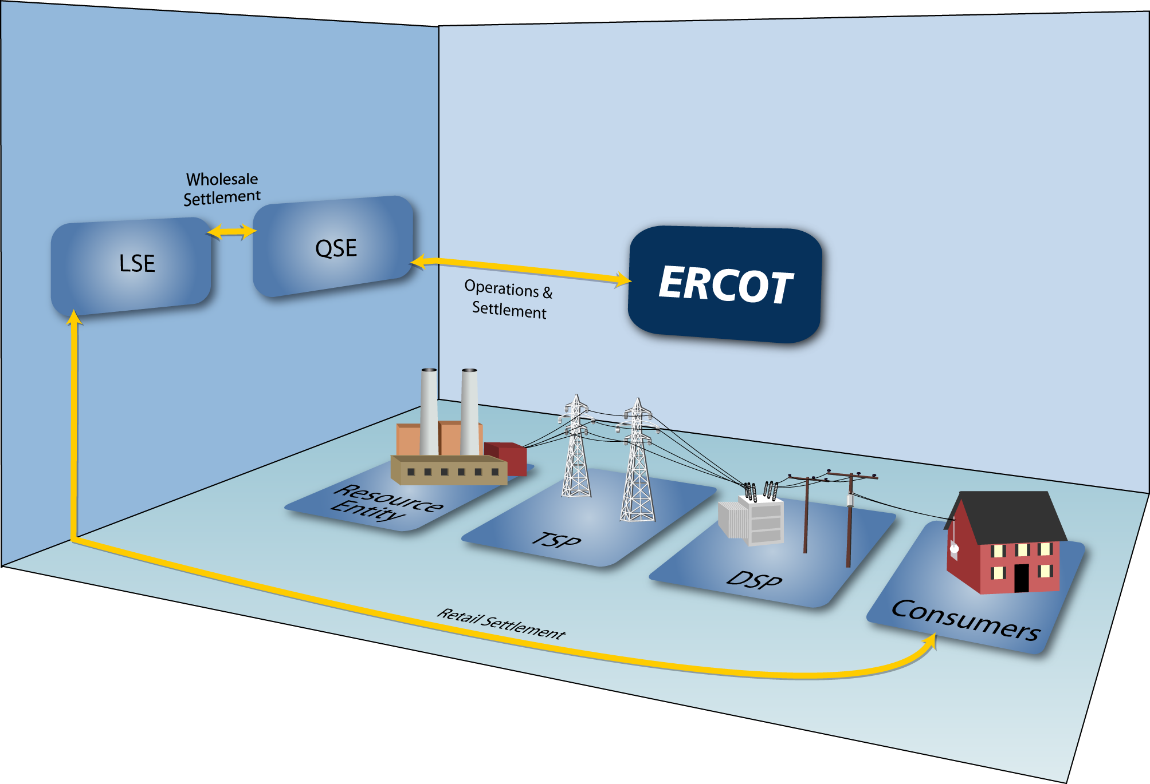
Overview of Retail Market Participants
Retail Transactions
Retail Transactions
Point to Point Retail Transactions
Billing / Customer Service

Slide 38
ERCOT’s Role in the Retail Market
Maintains the Centralized Registration Database
Serves as the transaction clearing house for retail transactions
    Switches
    Move-ins
    Move-outs
    Maintain ESIID
    POLR transitions
    Continuous service agreements
Compiles the information on market metrics
Addresses data discrepancies and dispute resolutions
Acts as Administrator for Retail Qualification and Testing

Slide 39
ERCOT’s Role in the Retail Market
Protocols and Guides:
ERCOT ensures Texas deregulated retail market processes are carried out according to ERCOT Protocols
ERCOT helps Market Participants understand the implementation of the Protocols, the Retail Market Guides, and the PUC rules
ERCOT Protocols and Guides are established, revised, and approved by market participants through the stakeholder process and ultimately approved by the ERCOT Board of Directors
Key protocol sections for Retail are 15, 19 & 24

Slide 40
Texas Standard Electronic Transaction (Texas SET)
‘…analyzes the need for new electronic transactions or modifications to existing electronic transactions based upon changes that occur within the retail electric market that affect EDI (electronic data interchange) transaction processing.’

Slide 41
Texas SET – Switch

Slide 42
Texas SET – Switch Requirements
Transaction | Business Process | From | To | Timing/ Business Rules | Example | Protocol Reference Section
814_01, Switch Request | Switch | CR | ERCOT | N/A |  | 15.1.1, Submission of a Switch Request
814_02, Switch Reject Response | Switch | ERCOT | CR | One Retail Business Hour | 814_01 received by ERCOT on Monday @ 1500 = Hour 0 | 15.1.1.8, Rejection of Switch Request
 |  |  |  |  | 814_02 sent to CR by Monday @ 1600 = Hour 1
814_03, Enrollment Notification Request | Switch | ERCOT | TDSP | One Retail Business Hour | 814_01 received by ERCOT on Monday @ 1500 = Hour 0 | 15.1.1.3, Switch Enrollment Notification Request to TDSP
 |  |  |  |  | 814_03 sent to TDSP by Monday @ 1600 = Hour 1

Slide 43
Performance Measures – Switch Compliance
There were 286,976 814_01 (Switch) transactions in the first quarter of 2014, which were 17,070 more than the fourth quarter of 2013.
814_02 (Switch Reject) transactions were sent by ERCOT 100% within Protocol in the first quarter of 2014. This is compared to 100% reported in the fourth quarter of 2013.
814_03 (Switch Request to TDU) transactions were sent by ERCOT 100% within Protocol in the first quarter of 2014. This is compared to 100% reported in the fourth quarter of 2013.

Slide 44
Market Participant Certification
‘Pursuant to PUCT rules, any entity intending to participate in the Texas Market must successfully certify their retail commercial applications through Texas Retail Market testing and maintain that certification in accordance with TX SET Version upgrades.’

Slide 45
(As provided to Retail Market Subcommittee: 4/1/2014)
Market Participant Certification
Flight 0214 Summary
Flight 0214 is currently 96.93% complete
13 New CRs (includes 9 Additional DUNS) are testing
Existing CRs: 15 CRs are testing with Sharyland, and 2 CRs are testing for a bank change
All Connectivity and Penny tests for the original CRs including the child DUNS that needed to test with Sharyland completed by 2/20/2014 (Day 4 of the flight)
5 Existing CRs testing late entry (Emergency service provider change)
1 New CR withdrew from Flight 0214
4153 total tasks are scheduled

Slide 46
MarkeTrak
‘The MarkeTrak tool is a Web-based database application used to track, manage and store data utilized by ERCOT and the market participants. This tool is the supported method to track ERCOT retail market issue management and data discrepancies in the market’

Slide 47
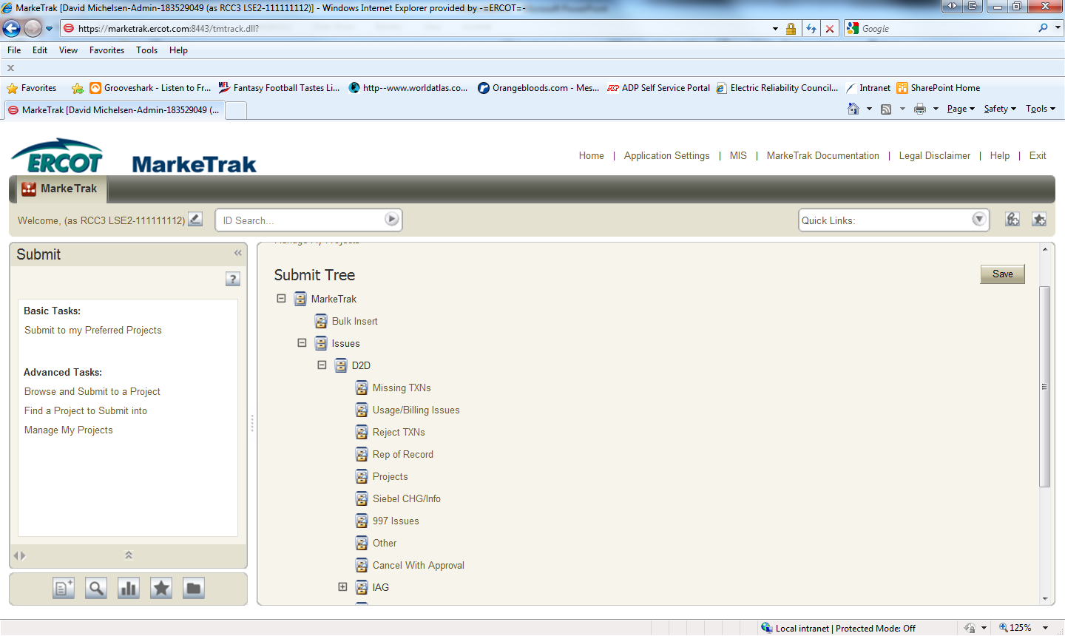
MarkeTrak
Issue Submissions – Q1 2014
CR: 46,630
TDSP : 2,117
ERCOT: 255

Slide 48
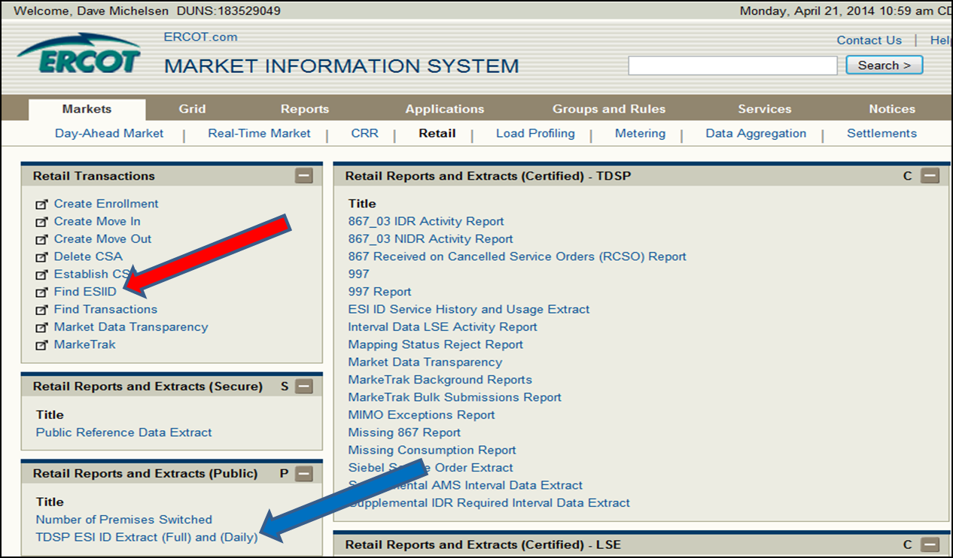
Retail – Market Information System (MIS)

Slide 49
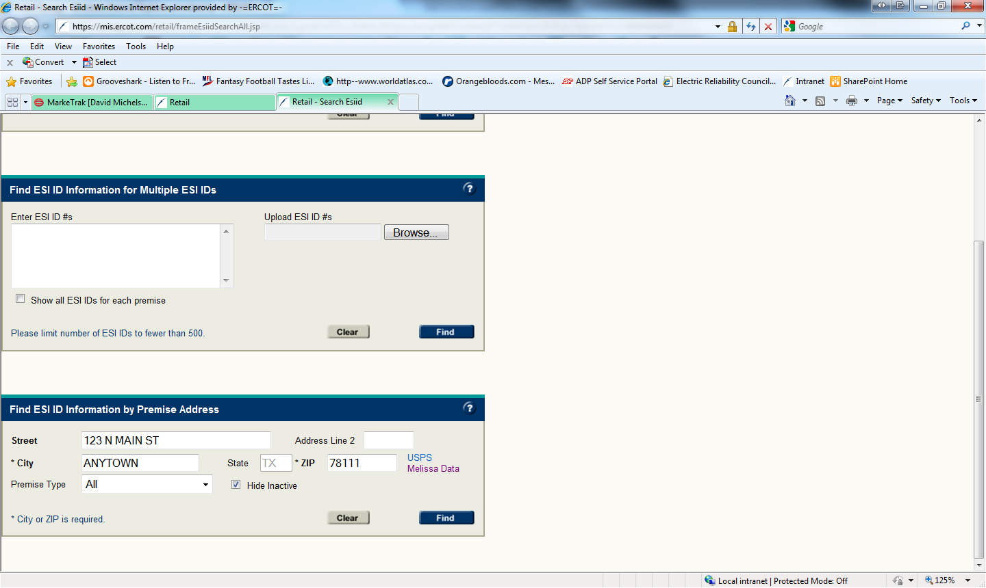
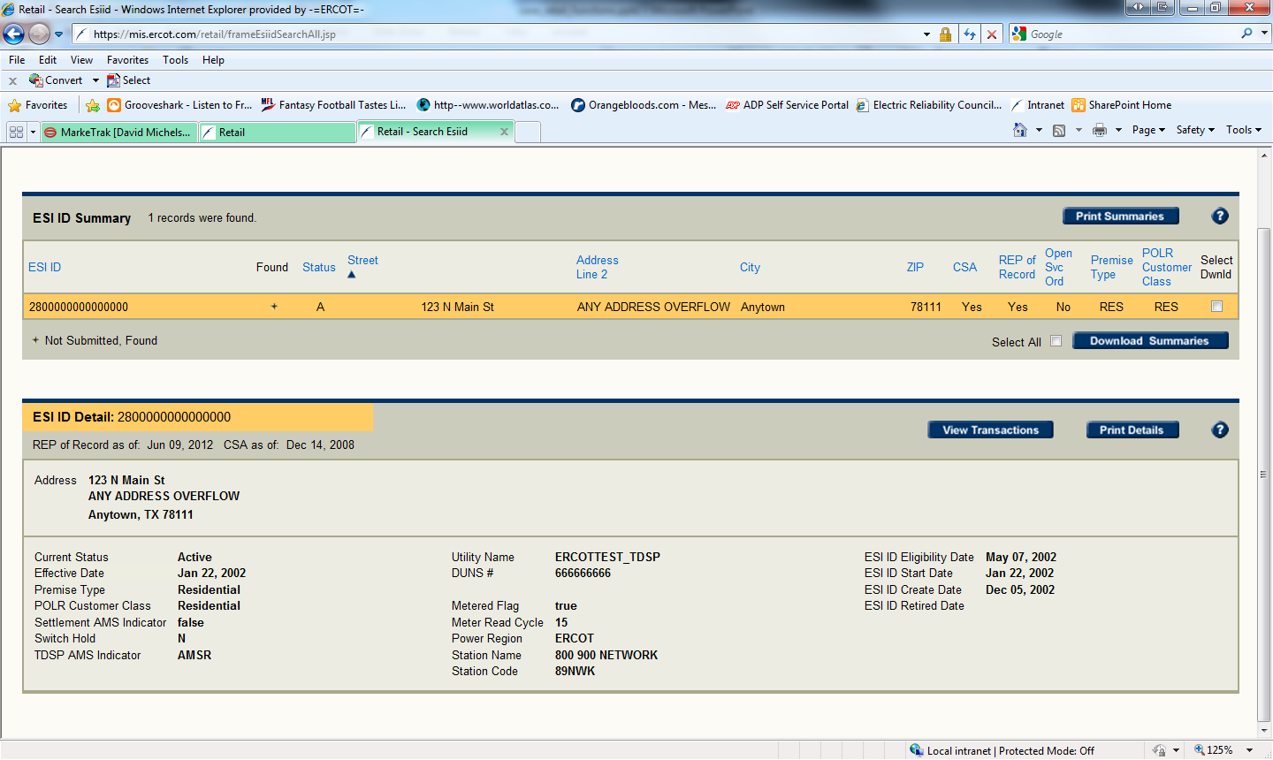
Retail MIS – Find ESIID

Slide 50
Retail MIS – TDSP ESIID Extract
General Report Information
The TDSP ESI ID Report provides information that allows Market Participants to verify the ESI ID and/or its characteristics by TDSP area for a Service Delivery Point (SDP) using the service address or ESI ID.
Column Name | Column Name
ESI ID | POWER_REGION
ADDRESS | STATIONCODE
ADDRESS_OVERFLOW | STATIONNAME
CITY | METERED
STATE | OPEN_SERVICE_ORDERS
ZIPCODE | POLR_CUSTOMER_CLASS
DUNS | SETTLEMENT_AMS_INDICATOR
METER_READ_CYCLE | TDSP_AMS_INDICATOR
STATUS | SWITCH_HOLD_INDICTOR
PREMISE_TYPE

Slide 51
Enrollments – Switching & Moving
May 8, 2014

Slide 52
Customer Choices
The focus will be on Competitive Retailer’s (CR)
  Non Opt-InEntities (NOIE) ie: Municipals and Co-ops not included
Retail Electric Providers (REPs)
  ERCOT lists 173 Certified Competitive Retailers
  Some nuances – some REPs have a narrow focus – but the point is…..Customers Have Options
Products
  There are numerous product options available
    Month-to-Month; fixed term; fixed price; market-based price; cash back; thermostats
    AMS Meters allowed Time of Use (TOU) products: Pre-pay; Free Nights; Free Saturdays; Free Weekends, etc.
Information
  Many REPs = Multiple Options
  Retail shopping websites, including Power to Choose, are available for customers to compare some REP product/plan offers

Slide 53
Behind the Scene……
ERCOT maintains a registration database of all metered and unmetered Electric Service Identifier (ESI IDs) in Texas for customer choice
ERCOT recovers the cost of the registration database through its System Administration Fee (SAF)
All customer registration processes are to be conducted using the appropriate Texas Standard Electronic Transactions (TX SET)
Electronic Data Interchange (EDI) transactions developed using ANSI ASC X12 standards (American National Standards Institute Accredited Standards Committee)

Slide 54
Common Transactions
ERCOT will reject any initiating transaction due to date reasonableness if the requested implementation date is of more than ninety (90) days in the future or two hundred seventy (270) calendar days in the past.
Initiating transactions are:
  814_01 - Enrollment Request
  814_16 - Move-In Request
  814_24 - Move-Out Request
A “Switch Request” is a request submitted by a CR on behalf of a Customer to switch service from that Customer’s (same legal entity) current CR to the requesting CR
The CR shall submit a Switch Request to ERCOT using the 814_01, Enrollment Request transaction
The First Available Switch Date (FASD) is the day received by ERCOT unless received on a Sunday or an ERCOT holiday. If received on a Sunday or an ERCOT holiday, the FASD will be calculated as the next day that is not a Sunday or an ERCOT holiday

Slide 55
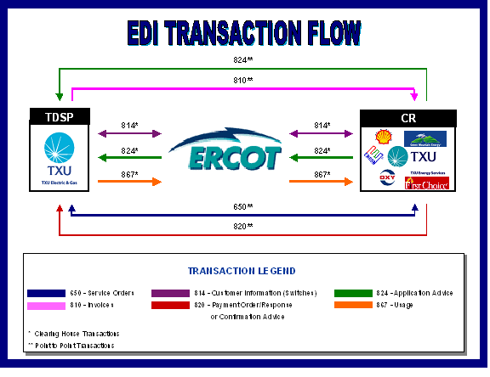
Overall Transaction Flow
AEP
CenterPoint
Oncor
Sharyland
TNMP
TXU Energy
Reliant
Amigo Energy
Green Mountain

Slide 56
Decoding the Transactions
Transaction Type | Use
814’s – 27 Different Types | MVI; MVO; Switch; Loss; Maintenance
810’s – TDU Invoice | TDU Bills the REP for Delivery Charges
867’s – Premise Usage | Initial Meter Read; Historical / Monthly Usage
820’s – Payments | REP Payments to the TDU’s
824’s – Reject Notification | Notice of Invoice / Usage Rejection
650’s – Service Order Requests | Switch Hold Removal; Premise Investigation; Outage Notification; Disconnects / Reconnects for Non-Pay

Slide 57
Customer Move-In (MVI)
Representative Example
REP
814_16
ERCOT
814_03
TDU
814_05
814_04
867_02
867_02
867_04
867_04
There are 16 Transactions to Complete a Move-In

Slide 58
Customer Switch
Representative Example
814_01
814_03
REP
ERCOT
TDU
814_05
814_04
867_02
867_02
867_04
867_04
867_03F
814_06
867_03F
REP #2

Slide 59
Common Transaction Timelines
Enrollment type Initiating Transaction | AMSR | AMSM |  | Non-AMS
 |  | Energized | De-Energized
MVI 814_16 | Same Day | 2 Business Days | 2 Business Days | 2 Business Days
Standard Switch 814_01 | Same Day | Same Day | N/A | Within Next 4 Business Days
Self Selected Switch 814-01 | Same Day | Same Day | N/A | At Least 2 Business Days
Notable Exceptions:
After 5 p.m.
New construction = 10 days
New meter sets
Meter communication failures
Sundays & holidays

Slide 60
Switch-holds
Eric Blakey
Just Energy

Slide 61
Switch-Hold
A “switch-hold” prevents a switch or move-in from being completed, and can be applied for one of the following reasons:
If the TDSP determines that electric meter tampering or theft of electric service has occurred at the premise.
If a customer enters into a deferred payment plan with their REP, and part of the agreement allows a switch-hold on the account until the terms of the deferred payment plan are satisfied.

Slide 62
Switch-Hold - Tampering
The TDSP must place a switch-hold prior to invoicing the current REP for any back-billed TDSP charges for meter tampering or meter repair/restoration charges.
The switch-hold shall remain in effect until:
  the REP of record notifies the TDSP to remove the switch-hold once satisfactory payment for the tampering charges is received from the customer;
  a move-out; or
  a mass transition.
The TDSP maintains a secure list of ESI IDs with switch-holds that REPs may access. The list shall not include any customer information other than the ESI ID and date the switch-hold was placed.
  TDSPs must post the lists daily by 9:00 AM so REPs can upload them into their system, to know if applicants have a switch-hold or not.
The customer will be notified by the TDSP that a switch-hold has been applied, usually via door hanger or possibly by letter.

Slide 63
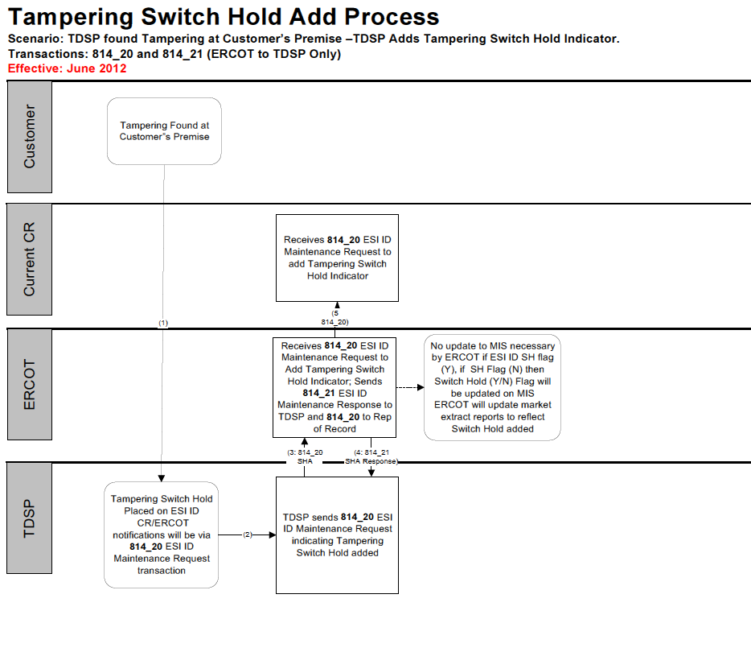

Slide 64
Switch-Hold – Level or Average Plans
Can be applied on level or average payment plans if the customer is delinquent when it is established.
  Prior to the customer’s agreement to the plan, the REP must provide an explanation of the switch-hold to the customer, saying:
    “If you enter into this plan concerning your past due amount, we will put a switch-hold on your account. A switch-hold means that you will not be able to buy electricity from other companies until you pay the total deferred balance. If we put a switch-hold on your account, it will be removed after your deferred balance is paid and processed. While a switch-hold applies, if you are disconnected for not paying, you will need to pay {us or company name}, to get your electricity turned back on.”
The switch-hold must be removed when:
  The customer’s deferred balance is zero or in an over-payment status.
  The customer satisfies the terms of any deferred delinquent amount and has paid bills for 12 consecutive billings without having been disconnected and without having more than one late payment.

Slide 65
Switch-Hold – Deferred Payment Plans
Can be applied on all deferred payment plans (DPP).
  Prior to the customer’s agreement to the plan, the REP must provide an explanation of the switch-hold, similar to level/average pay plans (i.e., “If you enter into this plan concerning your past due amount, we will put a switch-hold on your account…”).
DPPs must be offered in the following situations:
  Upon request, for bills that become due during an extreme weather emergency.
  Upon request, for customers located in an area declared to be in a state of disaster.
  If a customer has been under-billed for more than $50.
Must be removed after the customer pays the deferred balance owed to the REP.
  The REP must notify the customer when they have satisfied the obligation, and that the switch-hold is being removed.

Slide 66
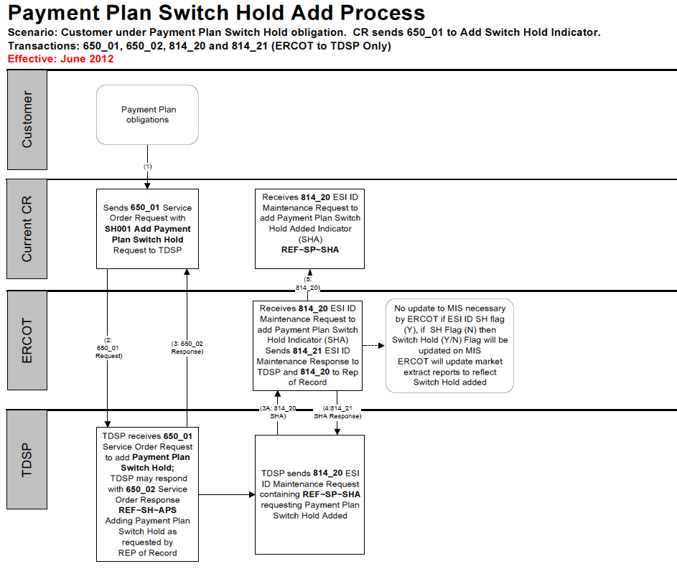

Slide 67
Switch-Hold – Removal for Move-ins
For new applicants moving in, the applicant must provide a signed statement that they are a new occupant of the premise not associated with the preceding occupant, and “adequate documentation”. Adequate documentation includes one of the following:
  copy of a signed lease,
  affidavit of a landlord,
  closing documents,
  a certificate of occupancy,
  a utility bill dated within the past two months from a different premise,
  other comparable documentation in the name of the retail applicant.
The new REP submits this information to the TDSP and current REP via a MarkeTrak. Upon receipt, the current REP can provide information that shows the applicant is not a new customer.
The TDSP reviews the documentation provided and determines whether to lift the switch-hold.

Slide 68
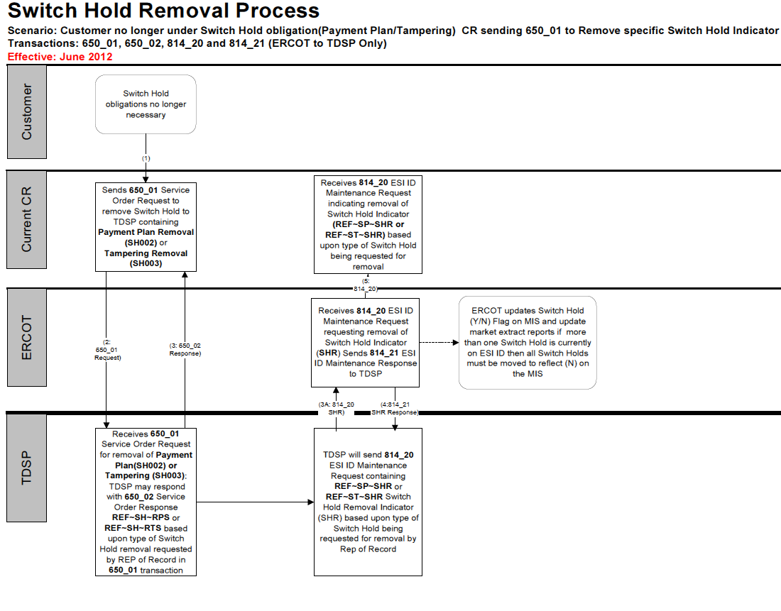

Slide 69
Questions?

Slide 70
Inadvertent Switch
Unauthorized Change of Retail Electric Provider

Slide 71
What is an Inadvertent Switch (IAS)?
Commonly referred to as either an Inadvertent Gain (IAG) or Inadvertent Loss (IAL), an Inadvertent Switch occurs when a customer is switched to a REP that is different than their expected REP of choice.
When resolving IAS issues, the ultimate goal is to return the Customer to their REP of choice in a quick and efficient manner with minimal inconvenience to the Customer.

Slide 72
How does an IAS occur?
IAS situations can occur under various circumstances. Here are a two of the most common:
  Incorrect information provided by Customer during enrollment
    Service Address or ESI ID
  Incorrect information entered by the REP during enrollment

Slide 73
Who does an IAS affect?
Five different entities are affected for any given IAS scenario: Customer, Gaining REP, Losing REP, TDU, and ERCOT (registration agent).
Gaining REP – Switching REP who inadvertently gained the customer
Losing REP – Original REP who lost the customer

Slide 74
Resolution Days:
Valid Inadvertent/Rescission Issues by Closed Date

Slide 75
Issue Counts:
Valid Inadvertent Issues by Month

Slide 76
Inadvertent/Rescission Issues:
Percentage of Enrollments

Slide 77
How is an IAS resolved?
As soon as a REP discovers or is notified of a potential inadvertent gain (either Gaining or Losing REP), the REP shall promptly investigate the matter.
If the Gaining REP determines that the gain was unauthorized or in error, the Gaining REP shall promptly submit an Inadvertent Gaining issue in MarkeTrak (MT) and assign the issue to the Losing REP.
** The Gaining REP shall not submit a Move Out or Disconnect for Non-Pay on an ESI ID that was gained in error. Doing so will abort/delay the IAS process. **

Slide 78
How is an IAS resolved?
Once the IAS issue has been agreed to by the Losing REP and Gaining REP, the two sides should work together to negotiate a reinstatement date for the Losing REP to take back the ESI ID.
Once agreed upon, the reinstatement date should be clearly noted in the MarkeTrak issue.

Slide 79
Reinstatement Date Options
Option A: “Date of Loss + 1” - the Losing REP takes the customer back to one day beyond the date of loss. Losing REP will send backdated Move In with the agreed upon reinstatement date.
Date of loss = Date the Customer started with the Gaining REP.
Option B: Any subsequent date chosen by the Losing REP, no greater than ten (10) days from the date the MT issue was submitted, for which the Losing REP had authorization to serve the Customer.
This is commonly referred to as “regaining on a forward going basis”.

Slide 80
TDU’s Role
As soon as a TDU is assigned the IAS MarkeTrak issue, the TDU acknowledges receipt of the issue by placing comments in the issue.
Once both REPs have agreed to terms, the TDU will then help facilitate the final steps of resolution by completing the Move In to return the customer to their REP of choice, and billing the appropriate charges to the REPs involved.

Slide 81
Charges Associated with Returning the Customer
Once the IAS MT issue has been agreed to, the affected REPs and TDU shall take all actions necessary to correctly bill all charges so that the REP that served the ESI ID without proper authorization shall pay all transmission, distribution and discretionary charges associated with returning the ESI ID to the Losing REP or REP of choice.

Slide 82
Third Party Gaining Intervention
In the event that a third party REP legitimately acquires the ESI ID while the IAS MarkeTrak issue is being worked, the IAS issue will be considered closed and the TDU shall respond with this statement:
“Gaining CR is no longer the REP of record or scheduled to be the REP of record for this ESI ID. A third party has gained or is in the process of gaining the account. The TDSP no longer considers this an inadvertent issue.”

Slide 83
Billing the Customer Due to IAS
Once the customer is back with their REP of choice…
Within five (5) days, the Gaining REP shall refund all charges paid by the customer for the time period for which the Losing REP ultimately bills the customer after the customer is returned to the Losing REP or REP of choice.
The Original/Losing REP has the right to bill the customer at the price disclosed in its Terms of Service (TOS) from the date the customer is returned; or any prior date chosen by the Original/Losing REP for which the Original/Losing REP had the authorization to serve the customer.

Slide 84
TDU Billing (to REPs)
After the Customer has been returned…
The TDU shall invoice all transmission, distribution and discretionary charges associated with returning the Customer to the Gaining REP.
The TDU is also responsible for invoicing all non-bypassable TDU charges to the REPs in accordance with the periods that they each served the Customer.

Slide 85
Provider of Last Resort (POLR)
§25.43

Slide 86
POLR Rule Overview
Purpose: to ensure continuity of service when the customer’s REP fails to provide service.
The Basics:
  There are 4 POLR customer classes: Residential, Small Non-Res. (<50 kW), Medium Non- Res. (50 kW <1000 kW) and Large Non-Res. (≥1000 kW).
  There are 28 POLR areas, 7 TDUs (AEP TCC, AEP TNC, CenterPoint, Oncor, Sharyland, Sharyland-McAllen and TNMP) x 4 POLR customer classes.
  A REP is eligible to serve as a POLR if the REP has been in business in Texas more than 18 months, is in good standing with the Commission, serves the POLR customer class in the TDU, and surpasses the minimum threshold for load and ESI ID count established by the commission. (This calculation roughly results in REPs with ~1% market share in a given POLR area being eligible to provide POLR service.)
  There are two types of POLR providers: Volunteer REPs and Large Service Providers (aka Non-Volunteer POLRs)
  The number of LSPs per area is capped at the 15 largest eligible REPs by annual MWh sales by area/class.
  Each POLR event is treated as a separate event.

Slide 87
POLR Rule Overview
During a mass transition
ERCOT segments and assigns ESI IDs to REPs.
  A VREP will not be assigned more ESI IDs than it has indicated it is willing to serve.
  If the number of ESI IDs is less than the total that the VREPs indicated that they are willing to serve, each VREP shall be assigned a proportionate number of ESI IDs.
  After VREPs have reached their ESI ID threshold all remaining ESI IDs are distributed to the LSP in a weighted manner based on the market share calculation made at the time of LSP designation.
  If a REP is both a VREP and LSP in the same area/class the REP is obligated to serve all the ESI IDs assigned to it.
  ERCOT assigns ESI IDs randomly.
TDUs process enrollments, provide meter reads, and historical usage.
REPs become the “REP of Record” for market settlement, process enrollments, fulfill customers with appropriate documents and begin serving assigned customers.
  The POLR is financially responsible for all costs of providing electricity to customers for as long as it is the REP of Record.

Slide 88
Mass Transition Process Flow
Daily Market Status Call
  867_02, Historical Usage
  814_04s, Enrollment Notification Responses, from TDSP to ERCOT
  814_14s, Drop Enrollment Requests, from ERCOT to POLR CRs
  Customer billing information sent by ERCOT
  CBCI file sent by ERCOT
Initial Market Call
Mass Transition process:
  ESI ID allocation
  814_03, Enrollment Notification Request, flow requesting second calendar day
  ESI ID lists for POLRs/TDSPs generated
Default confirmed and Notification e-mail sent
Daily Market Status Call
  TDSP sends to ERCOT – final 867_03, Monthly or Final Usage, will include out-of-cycle meter read charge
  867_04, Initial Meter Read, ERCOT sends to POLR CRs
Transition Date
  Daily market status call
  TDSP performs meter reads or estimates for self-selected switch
Monday
Tuesday
Wednesday
Thursday
Friday
Monday
Day -1
0
1
2
3
4

Slide 89
POLR Rule Overview
POLR Rates
VREPs serve customers exclusively at “month-to-month market based rates.”
LSP REPs may serve mass transition customers at either a market based rate or the POLR rate.
LSP POLR rate (in $ per KWh) = (Non-bypassable charges + POLR customer charges + + Demand Charge (Non-Res only) + POLR energy charge)/ kWh used
  Pass through of non-bypassable charges, which includes: TDU charges, ERCOT administrative fees, nodal fees, RUC Capacity short charges attributable to LSP load, and applicable taxes.
  Customer Charge ($/kwh for most customers)
  Demand Charge (applicable to Non-Residential Only)
  Energy charge is 120%-125% of the actual hourly real-time price of energy with a price floor based on a simple average previous year’s real time settlement prices. 15-minute price for Large Non-Residential.
  kWh used is based either on interval data or an allocation of the customer’s total actual usage to the hour based on a ratio of the customer’s ERCOT back-casted load profile.
Customer can switch to another REP/product of their choice at any time.
Notes:
Commission basis for rate design, see Preamble in (P-31416)
The POLR rate is designed to reflect several elements: a pass through of utility non-bypassable charges, a pass through of ERCOT charges, an additional POLR customer and demand charge (to reflect the costs to the POLR provider), and an energy charge that is 130% of the actual hourly market clearing price of energy (MCPE) with an associated price floor. For the large non-residential customer class, the POLR rate consists of a pass through of utility non-bypassable charges, a pass through of ERCOT charges, an additional POLR customer and demand charge, and an energy charge that is 130% of the 15 minute interval MCPE with an associated price floor. This POLR rate structure is similar to the current POLR rate structure for the large non-residential customer class.
The POLR rate is intended to recover the costs associated with POLR service and should not be a rate that competes with market offerings. The commission is concerned that the implementation of a 150% multiplier, in addition to customer charges, demand charges, and the flow through of wires charges creates a POLR rate that is slightly excessive and would give POLRs an incentive to keep customers on the POLR rate, and therefore has modified the multiplier to 130% of MCPE. The commission disagrees with OPC and Cities that an MCPE based formula is not the appropriate method of pricing POLR service for residential customers as the cost to serve customers is directly correlated with the MCPE. The POLR rate formula has been revised accordingly.

Slide 90
POLR Rule Overview
Customer Deposits
POLR REPs obligated to serve customers without a deposit for an initial period
  Residential- 15 days of flow with minimum 10 days request for deposit
  Small/Medium Non Residential- 10 days
  Large Non-Residential- 3 days.
LIDA customers may receive deposit payment assistance based on reasonable amount established by the Executive Director; funds come from Letter of Credit payable to the PUC and used by REPs to secure customer deposits.
Other Applications
  POLR rate used to set cap on pre-pay product prices
  POLR rate used to set LITE-UP discount rate
90
Notes:
The POLR rate is designed to reflect several elements: a pass through of utility non-bypassable charges, a pass through of ERCOT charges, an additional POLR customer and demand charge (to reflect the costs to the POLR provider), and an energy charge that is 130% of the actual hourly market clearing price of energy (MCPE) with an associated price floor. For the large non-residential customer class, the POLR rate consists of a pass through of utility non-bypassable charges, a pass through of ERCOT charges, an additional POLR customer and demand charge, and an energy charge that is 130% of the 15 minute interval MCPE with an associated price floor. This POLR rate structure is similar to the current POLR rate structure for the large non-residential customer class.
The POLR rate is intended to recover the costs associated with POLR service and should not be a rate that competes with market offerings. The commission is concerned that the implementation of a 150% multiplier, in addition to customer charges, demand charges, and the flow through of wires charges creates a POLR rate that is slightly excessive and would give POLRs an incentive to keep customers on the POLR rate, and therefore has modified the multiplier to 130% of MCPE. The commission disagrees with OPC and Cities that an MCPE based formula is not the appropriate method of pricing POLR service for residential customers as the cost to serve customers is directly correlated with the MCPE. The POLR rate formula has been revised accordingly.

Slide 91
Disconnect for Non-Pay (DNP)
Rebecca Reed,
NRG Retail Texas

Slide 92
Market Participant Roles
REP: customer facing, billing agent
  sends disconnect notices to customers, authorizes disconnection
  sends DNP (and RNP) 650_01 service order requests
ERCOT: registration agent, DNPs do not enter system
  650_01 service requests are a Texas SET transaction that goes from REP to TDSP via point to point protocol
TDSP: owns infrastructure, interacts with meter
  receives the 650_01 transaction and performs validations
  Physically or remotely preforms disconnection

Slide 93
Standard DNP Process
REPs authorize a DNP with notice when a customer…
  fails to pay an outstanding debt for electric service by noticed date;
  fails to comply with terms of a deferred payment arrangement;
  fails to pay a required deposit; or
  has a guarantor or assistance agency fail to pay the amount guaranteed or pledged

Slide 94
Standard DNP Process
REPs first issue a disconnection notice…
  not before the first day after the customers bill is due;
  stating the reasons for disconnection and amount overdue;
  stating actions the customer make take to avoid disconnection;
  providing toll-free contact information;
  the availability of payment assistance or billing arrangements; and
  containing a disconnection date falling on an eligible business day not less than ten days after the notice is issues

Slide 95
Standard DNP Process
REPs issue a 650_01 service order request…
  when customer fails to remedy the reasons for disconnection by the noticed disconnection date;
  following the DNP retail market process and according the TX SET guidelines

Slide 96
Standard DNP Process
TDSPs receives 650_01 service order request…
  preforms validations;
  if service order does not pass validation, sends 650_02 response with reason code explaining rejection;
  if service order passes validation, creates internal service order scheduling execution; and
  completes order and sends 650_02 response to REP signaling that DNP is processed

Slide 97
DNP Timeline (AMS)
DNP Date
DNP Notice
Issue Date Due Date
Actual DNP
REP issues customer bill (later of date on bill or postmark)
Due date no less than 16 days after issuance date
REP can issue disconnection notice on due date +1
REP can issue 650_01 starting 10 days after notice
TDSP preforms remote disconnect as authorized by REP:
  within 2 hours of receipt if request received by 2:00 PM
  by 8:00 AM next business day if request received after 2:00 PM or on a
  non-business day
If TDSP cannot preform DNP remotely will physically disconnect meter:
  by 4:00 PM if possible if request received by 2:00 PM
  no later than 4:00 PM next business day
Notes:
97

Slide 98
DNP Timeline (Non-AMS)
DNP Date
DNP Notice
Issue Date Due Date
Actual DNP
REP issues customer bill (later of date on bill or postmark)
Due date no less than 16 days after issuance date
REP can issue disconnection notice on due date +1
REP can issue 650_01 starting 10 days after notice
TDSP preforms remote disconnect as authorized by REP:
  within 3 business days of requested date if request received at least two business days before the requested date
  DNP requests received after 5:00 PM are considered received on the next business day
* TDSP will not disconnect before the requested date or between the
hours of 4:00 pm and 7:00 AM
Notes:
98

Slide 99
Special Case Scenarios
Critical Care and Chronic Condition Customers
  extended timelines for those with designated critical care/chronic condition status
Disconnection Moratoriums
  holidays, weekends, extreme weather events
Prepaid Service Customers
  separate notice requirements, and disconnection and reconnection timelines
Disconnection without Notice
  when known dangerous condition exists, service connected without authority, or when evidence of tampering or theft of service exist

Slide 100
Prepaid Service
Prepaid service customers waive certain customer protections including several disconnections provisions:
  Standard billing requirements;
  Standards notice requirements; and
  Standard notice timelines
  *Prepaid service is not available to critical care and chronic condition customers or customer who are not served by AMS

Slide 101
Prepaid DNP Timeline (AMS only)
Actual DNP
DNP Date
Balance Warning
Disconnect Balance Hit
REP provides a warning notice between 1 and 7 days before prepaid balance is estimated to drop below disconnection balance
Customer’s prepaid balance falls below disconnection balance
REP can issue 650_01 after disconnection balance reached as soon as notice day +1
TDSP preforms remote disconnect as authorized by REP:
  within 2 hours of receipt if request received by 2:00 PM
  by 8:00 AM next business day if request received after 2:00 PM or on a
  non-business day
If TDSP cannot preform DNP remotely will physically disconnect meter:
  by 4:00 PM if possible if request received by 2:00 PM
  no later than 4:00 PM next business day
Notes:
101

Slide 102
Key Documents
Source | Section | Description
PUC Substantive Rules | 25.483 | Disconnection of Service Rule
PUC Substantive Rules | 25.498 | Prepaid Service Rule
PUC Substantive Rules | 25.214 | Tariff for Retail Delivery Service
ERCOT Retail Market Guide | Section 7: Retail Market Processes | 7.6 Disconnect and Reconnect for Non-Payment Process
TX SET Implementation Guide | Texas SET V4.0 650 | Implementation Guides and Examples
Notes:
102

Slide 103

Questions

Slide 104
LITE-UP Texas
Low-income customers receive a discount of at least 10% on their electric bills
Low Income Discount Administrator (LIDA) chosen by PUCT – Solix, runs the day-to-day operation of the program; coordinates both telephone and electric discount programs
History:
  Began in 2002 with customer choice; year-round discount until September 2005
  No discount FY 2005-06
  Discount for summer months only, September 2007 - present
All retail electric providers (REPs)—apply discount to customer bills
Health & Human Services Commission—provides information on customer eligibility

Slide 105
How does the LIDA know who gets the discount?
LIDA determines eligible customers through:
Self-enrollment
  Customer applies for LITE-UP and provides proof that household income is at or below the qualifying level
  Self-enrolled customers must re-enroll every 6 months
Automatic enrollment
  HHSC client lists are compared to lists of electric customers, to determine which individuals appear on both lists
  Automatic enrollment takes place monthly

Slide 106
How does the discount work?
REP sends a file listing all residential customers to the LIDA
LIDA determines which of the customers in #1 are eligible for LITE-UP
LIDA sends a file listing all of the REP’s customers who are eligible for LITE-UP
REP applies the discount to each customer’s bill
REP reports the amount of the discount to the PUC, and receives a reimbursement

Slide 107
Phasing out LITE-UP
During the 2013 legislative session
Collection of the SBF fee stops in September 2013; customers in competitive areas will see a 65¢/1000kWh reduction in bills.
  No changes in eligibility to receive SBF dollars.
Discount, paid from the existing fund balance, is:
  up to 82% discount in September 2013 and May through August 2014
  up to 15% discount in September 2014 and May through August 2016
  up to a 6% discount in May through August 2015

Slide 108
Meter Tampering
Oncor Electric Delivery
May 8, 2014

Slide 109
Rulemaking Background
Project 37291 – Rulemaking Relating to Meter Tampering and Disconnection and Reconnection of Service for Customers with Advanced Meters
Intent of Rulemaking:
provide deterrent to tampering
prevent a switch or move-in to accounts that might be used to circumvent the disconnection at locations where tampering has occurred
require special notice by the TDU to both retail customer and REP if it detects tampering
re-align responsibility relating to tampering among REPs and TDUs
Effective July 1, 2010

Slide 110
Timeline - TDU
  Investigate and remedy possible tampering within 10 business days of date reported
  Place switch-hold on ESI ID same day of determination of tampering, which prevents a switch or move-in transaction being completed
  Provide notice to REP within 1 day and customer within 2 days of determination of tampering
  Restore normal meter registration and reading within 3 business days
  Upon receipt of a request to remove switch hold & supporting documentation, make decision on whether to remove within 4 business hours

Slide 111
Burden of Proof
“If a retail customer challenges the TDU’s determination of meter tampering, or the imposition of charges based on any such determination, in a contested case proceeding before the commission, the TDU shall bear the burden of proof that meter tampering occurred.”
Preamble to Rulemaking Order
  The commission notes that new §25.125(e) and §25.126(f) adopt a new burden of proof in meter tampering cases. Previously, a utility was required to prove meter tampering “by the customer” occurred. Under the new rules, a utility must only prove that “meter tampering occurred,” and the utility is not required to prove exactly who tampered with equipment. Because meter tampering often occurs in locations that are under the customer’s control and the meters are read monthly, there is often insufficient evidence to determine who did the actual tampering. However, the commission finds that a customer who actually receives unbilled electricity as a result of meter tampering has benefited from “unjust enrichment” and it is reasonable for the customer to pay for the benefit received, regardless of who engaged in meter tampering. Therefore, these new rules allow the utilities and REPs to recover lost revenues by back-billing the very customers who received the benefit of meter tampering, subject to the limitations within the rules.

Slide 112
Information to Support Determination of Meter Tampering
  The TDU shall make the information electronically and readily available to the REP of record.
  The TDU shall also provide the affected customer this information within five business days of the customer’s request.
  The information shall be retained by the TDU for the later of 24 months or resolution of a proceeding
  Information:
  Photographs as prescribed by Substantive Rule 25.126(d)(6)(A)
  Detailed description of the detection and investigation methodology employed
  Documented methodology used to determine the date the meter ceased registering accurately, consumption subject to back-billing and calculation of back-billing
  Affected meter and equipment
  Any other reliable and credible information that supports its conclusion that the meter was tampered with
  A sworn affidavit from an employee or other representative of the TDU

Slide 113
Back-billing limits:
Limit | Conditions
3 mos. | Equipment not affected by tampering and result in additional electricity charges to customer
6 mos. | Equipment has been affected by tampering and result in additional electricity charges to customer
Not limited | Equipment has not been affected by tampering and result in credit to the customer
Not limited | TDU finds it appropriate to assess charges beyond 6 months to end-use customer

Slide 114
Reporting
By April 1 of each year, TDU shall file the following for the previous calendar year:
(A) Total number of customers for which meter tampering was determined by the TDU;
(B) The number of customers back-billed and the average of the following charges per customer:
(i) utility delivery charges; and
(ii) meter repair, and restoration charges.
(C) Total number of cases referred to law enforcement for prosecution that included photographs, a descriptive incident report, affidavit, and notification to law enforcement of the availability of physical evidence in the case;
(D) Total number of cases prosecuted;
(E) Switch-hold statistics, including the number of ESI IDs for which a switch-hold was placed, the number of ESI IDs placed under a switch hold for three months, six months, one year, or longer; and
(F) The number of premises for which a TDU assessed charges directly to the customer pursuant to subsection (b)(4) of this section

Slide 115
Summary of Meter Tampering Data where Customer Choice has been Introduced as Reported for 2013
Total number of customers for which meter tampering was determined by the TDU | 14,363
Range of average charges per customer
(i) Back-billed utility delivery charges | $0.00 - $441.74
(ii) Meter repair and restoration charges | $194.00 - $409.91
Total number of cases referred to law enforcement for prosecution that included photographs, a descriptive incident report, affidavit and notification to law enforcement of the availability of physical evidence in the case | 711
Total number of cases prosecuted | 57

Slide 116
Summary of Meter Tampering Data as Reported for 2013
Total number of customers for which meter tampering was determined by the TDU | 19,716
Range of average charges per customer
(i) Back-billed utility delivery charges | $0.00 - $441.74
(ii) Meter repair and restoration charges | $31.75 - $409.91
Total number of cases referred to law enforcement for prosecution that included photographs, a descriptive incident report, affidavit and notification to law enforcement of the availability of physical evidence in the case | 869
Total number of cases prosecuted | 59

Slide 117
Smart Meter Data
Rob Bevill
NRG Retail Texas

Slide 118
Smart Meter Data
Who are the primary users of smart meter data?
What are the primary types of smart meter data?
How does smart meter data flow through the market?
What are the primary functions of smart meter data?

Slide 119

Who are the primary users of smart meter data?
TDU
ERCOT
REP
Consumer

Slide 120
What are the primary types of smart meter data?
A. Monthly Meter Readings
867_03 TX SET Transactions
Sent monthly to ERCOT & REPs
Used by TDU to calculate charges to REPs
B. 15-minute Interval Data
LSE Files
Sent daily to ERCOT and the
Smart Meter Texas web portal
Used by ERCOT to calculate charges to REPs
TDU

Slide 121
How does meter data flow in the market?
day 1
day 1
raw meter data
(15-min)
monthly
Home
TDU
ERCOT
monthly
day 1
day 2
day 2
REP
Smart Meter
Texas Portal
Consumer
SMT

Slide 122

What are the primary functions of smart meter data?
Home
ERCOT
TDU
monthly invoice
1. TDUs use monthly meter data to bill REPs for transmission and delivery charges
REP

Slide 123
What are the primary functions of smart meter data?
Home
TDU
ERCOT
2. ERCOT uses smart meter data for
-wholesale settlement (15-min)
-customer switching & moving (867s)
-determining collateral (15-min)
-load forecasting (15-min)
-grid management, etc…
REP
Consumer

Slide 124

What are the primary functions of smart meter data?
Home
TDU
ERCOT
3. REPs use meter data for:
-billing customers (867s or 15-min)
-providing additional services (15-min)
-customer analytics & forecasting (15-min)
REP
Smart Meter
Texas Portal
SMT
Consumer

Slide 125
What are the primary functions of smart meter data?
TDU
Home
ERCOT
4. Customers use meter data to:
-monitor usage (15-min)
-manage costs (15-min)
-compare to their energy bill (15-min)
REP
Smart Meter
Texas Portal
SMT
Consumer

Slide 126
Primary functions of Smart Meter Data
USER | FUNCTION | DATA TYPE
TDU | Billing REPs for T&D | Monthly Meter Reads
ERCOT | Wholesale Settlement Determining Collateral Requirements Load Forecasting | 15-minute Interval Data
REP | Billing Customers Providing Services to Customers (i.e. usage monitoring) | Monthly Meter Reads 15-minute Interval Data
Consumer | Monitor Consumption Manage Costs Compare to Energy Bill | 15-minute Interval Data 15-minute Interval Data 15-minute Interval Data
Questions?

Slide 127
THE END

Slide 128
Presenters
Name | Representing | Email Address
Kathy Scott Market Participant Roles | RMS (Chair) CenterPoint Energy | Kathy.Scott@CenterPointEnergy.com
Mandy Bauld Stakeholder Process | ERCOT | abauld@ercot.com
David Michelsen ERCOT as Registration Agent | ERCOT | dmichelsen@ercot.com
John Schatz Customer Enrollments | TXU Energy | John.Schatz@txu.com
Eric Blakey Switch Holds | Just Energy | eblakey@justenergy.com
Jim Lee Inadvertent Gains | Direct Energy | Jim.Lee@directenergy.com
Bryan Sams Mass Transition to POLR | NRG Retail Texas | Bryan.Sams@nrgenergy.com
Rebecca Reed Disconnect for Non-Pay | NRG Retail Texas | Rebecca.Reed@nrgenergy.com
Connie Corona LITE-UP Texas Discount | NRG Retail Texas | Connie.Corona@nrgenergy.com
Taylor Woodruff Meter Tampering | Oncor Electric Delivery | Taylor.Woodruff@oncor.com
Rob Bevill Smart Meter Data | RMS (Vice-Chair) NRG Retail Texas | Rob.Bevill@GreenMountain.com

