Slide 1
MarkeTrak API Query Results
Dave Pagliai
Manager, IT Support Services

Slide 2
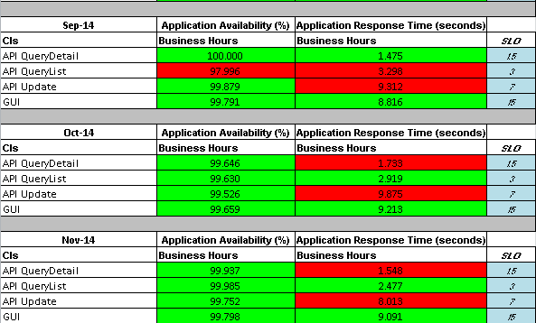
MarkeTrak Automated SLA Monitoring

Slide 3
MarkeTrak Automated SLA Monitoring - Current
MarkeTrak Automated SLA Monitoring
Automated monitoring and SLOs established in 2011/2012
The HP tool used for the automated monitoring is on ERCOT’s network, so does not reflect any latency that would occur traversing the Internet, or introduced by an MP’s infrastructure
The automated queries used by ERCOT are not representative of the actual queries used by ONCOR and Centerpoint (using test DUNS, low data volumes, etc.)

Slide 4
Actual API Query Average Response Times - Proposed
ERCOT’s data is extracted from their integration application, so it represents a portion of the actual response times that CNP and ONCOR would experience.
What is not reflected in this data is the time that the transactions take to traverse CNP and ONCOR’s IT infrastructure, the Internet, and ERCOT’s front end infrastructure (network, proxies, etc.).
The value of the data is that it represents a relative average response time, month to month, that can be compared to what CNP and ONCOR are experiencing.
If ERCOT is not experiencing any issues that would impact MarkeTrak SLOs, but CNP and ONCOR are experiencing higher than normal response times, those increased response times will most likely be attributed to elements outside of ERCOT’s control.

Slide 5
Actual API Query Average Response Times – ERCOT & CNP
Actual API Query Response Times as Measured by ERCOT and CNP
Comparison of four month period (Nov 2014 – Feb 2015)
Times are in milliseconds

Slide 6
Actual API Query Average Response Times - ERCOT
Actual API Query Response Times as Measured by ERCOT
Centerpoint and ONCOR queries averaged by month
ERCOT test transaction values are not included
Times are in milliseconds

Slide 7
MarkeTrak API Query - SLOs
Next Steps
Continue to monitor ERCOT results through June 2015
Determine new SLOs based on new method of measuring response times
Determine most appropriate way to report on MarkeTrak performance versus the new SLOs in ERCOT’s monthly updates

